Slide 1
Regional Consultation Workshop on National Health Mission
Grants of PM-ABHIM and FC-XV
Overview of implementation of
Comprehensive Primary Health Care

Slide 2
Structure of Presentation
Concept of Comprehensive Primary Health Care
Key elements of AB-HWC
Planning Priorities
Monitoring Conditionality Framework
GRANTS - 15th FC and PM-ABHIM

Slide 3


OUR PRIMARY HEALTH CARE SYSTEM
“PHC is a whole-of-society approach to health that aims at ensuring the highest possible level of health and well-being and their equitable distribution by focusing on people’s needs and as early as possible along the continuum from health promotion and disease prevention to treatment, rehabilitation and palliative care, and as close as feasible to people’s everyday environment”. (World Health Organisation)
8 Cs of Primary Care
1st point of Contact
Continuity
Comprehensive
Convergent and Coordinated Care
Client Centred
Communitisation
Cost free
AYUSHMAN BHARAT-HEALTH AND WELLNESS CENTRES

Slide 4






Universal Health Coverage: Ayushman Bharat
TERTIARY
PMJAY empaneled Public & Private Healthcare facilities
CHCs/SDHs/District Hospitals/Medical Colleges
SECONDARY
Referral/Gatekeeping
Follow-up
PRIMARY
Preventive, Promotive, Curative, Rehabilitative & Palliative Care
(Progressively for 12 packages)
Comprehensive Primary Health Care through HWCs
Unmet need: NCDs/other Chronic Diseases
Existing services: RMNCH+A
CONTINUUM OF CARE – CPHC & PMJAY
Notes:
Presently the Sub centre and Primary Health centre- currently provide preventive care mostly related to maternal and child health,
The epidemiologic and demographic transition ahs meant that India has a large burden of chronic diseases for which care is not available at PHC or below
NSSO data (71st Round. 2014) shows 11.5% and about 4% in rural and urban areas respectively sought any form of Outpatient care - at or below the CHC (secondary health centres) (except for Childbirth).
The need for primary health care is met by unqualified practitioners. particularly in the high focus states,
Ayushman Bharat is the path chosen by India to achieve Universal Health Coverage. Its two components – include universal access to primary health care through transforming 1,50,000 Sub-Health Centres and Primary Health Centres in rural and urban areas to Health and Wellness Centres and a social protection scheme- the PMJAY, for about 40% of the population.
Key interventions at the level of Sub Health Centre Health and Wellness level encompass preventive, promotive, curative, rehabilitative and palliative care close to community. Currently HWC provide services for RMNCHA and for common NCDs, leprosy and TB. Other additions to be made incrementally include : oral health, eye care, common ENT conditions, trauma and emergency, palliative and elderly care and mental health
The range of services to be provided needs to move from the current selective PHC package to a more comprehensive package to address the burden of chronic care.
The addition of a non- physician, Mid Level Health Provider to lead the team of existing multipurpose workers and ASHAs is expected to expand the range of serves including screening, early detection and issues of changing lifestyles and treatment adherence.

Slide 5
OUR PRIMARY HEALTH CARE SYSTEM
Each SHC Cover 5000 population;
Tribal and Hilly Area - 3000 population
Each UHWC Covers 15,000-20,000 population
URBAN
PHC
SHC
SHC
SHC
SHC
SHC
UPHC
UHWC
UHWC
UHWC
RURAL
EACH PHC Covers 30,000 population;
Tribal and Hilly Area - 20,000 population
Each UPHC Covers 50,000 population;
AYUSHMAN BHARAT-HEALTH AND WELLNESS CENTRES

Slide 6
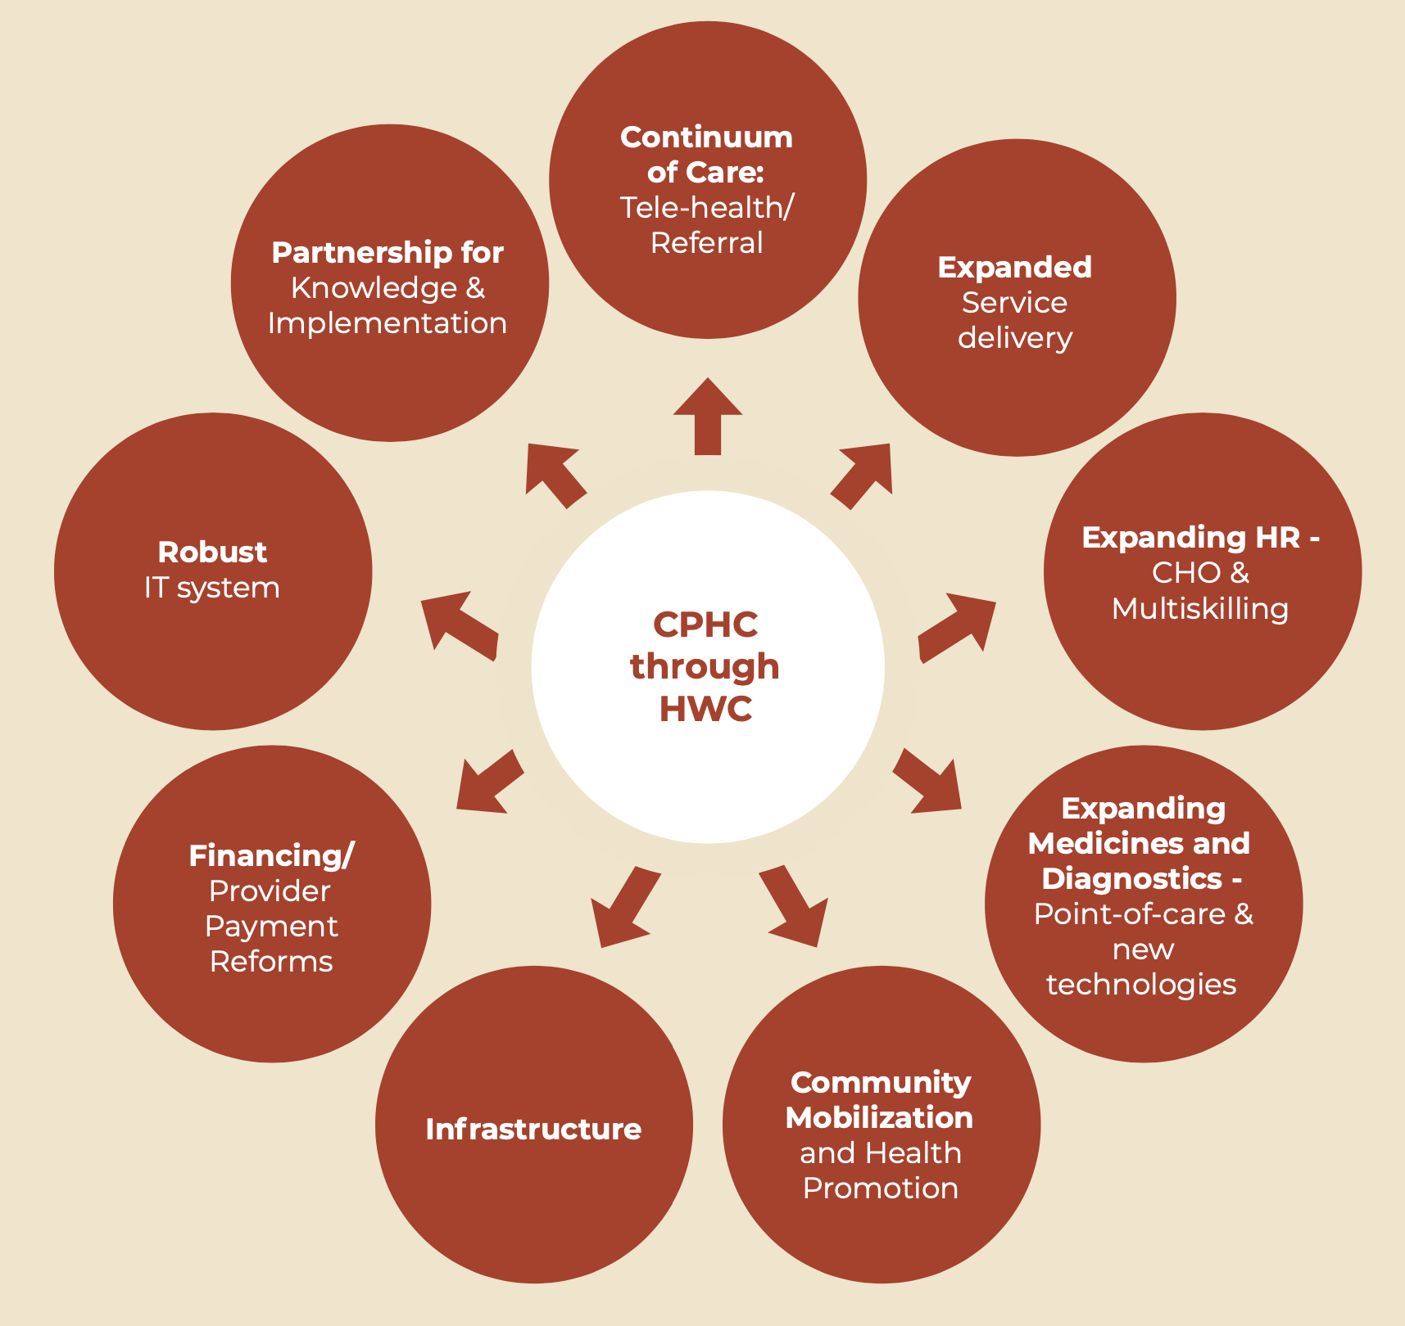
Key Elements of transforming SCs/PHCs/UPHCs to AB-HWC
9 point reform: multiple reforms, spanning all aspects of the health systems such as service delivery, HR, financing, access to medicines and diagnostics, community participation and ownership and governance.
It has ensured the shift from
  Selective Primary Care to Comprehensive Primary Health Care
  ‘illness’ focus to ‘wellness’ focus – Services For ALL PEOPLE throughout the life-cycle
  Fragmented Care to Continuum of Care
Institutionalize community ownership and management of health centres through Jan Arogya Samitis (JAS).
GoI introduced 15th Finance Commission and PM-ABHIM health grants in addition to National Health Mission Grants to strengthen and plug the critical gaps in the primary health care and involvement of local government to make health system more accountable to the people.

Slide 7
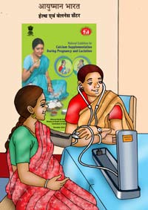
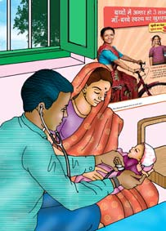
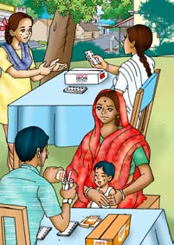
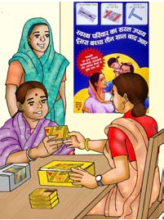
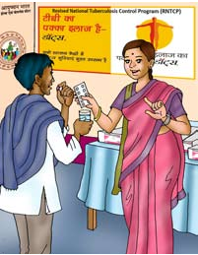
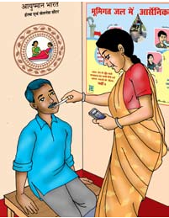
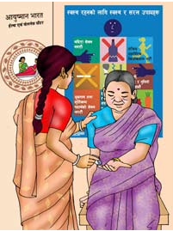
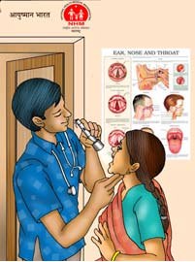
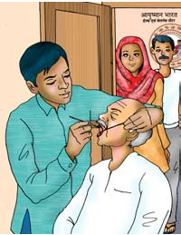
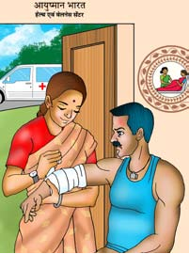
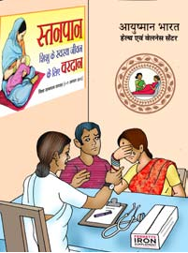
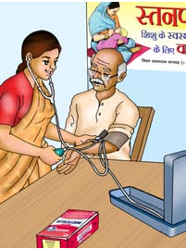
Expanded Package of Services
Care in Pregnancy
& Childbirth
Childhood & Adolescent
Healthcare Services
Management of
Communicable
Diseases
Outpatient Care
for Acute Simple Illness
Neonatal & Infant
Healthcare Services
Reproductive & Family Planning Services
Screening Prevention
& Control of NCDs
Eye & ENT
Care
Oral
Care
Elderly & Palliative
Care
Emergency Care
Mental health
Care

Slide 8
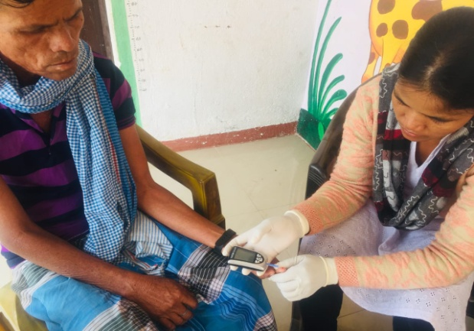


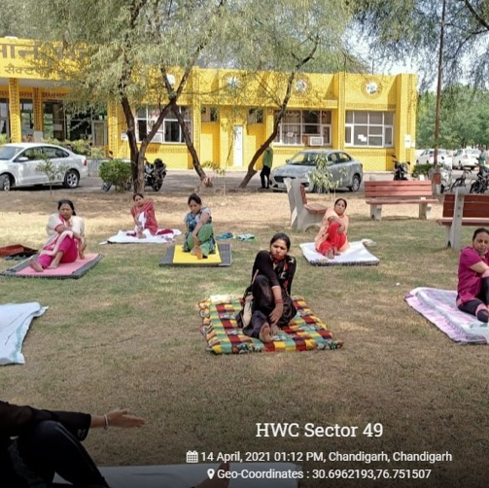
Illness to Wellness- Services For ALL PEOPLE throughout the life-cycle
Preventive healthcare
Screening/ follow-up
Tuberculosis & leprosy
Hypertension, diabetes and 3 common cancers
Promotive Healthcare
Eat Right
Yoga/Wellness Activities
Fit India Movement
42 health calendar days celebrated by AB-HWCs
Curative healthcare
Diagnosis
Follow up and treatment compliance
Treatment

Slide 9
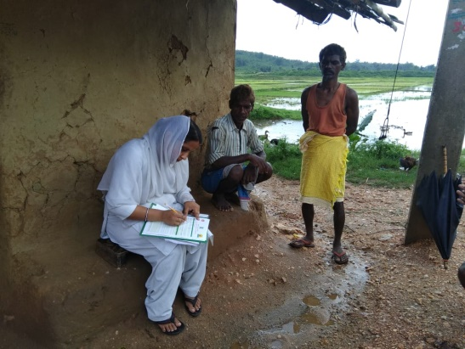
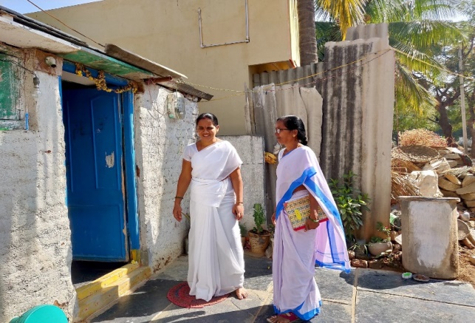
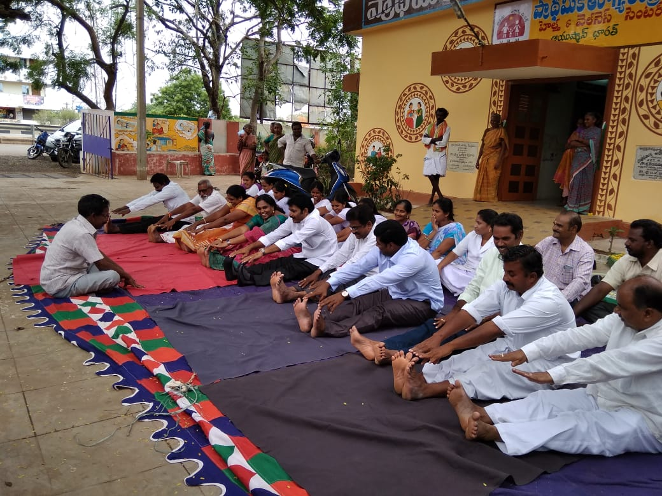
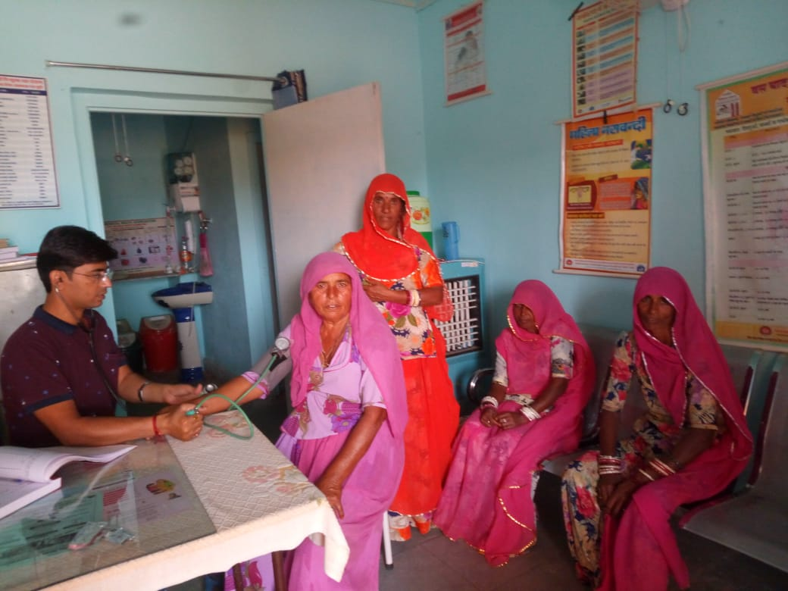
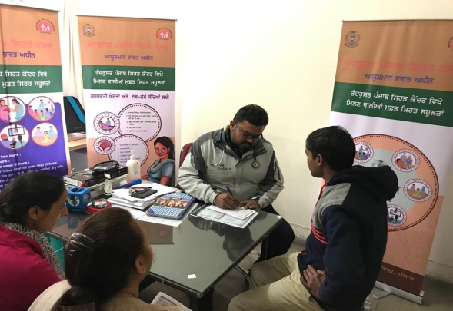
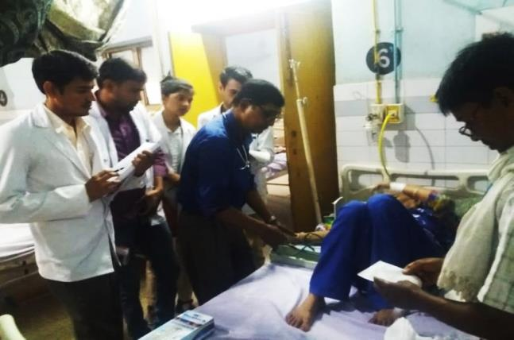
Maintaining Continuum of Care – Ayushman Bharat
First Level Care
NCD Screening
Use of Diagnostics
Medicine Dispensation
Record keeping
Tele-health
Referral to PHC in case of complication
Urban Ward
UHWC
Population Enumeration
Outreach Services
Community Based Risk Assessment
Awareness Generation
Counselling: Lifestyle changes; treatment compliance
Upward referral
Follow up post secondary and tertiary care
Upward & downward referral
Poly Clinic/CHC/SDH/DH
Upward & downward referral
UPHC-HWC
Advanced diagnostics
Complication assessment
Hospitalization
Tertiary linkage/PMJAY
Diagnosis for NCDs
Prescription and Treatment Plan
Gate Keeping role for outpatient and inpatient referral / PMJAY
Teleconsultation with specialists

Slide 10
Key Elements: Human Resources
Health & Wellness Centre – SHC (@5000 in plain areas and 3000 in hilly and tribal areas)
SHC Team
Community Health Officer: BSc/ GNM or Ayurveda Practitioner, Trained in 6 months Certificate Programme in Community Health/ Community Health Officer (BSc-CH)
1 MPW Female
1 MPW Male/Female
5 ASHAs (@1 per 1,000 population)
Health & Wellness Centre – PHC (@30,000) / UPHC (@50,000)
PHC team as per IPHS
Minimum Requirement-
  1 MBBS Doctor
  1 Staff nurse
  1 Pharmacist
  1 Lab Technician
  LHV
  Rural- 1 MPW + 5 ASHAs
  Urban- 5 MPWs (@1 per 10,000 population) and 20-25 ASHAs (@1 per 2,000-2,500 population)
PHC
SHC
SHC
SHC
SHC
SHC

Slide 11
Key Elements: Capacity Building
Cadre | Total Number of Training Days
MOs | 13.5 Days
CHOs | 14 Days
Staff Nurse | 11 Days
MPW-M/F | 12 Days (Face to Face training)
ASHA | 14 Days (Face to Face training)
Capacity Building for Expanded Package of Services (for CPHC in capsules of 3-4 days each)

Slide 12



Key Elements: Drugs and Diagnostics
Free medicines
105 @SHC-HWC
172@PHC-HWC
Free diagnostics
14 @SHC-HWC
63 @PHC-HWC

Slide 13


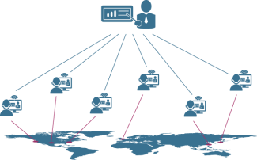
Key Elements: Technology
CPHC NCD Application
AB-HWC Portal / Application
Teleconsultation services
E Sanjeevani HWC
E Sanjeevani OPD

Slide 14
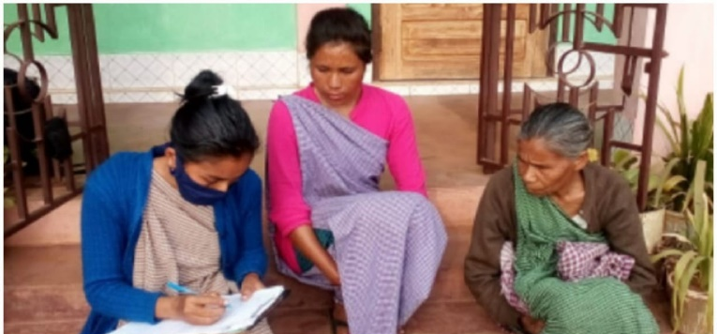
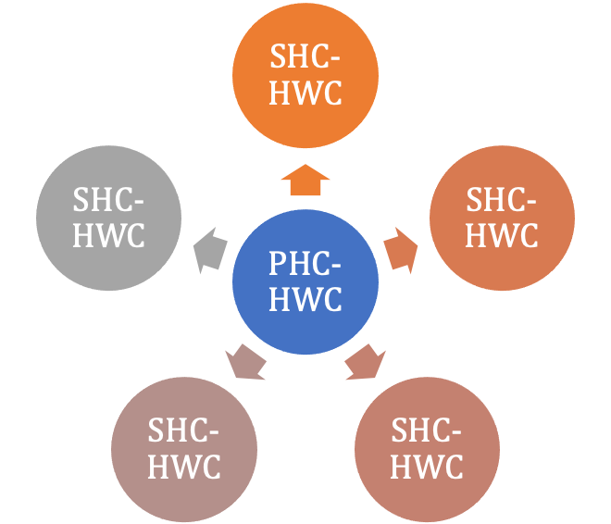
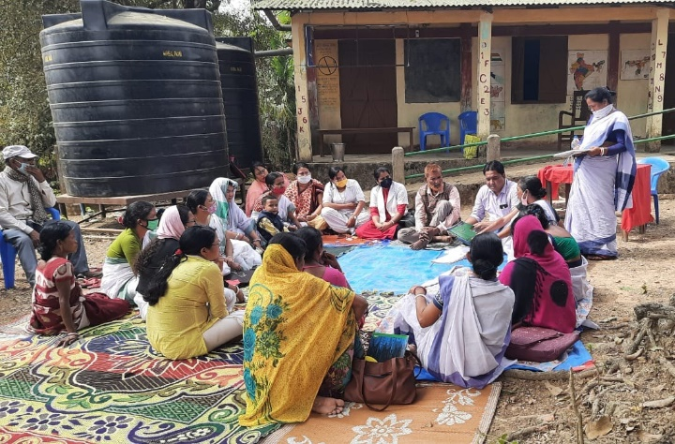

Ecosystem of primary healthcare in rural areas =
Health Care Providers +Community Institutions
2-3 Panchayati Raj Institutions (PRIs)
Jan Arogya Samitis @ SHC-HWC
VHSNC/revenue village
Action on social determinants of health
Health Promotion
Jan Arogya Samitis @ SHC-HWC
Jan Arogya Samitis @ SHC-HWC
JAS @ PHC-HWC
Jan Arogya Samitis @ SHC-HWC
Jan Arogya Samitis @ SHC-HWC
Together We Are 500 Members – WE COMMIT TO REACH HEALTH TO ALL PEOPLE in our area

Slide 15
GRANTS
Under XV FC grants are earmarked for health, channelized through Local Government and support to PM-ABHIM with objective to strengthening health system at primary, secondary and tertiary care levels.
 | XV-FC | PM AB-HIM
Total allocation | Rs. 70,051 Crores | Rs. 64180 Crores
Rural | Rs. 43,928 Crores | CSS- Rs. 54204.78 Crores
Urban | Rs. 26,123 Crores | CS- Rs. 9339.78 Crores
CSS Components | Rural Building-less Sub-centers, PHCs, CHCs Block Public Health Units Conversion of rural PHCs and Sub-Centres into Health and Wellness Centre Diagnostic infrastructure at Sub-Centre, PHCs. Urban Diagnostic infrastructure at Urban PHCs Urban Health and Wellness Centers (HWCs) & Polyclinics | Rural Building-less Health and Wellness Centres, Block Public Health units, Integrated District Public Health Labs, Critical Care Hospital Blocks Urban Urban Health and Wellness Centers (HWCs) & Polyclinics

Slide 16

Source of Funding
 | XV-FC | PM-ABHIM | NHM
New Infrastructure
Augmentation of Infrastructure
HR
Drugs
Diagnostic
Capacity Building
IT
Few states only

Slide 17
Centrally Sponsored Scheme (CSS) components
Fifteenth Finance Commission (FC-XV) | PM-ABHIM
Building-less Sub-centers, PHCs, CHCs in 28 states (Arunachal Pradesh, Assam, Bihar, Chhattisgarh, Goa, Gujarat, Haryana, Himachal Pradesh, Jharkhand, Karnataka, Kerala, Madhya Pradesh, Maharashtra, Manipur, Meghalaya, Mizoram, Nagaland, Odisha, Punjab, Rajasthan, Sikkim, Tamil Nadu, Telangana, Tripura, Uttar Pradesh, Uttarakhand, West Bengal) | Infrastructure support to Building-less’ (SHC-HWCs) in rural areas -17788 in 10 States (Bihar, Jharkhand, Odisha, Punjab, Rajasthan, Uttar Pradesh and West Bengal and three NE States viz. Assam, Manipur and Meghalaya)
Urban Health and Wellness Centers (HWCs) & Polyclinics in above mentioned 28 states | Mostly in the 2024-26
Diagnostic infrastructure at Sub-Centre, PHCs, Urban PHCs in above mentioned 28 states
Conversion of rural PHCs and Sub-Centres into Health and Wellness Centre in above mentioned 28 states

Slide 18
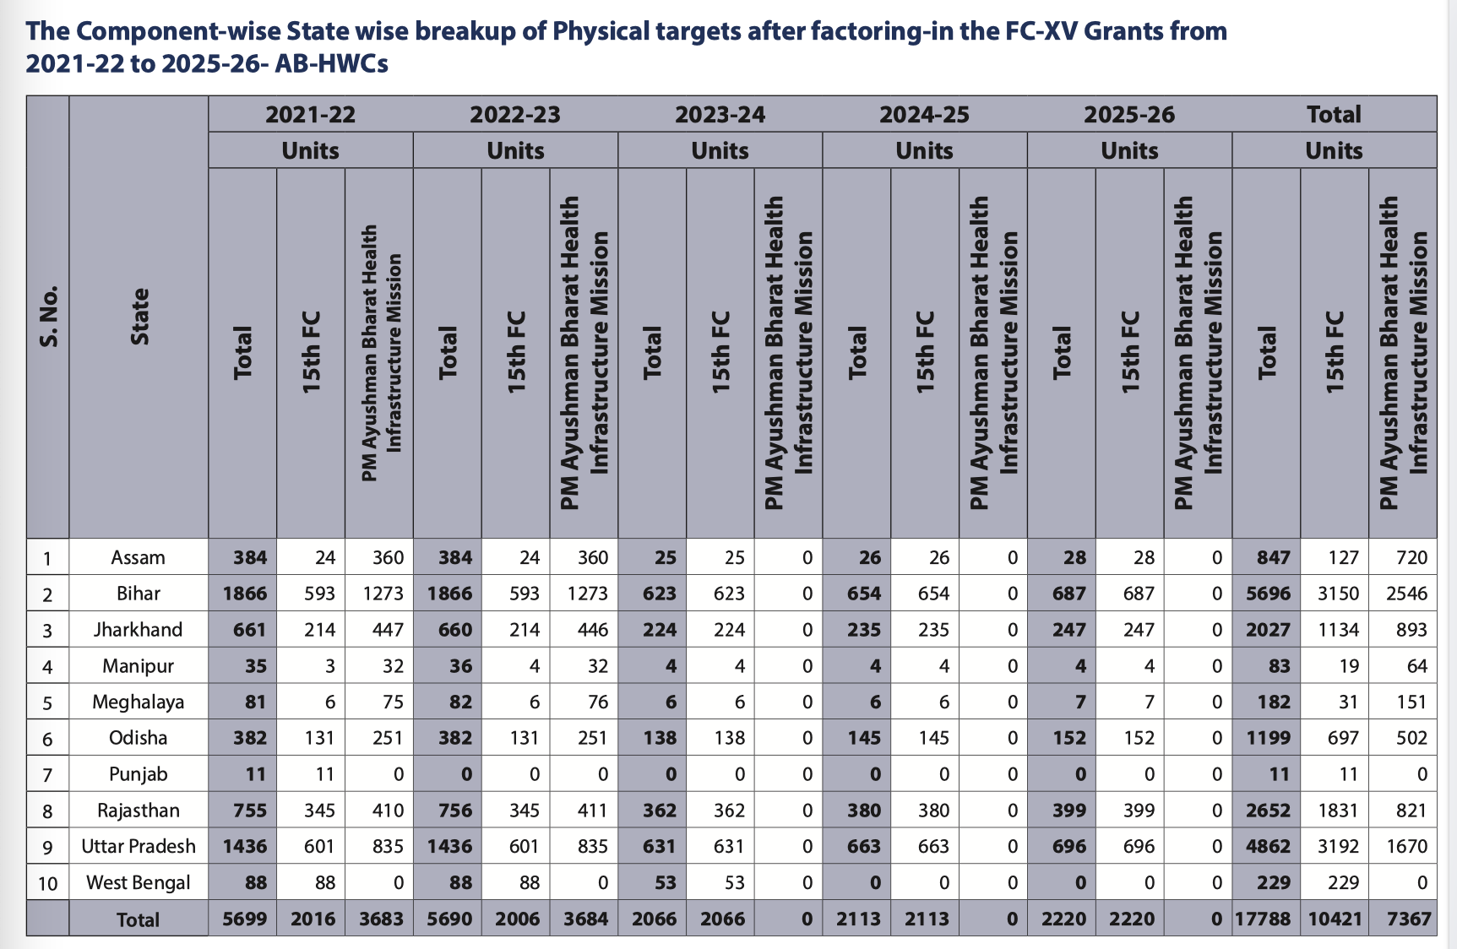
State wise physical deliverable Building less SHC under PM-ABHIM for the period of 2021-22 to 2025-26 after factoring in the FC-XV Grants

Slide 19
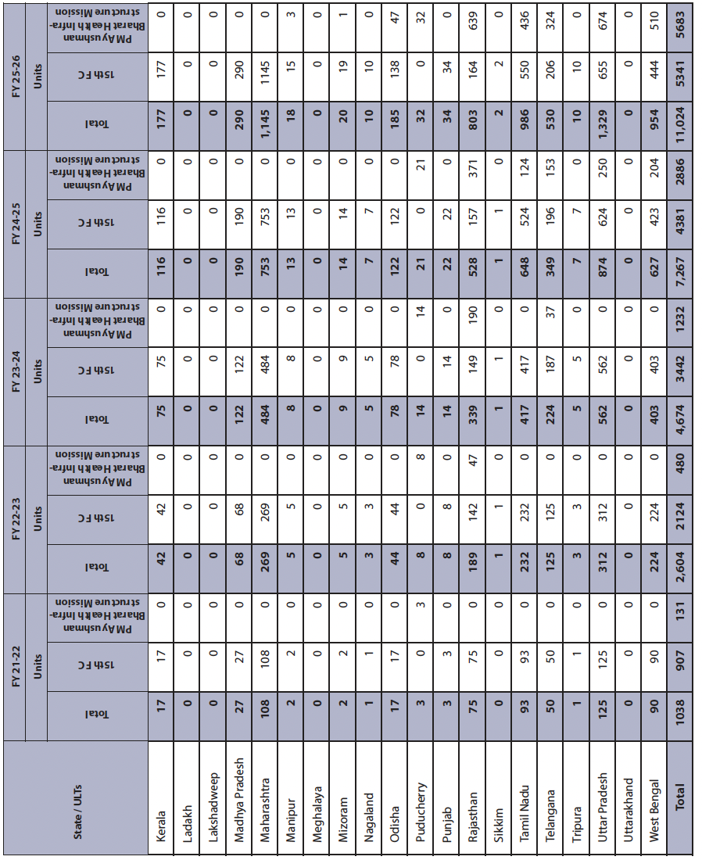
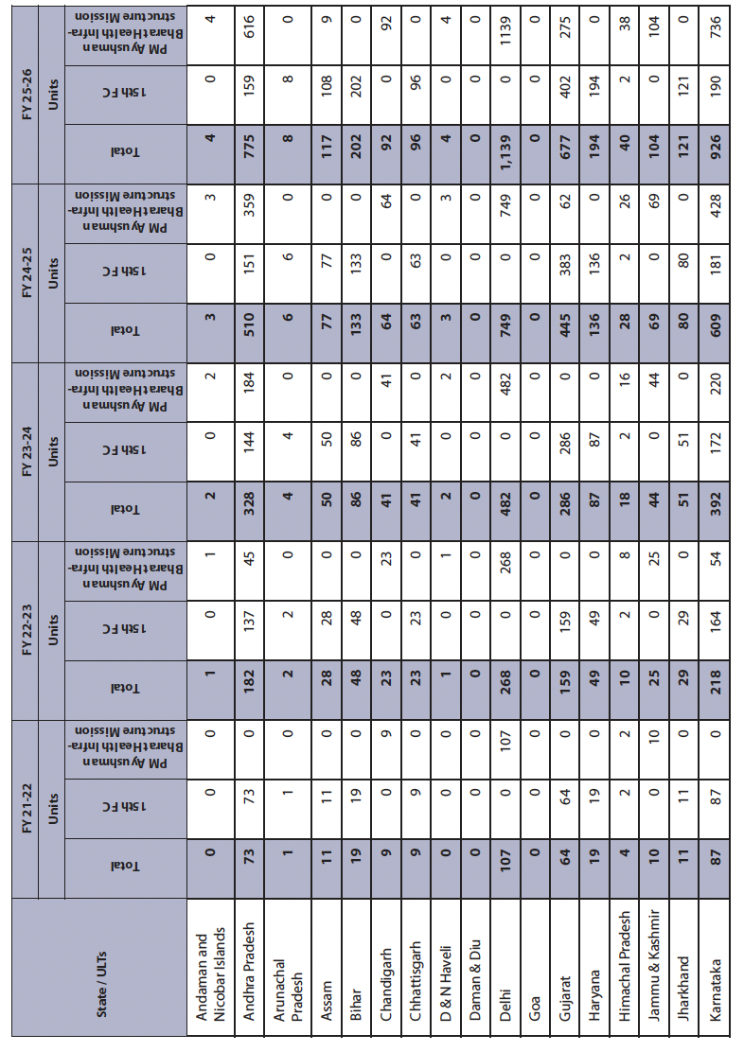
State wise physical deliverable U-HWCs under PM-ABHIM for the period of 2021-22 to 2025-26 after factoring in the FC-XV Grants

Slide 20
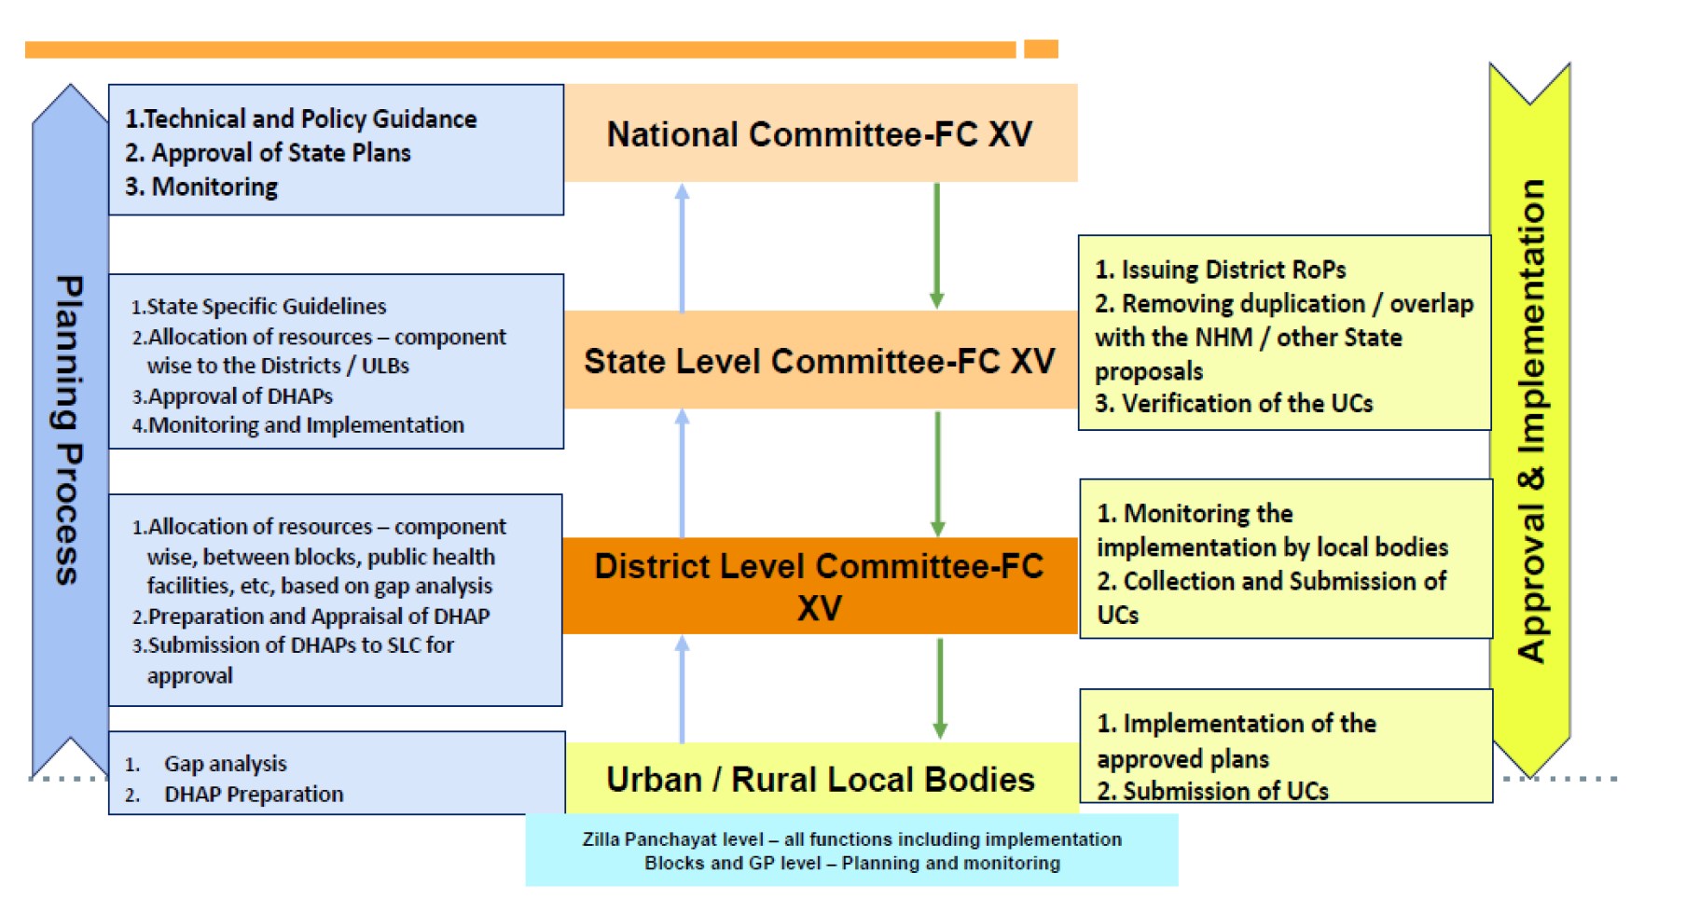
Planning, Preparation, Implementation and Monitoring
Developing the State specific guidance
Prioritisation
Indicating component wise physical targets and funds for each of the district/ULB to ensure that all the blocks are covered over a period of 5 years
Orientation and Capacity building
Gap Analysis

Slide 21
Priorities
Location
Aspirational Districts,
Tribal Districts
Infrastructure
Facilities that have basic infrastructure in place (Low hanging fruits)
Facilities that require augmentation/modification
Services
NCD,
Mental Health,
Elderly Care &
Palliative Care
HR
In Position Staff at the facility (E.g. MO at PHC)
Performance linked payment and Team based indicators
Capacity Building
MO and CHO
Drugs & Diagnostics

Slide 24
Monitoring of Services at AB-HWCs -
Conditionality Framework

Slide 25
 | Conditionality Framework |  | FY 2022-23 |  | FY 2023-24
S. No | Criterion | Indicator | Max Score for SHC-HWC | Max Score for PHC-HWC | Max Score for SHC-HWC | Max Score for PHC-HWC
1 | Functional AB-HWCs satisfying advanced functionality Criteria | HWC-01: Functional AB-HWCs providing all 12 expanded range of services | 20 | 15 | 20* | 15*
2 | Medicine & Diagnostics at AB-HWC | HWC-02: AB-HWC fulfilling expanded range of medicines and diagnostics as per Essential list of both (Medicines: SHC-HWC- 105; PHC-HWC-172 & diagnostics: SHC-HWC- 14; PHC-HWC- 63) | 10 | 10 | 10 | 10
3 | Functional HWCs providing wellness Services | HWC-03: AB-HWCs providing a minimum of 10 Wellness sessions per month | 10 | 10 | 10 | 10
 |  | HWC-04: AB- HWCs conducting at least 3 food adulteration tests in a month (Using Eat Safe Magic Box in PHC-HWC and by ASHAs in SHC-HWC) | 5 | 5 | 5 | 5

Slide 26
 | Conditionality Framework |  | FY 2022-23 |  | FY 2023-24
S. No | Criterion | Indicator | Max Score for SHC-HWC | Max Score for PHC-HWC | Max Score for SHC-HWC | Max Score for PHC-HWC
4 | Quality Care | HWC-05: Functional AB-HWCs scoring more than 70% in Kayakalp external assessment | 10 | 10 | 10 | 10
5 | Leveraging IT | HWC-06: Adoption of CPHC-NCD App with use of appropriate Health IDs | 5 | 10 | 5 | 10
6 | Continuum of Care | HWC-07: AB- HWC team following up on at least 70% of cases discharged from secondary/tertiary care facility within one week | 10 | 10 | 10 | 10
7 | Community Engagement and Payment of PLPs and TBIs | HWC-08: Constitution of JAS and conduction of at least 10 meetings in a year with minimum 60% quorum | 10 | 10 | 10 | 10
 |  | HWC-09: AB-HWCs whose primary healthcare teams have received timely incentives (Performance Linked Payment and Team Based Incentives) minimum 10 times a year | 5 | 5 | 5 | 5
 | Max scoring for an AB-HWC |  | 85 | 85 | 85 | 85
 | Score for meeting Target |  | 10 | 10
 | Score for exceeding target |  | +5 | 15 | 15 | 15
 | TOTAL SCORE |  | 100 | 100 | 100 | 100

Slide 27
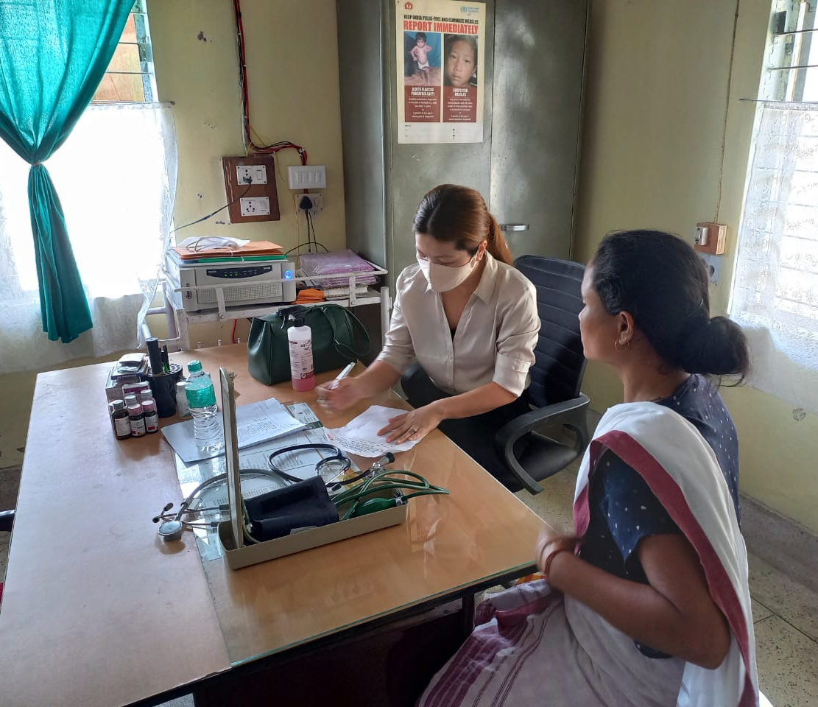
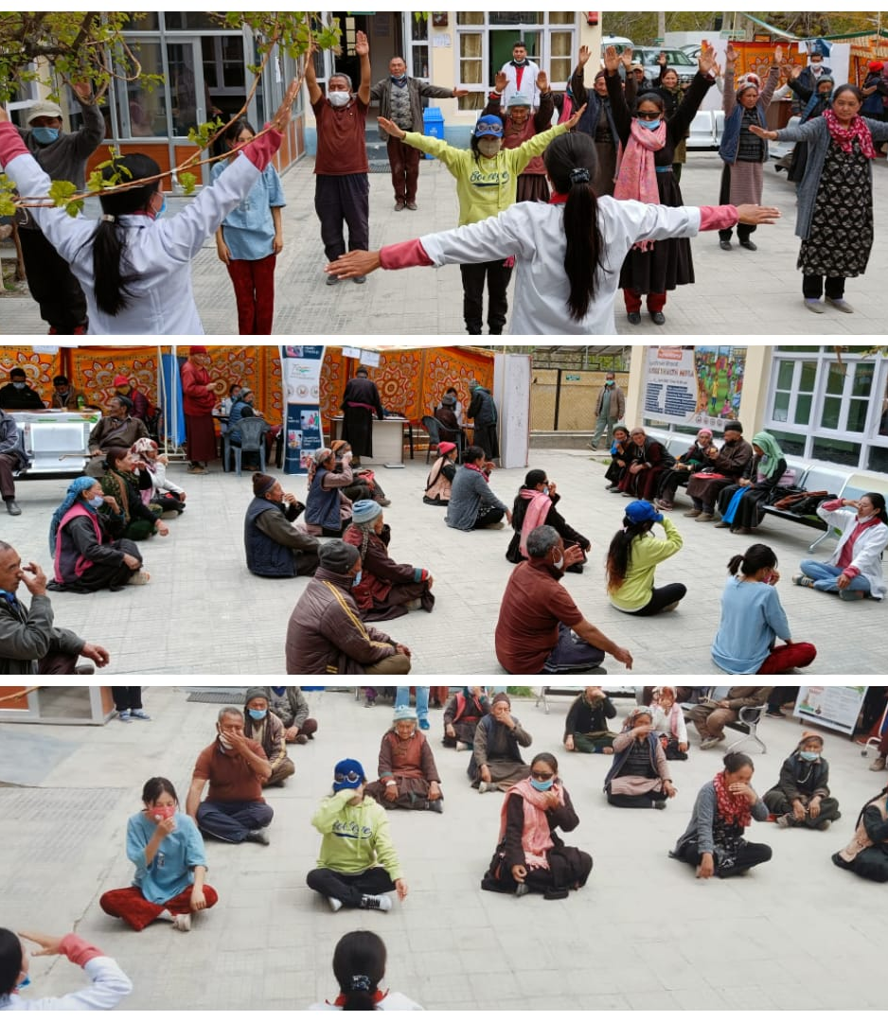
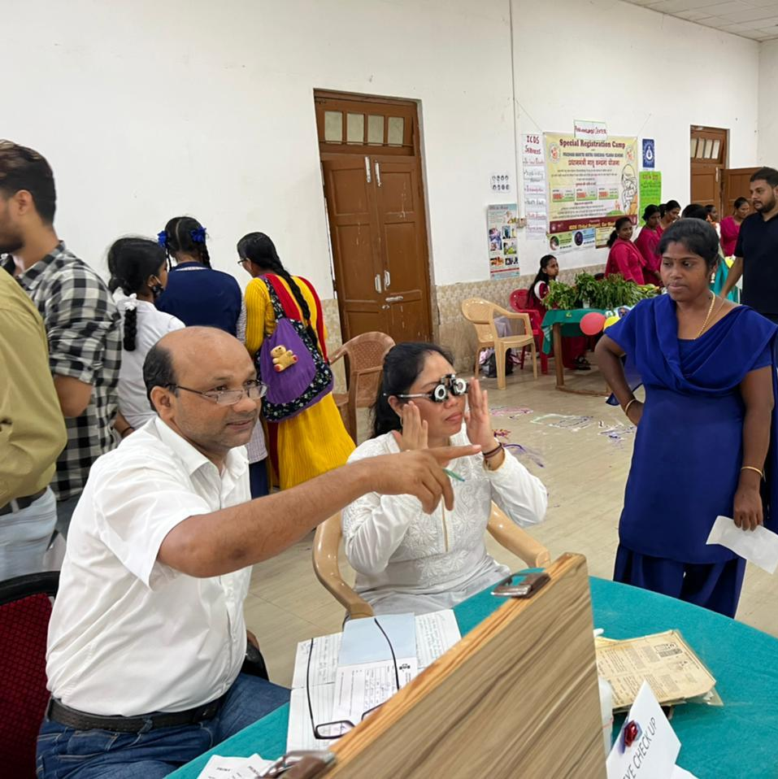
Health is now:
‘A Community Movement’ &
‘Not a mere Facility Event’
Thank you

