Slide 1

Comprehensive Planning for HRH
Mona Gupta
Advisor HRH HPIP NHSRC

Slide 2
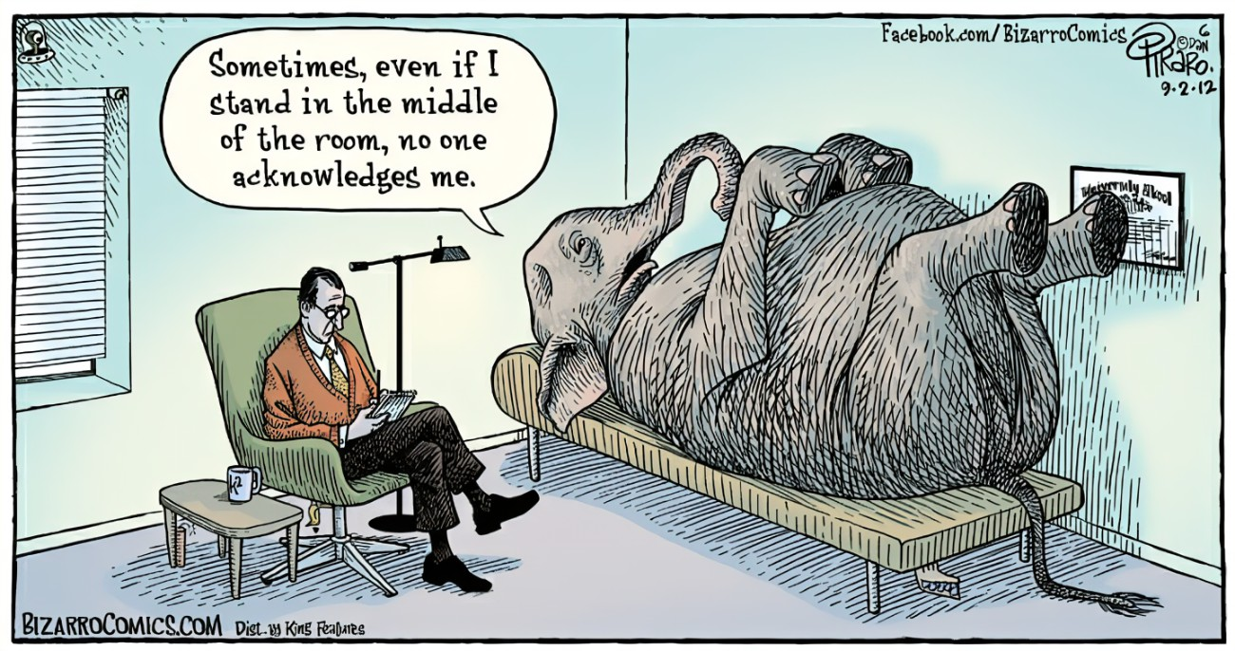
Elephant in the room

Slide 3
Why HRH
Must for moving other pillars of Health systems: Service delivery, Access to Medicines, Leadership and Governance, Health Information System, Finance
Not only for health but poverty reduction, quality education, decent work, inclusive economic growth and gender equality

Slide 4
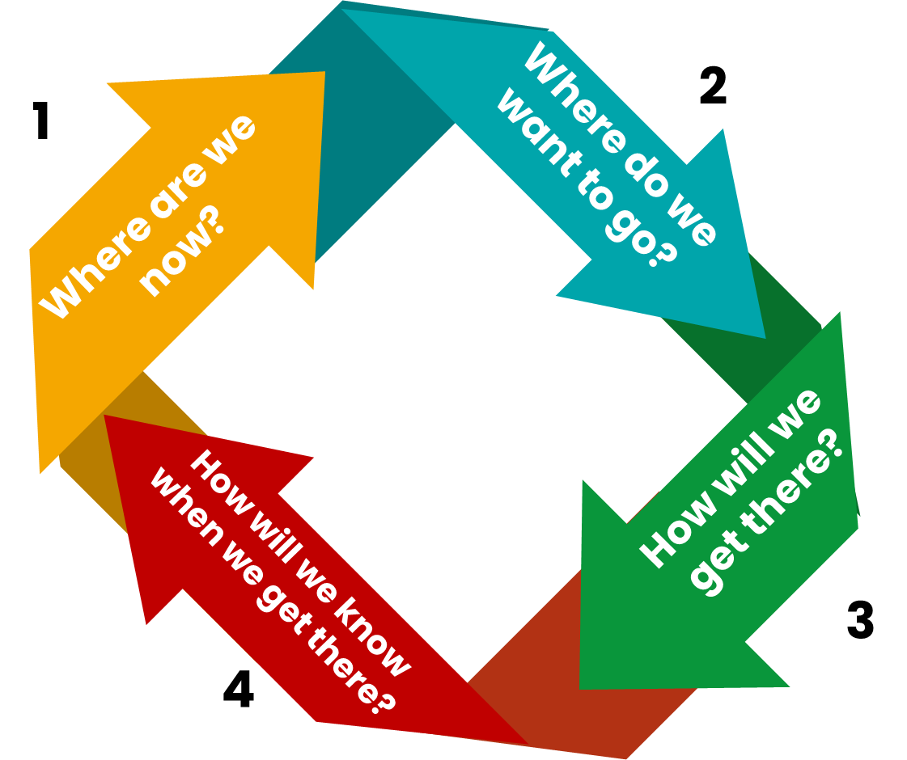
Fundamentals of
Planning

Slide 5
Where are we now?
Data :
  How reliable
  How updated
Time to get it reasonably robust: e-Samiksha, Pragati, NITI SHI,
  Conditionalities

Slide 6
Where do we want to go
Demography, burden of disease
Referral chain
Health seeking behaviour
Level of productivity
Work timings
Equipment: semi-automatic, automatic
Digitization
Task sharing and task shifting
HRH Forecasting
  In terms of numbers
  Skill mix
Standards
Work -Load Indicators for Staffing Needs
Time motion

Slide 7
Universal Health Coverage (UHC) and Human Resources for Health (HRH): Effective coverage
1.UHC cube
Services that entail a cost to the user
Y Axis represents direct costs, especially the proportion of all health services not requiring a fee at the point of services.
2. HRH cube: theoretical coverage by “availability” of health workforce
Quality
Service Utilization
Acceptability
Gap in essential services
Accessibility
Availability
Z Axis represents the proportion of essential services covered
Population needing services but not covered
Population: Who is provided effective coverage?
Effective Coverage Gap
X Axis represents the population, specifically the percentage of the population covered by the health service
Adapted from The world health report (2010), UN Economics and Social Council (2000) and Tanahashi (1978)

Slide 8
Aspects of HRH Planning
Availability: Numbers
  Supply Vs Demand
  Decent Job Opportunities
Accessibility: Distribution
  Public vs Private
  Urban Vs Rural
  Plains Vs Hilly-Difficult areas
Acceptability
  Language
  Culture/Tribe
  Skill-level
  Stream of medicine:
Productivity:
  Case load
  Cost effectiveness
Quality:
  Capacity/Skills
  Person Centric Behaviour

Slide 9
Start with :Population and need based geographically well distributed health facilities
HRH as per IPHS 2022 and caseload
Fine tune as you go
Way out:

Slide 10
Leveraging Partnership
What is the requirement of the district or the State?
What are the strengths and the mandate of the Agency?
Only if these two match could the collaboration be beneficial to the community and the health system and stay longer term.
PPP: not as a general strategy but to be leveraged where required in the form of Strategic Purchase. E.g. Assam’s Boat Clinics
Do not transplant innovations/ideas from other settings without a pilot testing in your context and a good evaluation
Communicate with your teams in district, blocks and facilities. Letters are not enough. It may not be grievance all the time. It could be a rumour or worry. Uncertainty will drain talent.

Slide 11
If you fail to plan, you plan to fail
Immediate (within 1 year): Fill up vacancy, find out reasons if vacancies remain
Medium(2-3 years): Start planning for posts you will require in 1-3 years
Long term(5-10 years and more): Demographic and epidemiological trend

Slide 12
 | Required | Sanctioned (R+C) | In-place (R+C) | Vacancy In numbers | Vacancy% (S-P) | Gap in numbers | Gap% (R-P)
MPW (M+F) | 1983 | 1426 | 1374 | 52 | 4% | 557 | 31%
Nurses | 3803 | 1587 | 1465 | 122 | 8% | 2216 | 61%
Lab Technicians | 504 | 242 | 227 | 15 | 6% | 262 | 55%
Pharmacists | 288 | 250 | 243 | 7 | 3% | 38 | 16%
Medical Officers | 769 | 597 | 494 | 103 | 17% | 172 | 36%
Specialists | 377 | 380 | 194 | 186 | 49% | -3 | 49%
Requirement as per IPHS 2022 for existing facilities, assuming all services as mandated are available
Training and Leave reserve would add 15% more numbers

Slide 13
Another Scenario: A bigger State
Provisions for HRH under PMABHIM and 15th FC would give:
4867 CHO
2448 MO
2298 MPW (M)
3270 Staff Nurses
888 Specialists
127 Dentists, Optometrists, physiotherapists, counsellors each
284 Epidemiologists, Public Health specialist,
307 Data Managers
821 LT
Notes:
81 Allied

Slide 14
Leveraging each source of funding
15th FC
PMABHIM
NHM
Less flexible More flexible

Slide 15

Thanks

