Slide 1

Monitoring Inequalities in Health Services Coverage: approaches and challenges
Ahmad Reza Hosseinpoor
Department of Health Statistics and Information Systems

Slide 2
Monitoring health
Select health indicators
Obtain data
Analyse data
Report results
Implement changes

Slide 3
Selecting health indicators & equity Stratifiers
Selecting health indicators
Select health indicators
Obtain data
Analyse data
Report results
Implement changes
Equity stratifiers
Economic status (e.g. income, wealth)
Education
Sex
Age
Place of residence (rural or urban)
Subnational area (e.g. province, district)
Race or ethnic background
Any other stratifier that can distinguish population minority subgroups

Slide 4
Equity stratifiers – methodological issues
Global monitoring vs. country monitoring
  Common set of stratifiers vs. context-specific ones
Number of subgroups / Type of grouping
Level of data used for grouping (unit of analysis)
  individual/household level vs. area level
Most commonly used equity stratifiers in the literature:
  All settings: race and economic status
  LMICs: economic status

Slide 5
Data requirements for equity analysis
Data sources must contain both health indicators & equity stratifiers
or
Possibility to link data sources must exist
Select health indicators
Obtain data
Analyse data
Report results
Implement changes

Slide 6
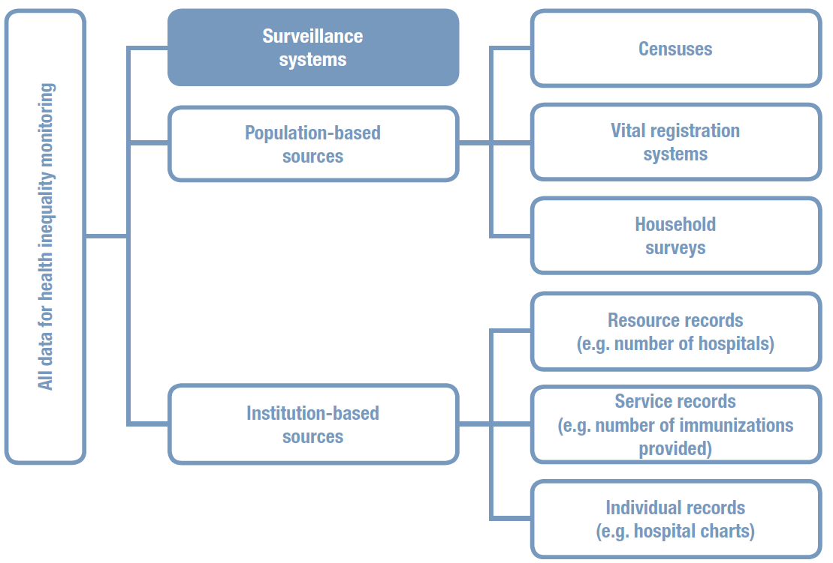
Data source mapping

Slide 7
Data sources
Most commonly used data sources:
  HICs: Institution-based data sources and household surveys
  one third of studies linking multiple sources
  LMICs: Household surveys

Slide 8
Measuring inequalities in health services coverage
Coverage mean values, by equity stratifiers of interest
Summary measures
Simple measures vs. complex measures
Absolute inequality vs. relative inequality
Equity stratifiers with a natural order vs. the ones that are non-ordered
weighted data vs. unweighted data
selection of the reference group
Select health indicators
Obtain data
Analyse data
Report results
Implement changes

Slide 9
Summary measures of inequality
Equity stratifier | Simple measures |  | Complex measures
 | Absolute | Relative | Absolute | Relative
Socioeconomic status (e.g. wealth, education, ) | Difference | Ratio | Slope index of inequality Population attributable risk | Relative index of inequality Concentration index Population attributable risk percentage
Urban/rural area | Difference | Ratio | Population attributable risk | Population attributable risk percentage
Sex | Difference | Ratio
Region | Difference | Ratio | Variance Mean difference from overall mean | Theil index Index of disparity

Slide 10
Communicating results
Essential considerations
Audience-conscious reporting
Designing effective data visualizations
  tables, graphs, maps
Key aspects of reporting:
    (a) latest status
    (b) trend over time
    (c) benchmarking
Select health indicators
Obtain data
Analyse data
Report results
Implement changes

Slide 11
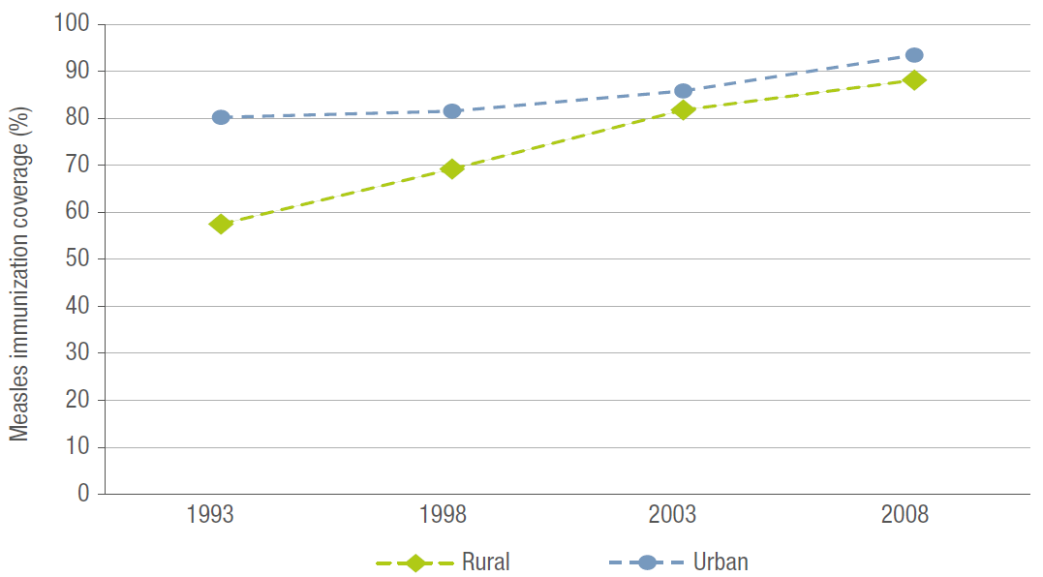
Communicating results – time trend
Time trend in measles immunization in Colombia, by place of residence, DHS 1993, 1998, 2003 and 2008

Slide 12
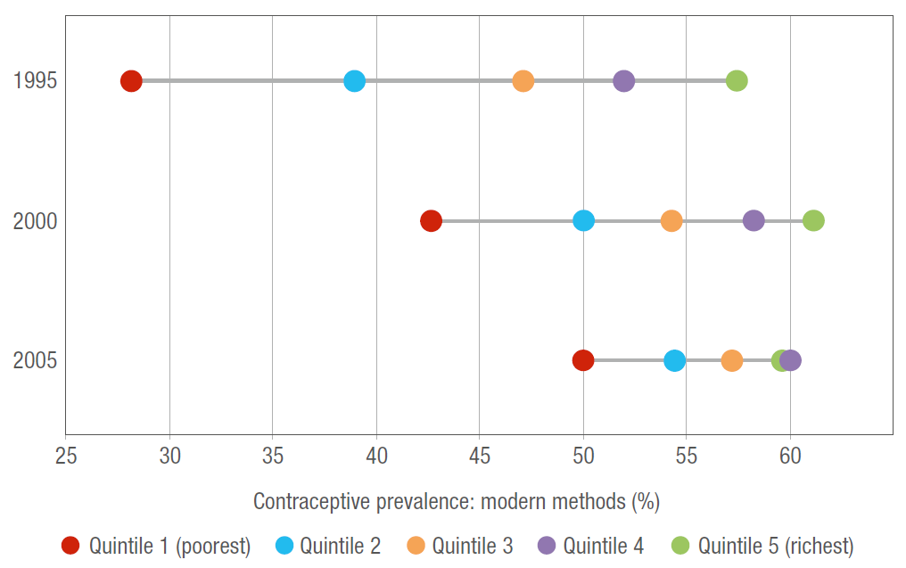
Communicating results – time trend
Contraceptive prevalence (modern methods) in Egypt, by wealth quintile, DHS 1995, 2000 and 2005

Slide 13
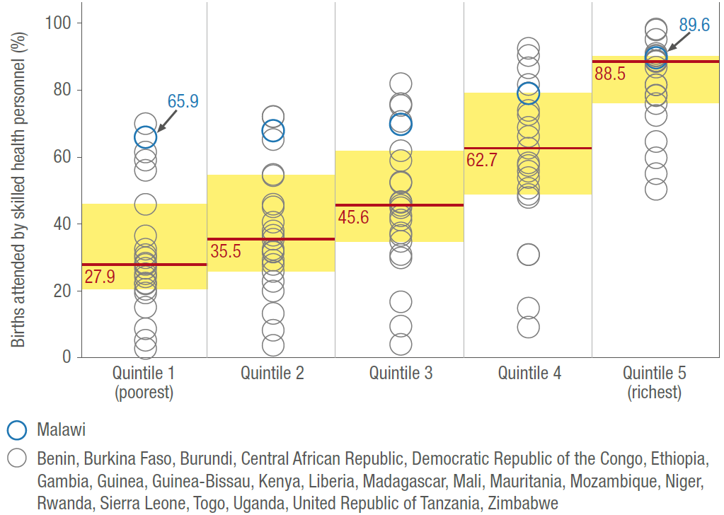
Communicating results - benchmarking
Benchmarking the latest status of births attended by skilled health personnel by wealth quintile in Malawi against low-income African countries, DHS 2005–2010

Slide 14
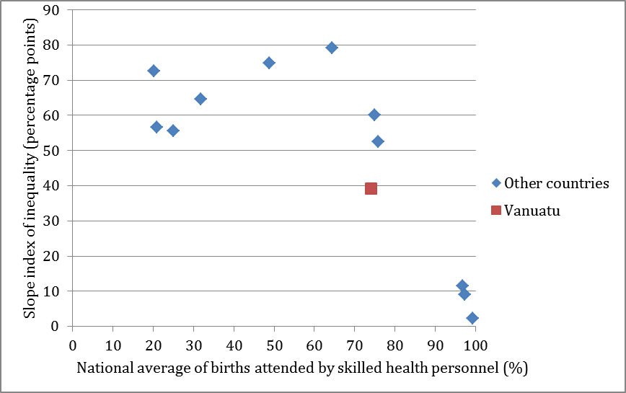
Communicating results - benchmarking
Benchmarking the latest status of wealth-based absolute inequality in births attended by skilled health personnel in Vanuatu against 11 other low- and middle-income
Asia-Pacific countries, DHS and MICS 2005–2010

Slide 15
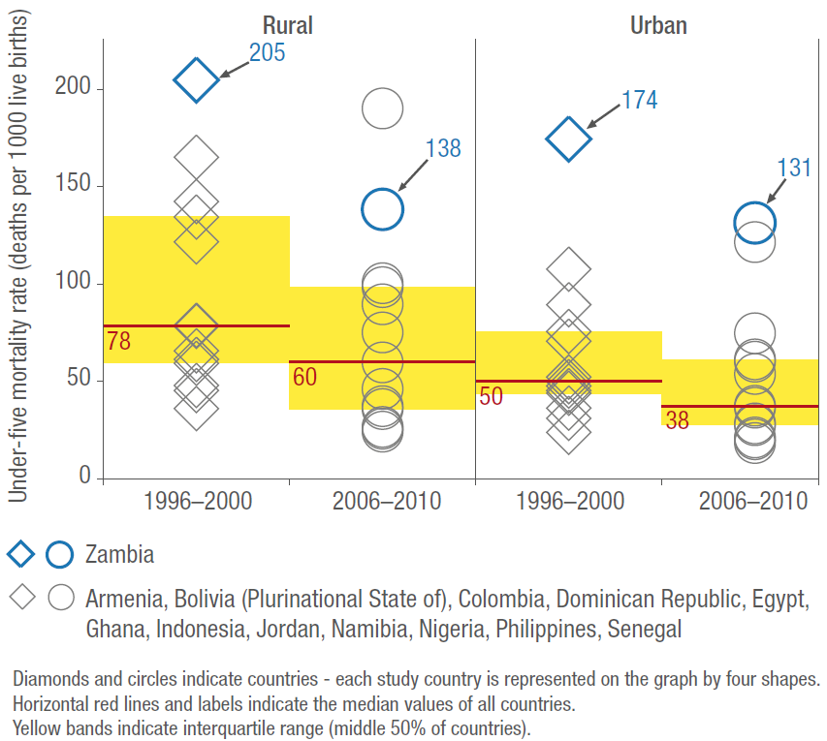
Communicating results - benchmarking
Benchmarking time trend in under-five mortality rate in Zambia against 12 other middle-income countries, by place of residence, DHS 1996–2000 and 2006–2010

Slide 16
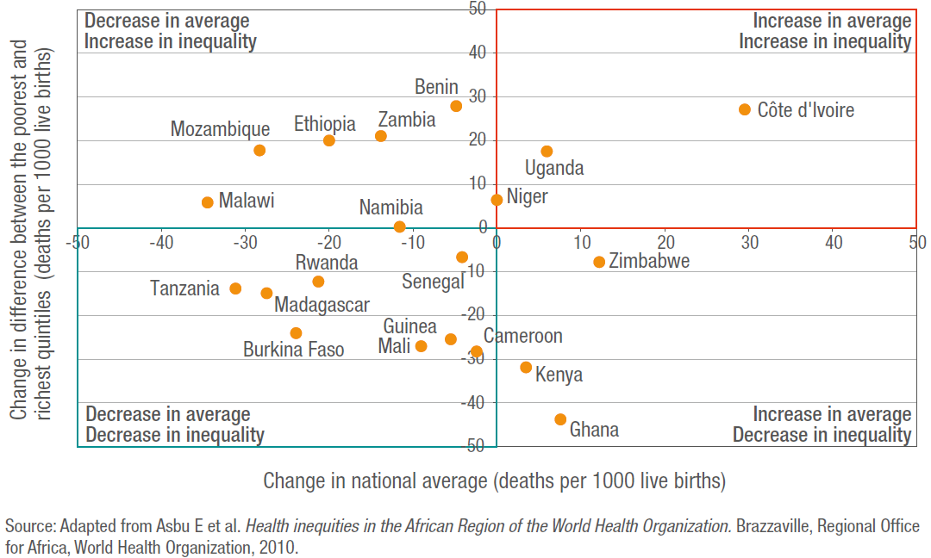
Communicating results - trend
Four-quadrant view of benchmarking time trends in infant mortality rate in 20 African countries over a five-year period, wealth-based inequality versus national average

Slide 17
Communicating results
What to be reported
Disaggregated data along with summary measures of inequality
National average along with inequality
Multiple dimensions of inequality simultaneously
Both absolute and relative inequality
Select health indicators
Obtain data
Analyse data
Report results
Implement changes

Slide 18
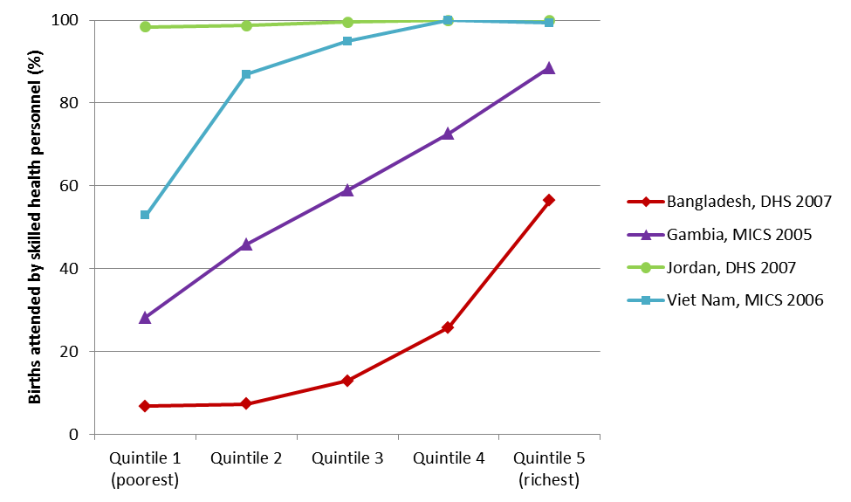
Describing patterns of health inequality using disaggregated data
Coverage of births attended by skilled health personnel in Bangladesh, Gambia, Jordan and Viet Nam, by wealth quintile, DHS and MICS 2005–2007
Complete coverage
Marginal exclusion
Queuing
Mass deprivation

Slide 19
Communicating results
What to be reported
Disaggregated data along with summary measures of inequality
National average along with inequality
Multiple dimensions of inequality simultaneously
Both absolute and relative inequality
Select health indicators
Obtain data
Analyse data
Report results
Implement changes

Slide 20
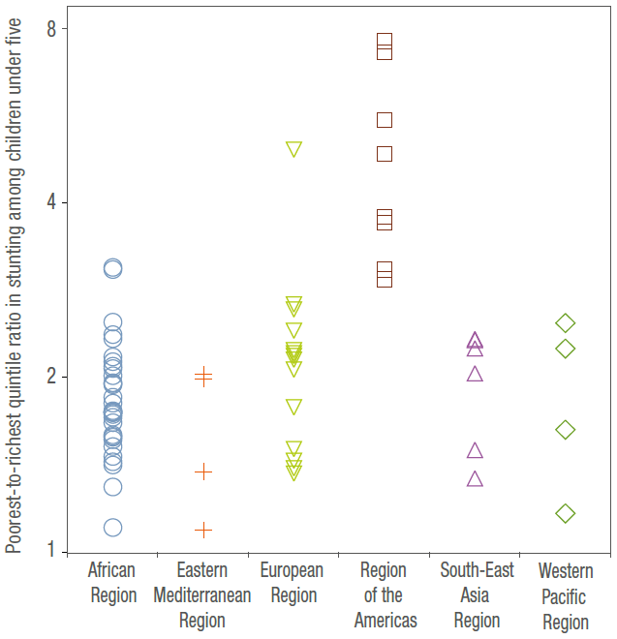
Reporting national average along with inequality (1)
Wealth-based inequality in stunting among children under five in 70 countries,
DHS and MICS 2005–2011

Slide 21
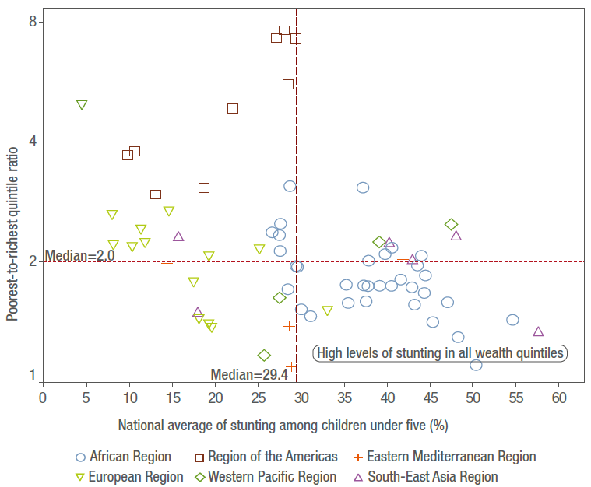
Reporting national average along with inequality (2)
Wealth-based inequality and national average in stunting among children under five in 70 countries, DHS and MICS 2005–2011

Slide 22
Communicating results
What to be reported
Disaggregated data along with summary measures of inequality
National average along with inequality
Multiple dimensions of inequality simultaneously
Both absolute and relative inequality
Select health indicators
Obtain data
Analyse data
Report results
Implement changes

Slide 23
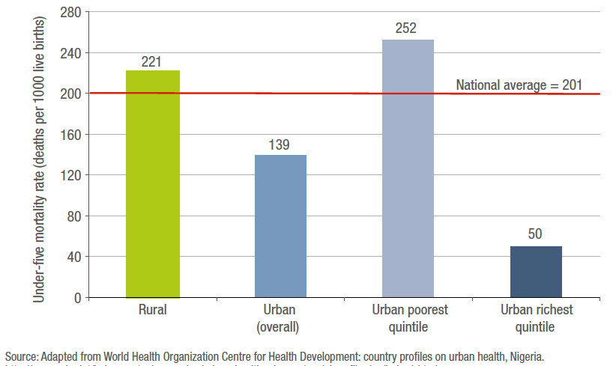
Multiple dimensions of inequality simultaneously
Under-five mortality rate in Nigeria, by place of residence and wealth, DHS 2008

Slide 24
Communicating results
What to be reported
Disaggregated data along with summary measures of inequality
National average along with inequality
Multiple dimensions of inequality simultaneously
Both absolute and relative inequality
Select health indicators
Obtain data
Analyse data
Report results
Implement changes

Slide 25
Assessing the situation and defining the priorities (1)
Assessing the latest status of inequality and national average in various reproductive, maternal and child health services in the Philippines with a simple numerical scale
1 indicates no action is needed
2 indicates action is needed
3 indicates urgent action is needed

Slide 26
Assessing the situation and defining the priorities (2)
Prioritizing the latest status of inequality and national average in RMCH services in the Philippines, using average scores for health indicators and equity stratifiers

Slide 27
Why conduct health inequality monitoring?
Agenda setting and implementing changes
Multisectoral effort - Social determinants of health framework
Select health indicators
Obtain data
Analyse data
Report results
Implement changes

Slide 28
Conclusions
Global monitoring
Reporting a common set of health services coverage indicators by common equity stratifiers e.g. economic status, education, sex, urban/rural area, if relevant, (and appropriate summary measures) using comparable data sources and similar calculation and reporting methods.
Country monitoring
Reporting context-specific health indicators and equity stratifiers, besides the common set.

Slide 29

Reference
Handbook on
Health Inequality Monitoring: with a special focus on low- and middle-income countries
WHO Global Health Observatory Health Equity Monitor

