Slide 1
Measuring the Progress towards Universal Health Coverage: Bangladesh Case Study
Shams El Arifeen, Tanvir Huda, Jahangir Khan
International Centre for Diarrhoeal Disease Research, Bangladesh (ICDDR,B)
18 September, 2013

Slide 2
Table of Content
Introduction
Service delivery and current source of information
What is currently measured and where are we in terms of UHC?
A framework for measuring UHC
Recommendation

Slide 3
Introduction
Despite significant achievement in the health sector Bangladesh lags behind in providing comprehensive heath services and financial risk protection
  Country has harvested all the 'lower hanging' fruits very successfully. So, the next challenge is to identify and act on the more difficult and formidable ones (BHW 2011).
Notes:
Bangladesh has made important progress over the past few decades. This is particularly true in the social sector which led some observers to call it 'a near
miracle. In human development,

Slide 4
Introduction
Democratic environment and constant economic growth over the last few years
  Right time and opportunity
Increase level of discussion among policy makers on UHC agenda
  No strong political commitment
  No visible initiative from the government
Notes:
This is because in Bangladesh, like any other LMIC countries, the main source of financing health care is out-of-pocket (OOP) payment at the point of service which currently exceeds 60% of the total health expenditure (BNHA 2010). This frequently leads to catastrophic health expenditures ('health shocks') and according to a report, accounts for 22% of all shocks in the lives of poor households in Bangladesh (WB 2008).

Slide 5
Introduction
Health financing strategy 2012-32 propose a road map for achieving UHC by 2032
  Emphasized on expansion of the coverage of prepayment schemes and increase public expenditure on health
A number of community based insurance schemes have been rolled out
  Most of them with very limited service and population coverage

Slide 6
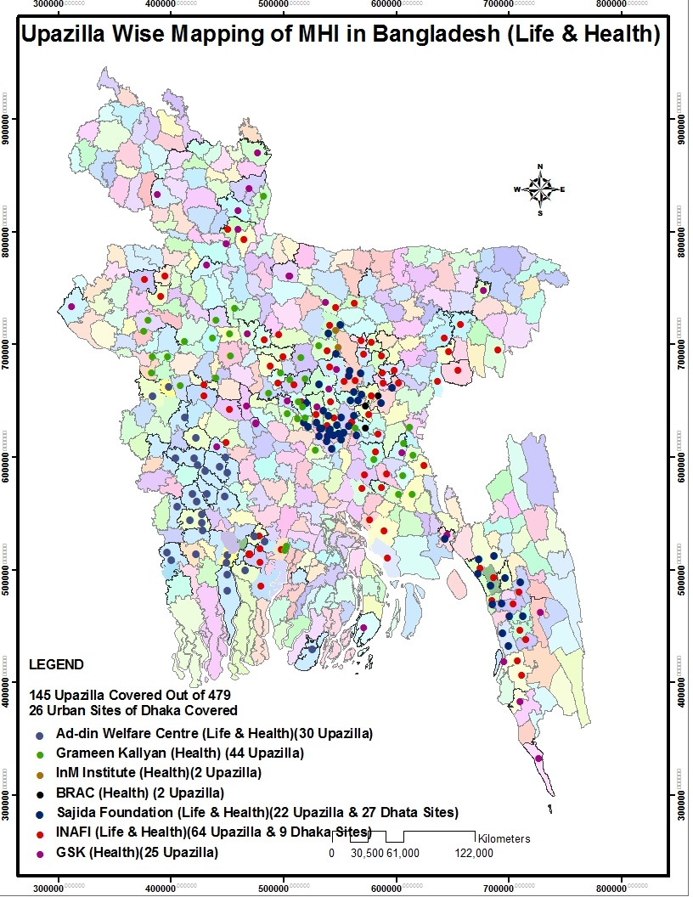
Notes:
Micro Health Insurance

Slide 7
Service Delivery and Current Source of Information

Slide 8
Health Service Delivery
Currently, health care services in Bangladesh are delivered by public, private (for profit), NGO and traditional sectors.
  Despite these multiple providers, public sector services still remain a key source of care for the population
Ministry of Health and Family Welfare implements its policies and plans through its two separate wings, the Directorate of Health Services and the Directorate of Family Planning
  Each directorate operates independently with its own separate services and separate cadre of health personnel

Slide 9
Health Service Delivery
There are mainly four levels of health facilities in Bangladesh which are
  Primary (UHC,UHFWC, USC & CCs)
  Secondary (District Hospitals)
  Tertiary (Medical College Hospitals)
  Super specialized (Specialized institutions)
A large number of govt and ngo based community workers providing ambulatory care
  including family planning services, maternal and child health care, immunization, symptomatic curative care, and upward referrals
Notes:
The WHO recently reported a density of 3·3 CHWs per 10,000 population in Bangladesh, which is much greater than that recorded in India and Pakistan (where it is 0·46 and 0·63 per 10,000 respectively), Moreover, a recently completed mapping study reported a total of 174,000 CHWs across rural Bangladesh alone. Of these, 54,000 were government workers (FWA and HAs) and another 52,000 were temporary workers supported by special MNCH programs.²⁵

Slide 10
Information System
Heavily dependent on periodic household surveys for measuring coverage of priority interventions
  Bangladesh Demographic and Health Survey (BDHS)
  Multiple Indicator Cluster Survey (MICS)
  Bangladesh Health Facility Survey (HFS)
  Bangladesh EPI Coverage Evaluation Survey (CES)
  Bangladesh maternal Mortality and Health Care Survey (BMMS)
  Utilization of Essential Service Delivery Survey (UESD)
  National Nutrition Survey
  Bangladesh Urban Health Survey (UHS)
  Non-Communicable Disease Risk Factor Survey Bangladesh
  Household Income and Expenditure Survey (HIES)
  National Health Accounts
Notes:
Child and Mother Nutrition Survey of Bangladesh
National Low Birth Weight Survey of Bangladesh

Slide 11
Results Framework for
HPNSDP 2011-2016
Goal Level Indicator | Means of Verification
Infant mortality rate | BDHS
Under 5 mortality rate | BDHS
Neonatal mortality rate | BDHS
Maternal mortality ratio | BDHS
Total fertility rate | BDHS
Childhood stunting prevalence | BDHS
Childhood underweight prevalence | BDHS
Prevalence of HIV in MARP | Sero-Surveillance Survey
Notes:
This is aptly exemplified by the results framework of the country's current health sector plan. Of the eight impact/goal indicators, all are to be measured through surveys, seven of which through the DHS.

Slide 12
Results Framework for
HPNSDP 2011-2016
^{[1]} Note for definition of improved: DSF upazilas that are “means-tested,” i.e. women need to meet specific criteria to be eligible for the voucher program
^{[2]} In 2006, MOHFW decided to upgrade 1,495 UH&FWCs to provide basic EmOC [Source: Mridha et al. (2009) Public-sector Maternal Health Programmes and Services for Rural Bangladesh, J Health Popul Nutr 27(2):124-138]
Service Delivery Indicators | Means of Verification
% of deliveries by skilled birth attendant | BDHS
Antenatal care coverage (at least 4 visits) | BDHS
Postnatal care within 48 hours (at least 1 visit) | BDHS
Contraceptive prevalence rate | BDHS
Unmet need for FP | BDHS
Measles Immunization Coverage by 12 months | CES
Under-5 children with pneumonia receiving antibiotics | BDHS
Under-5 children receiving Vitamin A supplementation in the last 6 months | BDHS
TB case detection rate | NT Program
Proportion of births in health facilities by wealth quintiles | BDHS
Use of modern contraceptives in low performing areas | BDHS
# of upazilas with improved voucher scheme for institutional deliveries | DSF Monitoring Reports
Rate of exclusive breastfeeding in infants up to 6 months | BDHS
% of children 6-23 months fed with appropriate IYCF practices | BDHS
# of Community Clinics with increasing number of service contacts over time | Project MIS
% of upgraded union-level facilities able to provide basic EmOC services | Health Facility Survey
Notes:
There are 16 indicators that relate to health services, mostly intervention coverage. Of these 11 are to be measured by data from the DHS and only two would be measured through programme data.

Slide 13
Routine Information System
Routine health information system is still very weak ( EPI MIS being the only exception)
      Paper based
      Multiple parallel system
      Unable to measure priority service indicators
      Redundant MIS tools
      Poor Quality
      Limited access and use of information
Notes:
The country’s routine health information system is still very weak and was a negligible sector until recently. The routine system is mostly paper based. Likewise the service delivery there is little coordination between different programs in collecting health information. As example the two large directorates have their separate information system. As a result the quality of routine information is always of questionable standards and historically there has been very little use of that data. The only exception is being the EPI (expanded program on immunization) MIS. The health assistant of the DGHS are responsible for collecting information on EPI program activities, which are checked by their supervisors and sent to the statistician who compile sub district data and submit to the district level supervisor. Data are then entered at EPI Data Management System (REPIDMS). The program also uses standard quality assessment tool to monitor the quality of data.

Slide 14
Routine Information System
Increase focus and attention in recent times
Multiple initiatives are ongoing to strengthen the RHIS
  Electronic system at the sub district and district level in patient facilities
  Electronic recording of pregnancy surveillance data
  Streamlined MIS tools
Notes:
The newly designed forms and systems are currently being piloted at district, sub-district, and community levels in 3 selected sub-districts and the district hospital of Tangail.
Piloting in all sub-districts of Habiganj including the district hospital in collaboration with Save the Children (under USAID-supported District Health Systems Strengthening project) is scheduled to start on 15/09/13.

Slide 15
What are we currently measuring? Where are we now?

Slide 16
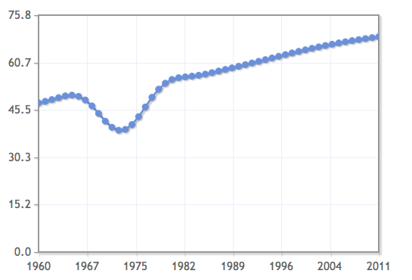
Life Expectancy at Birth
Notes:
life expectancy has increased by over 50% - from about 45 years in the early 1970s to over 65 years currently. More importantly, women now live a longer life than men, as expected biologically and experienced around the world.
More recent data
Male 68.23
Female 69.68
Total 68.94
47.76
1971 39.93
1972 38.97
1973 39.25
40.79
2011 68.94

Slide 17
Bangladesh on track to achieve MDG 4 targets well before 2015
Bangladesh Demographic and Health Surveys
Notes:
This is to remind ourselves of the progress made by Bangladesh
Under-5 mortality rate in Bangladesh has been declining by more than 5 percent per year
At this rate of reduction, the current under-5 mortality in Bangladesh may already be lower than the MDG 4 target of 48.

Slide 18
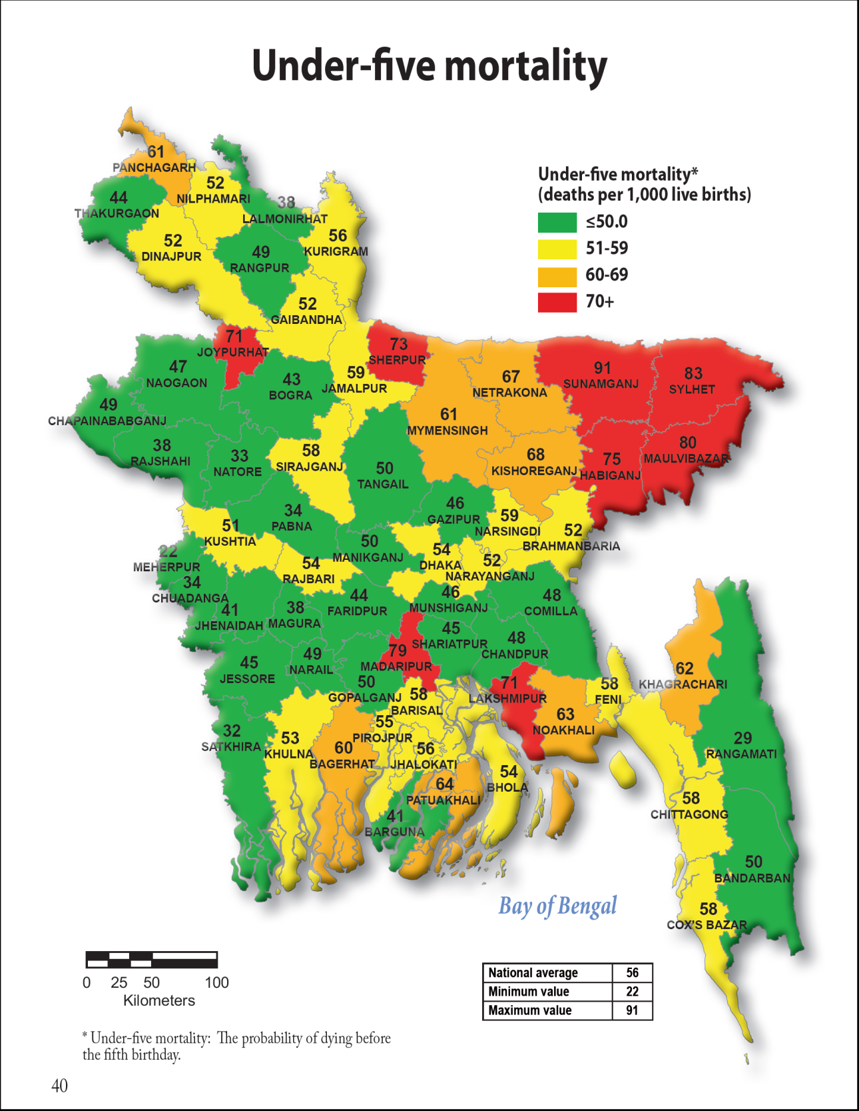
Bangladesh Maternal Mortality Survey 2010

Slide 19
At least one antenatal care visit from any provider
Bangladesh Demographic and Health Surveys
Notes:
Let's begin with antenatal care. As you can see, irrespective of type of providers overall care seeking during the antenatal period is consistently increasing - a 5 percentage points increase between last three surveys.

Slide 20
Skilled attendance at delivery
32
21
16
Bangladesh Demographic and Health Surveys
Notes:
How have we reached this 32% of skilled care? Of course gradually over the last decade. This is the portion who delivered at facilities and these are who delivered by skilled attendants at home. I would like to draw your attention to two issues here, (i) Since HPNSDP target is 50%; we have 20percentage points more to achieve in the remaining 4 years and (ii) almost the entire gain in skilled delivery care is because of facility delivery. Those of us are concerned about maternal health strategies should focus either on increasing skilled care at home or increase facility delivery or both.

Slide 21
Facility deliveries by wealth quintiles
Richest
Poorest
1:13
1:8
1:6
Bangladesh Demographic and Health Surveys
Notes:
For quite a long time maintaining equity has been an issue for all the maternal health care services. Programs like Demand Side Financing has been introduced to encourage poor to seek facility based care. Here we can see proportion of facility delivery by wealth quintiles. The HPNSDP target is to achieve a rich poor ratio less than 1:4 by 2016. Well done Bangladesh….. there are still large disparity to overcome..

Slide 22
Childhood vaccinations
Bangladesh Demographic and Health Surveys
Notes:
Bangladesh is continuing to do very well with immunization coverage. Overall, 83% of all children currently aged 12-23 months had received all basic vaccines by age 12 months and is just 7 % points below the HPNSDP target of 90%. Some regions of Bangladesh have already achieved this target, while substantial work remains to be done in Sylhet, Chittagong and Barisal.
The main drop-off in coverage occurs with the measles vaccine. Coverage with the 3rd dose of pentavalent vaccine or of the 3rd dose of polio vaccine is 93%

Slide 23
Measles vaccination by wealth quintiles
Bangladesh Demographic and Health Surveys

Slide 24
Antibiotics for childhood ARI by wealth quintiles
Bangladesh Demographic and Health Surveys

Slide 25
Childhood diarrhoea
5% of under-5 children had diarrhoea in previous 2 weeks
Without ORT:
With ORT:
Bangladesh Demographic and Health Surveys

Slide 26
ORS for childhood diarrhoea by wealth quintiles
Bangladesh Demographic and Health Surveys

Slide 27
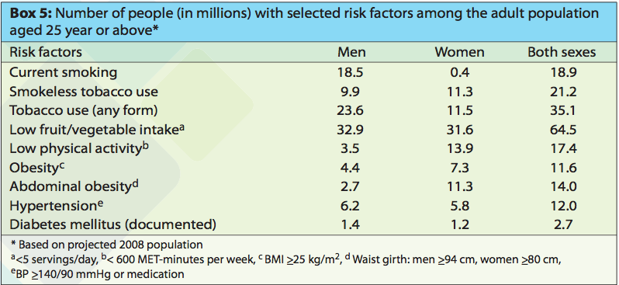
Prevalence of risk factor
Non-communicable disease risk factor survey, Bangladesh 2010

Slide 28
Prevalence rates for hypertension and diabetes among people of age 35 and over are high
Bangladesh Demographic and Health Surveys

Slide 29
Awareness about physical status, treatment and adherence to medication are low: Hypertension
About half of the women not aware about status
45% are taking medicine among which more than half does not have controlled blood pressure
Bangladesh Demographic and Health Surveys
Notes:
Not much difference between men and women

Slide 30
Awareness about physical status, treatment and adherence to medication are low: Diabetes
Around 60% of the women not aware about status
Around one third taking medicine among which 60% does not have controlled blood glucose
Bangladesh Demographic and Health Surveys

Slide 31
Trends in the Use of Family Planning
Percentage of currently married women
currently using any modern method
Bangladesh Demographic and Health Surveys
Notes:
There was a plateau in 2007 due to stock out of injectables in the months before the survey.
This dropped the modern CPR by 3.5%.
That CPR was increased again by 3.5% in the 2008 UESD survey after the stock out was resolved.
Aim of HPNSDP is 72% by 2016. What chances of achieving that? Up 11% in 5 years?
We have been seeing annual increases of CPR of less than 2% since the early 1990s, but now need to increase to more than 2% pa. How to do that?
P reduces unintended pregnancies and contributes in fertility decline
 FP saves lives
 Reduced maternal deaths, illness and deaths among young women
 Improved child health and survival
 FP improves women’s life
 FP helps countries reach development goals in health and development

Slide 32
Any method of family planning by wealth quintile
Bangladesh Demographic and Health Surveys

Slide 33
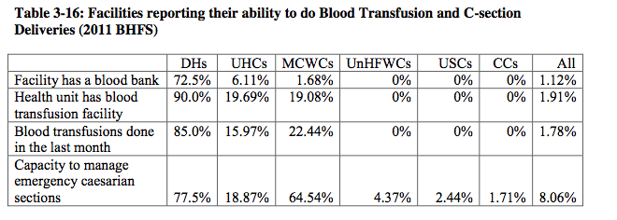
Ability to do Blood transfusion and C-Section
he Bangladesh Health Facility Survey 2011
Notes:
Access and readiness indicator

Slide 34
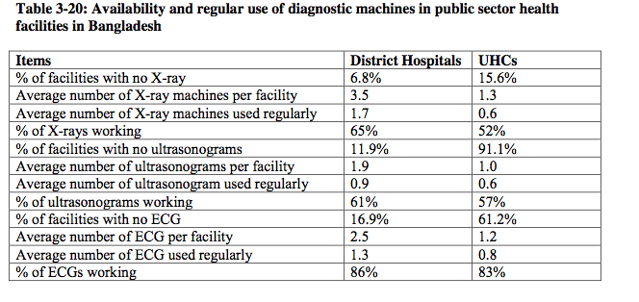
Availability and use of diagnostic machines
he Bangladesh Health Facility Survey 2011
Notes:
Access and readiness indicator

Slide 35
Affordability – Financing dimension of UHC

Slide 36
Healthcare Financing in Bangladesh 2006-2007
Source: MoHFW, 2010

Slide 37
Trends in health expenditure in Bangladesh, 1997-2007
Items | 1997 | 2001 | 2005 | 2007
Total Health Expenditure in PPP$ per capita | 20.0 | 27.0 | 37.0 | 46.0
Total Health Expenditure in US$ per capita | 9.2 | 10.6 | 13.7 | 16.2
Total Health Expenditure as % of GDP | 2.70% | 2.90% | 3.20% | 3.40%
Mean annual growth rate in THE |  | 13.0% | 15.0% | 16.0%
Mean annual growth rate in GDP |  | 7.0% | 11.0% | 14.0%
Public expenditure on health as % of THE | 36.0% | 31.0% | 26.0% | 26.0%
Public expenditure on health as % of GDP | 1.0% | 1.0% | 1.0% | 1.0%
OOP as % of total health expenditure | 57.0% | 59.0% | 64.0% | 64.0%
NGO expenditure as % of THE | 1.0% | 2.0% | 2.0% | 1.0%
External assistance to NGOs as % of THE | 5.0% | 8.0% | 8.0% | 8.0%
Other private expenditure as % of THE | 1.0% | 1.0% | 1.0% | 1.0%
Source: MoHFW, 2010

Slide 38
Allocation in public budget for health, 2009-2014
7,287 cr
7,667 cr
7,667 cr
9,470 cr
9,470 cr
Source: Ministry of Finance, GoB

Slide 39
Indicator of need for care : Rates of illness (per 1,000 populations) in past 30 days :
SEQ | Total
Poorest | 223.0
2nd | 215.9
3rd | 202.6
4th | 192.2
Richest | 155.1
Total | 196.6
Concentration index | -0.065
Unpublished data, HIES, 2010

Slide 40
Average out of pocket payments (US$) per household per month
SEQ | OOPP
Poorest | 5.5
2nd | 6.8
3rd | 8.5
4th | 9.6
Richest | 12.7
Total | 8.5
Concentration Index | 0.163
1 US$ = 76 BDT
Unpublished data, HIES, 2010

Slide 41
Source: Van Doorslaer et al, 2007.

Slide 42
Percentage households faced catastrophic health expenditure (10% threshold level) in Bangladesh, 2010
SEQ | Total
Poorest | 16.5%
2nd | 15.9%
3rd | 15.0%
4th | 13.8%
Richest | 9.2%
Total | 14.2%
Unpublished data, HIES, 2010

Slide 43
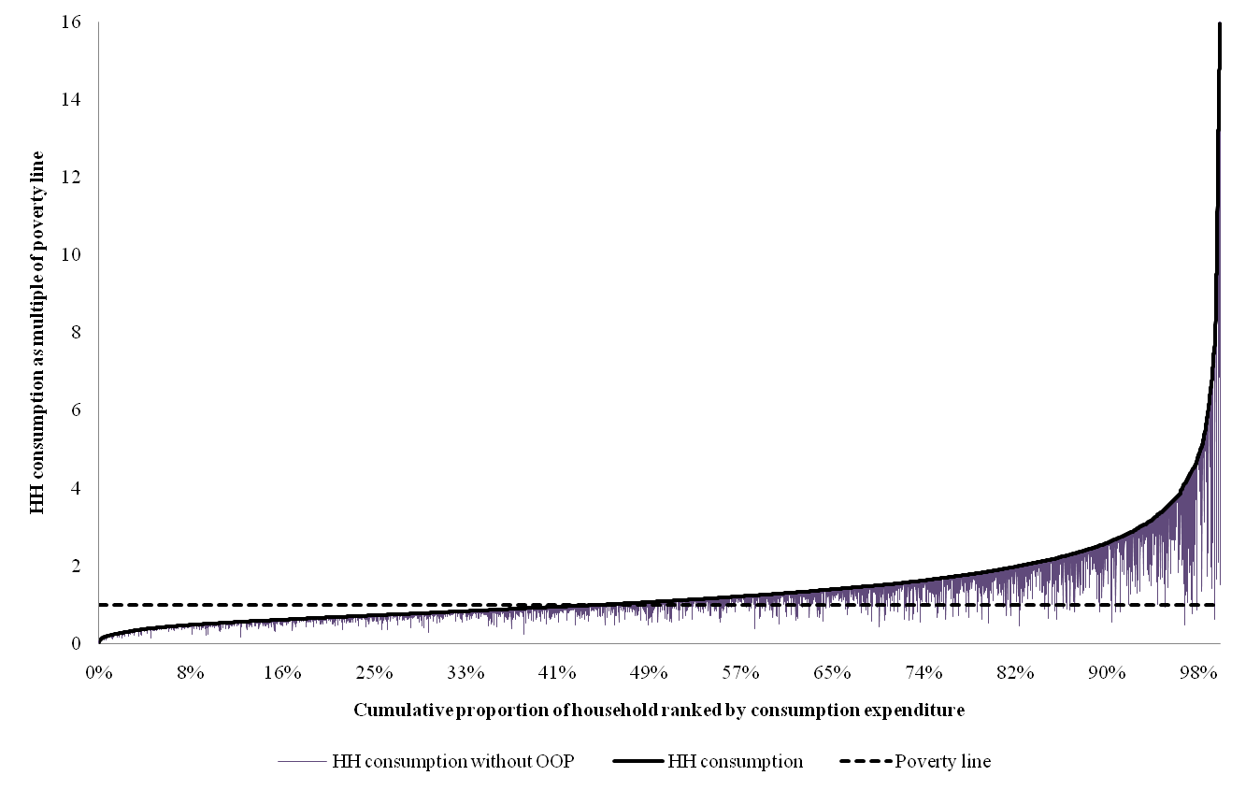
Poverty head count and falling into poverty in Bangladesh, 2010
With health payments | Without health payments | Difference
37.8% | 41.3% | 3.5%
Unpublished data, HIES, 2010

Slide 44
“Sample of proposed Indicators for measuring progress of UHC”

Slide 45
Inputs and Outputs
Health information
  Proportion of sub district hospitals with electronic MIS
Service Quality and safety
  Proportion of accredited facilities at different level
Service Utilization
  Number of outpatient visits per capita per year
Pooled financial resources
  Social, CBHI and Private HI contribution (as % of THE)

Slide 46
Outcome
Coverage of secondary and tertiary level Intervention
  Cataract Surgical Coverage
  Radiotherapy and Chemotherapy coverage for Lung/breast cancer
Coverage of Financial risk protection
  Share of people did not receive any healthcare or adequate healthcare due to economic hardship

Slide 47
Impact
Improved health status
  Case fatality rate (CFR) for major infectious disease
  Estimated death rates due to cancers
Improved household financial wellbeing
  Share of people did not receive any healthcare or adequate healthcare due to economic hardship

Slide 48
Recommendation
Need strong political commitment
Need better understanding about concept of UHC
In country discussion and agreement on minimum set of services to be covered under UHC reform
Proposed UHC M&E framework will need in country consultation and should be embedded in the health sector M&E framework
Quality of Population data need to be improved

