Slide 1
Addressing Tribal Health in Gujarat
Best Practices
P.K.Taneja, IAS
Principal Secretary, Public Health and FW, & Commissioner( Health)
Govt. of Gujarat, Gandhinagar, Gujarat

Slide 2
Problem Statement
Gujarat is considered a developed State. However, it has its own set of problems due to Socio -demographic profile:
High Tribal Population : 14.8 % Vs 8.6 % of India
Inequity in access of healthcare institutions, human resources, geographical barriers in Tribal areas, DDP areas etc.
Inherent problems like Sickle Cell Anemia – a genetic disorder, Leptospirosis, a zoonotic disease contracted from infected urine of rodents in certain tribal districts and is an occupational hazard.
Cultural barriers, local customs of dependency on faith healers.
Custom of home deliveries, by male members in certain sub-tribes

Slide 3
Problem Statement
Seasonal migration for seeking work.
Declining Sex Ratio now affecting tribal districts as well.
High prevalence of under-nutrition
The health delivery system of PHC, SC and field workers under administrative control of PRIs.
Rational Deployment is missing.
Health staff not staying in the HQs.
Sub-Optimal health indicators, dragging down overall performance of Gujarat.

Slide 4
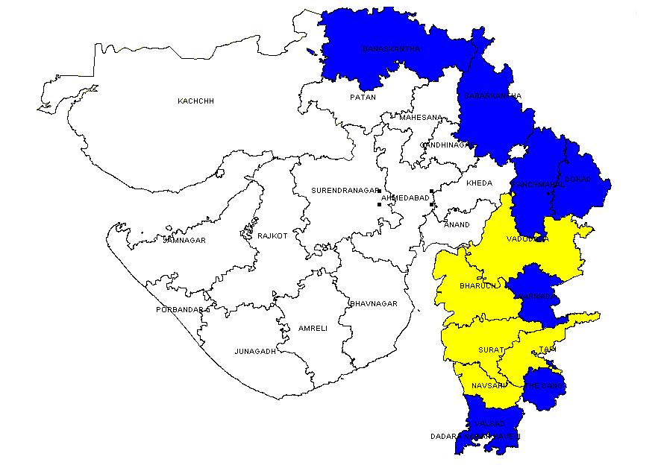
Tribal Districts of Gujarat (12)
Rajasthan
43 Talukas in12 out of 26 districts are Tribal
Entire eastern belt of Gujarat
Bordering Rajasthan, MP, Maharashtra having similar districts
89 lakhs tribals i.e. 14.76 % of population. (India : 8.6%)
Hilly terrain mainly.
MP
Tribal and HPD districts
Maharashtra
Tribal but not HPD districts

Slide 5
Comprehensive Strategy
Multi-Pronged Approach:
Identification of High Priority Talukas (HPTs), Backward Talukas etc using Score Card concept for targeted interventions.
Strengthening of service delivery systems – infrastructure, Health Resources, Rational Deployment etc
Use of Tools such as GIS Mapping Technology for Rational Planning and management of infrastructure.
Convergence with multiple line departments-Vanbandhu Yojna etc
Partnering with NGOs and Private Service Providers.
Relaxation of ASHA selection norms and Incentives to Health Human Resources.

Slide 6
Strategy
Identification of High Priority Talukas (HPTs)
13
38
2
16
Tribal+Backward Taluka
BRGF+Backward+Tribal Taluka
Tribal Taluka
9
Desert +Backward+BRGF Taluka
7
14
BRGF+ Tribal Taluka
2
5
7
BRGF Taluka
4
BRGF+DDP Taluka
Desert Taluka
Desert+Backward Taluka
Backward+BRGF Taluka
Backward Taluka

Slide 7
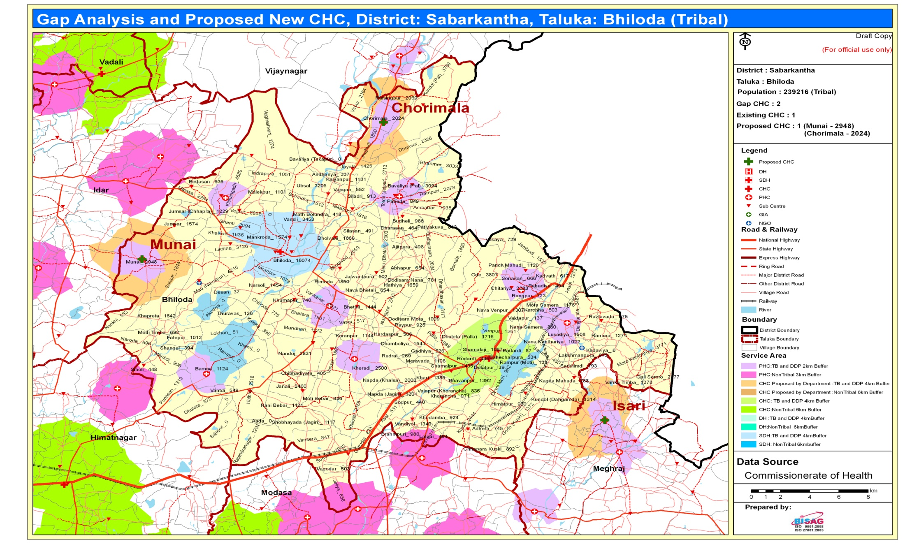
GIS Mapping Technology – a Tool for Rational Planning and Management of Health Infrastructure

Slide 8
Augmenting HR in Tribal Areas with Emphasis on HPTs in First Two Years of 12th Plan
New staff pattern for 358 PHCs of 12 persons (additional 1 MO, 2 Staff Nurses) against 9 positions
New staff pattern for 65 Community Health Centers (CHCs) of 32 personnel (1 additional Medical officer & 4 Class I specialists doctors) against 27.
200 Ayurveda doctors posts in PHCs are sanctioned in 2012-13.
Creation of 43 Taluka Health Officers at Taluka level.
Creation of 43 Female Health Supervisor at Taluka level.
Creation Post of MPHWs (Male) and ANM / FHW Post in proposed 400 sub centers in Tribal Area of the State.
CM – SETU (Chief Minister Services of Experts at Treatment Unit )

Slide 9
Augmenting Physical Infrastructure in Tribal Areas in First Two Years of 12th Plan
Establishment of 400 new Sub – Centers , 25 PHCs
Inter hospital transport facilities in 3 Hospitals for critical maternal and new born cases
5 new CHCs being set up and 3 CHC being upgraded
Strengthening of 7 SNCUs
2 ANM Schools at Vyara in Tapi and Nana Pondha in Valsad
District Training Unit in Dahod District
2 Ayurvedic and 1 Homeopathic colleges and hospitals

Slide 10
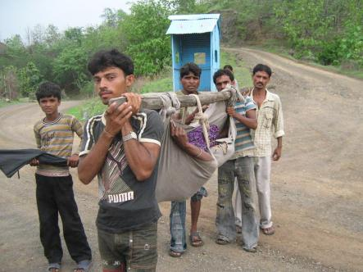
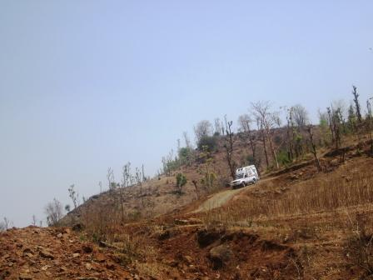
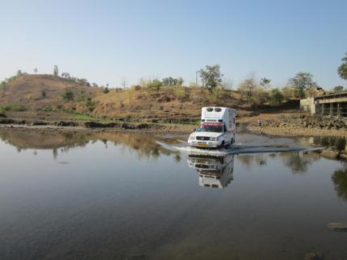
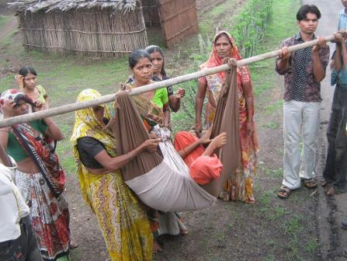
Provision of Special 4-Wheel Drive Emergency Ambulances (12) for Inaccessible Areas

Slide 11
Reaching Out:
Health Schemes in Tribal Areas
Chiranjeevi Yojana (CY)- PPP for free delivery services by NGOs, Trusts & private gynecologists . 46000 beneficiaries in FY 12-13
Bal Sakha Yojana (BSY)- PPP for free newborn care by NGOs, Trusts & private Paedetricians. 18,660 beneficiaries in 12-13
Kasturba Poshan Sahay Yojana (KPSY): Rs 2100 Conditional Cash Transfer (CCT) to more than 1 lac pregnant women of BPL families in installments in 12-13
Mamta Ghar : Birth Waiting Homes
Mamta Sakhi : Birth Companion Scheme.
Incentive Rs 500 per delivery (after 5 deliveries) to Nurse Practioners

Slide 12
Reaching Out:
Health Schemes in Tribal Areas
7. Mission Balam Sukham : 3 tier Treatment Centres for management of Malnutrition
VCNC – Village Child Nutrition Centers- 3536
CMTC – Child Malnutrition Treatment Centers : 50
NRC – Nutrition Rehabilitation Center : 11
8. Free treatment in Govt. institutions to ST population - 2,17,410 beneficiaries in 12-13
9. Free treatment for cardiac, cancer, kidney diseases in Super-speciality hospitals
10. Address the gap of Physical and Human Infrastructure on Priority.

Slide 13
Maximum Benefits to ST in
Village Child Nutrition Centres (VCNCs)
VCNCs - 1868

Slide 14
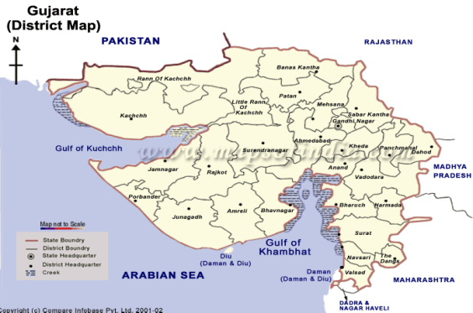
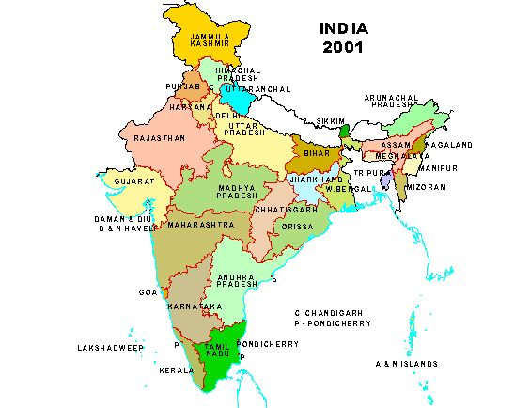
Sickle Cell Anemia Control Program:
A Flagship Program of Gujarat
Seen in all 12 tribal districts – all covered under Sickle Cell Anemia Control Program
A Hereditary disease caused by mutant recessive gene
Tribals mainly affected.

Slide 15
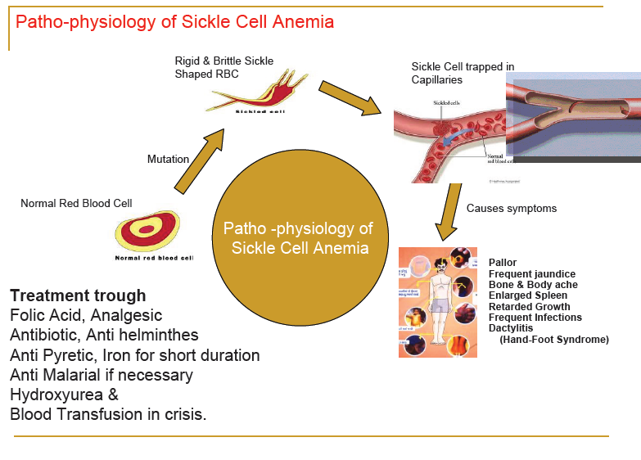

Slide 16
Sickle Cell Anemia - Overview
Sickle Cell Anemia - a genetic disorder
A major public health problem, mainly seen among tribals
Affected are medically underserved & from low socio-economic strata
>50% of the world Sickle gene carriers in India
As per one hypothesis, mainly seen in malaria endemic area
Need for Standard Treatment Guidelines (STGs) , Protocols and Technical Support

Slide 17
Estimated burden of Disease
 | Gujarat | India
Total Population | 6,03,83,628 | 1,21,01,93,422
Tribal Districts | 12 | 593
Tribal Population * | 89,12,623 | 17,86,24,549
Suspected Sickle Trait @ 10.0 % | 8,91,262 | 1,78,62,455
Suspected Sickle Cell Disease Patients @ 0.75 % | 66,845 | 13,39,684
* @ 14.76%

Slide 18
Serious Public Health Issue
Goals
If left untreated –
20% of Sickle disease children die by the age of two year – affects Under-5 mortality.
30% die before they reach adulthood. (ICMR survey-1989 )
Being genetic in nature, the numbers of diseased people are bound to rise, in absence of suitable interventions.
No Sickle Cell Disease childbirth by 2020.
Prevention of death from Sickle Cell Crisis.
To improve health status and quality of life of Sickle Cell Anemia patients.

Slide 19
Roll-out of Sickle Cell Anemia Control Program
2006
Program started in 5 districts of South Gujarat on PPP basis
2008
Extended to remaining 7 tribal districts of Gujarat
2011
Gujarat Sickle Cell Anemia Control Society formed to integrate efforts by different departments
2012
  Screening outsourced to qualified, competent & dedicated competitive agencies

Slide 20
Components of Program
1.Early diagnosis through
  New Born Screening
  Prenatal Diagnosis
  Antenatal Screening
  Adolescent Screening
  Mass Screening on mission mode
  a) DTT and b) HPLC based Hb Variant System
  2.Prevention through
    Marriage counseling
    Genetic counseling
    Building community awareness
3.Reduction in crisis episodes & mortality
  Supportive treatment
  Regular follow up and counseling
  Referral treatment and specialized hospital care
  4.Regular Training and capacity building of
    Health care providers & ASHA
    VHSNC members & Teachers

Slide 21
Initiatives in the Program
Involvement of NGOs for counseling, mobilization for screening, etc
Outsourcing the screening activity
Prophylactic Pneumococcal vaccine to all Sickle Cell Disease patients- 7000 patients covered.
Follow up camps at quarterly intervals.
Web based application - for Data collection and online tracing of any SCD patient.
Stem cell Research and Therapy center being set-up in Surat Medical College –a PPP initiative.

Slide 22
Year wise Community screened for Sickle Cell Anemia in Gujarat, Year 2006 to 2013
A substantial increase in mass screening from 12-13 onwards due to outsourcing initiative to complete the Mass Screening of entire population in 3 years.

Slide 23
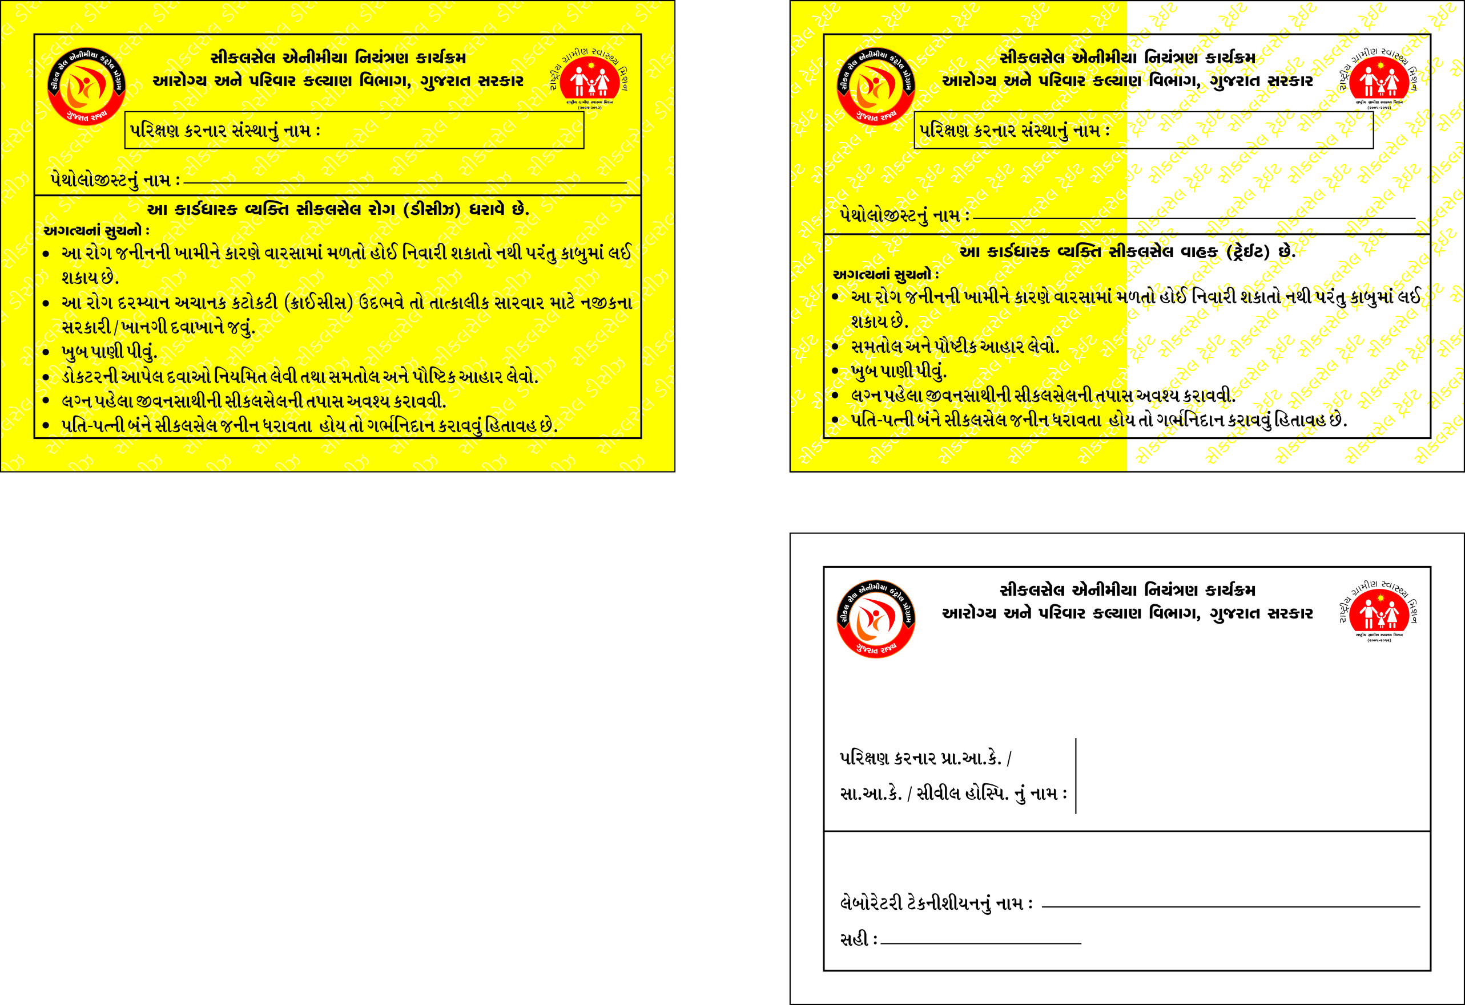
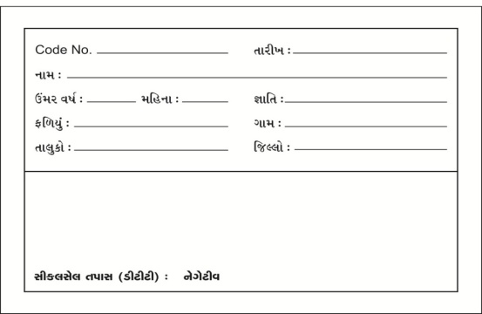
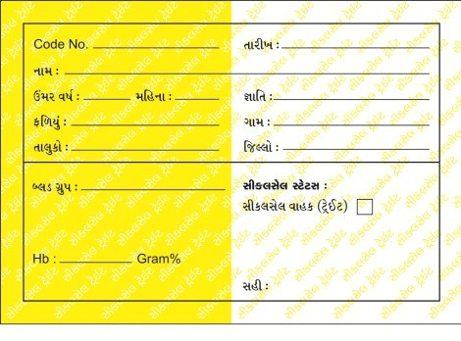
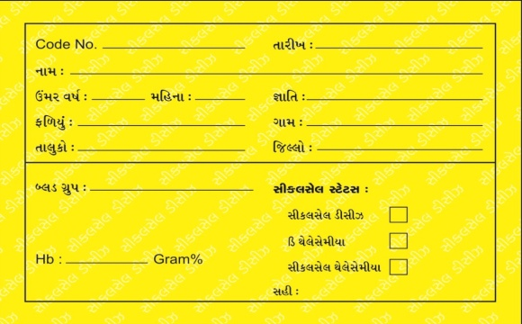
Sickle Cell Card
Normal
Sickle Cell Trait
Sickle Cell Disease

Slide 24
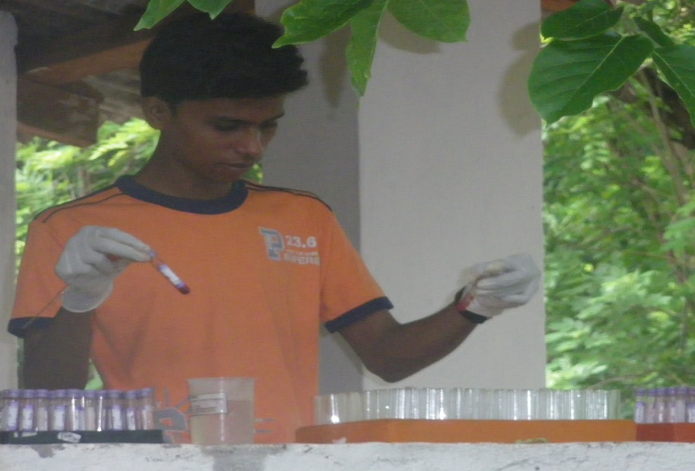
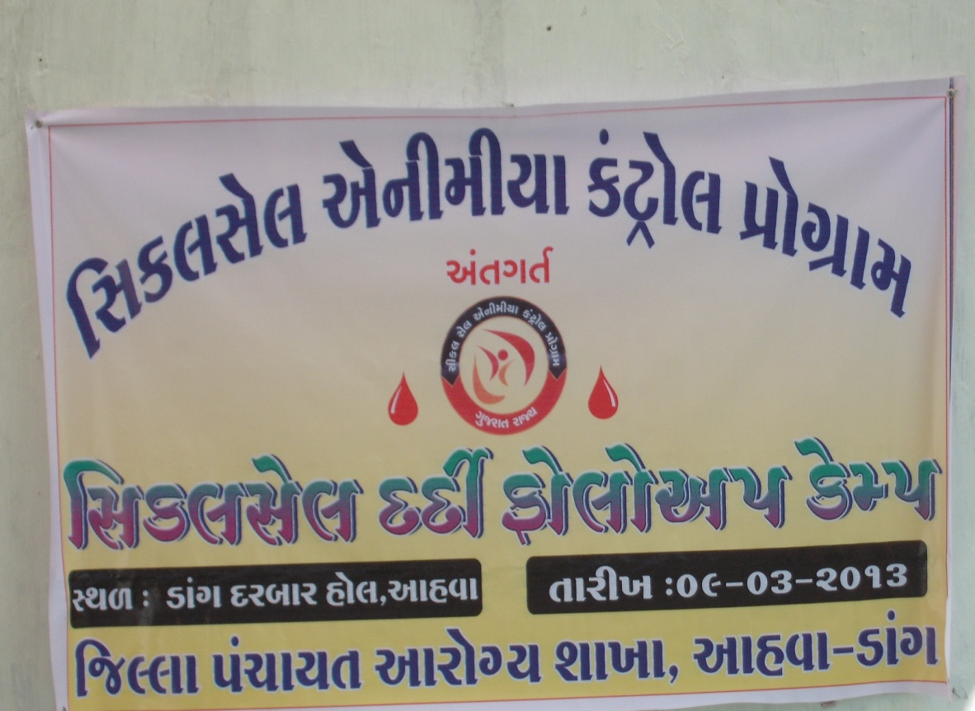
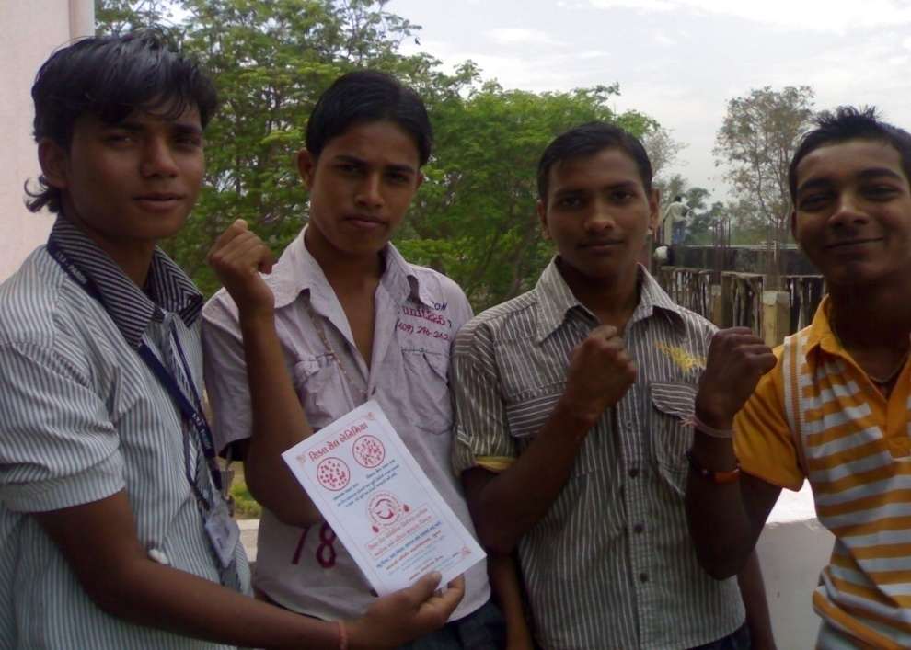
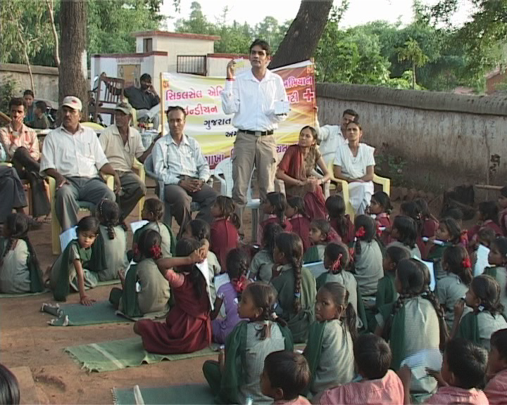
Screening Camp at Village Level
SCD Follow up Camp Camp at Village Level

Slide 25
Leptospirosis Control Programme
A zoonotic disease in which humans are affected when they come in contact with urine of infected carrier hosts such as rodents-A serious Occupational Hazard and Public Health Problem with high Morbidity and Mortality.
Results in serious complications such as meningitis , respiratory and kidney failure. Time to care is critical for survival.
Mainly seen in Surat, Navsari, Valsad & Tapi districts in monsoon season and affected population is tribal productive age group.
Convergence: Integrated actions are taken by different departments like Agriculture, Animal Husbandry, Information, Tribal Development, etc. for Prevention, Control and Treatment.
25
Notes:
Initiative: In the year 2005-2006, Department of Health & Family Welfare, Government of Gujarat passed a resolution No. S.C.K.-102005, New Matter-10-G dated 30th January 2006, to initiate a Public Private (Go- NGO) Partnership - Sickle Cell Anemia Control Program in the 5 districts of south Gujarat.
Now in 2010, it has been extended to all 12 tribal districts of Gujarat and steps are being taken to form a Gujarat Sickle Cell Anemia Control Society under society registration act 21 of 1860.

Slide 26
Leptospirosis Control Programme
Mass Educational and Awareness Programs are taken up jointly by all Departments through the District Authorities.
All PHC, CHC, District Hospitals & Medical Colleges geared up to meet the Challange to provide timely healthcare.
Mass chemoprophylaxis on DOT methodology with the help of AHSAs.
Anti Rodent Activity (ARA) is done before monsoon.
Toll decreased from 919 cases and 178 deaths in 2011 to 156 cases and 26 deaths in 2012
A proposal to GoI sent to undertake Operational Research and extend Technical Support.
26
Notes:
Initiative: In the year 2005-2006, Department of Health & Family Welfare, Government of Gujarat passed a resolution No. S.C.K.-102005, New Matter-10-G dated 30th January 2006, to initiate a Public Private (Go- NGO) Partnership - Sickle Cell Anemia Control Program in the 5 districts of south Gujarat.
Now in 2010, it has been extended to all 12 tribal districts of Gujarat and steps are being taken to form a Gujarat Sickle Cell Anemia Control Society under society registration act 21 of 1860.

Slide 27
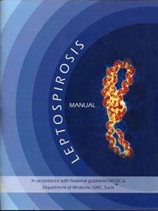
Leptospirosis Manual developed by Gujarat

Slide 28
Comprehensive Emergency Obstetric (CEmOC) & New Born Care Unit, CHC- Jabugam : PPP Model
Problem Statement.
Vacant Specialists post in Government Institution in Pavi-Jetpur or nearby tribal talukas.
No functional First Referral Unit in that area for providing emergency care.
Delay in receiving medical attention may lead to maternal/ infant death.
Process
MoU signed with Deepak Foundation, Vadodara for setting up of CEmONC at Jabugam CHC in Pavi-Jetpur, Vadodara in 2006.
Partner organization to build a 10 bed center in CHC premises.
Operating cost shared
Notes:
In 1997 UNICEF, WHO and UNFPA issued a set of indicators called ‘UN process indicators’ to monitor the availability, utilization and quality of EmOC. To standardize the use of the UN process indicators, they were published with a set of guidelines in the document ‘Guidelines for Monitoring the Availability and Use of Obstetric Services’, commonly referred to as the ‘UN Guidelines’.

Slide 29
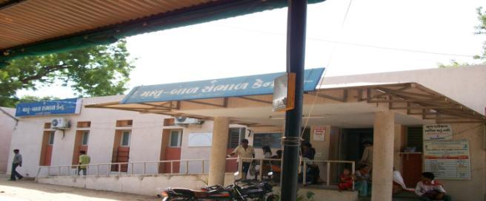

Slide 30
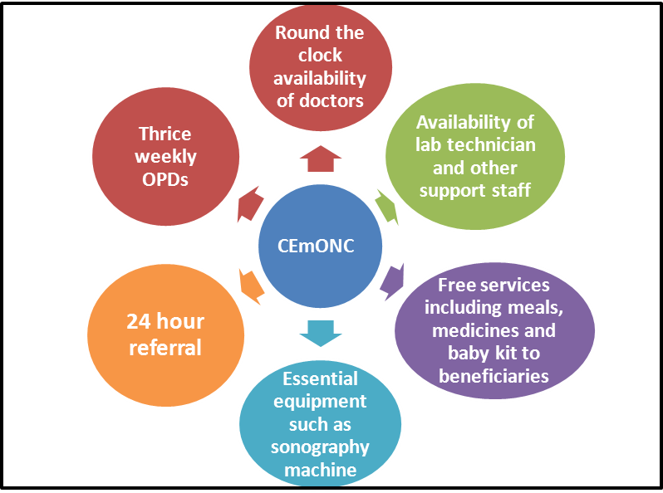
Outcome
Notes:
In 1997 UNICEF, WHO and UNFPA issued a set of indicators called ‘UN process indicators’ to monitor the availability, utilization and quality of EmOC. To standardize the use of the UN process indicators, they were published with a set of guidelines in the document ‘Guidelines for Monitoring the Availability and Use of Obstetric Services’, commonly referred to as the ‘UN Guidelines’.

Slide 31
Performance
Year | OPDs | Deliveries | Surgeries | High Risk Deliveries | Pediatric
2006-07 | 3312 | 201 | - | - | 0
2007-08 | 5505 | 666 | 26 | - | 606
2008-09 | 12267 | 1748 | 304 | 700 | 1004
2009-10 | 17102 | 1776 | 661 | 1036 | 1614
2010-11 | 22620 | 2603 | 309 | 1038 | 949
2011-12 | 23886 | 2518 | 671 | 946 | 751
2012-13 | 25233 | 2630 | 626 | 1019 | 1916
Model:
Replicable
Scalable
Cost effective
Tangible outputs
Notes:
In 1997 UNICEF, WHO and UNFPA issued a set of indicators called ‘UN process indicators’ to monitor the availability, utilization and quality of EmOC. To standardize the use of the UN process indicators, they were published with a set of guidelines in the document ‘Guidelines for Monitoring the Availability and Use of Obstetric Services’, commonly referred to as the ‘UN Guidelines’.

Slide 32
Other NGO / Trust partners for MCH Services
Seva Rural
Jhagadia
Dist Vadodara
Shamlaji CHC PPP model, Dist Sabarkantha
Gram Seva Trust Kharel, Dist NavsariRural
Shrimad Rajchandra Hospital, Dharampur, Dist Navsari

Slide 33
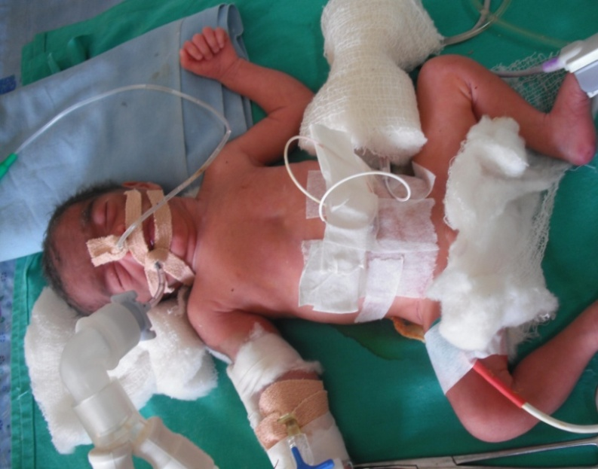
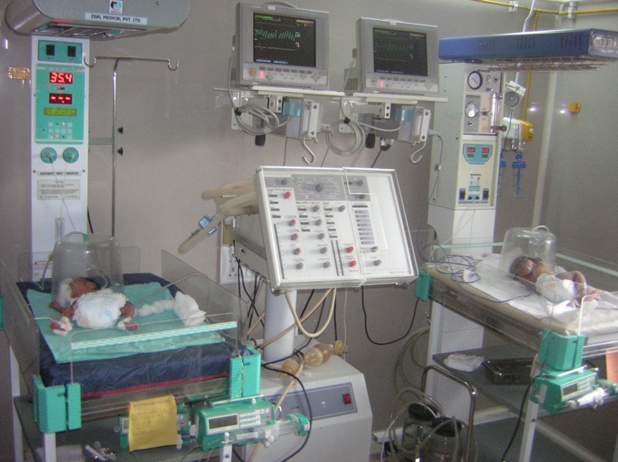
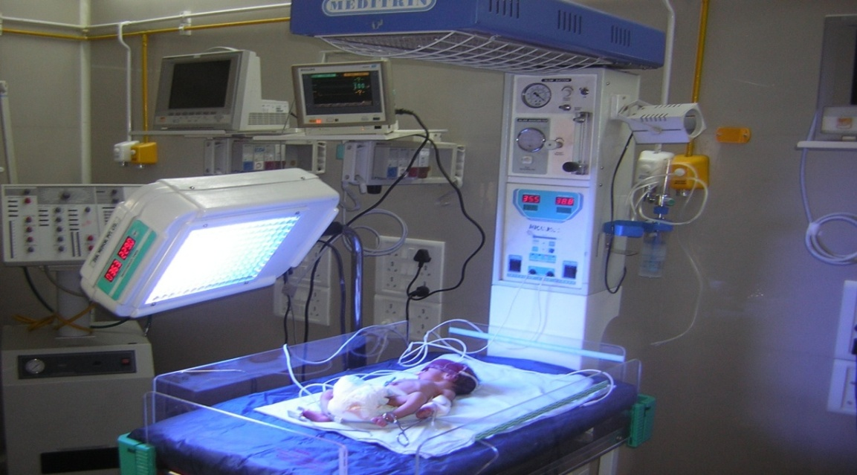
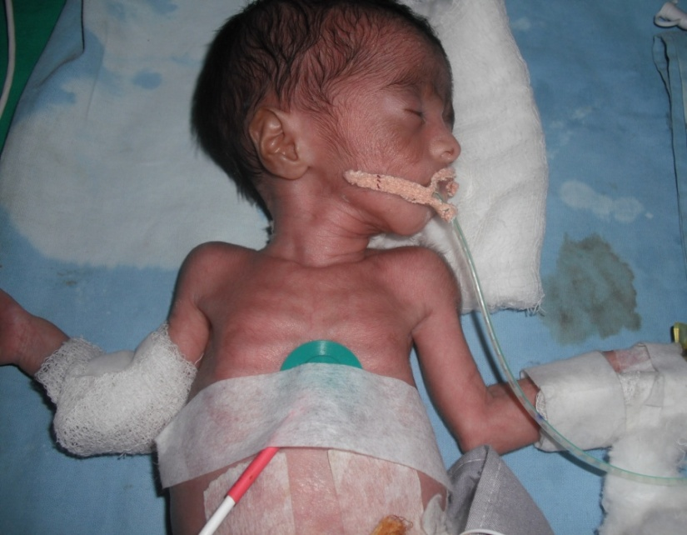
SNCU Facility in Tribal area at Shrimad Rajchandra Hospital, Dharampur, Dist Valsad

Slide 34
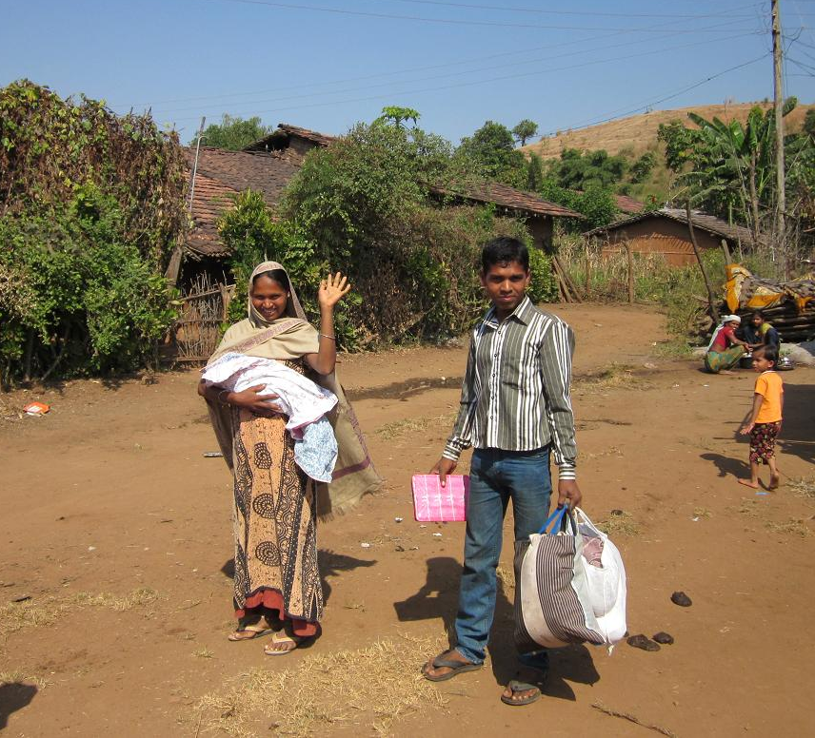
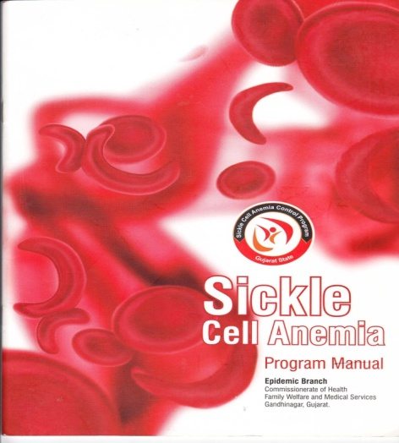
Do Visit Our Website
www.gujhealth.gov.in
Contact for further information:
Dr N.B.Dholakia
Additional Director, FW
079-23253311
09099075152
nbdholakia@rediffmail.com
Thanks

