Slide 1
National Summit on Best Practices and Innovation in Health Care date- 3-5th July 2013
Srinagar, J&K
Convergence in Urban Planning in Ahmedabad,
Gujarat
Dr. S. P. Kulkarni
Medical Officer of Health
Ahmedabad Municipal Corporation

Slide 2
Ahmedabad City
7th largest city of India and the largest city in Gujarat.
Total area increased from 192 Sq.Km.(2001) to 466 Sq.Km.(2006)
Total Population of Ahmedabad city is around 60 Lacs and the UHCs under Urban Health Society cater to approx. 32,00,000 slum/ slum-like population.
6 zones, 64 election wards. Popn about 1 lakh/ ward.

Slide 3
Vital Statistics
 | AMC-2012
 | Total | Within limit
Births | 105868 | 93184
Birth Rate | 17.99 | 15.83
Death | 42011 | 32437
Death Rate | 7.14 | 5.51
IMR (1000 LB) | 20.73 | 13.45
Sex Ratio | 879 | -
MMR (per1L akh LB) | 90 | 49
Data Source- RBD deptt. of AMC

Slide 4
Launching of RCH Services
RCH project launched in 2004 for 4 years.
Family Welfare Centres, Dispensaries which were located mainly in central area were converted to UHC and relocated as per wards.
Malaria surveillance investigators, Vaccinators, ANM were re-named as MPHW .
Available infrastructures used to set up UHCs.
NGO involved to recruit Link workers.
MPHW & Link workers trained.
43 UHC established and now 61 functional, 3 will be set up soon.

Slide 5
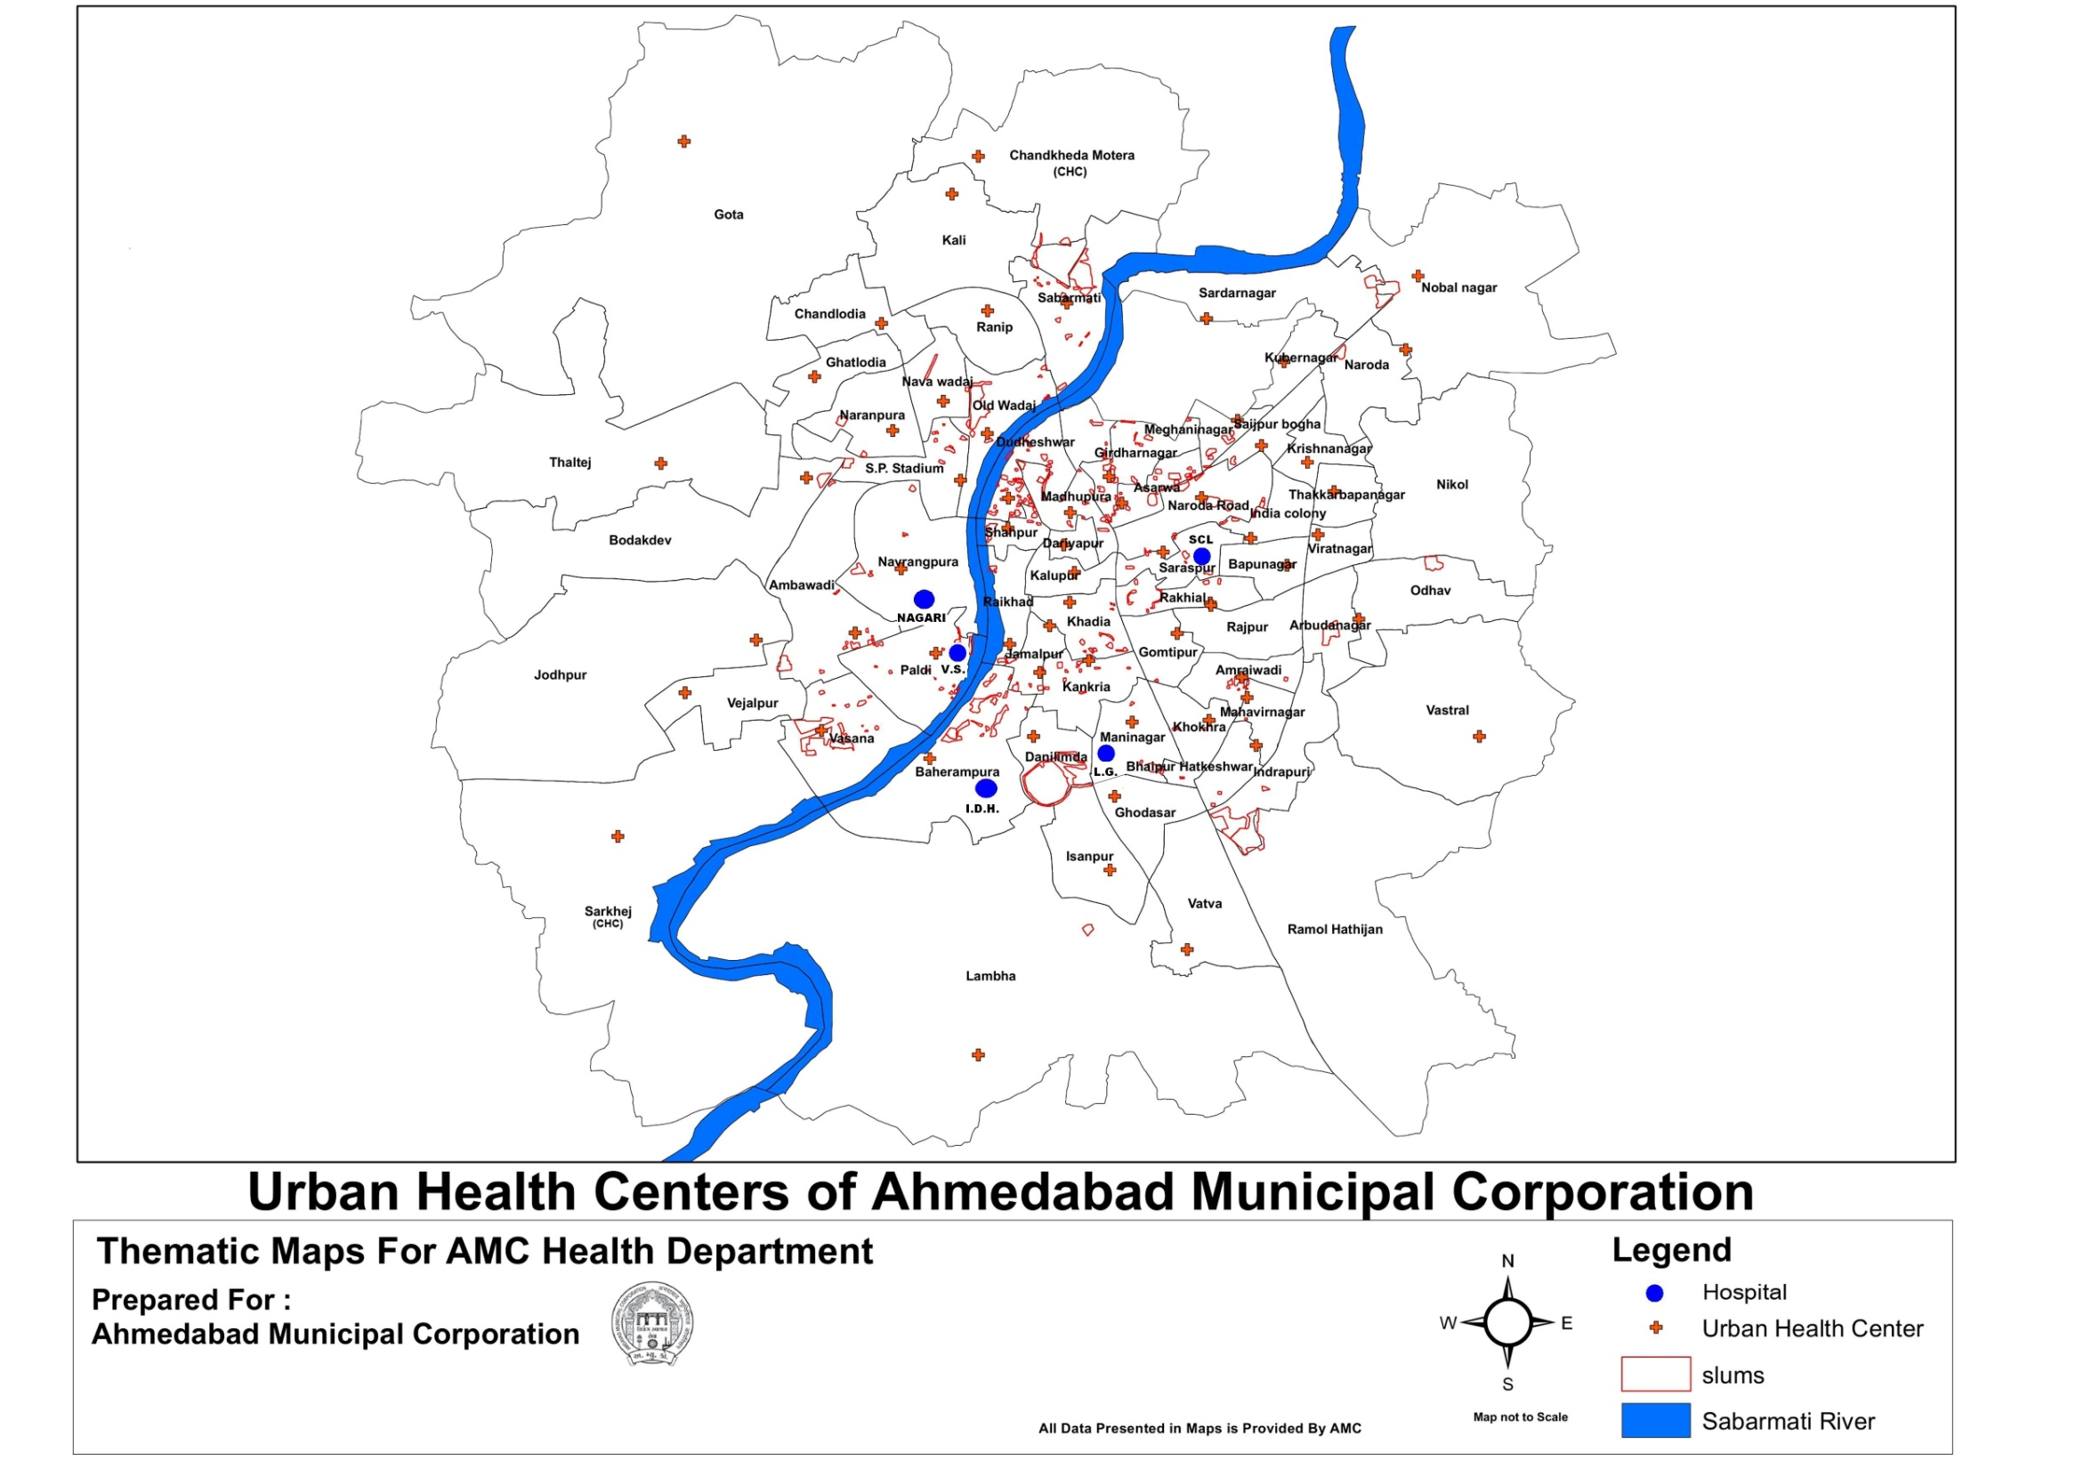

Slide 6
Organization Structure
MUNICIPAL COMMISSIONER (IAS)
Dy.MC (HEALTH)
Medical Officer Of Health (MOH)
DyHO
(Zones)
FWO
RBD &
Supdt. Vaccination
ICDS
RNTCP
AIDS
CONTROL
SOCIETY
CDPO
AHO
(In all zones)
CPC (CPMU)
PH Lab Analyst
MALARIA Dept
PHS
MO
SI
MPW
SSI
LINK WORKERS

Slide 7
Health Facilities
5 Corporation run Hospitals (Total Bed Capacity- 2325):
  V.S. Hospital (1155 Beds)
  L.G. Hospital (480 Beds)
  S.C.L. Hospital (480 Beds)
  Nagri Eye Hospital (100 Beds)
  Infectious Disease Hospital (110 Beds)
2 Govt. run Medical College hospitals:
  Civil Hospital (2000 beds)- Medical College
  Sola Hospital (415 beds) – Medical College
3 Corporation run Medical Colleges
  NHL Medical College (150 seats)
  AMC MET Medical College ( 150 seats)
  Swarnim Dental College ( 213-Dental Chairs & 12 beds )

Slide 8
Health Facilities (continue..)
61 UHCs
3 CHCs
10 Maternity Homes
2 Allopathic, 1 Ayurvedic, 1 Dental Dispensary
143 DOTS centers
25 ICTC centers including 9 PPTCT & 42 F-ICTC centers
10 mobile dispensaries

Slide 9
SERVICES OFFERED AT UHCs
REGISTRATION of Birth & Death/ ANC , Delivery , PNC beneficiaries
MATERNAL & CHILD HEALTH SERVICES
FAMILY PLANNING SERVICES
VACCINATION
GENERAL OPD SERVICES
LABORATORY FACILITIES
DISEASE SURVEILLANCE
ALL OTHER NATIONAL PROGRAMS

Slide 10
Urban Health Centre
Medical Officer - Head of the Unit
  Pharmacist
  Lab. Technician
  Supervisor
  MPHW
  Data Entry Operator
  Link Worker (CBHV)
  Peon/ Class 4
Provision of Health facilities:
  RCH services – Immunization, Family Planning,
  RNTCP services – DOT centre, Sputum collection
  ICTC – Testing of HIV, Counseling
  ICDS- Mamta Divas , Bal Shaktim Kendra (VCNC)
  Education Dept – School Health Programme

Slide 11
Existing Human Resource
(All Facilities)
 |  | AMC | NGO | RCH |  | Total
No | Cadre | Filled | Filled | Sanctioned | Filled
1 | MO | 50 | 15 | 30 | 28 | 93
2 | Sup /LHV | 2 | 15 | 40 | 25 | 45
3 | Staff Nurse | 89 | 0 | - | - | 89
4 | Pharmacist | 32 | 2 | 50 | 50 | 84
5 | L.T | 4 | 2 | 57 | 57 | 63
6 | MPW/ANM | 2 | 30 | 373 | 361 | 397
7 | Data Entry Operator | 0 | 0 | 57 | 57 | 57
8 | L.W | 0 | 0 | 1550 | 1355 | 1355
9 | Class 4 | 60 | 13 | 42 | 42 | 115

Slide 12
Convergence
City
Mayor, Standing Committee, Municipal Commissioner
Health& SWM committee, Hospital committee, Women & Child Development committee.
Zone
Ward level Committee
Deputy Municipal Commissioner, Add CE, DyHO, Estate Officer.
Ward
Asst Engineer, Public Health Supervisor, SI and SSI. ( Water & Sanitation), Malaria SSI ,MPW( VBD)
UHC- MO, MPW, LT,( Medical services), ICDS.

Slide 13
INTER DEPARTMENTAL CONVERGENCE
HIV/ AIDS
RNTCP
RCH/NRHM
ICDS
UCD
RBD
WATER & SANITATION
SCHOOL BOARD

Slide 14
Programmatic Convergence
Health Schemes with empanelled hospitals.
  PPP for delivery services
  PPP for specialist newborn care services
Insurance Schemes (RSBY & MA Yojana)-
Pvt Hospitals empanelled for services.
PSM dept of Medical colleges involved in public health activities, monitoring.
163 pvt hospitals report cases on-line to epidemic cell.
Honorary Specialists at UHCs
Thalessemia Prevention Program with Red Cross
Heat Action Plan with IIPH-G, NRDC, Emory
University,Georgia Tech University.

Slide 15
Thalessemia project - AMC
Joint Initiative of AMC and Indian Red Cross Society
Screening of Pregnant Woman
(Launched on June-2011):-
Budget : 1.38 Crore for 2012-13 (Red Cross funded from NRHM)
AMC and Indian Red Cross Society Joint Initiative
41102 - Antenatal Women Screened
1647 : Females Found to be Thal. Minor
130 : Husbands were Thal. Minor
81 : Prenatal Diagnosis done
Screening of Municipal School Board Children (Launched on Feb-13):-
Budget : 2.98 Crore
No of School Board Children screened- 4200
Minor Positive - 130

Slide 16
Convergence with NGO sector
29 out of 61 UHCs at AMC are being run by NGOs like IMA, Red cross etc.
PPP model UHC Vasana, Jodhapur, Navarangapura
NGO run UHC (FWC) are Govt. funded
Support given includes recruitment and salary of Medical & Para medical staff along with provision of health related services.
NGOs are involved in ICDS, AIDS projects, RNTCP implementation.
Thalassemia screening project –NGO like Rotary and Business community adopted schools.
1 Physiotherapy unit by Rotary Metro, 1 by Lions Club

Slide 17
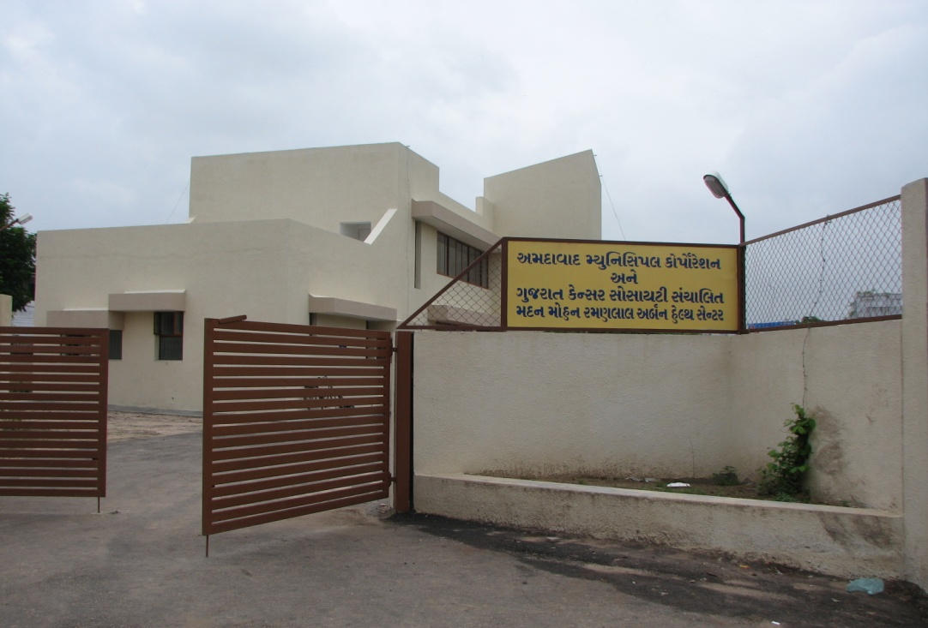
Vasana UHC- A real example of PPP
(Public Private Partnership)
Joint partnership of AMC ,Gujarat Cancer Research Institute, NGO Akhand Jyot Foundation & IIM (Indian Institute of Management).
AMC Land & Rs.15 lac from Mayor’s Fund.

Slide 18
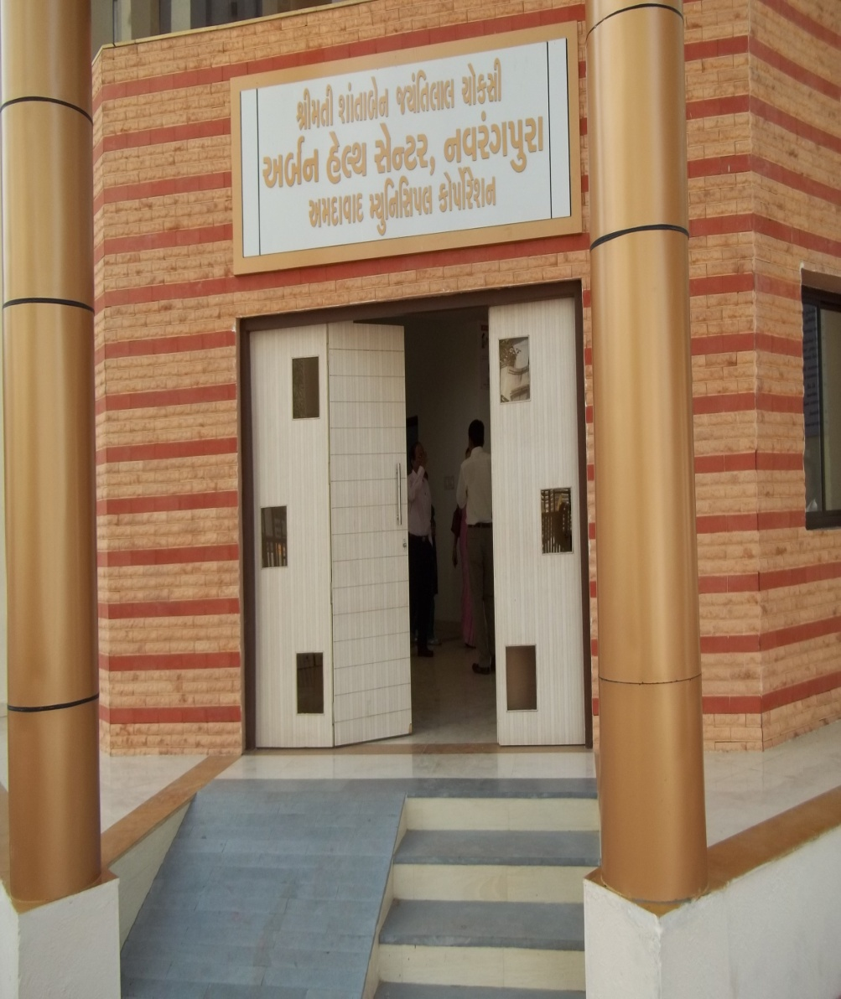
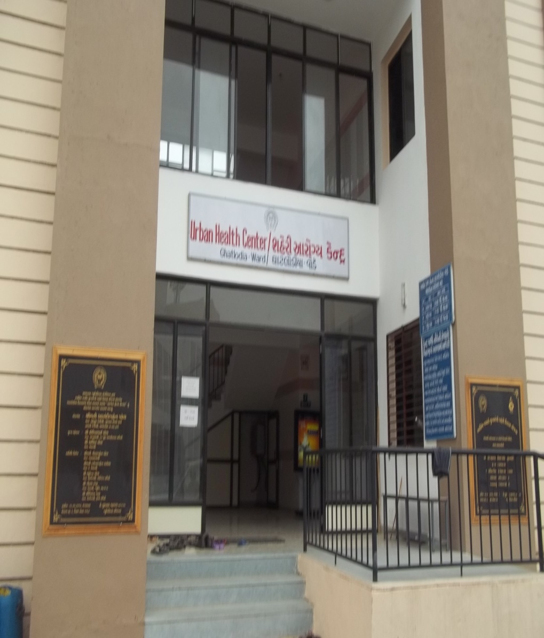
AMC Infrastructural Improvements

Slide 19
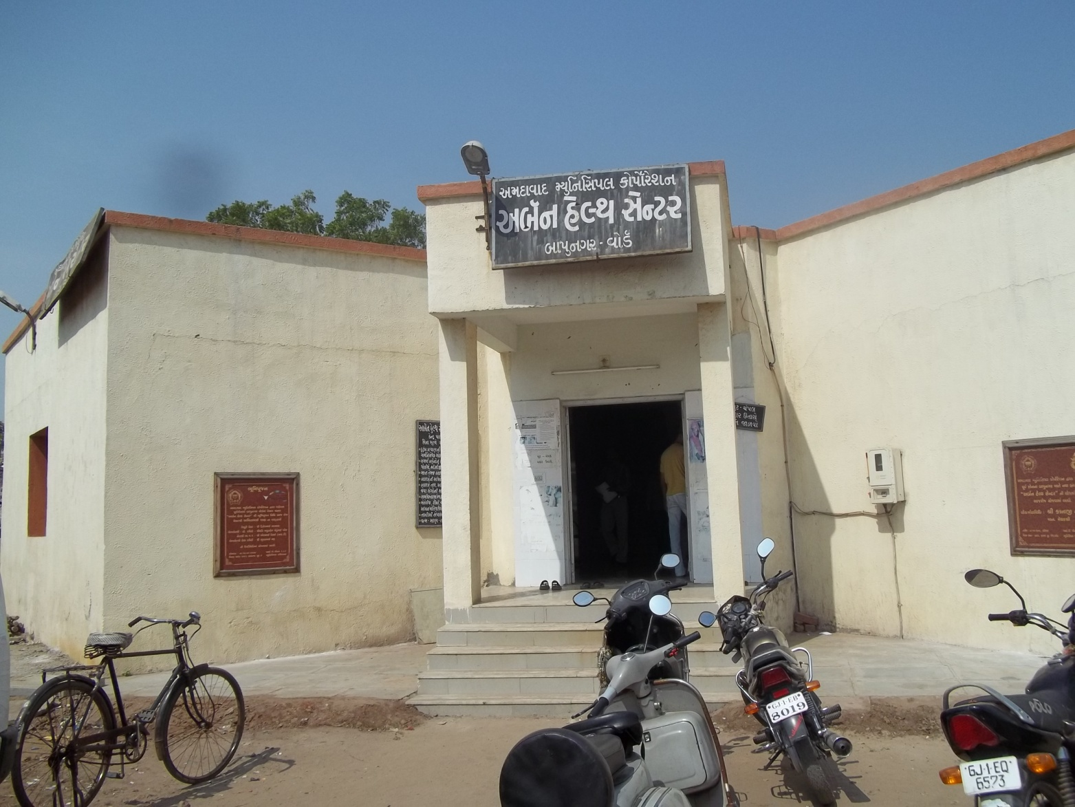
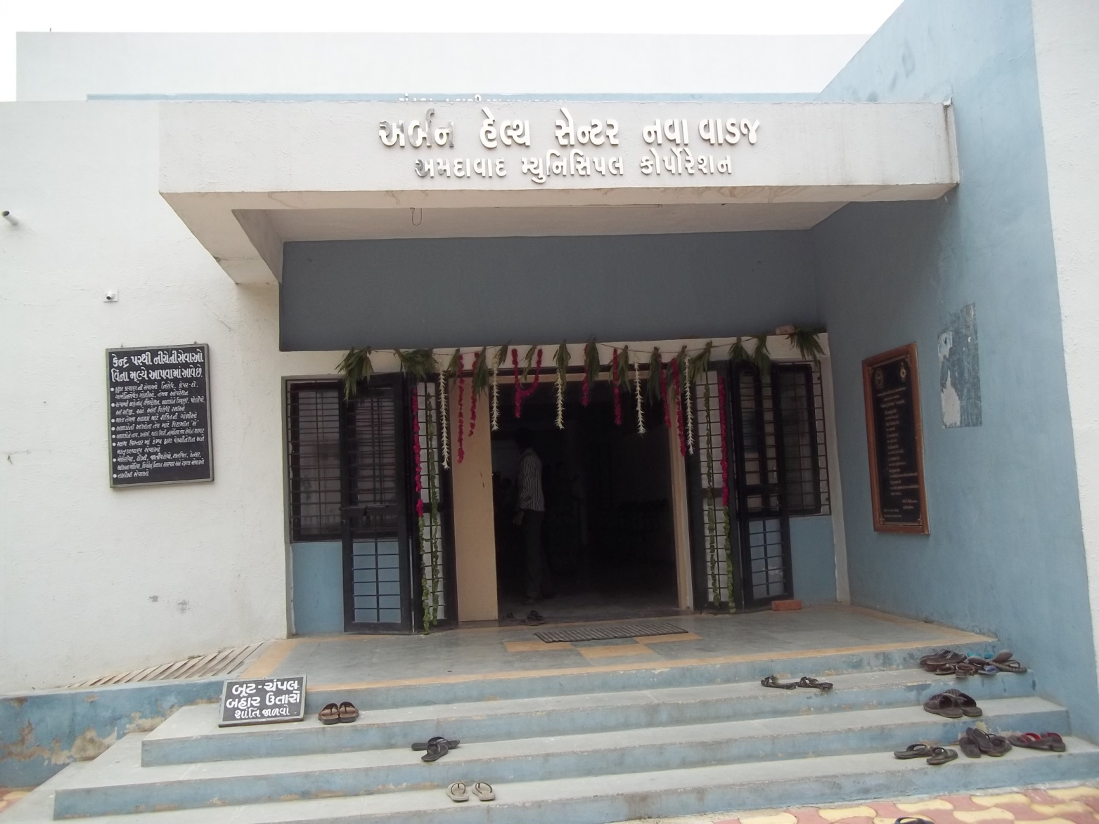

Slide 20
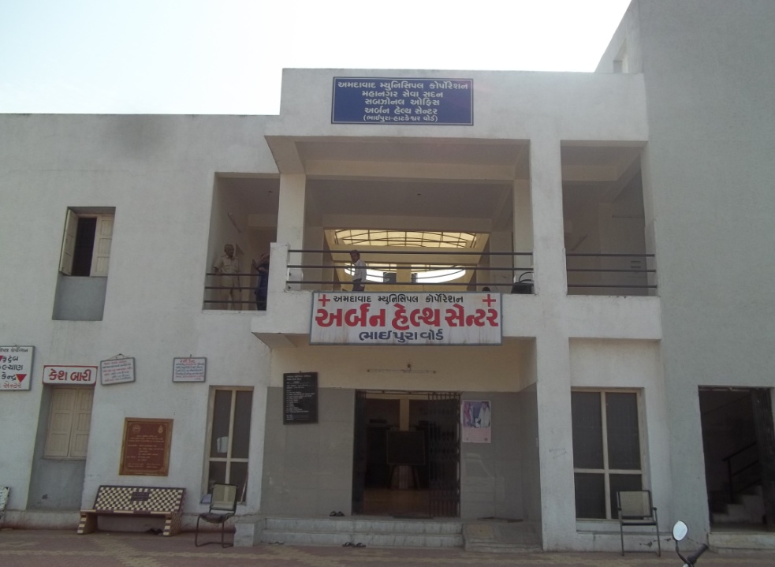

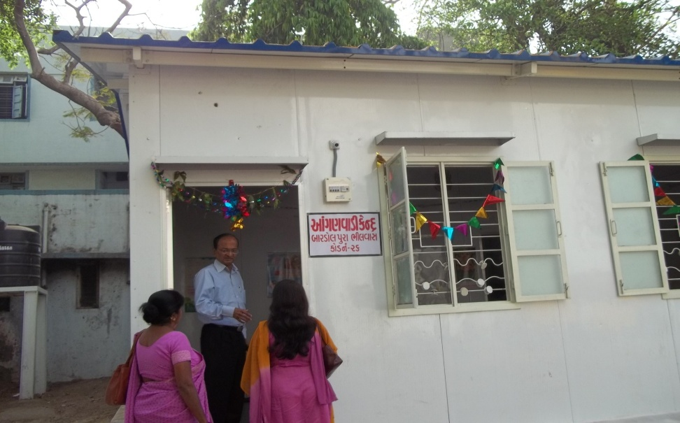
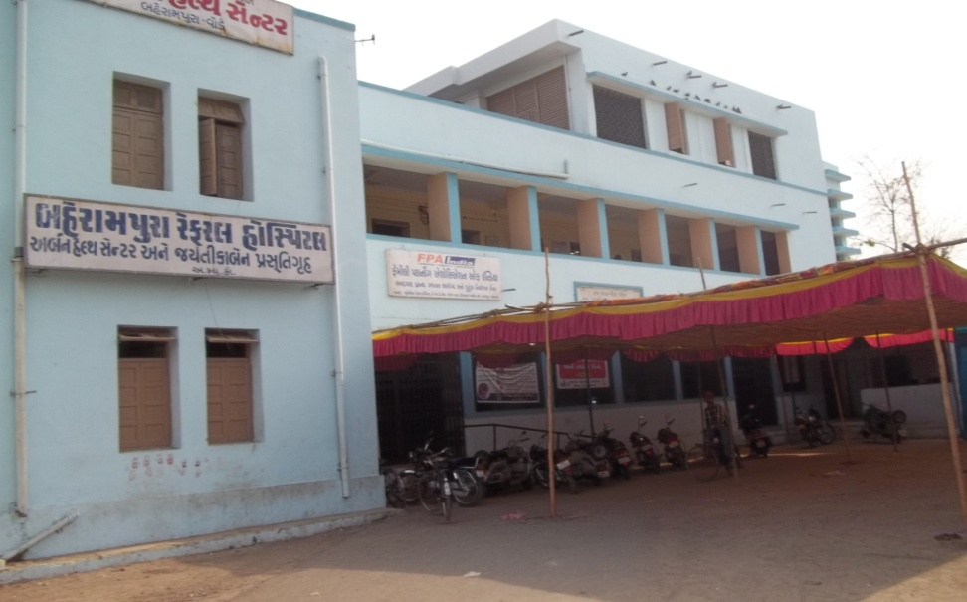
Notes:
nganwadies

Slide 21
ISSUES TO BE SOLVED
The duty timings of different staff to be made uniform.
Link worker locally not available, remuneration not attractive. Other jobs give more income.
NGOs do not get any supervision charges, so deduct from remuneration of link workers.
Site for UHC near slum not available in cities.
Different remuneration for same category in national programmes ex. RNTCP,AIDS,RCH,ICDS.
Data from private hospitals not easily available.
ESIS beneficiary duplication of services, can we merge with UHM and use infrastructure?

Slide 22
THANK YOU

