Slide 1
e-initiatives in Public Health in Maharashtra with focus on e-office & e-banking
Vikas Kharage (I.A.S)
Commissioner (FW) & MD-NRHM
Maharashtra
National Summit on Best practices and Innovations, Srinagar
3 -5 July 2013

Slide 2

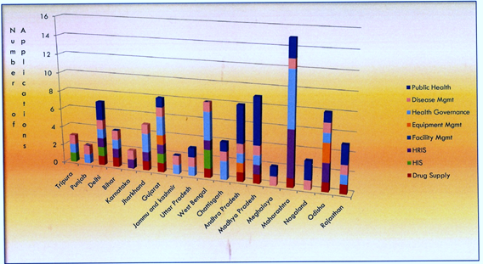
e-health initiatives - India and Maharashtra
Source: Report by National Institute for Smart Government, March 2013
Maharashtra is one of the leading states in e-Governance and
IT initiatives particularly in Public Health domain
with several applications.

Slide 3
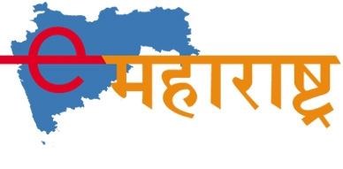
Best practices under e-governance in Maharashtra
e-office with e-banking -Proud to be 1st e-office in Maharashtra
Health Advisory Call Center (HACC)
Telemedicine
ASHA software
Other e-initiatives in
Public Health Department

Slide 4
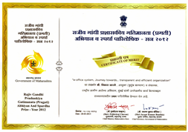
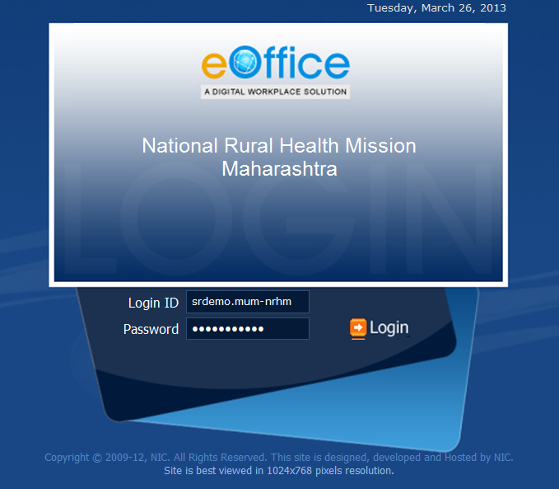
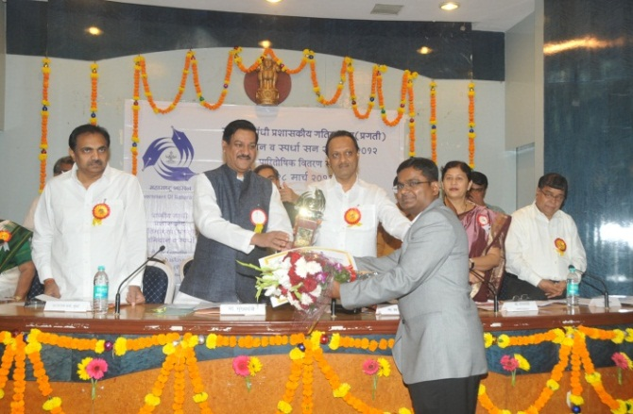
An Initiative of…
National Rural Health Mission, Maharashtra
Awarded FIRST PRIZE at the
'Rajiv Gandhi Prashaskiya Gatimanta Abhiyaan'
Award & Competition, 2012-13

Slide 5


Background…
Due to offices at two locations-Mumbai & Pune, physical file movement incurs lot of time .
Large volumes of files being managed and processed in our office.
Usually have overburden of piling and pending documents due to absence of senior officials on tour.
Difficulty of locate files.
Many crucial decisions get delayed due to slow movement of files.
Immediate need was to have a system to take care of above problems.

Slide 6
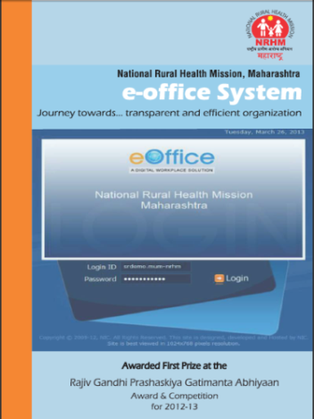
efile - Inception… to Implementation
Inception at LBSNAA ,Mussoorie
Discussion Regarding Implementation
Successful Implementation. No more physical files !!
Formed committees under Nodal Officer
Preparation of Proposal & Allocation of fund.
Training and Motivation of Staff
A
B
C
D
E
F

Slide 7
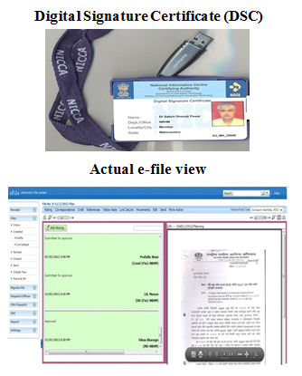

What is e-file system ?
Systematic and stepwise process of distribution of day-to-day correspondences,
managing the Inward/Outward documents, movements of files
followed by remarks & decision making by senior officials
- all through an online computing system
E-file uses Digital Signature Certificates for signing a file thus providing high level security to the users
Working very similar to physical file movement
Left-noting…right-correspondences
Inward Letters and files sorted at inward section and sent to officers as per hierarchy for approval or further action.

Slide 8
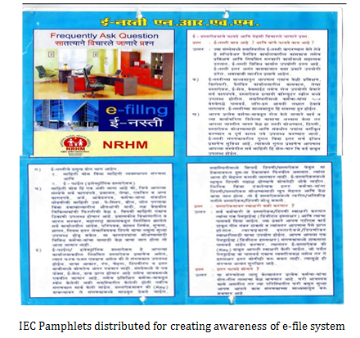
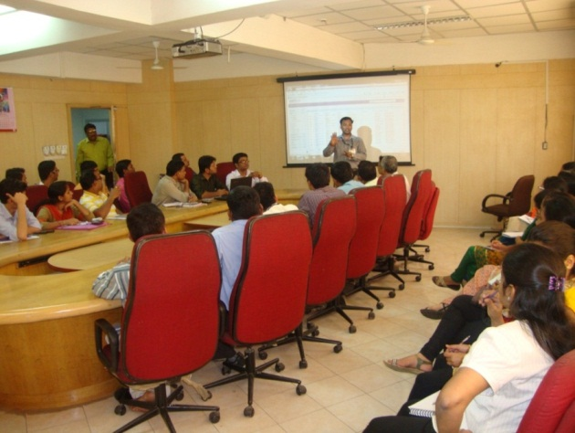
Money, Machine & Manpower Requirements …
A fixed cost towards e-filling hardware, up gradation of LAN connectivity and end to end Lease line connectivity.
Lease line connectivity charges are recurring on the annual basis.
Necessary Hardware
Software from NIC (free of charge)
6 months support from NIC-deputed 3 personnel each in Mumbai and Pune
IEC-creating awareness
Training and motivation of the staff

Slide 9
Our Journey so far…
Successfully Implemented at all the offices at Mumbai and Pune.
The e-file system output of the file and receipt creation till 30th June 2013 for Mumbai and Pune locations with e-file users are as below:
Not a single Physical file moved from table to table since last one year
Locations | No.of e-File users | Files created | Receipt Handled
Mumbai | 311 | 21,837 | 95,013
Pune | 225

Slide 10
Challenges faced…
Resistance from office staff due to fear and anxiety of technical skills required to handle the system
Overcome through frequent training and hands holding to individual users to enhance their comfort level.
Overcoming security issues related to finance, purchase and tender file.
Role of Digital Signature Certificate was well demonstrated during training. In addition, fire wall installed at NIC and server locations for enhanced security reasons.
Language compatibility-Initially e-File was compatible with English language only, but considering users in Marathi language e-File system was modified with Marathi font.
First model of e-File system having bilingual (Devnagari and English) language compatibility.

Slide 11
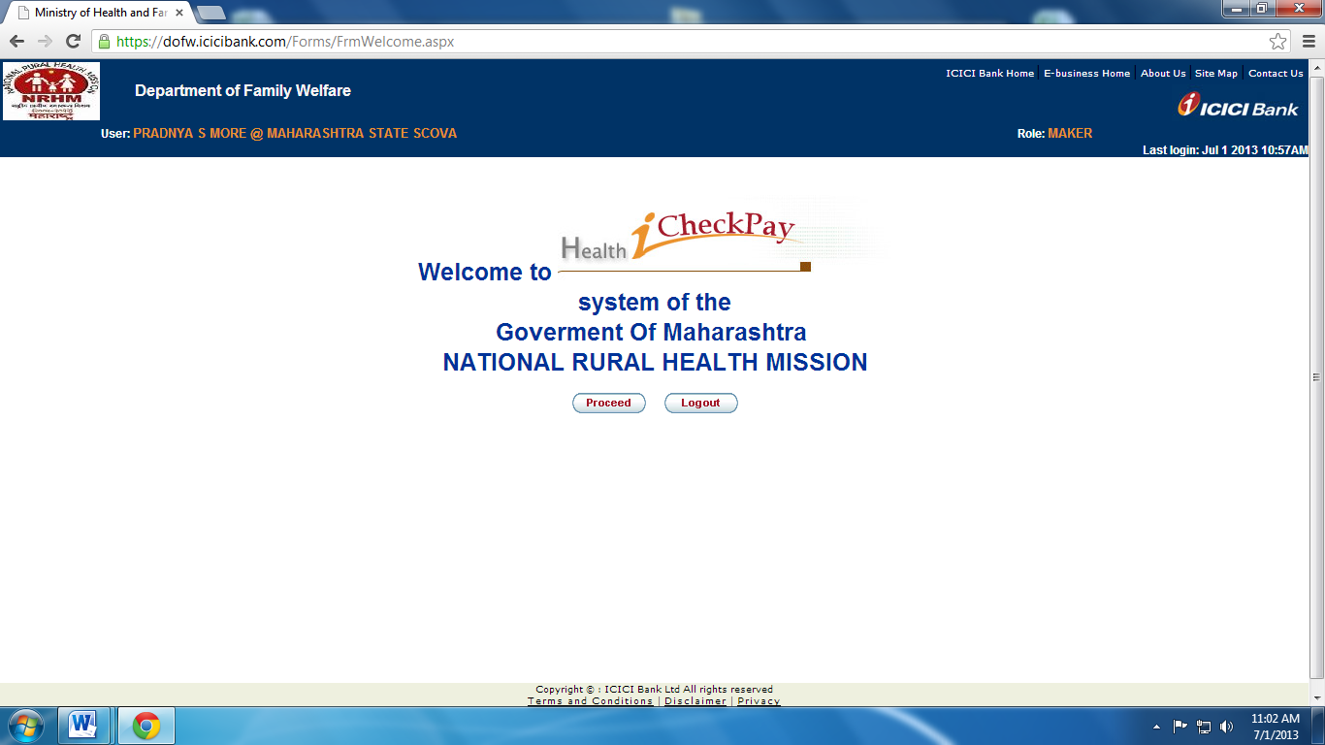
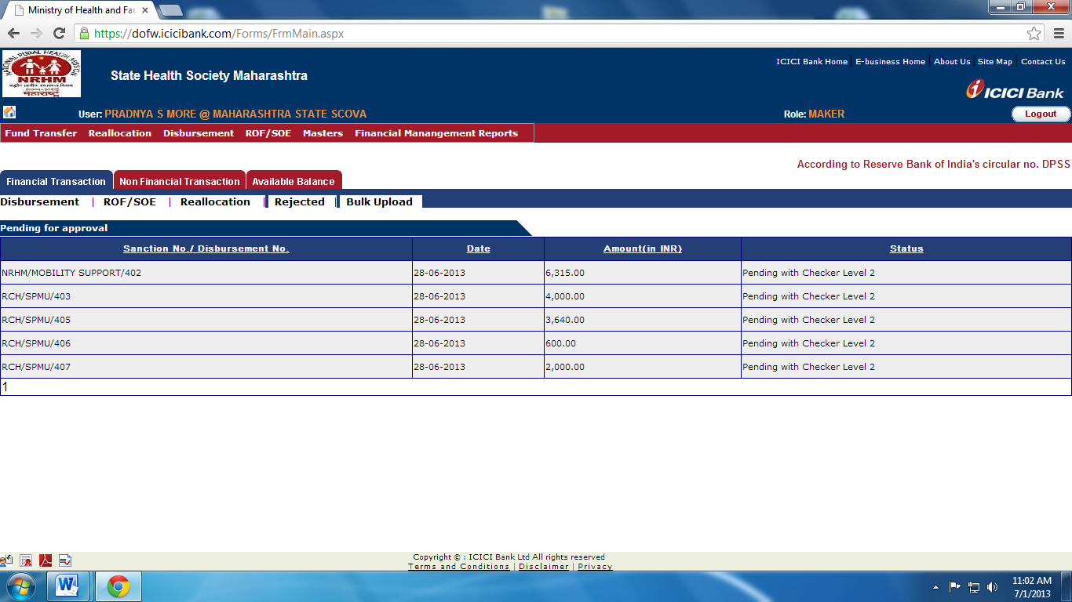
Advantages of e-file system
E Banking- Prime feature of e-office
Linking financial aspects of Public Health with e-banking.
Nearly 1200 banks across Mumbai and Pune have been linked through e-banking for funds tracking.
Real time fund transfer including employee salary, paying the vendors online, grant releases to districts and corporations etc.

Slide 12
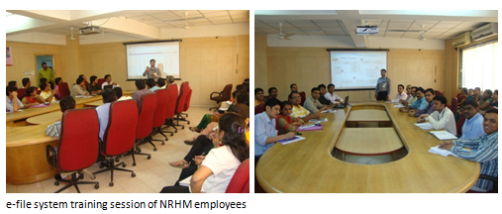
Sustainability and Scalability of e-office
Sustainable -
GR of Govt.of Maharashtra formulated and issued on 15 Feb. 2012.
Dedicated funds for e-governance through NRHM for smooth supply of resources
Repeated training and hand holding sessions to overcome difficulties and anxieties in using new technological initiative thus ensuring its sustainability in a long run.
Scalable -
Basic requirement primarily related to infrastructure and training
Software available free of cost. Thus model easily replicable in other government departments.
Already fully functional at Sindhudurg
Assam, Rajasthan and other organizations like PWD, MMRDA, FMC etc. have approached for demonstration /implementation

Slide 13
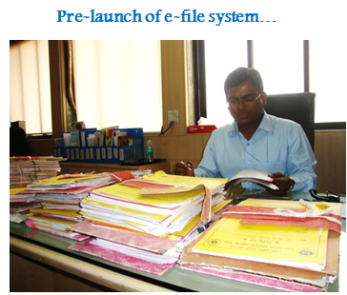
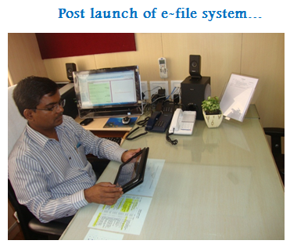
Added Advantages of e-file system
Easy to Implement and Easy to use-both for young and old
Transparency
Fast File Movement
Regular Monitoring of pending files
Prioritization of files
Easy Search
Safe and secure storage of records for further reference
Environment friendly-virtually paperless office
Uniform Work Environment
Unicode-Language no barrier
Resources saved – Time, Money and Manpower

Slide 14

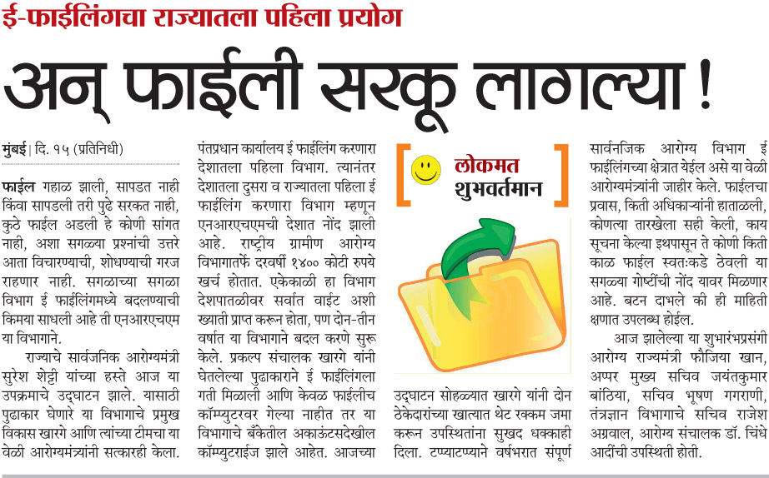
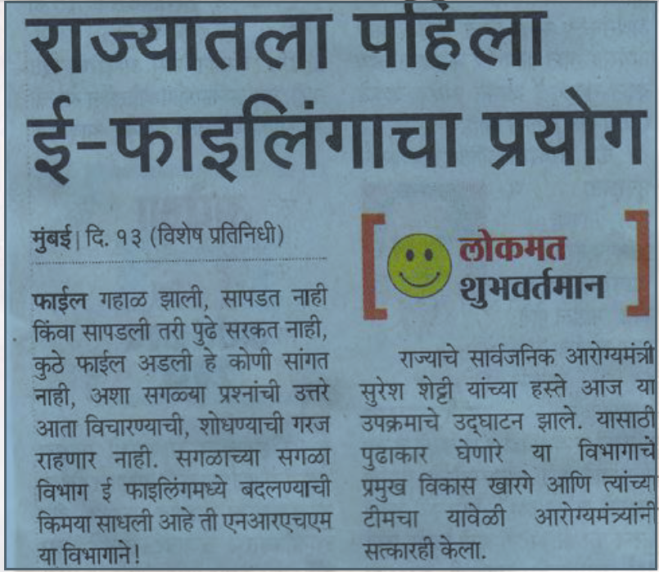
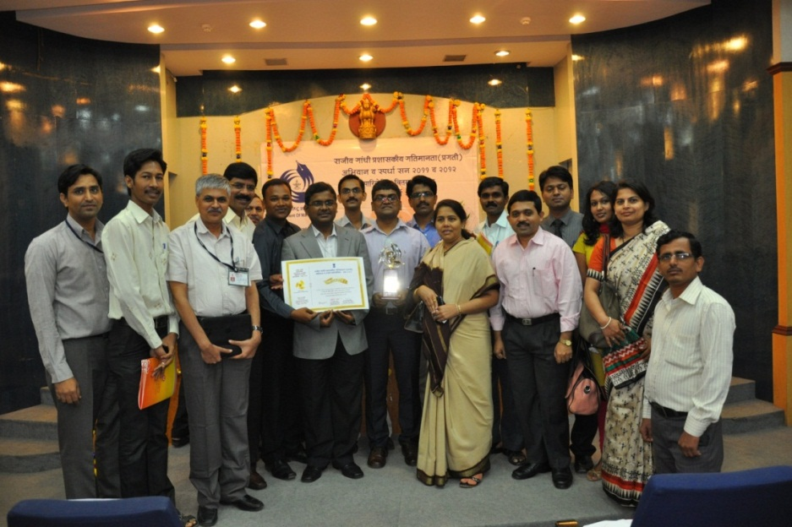
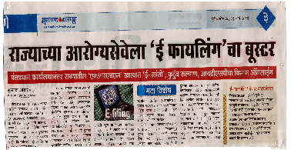
Words of Appreciation !
e-office team
with the RGGA award 2013

Slide 15

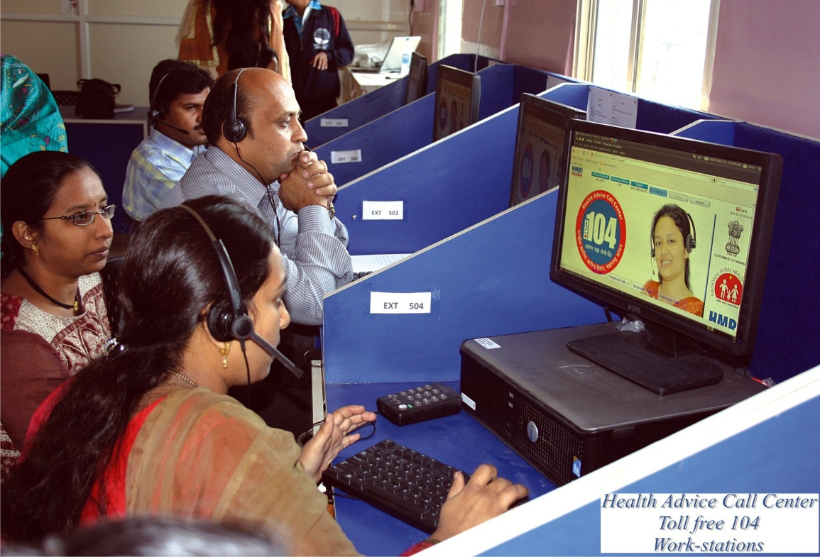
Health Advice Call Center
‘104’ Toll free Health Helpline

Slide 16
Objectives
To give 24x7 Technical supports to Health Care Provider for smooth and effective health care particularly for quick action in epidemic outbreak, disaster, natural calamities and in major accidents.
To provide 24x7 specialist advice to health care providers for providing health services.
Provide Directory Information of hospitals/Institutes regarding various services / Facility including Blood bank and Eye bank for proper and early referral.

Slide 17
Salient Features of HACC
This project being implemented on turnkey basis.
In first phase Call Centre of 10 seats has been set at Pune Chest Hospital, Aundh, Pune.
The calls are answered in Marathi and English, as per request of caller.
The trained Health Advice Officers (HAOs) and specialists are Pediatrician, Gynecologist, General Surgeon, Physician and Public Health Specialists.

Slide 18







CALL PROCESS in HACC
Exchange
HAO
Health Advice
Specialists
Health Advice
Maternal & Child
Health & other
National Program
Obgy.
Minor Ailments
Pediatrician
HAO – Health Advisory Officer
Medical Emergencies
Surgeon
School Health Program
Physician
Epidermic Outbreak
Public Health Spec.

Slide 19
PERFORMANCE OF HACC
January 2012-May 2013.

Slide 20

HACC –AWARD
HACC awarded e-India award for BEST INNOVATION IN HEALTH CARE THROUGH PPP 2012

Slide 21
Way Forward…
Linkage of Health Advice Call Centre (104) through Telemedicine Services in PHC's from Thane District
Inclusion of Public Grievances regarding Health Services
Link to EMS
Link to Telemedicine centres for emergency

Slide 22

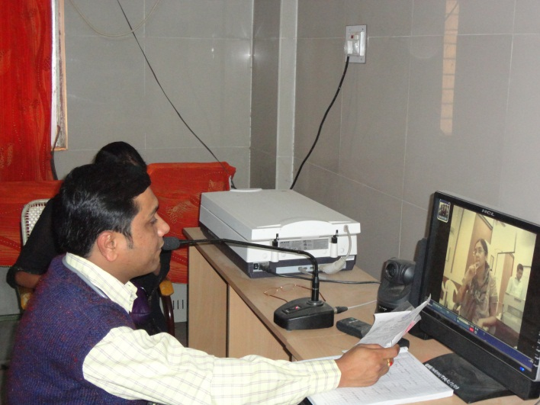
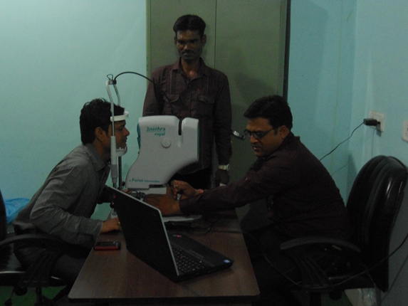
Telemedicine Programme

Slide 23
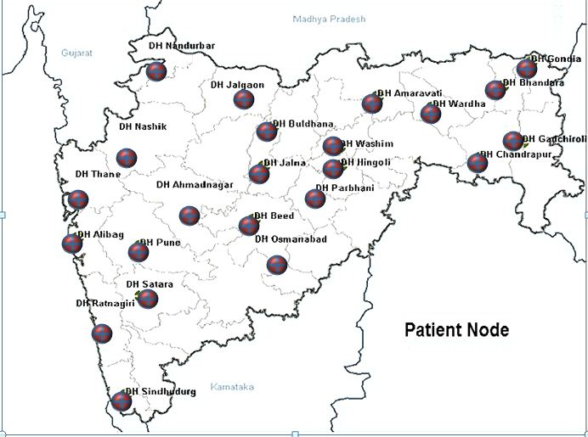
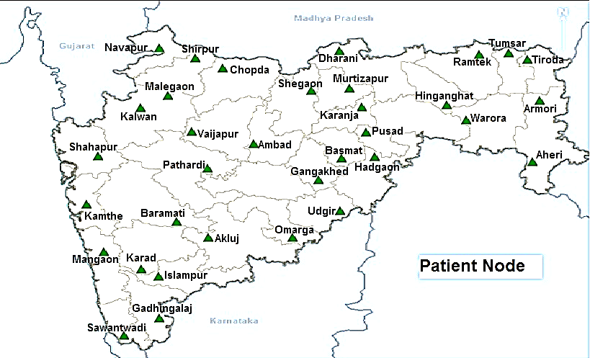
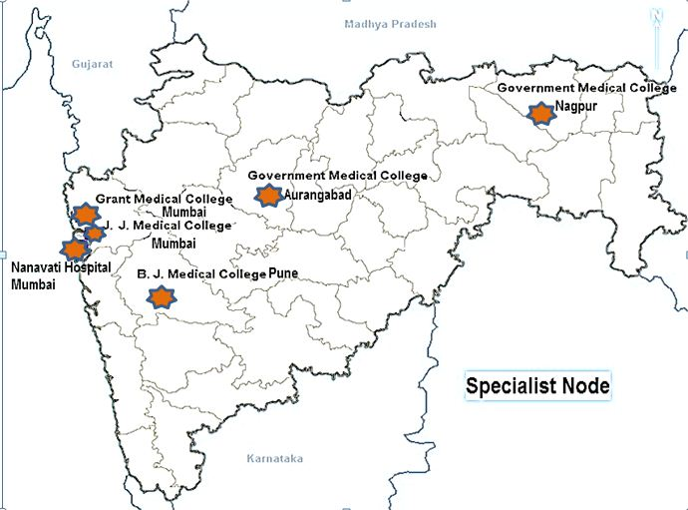
23 District Hospitals
Telemedicine Centers In Maharashtra
4 Sub- District Hospitals & 30 New Sub- District Hospitals
6 Specialist centers

Slide 24
Advantages of Telemedicine
Provide services to people living in remote areas particularly in emergency and critical care situations where moving a patient may be undesirable and/or not feasible.
Eliminate distance barriers and improve access to quality health services.
Facilitate patients and rural practitioners’ access to specialist health services and support.
Lessen the inconvenience, Patient need not travel and/or cost of patient transfers.
Reduce unnecessary travel time for health professionals.

Slide 25
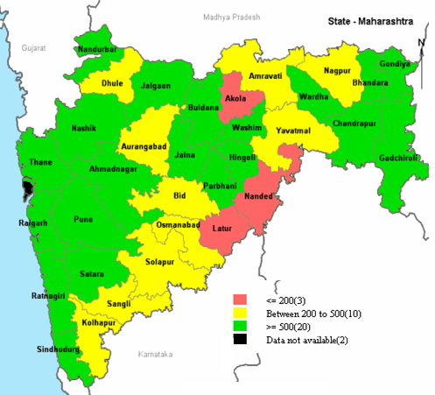
Year-wise progress
Telemedicine-Progress so far
Total Opinions received through Telemedicine in 2012- 2013

Slide 26
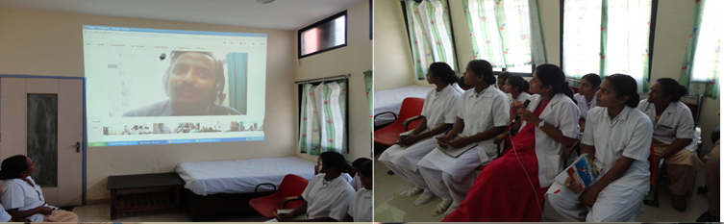
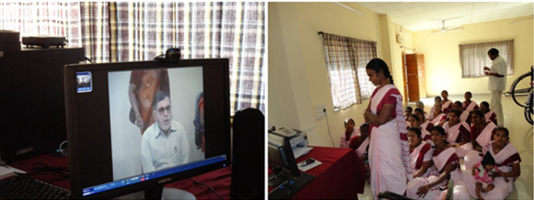
Urolithiasis CME at, DH Telemedicine Centre Osmanabad (Patient Node) Paramedical Staff with Government Medical College,Aurangabad(Specialist Node)
TB CME at, SDH Telemedicine Centre Akluj (Patient Node) for ASHA (Dist.–Solapur) with BJMC,Pune (Specialist Node)

Slide 27
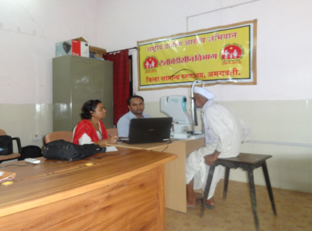
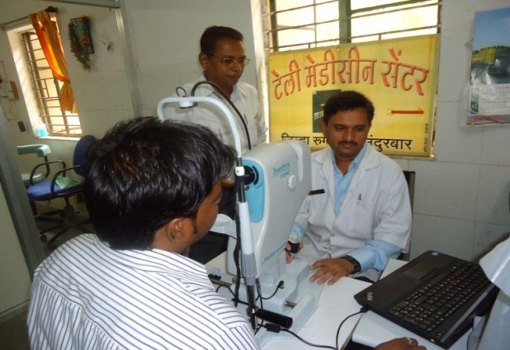
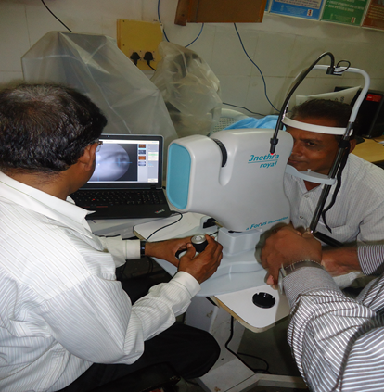
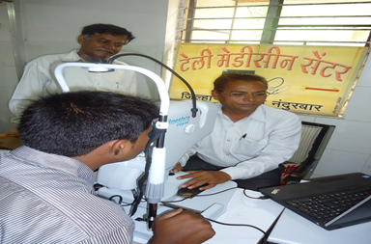
Tele-ophthalmology innovative activity started in tribal area for e.g. Nandurbar, Amravati (Melghat) Districts at telemedicine centres
Tele-ophthalmology innovative activity started in tribal area for e.g. Nandurbar & Gadchiroli Districts at telemedicine centres

Slide 28
Telemedicine Achievements
Video conferencing facility for online consultation.
Total 48,970 patient referred & 48670 expert opinions given at
District / Sub district hospital through telemedicine Centre.
376 CME conducted till date for Doctors & Para- Medical Staff at District / Sub District Hospital, Telemedicine Centre.
Online OPD conducted for Paediatrics, Sickle cell patients in remote and tribal area for e.g. Nandurbar, Melghat & Gadchiroli
Districts.

Slide 29
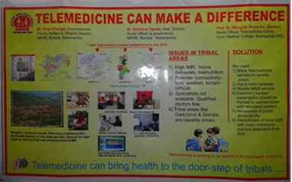
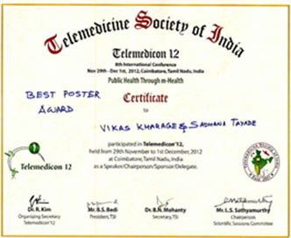
Achievements …contd
Not Only Allopathic, but also Ayurvedic & Unani Specialty Consultation given during Video Conversation.
Tele-ophthalmology started at telemedicine centres in remote tribal areas e.g. Nandurbar, Amravati (Melghat) & Gadchiroli Districts.
BEST POSTER AWARD at 8th International Telemedicine Conference 2012 of Telemedicine Society of India at Coimbatore.

Slide 30
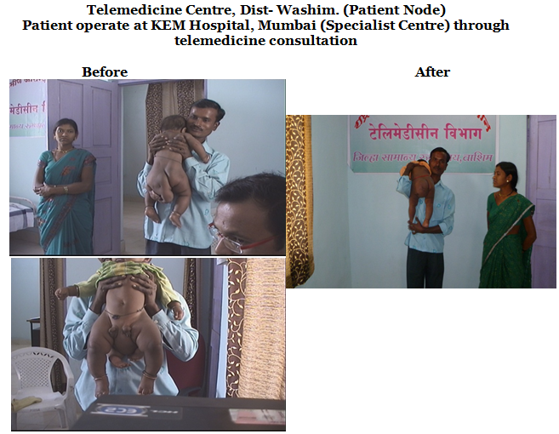
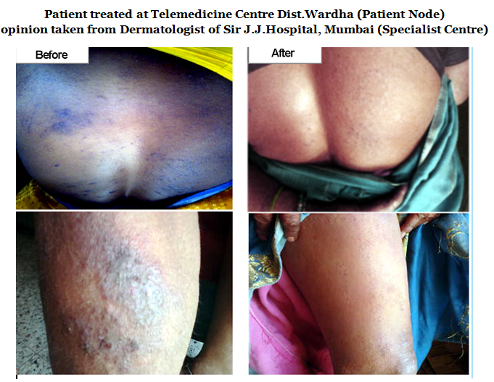
Success Stories of Telemedicine in Maharashtra
A child born with four feet operated successfully through Telemedicine in Washim District
A woman with skin infection treated successfully through Telemedicine in Wardha district

Slide 31
Future Plans…
Improving strengthening & functioning of existing District and Sub District Hospitals Patient nodes for better and improved utilization.
Increasing CME's for Medical & Paramedical staff.
Increasing referral of patients through video conferencing at District and Sub District Hospitals.
Innovative activity tele-opthalmology in 4 districts at telemedicine centres.
Extended telemedicine facility to 10 PHC's through HACC.

Slide 32
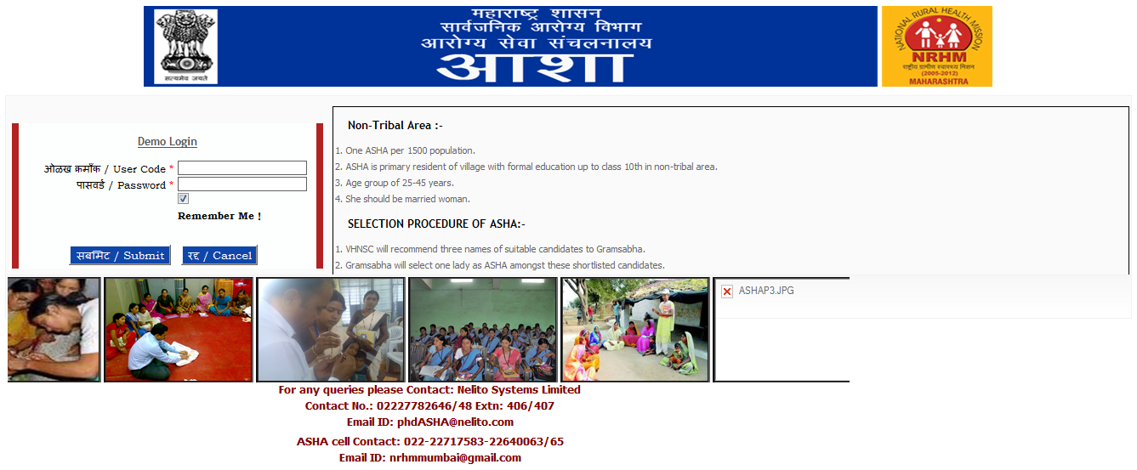
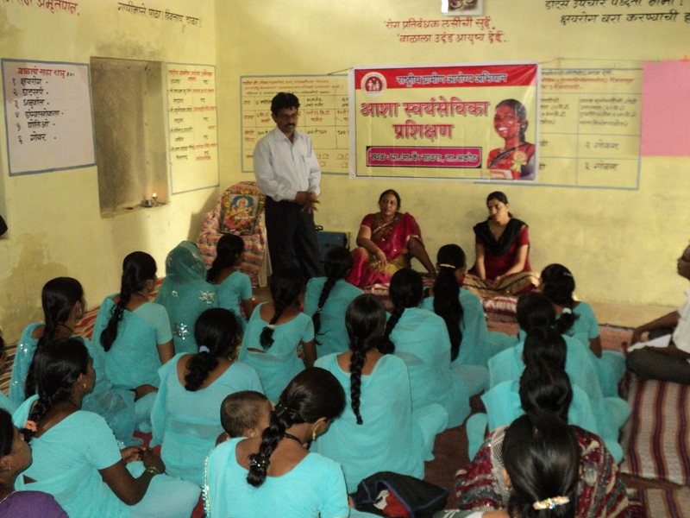
ASHA Software
“Effective Solutions for Complex Communication’’

Slide 33
Introduction to ASHA Software
PHD and NRHM Maharashtra has implemented online ASHA Software to capture and monitor the eminent ASHA Scheme.
Design of the Software is aimed at providing a well maintained monitoring of various important modules of ASHA Scheme ranging from ASHA Profile, Appointment, Training, Incentives and Payment.
The online Software can be accessed from the web portal www.maha-arogya.gov.in.
Objective
‘To track the personal information, training, recruitment and performance details of ASHA workers and increase their efficiency by leveraging the power of Information Technology’.

Slide 34
ASHA Software - Salient features
Web based Software
Comprehensive database of around 59,000 registered ASHA workers in the State
Online availability and monitoring of ASHA profile, training programme, performance and payment modules
Helped in understanding attrition rate among ASHAs and has helped NRHM take corrective action towards it
Generation of pertinent MIS reports at various levels in 20 different formats assisted in streamlining the whole programme
Users ID created as per hierarchy across PHC, Taluka, District and State level
Dashboard facility for providing the snapshot of various indicators
Provision of Alert Option for several modules
Customized excel and crystal report generation facility

Slide 35
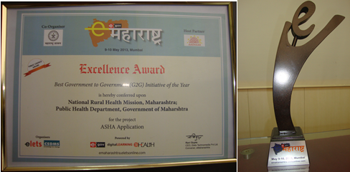
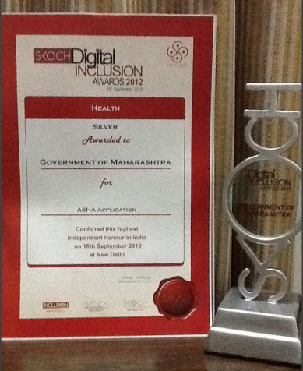
Achievements and Accolades….
ASHA Software won the Excellence 'Award in G2G Category 2013' at e-Maharashtra
ASHA software won the National Level Silver Award on September 2012 from Scotch Digital Inclusive Award, Delhi.
"Excellence, Leadership and Teamwork "

Slide 36
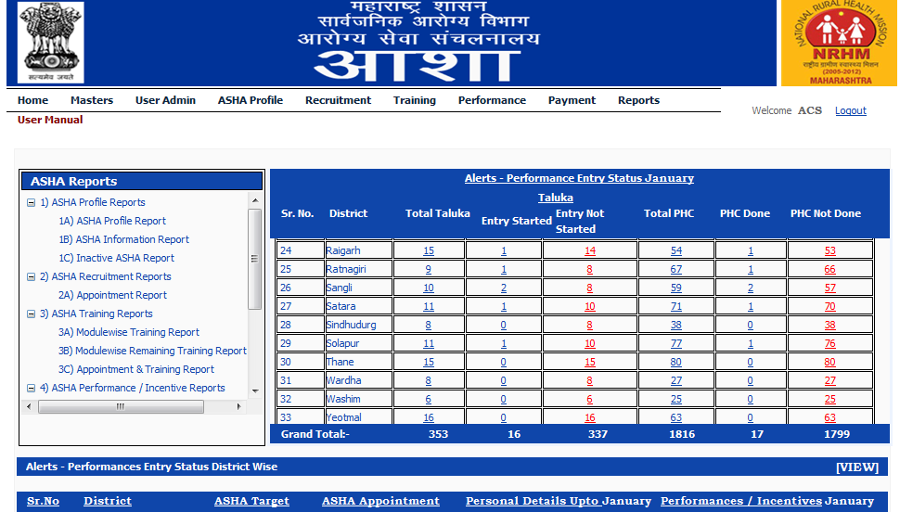
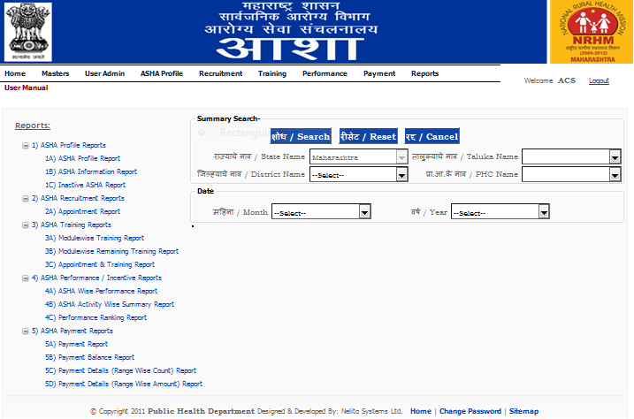
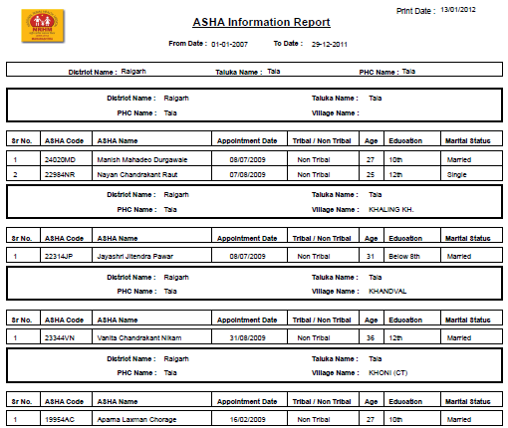
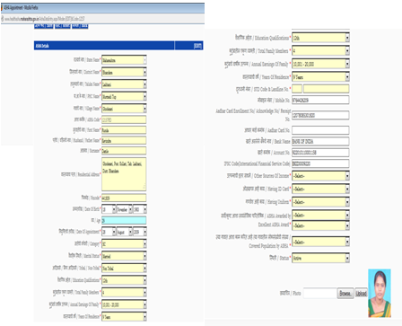
ASHA Software snapshots
Home
Page
Summary
Reports
Detail
Reports
Base register
Format

Slide 37
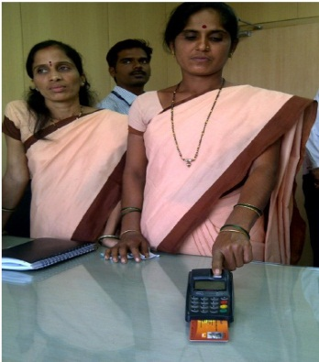
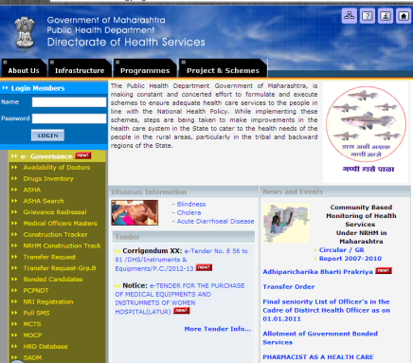
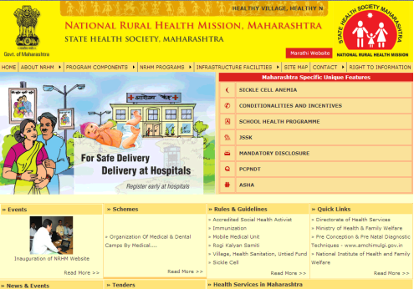
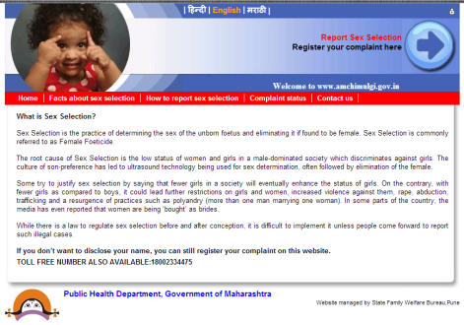
Some More e-initiatives in Public Health Department
Payment to ASHA's by BC Model through Micro ATM started
E- Aushadhi : Drug Inventory software
Construction Tracker
Web Sites-
  Maha-Arogya - www.maha-arogya.gov.in
  NRHM -www.nrhm.maharashtra.gov.in
  PCPNDT - www.amchimulgi.gov.in
  Pull sms for real time data reporting
Successful pilot testing at Nagpur on Android based Mobile telephone for real time data reporting and IEC to mothers
Software on issuing disability certificate
E-Hospital software in progress

Slide 38
THANK YOU

