Slide 1
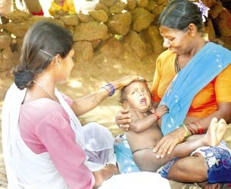
Mitanin Support and Career Development
in Chhattisgarh
NRHM, Chhattisgarh
July 2013

Slide 2
Context
Chhattisgarh, a new state carved out of MP in 2000
Inherited a public health system with shortage of human resources-from Doctors to ANMs
Around 6,000 more ANMs were needed to fulfill 2 ANMs per sub-centre norm
Problem of recruiting and retaining ANMs more severe in tribal areas
Mitanin Programme (prototype ASHA) started by Government of Chhattisgarh in 2002
Nearly, 60000 Community Health workers called ‘Mitanins’ covering all rural habitations of the state
Mitanins have received 56 days of residential training and have field based on-the-job guidance and support
Evaluations show Mitanins as skilled and effective.

Slide 3
Career Development of Mitanins
In order to augment the motivation for this volunteer workforce, it was necessary to create opportunities for career development and social security for Mitanins
Easier to retain health staff in tribal areas if they have cultural affinity
Mitanins are skilled, motivated and enjoy credibility in local communities
Decision taken to train Mitanins from remote areas as nurses and then to recruit them to work in their local areas

Slide 4
Mitanins in ANM Course
In 2009, 32 Mitanins sponsored for BSc. (Nursing), now in 4th year
In 2010, 310 Mitanins sponsored for ANM courses in private ANM schools; 134 more Mitanins given admission in Govt. ANM schools a few months later
Selection from 11 tribal districts, mainly from Bastar and Sarguja division
Selection based on marks scored in 10th standard
In private schools, Govt. fixed Rs.38,000 as annual fee and Rs.2000 monthly stipend per Mitanin
Around 300 Mitanins completed the course from private schools

Slide 5
Institutionalising - Mitanins as ANMs
From 2011 onwards, 40% of seats in Govt. ANM schools reserved for Mitanins, with in built vertical reservations
Minimum qualification 10th pass, first preference to 12th pass Mitanins, free Govt seats
400 Mitanins enrolled in Govt. schools in 2011 and 2012
Mitanins completing ANM course given direct recruitment as 2nd ANM in selected sub-centres (with 3+ deliveries per month)
Direct recruitment in her own Panchayat in Bastar and Sarguja division (10 districts) as per NRHM sanction
16 Govt. ANM schools, intake of 550 students per annum, out of it Mitanins get 220 seats per year, more ANM schools coming up

Slide 6
Other Career Avenues for Mitanins
Mitanin Trainers (ASHA Facilitators) recruited from Mitanins
1500 Mitanins selected as Mitanin Trainers, also improves quality of supportive supervision
Some Mitanins have also risen to Block and District level coordination roles in Mitanin programme
Help Desks set-up in District and Block Hospitals with Mitanins as Facilitators to provide navigation support to patients
400 Mitanins working as Help-Desk Facilitators in 160 facilities
2,500 Mitanins elected into Panchayats, some have got elected into Block and District Panchayats as well

Slide 7
Mitanin Welfare Fund
Education Support: Mitanins given cash incentive for studying further, Rs. 10,000 for passing 12th, Rs. 5000 for 10th standard
Scholarships for education of Mitanin’s children: Rs.1200 per child p.a. in 9-12th class
Life Insurance of Rs.50,000 in event of husband’s death
Swavalamban Pension Fund Scheme: Mitanins enrolled under PFRDA scheme, state puts Rs.1000 p.a. and PFRDA adds Rs.1000 p.a.; Mitanin to get pension of around Rs.1000 on age of 60 onwards
Computerised database of Mitanins at state level, all activities facilitated by a support structure and SHRC
Annual budget around Rs.11 Crore, Started with state budget, NRHM has sanctioned Rs.7.97 Crore this year

Slide 8
Conclusion: Impact and Scalability
These measures have created a sustained inflow of trained ANMs from and for tribal areas
Impact can be even higher if all districts get Govt. ANM schools
Stable mechanisms working for 2+ years – providing social security and education support to Mitanins
The measures have helped in increasing motivation levels of Mitanins
All the provisions are already on-scale in Chhattisgarh - operational for the entire state
ASHAs need and deserve such support as well as opportunities for upward mobility
Can be replicated by other states for ASHA

Slide 9
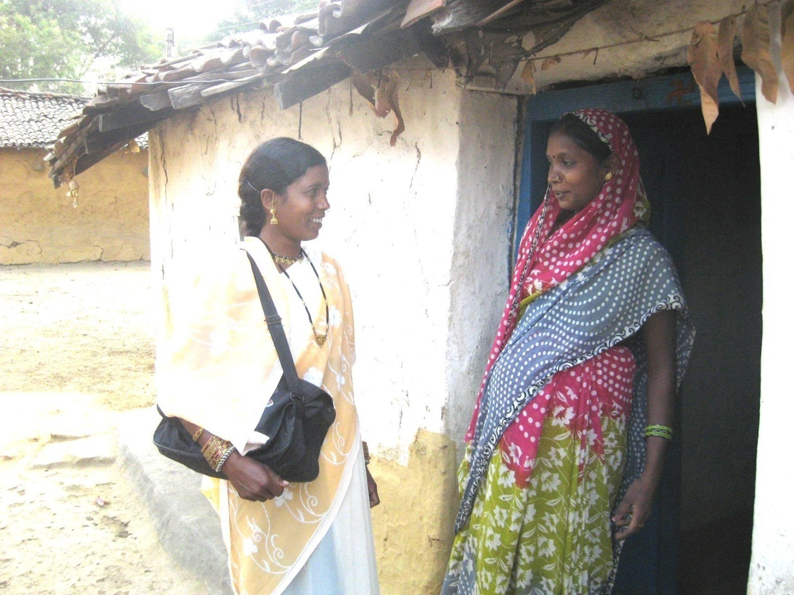
Thank You

