Slide 1
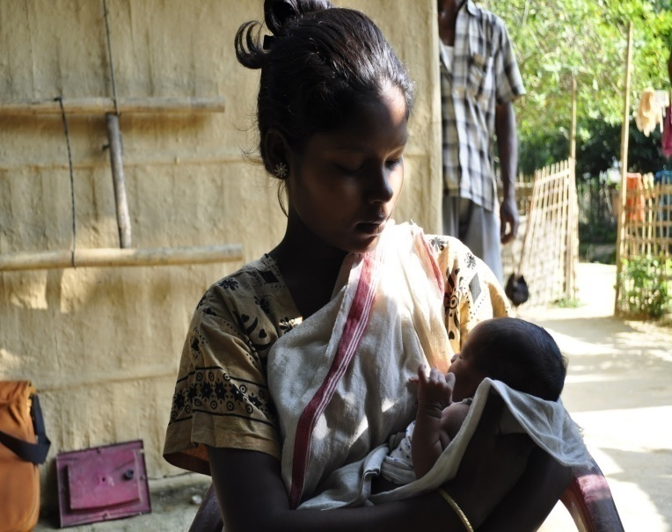

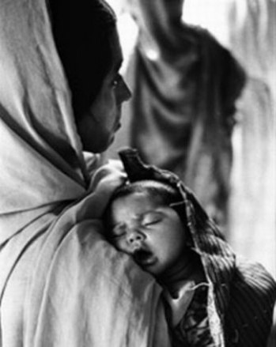
Maternal Death Review
Assam
Prateek Hajela, IAS
Mission Director, NRHM, Assam &
Commissioner & Secretary to the Govt. of Assam
Health & Family Welfare Department
National Rural Health Mission, Assam
Department of Health & Family Welfare
Govt. of Assam

Slide 2
Trend of MMR in Assam

Slide 3
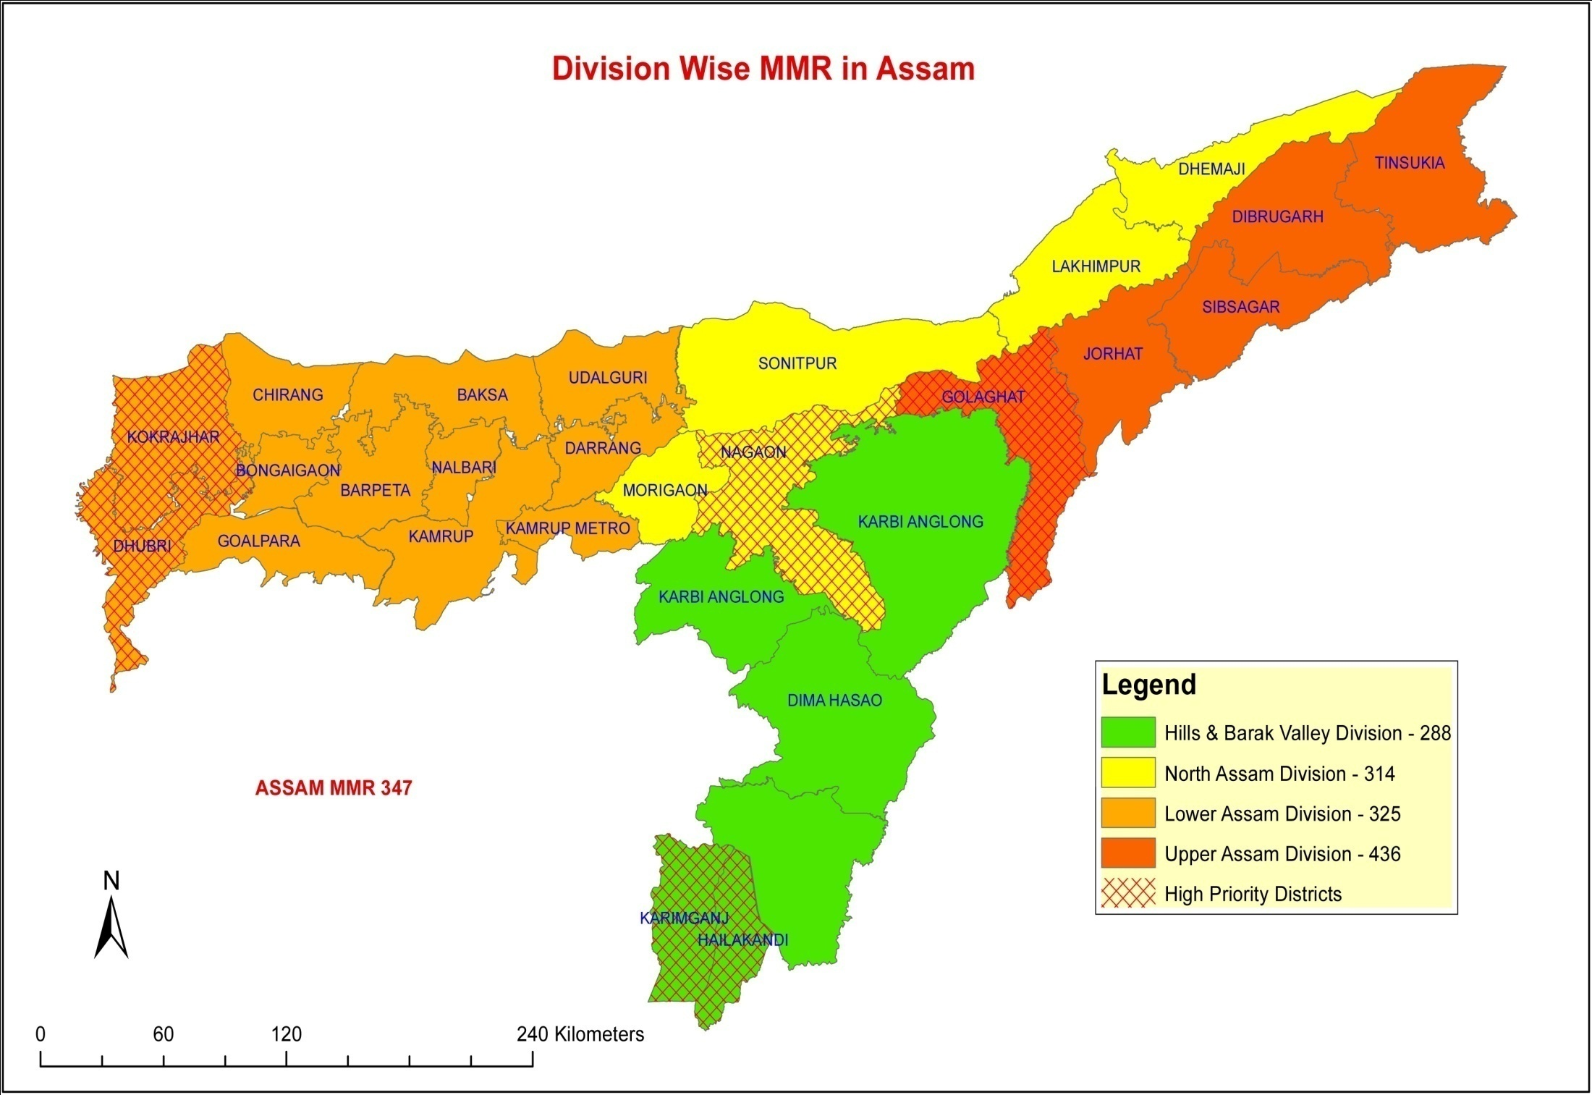
Division wise MMR in Assam – AHS 2011-12
High Priority Districts

Slide 4
Highest MMR: Upper Assam Division : 436 per 100,000 live births (increase from 430)
Lowest MMR: Barak Valley Division : 288 per 100,000 live births (decrease from 342)
MMR : Division wise (Source: AHS - 2010-11 & 2011-12)

Slide 5
Why do women continue to die?
Direct obstetric and non-obstetric causes
Hemorrhage, Sepsis, Eclampsia, Obstructed labour, Abortion related, anemia etc.
Underlying / contributory causes
Social, Behavioural, Cultural, Economic factors
“Three Delays”
Delay in Decision making
Delay in reaching the appropriate health facility
Delay in receiving health care at the facility

Slide 6
Why Investigate Maternal Death ?
To reduce Maternal Morbidity and Mortality
Improve Quality of Obstetric Care
Understand Determinants of Maternal Death
Provide stimulus for Action & to Identify High Risk Factors in Pregnancy
Take Corrective Action for Identified Gaps in Service Provision
Prerequisite: A commitment to act upon the findings

Slide 7
MDR Process ….. Status
Started in State in 2010-11
Training of Staff on Community Based MDR & Facility Based MDR in 2011-12.
Budget Allocation (2012-13) utilized for:
State level MDR Dissemination Workshop for all Jt. DHS, District Nodal Officer for MDR and District Programme Manager including participants from Medical Colleges.
Printing & Dissemination of MDR Guidelines

Slide 8
MDR Process ….. Status
Meeting of State level Task Force …6 monthly
Deputy Commissioner/ Chairman DHS …..conduct Quarterly MDR review in addition to regular Monthly District MDR Committee meeting.
District MDR Committees …. under Joint DHS in all the Districts.
Facility Based MDR Committee … in all Medical Colleges, District Hospitals and FRUs conducted monthly

Slide 9
MDR …….Initiatives
Facility Based Maternal Death Review (FB-MDR):
A qualitative, in-depth investigation of causes of and circumstances surrounding maternal death occurring at the health facility
Conducted for deaths that are initially identified at a health facility
Constitution of Facility Based MDR Committee in all Medical Colleges, District Hospitals and FRUs
Regular Monthly Review Meetings of the Committees
Community Based Maternal Death Review (CB-MDR):
Explores the medical and non-medical causes of the death of the woman
Identifies personal, family and community factors that may have contributed to the death of a woman
FBMDR to be conducted in 30 Private Hospitals with high delivery load from 2013-14 onwards

Slide 10
MDR …….Initiatives
Special “Maternal Death Review” team of Experts constituted
Expert Team constitute of a faculty of O&G dept. of Medical College or a senior Gynecologists of DH, Nodal Officer-MDR and a member of a professional body FOGSI /IMA)
Pilot in 5 Districts of Nagaon, Barpeta, Cachar, Dibrugarh & Sonitpur
Intensive Review of selected cases
Comprehensive Report including systemic gaps, gaps in quality of services
Presentation & Dissemination in District level MDR Meetings
Assess quality of FB and CBMDR already happening and suggest corrective action

Slide 11
MDR …….Initiatives
Online “Maternal Death Reporting System” developed under “Integrated MIS GIS System”
    All deaths captured within 24 hrs
    Deaths at home, in transit and in Pvt. Hospitals within 7 days
    Dashboard alert on high nos. of maternal deaths generated for follow up action
“Quarterly Report Collection Week” to capture missing Maternal and Infant deaths by special house to house survey through ASHA and ASHA Supervisor.
All data on maternal deaths collected & compiled in “Maternal Death Directory” for sharing with Stake Holders – Deputy Commissioners, Jt. DHSs

Slide 12
MDR Process: An Analysis

Slide 13
Year wise Comparative Analysis of Causes of Maternal Deaths
NB:- Other causes includes - Peripartum cardiomyopathy, Bronchial Asthema;Epilepsy; Cancer.

Slide 14
Causes of Maternal Deaths – 2011-12
NB:- Other causes includes - Peripartum cardiomyopathy, Bronchial Asthema;Epilepsy; Cancer.

Slide 15
Causes of Maternal Deaths – 2012-13
NB:- Other causes includes - Peripartum cardiomyopathy, Bronchial Asthema;Epilepsy; Cancer.

Slide 16
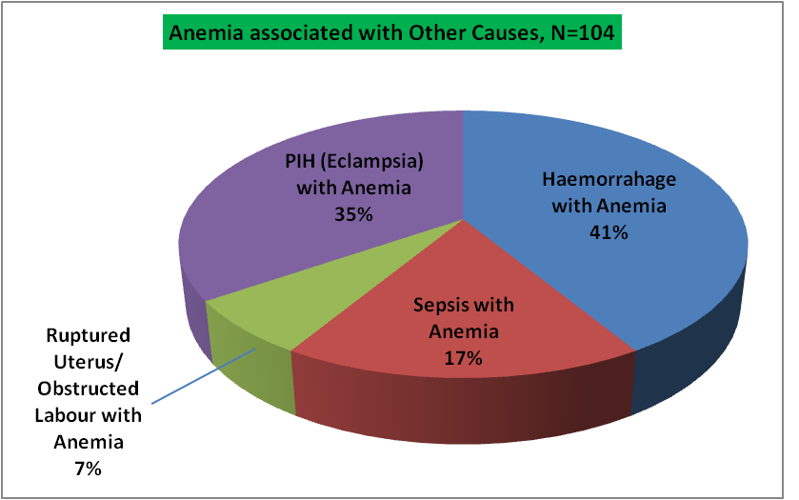
Analysis of other causes of Maternal deaths associated with Anemia for the Year 2012-13 (N=104)

Slide 17
Distribution of Maternal Deaths as per Ethnic Groups
in 2012-13 (N=1249)

Slide 18
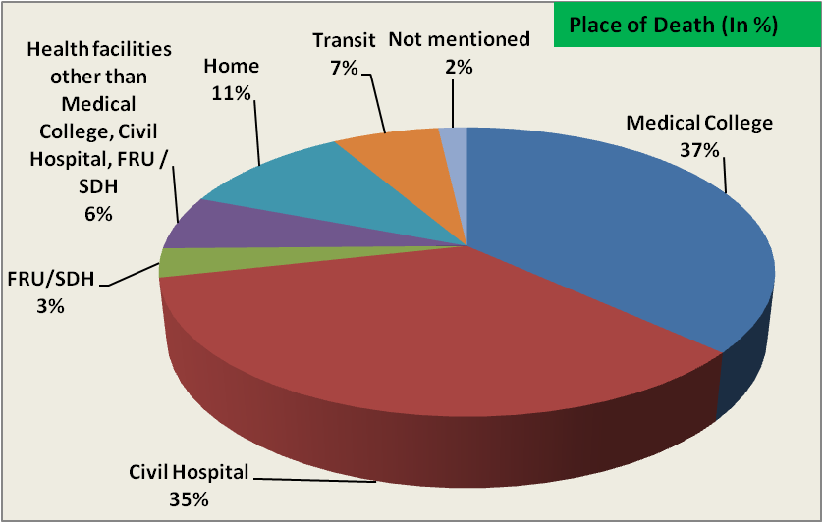
Distribution of Maternal Deaths as per Place of Death
in 2012-13 (N=839)

Slide 19
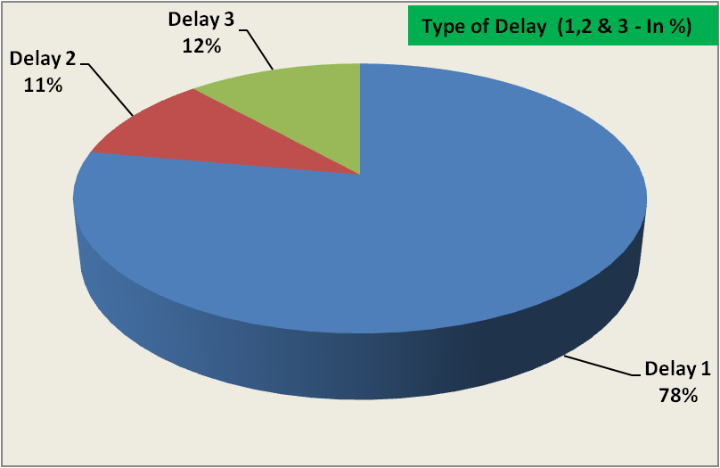
Analysis of Type of Delay resulting into Maternal deaths for the Year 2012-13 (N=352)
NB:-
Type 1 – Delay in seeking in care
Type 2 – Delay in Transportation
Type 3 – Delay in receiving adequate care at the facility

Slide 20
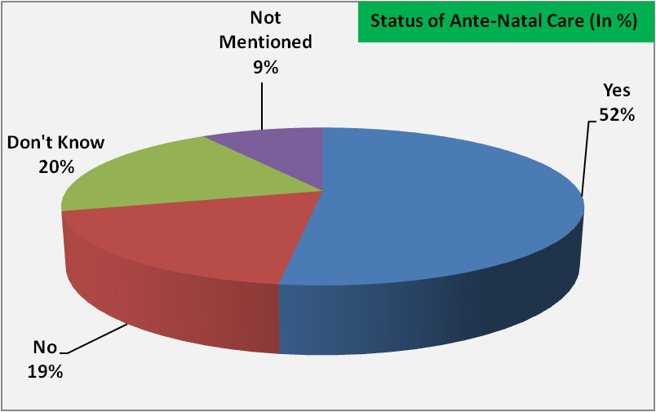
Analysis of Ante Natal care received amongst Maternal deaths for the
Year 2012-13 (N=839)

Slide 21
Month wise Maternal Deaths reported and Institutional Delivery
MDs in 2011-12 = 1245 MDs in 2012-13 = 1249

Slide 22
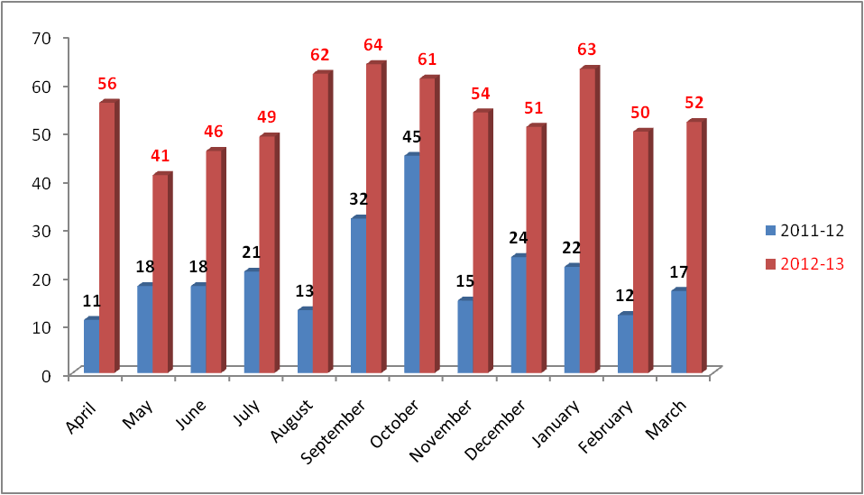
Comparison of Maternal Deaths reviewed by CMO during 2011-12 & 2012-13

Slide 23
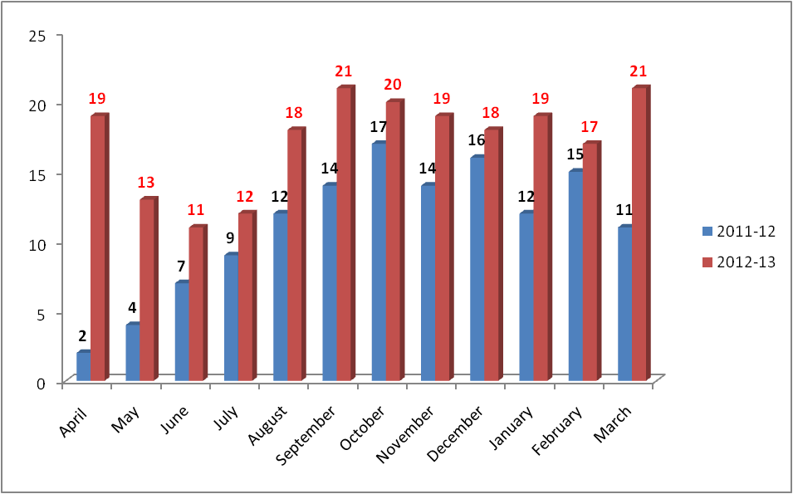
Comparison of Maternal Deaths Reviewed by DM during 2011-12 & 2012-13

Slide 24
DISTRICT PERFORMING WELL IN MDR PROCESS (DHUBRI & GOLAGHAT FOR THE PERIOD FROM APRIL-12 TO MARCH-13
Sl | Name of districts | Estimated Live Birth for the year 2012-13 | Probable Maternal Death Considering 270 as the MMR | Total Maternal Deaths Reported |  | Reviewed by District MDR Committees of CMO |  | Reviewed by DM
 |  |  |  | No | % Against Estimated Maternal Detahs | No | % against Maternal Death Reported | No | % against Maternal Death Reported
1 | DHUBRI (HPD) | 44,016 | 119 | 82 | 69% | 66 | 80% | 57 | 70%
2 | GOLAGHAT (HPD) | 23,692 | 64 | 60 | 94% | 44 | 73% | 39 | 65%

Slide 25
Community specific Gaps
Tea Garden Community
- Poor Nutritional Status and low availability of supplements
- Consumption of tea with Salt…Hypertension during pregnancy attributed to this
- Hook worm infestation high due to poor Hygiene and
sanitation
- Prevalence of Anaemia very high due to above
reasons
Riverine Areas
- The Health System set up and
frequent devastation due to floods
- The Riverine population shifts due to flood every year and
reorganize themselves at different habitations

Slide 26
Gaps identified - MDR and steps initiated
Improvement in Reporting
Incentive paid to ASHA for Maternal Death Reporting increased from Rs. 50/- to Rs. 200/-
Special focus on MCTS for Comprehensive quality care
Dissemination of information through MCTS to decrease drop outs.
Management of Anemia and PIH /Eclampsia
Provision of IV Irons Sucrose for Anaemic PW was started during 2011-12 in 8 Districts. All the Districts are being covered during 2013-14.
High Dependency Units (HDU) are being set up in all the 5-Medical Colleges for management of critical obstetric (PIH/Eclampsia) cases and will be functional soon. In AMCH, High Dependency Unit is already operationalised.
To improve quality ANC, Incentive to ASHAs of Rs 50 on registration of pregnant women within 12 weeks and other Rs 100 on full ANC (4 ANC, Inj. TT2/Booster, consumption of 100/200 IFA, examination of Blood and Urine).

Slide 27
Gaps identified - MDR and steps initiated
Identification of High Risk Pregnant Women
High Risk Pregnant Women (HRPW) are identified through MCTS and tracked to ensure complete service delivery
Special calls to HRPW by Doctor through MCTS Call Centre.
Special Red Stamp pasted in the MCP card of High Risk Pregnant Women for easy identification and special treatment. (Piloted in 4 districts).
Anemia in adolescents
Weekly Folic Acid Supplementation (WIFS) implementation for managing Anaemia in adolescents (10-19 years) for Govt. and Govt. aided schools (Class VI to XII) and out of school adolescent girls registered in the AWC

Slide 28
Gaps identified - MDR and steps initiated
Referral Transport
280 Ambulances and 5 Boat Ambulances for transportation of emergency cases including obstetric emergencies
Additional 100 smaller Ambulances and 100 Dolee (Palki) to be introduced to provide services to inaccessible areas.
Keeping the fleet young - 100 Old ambulances replaced last year and another 100 to be replaced this year by Govt. of Assam.
Another fleet of 450 ambulances – (200 new and 250 existing ambulances) started under 102 scheme to provide 100% coverage under JSSK
248 ambulances provided to Tea Garden Hospitals functioning in PPP mode with NRHM.

Slide 29
Gaps identified - MDR and steps initiated
Other Initiatives
Improving quality of Labour Rooms, OT practices
Ensure at least 48 hours stay at Hospital after delivery.
“Mamata Kit” (Baby Kit) is provided if mother stay at hospital for at least 48 hours after delivery
JSSK system implemented for free treatment, free diagnostics, free delivery, free c-section delivery, free transportation, etc
Monitoring of Drugs availability in hospitals through Online Drugs Monitoring System
Promotion of Institutional Delivery at Sub Centre specially in hard to reach areas through Rural Health Practitioner (RHP)
Difficult area incentive to Doctor and other medical staffs to ensure availability of manpower in difficult areas to conduct delivery at Hospitals
1 Year Compulsory Rural Posting of MBBS Doctors
Construction of 50 Riverine PHCs
Implementation of Boat Clinic Programme

Slide 30
Gaps identified - MDR and steps initiated

Slide 31
Way Forward ….
Analyze the Maternal Death Audit Report to act upon the gaps found out, Improve upon the quality of MDR and to ensure that no deaths go unreported
To ensure regular District Level MDR Committee and State Level Task Force Meetings and to review all the Minutes received from the districts
Online VHND Monitoring System developed to improve the quality of VHNDs and to ensure provision of quality ANC.
Detail Report
Tracking all the HRPWs in their first trimester itself

Slide 32
Online Maternal Death Monitoring System
http://nrhmassam.info

Slide 33
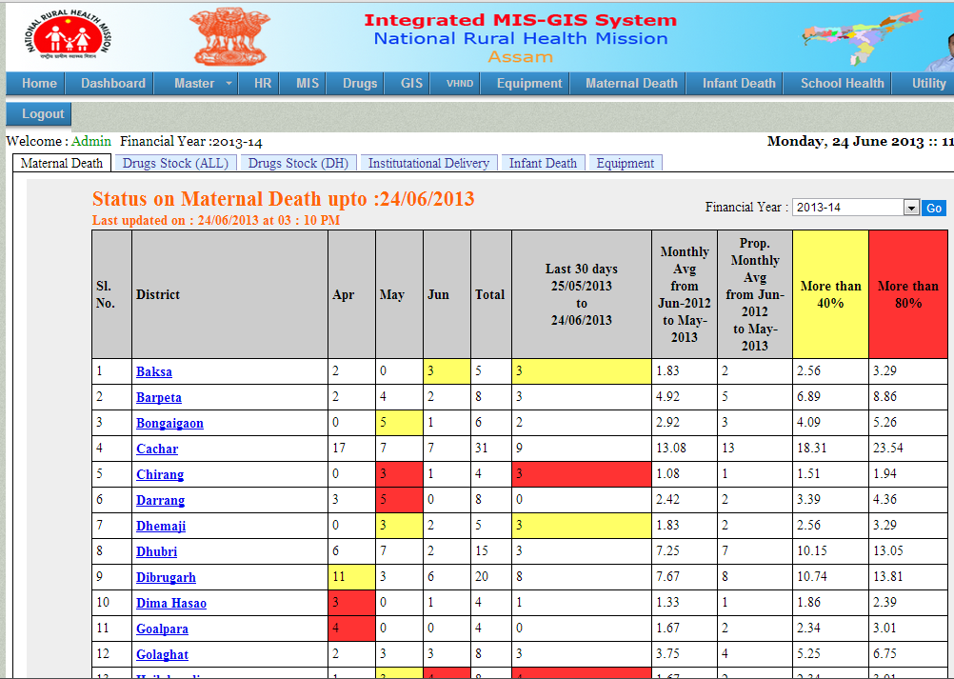
Online Maternal Death Monitoring System - Dashboard

Slide 34
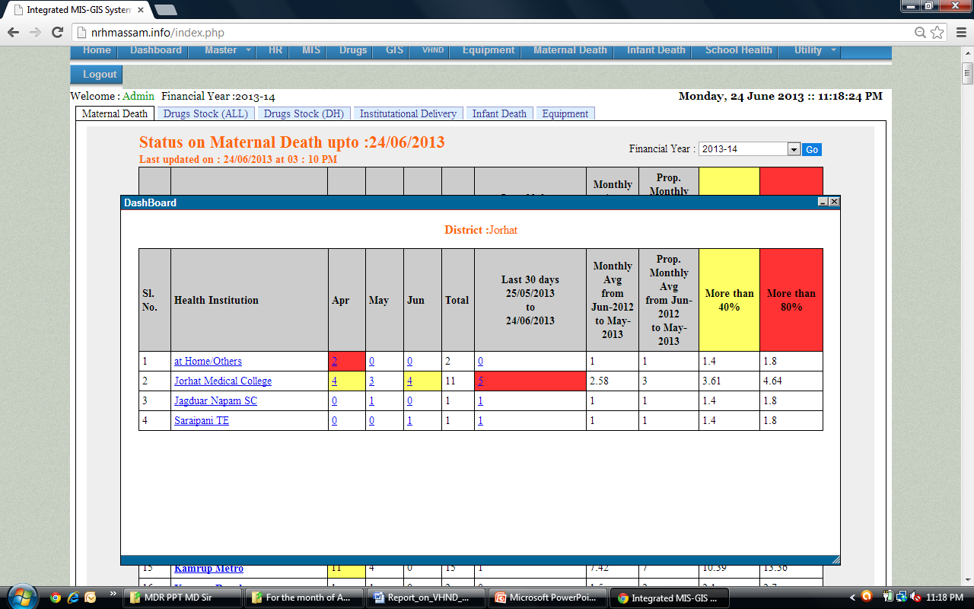
Online Maternal Death Monitoring System – Dashboard
Drill Down Option (Health Institution wise)

Slide 35
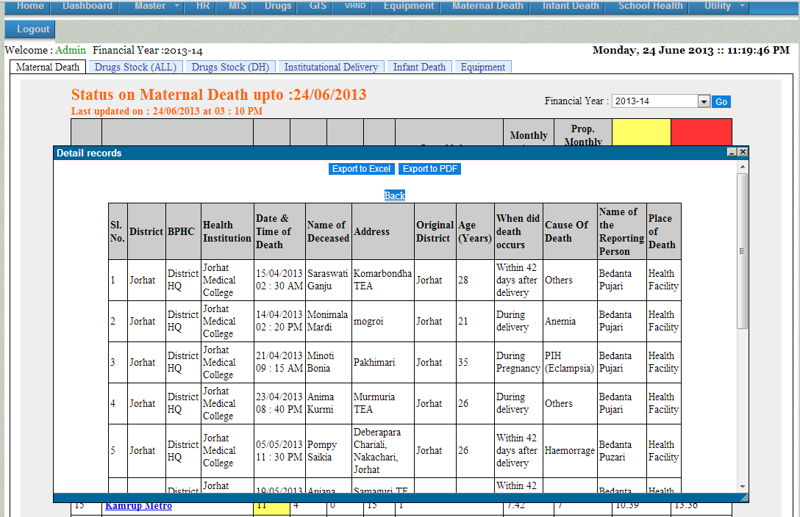
Online Maternal Death Monitoring System – Dashboard
Drill Down Option (Deceased wise)

Slide 36
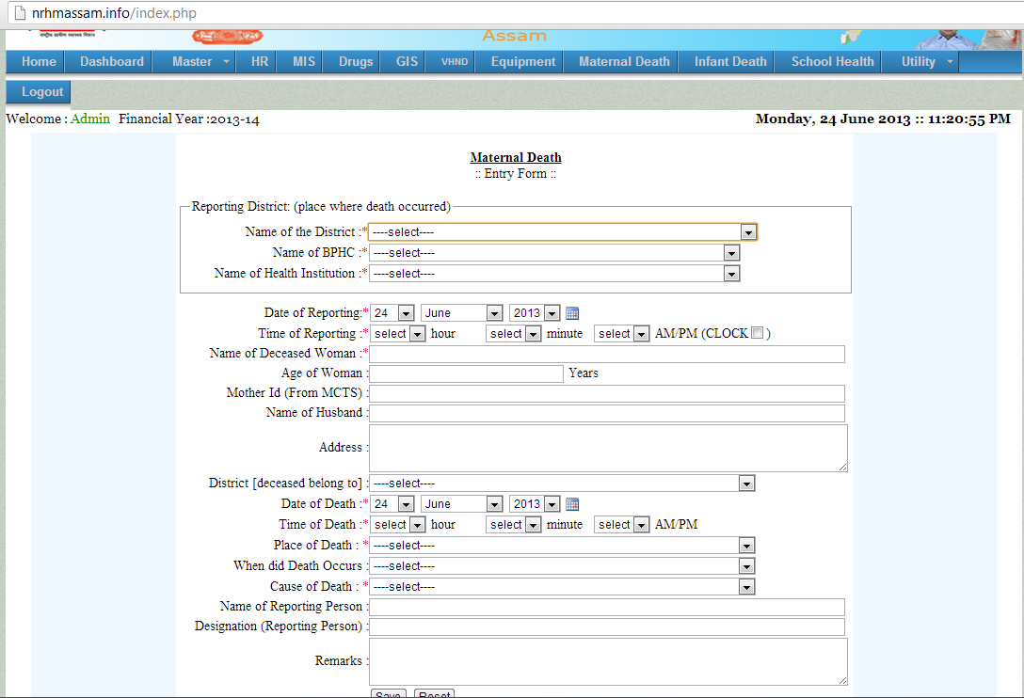
Online Maternal Death Monitoring System – Entry Screen

Slide 37
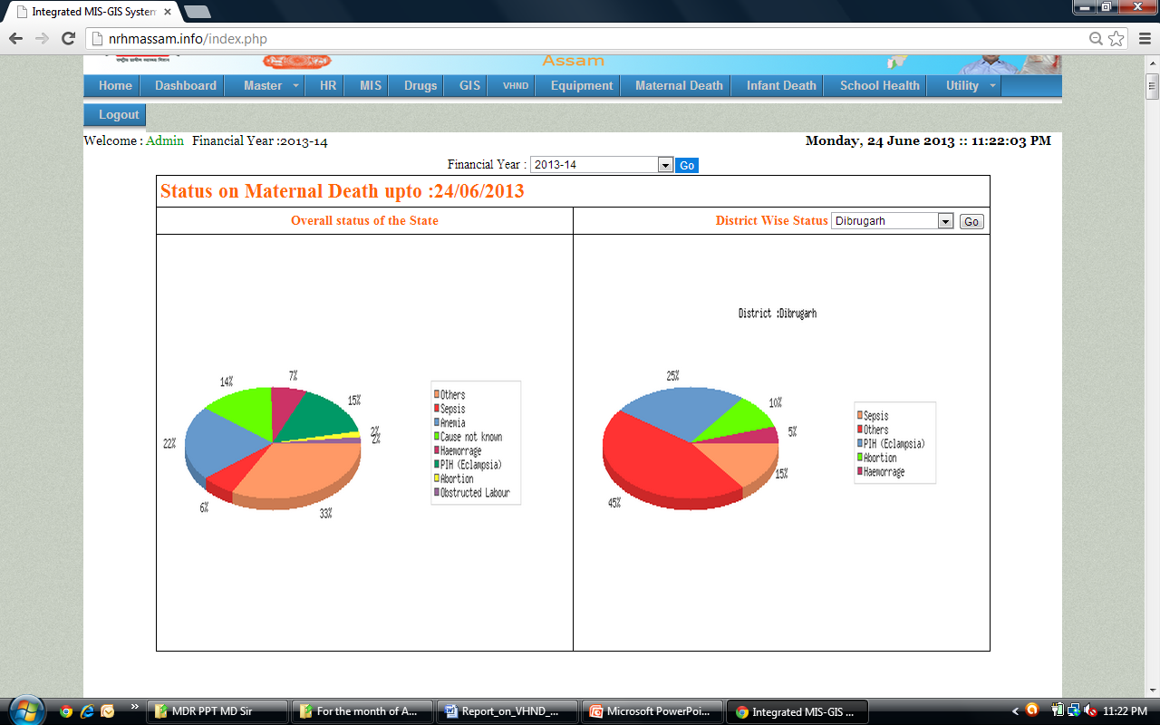
Online Maternal Death Monitoring System – Cause wise Analysis

Slide 38
GOI’s MDR
Software

Slide 39
MDR Software
Ease of compilation and analysis of data
Reporting tools capture information on several items on each maternal death case (Large database for data analysis)
Too many Formats & Repetition of information across the forms
Paper based Data
Difficult to manage the information for compilation and analysis for each death
Development of Software

Slide 40
MDR Software.....Progress so far
MDR Software Tools developed
Tools synchronised with MDR Guidelines Tools
Integration of Software with MCTS through the Mother ID
Software Compatibility with NIC Specifications
Completion of Security Audit
Testing of software with State Data on maternal deaths
MDR software is ready, deployed on the NIC server
&
Software website link is www.nrhm-mdr.nic.in

Slide 41
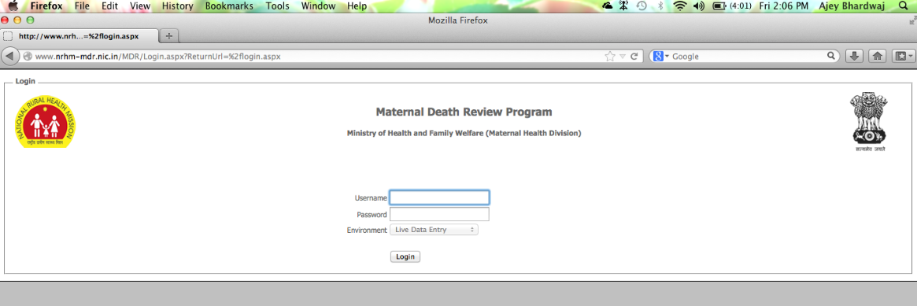
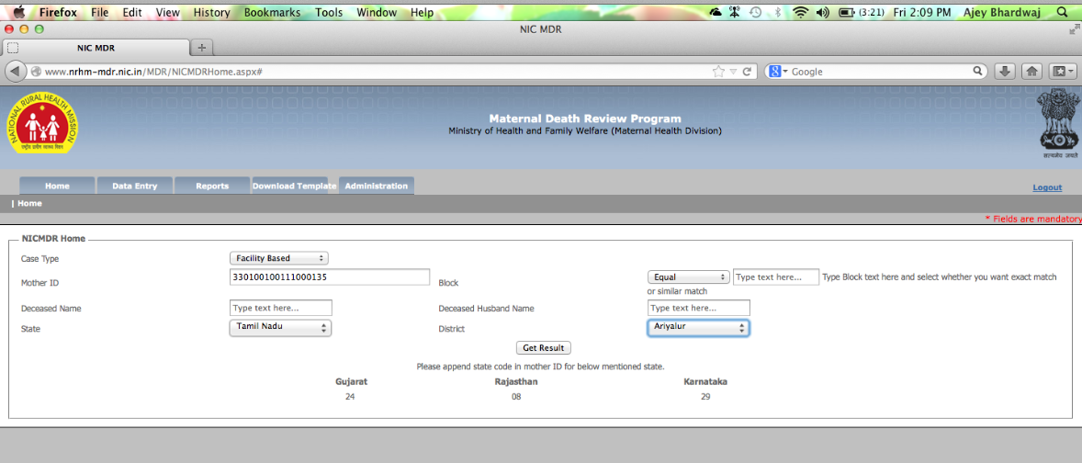
OPENING PAGE
LOGIN
PAGE 2
SELECT CASE TYPE
FEED MOTHER ID
CLICK GET RESULT TO OPEN FORMAT TO FEED DATA OF FB/CB CASE

Slide 42
Thank you

