Slide 1
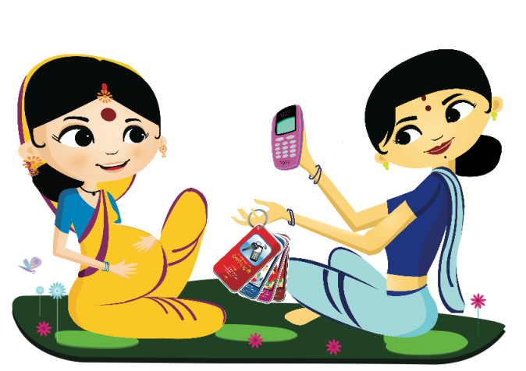
MOBILE KUNJI & MOBILE ACADEMY
Harnessing the Power of Mobile Phones to Enhance the Interpersonal Communication Capacity of Frontline Health Workers

Slide 2
The Ananya Initiative
Memorandum of Cooperation between Government of Bihar and the Bill & Melinda Gates Foundation
Ananya partner: BBC Media Action is committed to increasing demand for health services and shaping norms around positive health practices
Integrated approach: implemented across multiple communication channels to shift levels of knowledge, attitude, self-efficacy, social norms and health behaviors related to maternal and child health in the state

Slide 3
Aligning with RMNCH+A
RMNCH+A
Ananya
Information and counseling on family planning (including IUD insertion, OCP and condoms
Ante natal care, including IFA
Counseling and preparation of newborn care, feeding, breast feeding and birth preparedness
Institutional delivery
Home based newborn care
Danger sign recognition and care seeking for illness
Infant and young child feeding
Information and counseling on family planning
Institutional delivery, ante natal care and birth preparedness, including
IFA and TT
JSSK promotion
Preventive postnatal care, including
Thermal care, skin to skin care
Cord care
Immediate breastfeeding
Recognition of danger signs,
Infectious diseases recognition and treatment
Exclusive breastfeeding
Infant and young child feeding
Immunization
Hand washing

Slide 4
Bihar
10.4 crores population
2.5 crores women of reproductive age
18.6 million children under the age of 6
4,200 doctors across the state in public sector
Approximately 2,00,000 frontline health workers
Opportunities vs Challenges
Bihar is 89% rural
TV and radio reach is only 25%
But, 80% households have mobile access
85% frontline health workers own mobile phones

Slide 5
Frontline Health Workers A Critical Opportunity
Lack of doctors, especially in rural areas
FLWs are from local community, therefore readily available to community
Outreach to community primarily through FLWs
FLWs reach hard-to-reach homes where women have limited mobility
Despite trainings skill gap exists, so on the job skill building is crucial
Planning skills
Communication skills
Promoting critical contacts
Supportive supervision

Slide 6
Negotiated Communication Training Sales Cycle Approach
Establish a relationship
Identify a need
Formulate a solution
Get the family to commit to the solution
Follow up and reinforce the solution
Train FLWs to have a key objective in every interaction
Focuses on building self-efficacy and practice rather than just giving information
Linked closely to the design of Mobile Kunji cards

Slide 7
Job Aid for Health Workers Mobile Kunji
An audio-visual job aid designed to be used by FLWs during their counselling sessions with families
An IVR-based mobile service
A virtually indestructible deck of 40 illustrated cards on a ring
Each card communicates life-saving messages about maternal and child health
A unique shortcode at the bottom of each card plays the related audio health message to families
Calls can be made from any handset
Calls are toll free for health workers
Calls cost 40p per minute on average – to be covered by Government of Bihar

Slide 8
Training Course for Health Workers Mobile Academy
Anytime, anywhere standardised training
Delivered via mobile phone
Designed to refresh knowledge and enhance communication skills
190 minutes of content
50 paise per minute makes the course highly affordable
Paid for by users
Can be accessed from any mobile handset
Partnerships with Airtel, Vodafone, Reliance, Idea, Tata
Certificate of completion for FLWs who achieve at least 50% score in the quiz

Slide 9
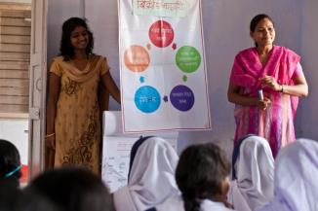
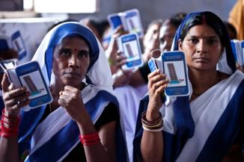
Training of Health Workers ASHAs and AWWs
Started in 8 districts simultaneously on 14 May 2012; completed 3 Nov 2012
District | Number in microplan | Registered | Completed
Begusarai | 4563 | 4400 | 4390
East Champaran | 6502 | 6241 | 6169
West Champaran | 5614 | 5326 | 5251
Gopalganj | 4542 | 4373 | 4355
Khagaria | 2760 | 2665 | 2655
Patna | 6674 | 6469 | 6394
Saharsa | 2553 | 2458 | 2449
Samastipur | 7055 | 6855 | 6849
TOTAL | 40263 | 38787 | 38512
Sales Cycle approach training to FLW
Source: Training Report
FLWs learn how to select cards

Slide 10
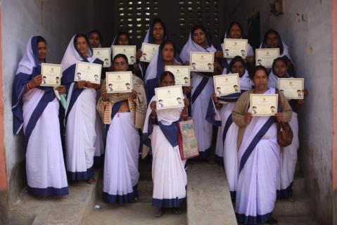
Mobile Academy Usage
Unique users
Total: 27,997
Minutes
Total: 3,193,372
Graduates
Total: 10,661
Successful graduates of Mobile Academy
Source: Online Reporting Interface for May 2012-May 2013
Notes:
Real time data about usage of the mHealth services is available through the back end reporting system. Mobile network operators’ systems capture usage data which is then shared with the MoTECH platform and is then reported through the program’s reporting interface. We are able to gather real time data about which FLW in the 8 districts uses MK or MA, what content she accesses and for how long

Slide 11
Mobile Kunji usage by FLWs
Unique Users
Total: 100,362
Minutes
Total: 2,722,208
In May
64% users were FLWs
Average number of minutes per FLW was 21.5 mins
Average number of calls per FLW was 12.26
FLW using Mobile Kunji
Source: Online Reporting Interface for May 2012- May 2013

Slide 12
Stories from the field
FLW Renu Devi, Raghunathpur village, Turkaulia block, East Champaran uses the Sales Cycle approach and Mobile Kunji to counsel a family about family planning. The young mother had a sterilization within a month of the interaction.
Renu Devi says: “Mobile Kunji to hamni ke kaam ke itna aasan kardewebala. Kunji ho gayel ba ki ekra bagair chhetra main kono ke kuch batawe ke koi fayda nahike”

Slide 13
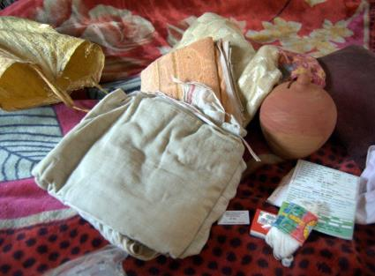
Stories from the field
Rinku Devi, a 19-years old, married and currently pregnant woman from Seehpur village, Gopalganj, Bihar, adopts the “five-cleans for home delivery” message delivered to her by the FLW by using the Mobile Kunji
“She brought out a little cloth bag to show us. In it, were her registration card, new thread, a new blade, soap, a clean soft cloth to wipe and wrap the baby and old towels – things that would be needed for her to have a safe and clean delivery at home.”

Slide 14
Family Timeline Service Kilkari
Time-appropriate audio information related to pregnancy, child birth and child care delivered to families who register
Pre-recorded calls made to families’ mobile phones
64 weeks – from 6th month of pregnancy to child’s 1st birthday
Families who subscribe to the service receive one call per week
Each call is 2 minutes long
Calls are billed to families on a weekly basis, at Re1 per week
Subscribers can unsubscribe from the service at the end of each weekly call
Target of 250,000 subscribers within first 6 months of launch

Slide 15
Thank you

