Slide 1

INITIATIVES TO REDUCE ‘OUT OF POCKET’ EXPENDITURE OF PATIENTS THROUGH REVAMPED MEDICAL STORE PROCUREMENT, FAIR PRICE MEDICINE SHOPS AND INCREASED PRESCRIPTION OF GENERIC MEDICINES
HEALTH & FAMILY WELFARE DEPARTMENT
GOVERNMENT OF WEST BENGAL

Slide 2
Structure of the Presentation
  West Bengal Health Facilities - at a glance
  Objectives of The Initiative
  Challenges
  Measures from the Gov of West Bengal
  to meet these Challenges
  Outcome as of now

Slide 3
Objectives of The Initiative
1. Minimizing out-of-pocket expenses of patients coming to Government Hospitals by a. Strengthening free distribution scheme of drugs b. Developing FPMS as a Secondary Source of supply that would dispense drugs at high discount
2. Providing value for public money spent on Drugs by a. increasing transparency in procurement b. Maintaining quality, and c. Enhancing accountability at all tiers.

Slide 4
CHALLENGES (1)
People in West Bengal largely depend on public health care system run by the State Government.
The Government Healthcare Facilities take approximately 78% of the total patient load of the state.
On an average, footfalls in Govt hospitals per year are of the order of 100 million.

Slide 5
CHALLENGES (2)
Free distribution scheme has limitations, can not cover all the needs of the patients for drugs etc
Public perception regarding quality of drugs available under free distribution scheme has not been good
Facilities of Free Scheme not available round the clock
Availability of Implants used in Medical Colleges (e,g Cardiac/Orthopedic Implants) at affordable rates continues to be major issues for the patients

Slide 6
CHALLENGES (3)
Due to inherent limitations of free scheme, patients are dependent to a large extent on the retail pharmacies operating outside the Hospitals to procure branded medicines prescribed by the Doctors at market rates (MRP rates)
The state government has no control over price and quality of these medicines procured from private retail pharmacies other than routine checks by Directorate of Drugs Control,

Slide 7
Initiatives taken to meet these challenges
Strengthening of Free Distribution Scheme for Medicines & Consumables.
Establishing Additional Delivery System of Medicines, Consumables etc at affordable cost round the clock through a chain of Fair Price Medicine Shops (FPMS) within the hospitals.
Encouraging Prescription of Medicines in Generic Names by Doctors of Government Hospitals

Slide 8
A. STREGTHENING OF FREE DISTRIBUTION SCHEME for MEDICINES & CONSUMABLES (1)
Significant increase in the Budgetary allocation from Rs 157 crore in 2011-12 to Rs. 287 crore and Rs 304 crore during 2012-13 and 2013-14 respectively.
e-Procurement of Medicines & Consumables using NIC portal ensuring transparency in the procurement process.
Departing from previous practice, only Manufacturers having adequate market presence are permitted to participate in tender process.
Reducing number of suppliers to a manageable level by changing the earlier system for better monitoring of delivery status and quality control over drugs received

Slide 9
STREGTHENING OF FREE DISTRIBUTION SCHEME for MEDICINES & CONSUMABLES (2)
Empanelment of a number of Drug Testing Laboratories including NABL accreditated Labs across the Country
Results of Quality Testing shared with the Hospital Authorities, thus helping to build confidence of the Doctors in the Hospital on quality of medicines under free scheme
Adequate penal measures included in the agreement with the suppliers

Slide 10
STREGTHENING OF FREE DISTRIBUTION SCHEME for MEDICINES & CONSUMABLES (3)
Installation of a dedicated web enabled soft ware on ‘Store Management Information System (SMIS)’ for participants including decentralized procuring authorities for all transactions
The system does not allow generation of delivery order unless matching fund is available, which is allocated and entered in the system centrally
The system does not allow further procurement of an item when there is adequate (25% of annual requirement) stock of that item.
Distribution of drugs to peripheral units done by decentralized stores through SMIS on FIFO Basis

Slide 11
STREGTHENING OF FREE DISTRIBUTION SCHEME for MEDICINES & CONSUMABLES (4)
A Vendor portal has been created for the vendors to provide on line information regarding supply order issued, delivery status of bill and payment status.
This has ensured transparency and accountability

Slide 12
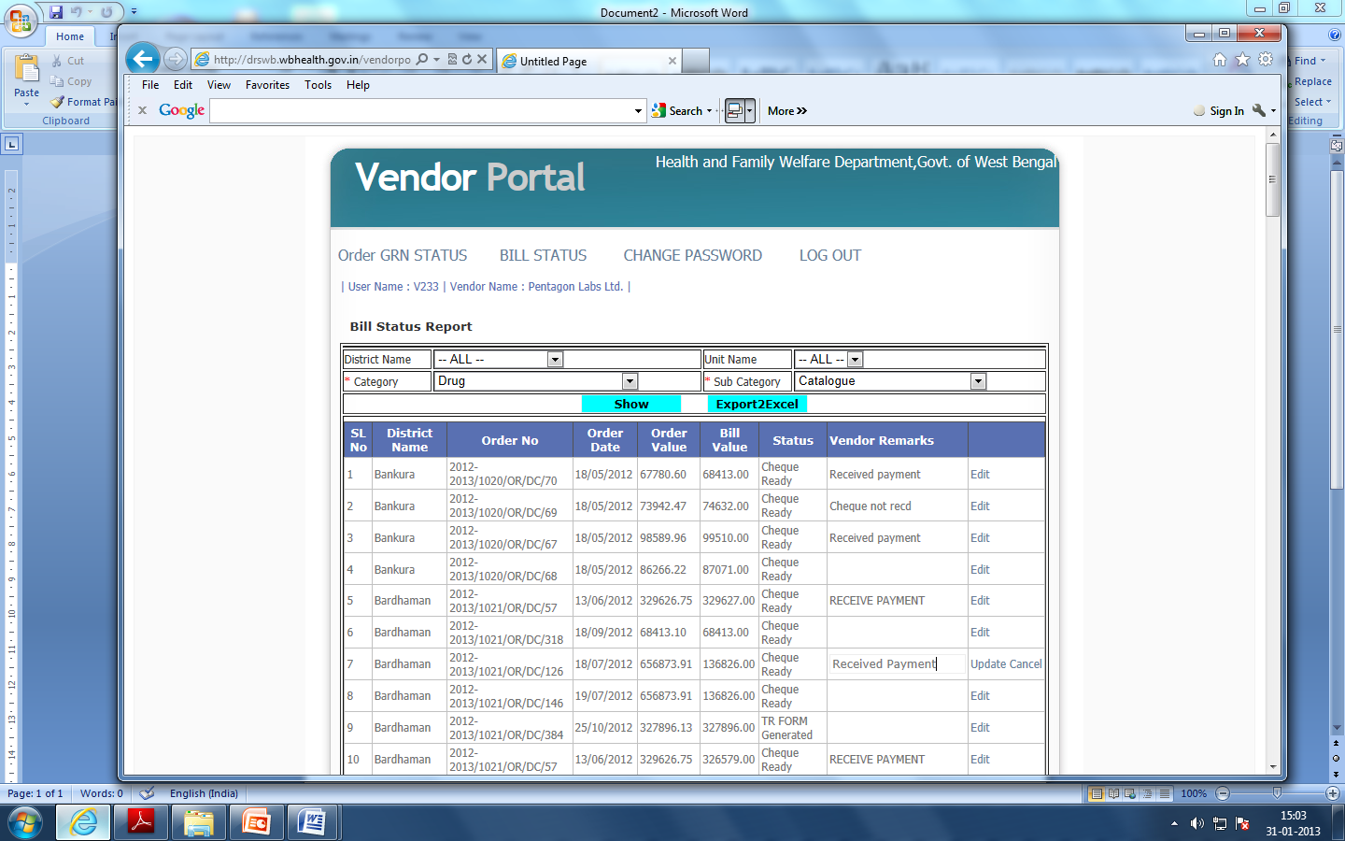

Slide 13
OUTCOME OF THE REFORMS BROUGHT TO FREE DISTRIBUTION SCHEME
Increased availability of Medicines in hospital pharmacies
Procurement of Better Quality of Medicines
Enhanced confidence of Patients and Doctors on drugs under free scheme due to improved quality & availability of drugs
Transparency and accountability has been established
Vendor portal, e-tender and e- payment has attracted participation of reputed manufacturer to tender process.

Slide 14
CONSOLIDATING THE GAINS OF FREE DISTRIBUTION SCHEME WITH THE SUPPORT OF
NATIONAL HEALTH MISSION (NHM)
INTEGRATION OF THE ‘FREE DRUG SERVICE SCHEME’ UNDER NHM IN THE EXISTING
FREE DISTRIBUTION SCHEME OF THE STATE
The state government fulfills eligibility criteria of the scheme under NHM as under
Essential Drugs are provided free to all OPD patients in the state run hospitals
2 Procurement, Delivery and Quality Control System of Drugs are all IT backed

Slide 15
CONSOLIDATING THE GAINS OF FREE DISTRIBUTION SCHEME WITH THE SUPPORT OF
NATIONAL HEALTH MISSION (NHM) [2]
INTEGRATION OF THE ‘FREE DRUG SERVICE’ SCHEME
UNDER NHM IN THE EXISTING FREE DISTRIBUTION SCHEME OF THE STATE
3. Procurement under existing free scheme is made using ‘Inventory Control Guidelines’ that places Drugs under Three Categories, viz, Vital, Essential and Desirable
The proposed scheme under NHM will further augment the resources for distribution of drugs to all patients free of cost

Slide 16
B. Additional Delivery System of Medicines & Consumables at affordable cost through a chain of Fair Price Medicine Shops under PPP
Even after reform, the scheme for free distribution of drugs at Government Hospitals has limitations.
With fixed budget, it can not meet all the requirements of patients visiting the hospitals.
Hospital Pharmacies do not operate on 24x7 basis although 24x7 Emergency Services exist in Hospitals.
It was felt necessary for creating a secondary source of supply outlets under PPP mode to ensure round the clock availability of products at pre approved discounted rates over the MRP, much lower than the market price

Slide 17
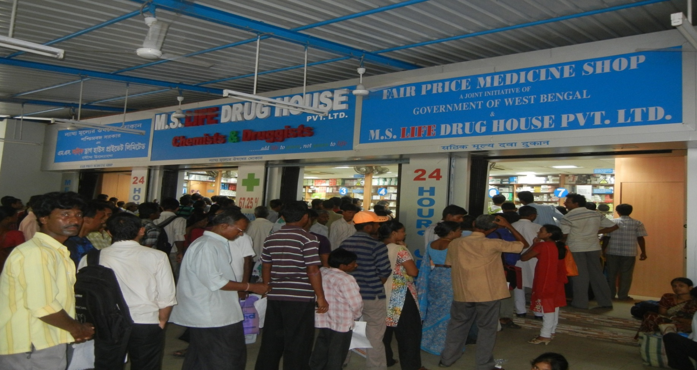
Additional Delivery System of Medicines & Consumables
24 Hours at affordable cost through a chain of
Fair Price Medicine Shops.

Slide 18
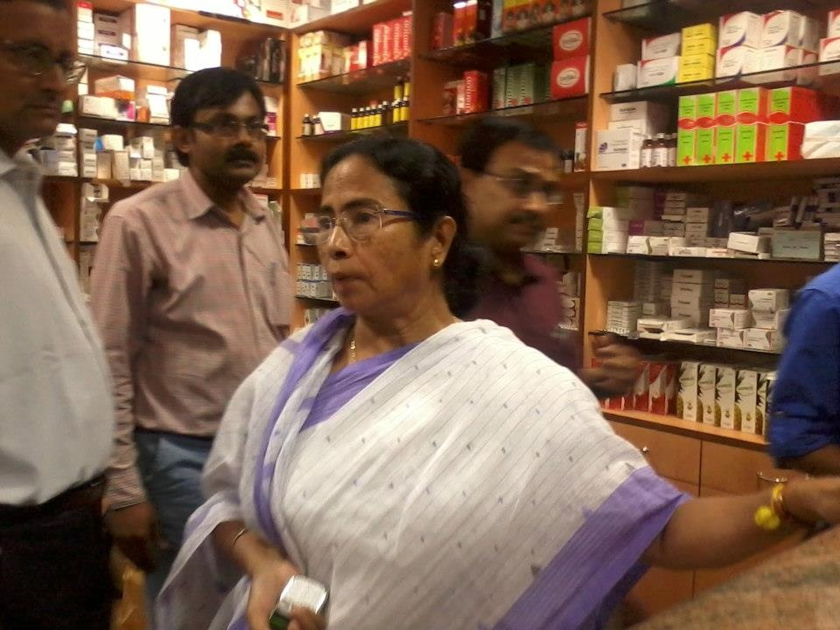
Additional Delivery System of Medicines & Consumables
24 Hours at affordable cost through a chain of
Fair Price Medicine Shops.

Slide 19
Additional Delivery System of Medicines & Consumables
24 Hours at affordable cost through a chain of
Fair Price Medicine Shops for the benefit of the patients
In the first phase, 34 such outlets, out of 35 planned, have become functional covering all the Medical Colleges, most of the District Hospitals and selected SD Hospitals between Dec 2012 and June 2013
In the second phase another 52 outlets would be set up during 2013-14. The selection of Private Partners is underway.
Clearly defined and transparent process of selection of private partners have been followed. The bidding parameter for selection of private partner was the maximum discount on MRP for each hospital offered by the technically qualified applicants

Slide 20
Fair Price Medicine Shops (FPMS) for the benefit of the patients
Products and Services available at FPMS
142 mandatory generic medicines as per list provided in the scheme. This list is dynamic.
Medicines listed under the guidelines of JSSK
The FPMS is also enlisted under RSBY scheme
Additional Medicines (Branded/Generic) over 142 items to meet the needs of patients.
Medical Consumables with mandatory list of 39 items along with surgical items.
Orthopaedic & Cardiology related devices/implants used in in higher tier hospitals (e. g Cardiac Stents)

Slide 21
Fair Price Medicine Shops (FPMS) for the benefit of the patients
QUALITY ASSURANCES
Quality and other important parameters for the manufacturers to be followed by the private partners for procurement of stocks have been incorporated in the agreement signed with the private partner.
Other measures include quality audits for randomly selected samples from these outlets undertaken by competent authority. A protocol for quality audit of drugs procured and sold by the FPMS has been introduced.

Slide 22
Fair Price Medicine Shops (FPMS) for the benefit of the patients
MONITORING MECHANISM
Approved software package installed in these outlets for day to day transactions including sales, inventory, stock outs etc. The programme is being connected with the concerned hospital as well as with Swasthya Bhawan for on line tracking of sales and inventory.
State level monitoring committee under the chairmanship of Director, Medical Education have been formed for this scheme. Similarly monitoring committee formed at each of the hospitals having FPMS outlet

Slide 23
Fair Price Medicine Shops (FPMS)
OUTCOME (BENEFITS FOR THE PATIENTS)
Discounts ranging from 48% to 67.25% on MRP are available in different hospitals under this scheme for all items providing immense benefits for the patients
Initial sales indicate overwhelming response of patients and acceptability by hospital doctors for medicines sold from FPMS. This means huge reduction of ‘out of pocket of expenses’ of patients.
Till 31st May 2013, in five months’ time, Gross sales, Discount availed by patients and number of patients benefitted are Rs. 34.65 crore, Rs.20.94 crore and 11.04 lakh respectively.

Slide 24
Fair Price Medicine Shops (FPMS)
OUTCOME (Performance Trend)

Slide 25
C. ENCOURAGING PRESCRIPTION IN GENERIC NAME BY DOCTORS OF GOVERNMENT HOSPITALS
The State Government has issued Order instructing Doctors for prescriptions in Generic Name to help patients procure drugs free of cost from hospital pharmacies or to procure the same from FPMS at much economical rates
Prescription audit has been initiated with the support of the Experts of the Department to ascertain rational use of drugs and extent of prescriptions in Generic Name
OUTCOME
NOTICEABLE iNCREASE IN THE PRESCRIPTIONS IN GENERIC NAME BY DOCTORS ESPECIALLY IN LAST TWO TO THREE MONTHS

Slide 26
CONCLUSION
INITIATIVES TAKEN IN IMPROVING DELIVERY SYSTEM OF QUALITY DRUGS & CONSUMABLES IN GOVERNMENT HOSPITALS
THROUGH STRENGTHENING OF FREE DISTRIBUTION SCHEME
CREATING A SECONDARY SOURCE OF SUPPY AT AFFORDABLE COST FROM FAIR PRICE MEDICINE SHOPS THROUGH PPP
AND
ENCOURAGING PRESCRIPTIONS IN GENERIC NAME BY DOCTORS OF GOVERNMENT HOSPITALS
ARE SHOWING POSITIVE OUTCOME AS IS EVIDENT FROM THE PERFORMANCE TREND IN TERMS OF BENEFITS TO THE PATIENTS

Slide 27
THANK YOU
Presented by:
The Department of Health & Family Welfare, Government of West Bengal
SRINAGAR; July2013

