Slide 1
INNOVATIONS IN PUBLIC HEALTHCARE
Dr. Gordon Zohmingthanga
Mission Director, NRHM
Mizoram

Slide 2
‘Wooden’ Radiant Warmers
First recorded wooden radiant warmer was made in 2002 at Civil Hospital, Aizawl
The warmers can be fitted with oxygen tubes, and utilise light bulbs for production of heat.
With better supply of equipments under NRHM, they are slowly replaced

Slide 3
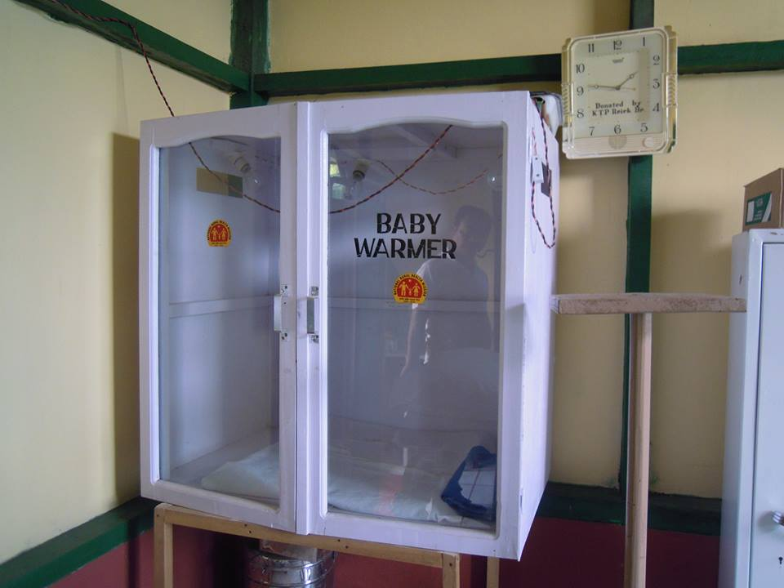
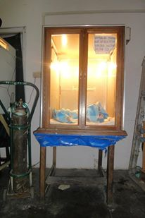
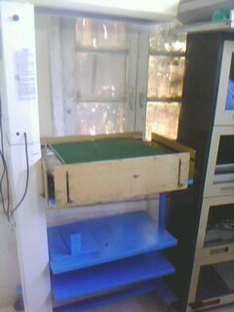

Slide 4
Wooden Labour beds
Made to resemble labour beds, but made of wood
Were Macintosh sheets are not available, matresses are cut, sewn with rubber sheets/ polythene sheets and used.
With better supply of equipments under NRHM, they are slowly replaced

Slide 5
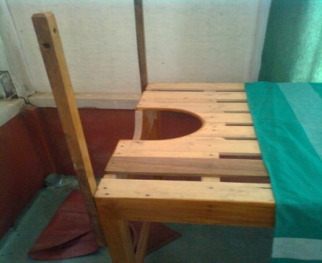

Slide 6
Community Constructed PHC
Chhingchhip PHC in Serchhip district was constructed by the community in 1982
Initially, the villagers hired health professionals
NRHM has now posted the necessary workers for proper functioning of the PHC.
New and better building was constructed under NRHM in 2008 - 2009

Slide 8
Community Constructed Sub Centre
Mawhre Sub Centre clinic under Tupiang PHC at Saiha District (HPD)
A village consisting of 100 houses of which 74 families are BPL.
No landline or Mobile network coverage.
Local ‘doctor’ trained by CNF/BNLF militia
Sub Centre built entirely by the village

Slide 9
Whole village actively participates in providing medicine, food, firewood and honorarium when possible.
ANM from nearby Chapui SC deputised to look after this clinic. ASHA selected from the local populace.
Can accommodate 6 patients.
Separate area for labour.
Serves the local and nearby villages and even villages from neighbouring Myanmar

Slide 10
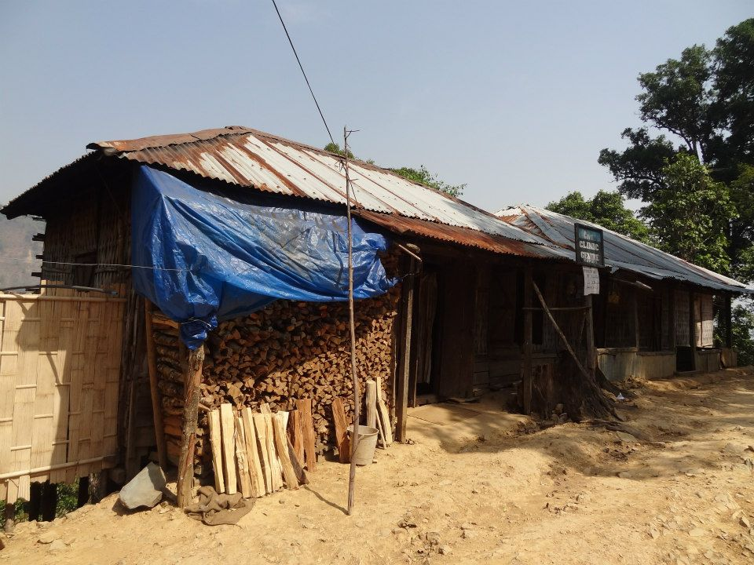

Slide 11
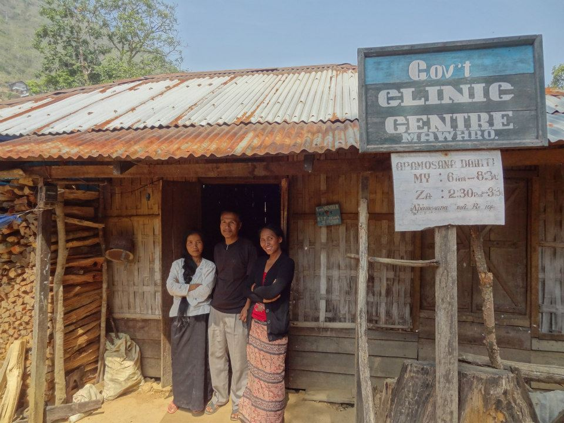

Slide 12
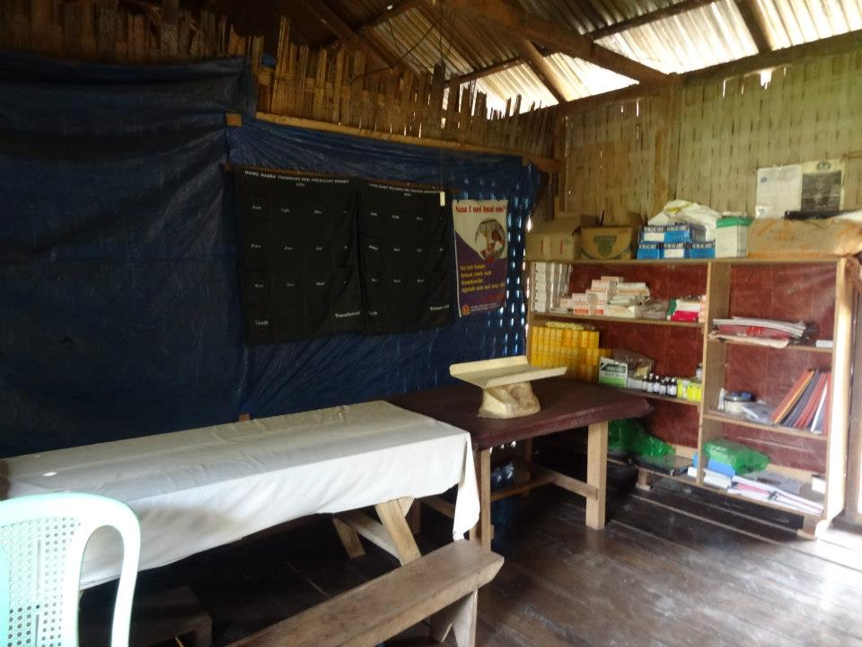

Slide 13
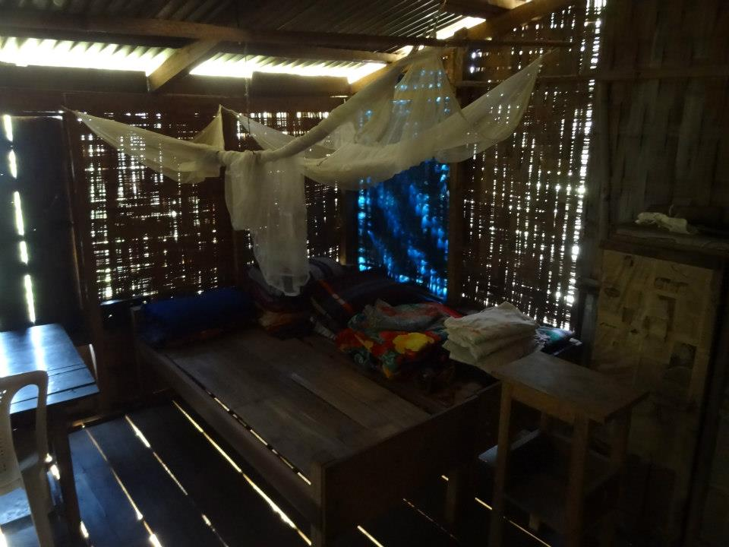

Slide 14
Human Ambulance : Stretcher
Started in the year 2009 in the then 3 backward Districts of Lawngtlai, Mamit and Saiha, now integrated into JSSK
Pregnant women from non motorable areas are carried on stretchers to the nearest motorable road/SC from where they are picked up by ambulance/private vehicles.
MOU is signed with local NGOs to carry out these Stretcher Transport.

Slide 15
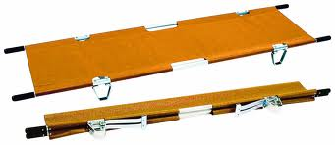

Slide 16
THE ROAD AHEAD

Slide 17
National Mobile Medical Units
The current MMU vehicles are unable to reach many of the hard to reach areas specially the border villages due to narrow roads during the rainy season, which takes up as much as 8 months in Mizoram.
To reach such places, smaller MMU vehicles with four wheel drives are required.
For 1 MMU team, 1 four wheel drive vehicle for passenger transport and 1 four wheel drive pik up truck for equipments and medicines is required.

Slide 18
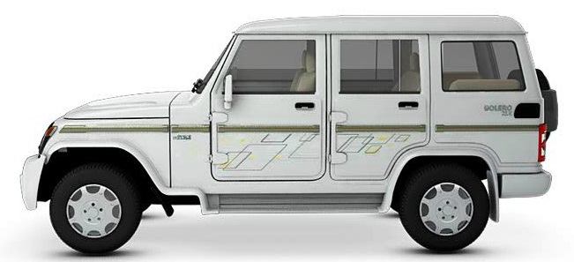
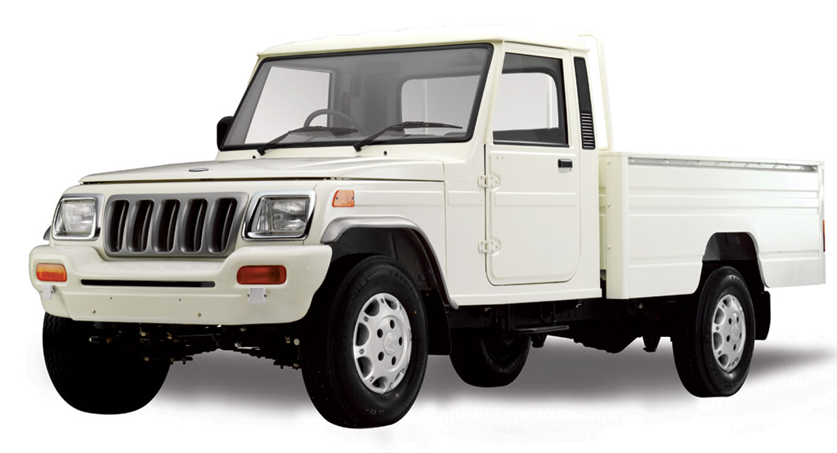

Slide 19
Bike Ambulance for Rapid Response
Aizawl is a small hilly city with narrow roads. Traffic jams occur throughout the day on the arterial roads. Making it impossible for ambulances to reach the palce of emergency within 20 mins.
Motorbikes, fitted with life saving equipments and drugs attached to the NAS in Aizawl will act as a Rapid Response team to reach the patients quickly before the main ambulance arrives at the scene.
The RRT will compose of 2 paramedical staff per bike, who will be given special training for this purpose. They will stabilize the patient(s), and when the ambulance reaches the site, one paramedic will accompany the patient on the ambulance.
The paramedics will be used as necessary at Civil Hospital Aizawl in between emergencies.

Slide 20
