Slide 1
Revitalizing NRHM in UP
Amit Kumar Ghosh, IAS
MD, NRHM-UP
Srinagar, July 2013

Slide 2
Challenges and Concerns in NRHM-UP
High Population 20 Crore (5th Largest country in terms of Pop^{n})
Low Female Literacy rate 59 %
18 Divisions and 75 Districts (requires huge techno-managerial on-going competence)
ANM is working on an average 8000 Population (IPHS for Pop^{n} of 5000 one ANM)
Shortage of Human Resource (highly skilled Gynecologist & Pediatricians)
Sub optimal functioning of NBCC & Delivery points
Insufficient Functional FRU 162/820 (19%)
Insufficient SNCU 7/75 (9%)
Early initiation of Breast feeding 33 % ( AHS2011)
Exclusive Breast Feeding 17-7% (AHS2011)

Slide 3
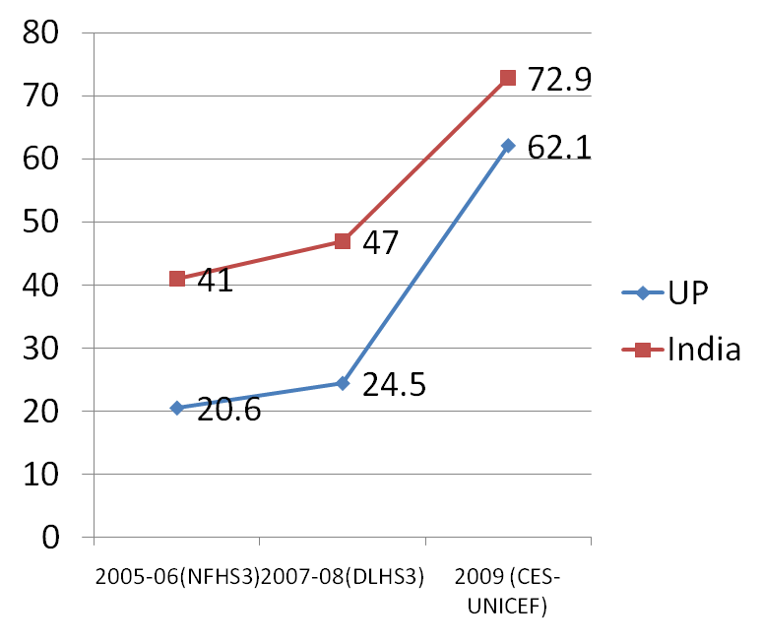
Institutional Deliveries
Big Jumps from a Small Base

Slide 4
Comparative Trends in MMR

Slide 5
Comparative Trends in IMR

Slide 6
Financial Trends

Slide 7
Conditions at the End of Phase 1

Slide 8
Conditions at the End of Phase 1
CAG

Slide 9
Conditions at the End of Phase 1
CAG
CBI

Slide 10
Conditions at the End of Phase 1
Crisis of Confidence
CAG
CBI

Slide 11
Strategy 3 Cs
Crisis of Confidence
Compliance
CBI

Slide 12
Strategy 3 Cs
Crisis of Confidence
Compliance
Control

Slide 13
Strategy 3 Cs
Communication
Compliance
Control

Slide 14
Strategy Compliance
Strategy | Objective | Output | Processes/Activities
Compliance | Systems restoration and/or systems strengthening | Compliance with GoI conditionalities CAG observations Implementation framework Financial guidelines | SHM and GB meetings being held Audits and financial compliance SPMU and DPMU augmentation

Slide 15
Strategy Control
Strategy | Objective | Outputs | Process/Activities
Control | Reinstate a system of monitoring, accountability and action against poor performance | Organizational controls – Defining roles and responsibilities; systems of transparency and accountability, including Social controls – Capacity building of VH&SC, RKS and PRI committees; community-based monitoring | Supportive supervision system operationalized – field visits in 10 districts per month Facility-wise reviews in DHS based on HMIS & MCTS data Community-based monitoring

Slide 16
Strategy Communication
Strategy | Objective | Outputs | Processes/Activities
Communication | 1. Internal communication – coordination with stakeholders and health functionaries at national, state, district and field level 2. External communication – Information, education and communication; | 1. Clear understanding of programme activities, roles and outcomes among functionaries and stakeholders at all levels. 2. Awareness and demand generation in the community | Regular meetings, conferences and reviews with DGs, SPOs, SPMU GMs Regional workshops A brand-focused RMNCH+A campaign to be launched CUGs to be given to all ANMs, ASHAs and MOICs

Slide 17
Focal Areas Continuum of Care
Intensification of delivery of the JSY and JSSK schemes
A brand-focused state-wide RMNCH+A BCC campaign to be launched
Introduction of ‘102’ ambulance service
Enforcing MCTS and linking it to ASHA payments

Slide 18
Focal Areas Newborn Care
2013-14 is the Year of Intensification of Newborn Care
Labour room upgradation – Equipment, training and standards
Activity/ Meaurable Outputs | Target 2012-13 | Current Status | Planning up to 2017
SNCUs | 27 | 23 | 75
New Born care Corners | 830 | 810 | 3500
Stabilization units in FRUs | 165 | 125 | 300
Nutrition Rehabilitation Centres | 26 | 24 | 75

Slide 19
Focal Areas Community-Based Monitoring
“Chalo Gaon ki Oar”
Education and awareness promotion:
Community awareness on health entitlements
Training of VHSNC and RKS
Display of Citizen’s charter and service guarantees
Monitoring and information sharing:
Collection of information and sharing of report cards, community experiences of health services, progress against village health plans
Active multi stakeholder Monitoring and Planning Committees at PHC, Block and District levels
Public dialogue:
Periodic public dialogue (Jan Samvad) - Engagement with providers based on community evidence

Slide 20
Focal Areas Monitoring and Evaluation
Regular review meetings and video conferencing with sub-state level authorities and officials, covering entire state
  Monthly meetings with ADs and Divisional PM
  Meetings with CMOs, CMSs, ACMOs, DIOs, DPMs, DCMs and DAMs every 2 months
  2 video conferences with CMOS, CMSs, Ads, Div. PMs and DPMs every month
Quarterly State Review Mission to be conducted on the pattern of Common Review Mission from the year 2013-14
Supportive Supervision: Regular mandatory field visit routines prepared for state, divisional, district and block level officers
  10 districts being visited every month
In 2011, a web-based beneficiary tracking system was launched to induce sense of transparency in the JSY programme
  http://www.jsyup.org contains district, block, facility-wise beneficiary details
Data of HMIS and MCTS being used for review purposes
All reporting from district to state to be web-based by August 2013

Slide 21
THANK YOU

