Slide 1











Knowledge Partnership For Improved Supervision
In
Haryana
Dr. Ravi Kant Gupta IRS,
Director, NRHM, Haryana

Slide 2
Why partnerships
Launch of new programmes on a continuous basis under NRHM
Competitive priorities of various programmes.
Different programmes are in varying stages of maturity– Some also in evaluation phase and requiring midcourse corrections.
Delays occur in launch and actual implementation of programmes due to lack of structured monitoring and supervision.

Slide 3
Why partnerships
Haryana being a non EAG state, many of international partner agencies in social sector had no mandate to work in Haryana
Lack of sensitization towards role of monitoring and partnerships
Local resources were inadequatly tapped
Limited capacity of state as there was:
  Inadequate manpower for supportive supervision.
  Lack of standard monitoring mechanism/tools
  Missing Analytic framework
  Mechanism for review, feedback and resolving identified issues was not well established

Slide 4
State Partnership Initiatives

Slide 5
Knowledge Partners
PGIMS, Rohtak
PGIMER, Chandigarh
USAID- MCHIP
IAP
NIPI- UNOPS
WHO-NPSP
JHPIEGO
NNF
SWACH
NRHM, Haryana
Medical Colleges
NGOs / Associations
International Organizations

Slide 6
Arenas of partnerships
PGIMER Chandigarh (Concurrent Evaluation, HMIS Validation, IMNCI, IDR)
PGIMS Rohtak (SNCU Trainings, IMNCI Trainings and Supportive Supervision)
MCHIP (Essential New Born Care, Immunization)
NIPI (Yashoda, HBPNC)
NNF (FBNC & Observership trainings)
WHO NPSP(Polio & RI)
UNICEF (SNCU data management & Immunization)
JHPIEGO (Maternal Health Baseline Facility Assessment)

Slide 7
PGIMS Rohtak
PGIMS, Rohtak is one of premier Medical Institutes of the State.
The PGIMS, Rohtak collaborates in Supportive Supervision through
  Preparing Monitoring checklist and tools.
  Planning of visits
  Conducting the supportive supervision field visits.
  Data entry & Analysis
  Feedback Presentation

Slide 8
Impact of Supportive Supervision

Slide 9
Availability of HB meter & Weighing scale

Slide 10
Availability of BP Apparatus & Stethoscope

Slide 11
Overall Availability of Equipment
Overall improvement from 55% to 80%

Slide 12
Availability of Iron Syrup & Cotrimoxzole

Slide 13
Availability of Zinc & ORS

Slide 14
Availability of Vitamin A & Urostix

Slide 15
Overall availability of Drugs
Overall improvement from 45% to 80%

Slide 16
Overall IEC activity observed
Overall improvement from 30% to 70%

Slide 17
Overall Infrastructure available (Subcenters)
Overall improvement from 65% to 80%

Slide 18
Overall Record keeping(Subcenters)
Overall improvement from 60% to 65%

Slide 19
District-wise overall scores

Slide 20

USAID- MCHIP: Immunization
MCHIP is Maternal & Child Integrated Program (an USAID grantee)
RAPID (Regular Appraisal of Programme implementation) for immunization
MCHIP supports orientation workshops, field visits, data analysis and debriefing.
Two districts directly supervised by MCHIP- USAID
9 districts done independently.
Follow up visits done in 4 districts (PNP, MWT, PWL, KTL)

Slide 21

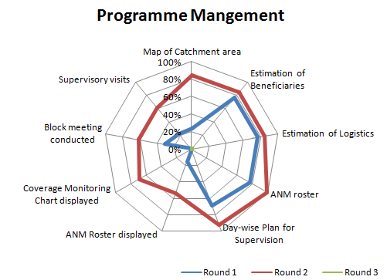
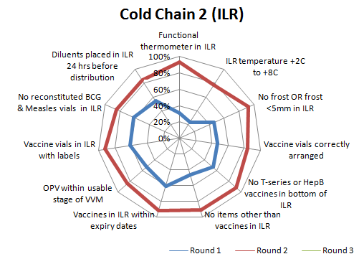
Round 1 & 2- Mewat

Slide 22
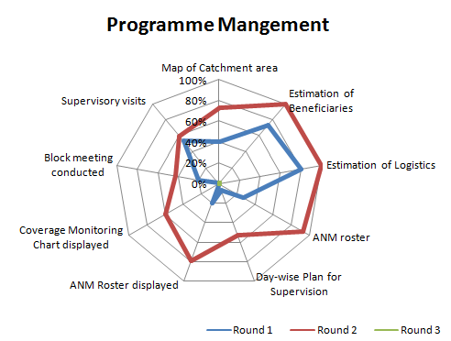
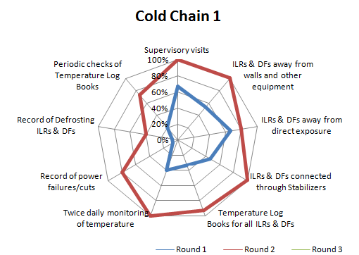
Round 1 & 2- Palwal

Slide 23

USAID- MCHIP: ENBC&R
(Essential New Born Care & Resuscitation)
Facility Readiness Assessment done with support of MCHIP-USAID
Two districts directly supervised by MCHIP- USAID
MCHIP- USAID organized a training visit to model centers in Jharkhand.
Technically supported formal training of facility assessors.
Developed the data entry & analysis tool
6 districts are already covered.
Facility wise report of actionable points prepared & shared with districts.
USAID helped in orientation workshops, field visits, data analysis and debriefing.

Slide 24
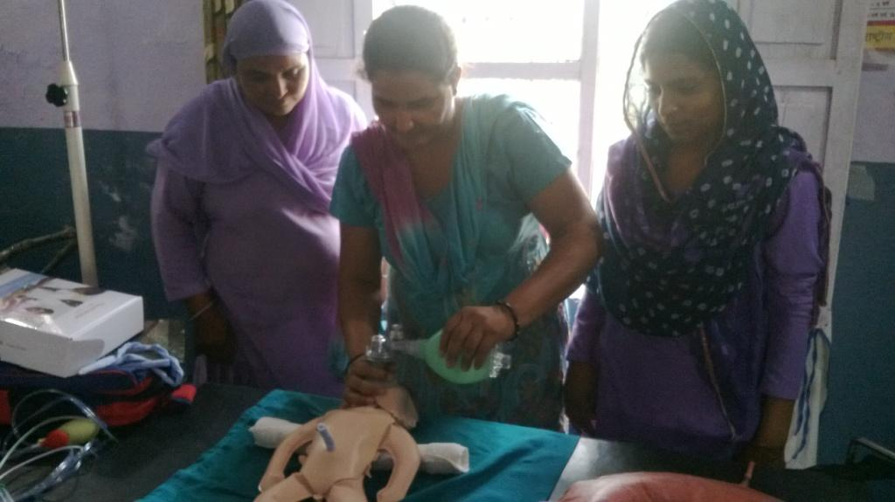
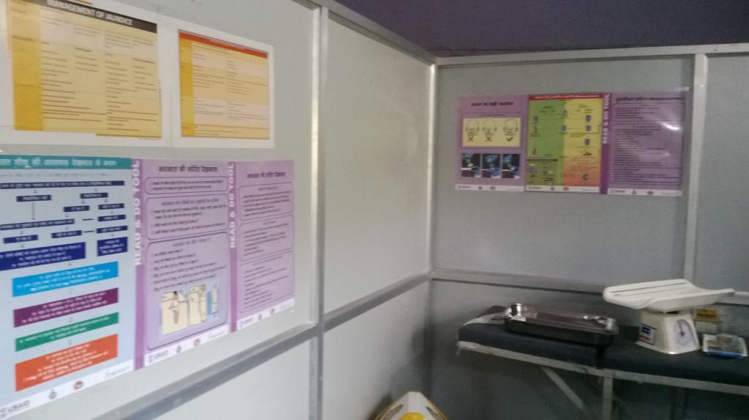
On-site demonstration
Read & Do Tools

Slide 25
Facility Readiness Assessment Score- Ambala

Slide 26
USAID -JHPIEGO
Maternal Health
  Baseline assessment of Health Facilities for:
    Intra Partum Care
    Immediate Post Partum Care
Pre Service Education of Nurses
  Supportive Supervision
  Monitoring & Evaluation

Slide 27
Implementation
For the 1st phase Delivery points with more than average 30 deliveries/month from 8 Districts were covered for implementation of the standards.
Average Baseline assessment score was 33.5%
Common gaps observed were
  Improper method used for infection prevention
  Lack of Awareness of the staff in Management of Complications like PPH, Eclampsia, Obstructed Labour etc.
  Counseling during PNC care
  Shortage of staff (MOs, Class IV, Sweeper etc.) at almost all the facilities was major gap in IHR standards.

Slide 28
Overall performance of 8 Districts covered

Slide 29
National Neonatology Forum
NNF is professional body of neonatologist of India, with expertise in development of training tools, protocols, clinical guidelines & assessment tool etc.
NNF is supporting Haryana
  FBNC trainings
  Observer ship trainings
  Mentoring visits
  Self assessment for accreditation
Tools provided
  FBNC guidelines
  Accreditation assessment tools
Progress so far
  More than 100 doctors & 200 nurses has been trained
  Observer ship trainings going on at various centers of repute
  Mentoring visits done by NNF members in district Faridabad , Gurgaon & Panchkula

Slide 31
Self Assessment scoring of SNCU: Haryana

Slide 32
PGIMER Chandigarh : Concurrent Evaluation
PGIMER, Chandigarh is regional collaborative centre in health for northen India
Concurrent evaluation & HMIS data validation.
  MCH Parameters covered
    Child Health, Immunization,Maternal Health, Family Planning, RT
Mechanism
  Investigators screen 2-3 sub centres per month (Approx. 55 sub-centres per month across the State)
  ~ 250 sub centres visited which are randomly selected
  Data entry analysis done by faculty of PGIMER CHD.
  Findings are shared with State on a continuous basis.
  Review done with CMOs in monthly meetings.

Slide 33
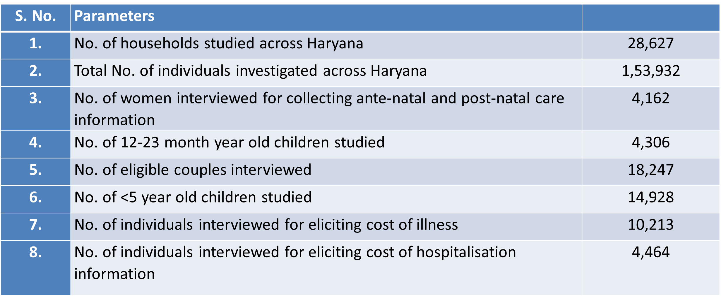
Extent of data collection

Slide 34
Coverage of Key MCH indicators
S. No. | Indicator | Concurrent Evaluation Results* | CES 2009 Results* | DLHS 3 Results*
1. | Proportion of pregnancies registered | 97.5 | 94.0
2. | Women with 3 or more ANC check-ups | 63.2 | 68.6 | 51.9
3. | At least one ANC at public sector care provider | 68.6 | 72.0
4. | 100 or more IFA tablets consumption | 21.3 | 43.2 | 29.0
5. | 2 or more TT injections | 87.7 | 87.6
6. | Institutional delivery rate | 83.2 | 63.0 | 46.9
7. | ASHA accompanying to health facility | 48.4 | 18.1
8. | ASHA staying at health facility | 32.0 | 17.4
9. | Initiation of breastfeeding within 1 hour of delivery | 35.7 | 51.0 | 17.4
10. | Exclusive breastfeeding for 6 months | 40.5 | 52.44 | 9.4
11. | Any contact of child with health services in first 10 days of birth | 42.6 | 45.8

Slide 35
WHO NPSP: IFVs for Intensified RI
50 Immunization Field Volunteers (IFV) hired
1-3 IFVs per district depending upon health indicators & geographical span.
Reporting is through regional consultants NRHM & SMO-NPSP
IFVs doing health facility, RI sessions & H-t-H monitoring.
Identifying the operational & micro planning gaps.
Participate in RI micro plan review and implementation.
Feedback shared same day to districts.
Data entry done in regional NPSP office with support from NRHM
Data analysis done at state , block wise RI evaluated coverage data is available.
Compiled feedback shared by NPSP unit on monthly basis.
Data shared with CMOs in monthly meeting.

Slide 36
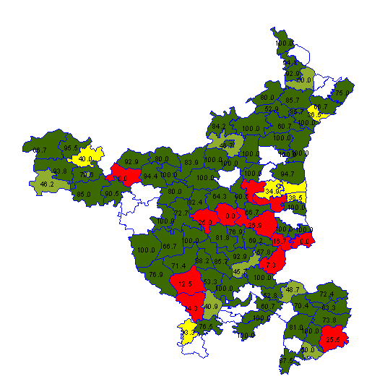
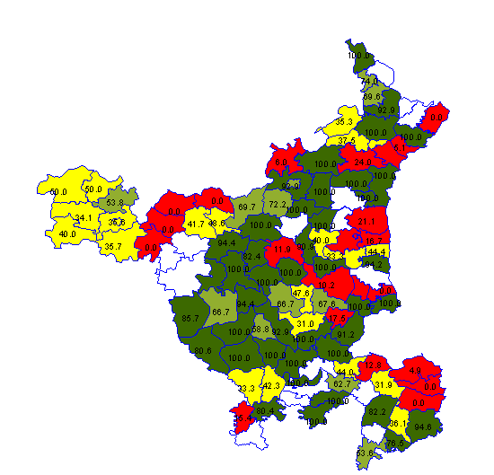


Due list AVAILABLE with ANM
RI Monitoring Indicators
Beneficiaries Mobilized to Session Site by ASHA
Data: 1st Quarter 2013

Slide 37

% Fully Immunized HRA
RI Monitoring Indicators
% BCG Coverage
We need not to wait for coverage evaluation surveys for taking corrective administrative actions
HRY – 92.2%
Data: 1st Quarter 2013
HRY - 64.9%

Slide 38
Partnership with Unicef
Unicef supported in the online SNCU Data entry
Trouble shooting and corrective action are supported
SNCU designing & learning visits to perinatal care unit and delivery centers
Training of SNCU data entry operators
Media workshop for measles & Pentavalent vaccine
Development in communication strategies

Slide 39
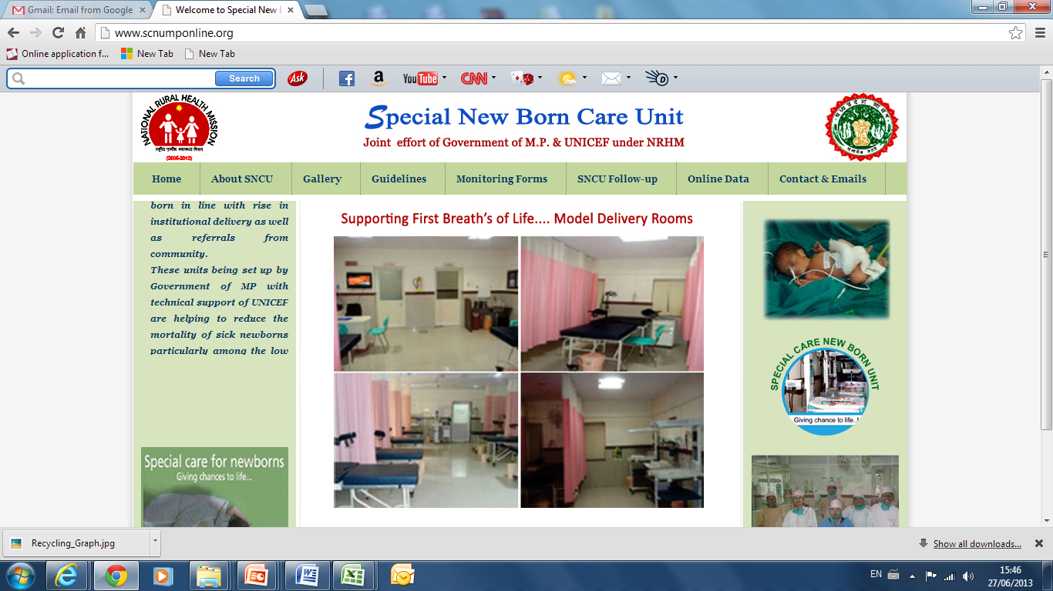
Partnership with Unicef

Slide 40
Summary
Supportive supervision has proved to be an effective tool for bringing substantial programmatic changes in public health programmes.
Knowledge & implementation partnership improve the service delivery mechanism – Letting the Experts Do what they know Best.
State has gained tremendously from expertise of various knowledge partners.

Slide 41
Way Forward
Incorporating the mechanism of supportive supervision as an integral component of various programmes.
Institutionalization of supportive supervision mechanism
In house capacity building
Restoration of health as a matter of right for citizen.

Slide 42


