Slide 1

Incentives for difficult areas in Himachal Pradesh
Best Practices
National Summit on Best Practices and Innovations in Health Care,
Srinagar 3rd July 2013

Slide 2
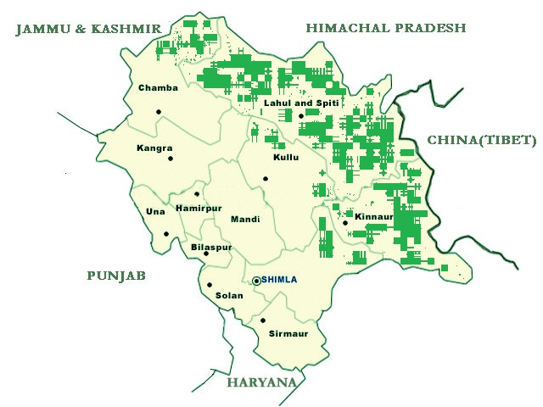
Difficult areas notified

Slide 3
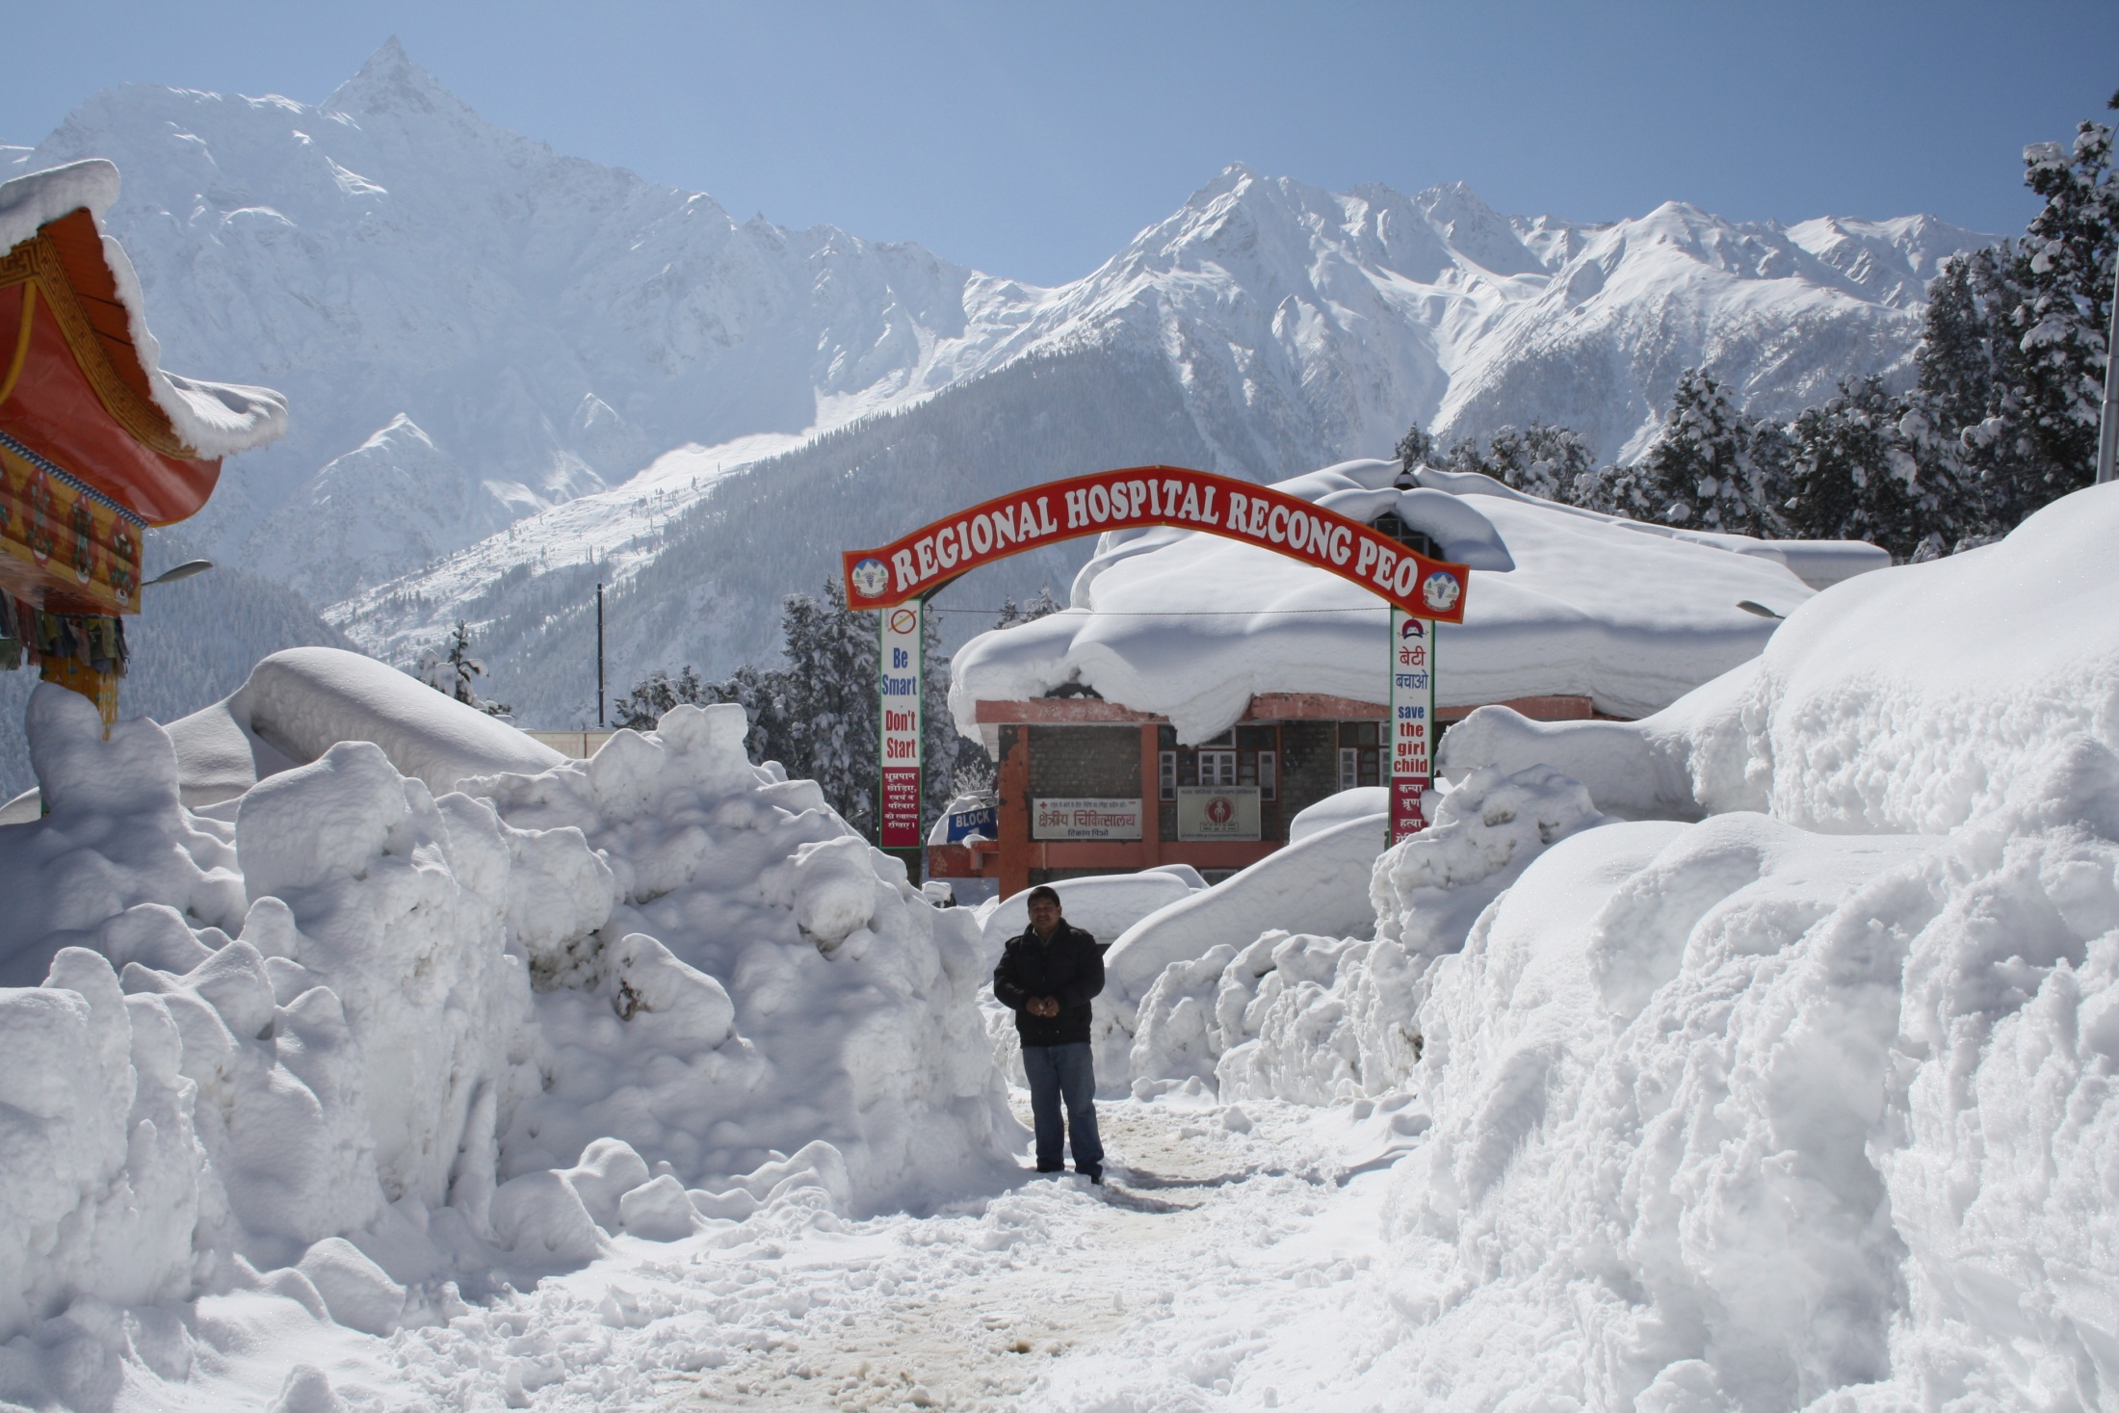

Slide 4
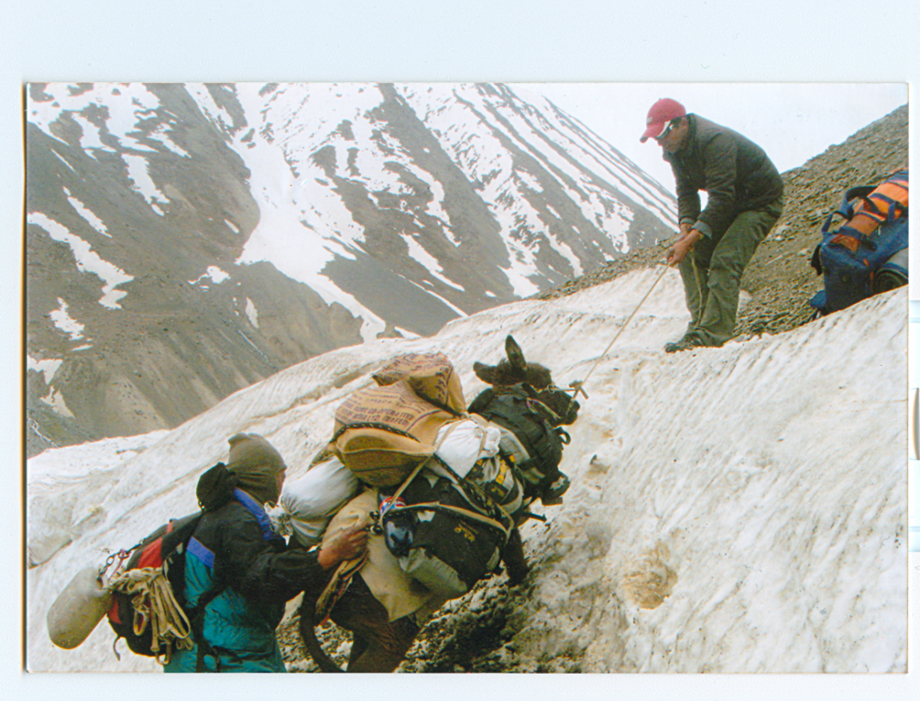

Slide 5
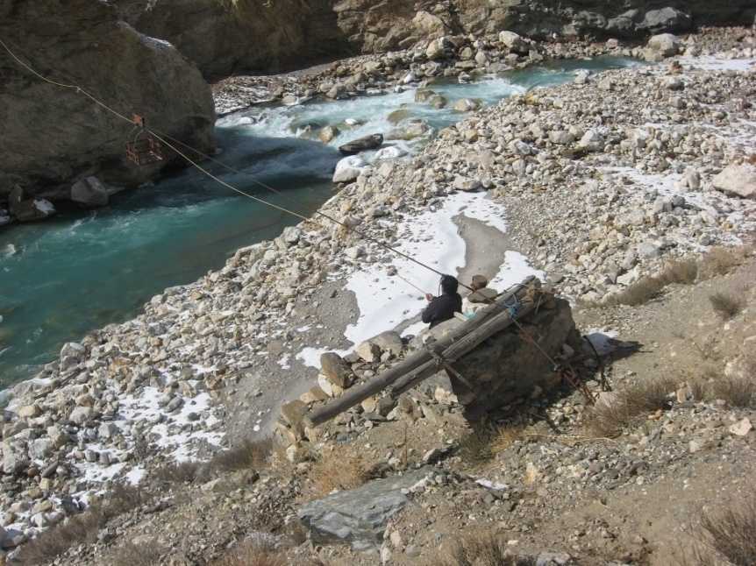

Slide 6
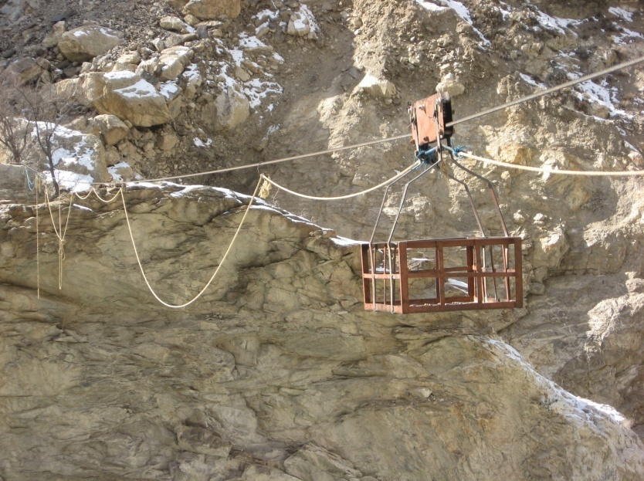

Slide 7
Why were the incentives required?
Extremely hard terrain
Medical staff not keen to go
Hardly any motivation
To attract younger doctors
To encourage posting of available contractual MOs and MO(Specialists) Govt. of H.P. has framed an incentive scheme over and above the fixed salary.

Slide 8
What are the incentives offered
Incentive to MOs revised upward from Rs. 10000 – Rs. 25000 & those for MO( Specialist) revised from Rs 20,000- Rs 40,000.
66% reservation for PG seats to GDOs having done mandatory service ranging from 2-3 years as against 5 years for other areas.
Choice place of posting after mandatory service.
Provision of retaining Govt Accomodation at State or District Headquarters for family during hard area posting

Slide 9
Manpower vis a vis the Incentives
Over 200 doctors recruited during the year after the incentives
Rational deployment of M.O. and M.O. Specialist being ensured.
2 years service after PG made mandatory for GDOs.
Recruitment through walk in interviews

Slide 10
Incentives to Medical Officers
AREA | Mandatory Service Period for PG | Monthly Incentive
 |  | MO | Specialist
Chamba – Pangi & Bharmaur, Tissa Lahaul & Spiti- All Medical Blocks Kinnaur – Sangla & Pooh, Nichar (Except bhabanagar) Shimla – Chirgaon, Nerwa & Tikker Mandi – Chohar valley of Padhar block | 2 yrs. | Rs. 25000/- | Rs. 40000/-

Slide 11
Incentives to Medical Officers
AREA | Mandatory Service Period for PG | Monthly Incentive
 |  | MO | Specialist
Kinnaur- Bhabanagar of Nichar Block, Kullu – Nirmand & Anni Mandi – Karsog & Janjheli Chamba – Pukhari, Choori, Kihar & Samote Sirmaur – Shillai & Sangrah Kangra – Mahakal Shimla – Nankhari, Matiana, Kotkhai & Kumarsain | 3 yrs. | Rs. 20000/- | Rs. 30000/-

Slide 12
Incentives to Medical Officers
AREA | Mandatory Service Period for PG | Monthly Incentive
 |  | MO | Specialist
Other Medical Blocks of the State (excluding the above and below) and NRHM office. | 4 yrs. | Rs. 10000/- | Rs. 20000/-

Slide 13
Impact of Policy in Kinnaur District
 | Sanctioned | Positioned Before Policy | Positioned after policy
No. of MO | 58 | 24 | 48
ANMs | 15 | 7 | 12
Staff Nurses | 45 | 19 | 34
No. of Gyneacologist | 1 | nil | 1
No. of Paediatrician | 1 | nil | 1
No. of Obstetrician | - |  | -
No. of Surgeons | 1 | nil | 2

Slide 14
Impact of Policy in hard areas of Chamba District
 | Sanctioned | Positioned Before Policy | Positioned after policy
No. of MO | 17 | 9 | 15
ANMs | 34 | 22 | 31
Staff Nurses | 13 | 7 | 10
No. of Gyneacologist | 1 | nil | 1
No. of Paediatrician | 1 | nil | 2
No. of Obstetrician | - |  | -
No. of Surgeons | 1 | nil | 2

Slide 15
Impact of Policy in Lahaul and Spiti District
 | Sanctioned | Positioned Before Policy | Positioned after policy
No. of MO | 48 | 15 | 31
ANMs | 30 | 10 | 22
Staff Nurses | 29 | 20 | 26
No. of Gyneacologist | 1 | nil | nil
No. of Paediatrician | 1 | nil | nil
No. of Obstetrician | - |  | nil
No. of Surgeons | 1 | nil | nil

Slide 16
Way Forward- Manpower Targets for State
Category | Posts to be filled | Category | Posts to be filled
Medical Officer | 150 | Lab Technician | 100
Specialists | 50 | Radiographer | 30
Psychiatrists | 12 | OTA | 50
Psy. Social Worker | 24 | ANM (FHW) | 200
Staff Nurses | 300 | Opthal. Asstt. | 40
Pharmacists | 85

Slide 17
Thank You

