Slide 1
Integration of NCD with Primary Health Care – Tamil Nadu Experience
Mr Pankaj Kumar Bansal IAS
Special Secretary to Government and
Mission Director, NRHM & Project Director
Tamil Nadu Health Systems Project
Chennai

Slide 2
NCDs control program in TN
Programs supported by NRHM
The programs implemented by TNHSP with World Bank Support
All the Programs are already integrated with Primary Heath Care services in TN
National Program for control of Blindness NPCB
National Program for Prevention and Control of Deafness NPPCD
National Mental Health Program NMHP
National Tobacco Control Program NTCP
National Oral Health Program NOHP
National program for Palliative Care NPPC
Musculoskeletal and Degenerative disorders
Hypertension and Diabetes – Through TNHSP
Cancer – Cervix and Breast – Through TNHSP

Slide 3
How the Project went about implementing the Program ?
Pilot interventions for Hypertension and Cervical cancer carried out during (2007 -10)
It was concurrently evaluated by National Institute of Epidemiology
Costing evaluation by Public Health Foundation of India
Gaps identified and lessons learnt were analyzed to address them when Up-scaling to the entire State
Up scaling in a phased manner covering 32 districts in Tamil Nadu ( 2012 – 13)
When up-scaling, Diabetes Mellitus and Breast cancer were included along with Hypertension and Cervical cancer

Slide 4
Four Diseases covered
Prevention, screening and treatment for
Hypertension
Diabetes Mellitus
Screening and treatment for
Breast Cancer
Cervical Cancer

Slide 5
CVD/Cancer
School Based
Work place Based
Community Based
Clinic Based
80 Primary Health Centres - screening centres.
18 Government Hospitals - Nodal centres.
Screening all people more than 30 years entering in to hospitals.
Treating newly detected hypertension patients and further follow up.
Group meetings in villages .
Rallies.
Village heart melas – rally exhibition and competition.
IEC – CVD message sign board on buses, Radio – Kodai FM.
Sensitization session - educational department officials.
CVD classes - students by trained teachers.
Forming Junior Heart Club (JHC) – to sustain the activity.
Special Lectures on CVD Risk factors—to Employers & Employees.
Eating Improvement
Programmes-To promote healthy diet in canteens.
Forming Heart Clubs-to Sustain the BCC activity.

Slide 6
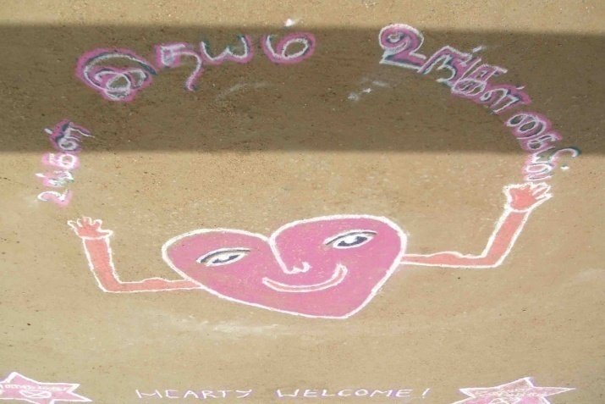
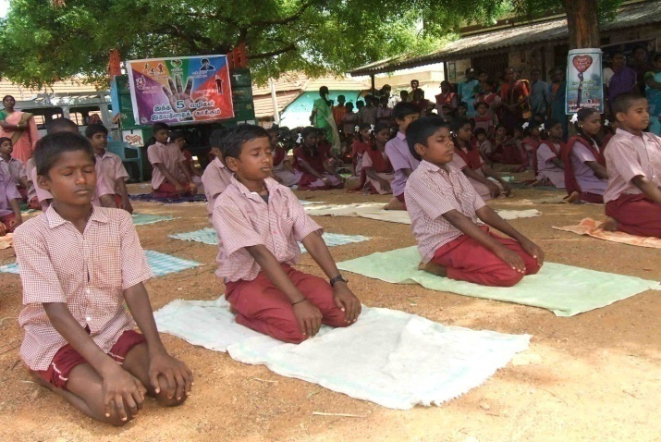
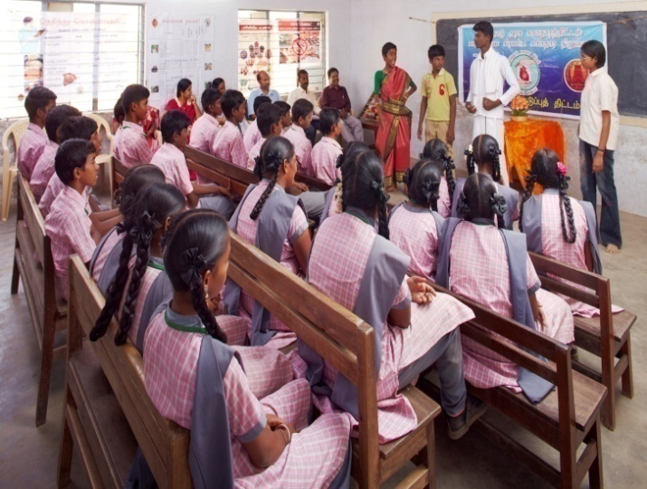
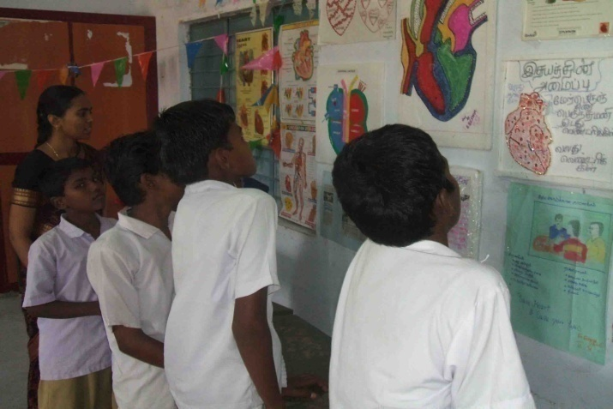
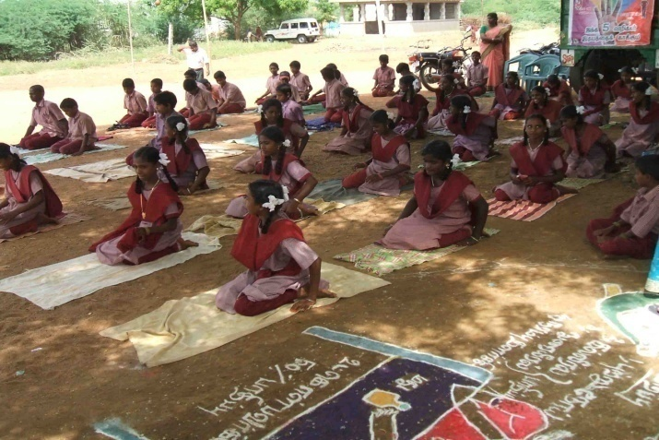
School based activities in sivagangai
Notes:
6

Slide 7
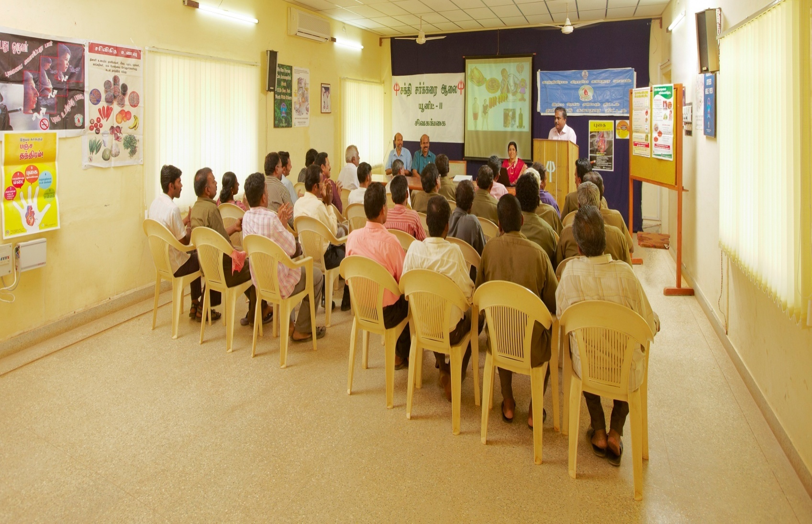
@ workplaces
Sensitizing working group through special lectures in banks

Slide 8
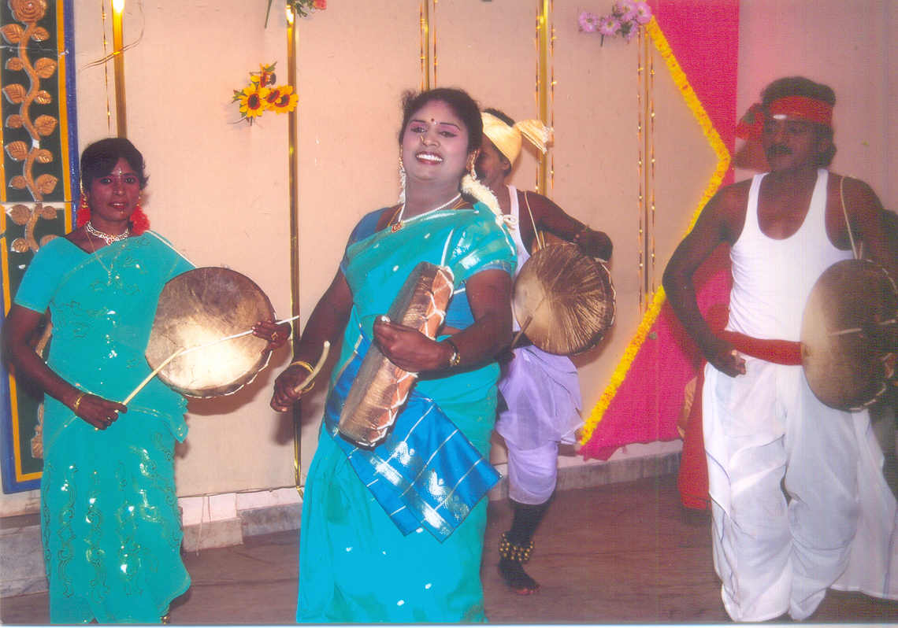
Community based activities…

Slide 9
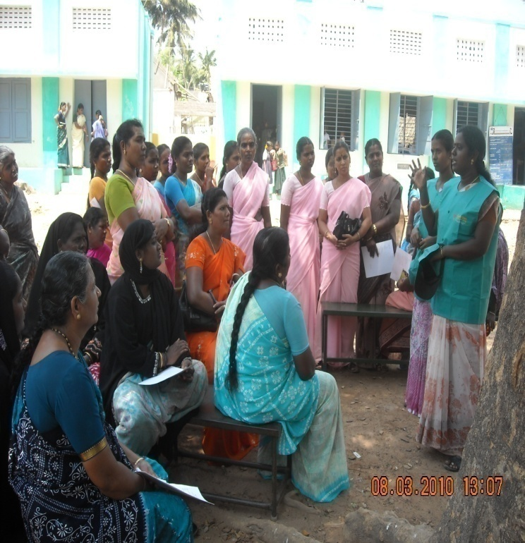
Community activities…

Slide 10
POSTERS & STICKERS

Slide 11
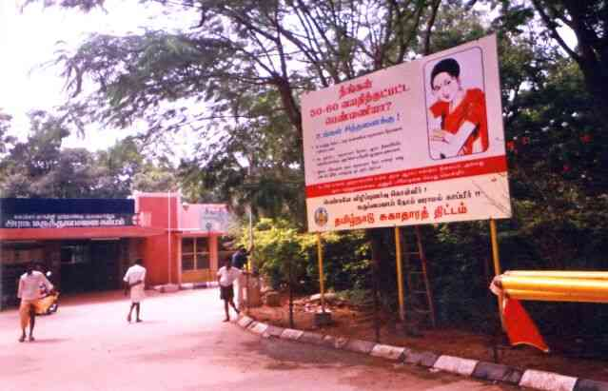
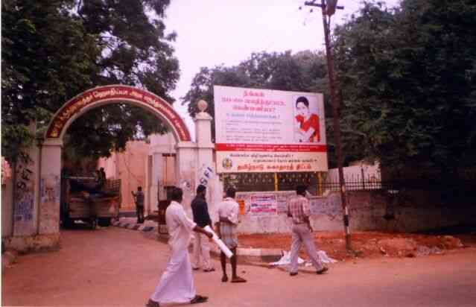
Hospital flex boards…

Slide 12
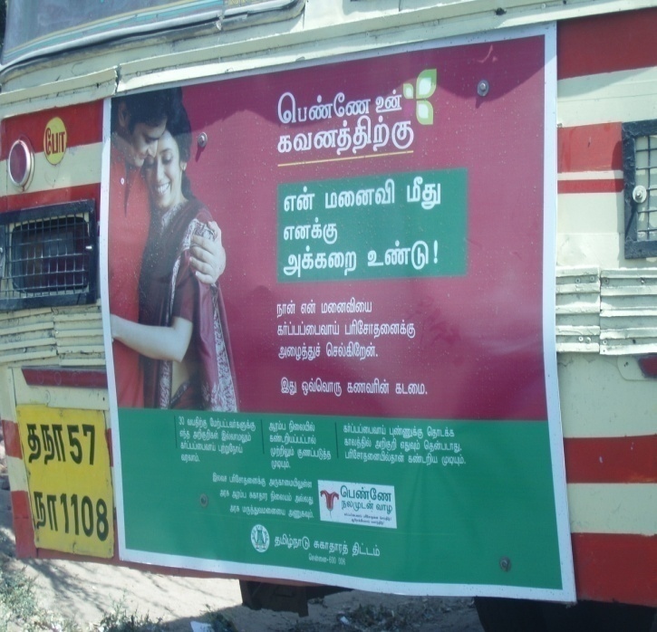
IEC- Bus boards…

Slide 13
IEC- Bus boards…

Slide 14
Support from TNHSP for IEC Materials and Clinical protocols for all four interventions to PHCs
Posters
Stickers
Flip books
Clinical protocols for display
CDs on clinical procedures – CBE /measuring BP / VIA / VILI
Short Tele-films produced by TNHSP

Slide 15
IEC Posters

Slide 16
IEC Posters

Slide 17
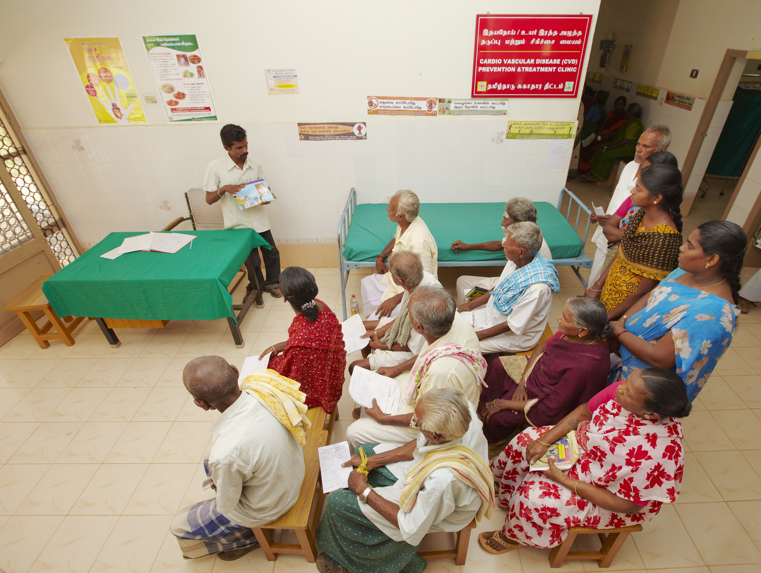
@ cvd clinics
counseling high risk group by counselors (through inter personal communication)

Slide 18
Departments coordinating with TNHSP in the implementation of NCD Programme
Education Department
through SSA
Rural Development Department
Labor Department
ESI
Municipal Administration & Corporation
School Based Intervention in 17000 Schools
Sensitization SHG Women in the community
Work Place Based Intervention
Clinic Based Intervention in ESI Dispensaries & Hospitals
Clinic Based Intervention in Municipal & Corporation Dispensaries & Hospitals

Slide 19
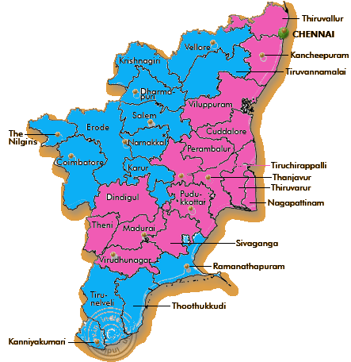
PHASING OF DISTRICTS - PHASE I and PHASE II DISTRICTS
Phase I (16 districts) | Phase II (16 districts)
Thanjavur | Thiruvallur
Virudhunagar | Thiruvannamalai
Sivagangai | Vellore
Theni | Salem
Chennai | Namakkal
Cuddalore | Krishnagiri
Kanchepuram | Dharmapuri
Villupuram | Karur
Trichy | Coimbatore
Perambalur | Tirupur
Dindigul | Niligiris
 | Erode
Nagapattinam | Ramanathapuram
Madurai | Tirunelveli
Thiruvarur | Thoothukkudi
Pudukottai | Kanniyakumari

Slide 20
CVD(HT)/DM Prevention and treatment programme - an overview
PHC, GH, GMCH, ESIC dispensaries & hospitals, 100 municipal dispensaries & hospitals
Target men & women screened for HT/DM using
BP, Height, Weight, BMI, Waist Circumference, Blood Glucose
Counseling on Life Style Modification on
Physical activity, Dietary habits, Cessation of Smoking/Alcohol, Stress management, etc.,
Screened positive
subjected to
Sr Cholesterol, Sr Creatinine, Urine albumin, ECG, ECHO
at specified centers
Treatment and follow-up to be done according to the designed protocol
At respective centers
Screened positive with complications will be referred
to Tertiary centers ; also linked with the
Chief Minister’s Comprehensive Health Insurance scheme

Slide 21
Breast / Cervical Cancer Screening and treatment programme - an overview
Target Women screened for Breast cancer (CBE) / Cervical Cancer (VIA/VILI)
PHC, GH, GMCH, ESIC dispensaries & hospitals, 100 municipal dispensaries & hospitals
Secondary evaluation using Mammography / FNAC , Biopsy, Nipple secretion cytology / Colposcopy
GH, GMCH, ESIC hospitals, 10 municipal hospitals
Microscopic confirmation through Histopathological examination
Govt. Medical College Hospital
Staging and treatment
Govt. Medical College Hospital
Diagnostic and treatment services are linked with the
Chief Minister’s Comprehensive Health Insurance scheme

Slide 22
NCD Online screens with CDSS
NCD online screens developed and deployed on the existing HMS platform
Clinical decision support system (CDSS) integrated with the screens for the assistance of physicians and NCD staff nurses

Slide 23
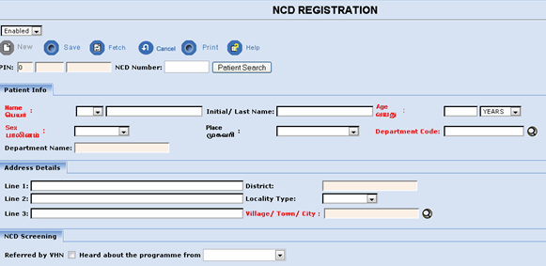
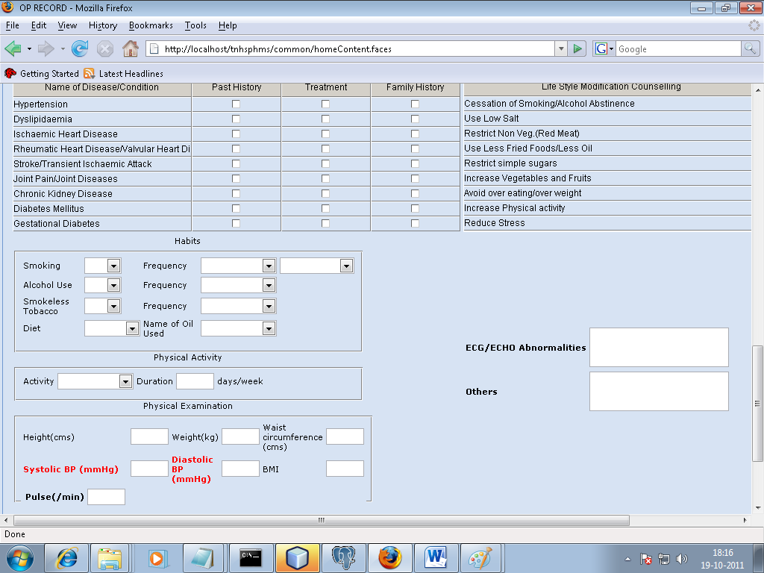
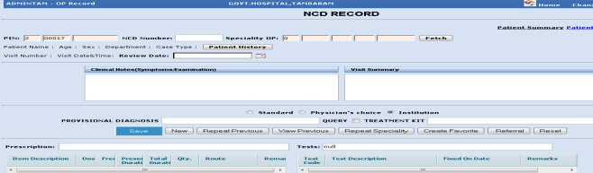
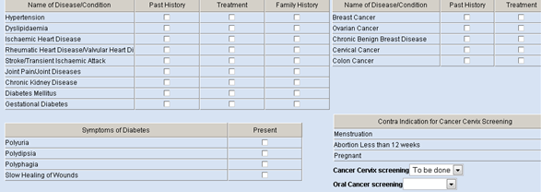
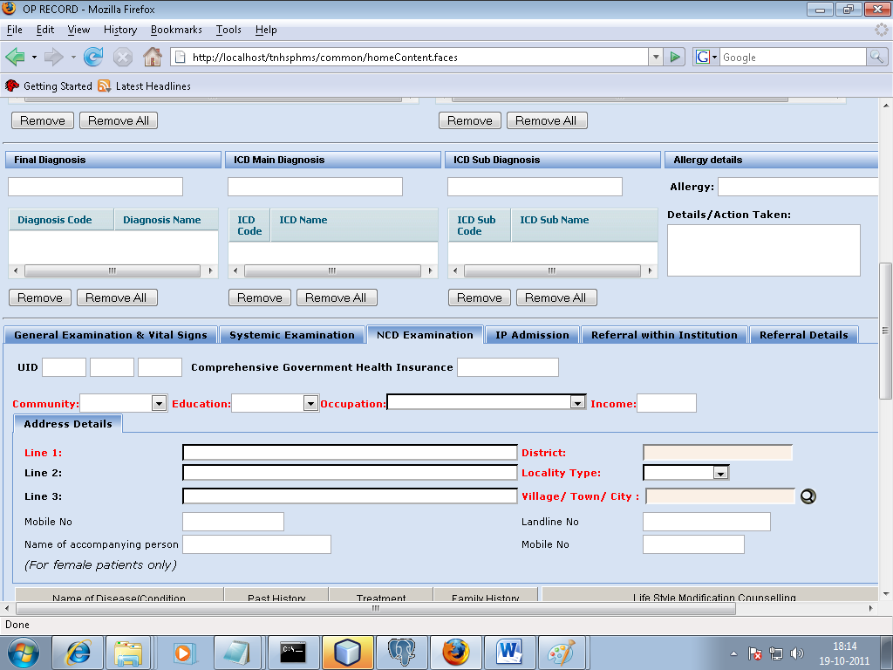
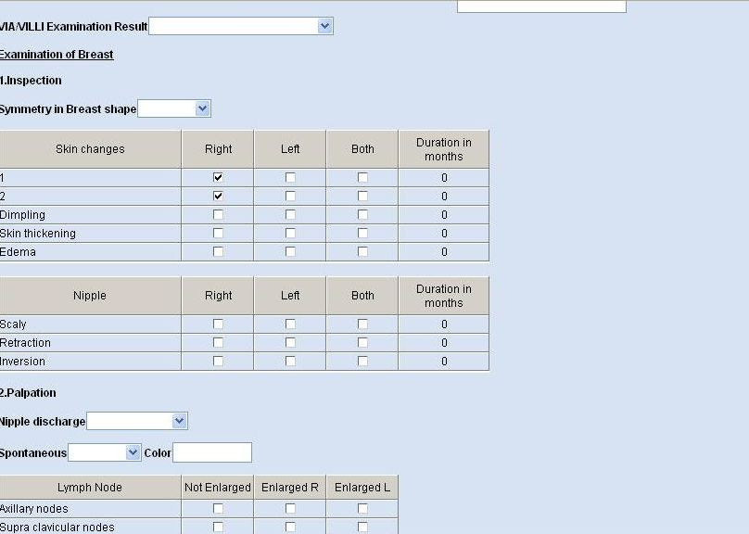
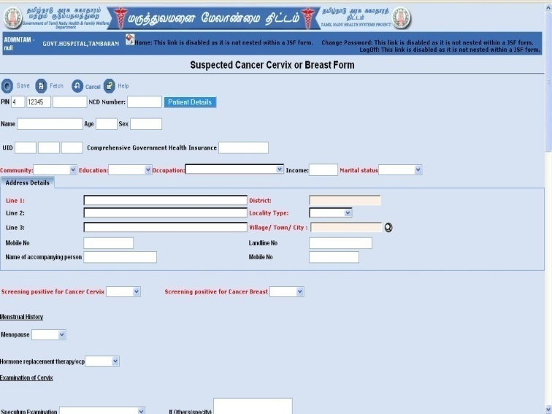
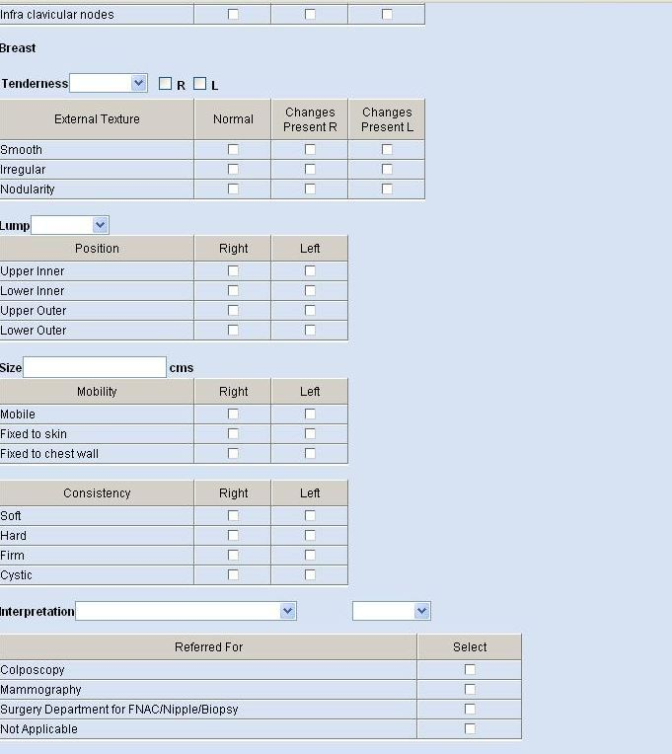
NCD registration screen
1
2
3
Suspected Cancer screen
5
4
6

Slide 24
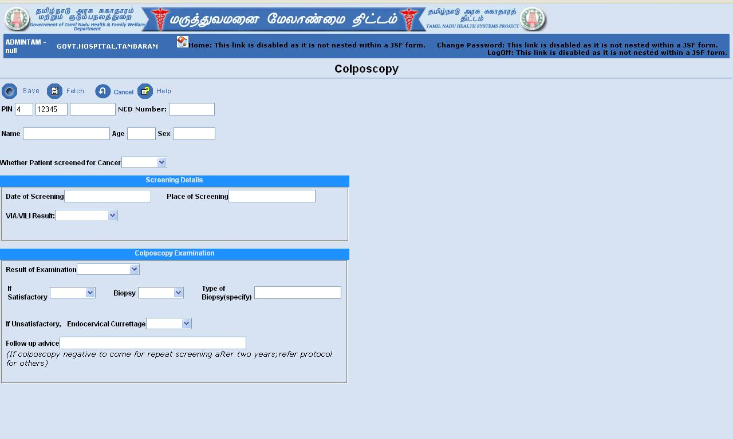
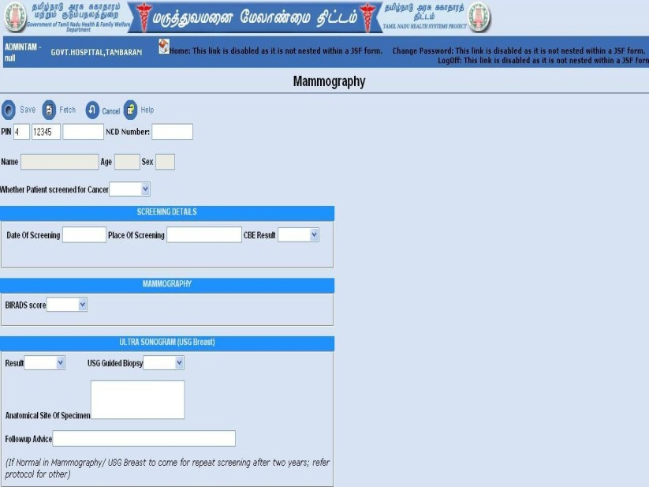
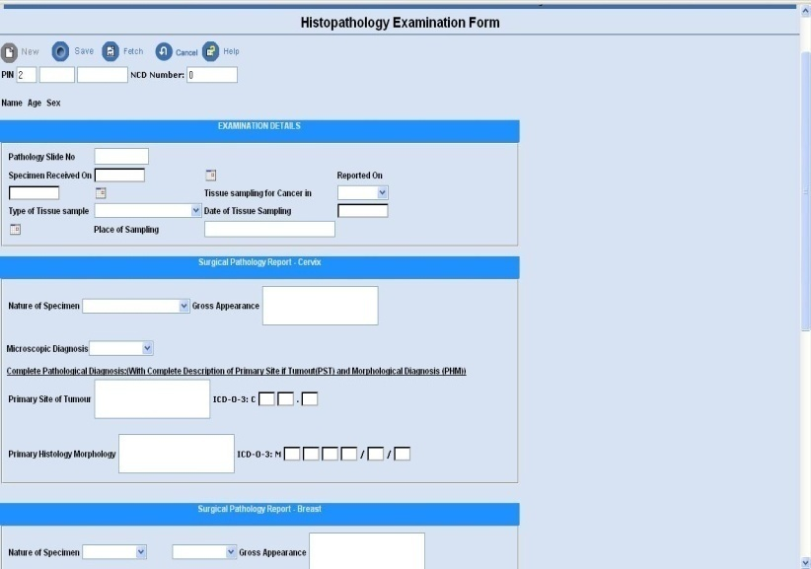
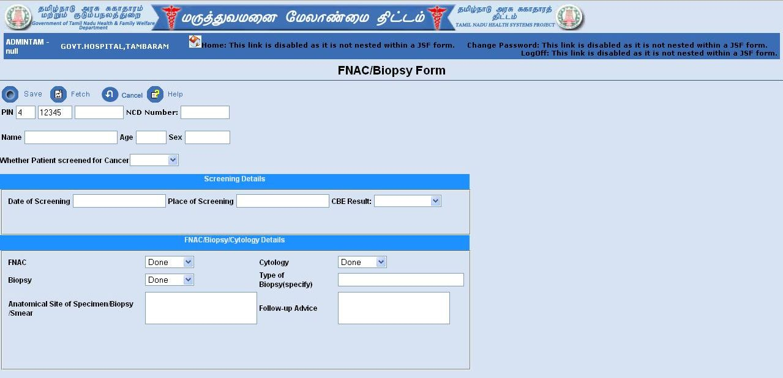
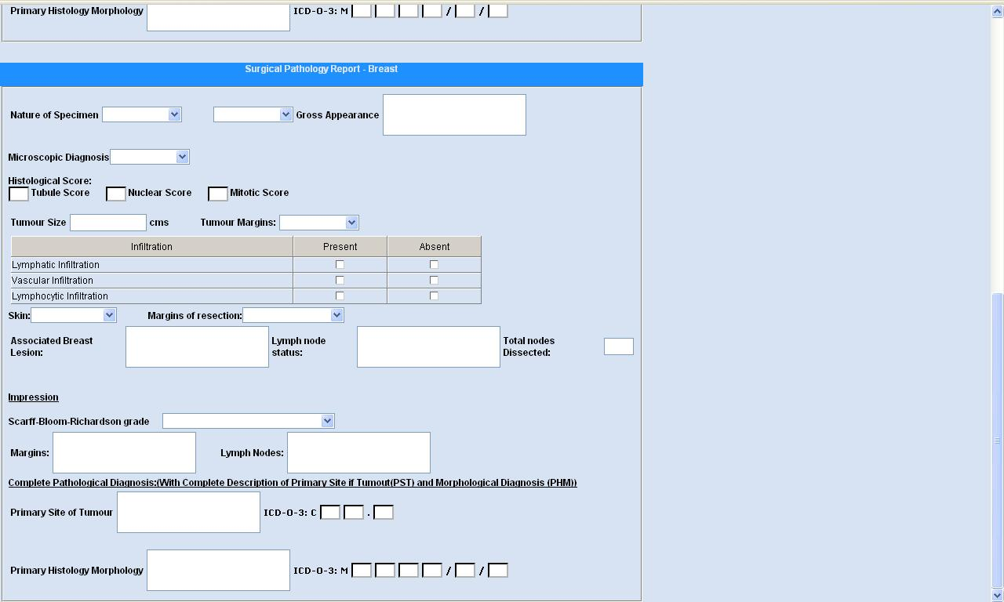
Mammography screen
Colposcopy screen
Histopathology Examination screen
FNAC/Biopsy screen

Slide 25
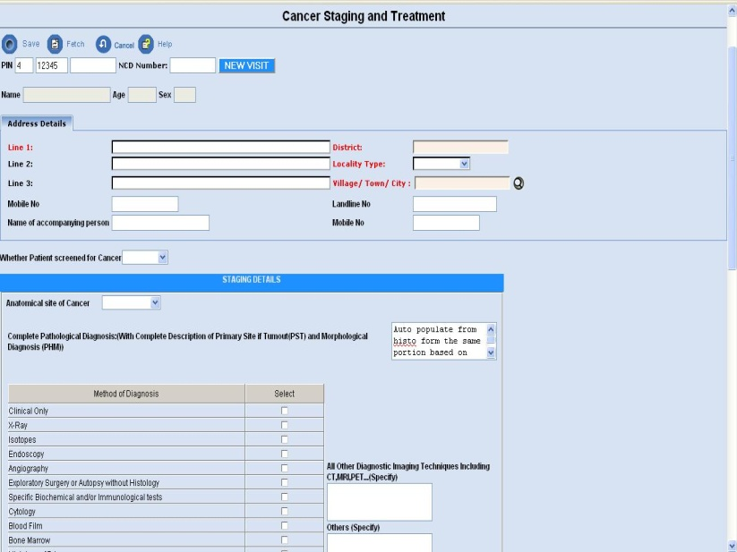
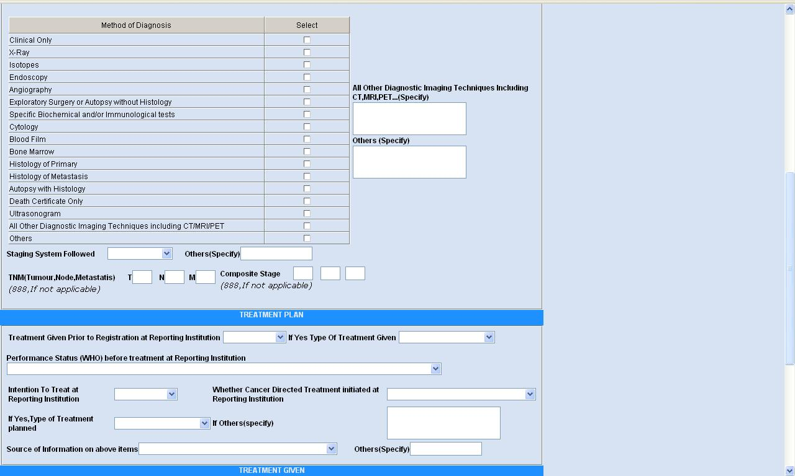
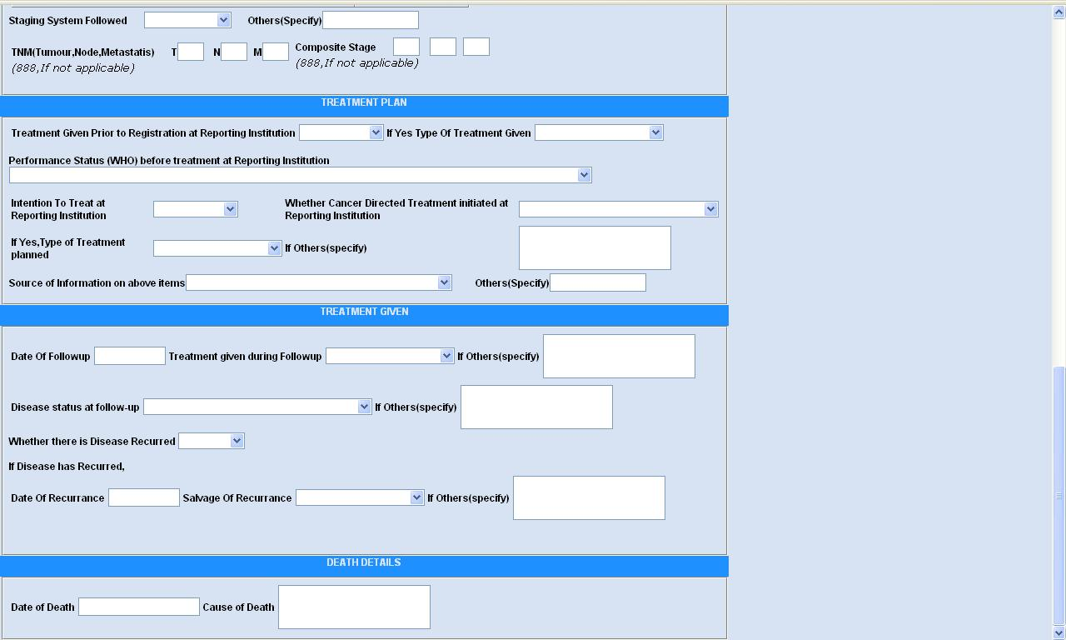
Cancer Staging & Treatment screens

Slide 26
Training Plan

Slide 27
List of modules under NCD intervention programme
1.Manual for programme managers (English & Tamil)
2.Clinical manual for medical and paramedical staff (English)
3.Manual on Colposcopy & Cryotherapy for medical professionals (English)
4.Manual on VIA/VILI & CBE procedures for medical and paramedical staff (English)
5.Module for lab technicians and pharmacists (Tamil)
6.Module for Field health staffs(Tamil)
7.Module for ANM(Tamil)
8.Module for CPs/CRPs for community based intervention(Tami)

Slide 28
Training Modules

Slide 29
Training Modules

Slide 30
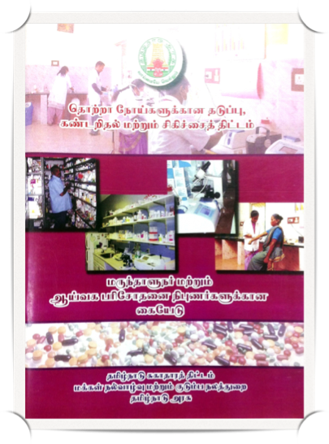
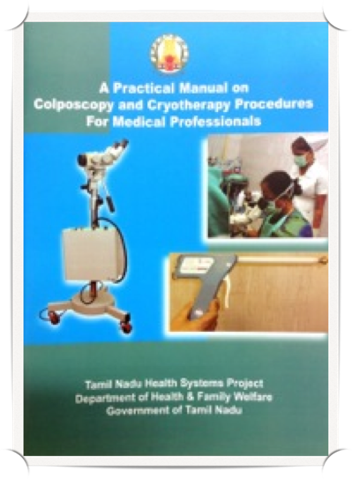
Training Modules

Slide 31
Sensitization Program
One day State level sensitization for State & District Officials of Health Department, ESI and Local bodies
One day Regional level sensitization in four regions for (CMS’s, Hospital Superintendents, RMOs & Nursing Superintendents)
Phase I Districts
Phase II Districts
October 2011
May – June 2012
Region I
Thanjavur
Virudhunagar
Sivagangai
Theni
Region II
Chennai
Cuddalore
Kancheepuram
Villupuram
Region III
Trichy
Perambalur
Dindigul
Region IV
Nagapattinam
Madurai
Tiruvarur
Pudukottai
Region I
Tiruvallur
Tiruvannamalai
Vellore
Region II
Salem
Namakkal
Krishnagiri
Dharmapuri
Karur
Region III
Coimbatore
Tirupur
Nilgris
Erode
Region IV
Tirunelveli
Thoothukudi
Kanyakumari
Ramanathapuram

Slide 32
State level TOT
Training of Trainers (TOTs) at state level (3 days)
Under JDHS control
4 per District
1 Medical officer
1 Pharmacist
1 Staff Nurse
1 Lab Technician
Under DDHS control
4 per HUD
1 Medical officer
1 Staff Nurse
1 Lab Technician
1 CHN
Govt. Medical College & Hospital
22 from each college
One faculty from Medicine, Surgery, Obs & Gynae, Diabetology, Pathology, Surgical Oncology, Medical Oncology, Radiology, Radiotherapy.
1 lab technician from Bio Chemistry lab
2 NCD Staff Nurse
One staff nurse from each of the above department &
1 pharmacist
ESI Hospital & Dispensaries in a phased manner
(4 zones)
The nodal officer from ESI HQ
From each zone covered, 1 RAMO , 2 MOs, 2 LTs, 2 Pharmacists, 2 ANMs & 2 Maternity
Assistants.

Slide 33
District Level Trainings
District Level Trainings for medical and paramedical staff
Under JDHS Control
Under DDHS control
Government Medical College &Hospitals
ESI Hospital & Dispensaries
Municipal Hospital & Dispensaries (to be combined with training of staffs under JDHS control)
All faculty in dept of Medicine (1 day)
All Medical Officers
(2 days)
All Medical Officers (2 days)
All Medical Officers (2 days)
All Specialist in dept of O&G (1 day)
All staff Nurses
(3 days)
All Medical Officers
(2 days)
All staff Nurses
(3 days)
All staff Nurses
(3 days)
All Specialist in dept of Diabetology (1 day)
All Pharmacists
(1 day)
All staff Nurses
(3 days)
All Lab Technicians
(2 days)
All His, SHNs & CHNs (1 day)
All specialist in dept of pathology (1day)
All Maternity Assistant
(2 days)
All Lab Technicians
(2 days)
All Pharmacists
(1 day)
All Pharmacists
(1 day)
All specialist in dept of surgical oncology (1day
All ANMs (2 days)
All Pharmacists
(1 day)
All specialist in dept of Radiotherapy (1 day)
All VHNs (2 days)
All UHNs (2 days)
All staff Nurses (1 days)
All ANMs (1 day)
All Lab Technicians(1 days)
All Pharmacists (1 day)

Slide 34
Training on Colposcopy /Cryotherapy Techniques & VIA / VILI Method of Screening
State Level TOT
5 days state level Training of Trainers (TOT) for Gynecologists identified from districts
(Level I trainers)
District Level training of Gynecologists
5 days training for all Gynecologists in the district by master trainers
(Level II trainers)
Training of district level staff by level II trainers
Female Medical Officers * & Staff Nurses from GH, Medical College Hospital & PHCs
ANMs from PHCs from the district.

Slide 35
Training of Officials & Staff of Tamil Nadu Corporation for Development of Women and Pudhu Vazhvu Project
One day state level sensitization for project officers (PO), APOs, District project Managers (DPM) APMs and Headquarters staff of the TNCDW and PVP
3 days TOT for community level Functionaries at chennai
2 days District Level Training for CP/CRP
The sensitization of SHGs by trained CP/CRP for a maximum of 6 days in a month

Slide 36
District level General NCD training
Category of health staff | Total number trained in Phase I districts | Total number trained in Phase II districts
Medical officers | 3073 | 3106
Staff nurses | 6703 | 5127
NCD Staff nurses | 1092 | 1094
Lab technicians | 878 | 780
Pharmacists | 1310 | 1084
Other paramedical staffs(VHN, SHN,CHN,HI,BHS,ANM) | 6547 | 6171

Slide 37
District level Skill based training
Category of health staff | Total number trained in Phase I districts | Total number trained in Phase II districts
Gynecologists (Colposcopy & Cryotherapy and CBE procedures) | 217 | 206
Female Medical officers | 506 | 241
Staff nurses | 3836 | 1512
NCD staff nurses | 1061 | 876
ANM | 451 | 180

Slide 38
District level Online training
Category of health staff | Total number trained in Phase I districts | Total number trained in Phase II districts
Staff nurses | 1092 (NCD Staff nurses) | 2379 (Designated NCD staff nurses & Outsourced NCD staff nurses)

Slide 39
Total staff trained in both Phase I & II districts
Name of Training | Total number trained in Phase I districts | Total number trained in Phase II districts
District level General NCD training | 19603 | 17362
District level Skill based training | 6071 | 3015
District level Online training | 1092 | 2379
TOTAL | 26766 | 22756

Slide 40
Funding support to PHCs
Salary of the NCD staff nurses posted PHC
Training activities at District level
Monitoring activities including fuel support
Support for Rural Development department to sensitize SHG women in villages
support for school based NCD activities in schools in villages
Workplace based activities in selected areas

Slide 41
Support to PHCs for Reagents, Equipments & Drugs flow mechanism
Reagents, Consumables and Equipments are supplied through TNMSC to PHCs
NCD Pass book to each PHC to separately indent and receive required drugs for NCD programme
Patient Welfare Funds (PWF) used for managing acute shortage of drugs, reagents & minor repair of equipments and any interim needs

Slide 42
Logistic support for Hypertension and Diabetes Mellitus from THNSP to PHCs
Equipments :
BP Apparatus
Weighing Machine
Stadiometer & measuring tape
ECG machine
Centrifuge machine
Semi Auto Analyzer( NRHM)
Echocardigram
Reagents :
Glucose kit with standard
Cholesterol kit with standard
Creatinine kit with standard
Urine album stick
Distilled water
(for District HQ Hospital only)

Slide 43
Logistic Support for VIA / VILI procedure for Cancer cervix from TNHSP to PHC’s
Equipments :
VIA / VILI Kit
Colposcopy Kit
Consumables :
3% Acetic Acid (500 ml)
Lugol’s Iodine (500 ml)
Sodium Hypochlorite
Solution (500 ml)

Slide 44
Logistic Support from TNHSP for chemicals and Consumables for Pathology Lab
Isopropyl Alcohol (500 ml)
Xylene (500 ml)
DPX (250 ml)
Paraffin Wax (500 gram)
Hematoxylin (10 gm)
Micro Slides (one box)
Cover slips (10 gm)
Glycerol (500 ml)
Alum (500 gm)
Acetic Acid (500 ml)
Hydrochloric Acid (500 ml)

Slide 45
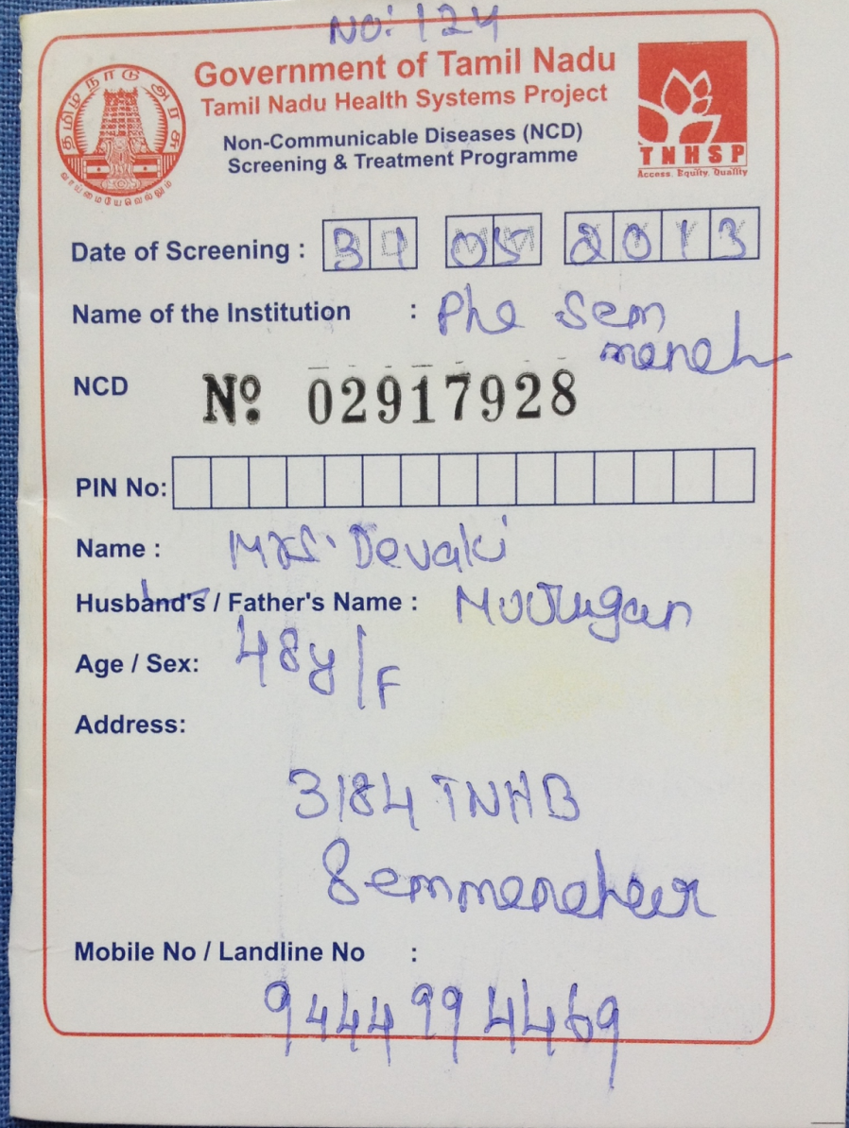
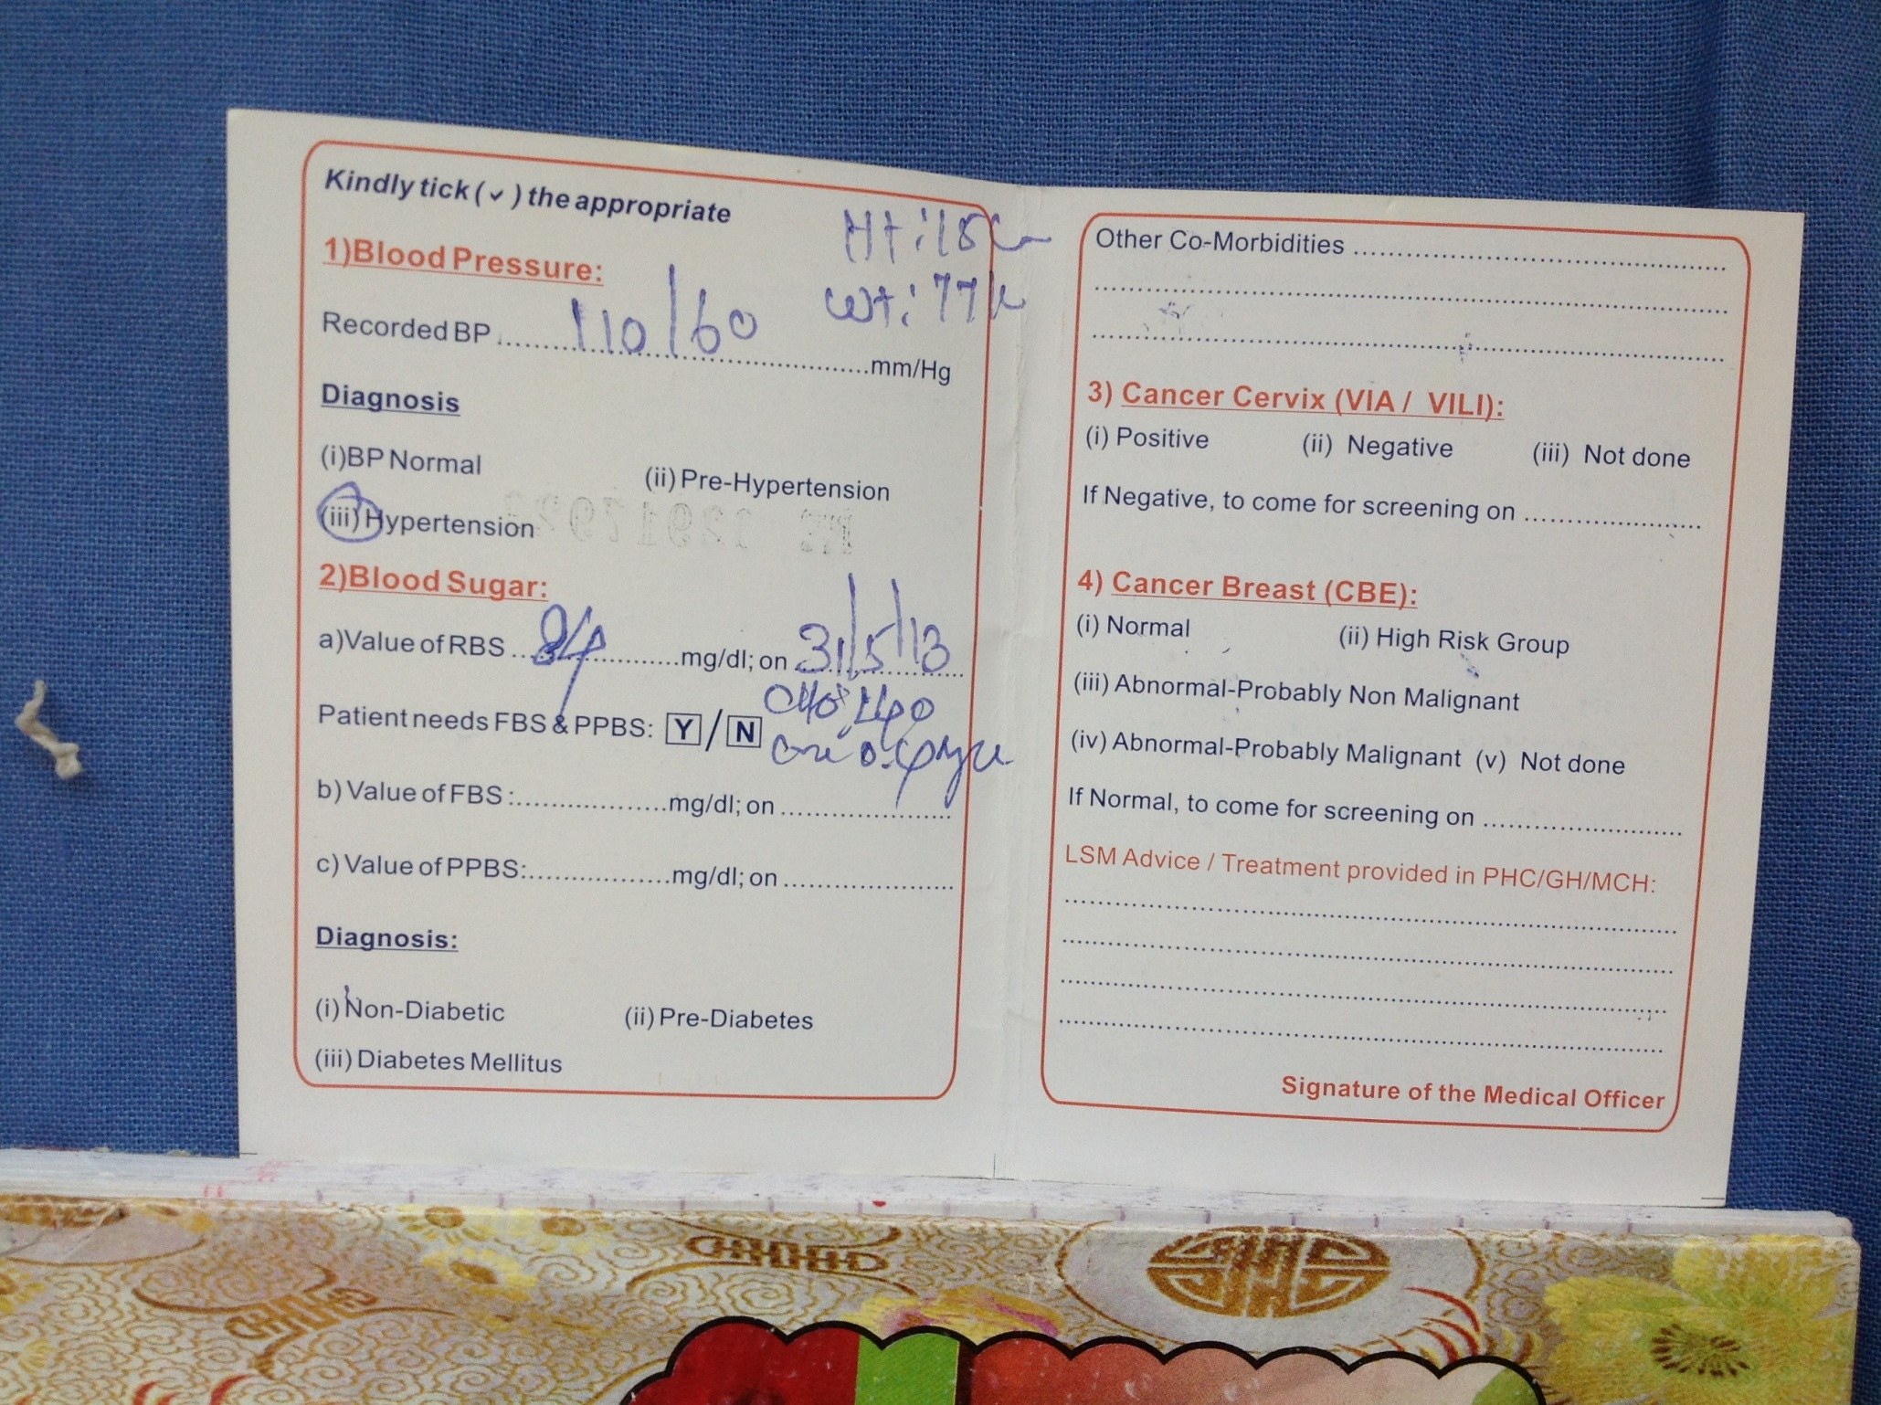
Patient ID Card

Slide 46
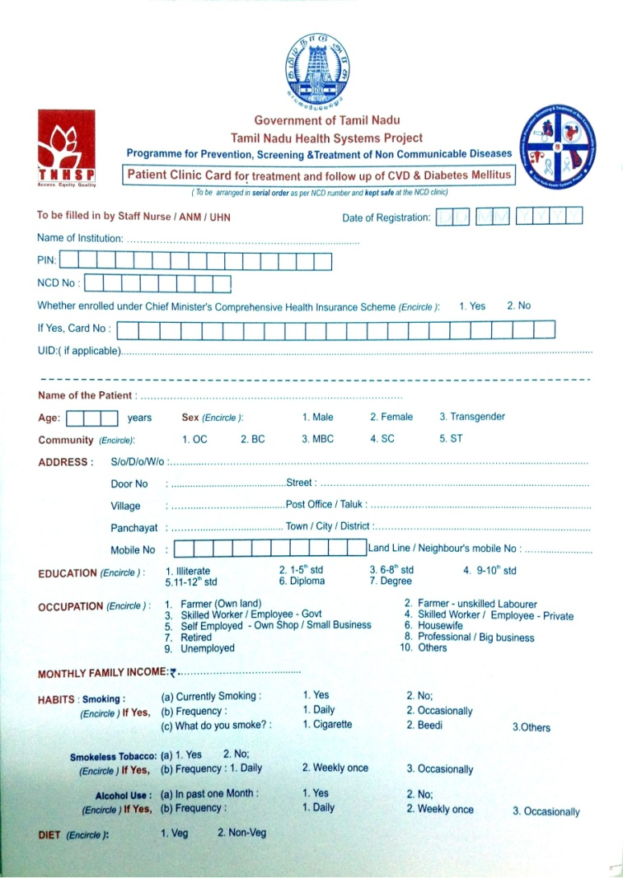
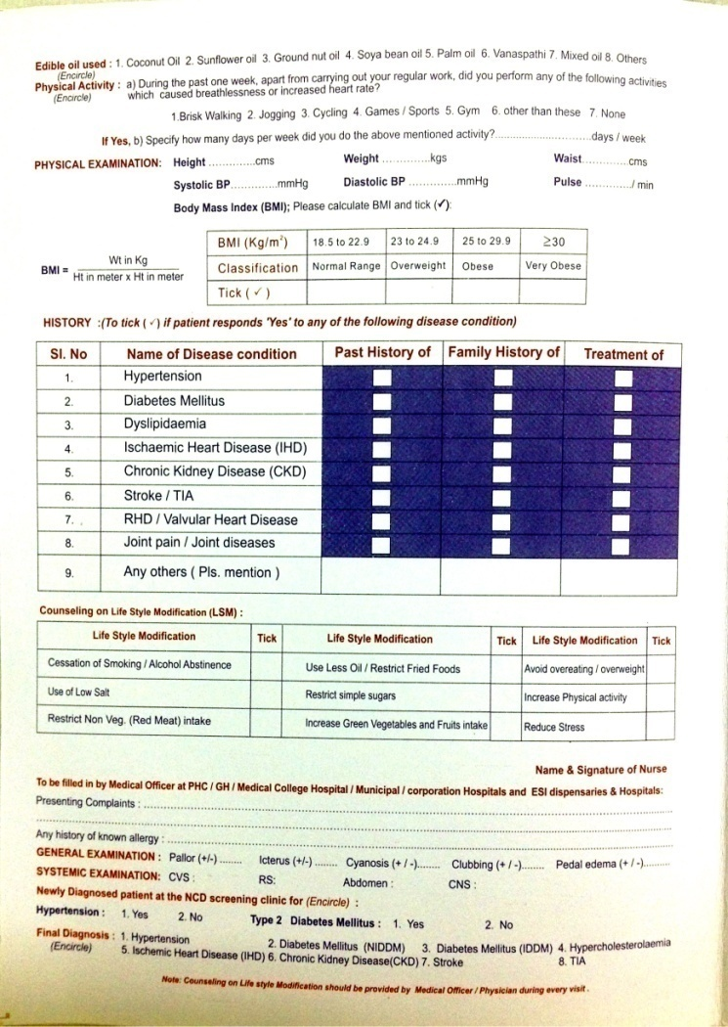
Patient Clinic Card

Slide 47
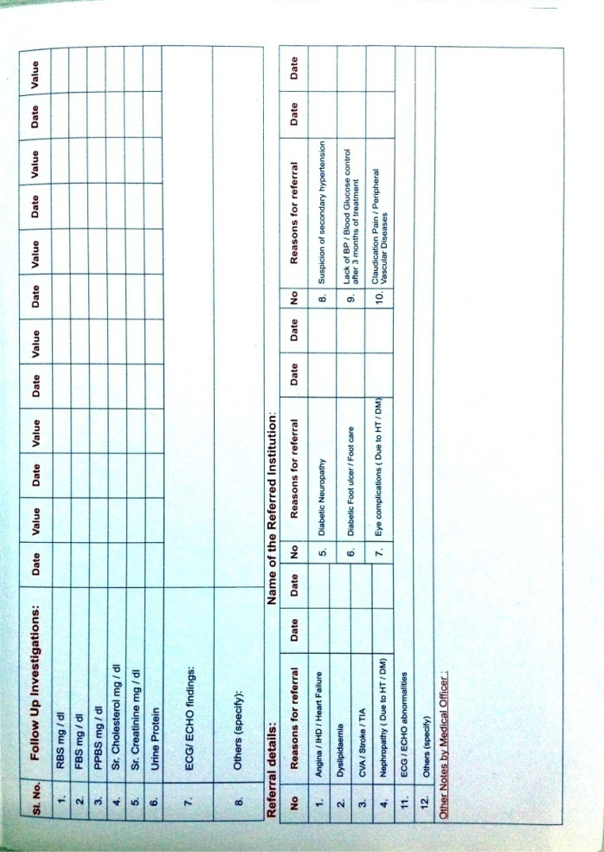
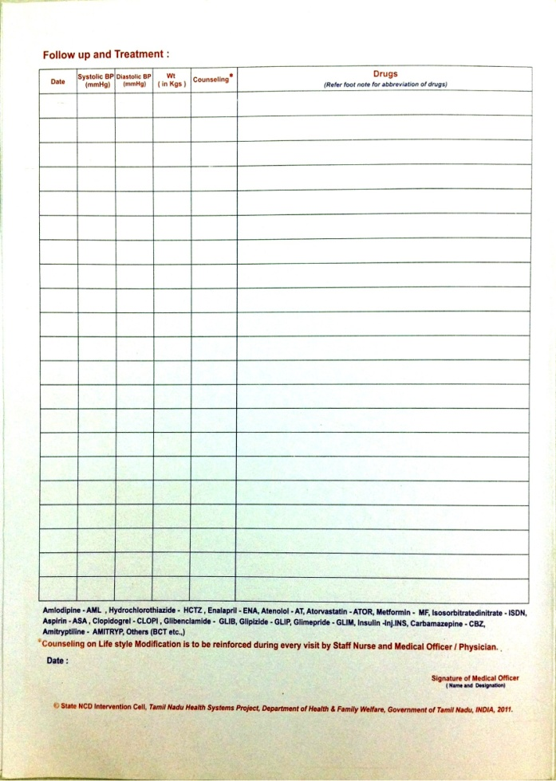
Patient Clinic Card

Slide 48
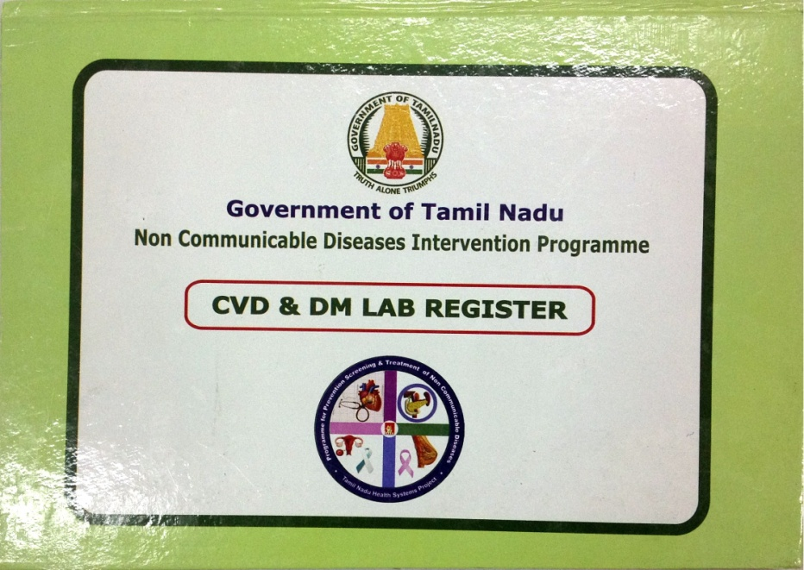
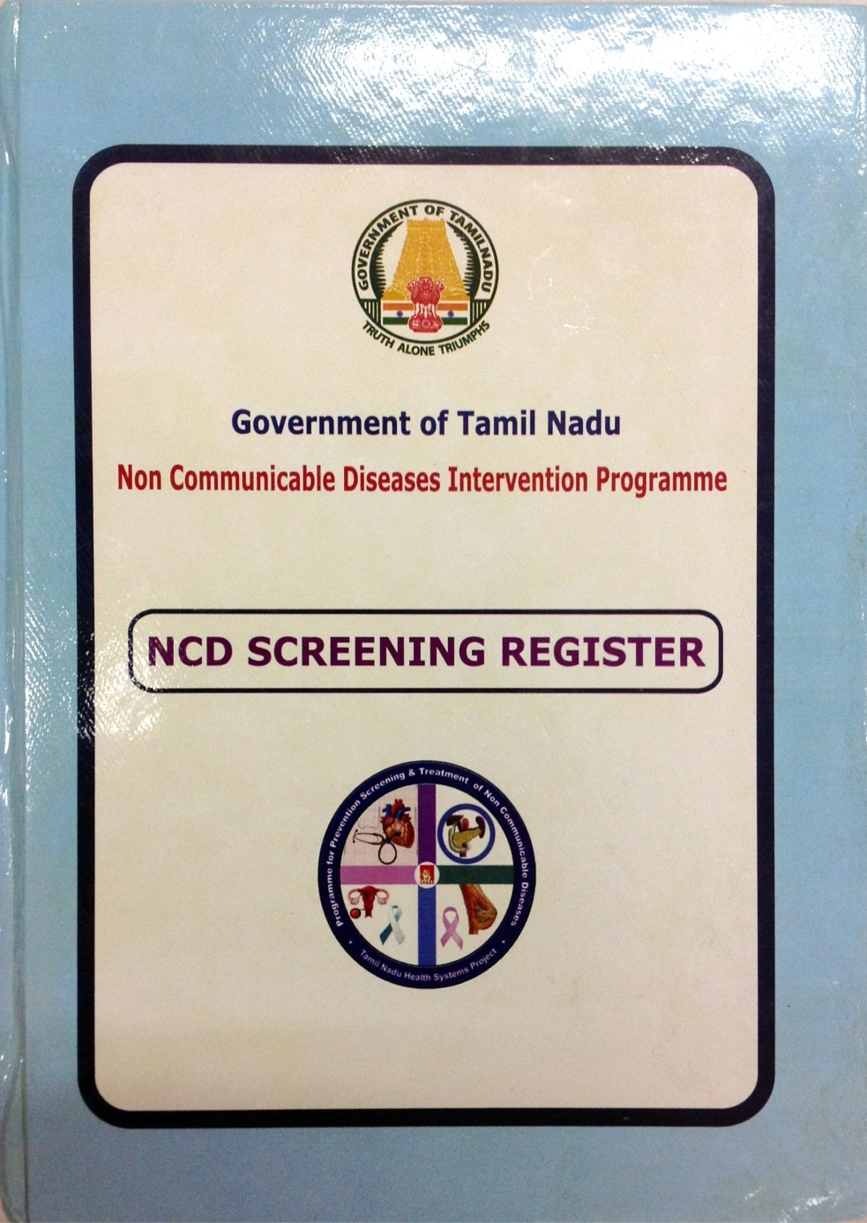
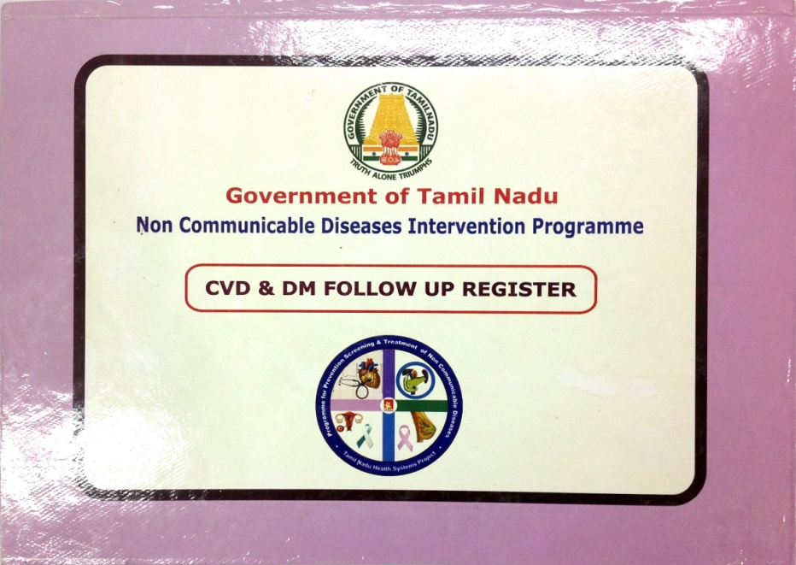
Registers

Slide 49
Manpower support to PHCs and the activities of SNs and VHNs
Every PHC is supported with Staff Nurse in addition to existing staff nurse and other manpower
All the members of PHC like MOs, SNs including RCH SNs, VHNs (ANMs) oriented and trained on NCD including VIA/VILLI training and Colposcopy hands on training as applicable.
SNs are trained to screened for HT/DM using BP, Height, Weight, BMI, Waist Circumference, Random Blood Glucose and refer for further management and follow up

Slide 50
Manpower support to PHCs and activities of SNs and VHNs
SNs are trained on Counseling on Life Style Modification
Screened positive subjected to further tests if needed
Women are screened for Breast cancer (CBE) / Cervical Cancer (VIA/VILI)
Positive cases referred for Mammography / FNAC Biopsy, Nipple secretion cytology / Colposcopy
Treatment is being provided to them according to the designed protocol
Diagnosis / Treatment is also available under CMCHISTN

Slide 51
Review of the program
State level review by Project Director with
District officials
Regional Consultants and Regional Medical Officers
Video Conferencing
District level review by DDHS (NCD Nodal Officer)
Medical Officers
NCD Staff Nurses
Combined (MOs & NCD SNs)
Block level review by Block Medical Officer
NCD Staff Nurses & VHNs

Slide 52
Supervisory visits
Weekly visits by Project Director and team
Regular visits on a daily basis by RCs and RMOs
Visits by District officials
Visits by Statistical Assistants (NCD) of NIE
Supervisory visits by state level staff of NIE

Slide 53
Performance in Phase I districts from July 2012 to May 2013

Slide 54
State Level Screening and detection & Positive case Phase –I from July to May -2013
S.No |  | Total Number screened |  |  |  | Number detected Positive in screening |  |  |  | Positivity Rate
 | Month | Number Screened for HT | Number Screened for DM | Number Screened for CACX | Number Screened for CaBr | HT | DM | VIA/ VILI+ | CBE+ | % positive for HT | % positive for DM | % positive for VIA/VILI | % for CBE abnormality
1 | July'12 | 204318 | 110122 | 10758 | 69021 | 13362 | 5568 | 447 | 383 | 6.54 | 5.06 | 4.16 | 0.55
2 | Aug'12 | 323992 | 161998 | 25237 | 107640 | 22720 | 8461 | 1333 | 794 | 7.01 | 5.22 | 5.28 | 0.74
3 | Sep'12 | 347690 | 168053 | 47034 | 114797 | 25366 | 8359 | 2360 | 1269 | 7.30 | 4.97 | 5.02 | 1.11
4 | Oct'12 | 367334 | 170820 | 62880 | 118752 | 25900 | 7560 | 2629 | 1338 | 7.05 | 4.43 | 4.18 | 1.13
5 | Nov'12 | 353251 | 159476 | 60316 | 110514 | 29827 | 6808 | 2226 | 987 | 8.44 | 4.27 | 3.69 | 0.89
6 | Dec'12 | 388653 | 191071 | 76005 | 127515 | 39420 | 8621 | 3606 | 1238 | 10.14 | 4.51 | 4.74 | 0.97
7 | Jan'13 | 362841 | 188163 | 76267 | 121237 | 37613 | 7293 | 3082 | 1103 | 10.37 | 3.88 | 4.04 | 0.91
8 | Feb'13 | 340860 | 183831 | 77389 | 118079 | 35630 | 6913 | 3460 | 1451 | 10.45 | 3.76 | 4.47 | 1.23
9 | Mar'13 | 394354 | 235657 | 106224 | 145153 | 40146 | 8770 | 4773 | 2060 | 10.18 | 3.72 | 4.49 | 1.42
10 | April'13 | 411362 | 254610 | 132138 | 170362 | 38520 | 8454 | 5921 | 2175 | 9.36 | 3.32 | 4.48 | 1.28
11 | May'13 | 459324 | 275454 | 212791 | 251871 | 39935 | 9298 | 10415 | 3787 | 8.69 | 3.38 | 4.89 | 1.50
 | Overall Total | 3953979 | 2099255 | 887039 | 1454941 | 348439 | 86105 | 40252 | 16585 | 8.81 | 4.10 | 4.54 | 1.14

Slide 55
Total screened at State and PHCs level for Hypertension from (July 2012 – May 2013)

Slide 56
Contribution of PHCs to Hypertension screening during July 2012 – May 2013
Total screened for HT |  |  | Total Positive for HT
State level | PHCs | Contribution of PHCs | State level | PHCs | Contribution of PHCs
3953979 | 2601892 | 65.8% | 348439 | 218549 | 62.7%
Positivity Rate for Hypertension
State level | PHCs
8.81% | 8.4%

Slide 57
Total screened at State and PHCs level for Diabetes Mellitus from (July 2012 – May 2013)

Slide 58
Contribution of PHCs to DM screening during July 2012 – May 2013
Total screened for DM |  |  | Total Positive for DM
State level | PHCs | Contribution of PHCs | State level | PHCs | Contribution of PHCs
2099255 | 1386502 | 66.04% | 86105 | 52754 | 61.21%
Positivity Rate for DM
State level | PHCs
4.10% | 3.80%

Slide 59
Total screened at State and PHCs level for Cancer Cervix from (July 2012 – May 2013)

Slide 60
Contribution of PHCs to Cervical cancer screening during July 2012 – May 2013
Total screened for CaCx |  |  | Total Positive for Cacx
State level | PHCs | Contribution of PHCs | State level | PHCs | Contribution of PHCs
887039 | 643597 | 72.55% | 40252 | 26669 | 62.25%
Positivity Rate for CaCx
State level | PHCs
4.54% | 4.14%

Slide 61
Total screened at State and PHCs level for Cancer Breast from (July 2012 – May 2013)

Slide 62
Contribution of PHCs to Breast cancer screening during July 2012 – May 2013
Total screened for CaBr |  |  | Total Positive for CaBr
State level | PHCs | Contribution of PHCs | State level | PHCs | Contribution of PHCs
1454941 | 1022193 | 70.25% | 16585 | 9585 | 57.7%
Positivity Rate for CaBr
State level | PHCs
1.14% | 0.94%

Slide 63
Performance in 16 Phase I districts (July 2012 to May 2013)

Slide 64
KEY Challenges
Motivating women to come forward for taking the screening test for Cervical and Breast cancer
Follow up of women found to be positive in the screening tests namely VIA /VILI or Clinical Breast Examination (CBE)
Compliance of individuals for screening especially Diabetes Mellitus
Compliance of patients put on treatment for both Hypertension and Diabetes Mellitus
Close supervision and monitoring at all level
Effective and sustained counseling on Life Style Modification (LSM) by staff nurses
Data monitoring and actions on issues

Slide 65
Initiatives in the pipeline
Initiatives to follow up of patients for which project is planning for ‘Automated Voice Alert system’
Incentives to VHN for follow up of positive cancer patients
Recognition of well performing staff nurses and Medical Officers at District level and many others
Linelisting of screen positive individuals for Hypertension, Diabetes, Cervical & Breast Cancer

Slide 66
NPPCD
Tamil Nadu is the first state to take up the NPPCD in the districts in all the districts
Objective
To prevent the avoidable hearing loss on account of disease or injury.
Early identification, diagnosis and treatment of ear problems responsible for it.
To medically rehabilitate affected persons
To strengthen the existing inter-sectoral linkages
To develop institutional capacity

Slide 67
Integration of NPPCD in Primary Care Services
4320 PHC Doctors are trained to handle temporary deafness and they conduct Special OP on Fridays after 10 AM
In the PHC MOs are able to
To remove wax – 4502
Remove foreign body – 1187
Treated Acute Otitis Media - 4614
Chronic Supportive Otitis Media - 8157
Deafness identified are referred to GH – 632
Hearing aid given to under 15 years – 1669
In the field
VHNs, School Teachers and Anganwadi workers are trained
MO PHC train the field staff so that they are able to create awareness in the public, assess the children and do the necessary counseling and refer them to further management

Slide 68
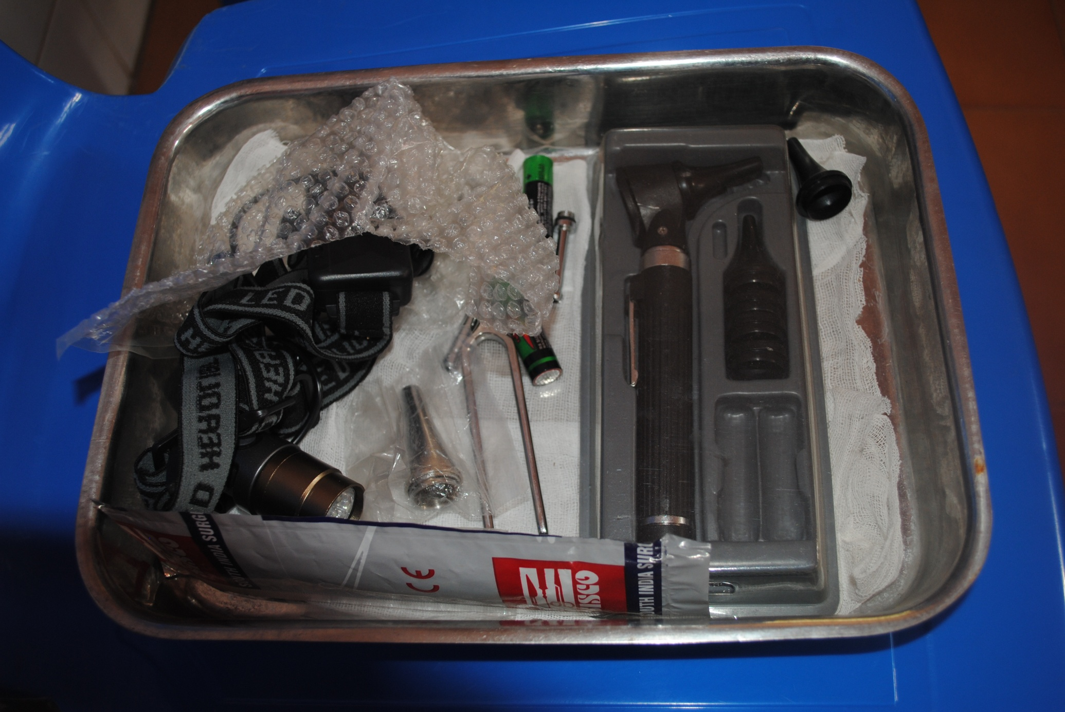
In the PHC – Equipments supplied
Otoscope, head light, Probe, Tuning Fork, Ear Syringe etc - to all PHCs

Slide 69
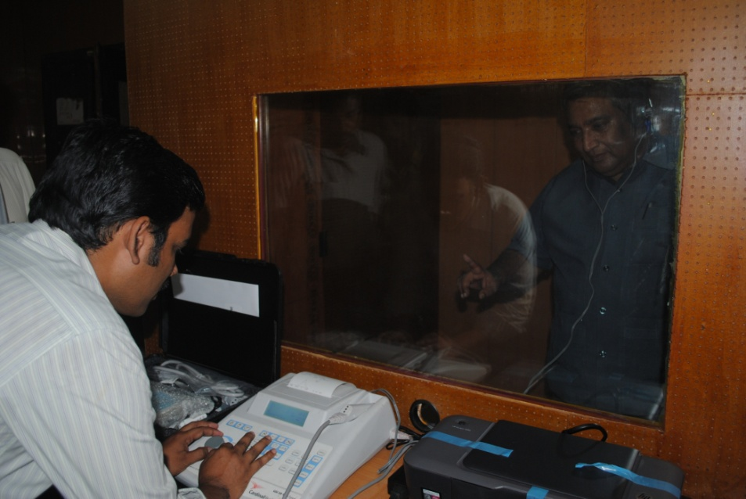
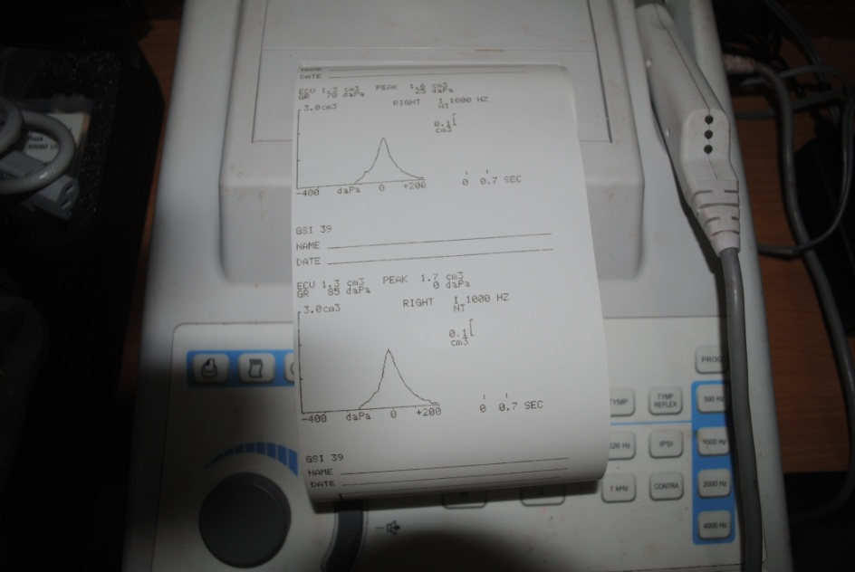
At District Head Quarters Hospital
Investigation to asses the status of deafness
Surgical correction
Profound Deafness is provided with Hearing Aid
Cochlear Implant is provided under CMCHITN
Investigated – 12-13 |  |  |  |  |  |  |  | Referred
Pure tone Audiometry |  | Impedance Audiometry |  | OAE |  | ABR
Male | Female | Male | Female | Male | Female | Male | Female | Male | Female
3365 | 1297 | 297 | 167 | 69 | 10 | 34 | 0 | 1043 | 30
Sound treated room
Assessment of hearing

Slide 70
NPPCD Program Plan
D
I
S
T
R
I
C
T
Medical College ENT Units
Specialist Flow
Case Flow
District ENT Units
Cases Identified – Hard of hearing and require more specialized care
Referral Slip
PHC
Health Melas
one per parliamentarian
Constituency in the district
per year-
All age group
PHC – Weekly Special Clinic
Specialist Visit once a month by Hired ENT Surgeon
VKT Camps –
one per HSC
(5000)- Once per project period (2-2.5 yrs)
All age group
V
I
LLAGE
Anganwadi Worker
“Campaign”
once a year – Age 0-5 yrs
Immunisation Card
MPHW/ VHN
VHNDay – Once a month- age
0-5 yrs
School Health Card
School Health Visit
by ANM / LHV – age
6-15 yrs

Slide 71
National Program Control of Blindness NPCB
Primary Health Centers MO PHC
Establishes vision center – separate room with sufficient space
Treats common eye infections
Suspected cases sent to PMOA for examination
PMOA – examines
Identifies Refractory error
PMOA identifies cataract blindness cases
Visits all the PHCs in the block
Mobilizes cataract cases for surgery in govt facilities
PMOA maintains blindness register
Verifies cataract cases operated by NGO / Private
Maintains all records related to NBCS
Organize Special Screening in Out Reach Camps
School Eye Screening for Refractory error

Slide 72
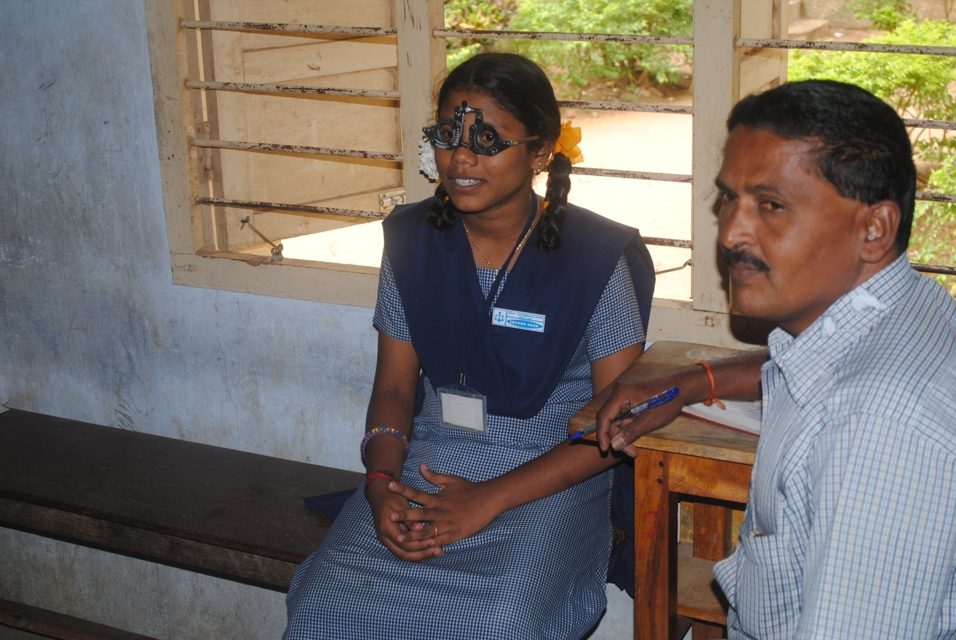
School Eye Screening for refractory error
Kottaram Block PHC

Slide 73
National Program Control of Blindness NPCB
342 PMOA are available
81404 cataract cases PMOA identified and operated in the year12-13
NGO verification – 5% by PMOA in the operating center – 26882
Assist DPM to verify all records

Slide 74
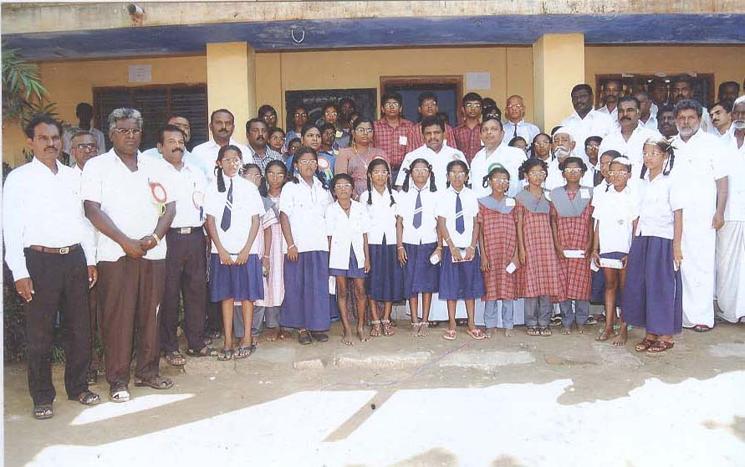
School Eye Screening for refractory error
Fully executed by Primary health center
Planned to cover high and higher school children in phased manner.
Started with 6th to 8th Std the coverage followed by 10^{th,} 11th and 6th Std and subsequently 6th with follow up of all who are having spectacles.
It will be integrated as regular School Health Programe.
Teachers are identify refractive error using Snellen’s Chart.

Slide 75
School Eye Screening for refractory error
Particulars | 2009-10 | 2010-11 | 2012-13 (Extended)
Standards Covered | 6th to 8th stds. | 6th & 10th stds. ( 11th & 12 stds in some HUDs) | 6th std & 7 std (Recheck up and follow up)
Total No. of Schools Covered | 14,801 | 15,306 | 13,382
Total No. of Students Examined | 30,04,749 | 38,47,827 | 28,23,852
Total No. of Students with refractive error | 1,60,983 | 1,69,721 | 93,823
Refractive Error Prev. Rate | 5.3% | 4.3% | 3.3
Total No. of students received spectacles | 1,60,983 100 % | 1,68,047 96.1% | 35,823 (balance in the pipeline)

Slide 76
NATIONAL MENTAL HEALTH PROGRAM

Slide 77
Tertiary
Teaching Institution
District HQ
Secondary
Mobile Psychiatric Team
Primary
PHC Doctors
Identification by social workers/SHG volunteers /religious people

Slide 78
District Mental Health Program
PHC Medical Officers are trained – to clinically diagnose and treat depression and other psychological problems
Management of Psychiatric Illness are initiated at the PHC.
Basic Psychiatric Medicine are made available at all the PHCs
Counseling skill is being provided to field workers

Slide 79
District Mental Health Program- continuation
The District Psychiatrist of DMHP is providing the technical assistance and treatment services for the residents –
The Clinical Diagnosis followed by Field follow up by Psychologists and Psychiatric Social workers periodically providing Counseling assistance and other psychosocial care services to the family members. – Mobile Team
Advance medical facilities are available at tertiary care centres

Slide 80
TOTAL NUMBER OF PATIENTS TREATED UPTO Dec’ 2012
11,23,735
10,42,023
87,70,14

Slide 81
Other Activities - Mental Health
The public enquiring about
Drug Abuse
Suicidal & Paranoid ideas
Behavioral disturbances and changes
Problems of children eg-refusing to go to school etc
Out come
Public bring patients for treatment.
More number of referrals.
Rs.50,000/- is allotted for Each Districts to conduct Mental Health Festival

Slide 82
School Mental Health Programme
Head Of the Institute are sensitized about the merit and need of School Mental Health Programme.
Teachers are trained on how to deal with problematic children in more effective manner
Students are trained on Life Skills Education with the guidance of WHO manual.
Parents are trained on how to deal with their children.

Slide 83
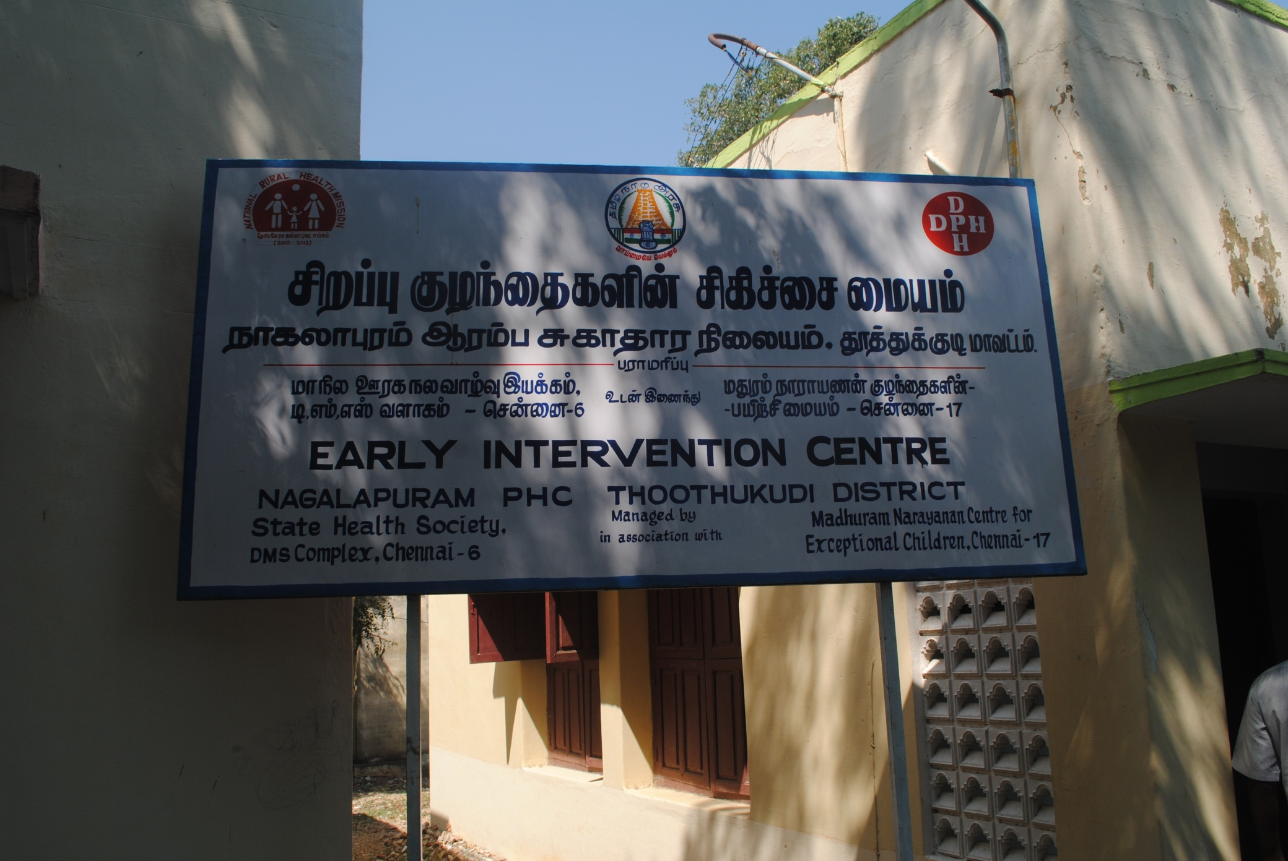
Mental Retardation Rehabilitation – Through NGO in Thoothukudi District established in 4 PHCs – Maduram Narayanan for training the mothers having disabled children. It is run in PPP mode.

Slide 84
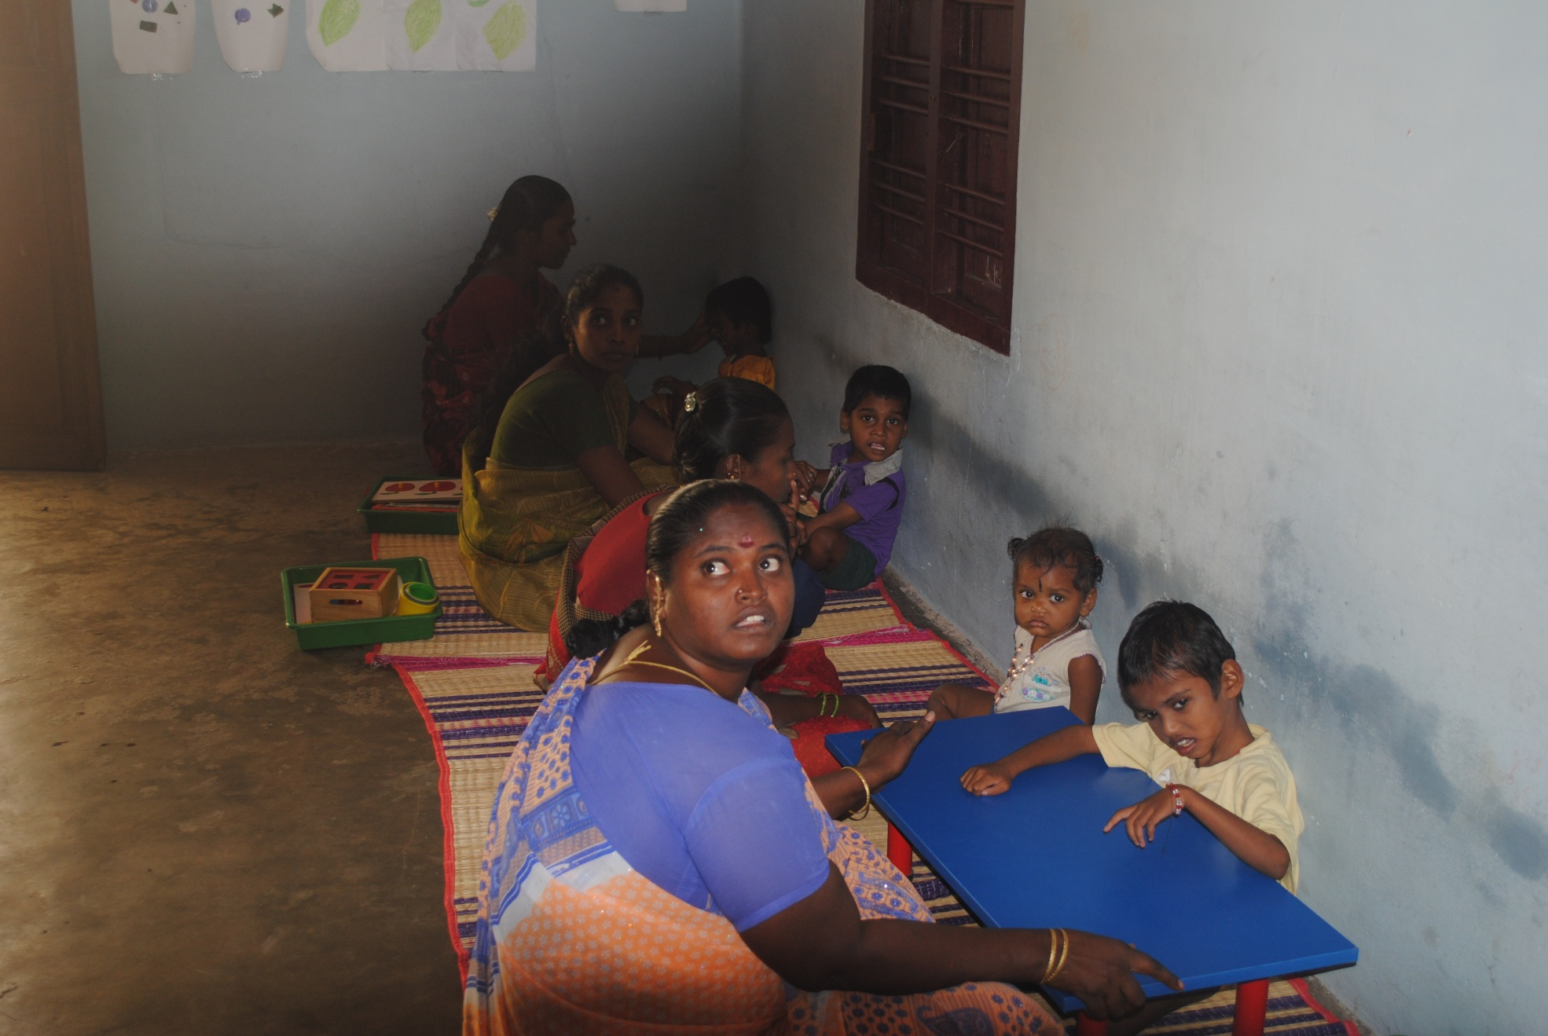
There are 46 registered mothers in this center covering 4-5 blocks but on an average 15-20 children with parents attend. Bus pass is given for the travel. Food is provided. Minor ailment treatment is provided from the PHC.

Slide 85
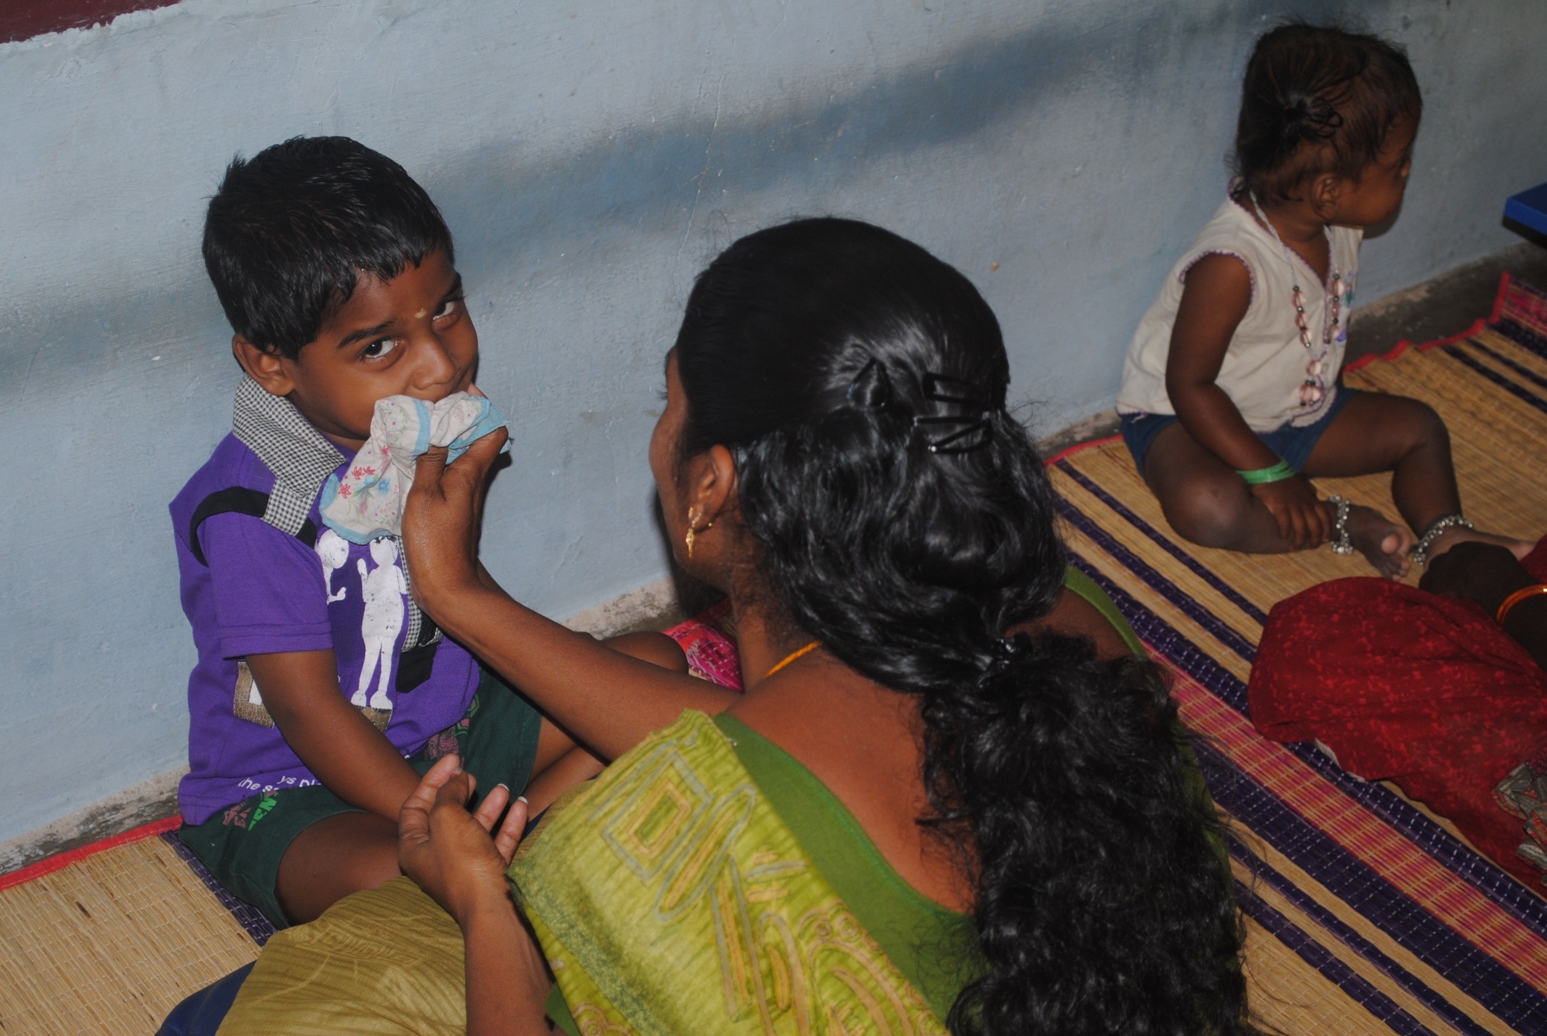
Established in Thothukudi and Cuddalore and likely to expand to other districts.

Slide 86
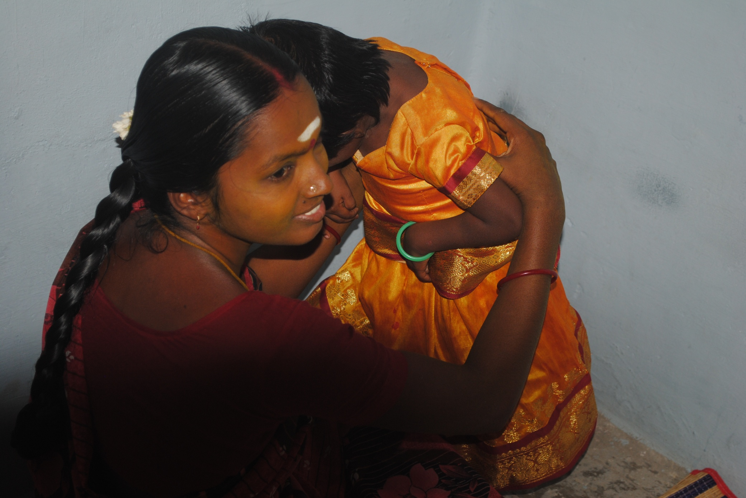
Anxious mother with Cerebral Palsy Child do keep the child neat and clean; girl child not neglected.

Slide 87
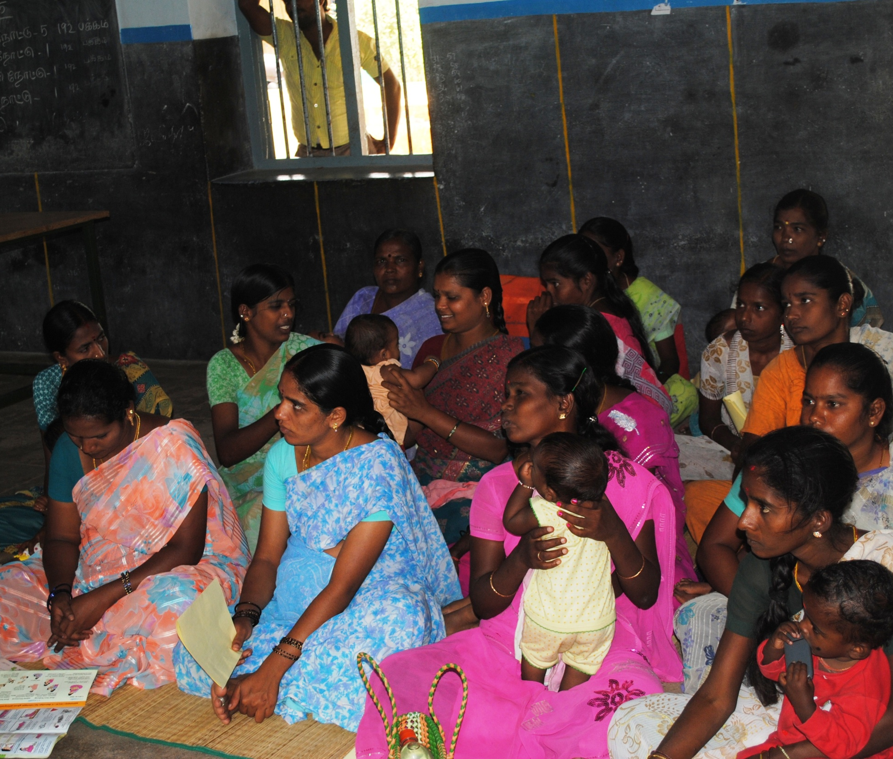
Dr.Chandra Rtd Prof of Ped Conducting Training Session – AN and PN Mothers on early Identification of Developmental Disorders on 23 June 2011 at Luckynaickanpatty, Kandhili Block, Tirupattur HUD

Slide 88
Duchene Muscular Dystrophy -
Molecular Diagnostics, Counseling , Care
and Research Centre ( MDCRC),
Health Staff trained to identify DMD
Identified cases further investigated by
Collecting blood samples
Counseling provided to the family.
Covered 6 districts – Coimbatore, Tiruppur, Erode, Dharapuram, Dharapuram HUD and Chennai Corporation.
Now extended to The Nilgiris, Namakkal and Karur districts.

Slide 89
Molecular Diagnostics Reports of Overall total Number of DMD cases received in Coimbatore, Erode, Salem, Tirupur, Dharapuram & Chennai
Districts | Total No of DMD Cases received | mPCR status |  | Genetic Counseling status |  |  | MD care status |  |  | MLPA Status
 |  | Total No of mPCR +ve cases received | Total No of mPCR -ve cases received | Total No of Families Counseled | On Going Genetic Counseling | Not Interested/ Switch off | Total No of Children attended MD Care | On Going | Not interested to attend | MLPA done Samples | MLPA on Going
 |  |  |  |  |  |  |  | MD Care
Overall Total | 585 | 374 | 211 | 126 | 198 | 50 | 89 | 237 | 48 | 76 | 135
FROM OTHER DISTRCTS | 60 | 42 | 18

Slide 90
National Oral Health Program
TN established Rural Dental Services in UGPHCs with 30 beds and all taluk and non-taluk with 30 beds will be provided with dental unit.
Clinical Dental Services – diagnosis and treatment
School Dental Services
Oral Cancer Screening (Pilot)

Slide 91
Oral Health Program with NRHM support in Tamil Nadu
Covered in 252 Block PHCs and 9 addition PHCs with 30 beds are having dental surgeons.
Under NRHM – Dentist are appointed on contract for each session of 3 hours in the morning on all 6 days a week.
Chair and Equipment including Dental X-rays are provided.
Consumables provided @ Rs.1000/ month per unit
One Dental Assistant is provided to help the dentist.
Dentist – to attend School Dental Screening after the session

Slide 92
TN - Dental Clinics conducted during May’13 Every month reviewed performance
Month | Dental Units in PHCs | Dental Doctor Available | Clinics Conducted (Expected 27 x 225) | Total OP | OP / Clinic
May 13 | 266 | 225 | 22357 | 77785 | 33
Dentist position is based on the decision by the district health society as and when vacancy arises.

Slide 93
SCHOOL DENTAL PROGRAM
Using available infrastructure and facilities
Dentists conduct camps in the school itself.
Covering all the schools –3rd Std to 8th Std children
For removal of grossly decayed milk teeth and filling up of permanent teeth and milk teeth.
Filling material Glass Ionomer (ART) 9 is used.
No gridding of teeth cavity
Preventive dentistry through examination of 28 out of 32 teeth during childhood.
Teachers are trained to identify carries
Case sheet form provide parents consent for extraction or filling
The area VHN assist the team for sanitation of camp site.
Other support by Head Master of the school.

Slide 94
SCHOOL DENTAL PROGRAM
Consumables provided – Gloves, cotton, Xylocaine with adrenaline injection and dust bin
Gloss Ionomer 9 preparation
Biological waste disposed by deep burial in the school site

Slide 95
Performance of School Dental Program
No. of HUDs conducted Dental Camps | 42
No. of Blocks that conducted the camps | 42
No. of Camps Planned | 1530
No. of Camps Conducted | 1539
No. of students screened by teachers | 3,01,179
No. of students identified with dental problems by teachers | 1,53,632
% of Dental Problems identified by teachers | 51.0 %
No. of students attended the dental camp | 1,45,604
% of Attendance | 94.8 %
% without parental consent and absent during camp | 5.2 %
No. of students treated for dental problems Milk Teeth Extracted Milk Teeth Filled Permanent Teeth Filled | 94,587 – 61.2% 18,638 – 0.13% 55539 – 38.1% 20,410 – 14.0%
% of Treatment given to the students attended camps | 64.9 %
No. of students referred | 39,858
% of Referral | 27.4 %

Slide 96
Pain and Palliative Care
TN has formed an advisory committee on Pain and Palliative Care under the State Health Secretary.
The committee advices the Government on establishing care at various levels.
Pain and Palliative Clinic in Hospitals
Auspice Type of Services
Field Based Activities
Care for terminally ill patient.

Slide 97
PAIN AND PALLIATIVE CARE - under Public Private Partnership
MO PHC is providing place for NGO.
Patient needing drugs like antibiotic etc are provided by PHC.
PHC – Staff Members Trained by NGO .
NGO to provide - Clinical care services, provide pain
Home service includes hydration, dressing, enema, ascites tapping, maggot removal, pressure sore dressing, management with home made diapers, sponge bath, eye care, oral care were provided by a team of personnel with adopting proper protocol for clinical treatment to give a dignified living in prior to the end.

Slide 98
PAIN AND PALLIATIVE CARE – Under PPP
The patients treated in home were
Elapuram block (Tiruvallur District) – 196 patients,
Kancheepuram block (Kancheepuram District) – 296 patients,
Koilyanur Block Villupuram District) – 198 patients
Andhanallur Block (Trichy District) – 156 patients
Approximately 6-8 had dignified death in their village in each block.
PHC provides assistance as and when required by the NGOs.
PIP 2013-14 it is proposed to extend it to 100 blocks with Rs.15 lakhs per block
Average Cost is Rs.20 per day per terminally ill patients with 250 patients with varying degree.

Slide 99
National Tobacco Control Program
Implemented through STCC under DPH&PM
Monitors through HIs and BHSs
Prohibition of smoking in the public Places
Sale around educational institutions
Sale to the minors
Prohibition of advertisements
So far 72,902 violations were fined for Rs 83.01 lakh in the state

Slide 100
Challenges in NCD Prevention and Control
Need for partnership with different sectors
Human and financial resources constraint along with uneven distribution and poor training and orientation
Limited access to prevention and treatment
Public ignorance and Limited interest from public for preventive measures
Limited commitment from private health care sector
Utilizing the services of AYUSH along with Allopathic
Need for long time budget allocation from Central and State

Slide 101
Thank you
Thank you
Thank you

