Slide 1
A multi-pronged strategy is advancing the state towards kala-azar elimination, west bengal, 2014
Dept. of Health & FW, Govt. of West Bengal; July, 2015

Slide 2
Introduction
Kala-azar (KA) is a tropical disease affecting mostly the rural poor. Caused by a parasite that is transmitted by an insect called sand fly.
Presently 4 states of India are endemic for KA.
By case count in 2013/2014, West Bengal is the 3rd endemic state next to Bihar & Jharkhand.
In West Bengal, 11 of 20 districts are affected with KA. 595 cases & 2 deaths reported from 58 blocks & 4 urban areas in 2013.
India targets elimination of Kala-azar by 2015.
Criterion of elimination: Less than 1 new case in a year per 10,000 population at sub-district (block) level.

Slide 3
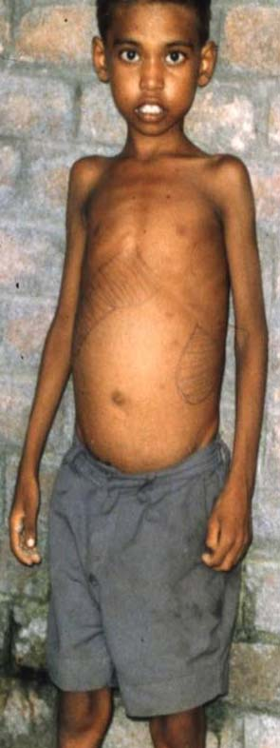
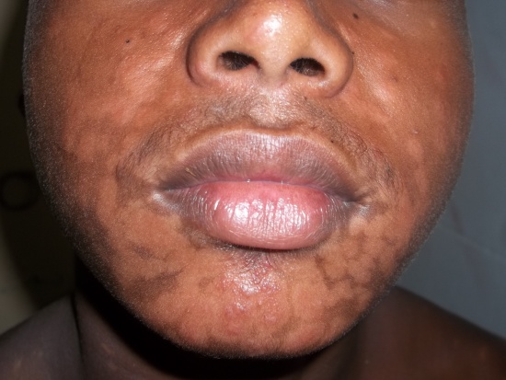
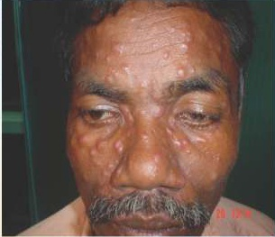
Two forms of KA in India
(1) VL (visceral leishmaniasis)
Chronic fever, weight loss, weakness, anaemia, swelling of abdomen (due to enlarged liver & spleen). May be fatal !
(2) PKDL (post kala-azar dermal leishmaniasis)
Pale/whitish patches or nodules on the skin. No fever. No complaint except cosmetic problem. But, they can be source of infection; so threat to others !

Slide 4
Elimination strategies we follow
1. Early detection & complete treatment
2. Continued surveillance for the disease
3. Vector management – (a) Indoor residual spray (with DDT) (b) Environmental management
4. IEC/BCC : an over-arching strategy
5. Administration/programme management

Slide 5
Active case search followed by diagnostic camps, Dec-2014
Purpose: case detection & treatment.
Objective :
To find out the undetected cases of VL & PKDL and put them on treatment so as to reduce morbidity & mortality and contain further transmission of the disease.

Slide 6
Steps of Case Search & Camp……(1/3)
1. Preparation of microplan
Search workers identified for active case search : Mostly ASHA-s; volunteers at only some places.
2. Orientation training for search workers, supervisors & MO-s.
Detection of both VL & PKDL emphasized in training.
Flash card developed on kala-azar; given to each worker.

Slide 7
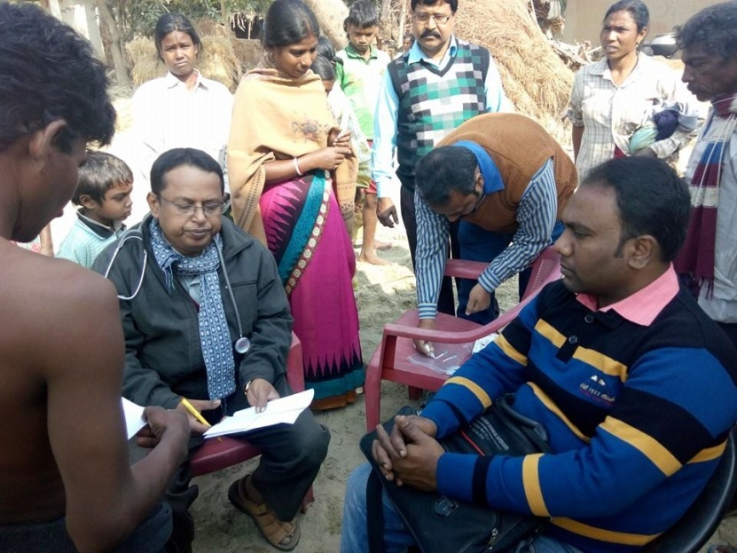
Steps of Case Search & Camp……(2/3)
3. House-to-house visit for case search
Suspected cases line-listed. Referral slip given. Motivated them to attend diagnostic camp on a pre-fixed date.
4. Organization of diagnostic camps at decentralized venues
Attended by Medical Officers from Block PHC/PHC.
Cases diagnosed as VL or PKDL – listed for treatment.
In case of diagnostic difficulty, referral to DH/SDH/MCH.

Slide 8
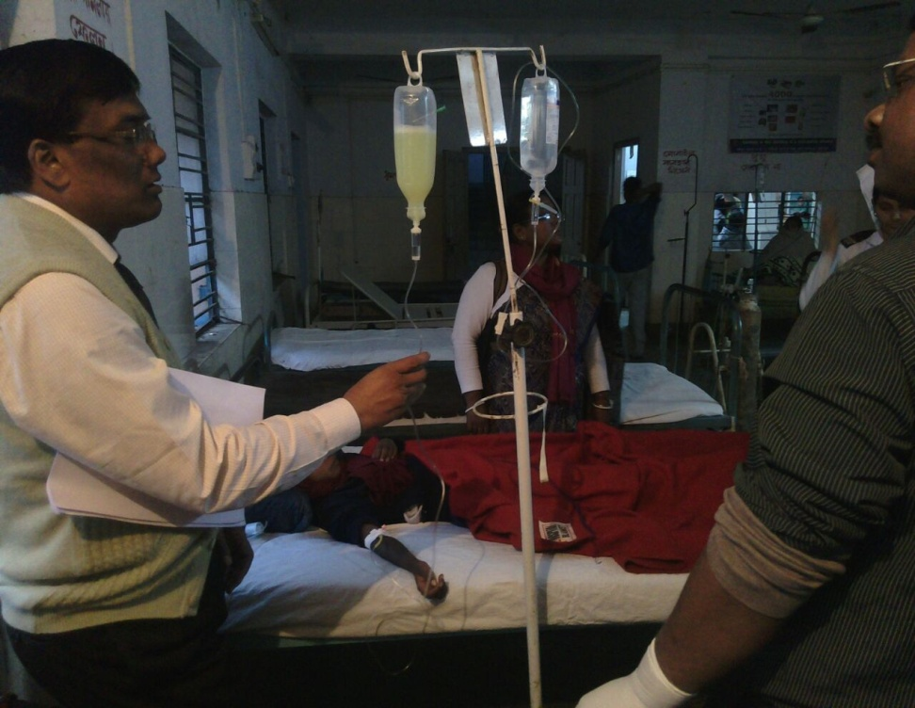
Steps of Case Search & Camp……(3/3)
5. Treatment of cases in Block PHC/Rural Hospitals
Treatment with liposomal amphotericin-B (latest drug).
MO-s oriented for use of the drug.
Cold chain ensured (for the drug) at peripheral units.
Cases tracked individually. Treatment completed for all VL-cases and also all PKDL-cases barring a few who had moved away.

Slide 9
Yield of Case Search & Camp
103 VL-cases & 156 PKDL-cases found from 394 villages and 5 urban wards.
 | KA-cases detected in 2014
 | V.L. | P.K.D.L. | Total
Cases detected before Active Search (Dec’14) | 315 (84%) | 59 (16%) | 374
Cases detected in Active Search (Dec’14) | 103 (40%) | 156 (60%) | 259
Large no. of kala-azar cases (mostly PKDL), hidden until then, could be detected in the Active Search drive! Treating the cases would cut off the transmission chains to reduce chances of future cases!!

Slide 10
Vector management
(a) Indoor residual spray with DDT – to kill sand fly. (b) Improvement of housing – to eliminate resting sites of sand fly.*
* Sand flies rest in cracks & crevices of houses

Slide 11
Initiatives to improve Indoor Residual Spray (IRS)
Coupons distributed in households by ASHA for prior intimation & I.P.C.
Development of a guideline in Bengali
Sensitization of ASHA
Hands-on training of spray workers, based on a written manual
Development of a brief manual & check-list
Orientation of IRS-supervisors

Slide 12
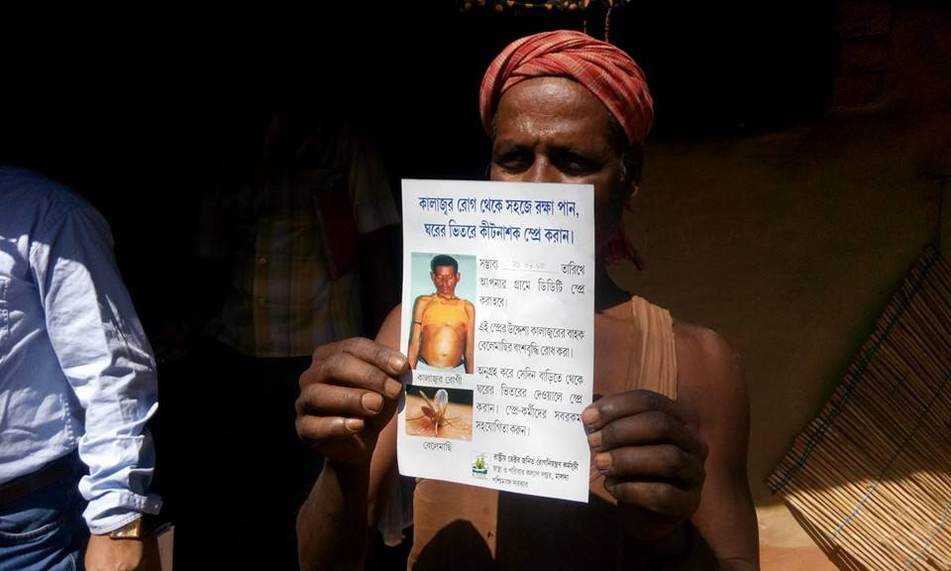
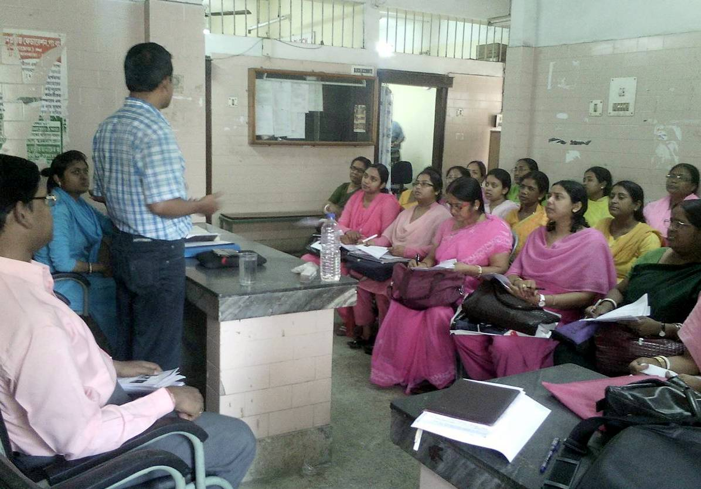
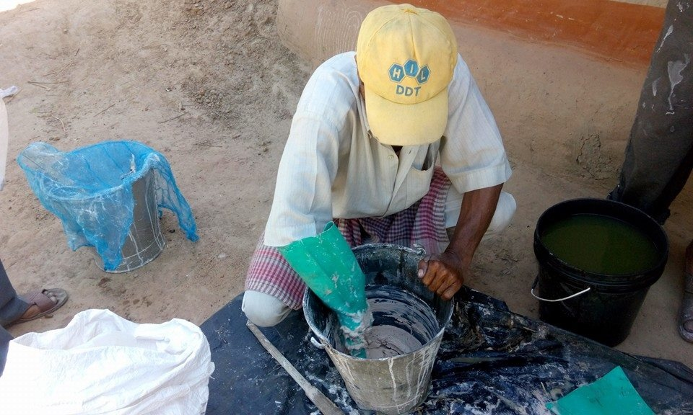
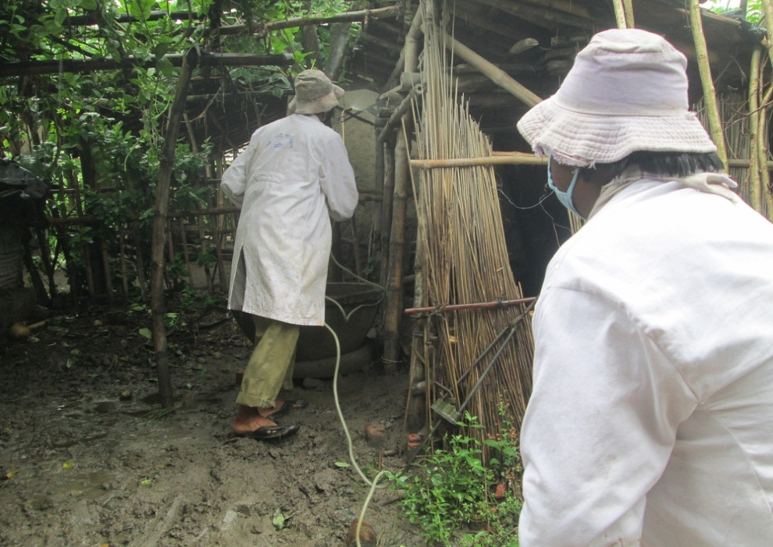
A villager showing the coupon
Orientation session on IRS-supervision
Preparation of DDT-suspension
Spraying in a cattle shed

Slide 13
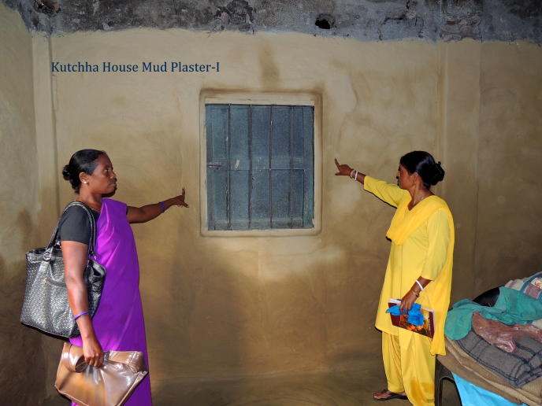
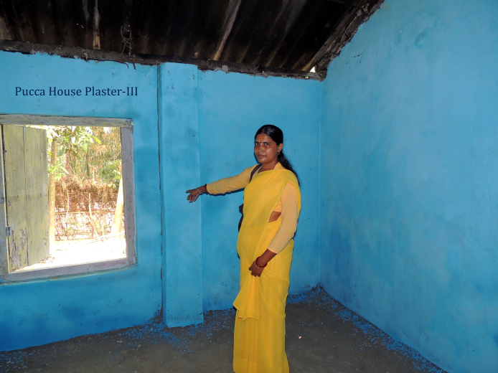
Repairing of houses
State Govt. going to allot fund. Selected villages of 3 blocks are being taken up in 2015-16.
Mud plastering for kutcha houses; mortar plastering for pucca ones.
Plastering of cracked walls of houses in selected villages of high incidence blocks.
Test model of kutcha house
Test model of pucca house

Slide 14
Administration/programme management
Kala-azar declared as a notifiable disease in the state
Formation of State Task Force for KA
Publication of State Road-Map of Kala-azar Elimination in tune with national document
Convergence with leprosy case search – to find out P.K.D.L. mistaken as leprosy

Slide 15

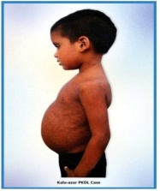
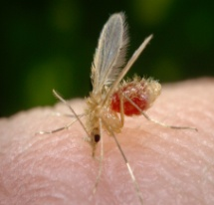
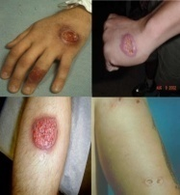



Government of West Bengal
State Road Map for
Elimination of Kala-azar
in West Bengal
National Vector Borne Disease Control Programme
Department of Health & Family Welfare
January, 2015

Slide 16
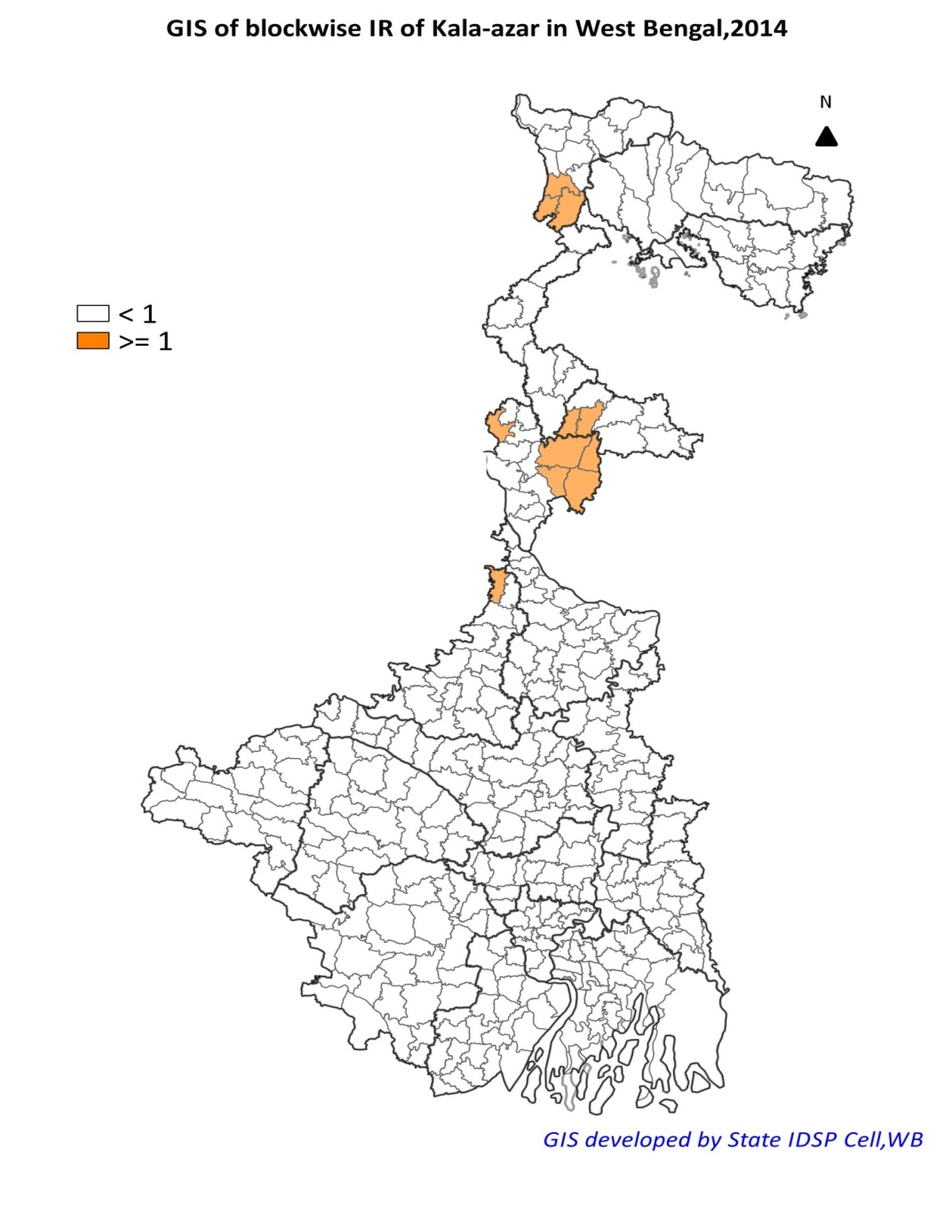
Blocks with Annual Incidence Rate of KA ≥ 1,
West Bengal, 2014
If elimination judged by only VL, only 1 block doesn’t qualify; but, we put more stringent definition for us by counting both VL & PKDL.
So, in that terms, 11 blocks in 4 districts are above elimination level at the end of 2014.
Apart from routine surveillance & programme activities, we’ll now focus on these blocks to make elimination happen.
Incidence rate per 10000 population
Blocks above elimination level of incidence were 22 in 2009.
Brought down to 11 in 2014 !
T H A N K S

