Slide 1
Accreditation and Certification of Government Health Care Institutions
Dr K Sandeep
Senior Consultant ME and QA
NHM, Kerala

Slide 2
Quality Assurance in Health Care | Accreditation and Certification of Govt Health Facilities
 | Quality Assurance Programme started in 2009. NABH accreditation of Health Facilities – 8 accredited KASH accreditation – State level programme – 18 accredited National Standards on Quality Assurance – 4 certified by SQAC Measures to Reduce MMR and IMR
Implementation
State and District level Quality Assurance Committees formed
State and District Quality Assurance Unit functioning
Hospital Team / core committee functioning in the hospitals
Hospital Infection Control committee and other committees are functioning
Quality Assurance Officers and Biomedical engineers are appointed at District level
Sl No | Year | Number of trainings | Total participants attended
1 | 2012-13 | 353 | 14654
2 | 2013-14 | 208 | 8072
Decentralized training process
Short duration trainings
Training at institutions

Slide 3
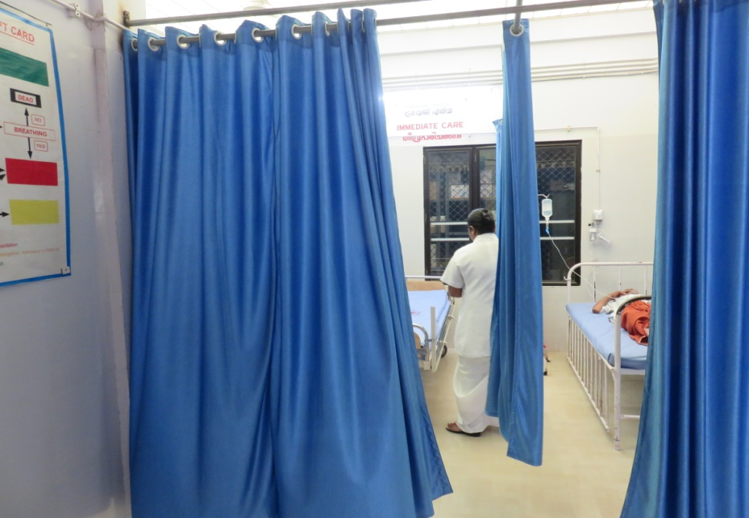
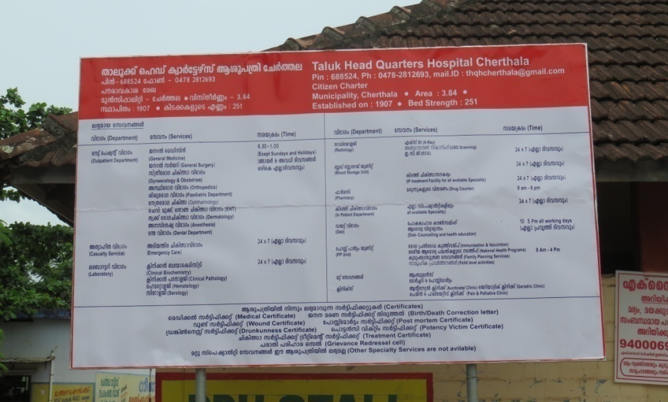
NABH | NABH accreditation of Hospitals
 | General Hospital Ernakulam – First accredited NABH GH in India THQH Cherthala - First NABH accredited Thaluk Hospital in India WC Thycaud - First NABH accredited W and C Hospital in India Blood bank Aluva , RCC Trivandrum,- First NABH accredited RCC in India WC Kozhikode – Second NABH accredited W and C Hospital ICCONS Shoranur – Specialty Hospital CHC Pandapilly - Second NABH accredited CHC in India
Patient Privacy in Casualty TH Cherthala
Services available - TH Cherthala

Slide 4
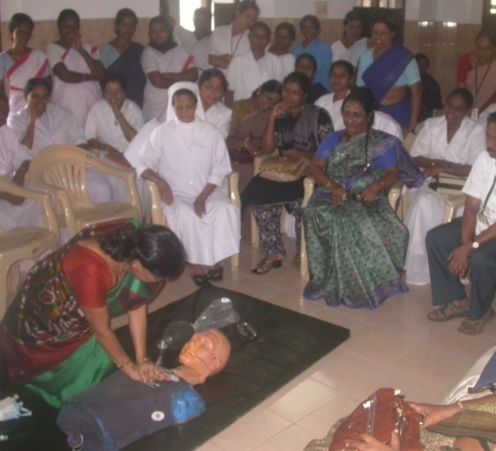

NABH | Key Strategies
 | Standardization of all Available Services Patient Oriented Services Defined Management Responsibilities Standardization and Calibration Equipments Training of Staff Basic and Optimum Infrastructure Development and implementation of SOP and Manuals
Code Blue Training
Standard Operating Procedures and manuals

Slide 5
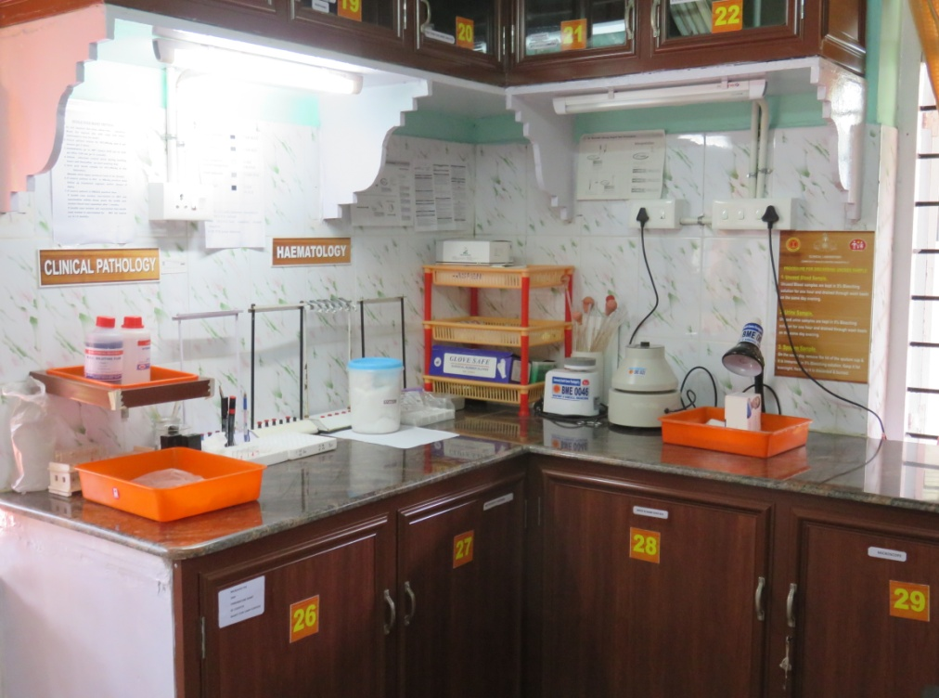
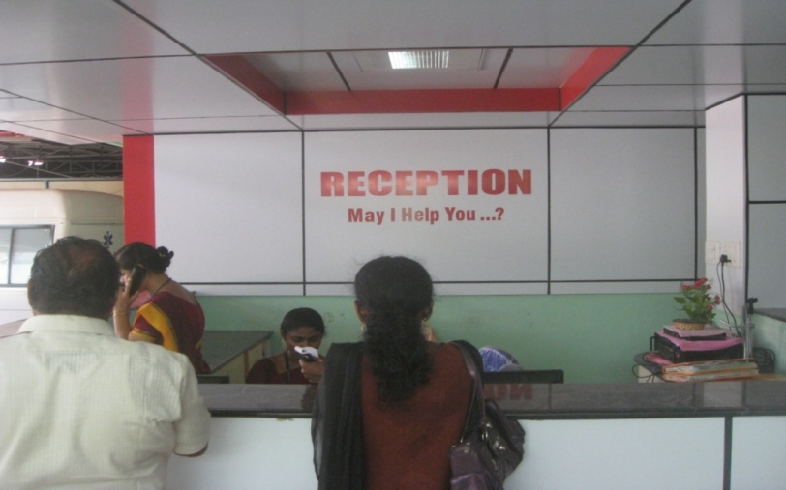
KASH | Kerala Accreditation Standards for Hospitals (KASH)
 | Government of Kerala has introduced an Accreditation program in the state covering all the Government health care institutions. 18 Health Care Institutions are accredited Kerala is the first state in India to introduced a state level Quality Assurance Programme
Laboratory CHC Pandapilly
Reception THQH Punalur

Slide 6
KASH | Advantages of State level programme
 | Less expensive to implement in all Health Care Institutions, without compromising quality Extensive and Effective Training provided to all Hospital Staff Staff pattern based on the services provided. Separate Standards for Different category
 | ISO | NABH | IPHS | KASH
Services available |  | ü | ü | ü
Patient oriented standards |  | ü |  | ü
Management Responsibilities |  | ü |  | ü
Infrastructure |  |  | ü | ü
Human Resources |  |  | ü | ü
Equipments required |  |  | ü | ü
Public Health Services |  |  | ü | ü
Separate standards for Different category |  |  | ü | ü
Quality in Health Care | ü | ü |  | ü
Manuals and Standard Operating Procedure | ü | ü |  | ü

Slide 7
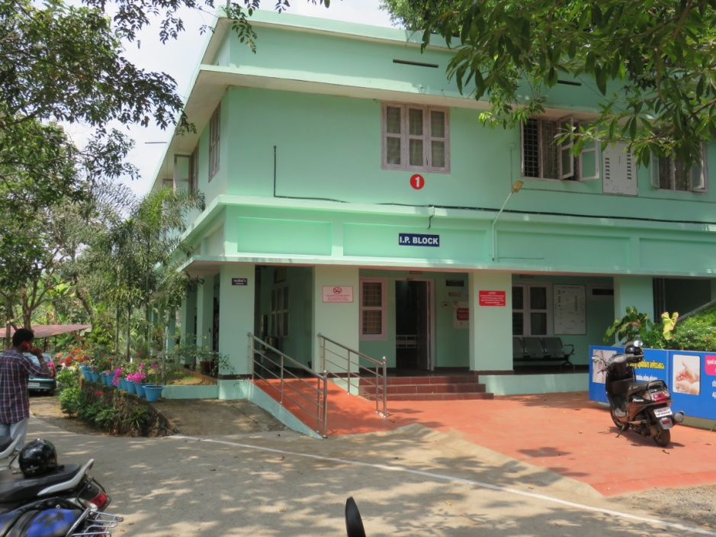
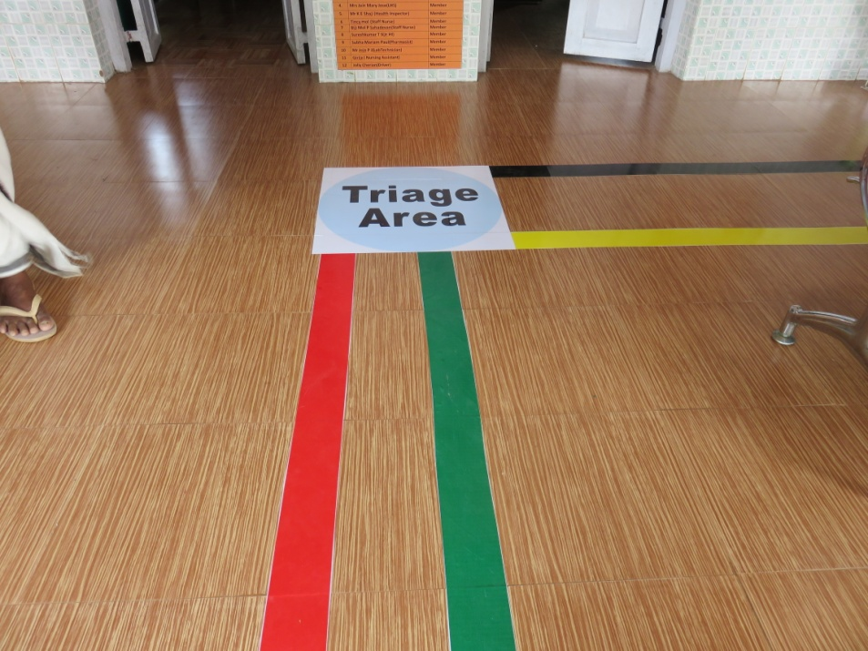
National standards on QA | National Standards on QA
 | State level certification for 4 Health Care Intuitions. GH Ernakulam, CHC Panapilly, CHC Vellarada, PHC Chemaruthi 4 Hospitals are ready for National Certification 3 Regional level training conducted by NHSRC and NHM 2 days internal assessor training conducted 5 days External Assessor training programme conducted at Trivandrum Kayakalp is being implemented
CHC Pandapilly – SQAC Certified
Triage Plan – CHC Pandapilly

Slide 8
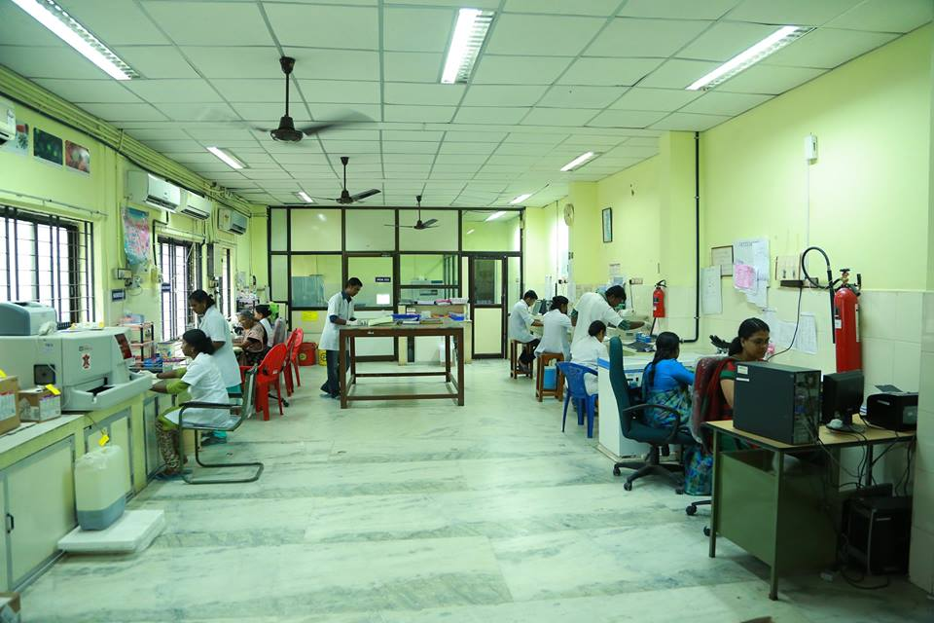

Quality Assurance in Health care | NABH Certification of Medical Laboratories
 | 3 Laboratories were certified by NABH State Public Health and Clinical Laboratory Clinical Laboratory. DH Manjeeri (MCH) Clinical Laboratory Mananthawady 195 Hospital Labs were certified under Essential standards for Laboratory programme
Medical Laboratory – GH Ernakulam
Laboratory CHC Pandapilly

Slide 9
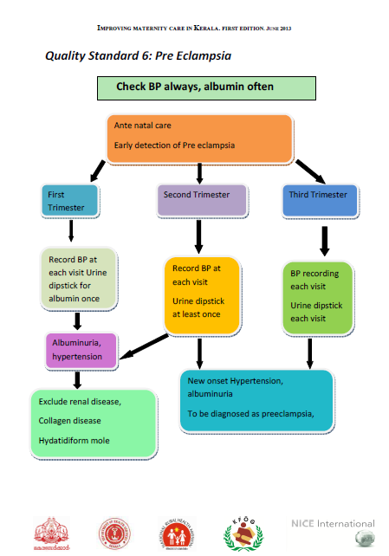
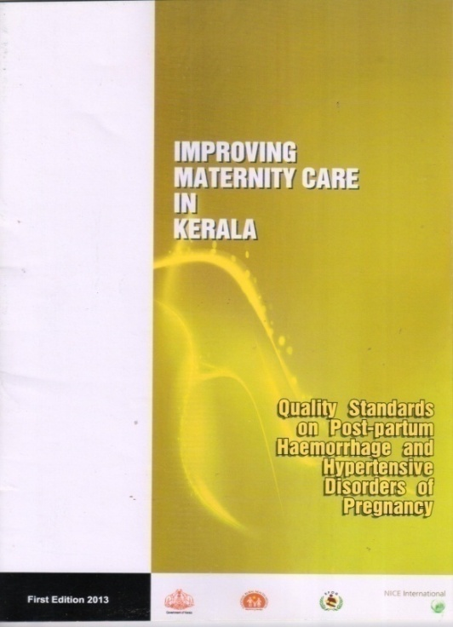
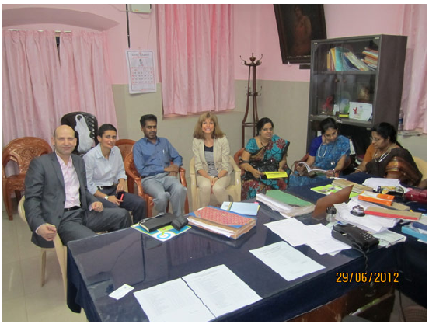
Reduction of MMR | Measures to reduce Maternal Mortality in Kerala.
 | All maternal death in Govt and Private sector are audited 10 Quality Standards developed and implemented in 13 hospitals Will be up scaled to 27 more hospitals. A new register for the labor room was developed and implemented Equipments and delivery kits provided for the implementation of Quality Standards Trainings were conducted in association with KFOG

Slide 10
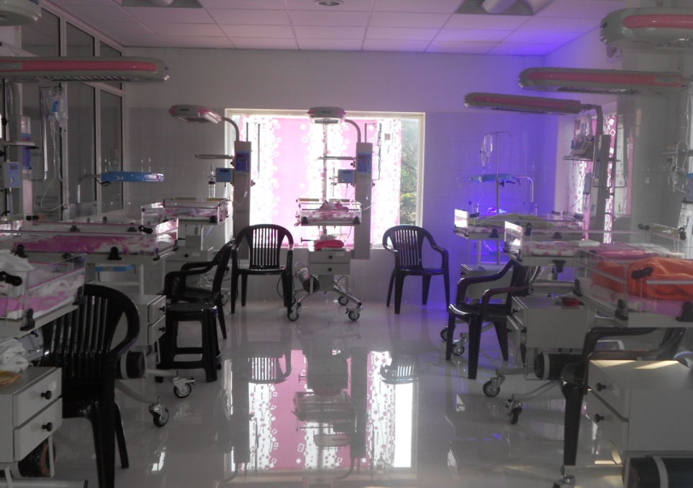
Reduction of IMR | Measures to reduce Infant Mortality Rate in Kerala.
 | Implementation of Quality Standards in selected Health Care institutions with technical support from ACCESS Health International. 13 Quality Standards were developed 17 hospitals are selected for the first phase Training will be conducted in association with IAP

Slide 11
Quality Assurance in Health Care | Achievements
 | High Quality Health Care to the patient “Quality of Care” concept across the Institutions Well trained staff in all selected Institutions Hospitals able to manage all Emergency Situations Introduction of standardization and Calibration of Equipments
Patients Rights are respected
Signage- information to patients provided
Patient and staff safety ensured
Patent and employee feed back in every 6 months
Provided safe food and drinking water to the patients
Hospital cleanses ensured
Hospital Infection Control practices implemented
Hand wash policy implemented
Biomedical waste management as per rules
Hospital safety codes are introduced.
Medical records are stored properly

Slide 12

Thank You

