Slide 1
Birth preparedness & Parental Education for better maternofetal outcome
TELANGANA

Slide 2
PROBLEM STATEMENT
Poor and inadequate preparation of Mother & Family during Pregnancy and Childbirth contribute to preventable morbidity , mortality of mother and newborn including female feoticide.

Slide 3
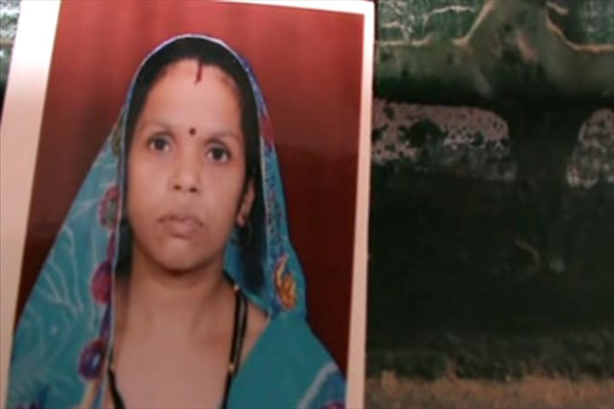
Ignorance on sex development in utero causing
Ill treatment/ second mariages/ loss of young women
#Agra Uttar Pradesh
A young productive life brought to End- A mother allegedly burnt to death by her husband and in-laws, as she was unable to bear a male child.
The victim Bimla, married for ten years was being pressurised by her in-laws for a male child after she had consecutively given birth to two girls

Slide 4
NEED FOR PARENTAL EDUCATION
Low literacy ,lack of Women Empowerment, Faulty Beliefs & Cultural Practices require Standardized informative, a two way Parental Education sessions leading to raised awareness, informed choices and final goal of Safe Motherhood.

Slide 5
AIM
Mothers and Newborn experience safe and pleasant child birth through planned and structured Birth Preparedness and Parental Education sessions.

Slide 6
OBJECTIVES
To provide information - mother and family members
about growth & development( also gender sensitive specific information )of fetus
nutrition and emphasis on prevention of anemia .
Information on the stages of labor and puerperium.
Knowledge of Danger Signs so as to combat emergencies
Informed choice on Institutional delivery
Best Practices – Breast Feeding
All aspects of safe motherhood for best choices to safe materno - fetal outcome

Slide 7
Organizing A.N clinic day
Allotting a specific day for organizing A.N clinic uniformly throughout district/state
Ex: If Monday is allotted for A.N clinic
Divide all four Mondays according to Trimester & the structured informative sessions are also allotted according to the trimester ( improved after discussing with concerned ANM who is practicing Birth Preparedness sessions)
Every Monday (1st three months) –– for early registration, investigations, explain about MCP card and regular A.N check ups .
2nd Monday - 2nd Trimester ( 4th, 5th & 6th months)
3rd Monday - 3rd Trimester (7th, 8th, 9th months)
Fourth Monday - Home visits concentrating on high risk AN, postnatal mothers & Newborns

Slide 8
Planned & Systematic Health Information
Every Monday - First Trimester – (Before 12 weeks)
Registration
Detailed Obstetrical history
Investigations:
  Blood
  Urine
Thorough Physical Examination
  Height,
  Weight ,
  vitals – emphasis on B.P, Anemia assessment
  Breast Examination
  Other systems
Provision of individual instructions on
  Importance of MCP card to mother and child
  importance of A.N checkup ,Follow up visits
  how to cope with early symptoms like morning sickness .
  seeking Support of Family
  Importance of IFA Tablets & T.T injection

Slide 9
Second Trimester( 4-6 months)
16th week - Information on nutrition - special focus on prevention of anemia
20th week - Sex Development in mothers womb - Suggestion for Family planning. Information on Hygiene, exercise and rest
24th weeks - Identification of complications, and readiness.

Slide 10
Third Trimester (7-9 month)
28th week - Preparation for hospital delivery
32nd week – Information on process of labour
Care during the first stage – mother demanded care
Second stage – Cooperation with S/N
Prevention of PPH –alerting on early signs and symptoms
Care of mother and child during postnatal period
34th week -
Essential New born care including early initiation of breast feeding.
Family planning (Temp & permanent)

Slide 11
Fourth Monday
Home visits: concentrating on MCH services.
Identifying the new mothers & also dropouts .
DROPOUTS -Meeting the pregnant mothers who did nod not attend the A.N clinic – cause analysis and solutions
MIGRANTS-Identifying the mothers who came to mothers house /for work and inviting them for A.N clinic
POST NATAL CARE : Visiting P.N mothers & Newborns as per the schedule and checklist.
High risk mothers along with family members for counselling and micro birth planning

Slide 12
Advantages
Uniform Standardized information to all mothers
Peer group suggestions in the group discussion will help the mothers overcome hidden fears/ beliefs/customs & to follow the instructions
Information is disseminated to other mothers on one to one basis in the community.
Confidence is developed on ANM/Staff nurse as she interacts with mothers which instills Confidence and alleviates Anxiety & Fears.
Mother & family members know what to expect from the health staff and demand care.(Early Initiation of Breast Feeding )
Informed choices for normal , cesarean deliveries & FP Procedures.

Slide 13
Improved set up L.Rs, Organized A.N clinics and parental education gradually increased the number of deliveries in round the clock PHCs. a month wise reports

Slide 14
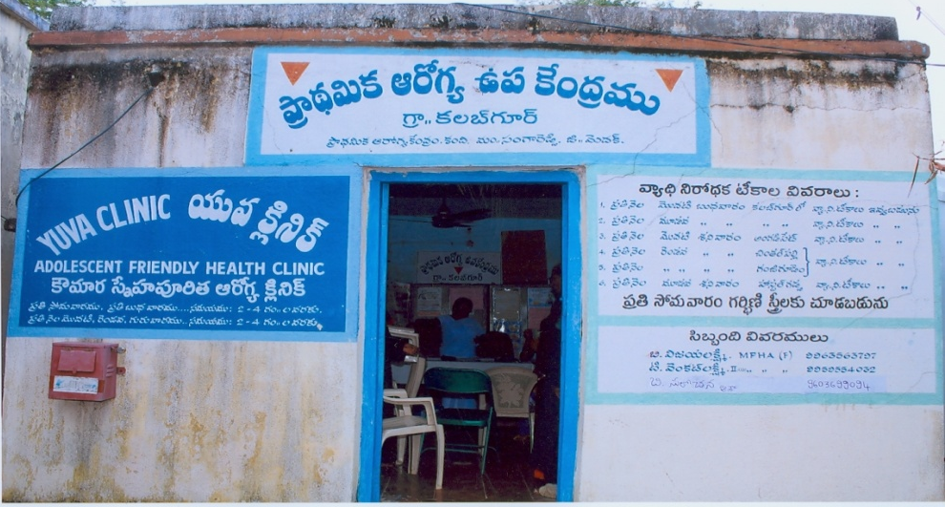
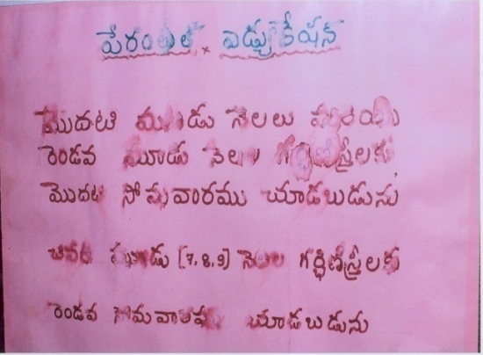
Planned birth preparedness and parental education sessions
Kalbgur PHC, Medak district Telangana state an ANM Organizing the A.N clinic days as per the trimester
Improved & Suggested plan
Every Monday - 1st trimester
Second Monday - 2nd Trimester
Third Monday - 3rd trimester –
Fourth Monday – Home visiting of mothers & newborns
Literal translation of adjacent board
Parental Education &Pregnant mother checkup
first Monday - 1st & 2nd trimester
Second Monday - 3rd trimester

Slide 15

Conducting birth preparedness and parental education session

Slide 16

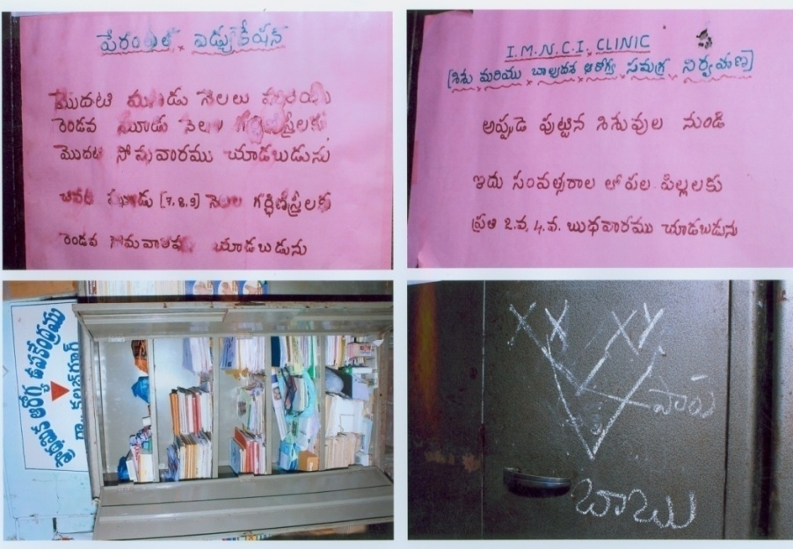
Teaching Aids - ANM kept in her clinic
Girl
Boy

Slide 17
Training & Budget
Training of Trainers at State Level : DPHNOs – Two from Each District
District Level of Trainers: CHOs(lady), PHNs , Staff Nurses from PHC
Facility level Training: Supervisors (F), PPP unit field staff, ANMs from PHCs
Training sites: PHC, cluster/block, CHC, AH & DH
Budget : Rs 5,79,295 / District (Approximately 800 to 900 participants)

Slide 18

“
Each Pregnant mother is unique & precious let us prepare them carefully

Slide 19
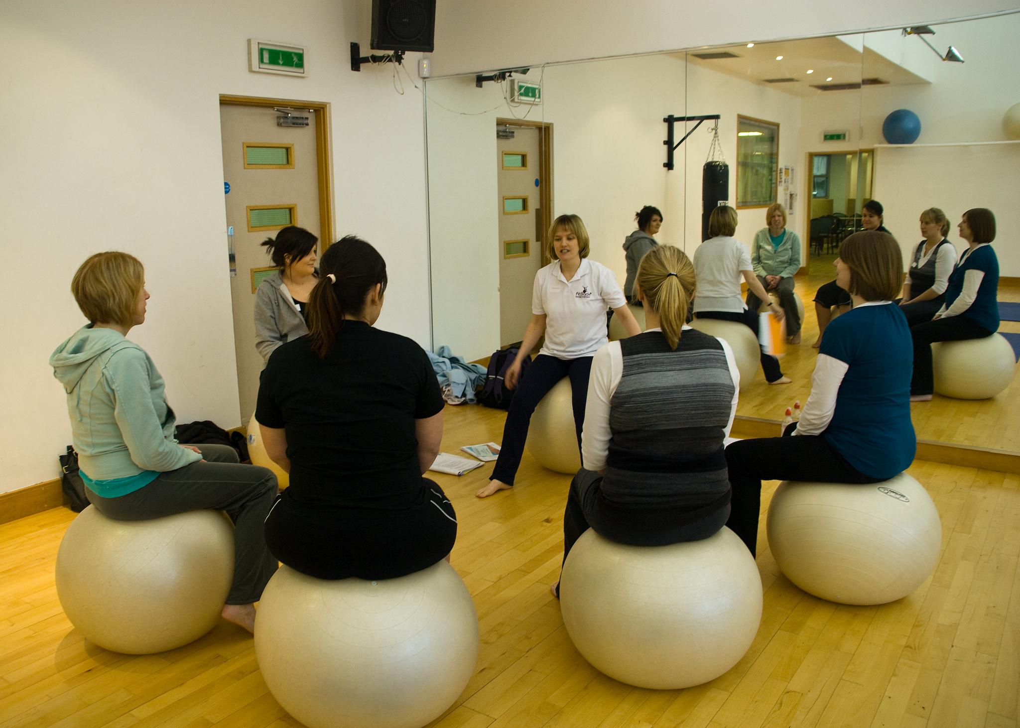
Strengthen Midwife
Promote
Safe motherhood

