Slide 1
Department of Health & Family Welfare Punjab
Cancer and Drug De-Addiction Initiatives
Hussan Lal, IAS
Secretary Health &
Mission Director- NHM
Department of Health & Family Welfare
Government of Punjab
1

Slide 2
BACKGROUND
Media – Print and Electronic declared cotton belt of Punjab as Cancer bowl
Train from Bathinda to Bikaner termed as Cancer Train by the people
Adverse effects on Matrimonial Alliances
Various academic, administrative and social bodies carried out studies but no evidence that Punjab has more Incidence or Prevalence of Cancer
No scientific data about the total cases, incidence or prevalence of cancer
Studies trying to relate the issue with consumption of polluted water and use of pesticides, however no linkage could be established.
The only academic study conducted by PGIMER, Chandigarh in two Community Development blocks- Talwandi Sabo (Bhatinda) and Chamkaur Sahib (Ropar) had put the figures of 125.4 /lakh and 72.5/lakh population respectively
Hospital Based & Population Based Cancer Registry at GMC Patiala and at PGIMER Chandigarh was initiated but no reliable data emerged.
2

Slide 3
AIMS AND OBJECTIVES
To carry out mass awareness campaign about cancer, its warning signs with a focus on the early diagnosis and treatment.
To identify individuals having warning signs/ symptoms .
To locate diagnosed cancer cases for treatment & palliative care and number of cancer deaths in last 5 years.
Capacity building amongst the ASHAs, ANMs, MPHWs, Nursing Students, Medical and Para Medicals for survey & awareness generation amongst them
3

Slide 4
CONCEPTUALIZATION
A core committee comprising of members from Medical Colleges, PGIMER, DMER, DHS, NHM, PHSC & SHSRC constituted at State level for state wide cancer awareness campaign
Consultations with experts from Government and Private Medical Colleges and from PGIMER, Chandigarh.
Opinion emerged that there is no scientific evidence of the extent of the problem
Door to Door survey through ASHAs, ANMs and Nursing students for Awareness and Symptom Based Early Detection of Cancer Cases.
Core Committee of experts constituted to work on various technical and professional issues.
Review Committee of Experts and the Administrators for regular review of the pace and progress of the campaign.
4

Slide 5
PILOT PROJECT
One District with population of 6.18 lakh is selected as pilot
Pilot project was launched on 02.10.2012 by Hon’ble Health Minister, Punjab and Special Secretary Health, Government of India
State Administrative Secretaries/ Officers, Politicians, Medical Universities Officers, Principals of Nursing Colleges, Nursing students etc. also attended the pilot project launch ceremony
To create awareness amongst public about the campaign and for seeking cooperation, mass rally was organised
5

Slide 6
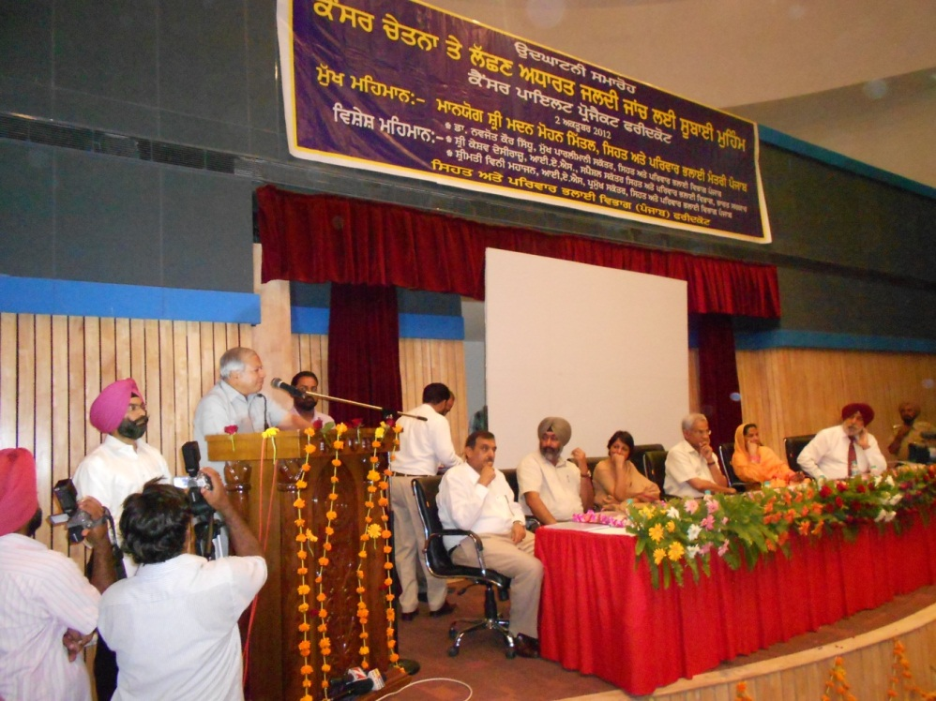
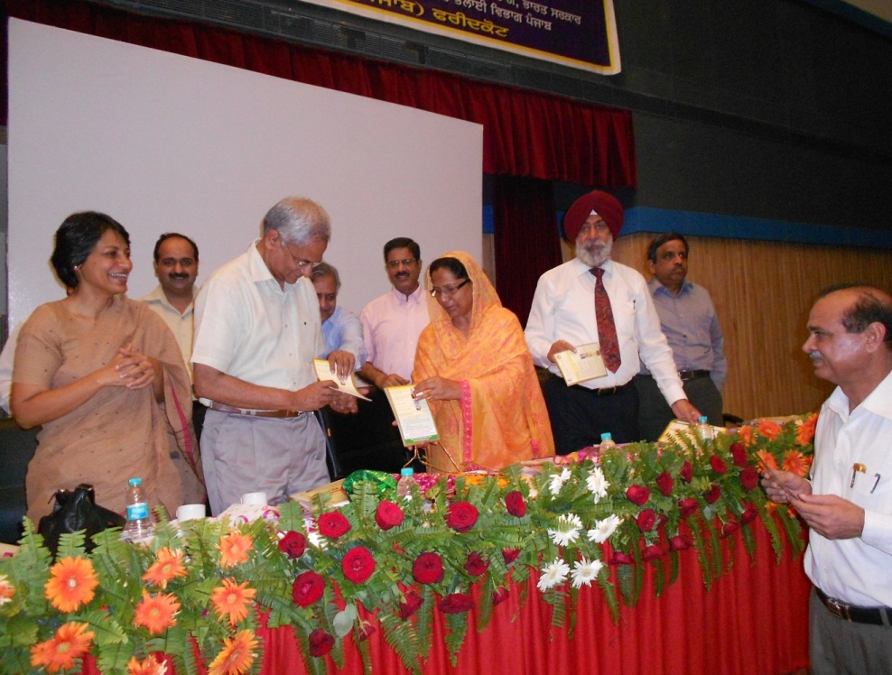
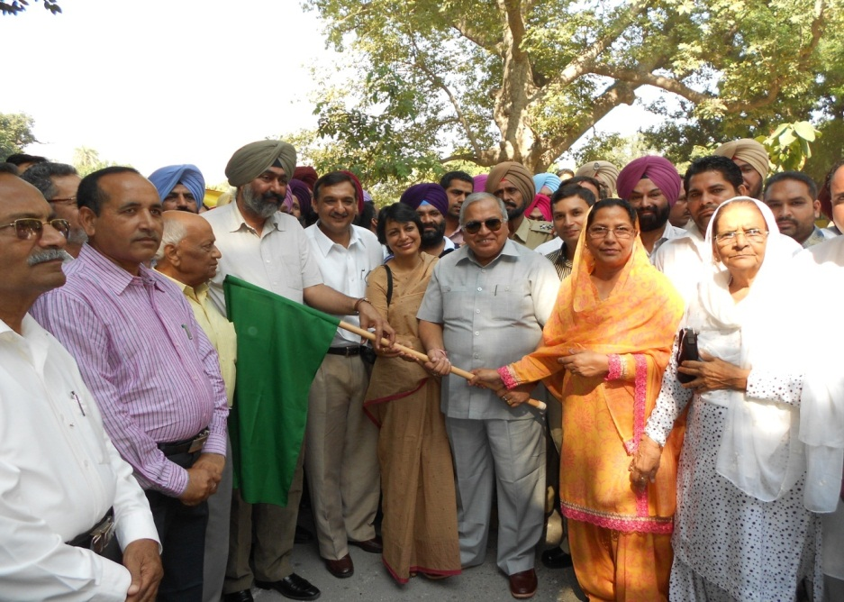
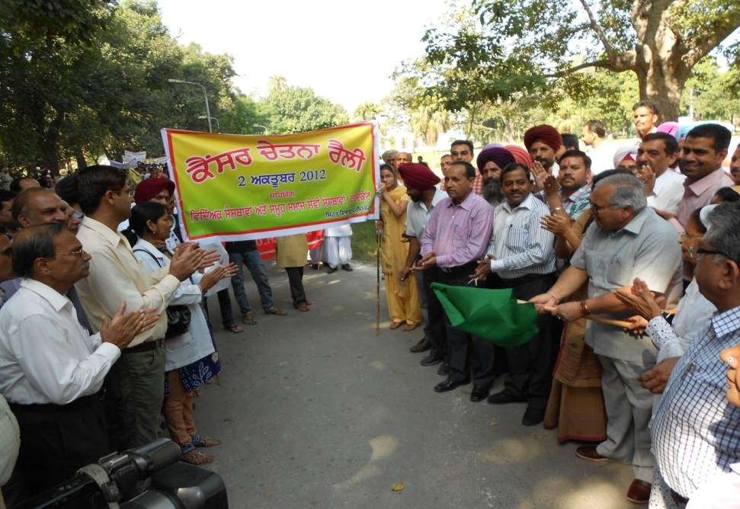
6

Slide 7
RESULTS & EXTERNAL EVALUATION OF PILOT PROJECT
94% Population of the district was covered
Outcome of Pilot project
  2950 suspected patients,
  785 confirmed cancer cases
  1112 deaths due to cancer in last 5 year
Pilot project was conducted by 767 members (ANMs, ASHAs, Nursing students etc.)
Data was transferred by ANM through Mobile Phones in Rural Areas and online data entry in the portal by Nursing students in Urban Area
External Evaluation of Pilot Project was done by School of Public Health, Post Graduate Institute of Medical Education and Research (PGIMER) Chandigarh
7

Slide 8
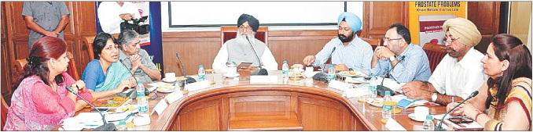
RELEASE OF STATE PROJECT
State Project proposal released by Chief Minister Punjab on 30th September, 2012 at Punjab Bhawan, Chandigarh
8

Slide 9
CONSULTATIONS, MEETINGS, ORIENTATION & REVIEW BEFORE ROLL OUT
Core Committee Meetings: Many Core Committee meetings held during this process. One under the chairmanship of Chief Minister, Punjab; one under the Special Secretary, Ministry of Health and Family Welfare, Government of India and the rest of the meetings under the chairmanship of Principal Secretary, Health and Family Welfare, Government of Punjab.
Review Meetings: Review meetings held regularly at the State Headquarter as well at the District Headquarter with the State and District Programme Officers.
Orientation Workshops: Various workshops held in the field & at a state-level workshop at the State Institute of Health and Family Welfare (SIHFW), Mohali.
Civil Surgeons’ Conferences
9

Slide 10
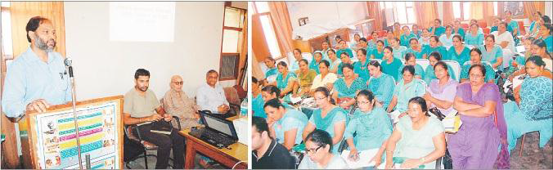
ORIENTATION WORKSHOP
Orientation workshops held by the SHSRC, Punjab in 19 districts.
Experience showed that orientation workshops acted as very good vehicle for orientation of the officers and the field workers, sensitization of the workforce and also helped in testing of proforma.
10

Slide 11
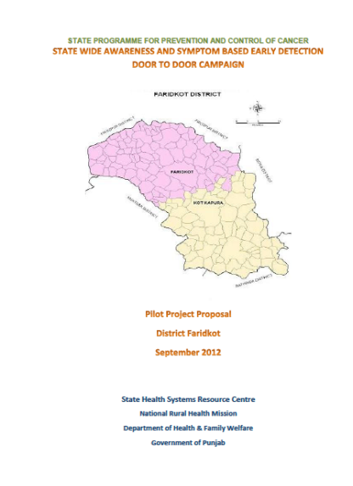

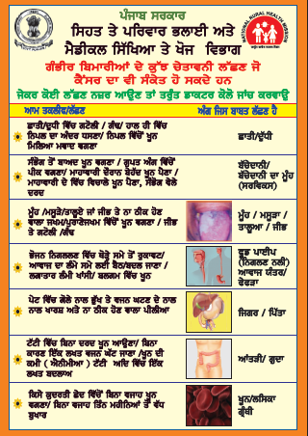
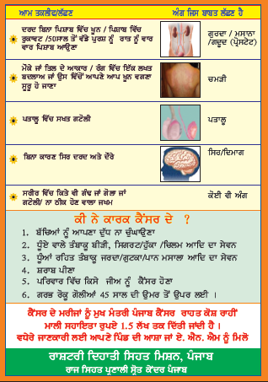
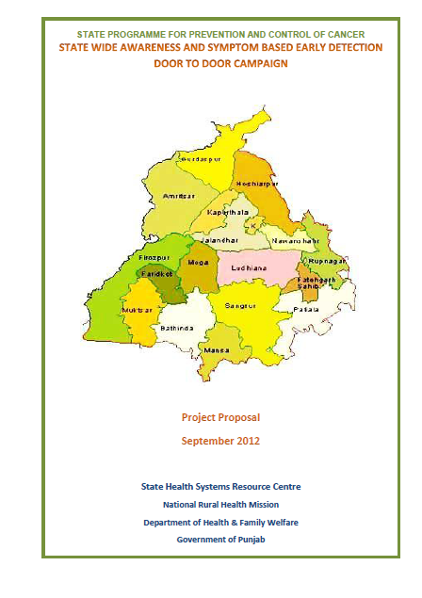


CAMPAIGN MATERIAL
11

Slide 12
TRAININGS
Key Resource Persons (KRPs)
State Resource Persons (SRPs)
Civil Surgeon/ACS, 4-5 District Programme Officers
District Resource Persons (DRPs)
District Officers, Dy. MEIOs, SMOs, Nursing Institutes Coord.
Block Resource Persons (BRPs)
Medical Officers, BEEs, LHVs, Nursing Institute Faculty
Field Workers
ANMs, ASHAs, ASHA Facilitators, Nursing Students
12

Slide 13
Information, Education & Communication (IEC)
Press Conferences: Press conferences held by the Chief Minister, the Health Minister and various health administrators. Widely covered in the media and acted as a strong medium of information.
Electronic Media :All India Radio and various channels carried detailed stories.
Advertisements published by NRHM, Cancer Control Cell, AIDS Control Society Punjab and MAX Hospital
Handout distributed
Slogans
Awareness Posters
13

Slide 14
STATE ROLL OUT
State Wide campaign was launched on 1st December, 2012
Inaugurated by Various Community leaders, government functionaries and prominent citizens all over state
Roll out widely reported in various newspapers in English, Hindi and Punjabi languages
14

Slide 15
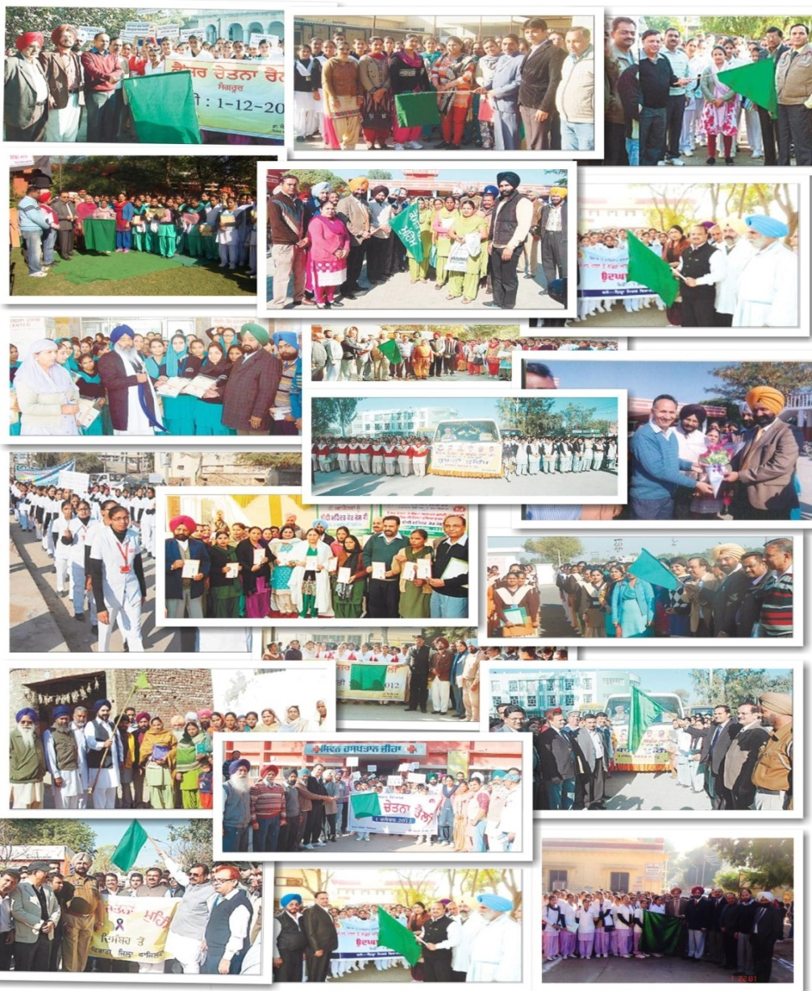
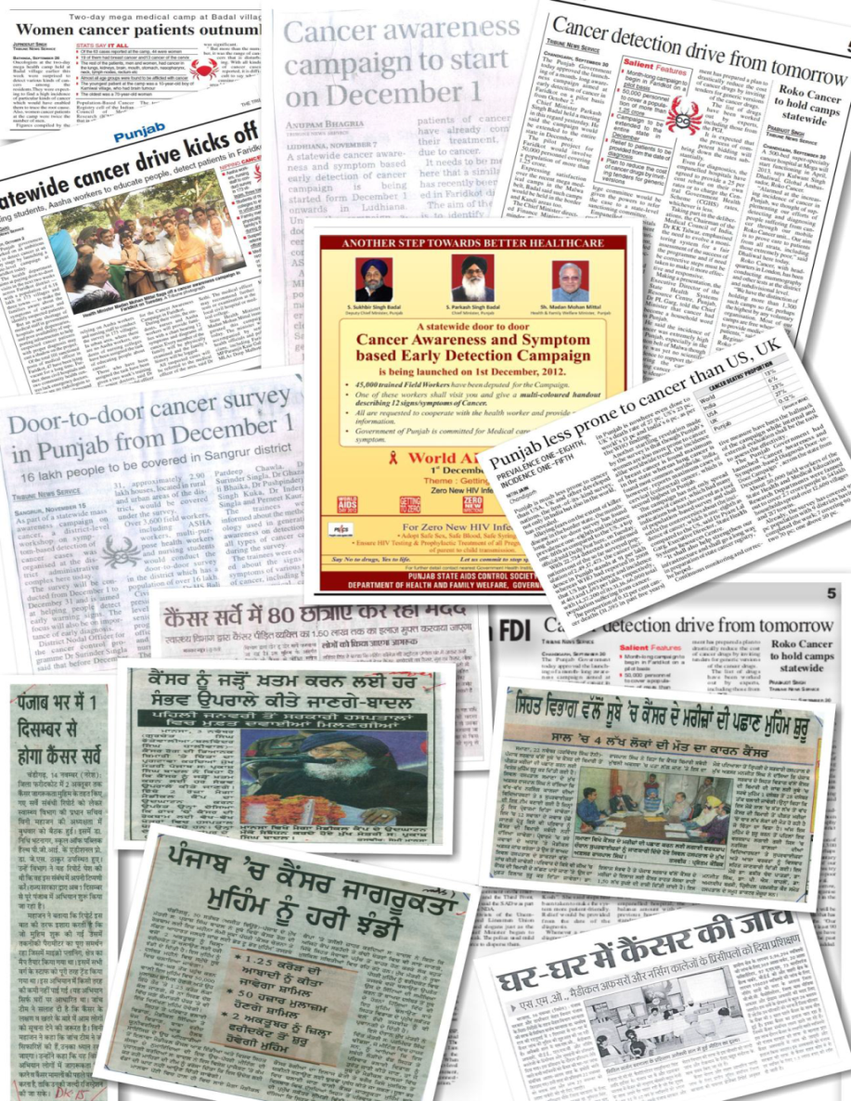
15

Slide 16
OUTCOMES
Time Frame
House to house visits completed in 45 days i.e. Dec 1, 2012 to Jan 14, 2013.
Coverage
51,58,184 households visited
2,70,67,539 population covered during the campaign
87,403 suspected cases found suffering from warning signs/ symptoms
24,659 self-declared cancer cases enlisted
34,430 deaths in the last five years due to cancer enlisted
Motivated and Generate Awareness on Cancer among Field Worker and Block Resource Persons
16

Slide 17
OUTCOME
17

Slide 18
FURTHER ACTIONS BASED ON OUTCOME
Revise the state specific Mukh Mantri Punjab Cancer Rahaat Kosh Scheme (MMPCRKS) guidelines and procedure
Simplified the procedure to avail the MMPCRKS benefit
Provision to provide 118 cancer drugs at cheap rates
Launched census bases cancer registry programme
In collaboration with Government of India and Tata Memorial Research Centre, Mumbai, state is going to establish 300 bedded Homi bhabha Cancer hospital
Established 100 bedded Advance Cancer Diagnostic Treatment and Research Centre in collaboration with Baba Farid University of Health Sciences
Established Cancer Care Facility centre at District Hospital Sangrur in collaboration with Tata Memorial Cancer Research Centre, Mumbai
Installed ‘State of Art’ equipment in Radiology Department of each and every Government Medical Colleges and Hospitals of the state
18

Slide 19
FURTHER ACTIONS BASED ON OUTCOME …..Contd.
Installed Brachytherapy machine at Medical College Patiala
Installed Cobalt Unit for cancer patient treatment at Medical College, Faridkot
Installed Cobalt Source for cancer patient treatment at Medical College, Amritsar
Free travel in Punjab Roadways and PRTC buses to cancer patients for treatment
19

Slide 20
PROBLEM OF DRUG ADDICTION
DRUG DE-ADDICTION INITIATIVES
20

Slide 21
PROBLEM OF DRUG ADDICTION
High prevalence rate: as per various news items and media reports
But No Scientific Study
ICMR has been requested to conduct study
Highest seizure of opium and heroin: 60 percent of all seizures in India
3.3 lakhs patients treated on OPD, 11,656 as indoor patients and 22,000 patients in jails
21

Slide 22
FACTORS LEADING TO EPIDEMIC EXTENT
Slipping growth rate
Stagnation in rural economy
Lack of industrial growth
Rising unemployment
High rate of migration
High affluence and middle class aspirations
22

Slide 23
FACTORS LEADING TO EPIDEMIC EXTENT
Health
Increased morbidity and mortality
Occupational
Absentism, loss of job
Family
Fights, neglect, divorce
Costs and externalities of drug use
Social
Stigma & Isolation
Financial
Forced expenditure, debts
Legal
Crime, accidents & Fights
23

Slide 24
RATIONALE FOR GOVERNMENT INTERVENTIONS
Initial drug consumption may be voluntary, but after addiction it is non-voluntary and forced (forced exchange by seller)
It has negative impact on family members and society (externalities)
Protection from violence (health hazard)

Slide 25
OBJECTIVES
Reduction in drug demand
  Create awareness
  Identification through community participation
  Detoxification and de-addiction
Healthcare and harm reduction
Rehabilitation through counseling and de-stigmatization
Capacity building of human resource
Creation of treatment and rehabilitation infrastructure

Slide 26
POLICY PLAN
Planning prepared under the guidance of experts from PGI, Chandigarh (Dr. Ajit Awasthi & Dr. D. Basu)
Master trainers trained by the PGI
Initial training for Rehabilitation By PGI
Prevention of potential addiction
  Awareness: harms of drug use
  IEC Activities: Targeting vulnerable and high-risk groups
  Awareness campaigns: School and colleges
  Workshops and interactive sessions with media
  Development of educational material
  Outreach programmes
    Schools & Colleges
    Night shelters

Slide 27
DRUG DETOXIFICATION
Identification of drug addicts
  Sensitization of family and community
  De-stigmatization: Acceptance of need for treatment
Treatment
  Drug De-addiction Centres
    CHC (150) : One GDMO
    SDH & District Level (31) : 10 and 20 bed
    Central Jails (8) : 50 bed
    Model DDCs (5) : 50 bed

Slide 28
DRUG DE-ADDICTION: TREATMENT
Three tiered structure
Level III:
MDDCs
Level-II: DDCs
Level-I: Primary Services-Referral

Slide 29
REHABILITATION
Rehabilitation and Social Integration
  Rehabilitation Centres (22 at District level)
    New Buildings (Under Construction)
    Skill development/Vocational Training
    Employment
    Counseling of patient
  Social Integration
    Awareness campaigns and sensitization
    Counseling of family members

Slide 30
DRUG DE-ADDICTION PROGRAMMES IN JAILS
Persons who have undergone complete t/t in Detoxification Barrack : 22669
Persons currently in Detoxification Barrack : 461
Persons currently in Rehab Barrack :718

Slide 31
IMPLEMENTATION STRATEGY
Stakeholder interface- medical & para-medical staff, NGOs, Schools & Colleges, media, PRIs, police and government officials, religious leaders
Creating linkages: Specialized medical institutions (AIIMS, NIMHANS, NACO, Medical colleges), ITIs, Polytechnics, Industries
Capacity building: Medical professionals & staff, NGOs, PRIs, prison staff, stakeholder groups
Administrative Structure
  Stale Board chaired by CM
  State Monitoring Committee under CS
  District-level Society under DC
Cancer & Drug Addiction Treatment Infrastructure Fund (CADA Fund)

Slide 32
CANCER & DRUG ADDICTION TREATMENT INFRASTRUCTURE FUNDS (CADA FUND)
Fund flow from:
  0.25 % of Purchase value of Basmati Paddy
  2% value of auction of any property
  1% of any infrastructure project
  33% of tax on Tobacco products and so on
  Total collection: Rs. 174.02 Crores

Slide 33
IMPLEMENTATION STRATEGY
Tackling government failure (simulating markets)
  Rehabilitation Centres , Drug Deaddiction Centres and IEC campaigns to be run by NGOs
  NGOs may competitively bid for projects
  Minimum standards of services

Slide 34
COST IMPLICATIONS
S. No. | Head of expenditure | Amount (in crores)
1 | IEC (Prevention & Identification) | 10.00
2 | Capital Expenditure (RCs & DDCs) | 142.0
3 | Operation & Maintenance | 20.0
4 | Administration & Control | 12.27
 | Total Cost Implications | 184.27

Slide 35
MONITORING & EVALUATION
Drug Abuse Monitoring System
Administrative review
Social audits
External evaluation

Slide 36
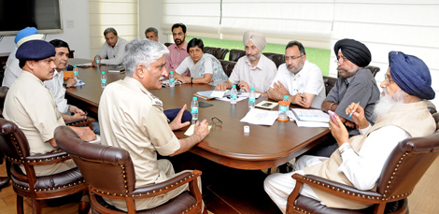
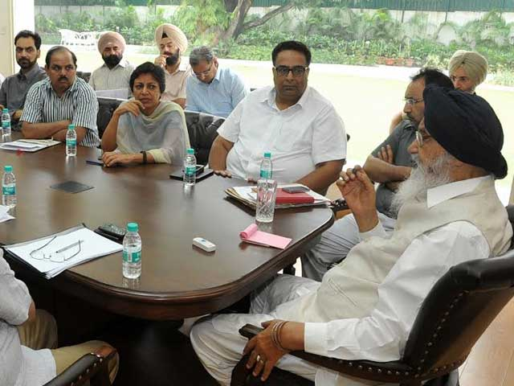
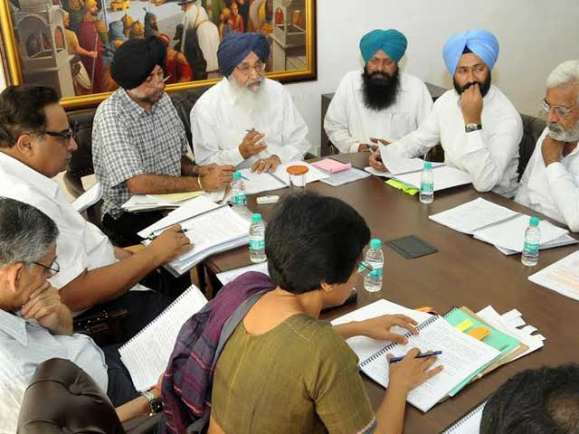

Slide 37
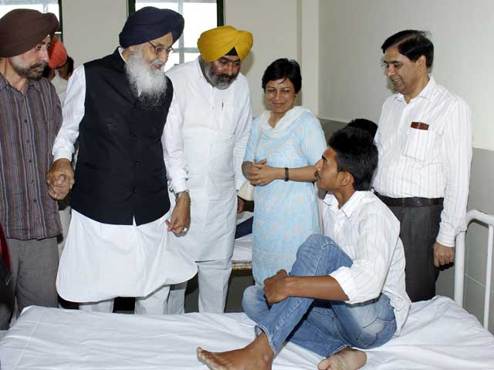
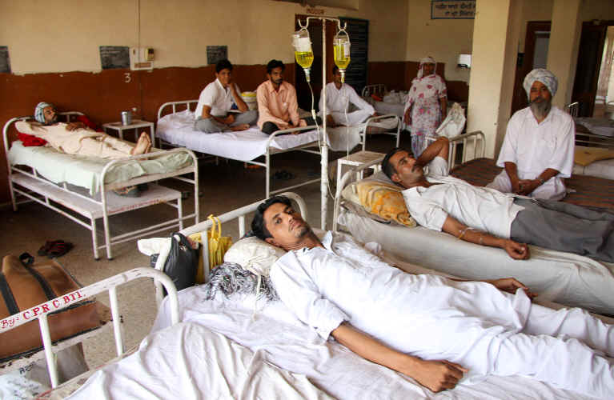
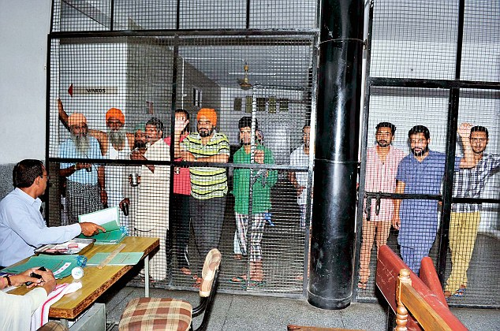
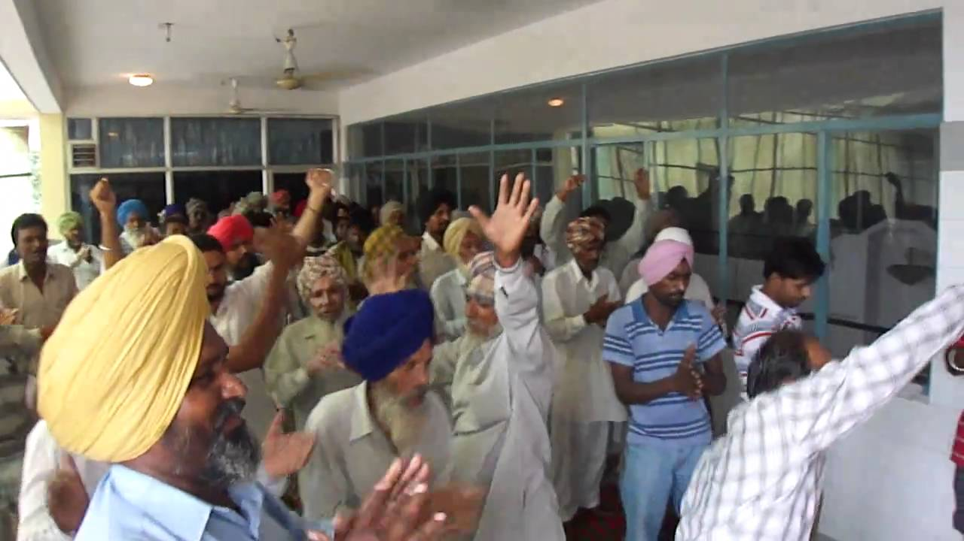

Slide 38
THANK YOU

