Slide 1

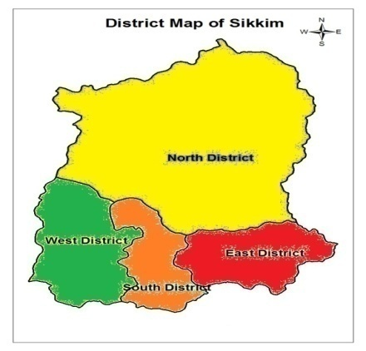
“Ensuring Institutional Delivery through VHSNC Participation”
National Summit on Good and Replicable Practices and Innovations in Public Health Care, Shimla.
2nd July 2015

Slide 2
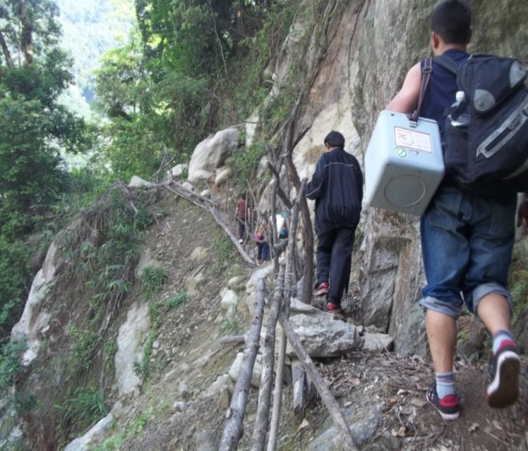
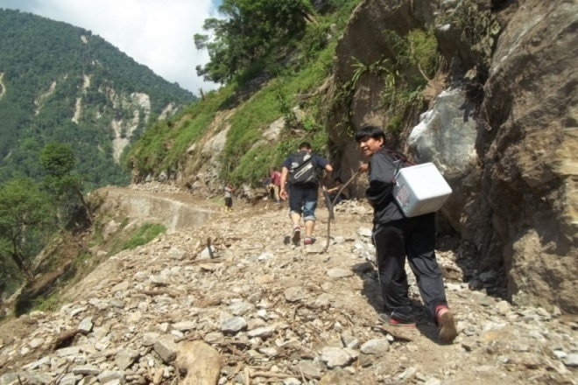

Situational Analysis
Smallest hilly state in Northeast with a population of 6,10,577. > 90% of population depend on Public Health facilities
Home delivery was unavoidable due to difficult geographical terrain, more challenging due to bad roads, weather conditions, expensive but limited transport services etc
This could have been a major factor for maternal as well as newborn deaths in the state
To address the problem of home delivery it was essential to involve the community participation in decreasing the home deliveries at their own villages

Slide 3
Operationalisation of the Practice
Extensive one day training was conducted to VHSNC members in all districts covering all under each PHC and districts. (641 numbers of committes )
Training was taken up to strengthen the existing VHSNC committee and reinforce the concept of safe institutional deliveries to unsafe home deliveries through presentations on roles and responsibilities of the members and for their support in RMNCH+A implementation activities in their respective areas
The members were encouraged to take ownership to make their village area healthy with combined efforts from PRI members, Health workers, ASHAs ,AWWs ,NGO members and others
Initiated from 2013 and was taken into field in May 2014 in North district and subsequently in other districts

Slide 4
Impact of the Practice…
Institutional deliveries has gone up with decrease in home deliveries due to community participation and active involvement of ASHAs,AWWs and the PRIs in their respective areas (VHSNC)
Pregnant mothers were brought to or near the available health/transport facilities before the expected date of delivery in many hard to reach areas by the help of community especially ASHAs
Quality care services is ensured at all the health facilities for the mothers delivering at the institution which as per the demand of the community

Slide 5
Impact of the Practice contd..
Year (Source HMIS) | Percentage of ID against reported delivery | Decrease Home delivery status | Maternal Maternal deaths by absolute number | IMR ( SRS)
2012-13 | 82.7% | 17.3% | 26 | 24
2013-14 | 93 % | 07% | 11 | 22
2014-15 | 97.9% | 2.1% | 15 | -

Slide 6
Impact of the Practice

Slide 7
District Wise Impact of the Practice
Year | Percentage of ID against reported delivery |  |  |  | Home delivery status
 | North | East | West | South | North | East | West | South
2012-13 | 77.4 | 94.4 | 78.4 | 86.7 | 22.6 | 5.6 | 21.6 | 13.3
2013-14 | 92.7 | 96.4 | 84.1 | 90.7 | 7.3 | 3.6 | 15.9 | 9.3
2014-15 | 96.8 | 98.5 | 97.8 | 96.4 | 3.4 | 1.5 | 2.2 | 3.6

Slide 8
Impact of the Practice..

Slide 9
Way forward…
Continue Supportive supervision & monitoring of the activities by the concerned officers from the PHC, District and the State
Regular review of pockets of home deliveries and ensure MDR & CDR
VHSNC members to continue active participation and provide full support to the health system in their respective areas for quality health care services
Review of VHND at all levels
Registration of all PW in MCTs

Slide 10
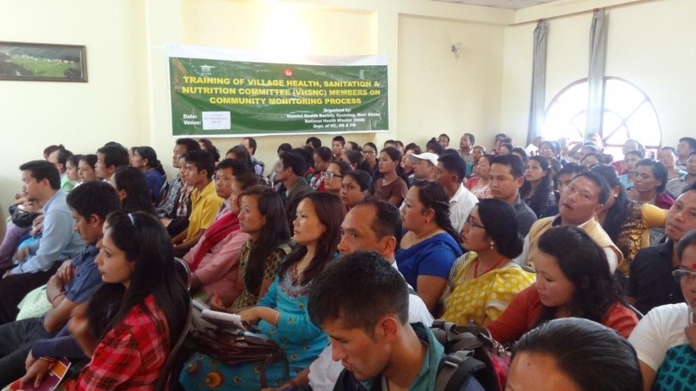
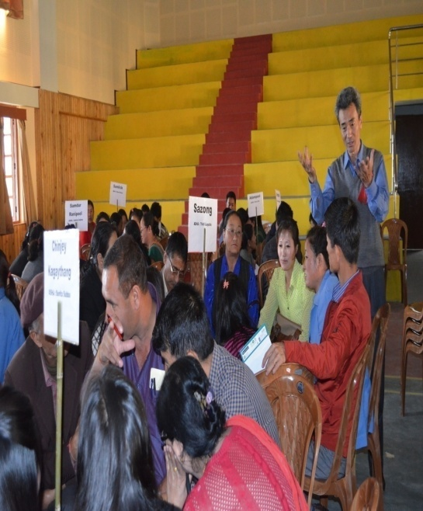
A few glimpse …

Slide 11
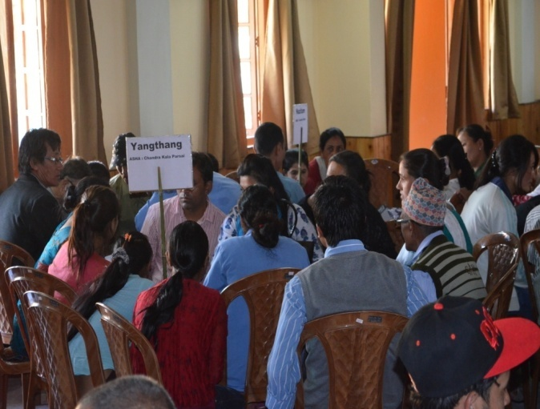
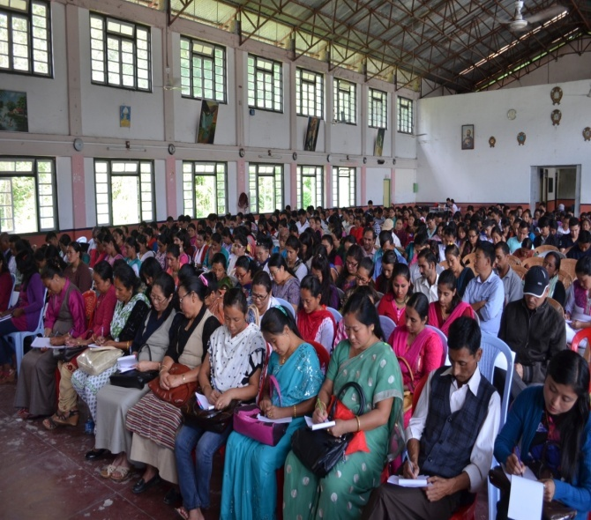

Slide 12
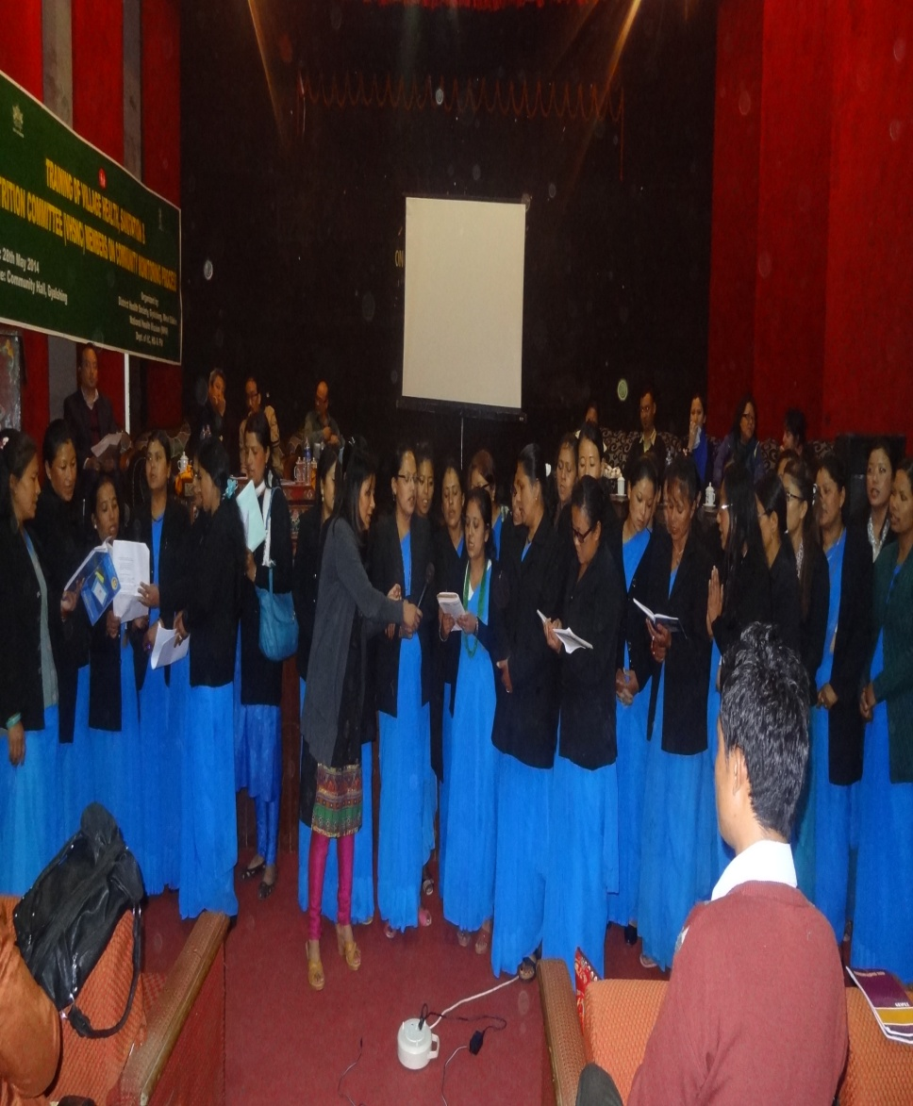
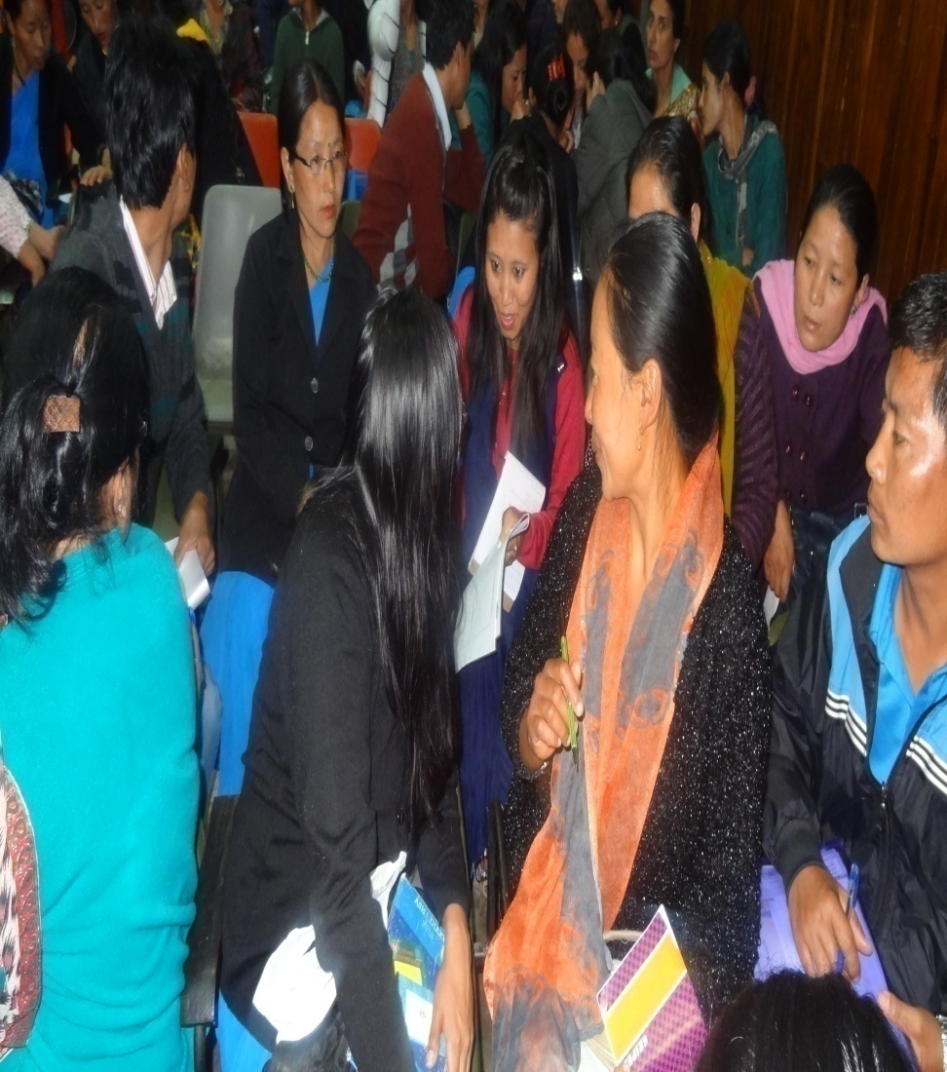

Slide 13

Thank you
Dr N. Shenga
Joint Director( RCH )
Sikkim

