Slide 1




National Health Mission Dept. of Public Health & Family Welfare, MP
DAKSH
Skills Lab
MADHYA PRADESH

Slide 2

Situation Analysis
Madhya Pradesh
76 (2004-06)
54 (2013-14)
IMR
3.5 (2005-06)
2.9 (2013-14)
TFR
335 (2004-06)
221(2011-13)
MMR
Maternal Deaths: 4080
Neo.N Deaths: 68,845
Still birth: 9250
Disparity in MMR with high burden districts being Sagar (322), Shadol (361) & Rewa (228)
Live Births: 18.5 lakhs
Population: 725.9 lakhs
Source SRS

Slide 3
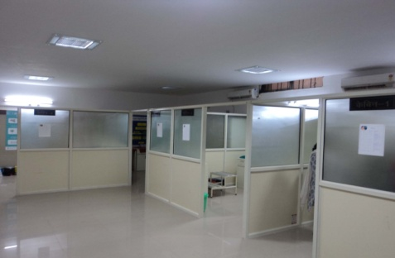
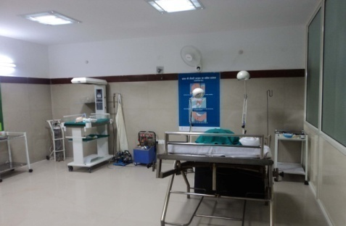
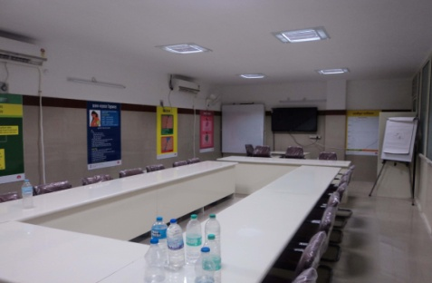
Objectives of Skill Lab
Focus on RMNCH+A Services
  Facilitates acquisition / reinforcement of key standardized technical skills and knowledge by service providers for RMNCH + A services
  Ensures the availability of skilled personnel at health facilities
  Improves the quality of in service training

Slide 4
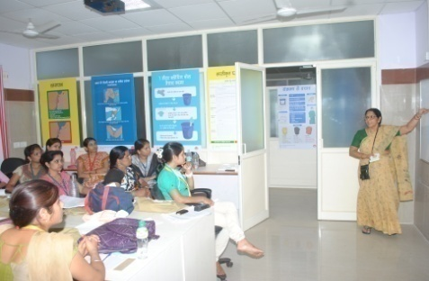
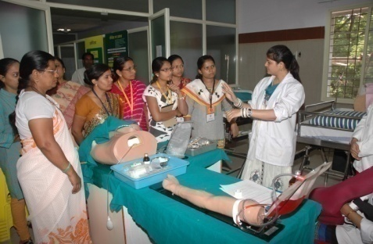
Objectives of Skill Lab
Focus on RMNCH+A Services
  Provides Continuing Nursing Education / Continuing Medical Education.
  Skill lab Training is a complementary to SBA Training. Skill lab provides training on 39 skills in 6 days duration
DAKSH
Notes:
Combine 3 and 4

Slide 5
Steps for Operationalization-
GoI guidelines
Divisional Joint Director (Supported by Divisional Programme Management Unit)
Orientation:
Select a location:
Divisional Level Training Institute (SIHMC/RHWTC/DH)
Divisional level-DNO:
Nodal Officers in competency based training models and operational guidelines on Skill lab.
Dy. Director Maternal Health (supported by Skill Lab. Consultant)
State level- SNO:
With FA and TA of UKAID/MPTAST

Slide 6
Location and Coverage of skill Lab
Gwalior
Jamia Hamdard is the National mentoring skills lab
Rewa Div
Sagar Div.
NEW
Bhopal
NEW
Indore
Will start shortly
Skill lab Catchment area Bhopal – Bhopal and Sagar Division , Gwalior - Gwalior and Jabalpur Division , Indore - Indore and Ujjain division , Rewa - Rewa Division

Slide 7
Operationalization of Skill Lab (as per GoI Norm)
Establishment
  Approximate 3000 sq feet area is required to establish 4 Skill cabins (12’ x 12’), 1 model LR (10’ x 12’) , 1 Seminar hall (1000 sq feet) & office (600 sq feet)
  State Civil wing- construction/refurbishing of identified site for skills lab
  State Procurement cell- facilitate procurement of mannequin
  Regional Joint Director - Teaching/learning aids
  Human resource-1 MO+5 SNs as trainers ,1 DEO and 1 support staff (4 SNs on out of 10 on Deputation),one faculty of training institute /DD of Div JD office
Operationalization
  Preference given to SNs/ANMs of HPDs for providing skill lab training
  District wise list of Delivery points identified on the basis of delivery load.
  Scheduling of batches from high delivery load facility.
  Mentoring
  Regular one week mentoring visits every month by trainer from Skills Lab & District level Skill lab trained staff.
  A roster has been prepared for all the teams
  Duration: Depends on delivery points to be covered and number of trained personnel to be supervised.
Notes:
Put it in table

Slide 8
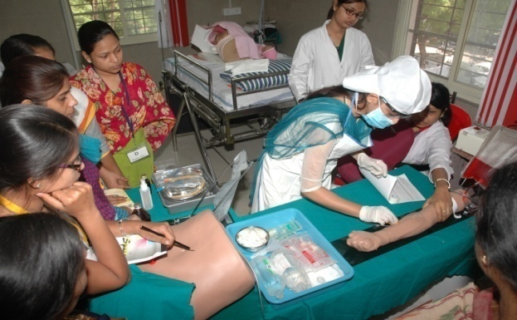
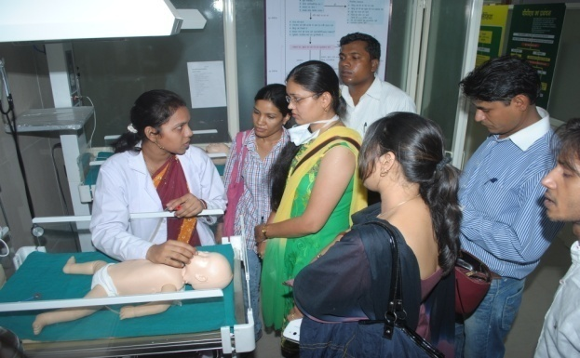
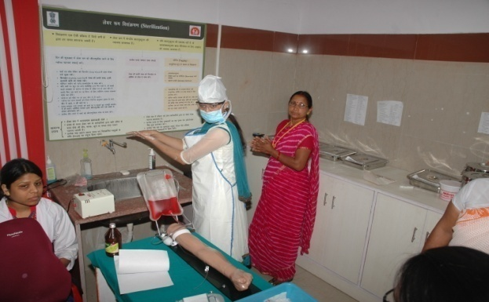
Financials- per Skill Lab.
 | One time Cost | Recurring Cost
1 | Civil Work @ Rs. 20 lakhs | HR 1 Medical Officer, 5 Staff Nurses, 1 DEO and 1 Office Assistant
2 | Procurement of mannequins @ Rs. 15 lakhs | Training Batches @ Rs. 1,32,400
3 | Teaching aids @ Rs. 3 lakhs | Mentoring visit @ Rs. 75,000 per month
4 | Teaching and medical Equipment @ Rs. 13 lakhs | Annual maintenance Rs. 50,000 per year
Establishment cost of all 4 skill lab and operational cost for Bhopal and Gwalior skill lab for the FY 2014-15 provided by DFID
Provision of honorarium of Human Resource, Training, Mentoring Visit and annual maintenance in PIP 2015-16

Slide 9
Time Utilization in Skill Labs (in days)
 | Gwalior | Bhopal
No. of days since intiation | 208 | 338
Batches of Service providers | 102 | 162
Mentoring visits | 30 | 48
SBA trainers assessment | 8 | 8
Nursing tutors training | 12 | 12
LHV training | 18 | 0
Matrons training | 18 | 18
Master trainers of other states | 0 | 12
TOT of Skill lab trainers | 0 | 18
Total days utilised | 188 | 278
% days | 90.4 | 82.2

Slide 12
Way Forward
The skill lab to be utilized for pre recruitment assessment and training to Nursing College faculties and DPHNOs and Mos of delivery points
1596 identified MCH Centers and a total of 4264 Nursing Staff posted to be trained through 4 skill lab in 2 years.
    Bhopal skill lab – Sagar and Bhopal Division (374 Facilities and 1393 Nursing Staff)
    Gwalior Skill lab – Gwalior and Jabalpur Division (538 facilities and 1559 Nursing Staff)
    Indore Skill lab – Indore and Ujjain Division (451 Facilities and 1428 Nursing staff)
    Rewa Skill lab – Rewa Division (233 facilities and 732 Nursing staff)
Due to large catchment area with large number of delivery points and trained staff mentoring visit would be a challenge.
Online Capturing of improvement of quality of LR practices (MWMIS)
Scaling up and improvement of training quality through Virtual Classes
Notes:
To improve pace and refresher trainings using the skill lab as a base for training giver, IT ifra and app of NIC and districts as recepients.

Slide 13
Lets join hands….
…to save the mothers & newborns

