Slide 1
Health and Family Welfare Department, Gandhinagar
Best Practices and Innovations-
Surat Municipal Corporation
Date : 04/06/2015
Venue : Shimla

Slide 2
Specific Character of the City
Surat city is the 4th rapidly growing city of India with highest migration rate in the country.
Highly industrialized city cover approximately 50 lacs population out of which 40% city area is slum and slum like.
Surat city is highly conducive (suitable temperature and humidity) to increase the disease burden (vector borne and water borne) and hence Surat has one of the model VBDC activities in the nation.
City have faced 24 floods in last century, last was in 2013 and several new resurgent infections in last two decades.
Surat has storm water drain facilities.
Notes:
Surat lies in the flood plain area. Repetitive floods, high population density, river side location, changing rainfall pattern, socio demographic structure, and rapid industrial development activities are the reason for increase in burden of VBD.

Slide 3
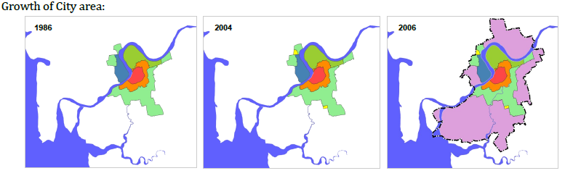
Specific Character of the City
This increase in population has led to:
Increase in demand on efficient urban infrastructure and services
Needs of improving the monitoring and the complaint system
Requirement of adopting the Urban Service Level Benchmarking (SLB) on basic services for evaluating the performance of infrastructure projects funded under various National programmes

Slide 4
Organogram of Corporation
COMMISSIONER
Zonal Head
DEPUTY COMMISSIONER
(Health & Hospital)
Asst. Commissioner
MEDICAL OFFICER OF HEALTH
Dy. M.O.H.
(Zone Level)
Urban
Health
Centers (41)
Family Welfare (11)
ICDS
VBDC
Food Hygiene
Birth , Death & Marriage
Reg.
S.W.M
RNTCP

Slide 5
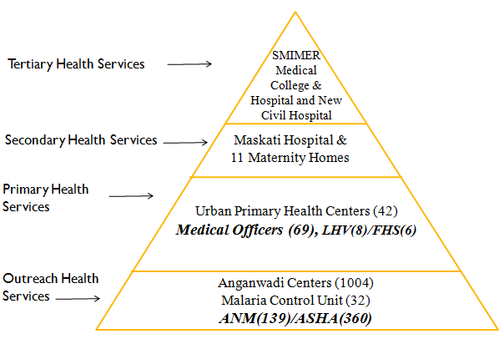
Organogram of City Health Facilities
As per Census 2011,
Total Population: 4461026
Slum/ slum like Population: 1807241

Slide 6
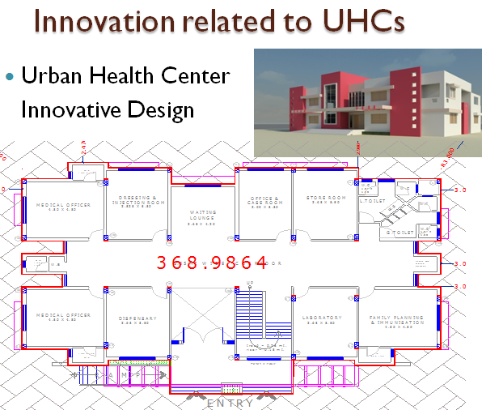
Notes:
UHC is designed according to IPHS Standards.

Slide 7
Management & Referral Arrangement at UHCs
RMNCH+A
IDSP
NVBDCP
RNCTP
UIP
SHP
ICDS
Medical Officer at UHC
FHS/LHV
SI
SI
SI
RBSK MO
Supervisor
TB Health Visitor
ANM/FHW
FHS/LHV
SSI
SSI/ANM
ANM
AWW
ASHA
SSI
Primary Health Worker
AWW/ASHA
MAS
ANM/FHW
Mobile Mamta Van
Ambulance Facilities- 108 and corporation ambulance

Slide 8
Best Practices and Innovations Initiated by
Surat Municipal Corporation, Gujarat

Slide 9
Best Practices 1: Enhancing accessibility of Specialists’ Medical Care at U-PHC
Need of this initiative:
  Patient attending U-PHC OPD need referral services/ consultants care are likely drop out due to monetary constraint.
  To minimize drop-out rate of patients and to provide expert care services at U-PHC, the initiative is taken.
Private consultants (Physician, Obstetrician, Pediatricians, Anesthetists, Dermatologists, Ophthalmologist) are invited to join as honorary consultants to provide two days per week services at U-PHC and are paid nominal honorarium of Rs. 3000/ month.
Presently, 22 UPHCs and 11maternity homes are covered under this project and 54 consultants are providing honorary services. As an upscale projection to tie up with 197 more specialists is in process.

Slide 10
In the year 2014-15, 34911 cases were attended by honorary consultants.
Budgetary provision of Rs. 20 lacs is done by SMC every year.
These honorary consultant services have improved the access of higher level medical care for needy patients, its cost effective approach.
  This project has changed the health care seeking behavior of the patients towards the U-PHC.
  The OPD has increased.
  The RCH services are strengthened.

Slide 11
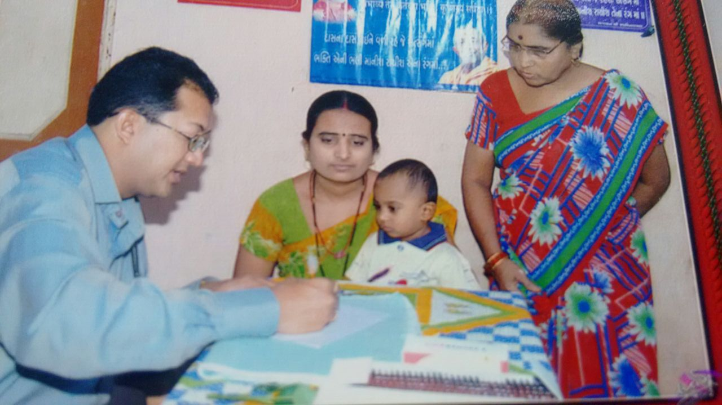
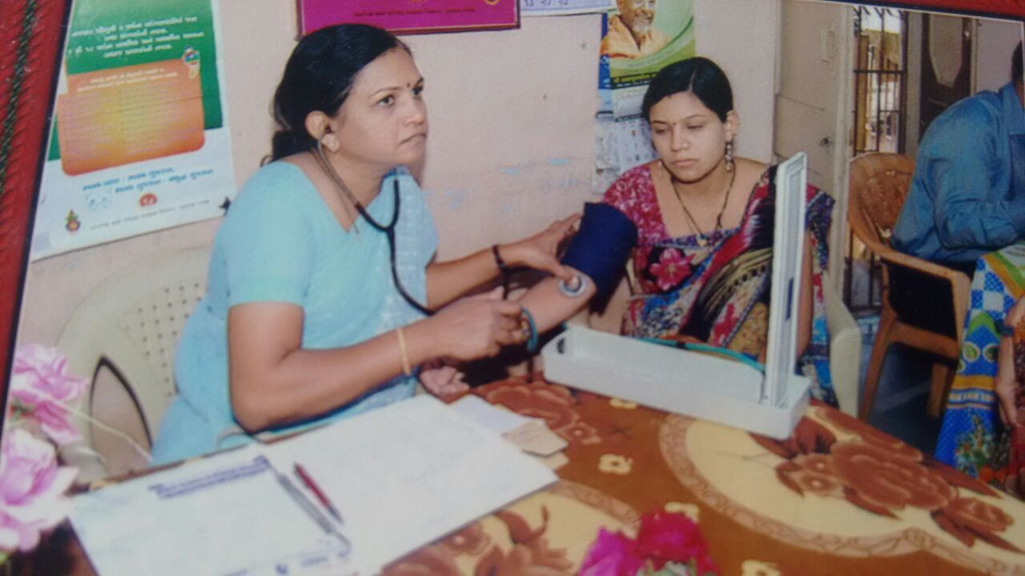
Pediatrician and Gynecologist attending the beneficiaries at Urban Primary Health Centre

Slide 12
Best Practices 2: Urban Service Monitoring System (UrSMS)
Need of this initiative:
  Even though the manual data collation system with paper-based approach was effective, the process was cumbersome and time consuming.
  It hinders the possibility of near real-time decision making due to bottlenecks within collection, data entry, validation, and information dissemination.
  A felt need of real time data collection and analysis lead to UrSMS project.
The project was developed for improving the monitoring and grievance redressal for health, water supply, sewerage and solid waste services.
Notes:
SMC has initiated the complaints registration by introducing phone based and Internet based complaints systems. This process can reduce the extra human resources required for data entry and quality check of redressal process which could be utilized for monitoring the performance of the system.

Slide 13
The main objective of the UrSMS is to elevate the existing complaint & monitoring system to a much advanced as well as involving people-participation.
The main feature of the system is designed
  To enable SMC officials to view the map, data and relevant statistics on near real time basis.
  To enable decision makers to evaluate the performance and bottlenecks at various levels to take timely action.
The UrSMS has two components
  1) Services Monitoring System and
  2) Complaint System

Slide 14
UrSMS allows residents of Surat to report and receive information on water supply, drainage, solid waste collection via their mobile phones.
System components:
  Water supply complaint system
  Door to Door – Solid waste collection complaint system
  Drainage & Sewerage complaints system
  Water distribution quality monitoring system
  Health monitoring system
This web base system provides structured form based interface for ease in data collection and also facilitate the data storage, sorting and analysis.

Slide 15
The system has two main interfaces:
  Mobile phone based structured text messaging system has been developed.
  PC interface for collecting data and visualizing the information as charts, reports and maps.
This helps city health officers to select the location, disease-type and time-period to generate structured reports and maps. Patient history is also available to the health institutions.
This project has been recognized as winner “Projects to watch” in the UN Big Data Climate Challenge Award (2014).
http://surat.ursms.net/cms/Home.aspx

Slide 16
UrSMS Action Plan
Private/ SMC
Hospital
Online
dissemination
Action
at
Zone office
Urban Health Centers
CASE
Report at HQ
Action
Feedback
Other hospitals/
Laboratories
General Practitioners
Daily
With in 24 Hrs
http://surat.ursms.net/cms/Home.aspx

Slide 17
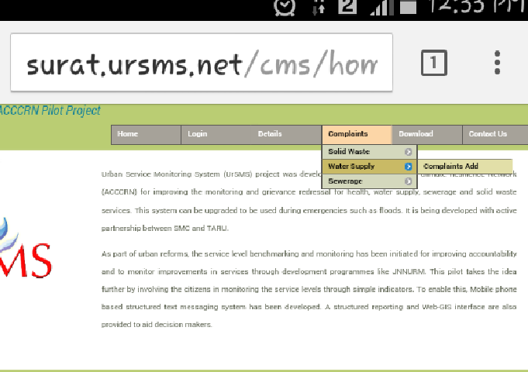
Complaint System
http://surat.ursms.net/cms/Home.aspx

Slide 18
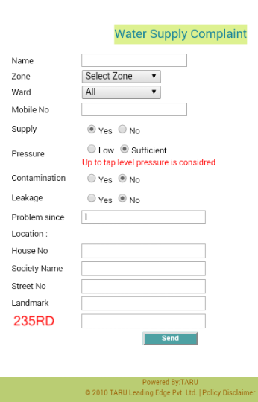
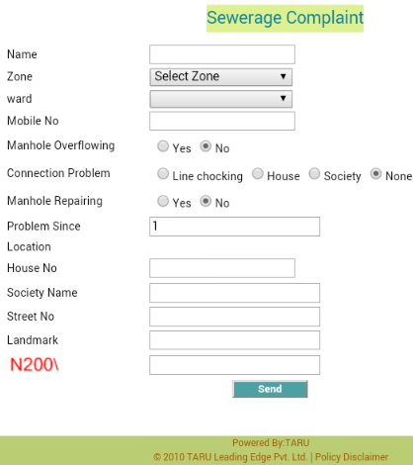
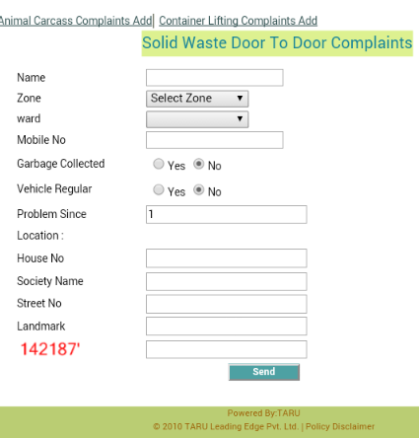
http://surat.ursms.net/cms/Home.aspx

Slide 19
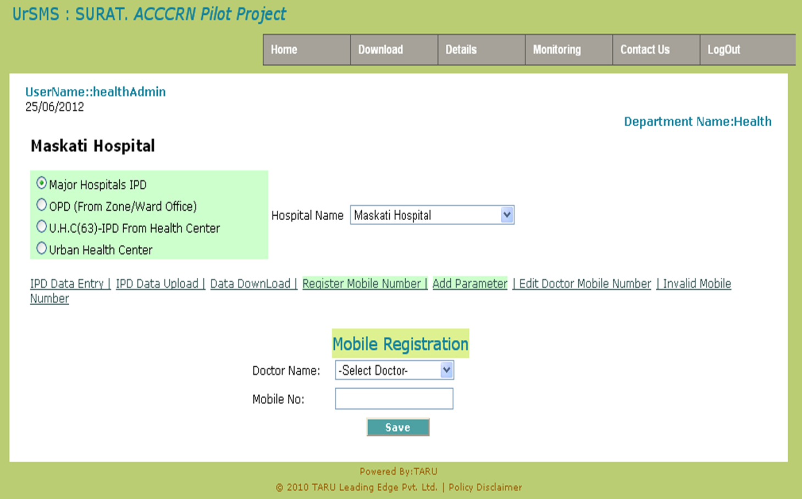
Operating System
http://surat.ursms.net/cms/Home.aspx

Slide 20
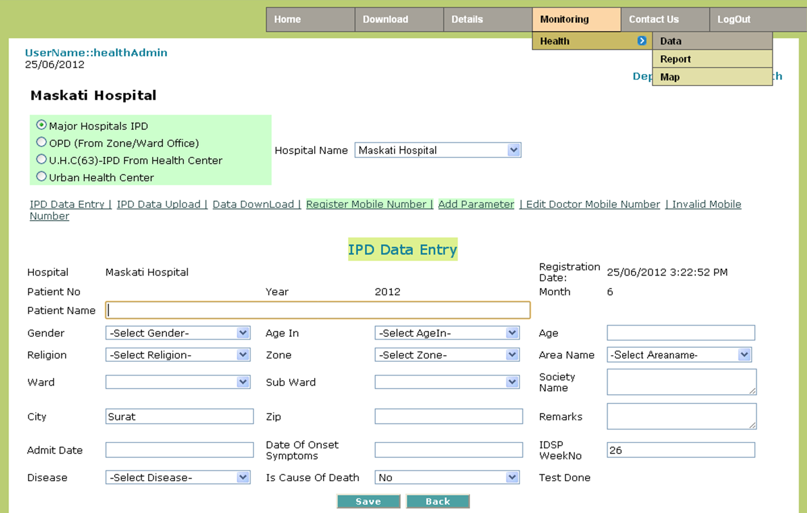
http://surat.ursms.net/cms/Home.aspx

Slide 21
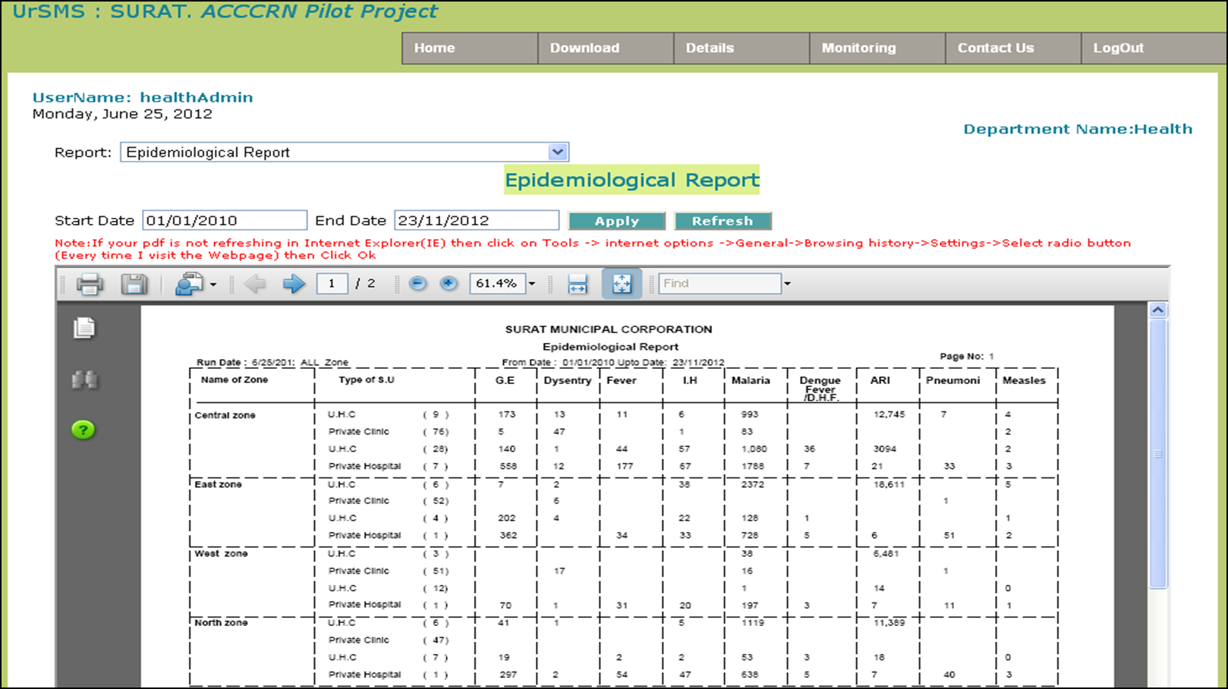
Monitoring System
http://surat.ursms.net/cms/Home.aspx

Slide 22
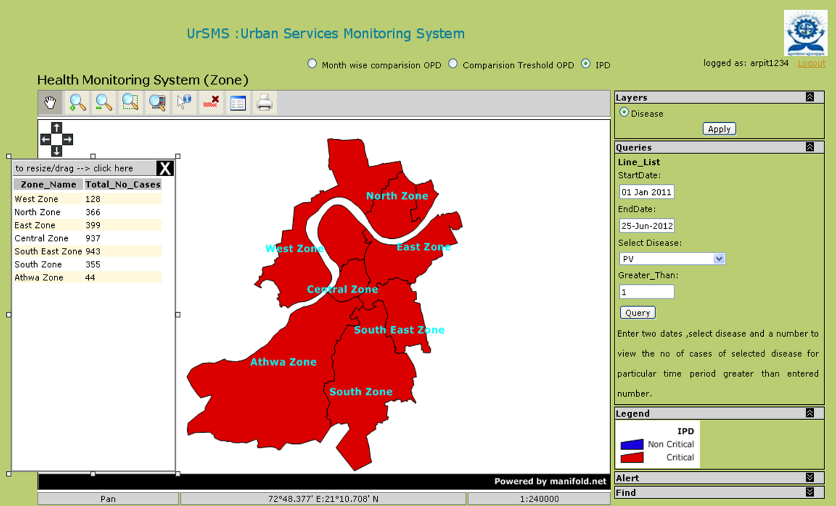
http://surat.ursms.net/cms/Home.aspx

Slide 23
Best Practices 3: Urban Health and Climate Resilience (A Public Health Observatory)
Urban health and Climate Resilience Center (UHCRC), Surat was launched in March 2013 as the latest health related climate change project by the Asian Cities Climate Change Resilience Network (ACCCRN) and supported by Rockefeller foundation through Surat City Climate Trust in which Surat Municipal Corporation is a main stakeholder.
  Need of this initiative: To develop a knowledge hub in urban health and climate resilience sharing local, state and national experiences for larger benefit is need of the hour. This observatory will help in achieving the Goal of Healthier Citizens in Healthier Cities.

Slide 24
UHCRC thrives to become the knowledge hub in the subject of Urban Health and Climate Change Resilience.
UHCRC is developed under the seed money (INR. 16561,625) by ACCCRN for 3 years and has an excellent potential of sustainability
UHCRC works through five approach:-
  Research
  Documentation
  Advocacy
  Training
  Consultation
Evidence based research is one of the key areas of the Centre with the mission of “Healthier Citizens in Healthier Cities”.

Slide 25
Achievements of UHCRC
Six Arogya Samvad (Community Health Dialogue Forum) were organized to know the community perception on climate change and health vulnerability.
Two meetings of healthy Surat Working Groups were organized.
Articles Published:
  Temperature and Humidity Variability over Surat (coastal city), India
  Climate change and its impact on public health
  Building Resilience to Climate Change and Health: Can Adolescents in Urban Slums

Slide 26
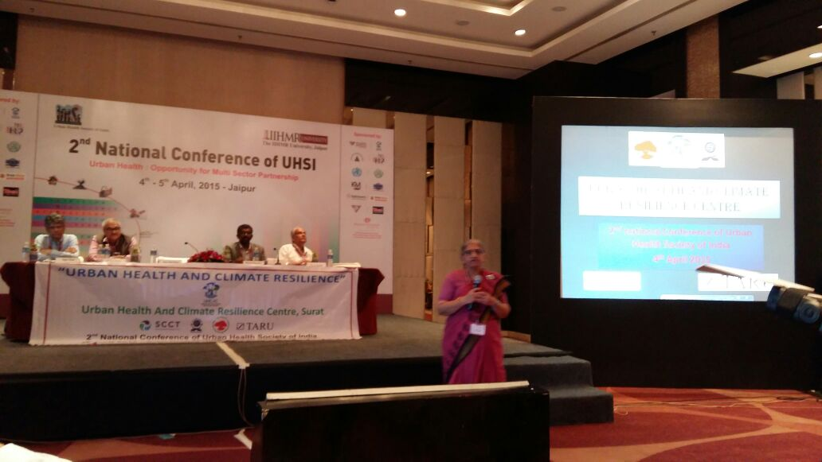
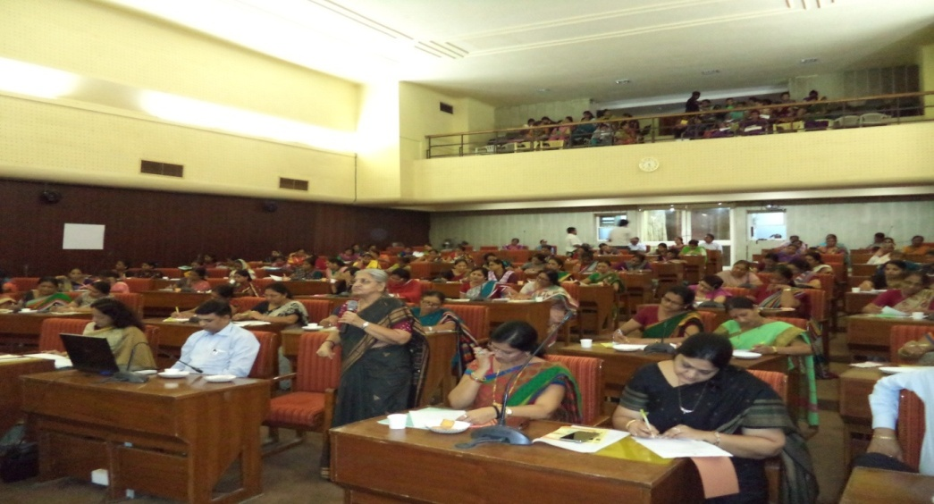
UHCRC team actively participated in State, National as well as International Conferences on Urban Health.

Slide 27
Other Initiatives taken
Other Initiatives taken

Slide 28
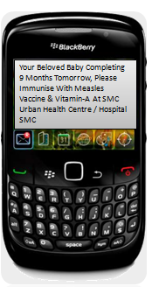
m-Governance
Use of mobile phones to provide real time information on vaccinations for babies is an m- Governance initiative of the (SMC) that should reduce costs of healthcare for parents.
Parents who provide their mobile number at time of registering the birth of their child are issued alerts to vaccinate their child against preventable diseases according to the schedule prescribed under UIP.
The alerts are personalized and child-specific, compared to the usual standardized print and electronic blurbs, and have evoked the desired response.
The service is low cost for the Corporation and involves no cost to the citizen.
Over 8,09,866 messages have been sent since the start of the initiative in 2009, covering nearly 1,17,248 parents who have availed of the 'vaccination alert on SMS' initiative.

Slide 29
Objectives to introduce m - Governance Concept
To reduce paperwork and increase efficiency of the services.
To increase capacity of SMC in monitoring and management of urban services in near real time.
To provide better services to people.
To enhance capacity in developing strategies and build resilience to current and future risks

Slide 30
Feel Free to Contact
Dr. G. C. Patel
Deputy Director- Urban Health
Commissionerate of Health
Gandhinagar, Gujarat
Email: gujurbanhealth@gmail.com
Mobile: +91-9727723301
Dr. K. A. Shroff
I/C Medical Officer of Health
Surat Municipal Corporation,
Muglisara, Surat, India
Email: moh.health.surat@gmail.com
Mobile: +91-9724345472
Dr. H. S. Desai
Deputy Commissioner
(Health and Hospital),
Surat Municipal Corporation,
Muglisara, Surat, India
Email: desaihs@yahoo.com
Mobile: +91-9724345014
Dr. Vikas Desai
Technical Director
UHCRC Surat, India
Email: uhcrcsurat@gmail.com
Mobile: +91-9825117259

Slide 31
Thank You

