Slide 1
“Improving Cleanliness at Public Healthcare Facilities”
Mahatma Gandhi Swachhata Mission
Quality Improvement Programme
Department of Health & Family Welfare
Government of Gujarat
Mahatma Gandhi Swachhta Mission - Action Plan, Health & Family Welfare Department- Gujarat

Slide 2
Introduction
Type | Programme
Phase | Emerging
Since when | 6th December 2014
Coverage / Geography | All Public Health facilities (e.g. SCs, PHCs, CHCs, SDHs, DHs, Medical College hospitals, Super Speciality Hospitals, ESIS Hospitals, ESIS Dispensary, UHCs, Dist. TB Hospitals, Mental Hospitals, Dental Hospitals and Municipal Corporation Hospitals etc.)
Rural / Urban | Both Rural and Urban
Pop. Covered | Approx. 6 Crores (Total Gujarat Population)
Sector | Public / NGO (UNICEF-WASH)
Evaluation | In-House
Cost | Approx. Rs. 20 lakh (State & District level Launching of Programme, Printing of Guideline etc)
Website | https://www.facebook.com/pages/Swachata-Mission/387206758105232?ref=br_tf
Mahatma Gandhi Swachhta Mission - Action Plan, Health & Family Welfare Department- Gujarat

Slide 3
Objectives
    To enable the hospital management to address various aspects of cleanliness, hygiene and infection control practices,
    To train the staff and users regarding hospital cleanliness and infection control practices,
    To promote assessment and peer review of ‘Swachhata’ at Public Health Facilities
To sustain improved cleanliness practices at health facilities.
Mahatma Gandhi Swachhta Mission - Action Plan, Health & Family Welfare Department- Gujarat

Slide 4
Broad Strategy
Certification & periodic renewal of facilities as per BMW Rules
Strengthened Capacity Building of health care workers (Approx. 2000 health functionaries trained so far with technical support of UNICEF)
Solid waste management & creation of composting pit facility up to PHC
Provision of toilets facilities & proper drainage system.
Provision of safe drinking water facility (Piloting for Bacteriological water quality testing in health centers in partnership with UNICEF & WASMO)
Residual chlorine monitoring at community level.
Regular condemnation of out of order equipment (Approx. 5 Crore INR generated)
Coverage under Annual Maintenance Contract/Calibration
Internal & External Monitoring system (by PRI) with standards Checklist & WASH Gap Assessment in HPDs in partnership with UNICEF.
Appreciation & Award distribution
Mahatma Gandhi Swachhta Mission - Action Plan, Health & Family Welfare Department- Gujarat

Slide 5
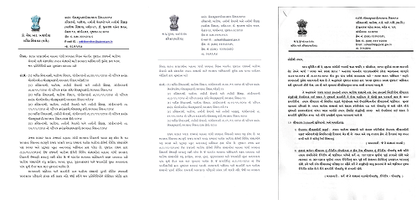
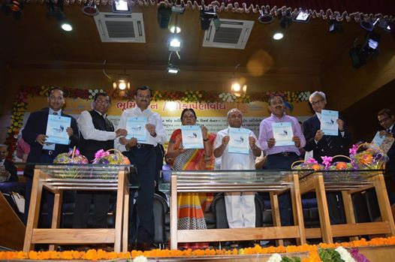

Implementation
Various office orders issued by Commissionerate of Health for activities to implement action plan of swachata mission
State Specific Guidelines of Swachata Mission in Public Health Facilities and area wise monitoring checklist
Launch of state wide campaign of swachata mission by Chief Minister of Gujarat on 6th December, 2014 at Civil Hospital - Ahmedabad
Mahatma Gandhi Swachhta Mission - Action Plan, Health & Family Welfare Department- Gujarat

Slide 6
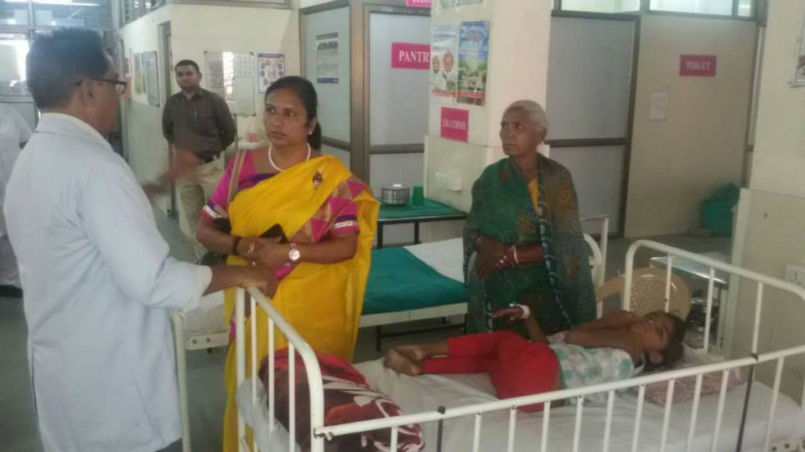
Social Audit & Free Online Reporting System
Mahatma Gandhi Swachhta Mission - Action Plan, Health & Family Welfare Department- Gujarat

Slide 7
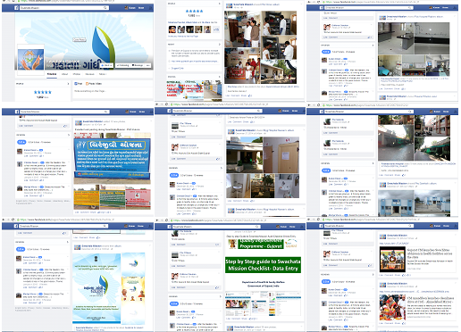
Use of Social Media
Mahatma Gandhi Swachhta Mission - Action Plan, Health & Family Welfare Department- Gujarat

Slide 8
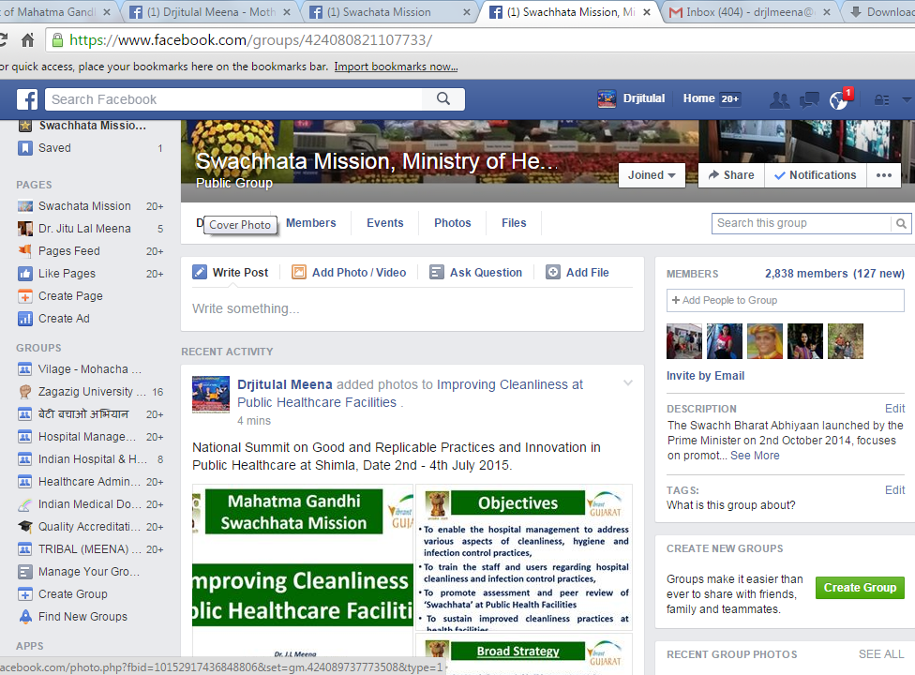
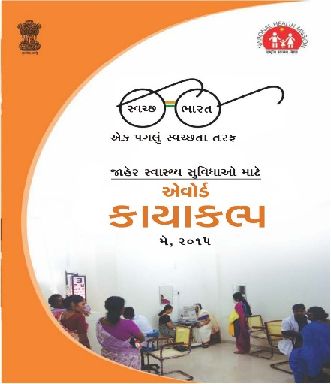
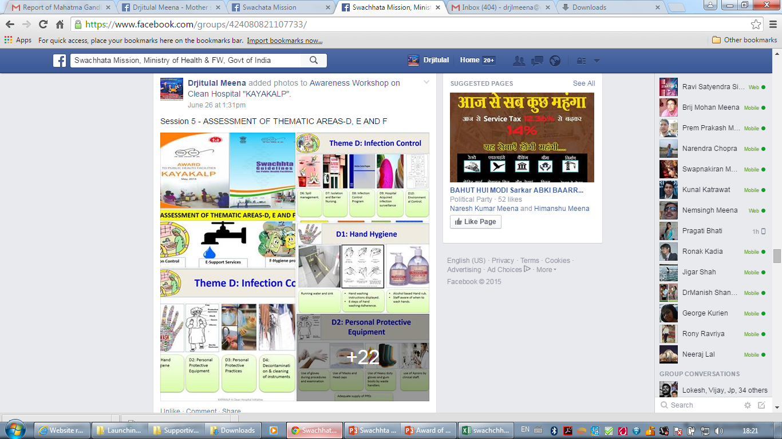
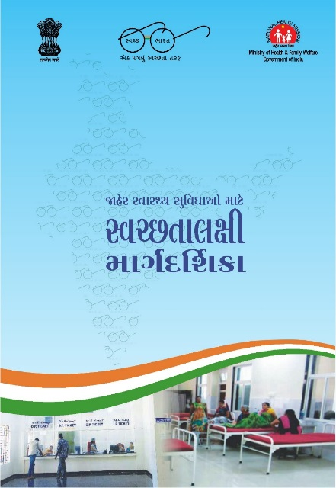

Slide 9
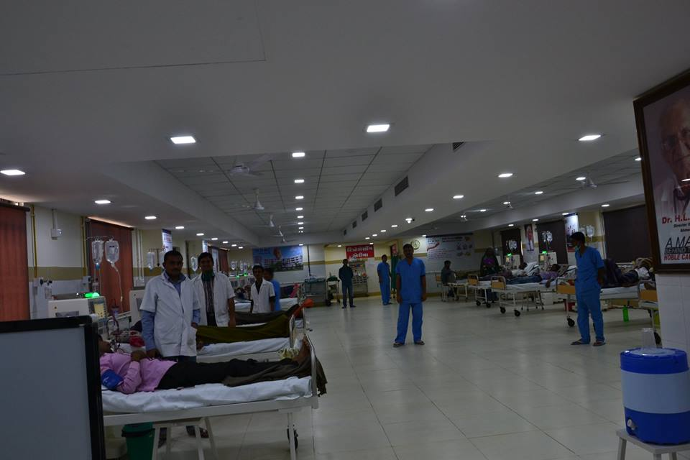
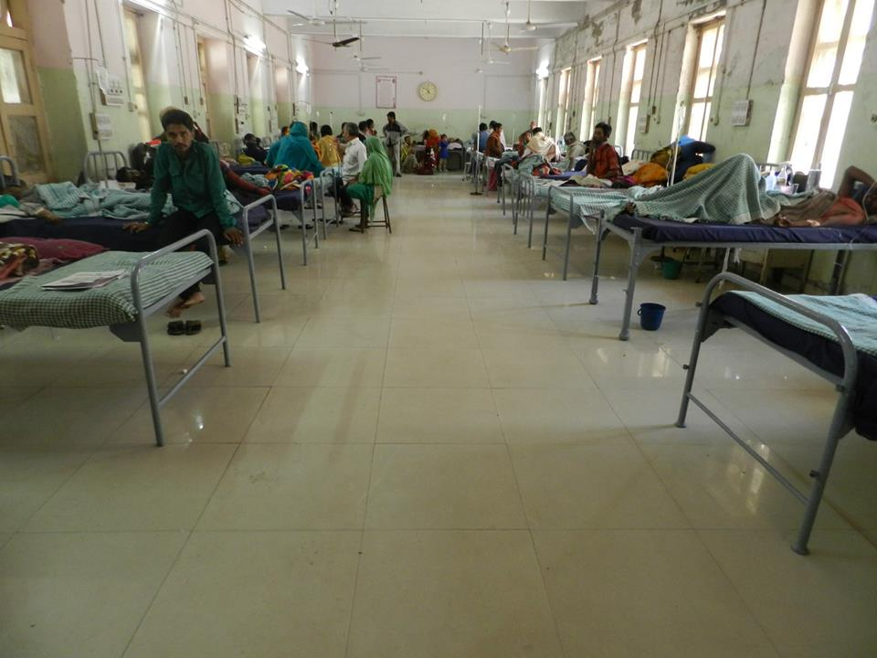
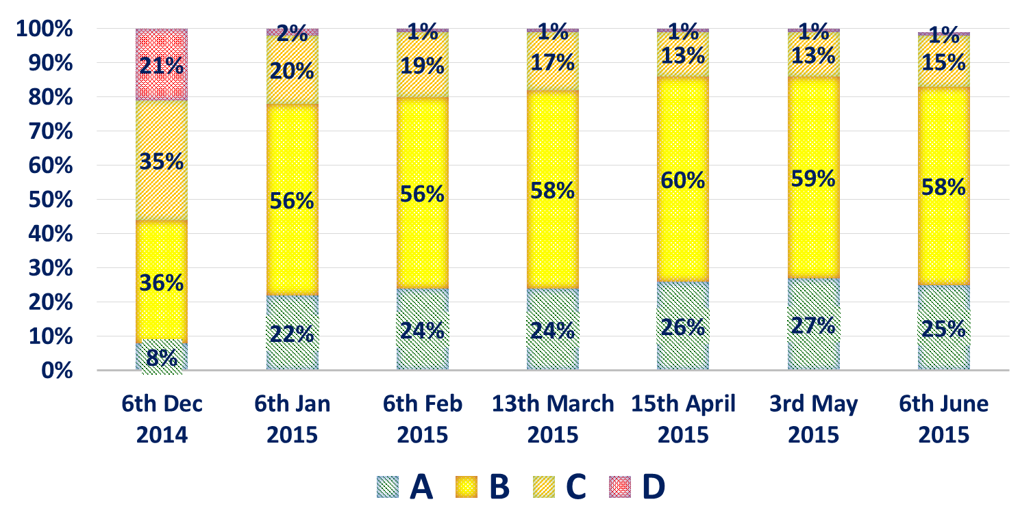
Impact
GMERS Dharpur & PDU MCH Rajkot
Grading As per %:- A= Score >90 %, B= Score >75-90 %, C= Score >50-75 % & D= Score 0-50%
Mahatma Gandhi Swachhta Mission - Action Plan, Health & Family Welfare Department- Gujarat

Slide 10
Impact
Work carried out Under Mahatma Gandhi Swachhata Mission Programme (Total Expenditure =2612.32 Lacs).
Campus Cleaning | Jungle Clearing & tree treaming; Cleaning & Development of Campus, Construction of Compound Wall and Main gate of Campus, Fencing
Colour Work | C/wall Colour, Indoor Painting work
Drainage | Proper functioning drainage & sewage system (New construction, Repair & Cleaning); Construction of new soak pit & septic tank slab; Cleaning of septic tank, Provision of interlocking block for better cleaning,
Toilets | Functioning toilet block (Construction & Repairing of W.C. pan), Creating Handicap Toilet, Repairing of Door/window Shutter, Replacing older glazed tiles
Hand Hygiene | Construction of New washbasin
Water Supply | Refitting of leakage water supply lines, Changing all rusted water supply lines
Water Tank | PVC tank cleaning
Others | Terrace Water proofing, MS grill to balcony, Plastering and required plumbing work
Mahatma Gandhi Swachhta Mission - Action Plan, Health & Family Welfare Department- Gujarat

Slide 11
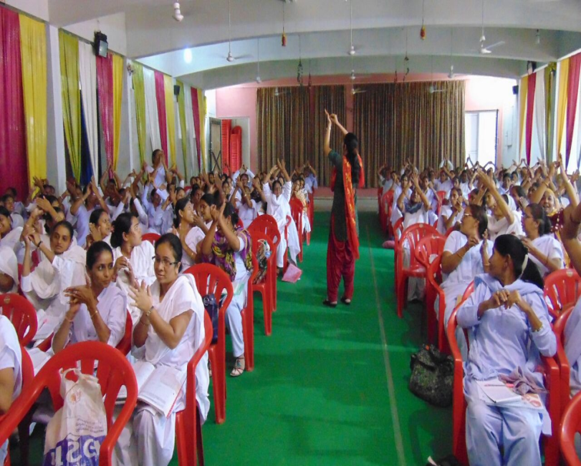
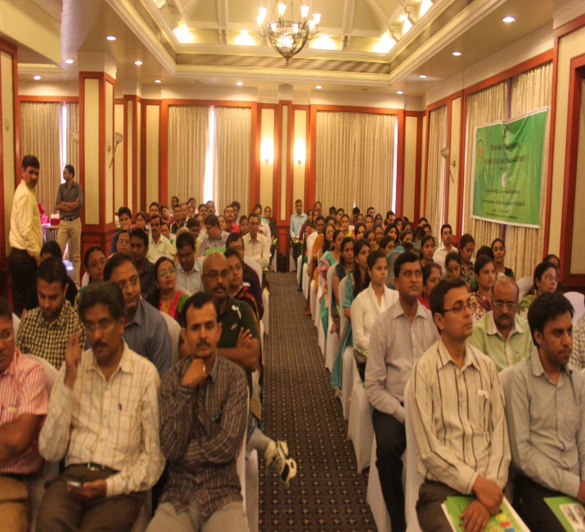
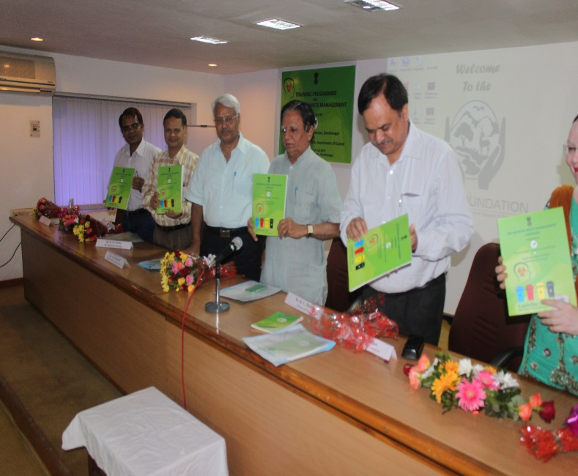
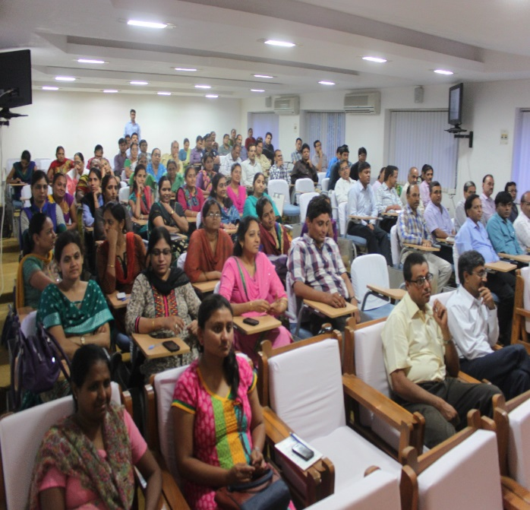
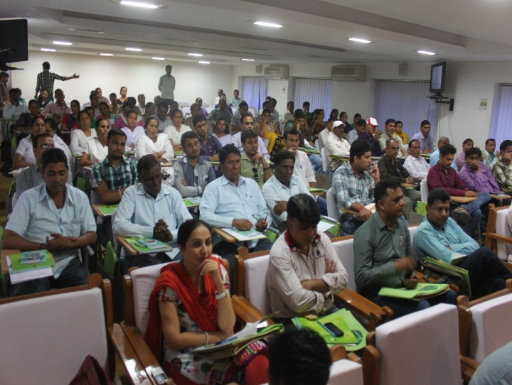
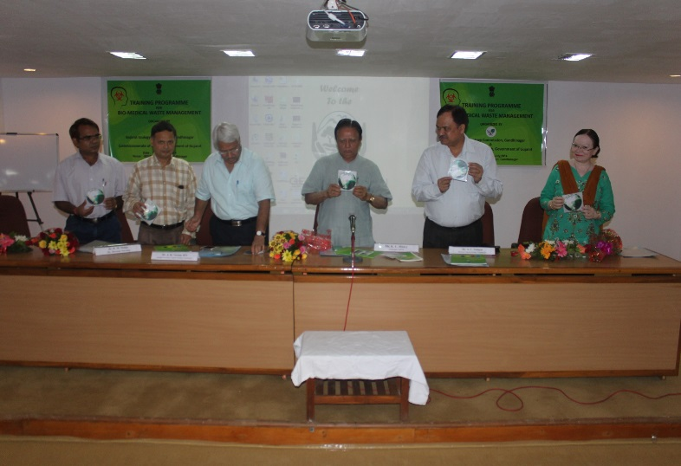
Impact (Launching of BMW Guideline and IES Material )
Mahatma Gandhi Swachhta Mission - Action Plan, Health & Family Welfare Department- Gujarat

Slide 12
Conclusion
Very cost-effective approach: For reducing hospital acquired infection, improving cleanliness & enhancing patients’ Experience
Involvement of ‘Jan Pratinidhi’ (Community Representatives): Increased community ownership creates positive pressure on the system, RKS & facility I/C to keep the facilities clean
Scalability:
Roll out of action plan in Three phases - Short (till December 2014), Medium(2014-16) & Long term(2014-19)
Online reporting mechanism for tracking the progress
Adopting of Kayakalp guidelines
Mahatma Gandhi Swachhta Mission - Action Plan, Health & Family Welfare Department- Gujarat

Slide 13
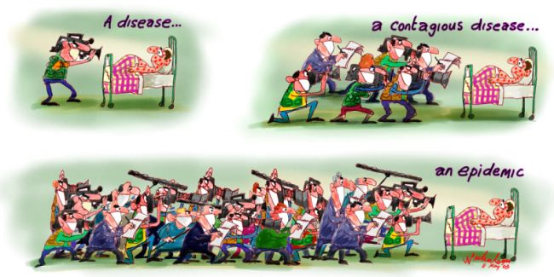
Thanks
Quality Improvement Programme
Mahatma Gandhi Swachhta Mission - Action Plan, Health & Family Welfare Department- Gujarat

