Slide 1
Palliative Care
A sustainable model of public health approach in Kerala
Dr. G.Sunil Kumar
SPM NHM & DD FW, Government of Kerala

Slide 2
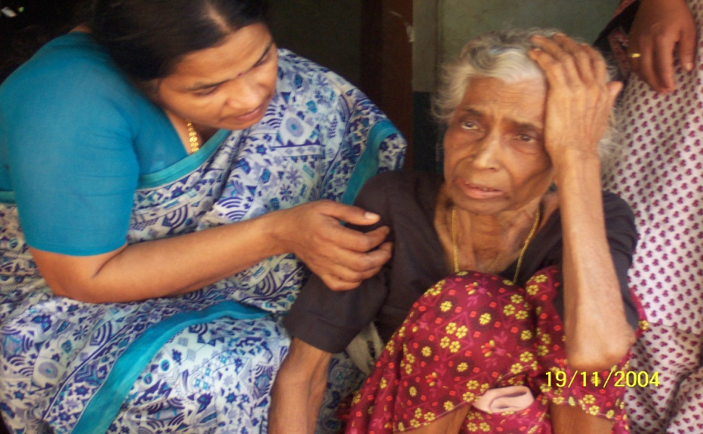
Palliative care- the concept
Palliative care is the active total care of the patients whose disease is not responsive to curative treatment
Adding life to years
" Low tech. High touch "

Slide 3
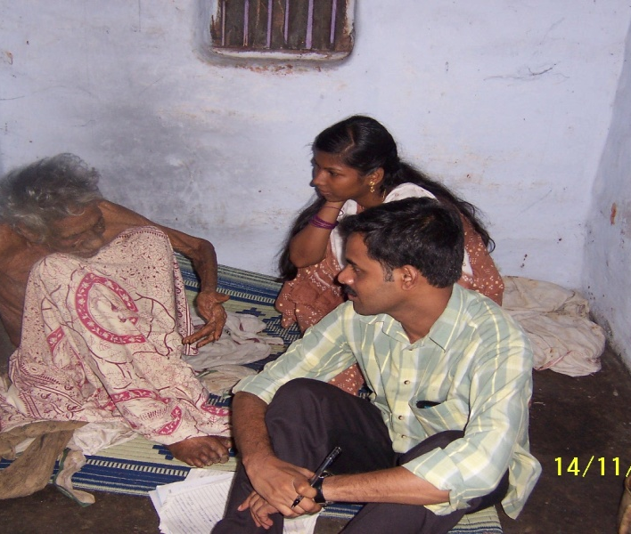
Palliative care- the concept
Patient centric and not disease centered
Offers a supportive system to the patient and family
Empathy and Hope

Slide 4
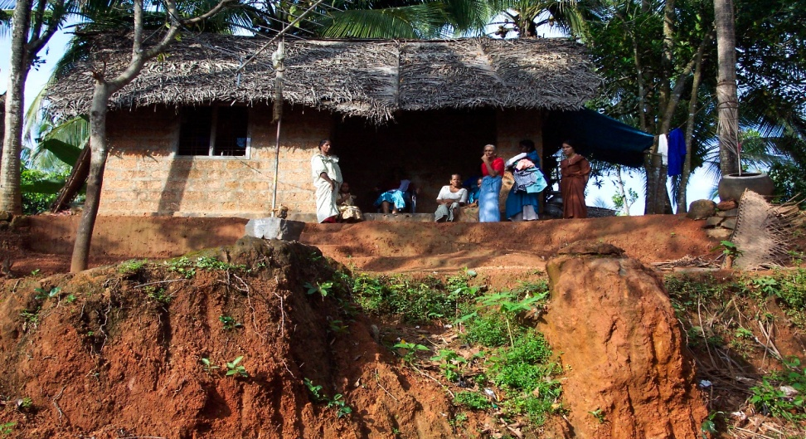
Palliative care – The need
Kerala has > 125000 incurably iIl, bed-ridden and dying patients.
With physical, psychological, family, social and economical implication
Conventional medical approach not suitable
Need a new approach

Slide 5
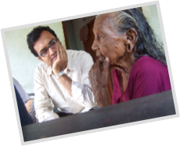
Nurse lead
Doctor supported Home care through all the health care institutions with support of LSG
Main streamed in LSG with assured fund & institutional support
Volunteers from all walks of life including elected representatives got interested
Community involvement 2000
Riding role of NRHM & department of health in 2007
Initiation by the professionals in 1993

Slide 6
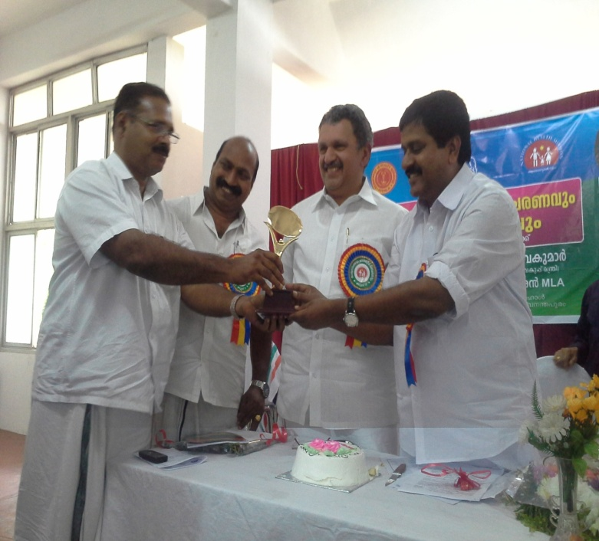
PROCESS
Willingness of LSG
Stakeholder meeting of all groups
Development of program concept
Training of interested volunteer group
Sensitive identification of the target group by the volunteers
Need assessment through house visit by home care teams and documentation of the need – by trained nurses, field staff, elected members, ASHA, volunteers
Joint meeting for project formulation based on need

Slide 7
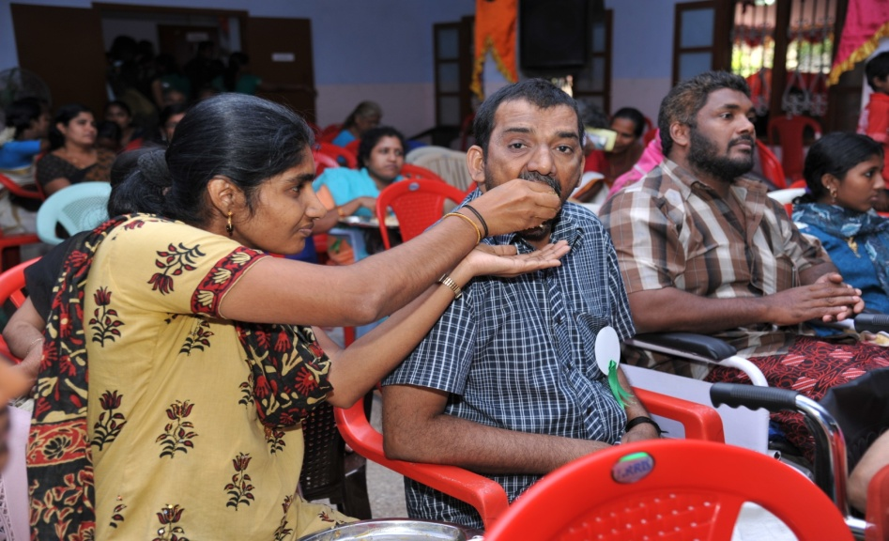
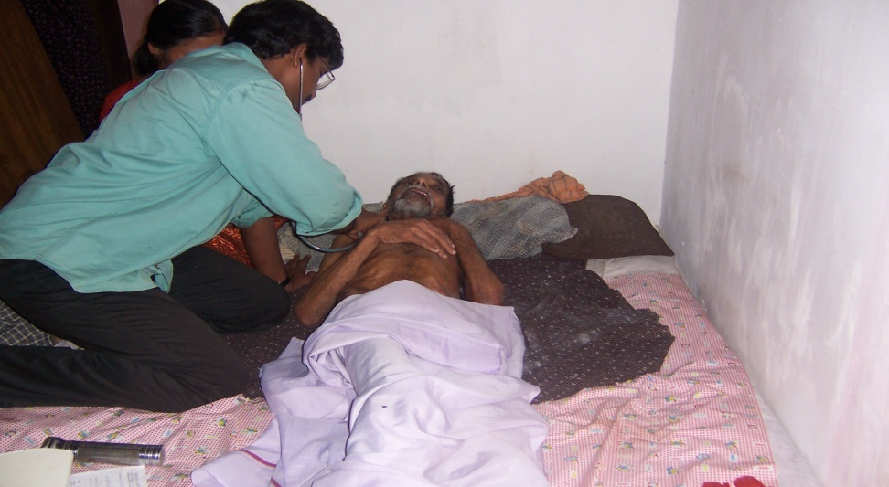
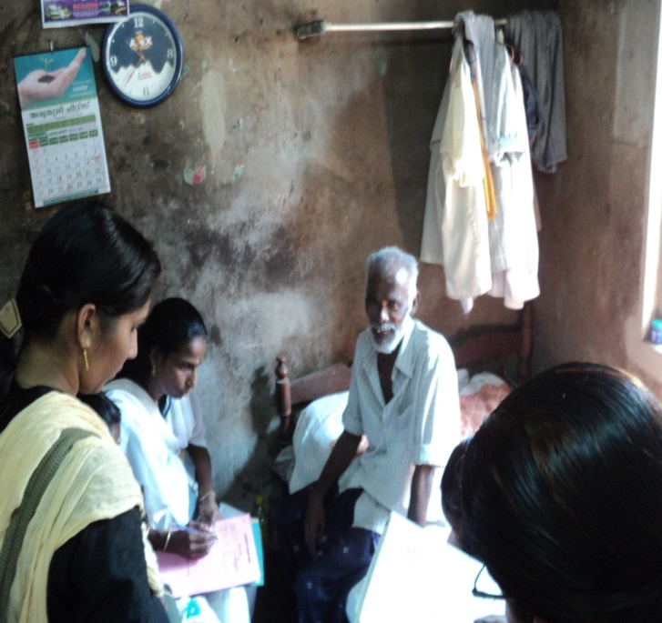
Target Group
Persons affected by
End Stage Cancer
Stroke ( haemorrhagic)
Very old people ( end of life stage )
End stage – systemic Diseases ( cardiac, respiratory, Renal, etc )
c/c neuromuscular disorders
AIDS.
Head injuries, spinal injuries, paraplegics
Mental and physical incapacitation esp. Children

Slide 8
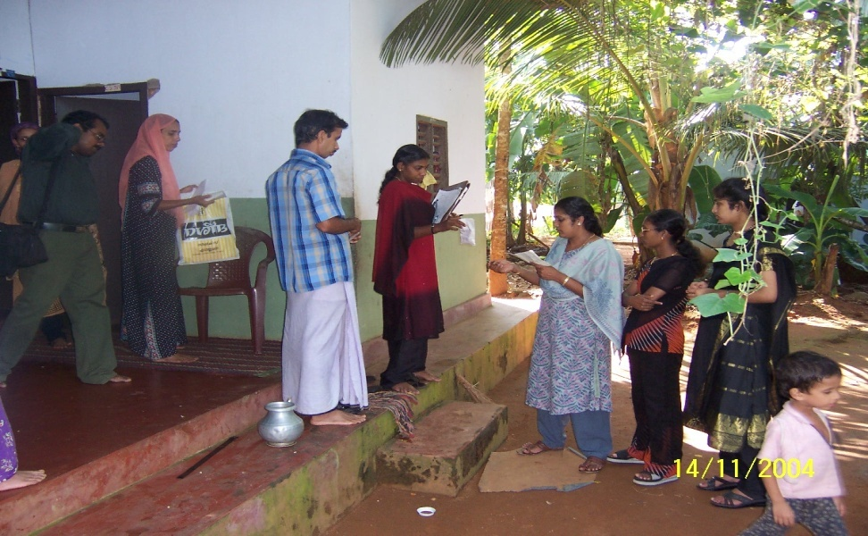
DELIVERY OF CARE
Volunteer support- each patient linked to a volunteer who mobilizes psychosocial support- through home visit as per need.
Follow up home visit by trained palliative care nurse as per need
  Training of family in basic care of bedridden patient, wound care, catheter care and change, Naso gastric tube care and change, etc
Basic medical follow-up – through special OP clinic conducted one per week at the PHC
PHYSIOTHERAPY SUPPORT
Reference as per need to higher centers in Govt and Pvt sectors
Special support like provision of waterbed , wheel chairs, etc

Slide 9
Achievements - Quantitative
Palliative care in
  Grama Panchayat : 978/978
  Municipalities : 60/60
  Corporations : 5/5
  Total patients under care : 89,304
  Completely bedridden : 50,304
  Catheter care : 12 876
  Wound care : 6311
Total number of trained volunteers
  60,000 persons
Total number of community nurse working - 1063
Total number of LSG members trained - 5720
Total project fund by LSGI for palliative care 2014 -15
    62 Cr

Slide 10
SUSTAINABILITY
A robust methodology developed through trial and error: yet a dynamic model
Committed professional support to the programme especially in training and monitoring led by Institute of Palliative Medicine, Kozhikode
An effective participatory monitoring system
    Local Government level
    District Panchayat level
    Director of Health Service (DHS)/NRHM level

Slide 11
SUSTAINABILITY (Contd..)
State Policy emerging out of practice - First state to have a Palliative Care Policy(2008)
Formal Government support – Orders by Health and LSG Departments
Mainstreamed in the Local Government planning and implementation process
    Assured institutional support
    Assured fund

Slide 12
SUSTAINABILITY (Contd..)
Widespread social acceptance and support
  Personal involvement of elected members
  Flow of motivated volunteers
  Support from civil society organizations

Slide 13
NEXT STEPS
Simplification of procurement of drugs / materials and streamlining supply through Kerala Medical Services Corporation Ltd.
Tie up with private hospitals by providing follow up home care for patients discharged
Training Centres in all districts – capable of community level capacity building
Institutionalizing the process in the Twelfth Five Year Plan

Slide 14
INNOVATIONS – A RECAP
A viable public health model for an incurable non-communicable disease
A people-centered programme by the community led by local governments
A working model of private, public, professional, panchayat partnership
Nurse-led, Doctor-supported professional component
Operations through the PHC

Slide 15
INNOVATIONS – A RECAP (contd…)
Convergence of different programmes and resources
Bottom up method of development and operationalization of the programme
Palpable element of care and compassion in a public programme – humanising public service delivery
“POTENTIAL MODEL OF PRIMARY HEALTH CARE TO ADDRESS ALL NON COMMUNICABLE DISEASES”

Slide 16

Thank You..

