Slide 1


Slide 2

Outline of
Presentation
Key Features
Operational Framework
Mechanisms for registration
Communication Plan

Slide 3
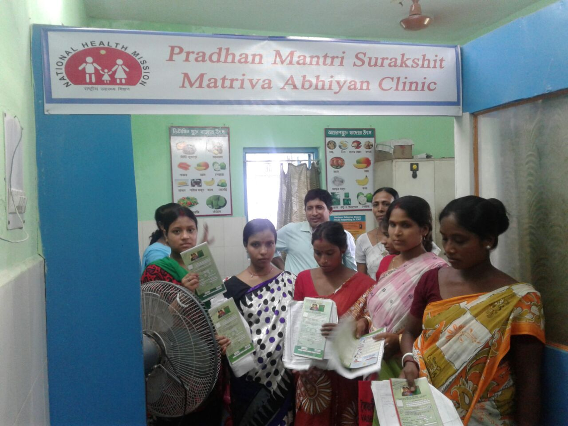
Pradhan Mantri Surakshit Matritva Abhiyan
Key Features

Slide 4
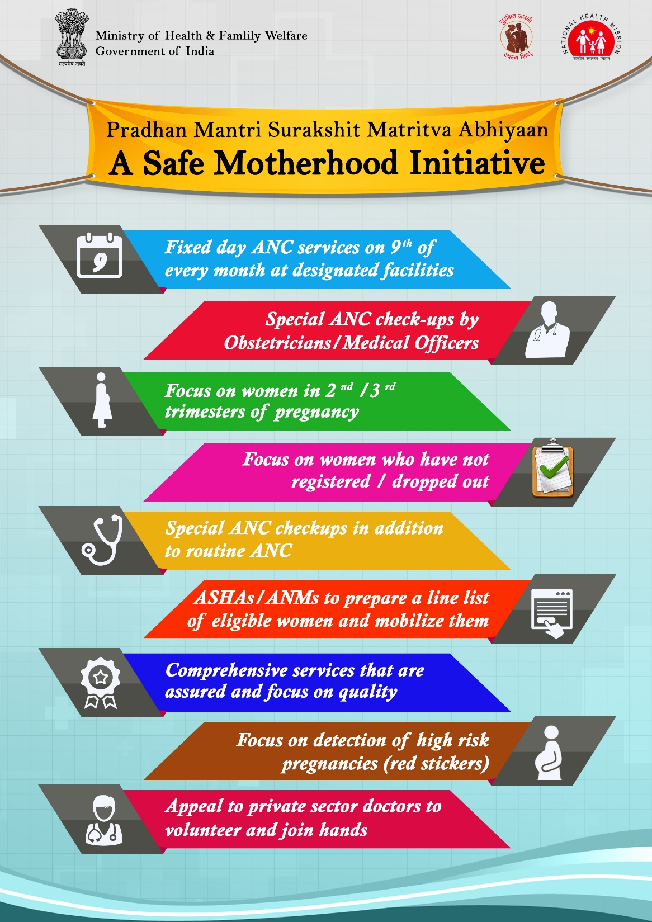
PMSMA – KEY FEATURES

Slide 5
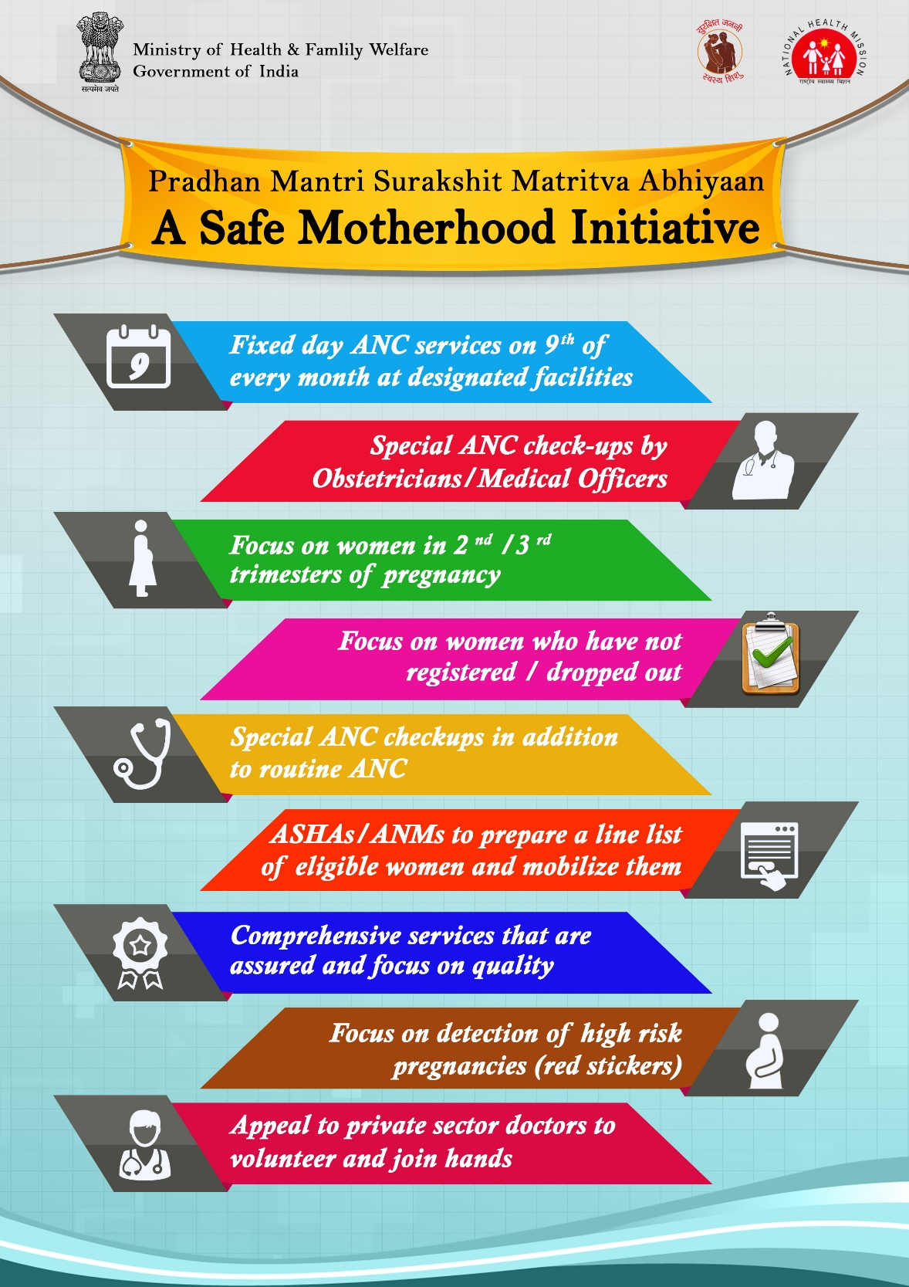
PMSMA – KEY FEATURES

Slide 6
PMSMA – KEY FEATURES
Ensure follow up & delivery in FRU

Slide 7
Pradhan Mantri Surakshit Matritva Abhiyan
Operational Framework

Slide 8
Implementation of PMSMA
Most States/ UTs have initiated the implementation of PMSMA
Interactions with programme officers & observations from field visits
Need for a detailed operational framework for complex elements such as engagement with the private sector, USG services, budget etc

Slide 9
Dissemination of PMSMA Guidelines
Implementation Planning & Programme Management
Drugs and Logistics procurement
Training / Sensitization
IEC - Community Awareness and mobilization
Implementation of PMSMA on 9th of every month
Monitoring and Evaluation
CRITICAL COMPONENTS OF PMSMA
Implementation Approach

Slide 10
Registration of PW
PW takes the test report and goes to doctor for examination
Doctor examines the PW and labels the patient as High risk or non high risk
Drugs and appropriate treatment / referral provided along with counselling
Lab technician takes blood and urine sample for testing
ANM takes the weight, height BP and completes the MCP card
PW is referred for USG and reports back to the doctor with the report of the USG. Based on the report the doctor modifies the red/ green label if required
PW provided a printed list of investigations
Flow of Beneficiaries on 9th i.e. PMSMA day

Slide 11
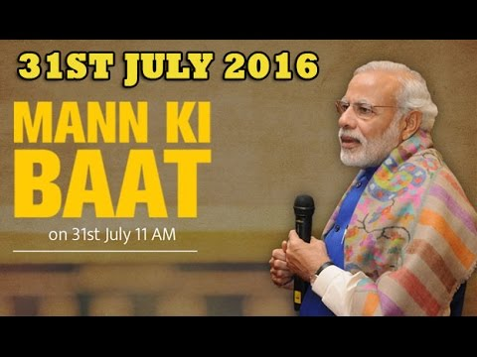
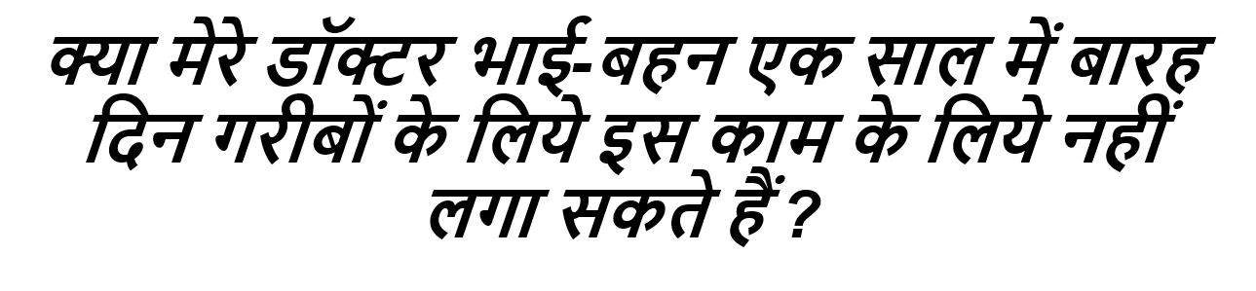

Slide 12
Overview - Strategies for Engagement of Private Sector
Generate Awareness
Sustain Participation
Facilitate Participation
Appeals by Hon’ble Chief Ministers and Health Ministers
Multi-pronged Communication Strategy
Collaborations with FOGSI/ IMA/ Rotary/ Lions Clubs etc
Mechanisms for registration of private doctors willing to participate
Rewards/ recognition using multiple platforms such as award functions, radio, social media etc

Slide 13
Private sector engagement for PMSMA
Obstetricians/ physicians from private sector - encouraged to provide voluntary services at designated public health facilities
Volunteer doctors who require transportation - provided transportation
Volunteer doctors assigned health care facilities as per the mutual convenience of the district authorities and the volunteer

Slide 14
Awards to Encourage Private Sector Participation
At the State and district levels namely:
For volunteers who have served maximum number of patients
For volunteers who have consistently provided services on all PMSMA days. For volunteers who have served in remote/ inaccessible areas
Any other criteria deemed fit by the district/ State authority
Doctors felicitated with a certificate –by DM at district level
Doctors providing exemplary services would be nominated for State & National level recognitions.

Slide 15

Use of Social Media for Recognizing Contributions
Creating a virtual Hall of Fame: Achievers/ prominent volunteering doctors to be felicitated online through various platforms for their services
Profuse use of Twitter, Facebook, Linkedin proposed for viral dissemination
Hon’ble State Health Ministers may like to offer their felicitation through these platforms
Hall of Fame

Slide 16
Government functionaries - Foundation on which the Implementation of PMSMA rests
Awards for Block/ District Teams
Percentage coverage against the target
Percentage coverage of beneficiaries receiving the complete set of drugs/ diagnostic services
In subsequent years, improvement in coverage also to be considered
Achievements of three best performing States recognized at national level
Felicitation of government doctors providing exemplary services under PMSMA

Slide 17
Budgetary Considerations
Transportation facilities to PW residing in difficult / inaccessible areas, in blocks with home deliveries >20% under JSSK.
Funds for USG services- Free Diagnostics Initiative/ JSSK funds
Districts
Rs. 50000- Rs. 200000 / year for undertaking activities such as sensitization of stakeholders, meetings of committees, IEC campaigns etc
States
Rs. 300000- Rs. 500000/ year for undertaking activities such as sensitization of stakeholders, meetings of committees, IEC campaigns etc

Slide 18
Mechanisms for Registration of Private Doctors

Slide 19
Mechanisms for Registration of Private Doctors –Details to be shared once mechanisms are operational
Toll Free Number
Doctors can call 18001801104 to register.
SMS
Doctors can sms ‘PMSMA <space> Name’ to 5616115
PMSMA portal
Register at www.pmsma.nhp.gov.in

Slide 20
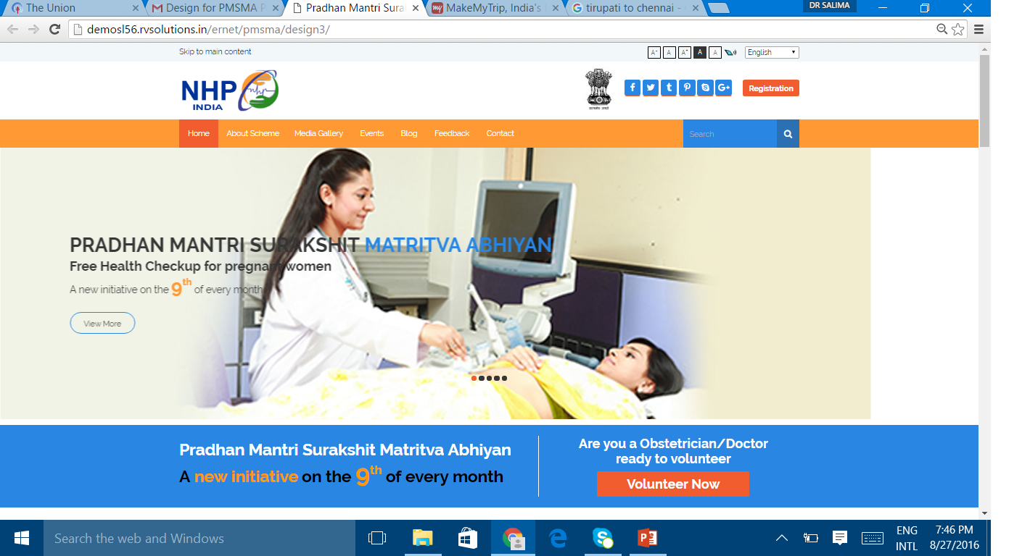
PMSMA Online Portal

Slide 21
Large Multi Media Campaign for Motivation of Private Obstetricians/ physicians who are freshers/ in practice/ retired doctors etc
Motivated Doctors give a call/ sms to a toll free number
National Level Call Centre arranges call back and collects vital information namely, registration number & generates PMSMA enrolment number
An email/sms indicating the enrolment number of the private practitioner, and link to the online website would be sent to the practitioner
State Nodal Officer/District CMO checks the portal for list of volunteers & Contacts the volunteers to assign a government facility where the private practitioner would provide services on a voluntary basis for the said month (not on portal)
District CMO Enters information on the portal on services provided by the volunteer
PMSMA Enrolment Number of the Private Practitiioner is generated

Slide 22
Responsibilities of State Nodal Officers/ District CMO
Login to the PMSMA portal (login ids would be sent to States who would share it with District CMOs)
Regularly monitor the portal and ascertain the list of volunteers
  District –wise list of volunteers would be available on the portal
Contact the volunteers and assign facilities as per mutual convenience
Arrange for transport if required
Collect information on services provided by the private provider and upload it on the portal

Slide 23
Suggested Communication
Plan

Slide 24
Communication Plan
Target Audience
Audience set 1
Obstetricians/ physicians working in the private sector
Audience set 2
Pregnant women in rural areas

Slide 25
To motivate doctors to sign up
Create alliances with professional medical bodies: IMA, FOGSI
  Urge them to mount their own online and offline campaigns
  Use their social media platforms for creating buzz
  Create alliances with private hospital chains- Peer influence
FOGSI CHAMPIONS in Chhattisgarh & Karnataka have been identified and are willing to go on 9th of every month to the facilities where specialists are not present
- Email by FOGSI Member

Slide 26

To motivate doctors to sign up
Message: appeal to heart and mind- Help lower MMR
Doctors – The celebrities & hero’s of the campaign
Motivating doctors to join hands with the campaign !
Celebrity Endorsements- Celebrities who are doctors (preferably) to be roped in for advocacy and endorsement

Slide 27
To motivate doctors to sign up
Offline: National Print, National TV (campaign awareness), Health magazine
  Strong Social Media presence through vigorous use of all effective platforms, leveraging cross linkage between the platforms
Create alliances with digital aggregators (such as Practo, Curofy, Lybrate) to reach out to medical practitioners on their database and use their social media linkages

Slide 28

To motivate doctors to sign up
Special Radio Campaigns:
RJs of popular Radio (FM) channels to interact with private doctors for giving wider publicity, encouraging other private doctors and creating a buzz around PMSMA
Hon’ble Chief Ministers / Health Ministers requested to interact live with one/ any of the RJs

Slide 29
Next Steps
30 States/Uts have started the Abhiyan. Remaining States to initiate on 9th September 2016
Map facilities that would be conducting PMSMA
Hold meetings with State chapters of FoGSI, IMA, Rotary & Lions clubs
Ask District CMOs to regularly monitor registrations on portal and submit information on services.
Submit progress reports to GoI on monthly basis
Develop a State level communication plan for PMSMA with special focus on social media
Ensure that ANMs continue to provide ANC checkups at outreach sites.

Slide 30


