Slide 1
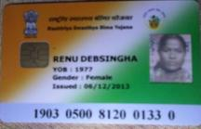
RASHTRIYA SWASTHYA BIMA YOJANA Monitoring System Through Effective Use of Data 4th⁻July 2015 At Shimla, Himachal Pradesh By State Nodal Agency Department of Health & Family Welfare Government of West Bengal

Slide 2
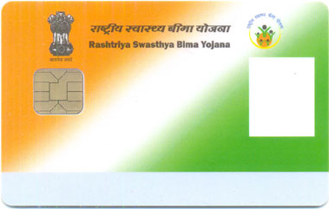
Unique features of RSBY
Cashless hospitalization expenses of INR 30,000 per family , mainly for primary and secondary health care
Eligibility:
BPL family and other identified categories of unorganized workers.
Up to five members on a floater basis, plus baby up to one year
All Pre-existing Diseases covered from day one of hospitalization.
Day care treatment cover for specified illness.
Pre and post hospitalization, investigations, diagnostics for one day before admission and 5 days after discharge covered.
Transportation Cost (per visit INR 100 & overall limit of INR 1000/-,).
Biometric smart card to identify beneficiaries & control fraud
Photograph & Fingerprints captured
Empanelled hospitals have card reader connected real-time
1441 Packages based treatment to ensure fixed benefit.
Cash less and paperless transactions through web based IT system
Network of 1043 hospitals and inter state network of hospitals.

Slide 4
Benefits extended in West Bengal
Families enrolled
6.059 mn
Hospitals participating
Public : 372
Private : 654
Patient treated so far
1.03 mn
Considering present Incidence, 4 lac+ patients will get treatment this year

Slide 5
New Initiatives by H&FW Dept since Sept 2013
Empanellement of all Government Hospital for RSBY
Women as Head of Family
Dedicated Medical Audit team in each District
RSK Support extended up to BPHC/RH
Revenue earned by Government Hospitals are fully utilised for the benefit of Patient by the hospital
Additional transport allowance up to Rs 500 from Government Hospitals.

Slide 6
How the Idea evolved ?
Development of IT based model
Problems identified
Several meetings were conducted
A critical review of the existing scheme
Rashtriya Swasthya Bima Yojna or RSBY
Transferred to Health and Family Welfare Department, GoWB from from 23rd September 2013

Slide 7
RSBY
Weakness
1. Lack of transparency
2. Fraud and abuse
3. Lack of awareness
4. Lack of monitoring
Strength
Huge availability of data A lot of data has been generated
under RSBY, which can be
effectively use for much stronger
monitoring system

Slide 8
Tool for Overcoming weakness
Online claim management
Balance & Validity checking
TAT monitoring
MIS
(Management Information
System)
Trend & trigger
Automated SMS service
Call Centre Management
Online grievance monitoring

Slide 9
SMART WEB PORTAL SERVICE
RSBY web portal not only provides the details of RSBY but also acts as the Portal for data transfer, data sharing, claim management and a monitoring tool for the internal stakeholders of the scheme.
The aim of the scheme is to use technology not only for control of fraud and monitoring, but also to find innovative solutions to address the problems.
All the MIS and reporting format developed IN HOUSE and as per the requirement of the stakeholders.
Successful implementation & acceptance of the web portal has ensured the desired Transparency that was lacking in the system.
This web portal has become one of the most important source of information and one of the best tool used in our programme for the benefit of beneficiaries.

Slide 10
Details of the Web Portal accessibility
Online registration of patients
Real time MIS and online monitoring
System Based Trigger and trend
Online claim settlement including IO Based on
SNA Server Data
Patients details tracking
Online grievance Redressal
Automated SMS service
Additional transport cost calculator
Real time communication

Slide 11
Impact
More than 80000 times logged into the website in last two months
In June 2015 - 31,289 patents availed benefit amounting Rs 20,07,14,937

Slide 12
Thank You

Slide 13
Problems Identified
Hospitals – 1. Claim related issued such as unavailability of payment details,
pending claims details, reasons for rejected claims .
2. Unnecessary delay in payments and worse situation in IO claim
3. Lack of transparency regarding claim available in server
Beneficiaries – 1. Lack of awareness about the scheme, its benefits, food,
medicine, laboratory tests, additional transport allowance etc. 2. Unavailability of a strong communication tool
Insurance and TPA – The strength in terms of availability of data can be leveraged much more for monitoring than what is happening at present and
Weak monitoring system
Under utilization of data : Though a lot of data has been generated under RSBY, use of such exhaustive data does not happen effectively. Since data flows every day from each hospital to the government and insurance company, it can be analyzed for identifying trends and patterns.
Increase in fraud and abuse : Tackling fraud and abuse are challenges in health insurance schemes across the world. RSBY is also no exception. Availability of data ensures that RSBY is better positioned to tackle this but not explored to it’s potential.

Slide 14
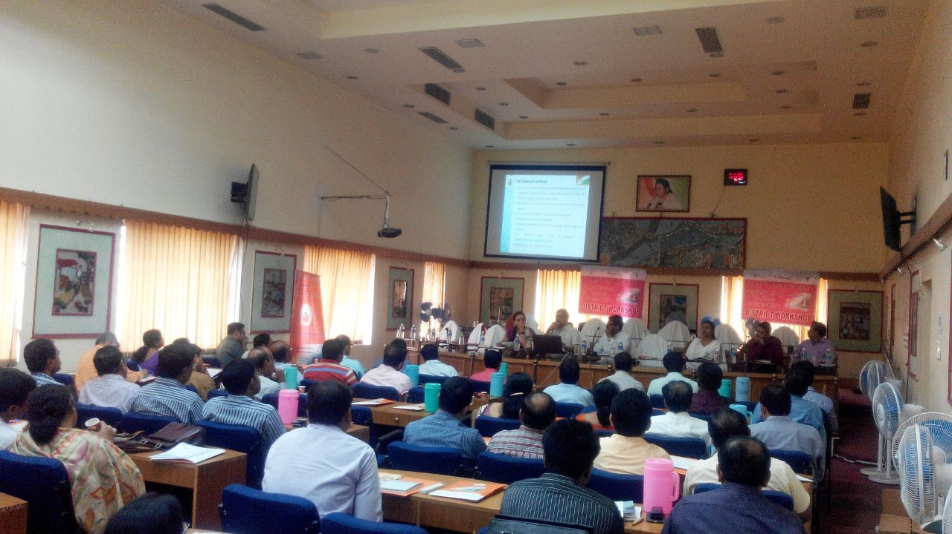

Slide 15
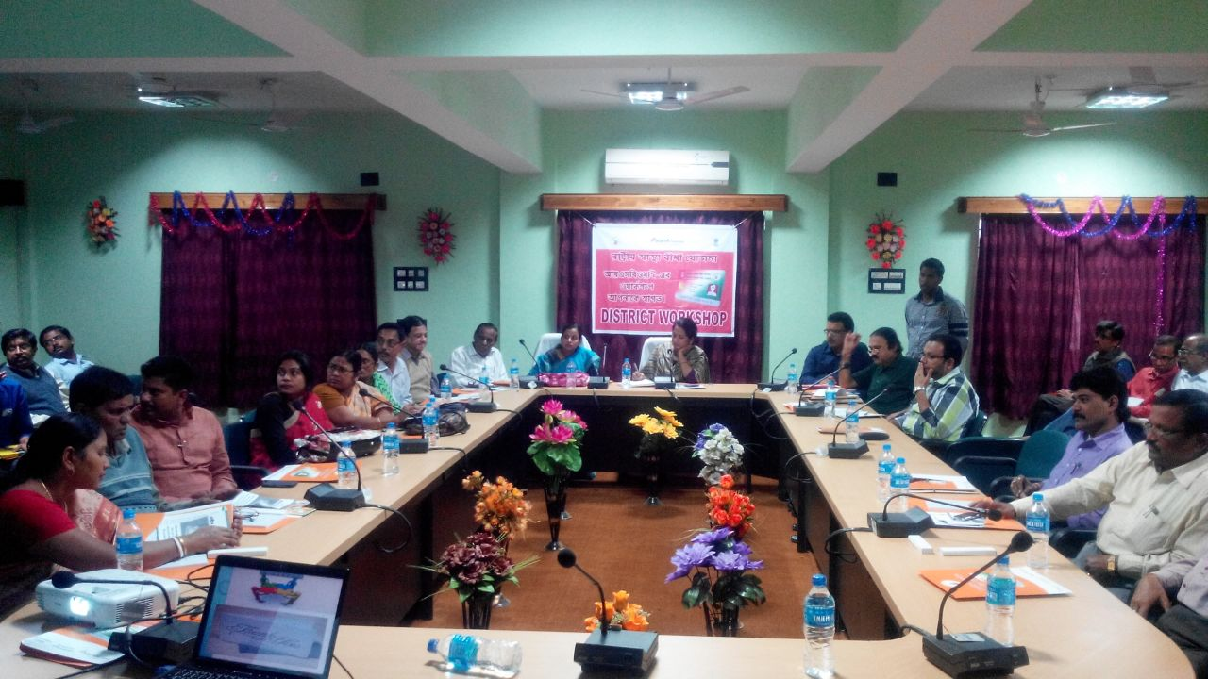

Slide 16
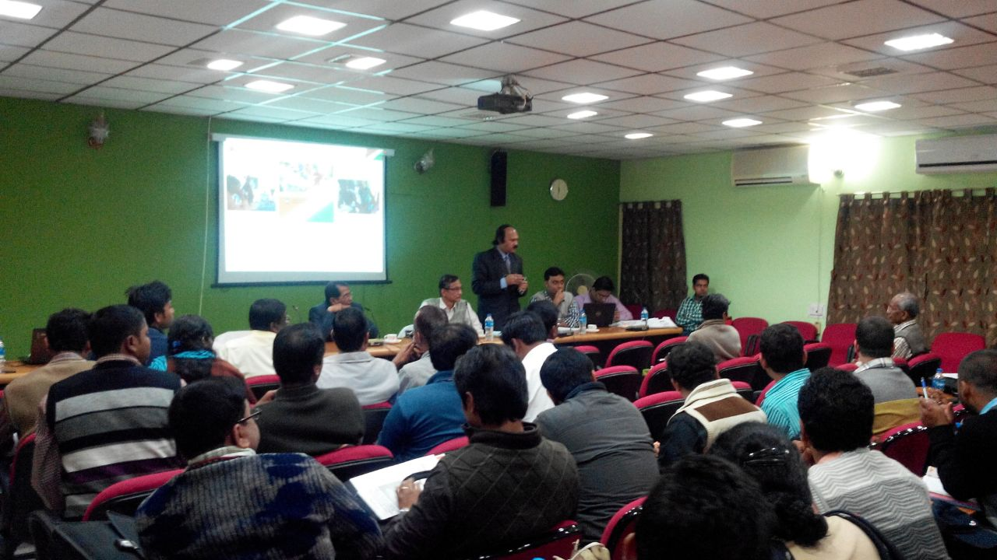

Slide 17
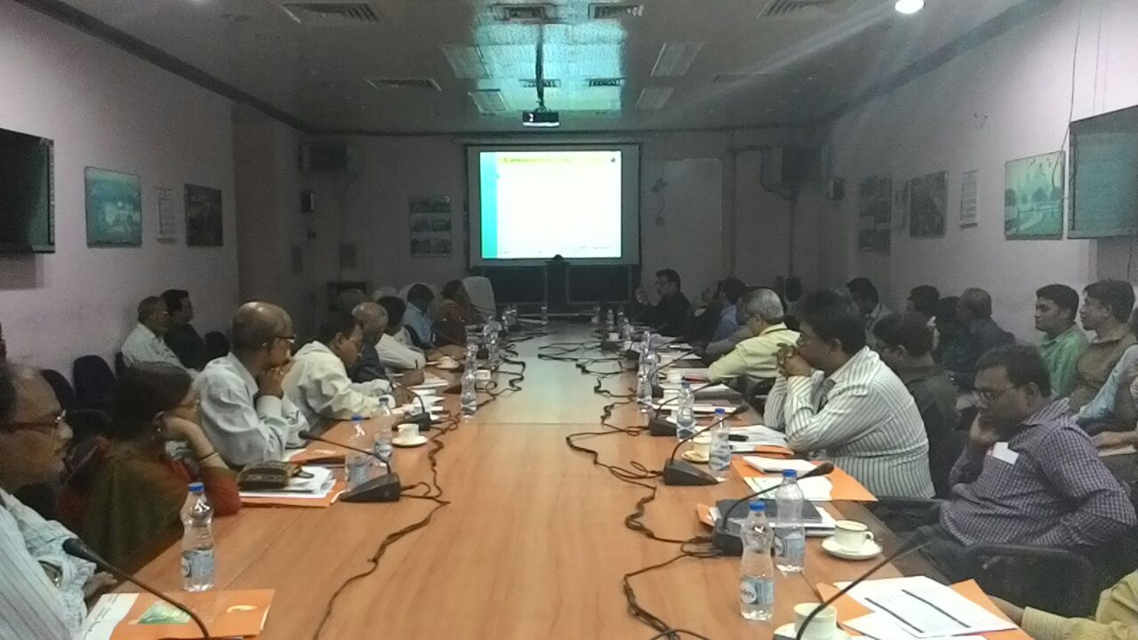

Slide 18
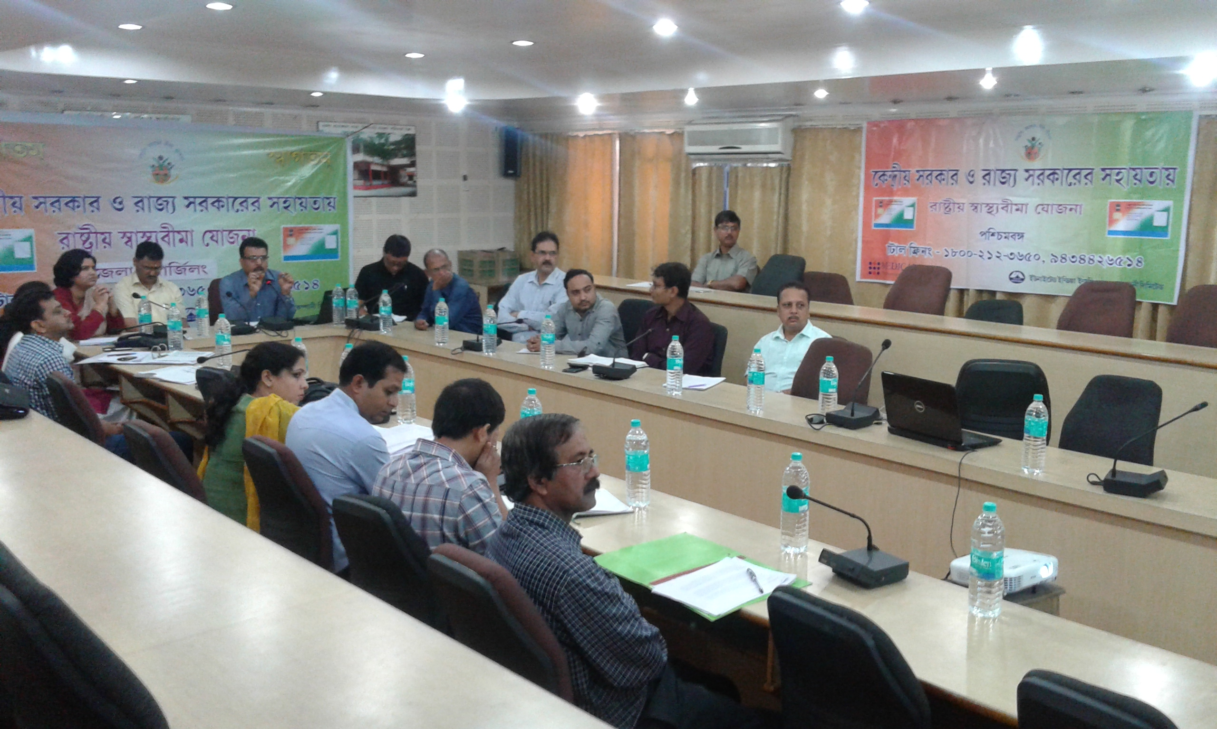

Slide 19
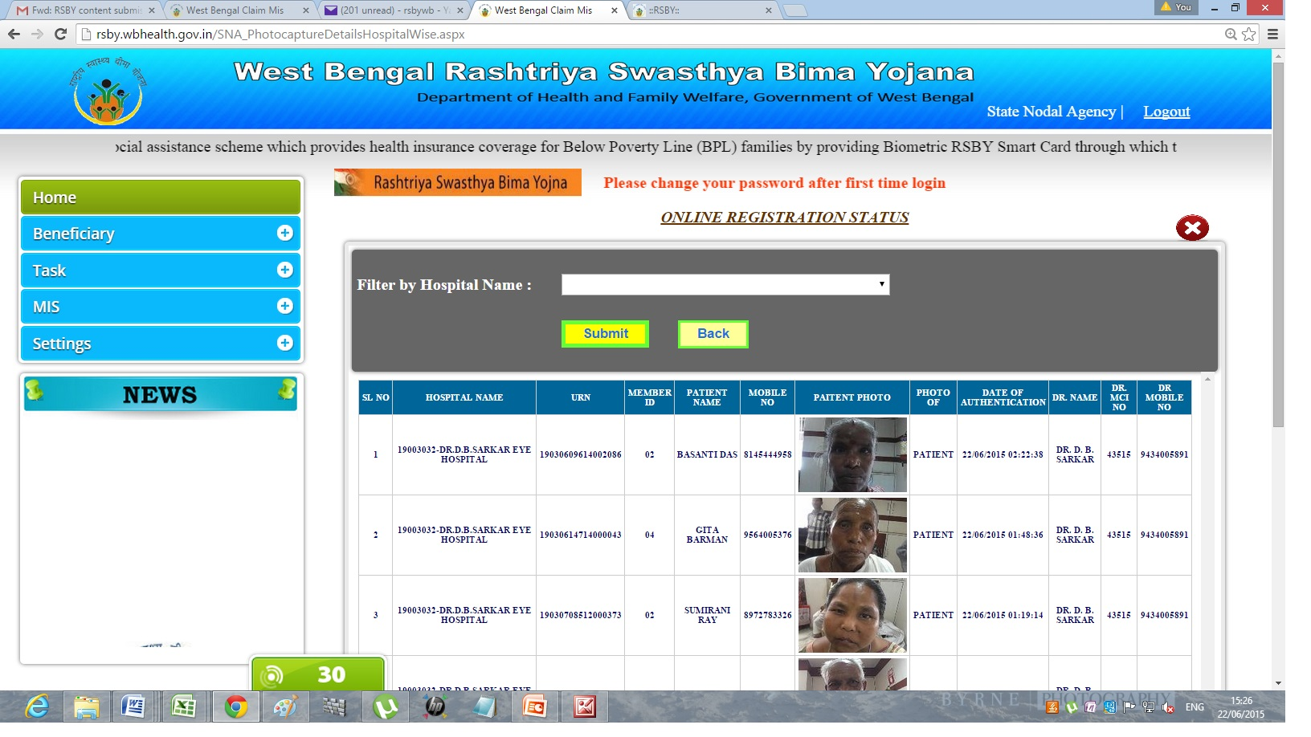

Slide 20
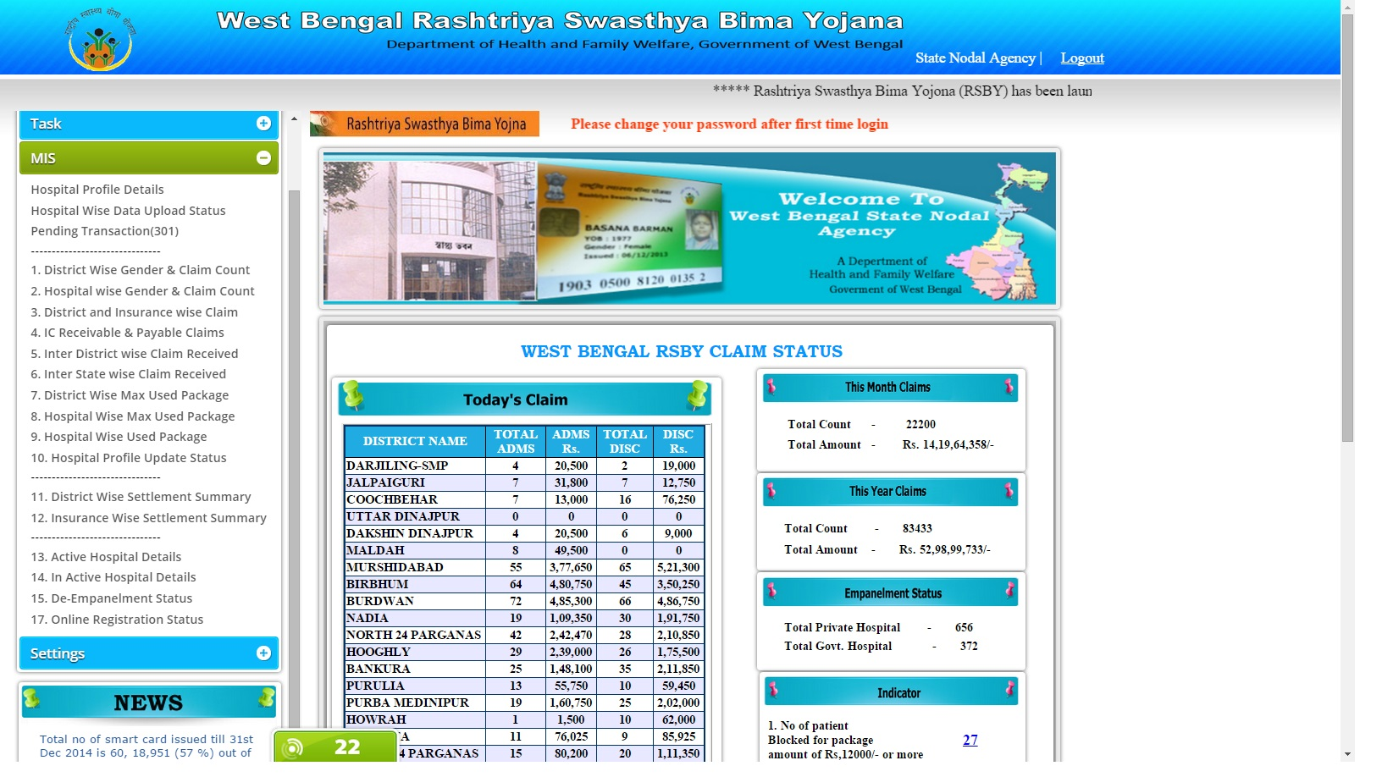

Slide 21
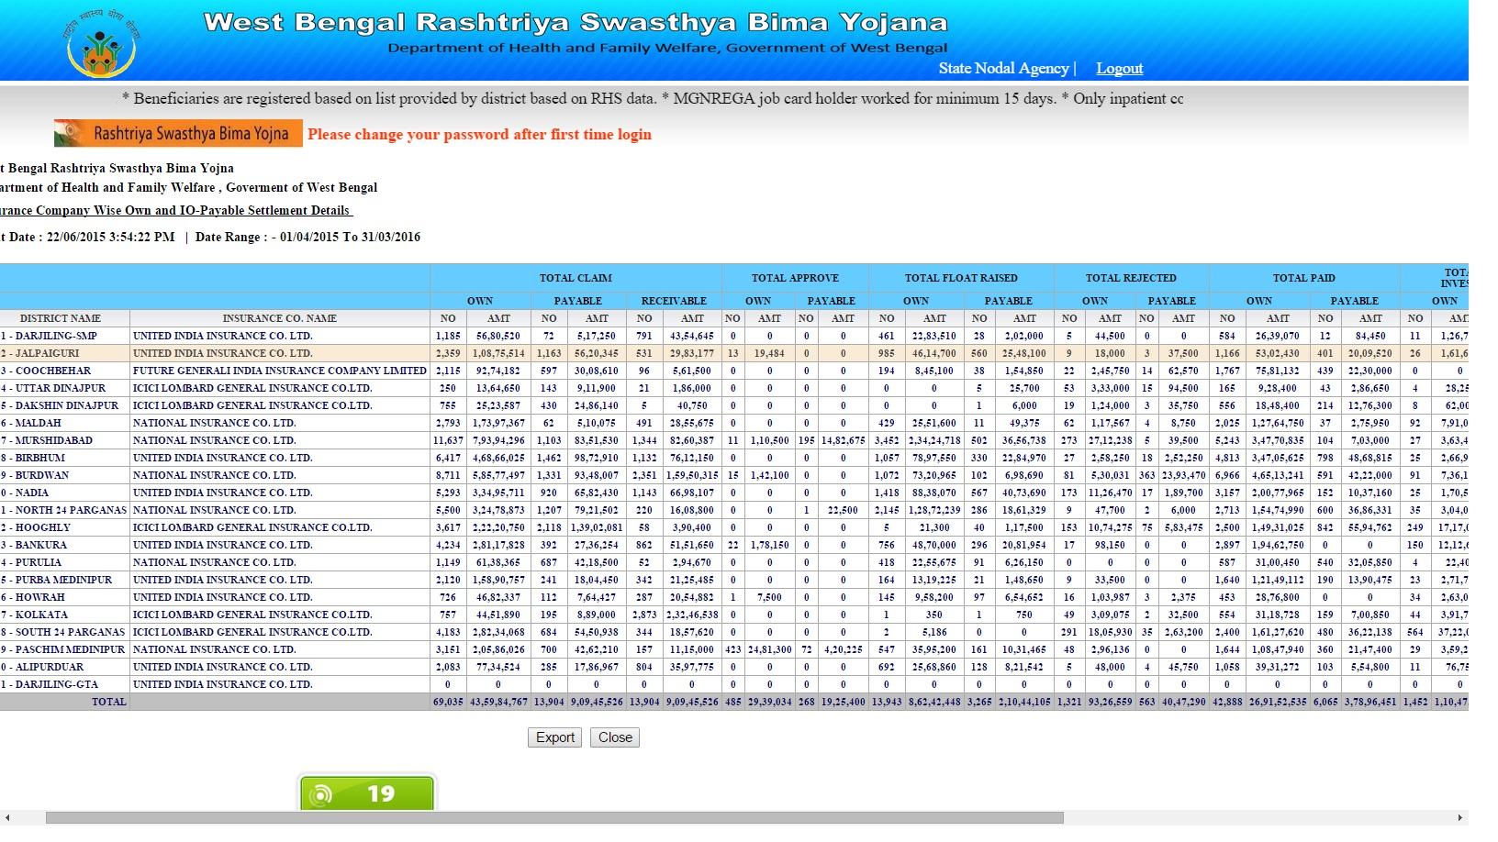

Slide 22
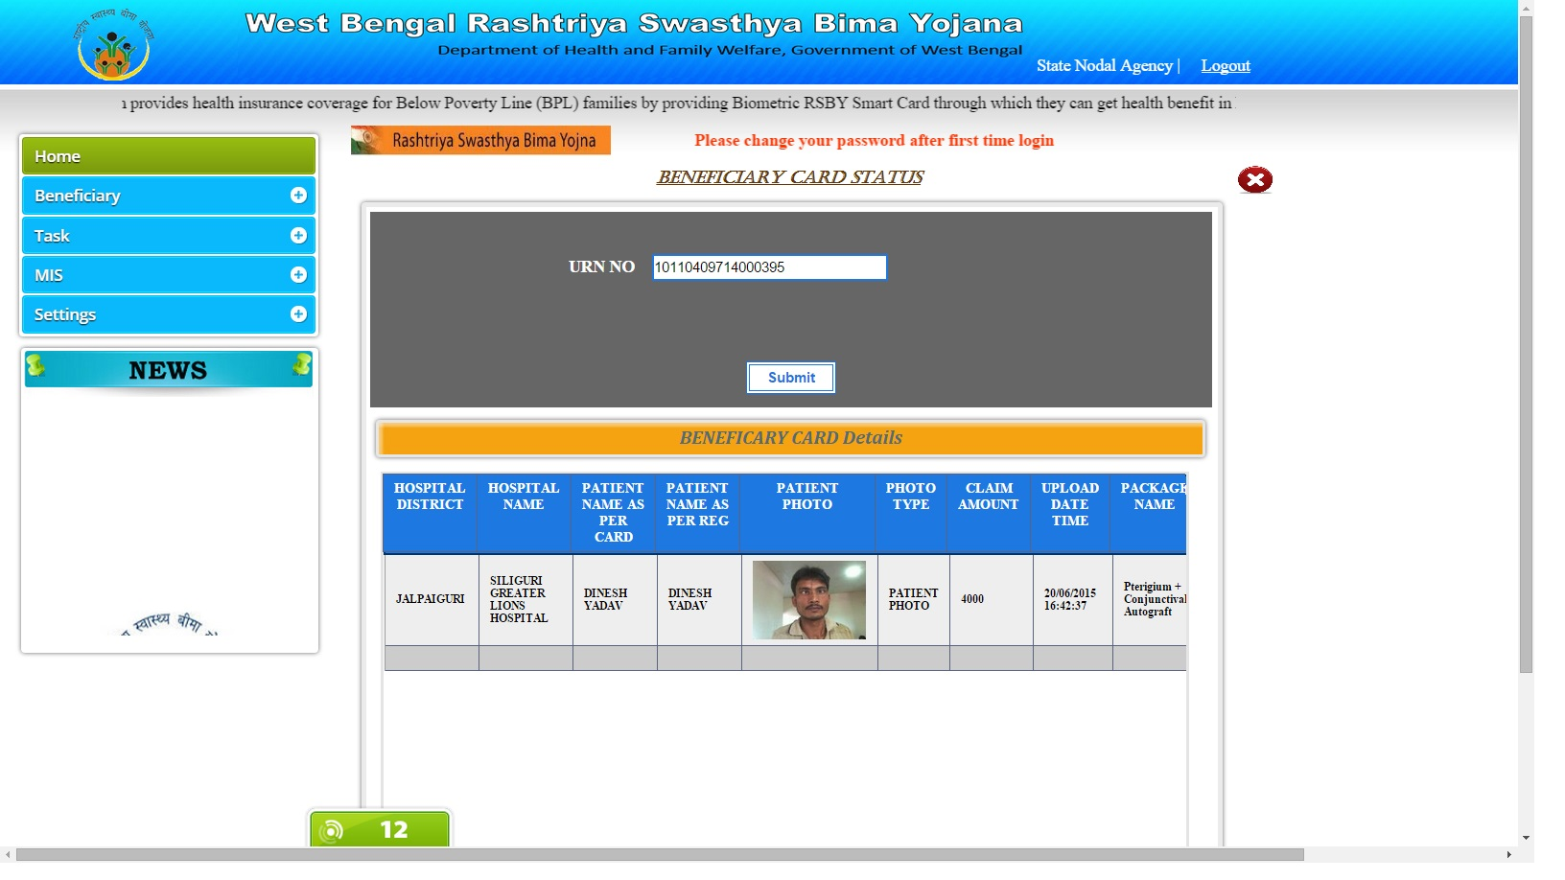

Slide 23
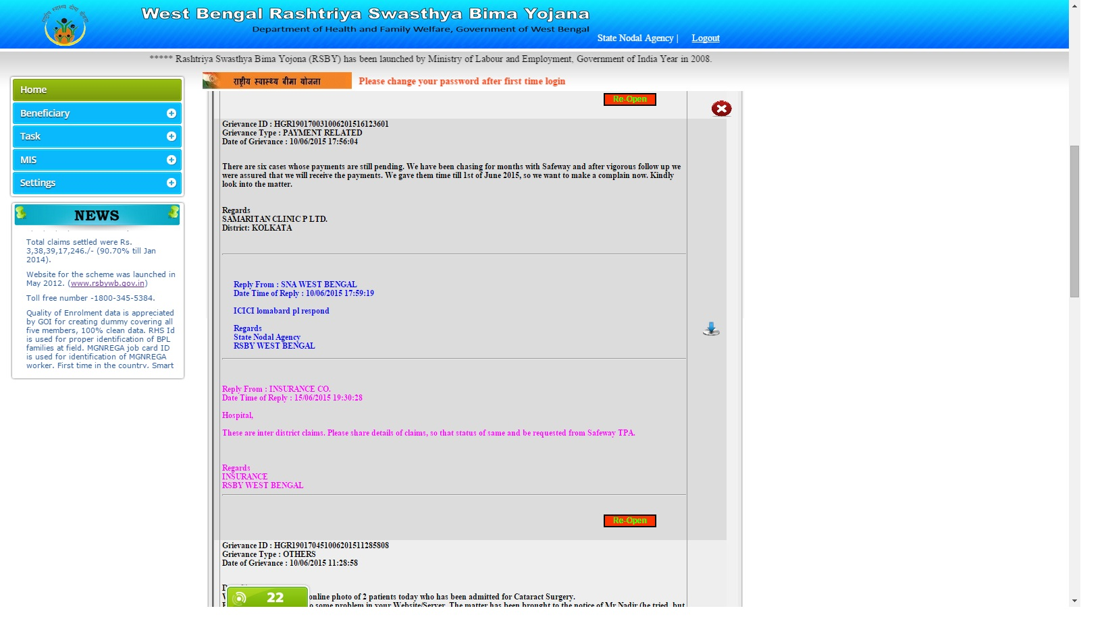

Slide 24
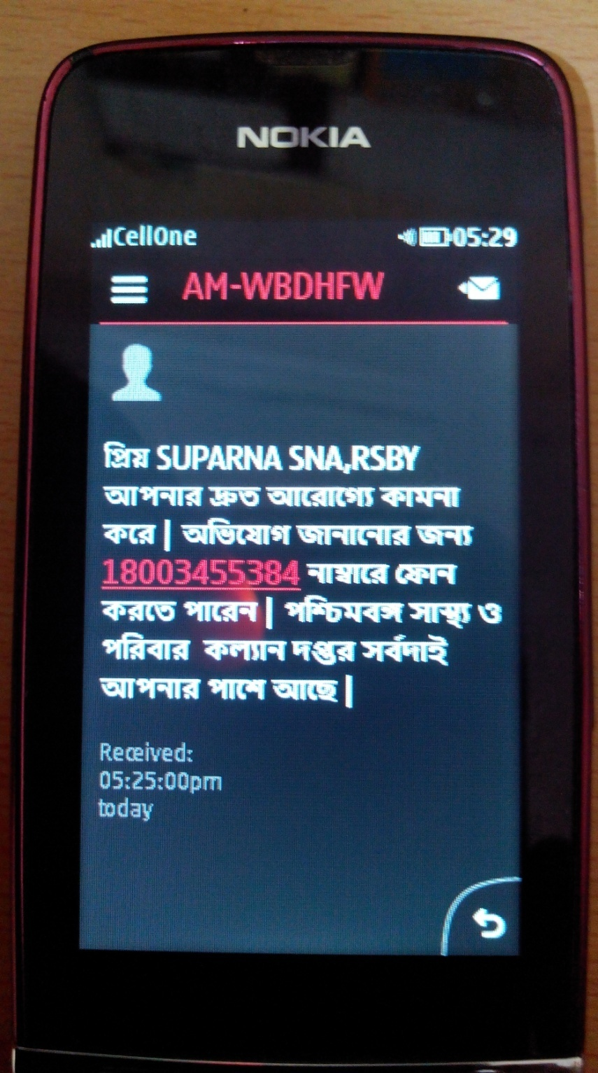
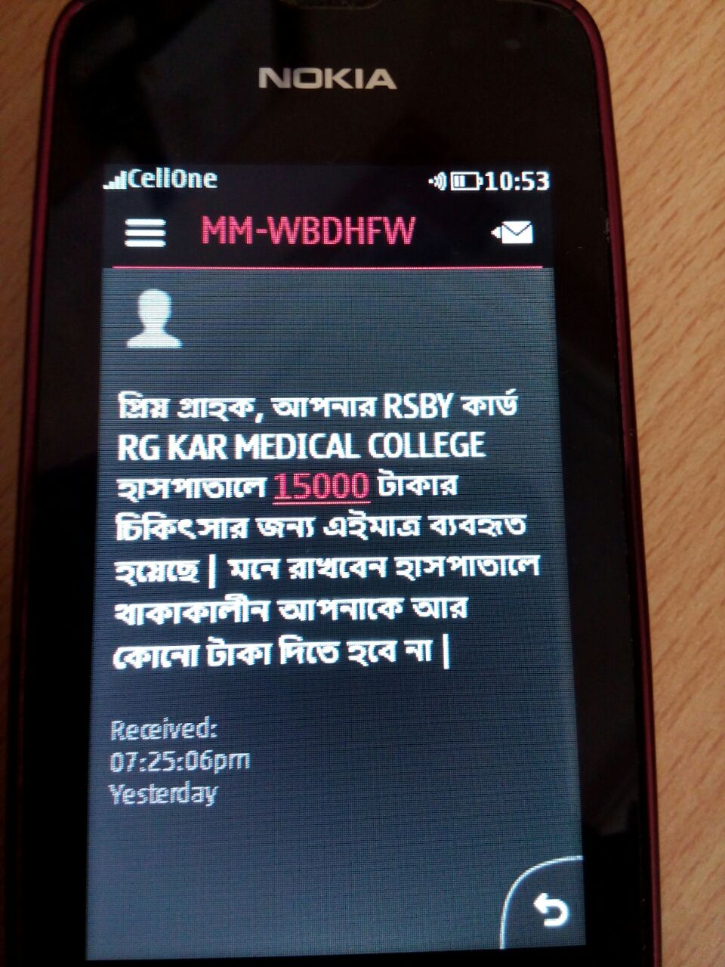

Slide 25
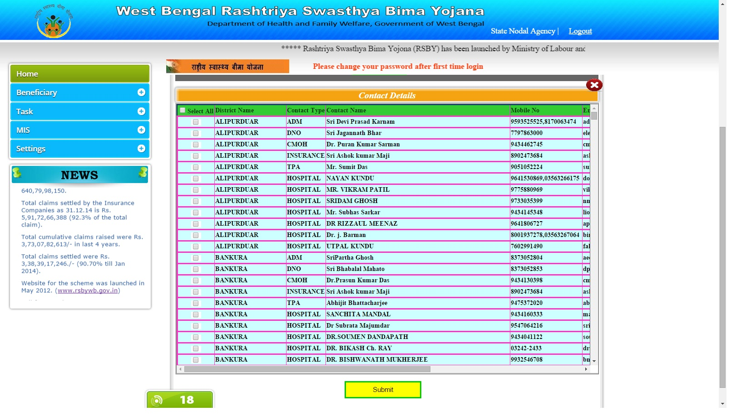

Slide 26
