Slide 1
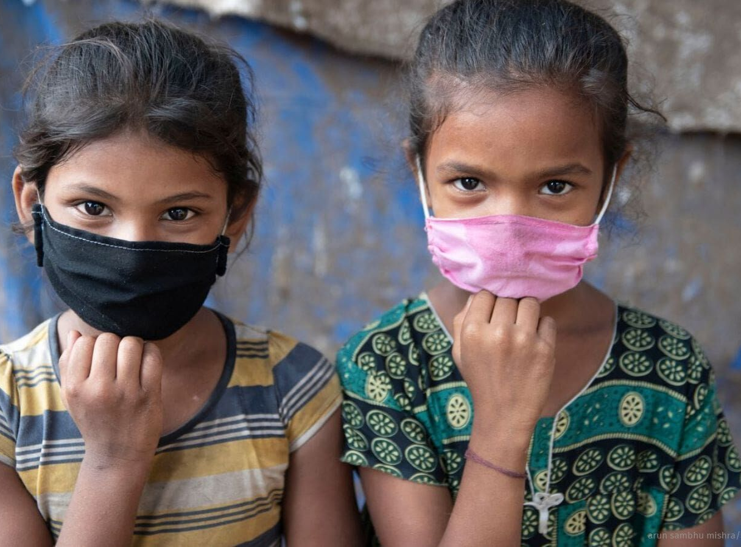


IMNCI approach to A Pediatric COVID case

Slide 2


Principles of IMNCI approach
ASK
LOOK, LISTEN, FEEL
DECIDE

Slide 3
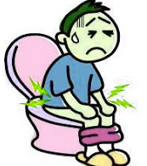
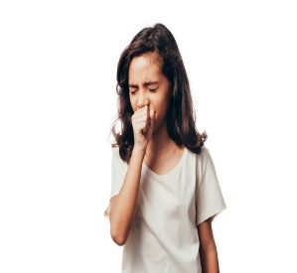
ASK
Fever
Runny nose
Loose stools
Poor feeding
LOOK
Breathing rate *
Nasal flaring
Chest indrawing
Lethargic
Sunken/ pale/red eyes
Skin rash
LISTEN/ FEEL
Grunting
Temperature – hot/ too cold
Skin pinch - dehydration

Slide 4
* How to decide fast breathing
AGE BASED RESPIRATORY RATE CUT OFFS – FAST BREATHING
< 2 mon. : > 60/ min
2- 12 mon. : > 50/ min
12 mon - 5 yrs.: > 40/ min
> 5 yrs: > 30/ min

Slide 5

Danger Signs
Infant/child is lethargic/ unconscious
Movements less than normal
Unable to drink or Vomits
Dry oral mucosa/ sunken eyes
Skin pinch goes back very slowly – more than 2 seconds
Skin rash, stomach pain, red eyes, pallor/ extremely tired

Slide 6
What to do?
Mild
Home based care with teleconsultation and daily monitoring
CHO to monitor
Moderate
DCHC level – usually at CHC / DH
Inform PHC MO and CHO to follow up
Severe
Care at the DCH level – specialist care at DH
PHC – MO to refer and monitor daily
CCC based care for those who cannot stay at home

Slide 7
LEVEL OF DISEASE | WHAT TO DO
MILD Fever+ Stuffy nose+/- Mild cough, normal breathing, no grunting Oxygen spO2 > 95% No other danger signs Asymptomatic child | Report to CC ever day through teleconsultation Reassess daily Paracetamol – 10-15 mg/kg per dose 4-6 hrly Continue breast feeding
MODERATE Fast breathing for age AND No chest retractions Fever > 5 days (axillary temp >37.5Deg. C) Temp < 35.5 deg C Develops any danger signs Any comorbidities | Refer to CCC using ambulance with oxygen and pediatric equipment. Ensure bed availability prior to transferring Accompany the child
SEVERE Fast breathing for age Nasal flaring, grunting sPO2 < 94 % Cold extremities Poor oral intake Lethargy / unconsciousness Seizures | Inform designated CCC and transfer to nearest tertiary care ( DHC) using ambulance with oxygen and pediatric equipment Inform MO and Pediatrician Transfer on oxygen

Slide 8
Who follows the IMNCI approach in the field?
Community level – ASHA/ MPW
HWC level – CHO
PHC level – SN

Slide 9
Case 1 – Ganesh, 6 yrs old
Mother and father COVID positive
Child has fever, dry cough and is listless
No other complaints
Temp – 99 degrees F
pO2 – 96%
What will you do?
Which category do you think this child is in?

Slide 10
Shilpa, 4 years old
Fever, cough
Not drinking or eating
Temp – 100
Breathing rate – 40/min
pO2 – 93%
What will you do?
Which category do you think this child is in?

