Slide 1


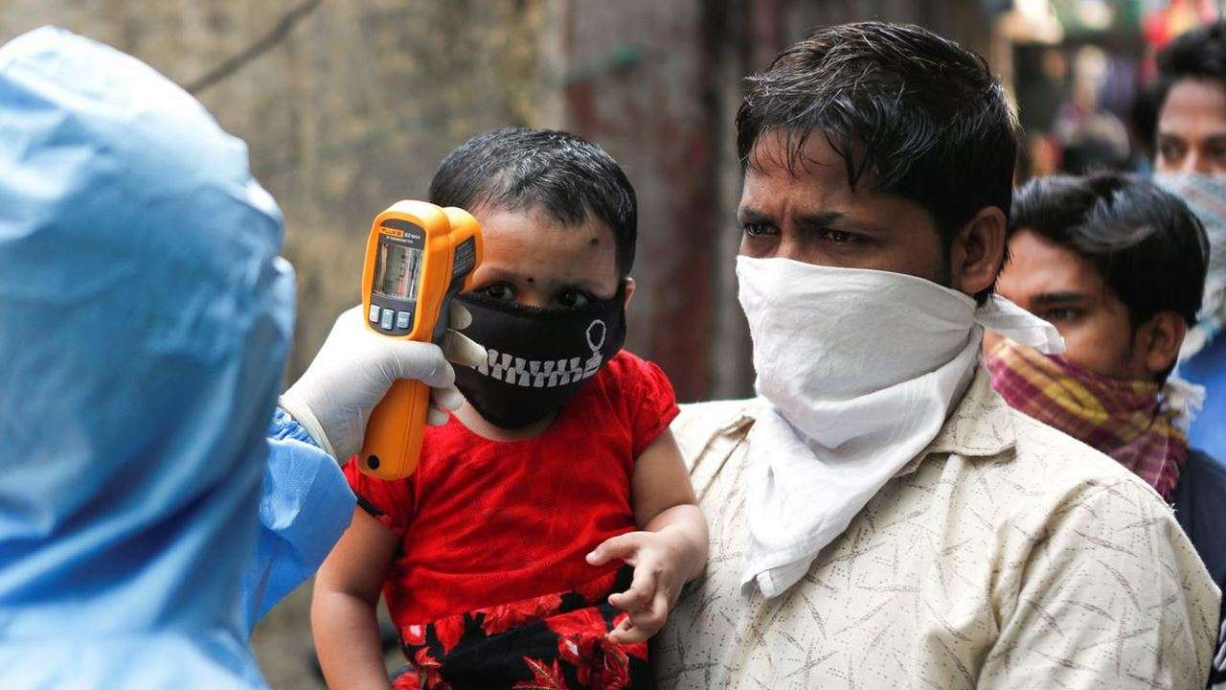
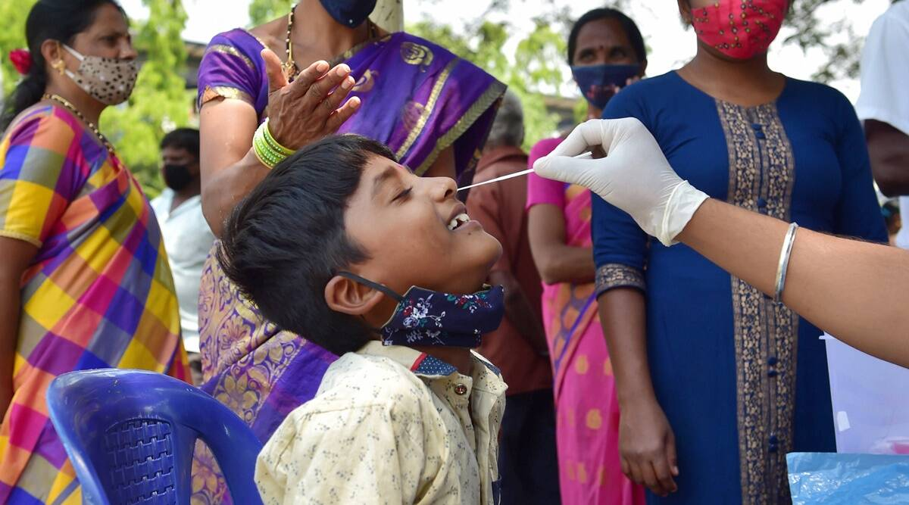
Testing for COVID 19 in Children

Slide 2
When to suspect COVID – 19 in a child?
Fever, headache, myalgia, fatigue, tiredness, runny nose,
Cough, sore throat, rapid breathing
Diarrhea, vomiting, abdominal pain
Poor feeding in an infant, loss of taste or smell (>8 Yrs)
Rash, conjunctival congestion, mucositis, shock
Asymptomatic but has a close/ household contact

Slide 3
When should I get my child tested for COVID-19?
Get your child tested for COVID-19 if:
Family members, that your child has been in contact with, test positive for COVID-19.
Your child has symptoms of COVID-19.
Your child has a fever that has continued beyond three days.

Slide 4
When to test
Recommended for all the suspect cases
Prior to any procedure/ hospitalization
Can be deferred for asymptomatic if no testing resources available
Children with comorbidities and contact must be tested
If not tested but has mild symptoms and known contact with a positive family member, then should be presumed to be COVID—19 positive and managed appropriately
Comorbidities: - Chronic kidney disease congenital heart disease, chronic liver disease, severe malnutrition, current malignancy, immunocompromised state, juvenile diabetes

Slide 5
Which tests to do
Test as soon as possible after onset of symptoms
Rapid Antigen Test ( RAT) in nasopharyngeal swabs
  Low sensitivity – so if negative , RT-PCR should be done
RT-PCR in nasopharyngeal +/- oropharyngeal swabs
SARS CoV-2 antibodies also if features of MIS-C
Children with symptoms suggestive of COVID-19 but negative RT-PCR test, should undergo repeat RTPCR and evaluated for other illnesses
If symptoms are protracted and RT-PCR is negative, CT chest may be done.
If not alternative diagnosis, treats as if COVID – 19 positive

Slide 6
Rapid Antigen Tests (RATs)
Recommended in India for COVID-19 testing in June 2020.
Short turn-around time: 15-30 minutes
Advantage of quick detection of cases
Helps in isolating and treating cases early
Helps in curbing transmission

Slide 7
Testing Algorithm - RAT
Rapid Antigen Test (RAT)
Positive (irrespective of symptomatic status)
Asymptomatic
Negative
To be treated as positive and all precautions should be followed immediately
Symptomatic
Send sample for RT-PCR
If individual is symptomatic later – then RAT or RT-PCR

Slide 8
Points to Remember - RATs
Symptomatic individuals identified positive by RAT should not be re-tested and advised to go through home-based care.
Symptomatic individuals identified negative by RAT should be linked with RTPCR test facility and in the meantime be urged to follow home isolation and treatment.

Slide 9
RT-PCR Testing
Helps identify infection in a person
Common sites for sample – Back of the nose and throat
Single RT-PCR positive test –
  Confirmatory
  No repeat testing.

Slide 10
Testing Algorithm – RT-PCR
Positive
Negative
No infection detected
All precautions should be followed immediately (irrespective of symptomatic status)
RT-PCR
If symptoms develop following a negative RAT test, a repeat RAT or RT-PCR should be done.

Slide 11
Points to Remember – RT-PCR
RTPCR test must not be repeated in any individual who has tested positive once either by RAT or RTPCR.
No testing is required for COVID-19 recovered individuals at the time of hospital discharge in accordance with the discharge policy of MoH&FW

Slide 12
Points to Remember – Reporting of the Test
The vaccination status of all individuals tested for COVID-19 must be entered into the Sample Referral Form (SRF) in the RTPCR app both for individuals tested by RTPCR and RAT. This information is of critical importance.
All RTPCR and RAT test results should be uploaded on ICMR portal at: https://cvstatus.icmr.gov.in.

Slide 13
What should I do if my child tests positive for COVID-19?
The testing team will explain to you what to do
If the symptoms are mild, you will be asked to take your child home and follow home isolation. The ASHA and MPW will follow up with you
If you are unable to isolate the child at home, you can put him/her in the Covid Care Centre at the PHC level
Moderate and severe cases will be admitted into special care hospitals at the CHC or district level as advised by the medical officer.

