Slide 1


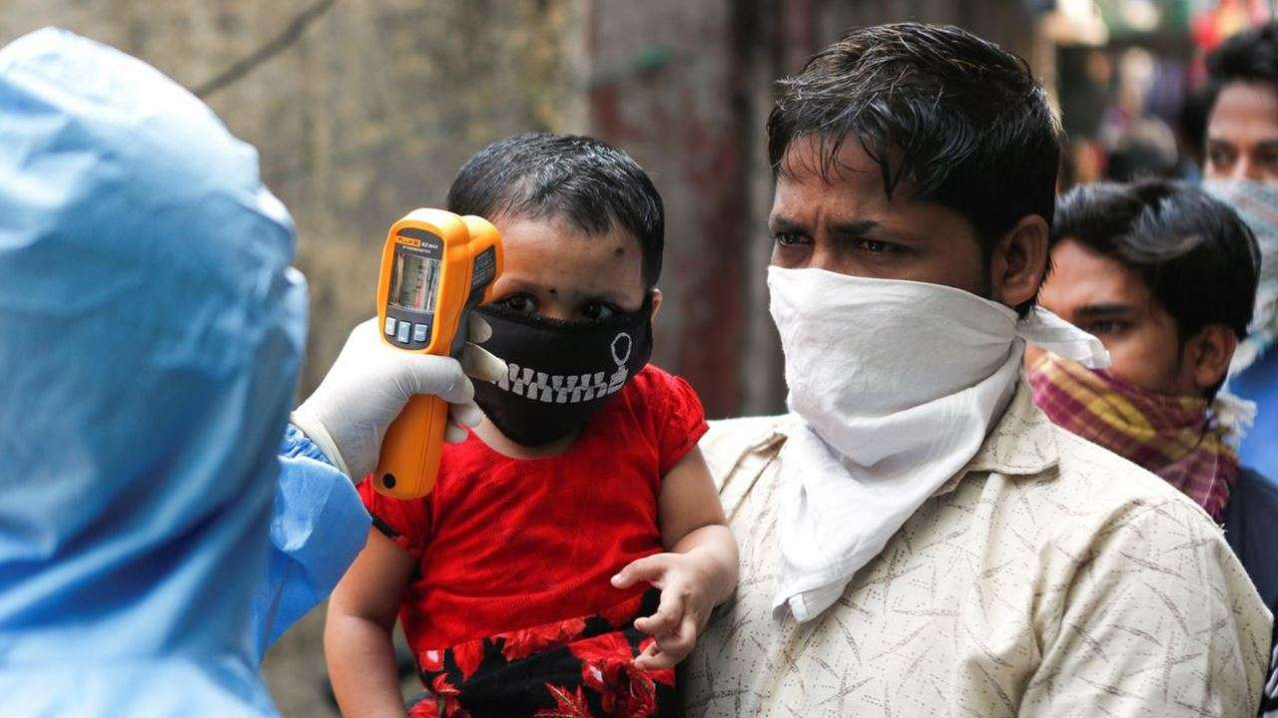
Testing and triaging for COVID-19 in children

Slide 2
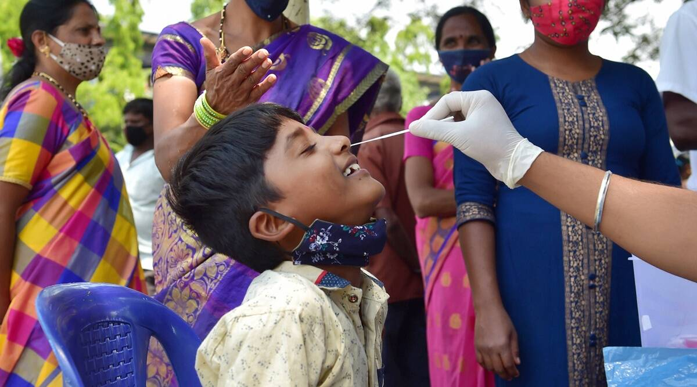
COVID-19 Care Centre (CCC) – Mild or asymptomatic cases in case home isolation is not possible
Dedicated COVID-19 Health Centre (DCHC) – Moderate cases
Dedicated COVID-19 Hospital (DCH) – Severe Cases
Admission criteria in different types of health facilities:
Based on these criteria, patients can be categorized as mild, moderate or severe.
The mild cases are then referred to COVID Care Centre or home isolation.
Pediatric cases screened with moderate and severe symptoms should be referred to higher facilities (DCHC or DCH).

Slide 3
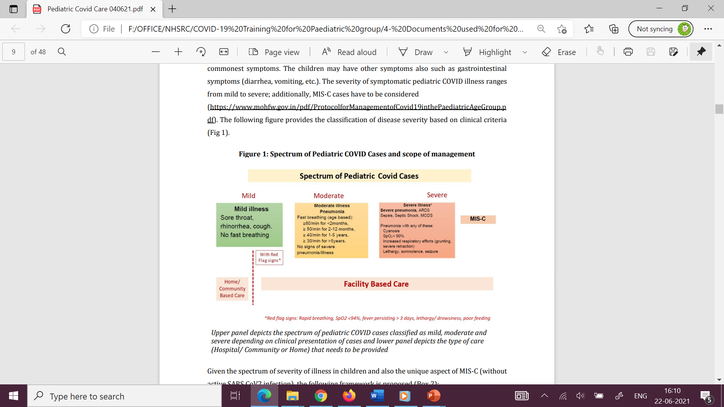
Red flag sign:
Rapid breathing, SpO2<94%, fever>3 days, lethargy,/ drowsiness, poor feeding

Slide 4
Triaging
For deciding the level of care of children with COVID-19
Triaging involves two stages –
  at the entrance/ screening facility/ ER
  The other at the holding area before entering into the isolation ward/rooms.
Screening + detailed evaluation

Slide 5
Triaging - 1
Referred from CCC/DCHC
Patient with COVID like symptoms/ asymptomatic / in contact with COVID positive patient
Walk in
Entrance
Waiting line
Triage-1 ( Screening for COVID-19)
Non-COVID
Essential services
COVID positive or symptomatic
Asymptomatic
Result

Slide 6
Triaging - 2
Result
Negative
Awaited
Positive
Home
Positive
Triage 2( clinical triage to assess the severity)
Severe
Mild
Moderate
Admission to dedicated Pediatric COVID ward/ICU/HUD
Isolation Ward
If no beds
CCC/Quarantine facility / Home quarantine /

Slide 7
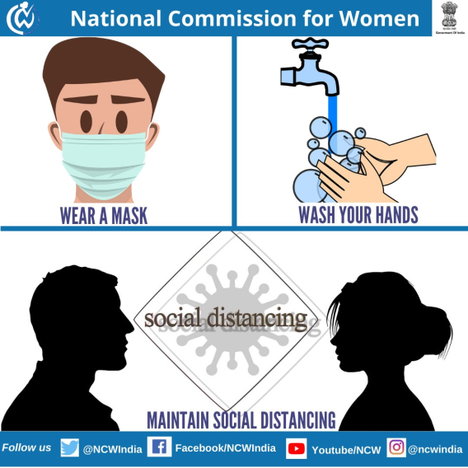
Initial Screening and Triage 1 at the health facility
1) At entry gate
  Screening the patient by trained personnel with PPE
  Temperature recording
  SpO2 using finger pulse oximeter
  History of contact with COVID-19 or with any symptomatic person
  Patients with low SpO2 (<94%)-
  Immediate oxygen support in the triage area.
2) Attendants and patients beyond 5 years of age group
wear mask
follow hand hygiene
Social distancing- at least 1- meter distance
to be maintained

Slide 8
Triage 2
Undertaken by attending doctor
Moderate symptoms
Severe
shifted to the yellow/ orange area where COVID-19 testing is done (if not tested earlier).
emergency should be equipped
ventilator support, access to
oxygen support and
multipara monitors
Positive
Negative
DCH/ DCHC for
advance care. .
provide non- COVID-19
essential services
After stabilization in Emergency→
shift to paediatric ICU

