Slide 1



Management of Pediatric COVID19 at Community level -
Home care and HWC level
Dr. Sumita Ghosh
Additional Commissioner & Incharge
(CH, AH, RBSK, CAC and ADs), MoHFW

Slide 2
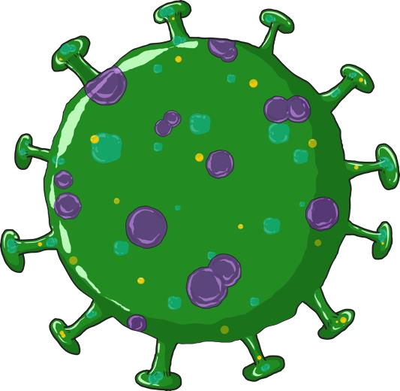

CORONAVIRUS DISEASE 2019 (COVID-19)
The COVID-19 (SARS-CoV-2) is a major public health crisis, that has affected people of all ages, gender and race.
Among confirmed cases <12 % individuals belonged to <20 years of age .
There is now focus on enhancing preparedness for the next wave; including paediatric care facilities .

Slide 3

Classification of disease
Asymptomatic
Infection is diagnosed while screening family members; child is otherwise asymptomatic.
Mild
Fever and/or upper respiratory symptoms without any evidence of fast breathing and normal oxygen saturation on room air (Spo2 => 94%)
Moderate
Fast breathing and/or oxygen saturation (SpO2) between 90-93% on room air.
Severe disease
Any signs of severe respiratory distress and/or SpO2 less than 90% on room air.
Children with SEVERE DISEASE are at high risk for respiratory and multi-organ failure and need critical care support.

Slide 4
LEVEL OF MANAGEMENT
Patient at community
TRIAGING AT PHC/ CENTRE LEVEL
MILD DISEASE
SEVERE DISEASE
MODERATE DISEASE
After recovery – follow up
Home
DCH
home isolation possible
Covid Care Centre (CCC)
DCHC
home isolation NOT possible
Worsening of Symptoms

Slide 5
Common symptoms of COVID-19 in children
Fever
Cough /Difficulty in breathing
Loose motion
Sore throat
Rhinorrhea/nasal block
Body ache/ Malaise
Headache
Loss of sense of smell/taste
Anorexia, Nausea/vomiting
Common symptoms of COVID’19

Slide 6
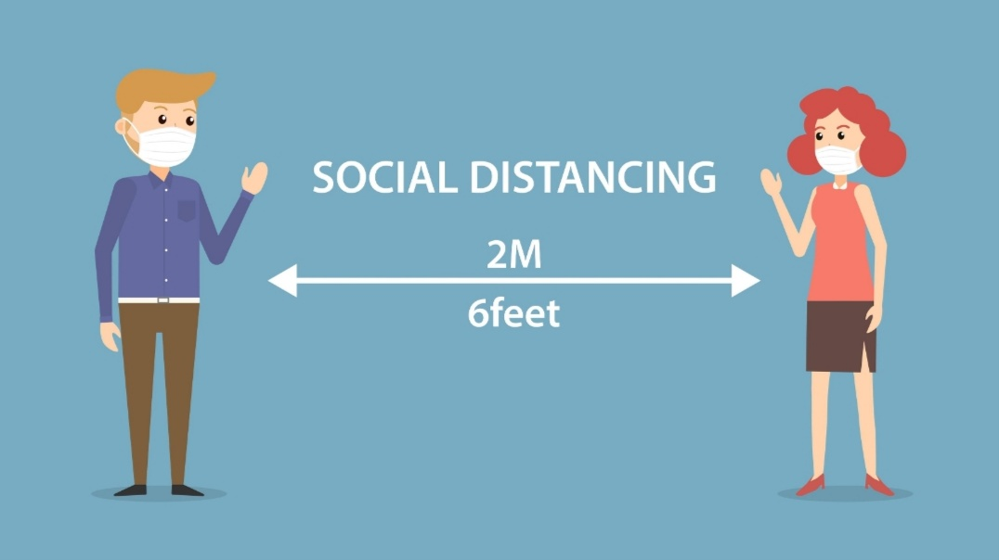


COVID-19: Prevention
Masking Social Distancing
Respiratory
hygiene
Hand Hygiene
Essential Nutrition Practices For Good Immunity

Slide 7
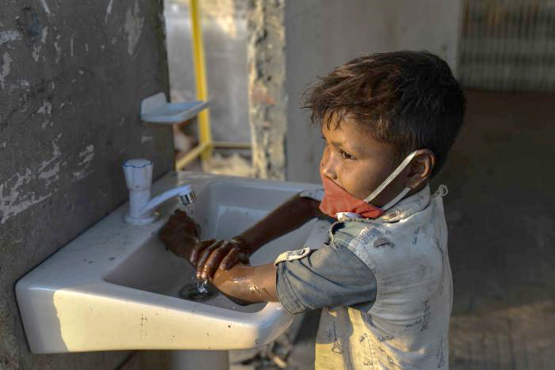
Principles of community based care by ASHA/MPW
Daily home visits by ASHAs and MPWs
Update the CHO on the status.
Ensure that
  Home delivery of required drugs
  Look for danger signs
Fill up checklists
  Checklists for surveillance and monitoring by ANM/ASHA
  Physical Triage Checklist- Home Isolation Daily checklist
Instructions to caregivers
Do not panic. Most cases can be managed at home with simple monitoring
Children will need a care giver to be with them
Recognize danger signs and immediately inform ASHA/ MPW
All family members and close contacts to be monitored and tested as per protocol
Ensure strict adherence to COVID appropriate behavior.
Food and Nutrition of the child need special attention
Ensure Cleanliness and regular disinfection . Child to be kept in a well ventilated room.

Slide 8
Symptomatic Management of Home isolated children
Symptomatic Management of Children with Mild COVID at the CCC
For Fever: Paracetamol 10-15 mg/kg/ dose and can be repeated every 4- 6 hours
For cough: In older children – saline gargles
: Cough syrup can be given
Fluids and feeds: Ensure oral fluids to maintain hydration
Antibiotics: not indicated

Slide 9
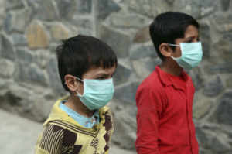
Red flags / danger signs for referral
Rapid breathing (age based)*
Grunt, nasal flaring
Severe Chest indrawing
SpO2< 94%
Cold extremities
Poor oral intake (esp. infants and young children)
Fever persisting >3 days
Lethargic (esp. infant and young children)
Seizures/ encephalopathy
*Age based Respiratory rate cut-offs for rapid breathing
<2 months | more than or equal to 60/ minute
2 to 12 months | more than or equal to 50/ minute
12 months to 5 years | more than or equal to 40/minute
More than 5 year | more than or equal to 30/ minute

Slide 10
Post COVID19 care in children
A pulse oximeter should be given to the patient at discharge
Advice about warning signs
Development of fever
Persistent drop in oxygen saturation
Increased cough
Breathlessness
Chest pain
Headache
Jaw pain/ tooth pain
Nasal blockage.
Emergency contact number of ASHA, MPW, CHO - in case of warning signs

Slide 11
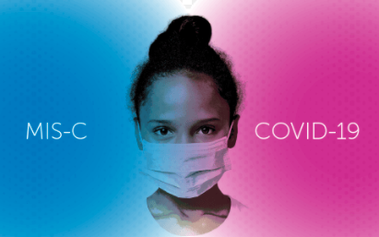

When to suspect MIS-C?

Slide 12
When to MIS-C?
MIS-C is a severe post-COVID-19 inflammatory disorder in children
Associated with complications such as cardiac dysfunction, coronary aneurysms, thrombosis, and multi-organ dysfunction etc
MIS-C cases tend to peak 2-6 weeks following the peak of COVID-19 cases in the community
MIS-C should be suspected in children with
Persistent fever beyond 3 days with (Rash, bilateral non-purulent conjunctivitis, diarrhoea, vomiting, or abdominal pain, bleeding, respiratory distress, shock),
Especially if child had contact with COVID-19 patient in past 1-2 months or had acute COVID infection.

Slide 13
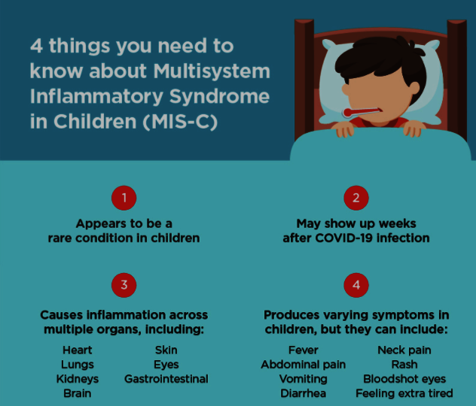
Case definition of MIS-C
New syndrome-Multisystem inflammatory syndrome (MIS-C) seen in children
Characterized by:
Unremitting fever > 38 C
Epidemiological linkage with SARS CoV – 2
Clinical features suggestive of MIS

Slide 14
Emergency warning signs of MIS-C
Severe stomach pain
Difficulty breathing
Pale, gray or blue-colored skin, lips or nail beds — depending on skin tone
New confusion
Inability to wake up or stay awake
Pain or pressure in the chest that does not go away

Slide 15
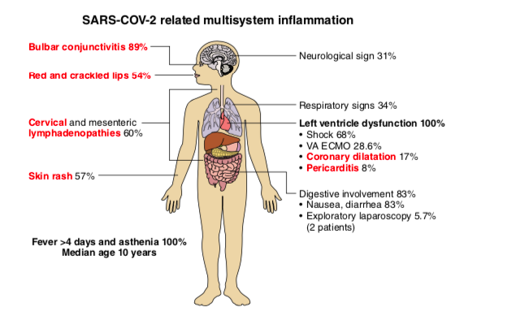
Diagnostic criteria of MIS-C (WHO criteria)
Constellation of clinical and laboratory parameters has been suggested for diagnosis
Children and adolescents 0–19 years of age with fever ≥ 3 days
Clinical (Signs & symptoms any 2 of these)
Laboratory
Rash or bilateral non-purulent conjunctivitis or muco-cutaneous inflammation signs (oral, hands or feet).
Hypotension or shock
Features of myocardial dysfunction, pericarditis, valvulitis, or coronary abnormalities (including ECHO findings or elevated Troponin/NTproBNP)
Evidence of coagulopathy (by PT, PTT, elevated d-Dimers)
Acute gastrointestinal problems (diarrhoea, vomiting, or abdominal pain).
Elevated markers of inflammation such as ESR, C-reactive protein, or procalcitonin.
No other obvious microbial cause of inflammation, including bacterial sepsis, staphylococcal or streptococcal shock syndromes.
Evidence of COVID-19 (RT-PCR, antigen test or serology positive), or likely contact with patients with COVID-19.

Slide 16
Formats for Home Monitoring, HWC & PHC Level Care

Slide 17
What to do if you suspect MIS- C?
REFER IMMEDIATELY TO THE DCH – LEVEL ONLY

Slide 18

THREE IMPORTANT CHECKLISTS
Checklists for surveillance and monitoring by ANM/ASHA
Physical Triage Checklist- Home Isolation Daily checklist
Facility level checklist for Surveillance in Children
(To be used by Community Health Officer/Staff Nurse/Medical Officer)

Slide 19
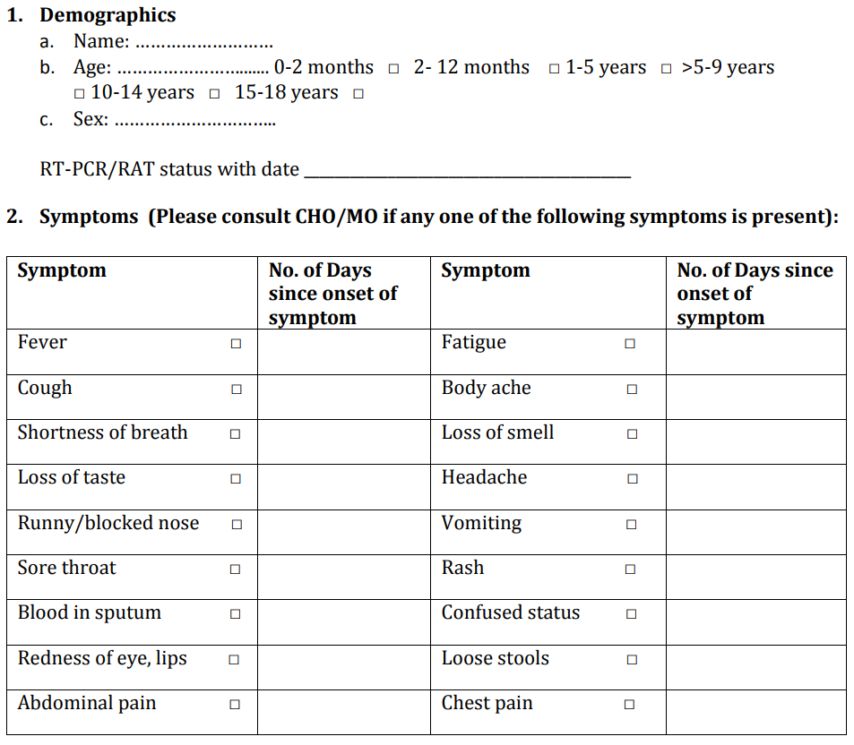
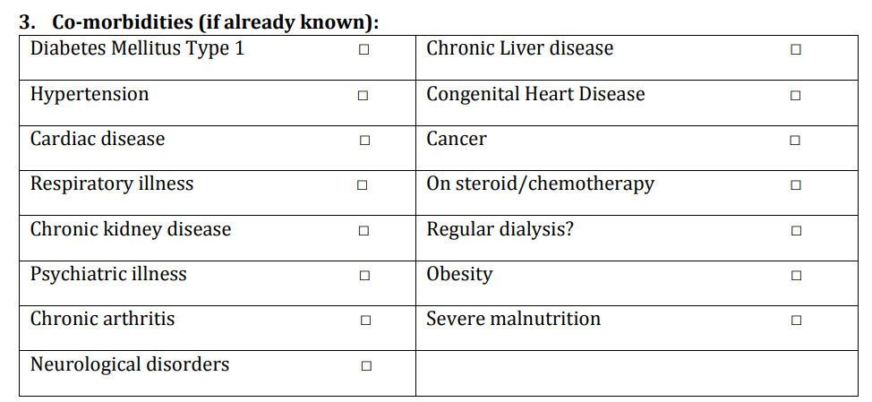
Checklists for surveillance and monitoring by ANM/ASHA

Slide 20
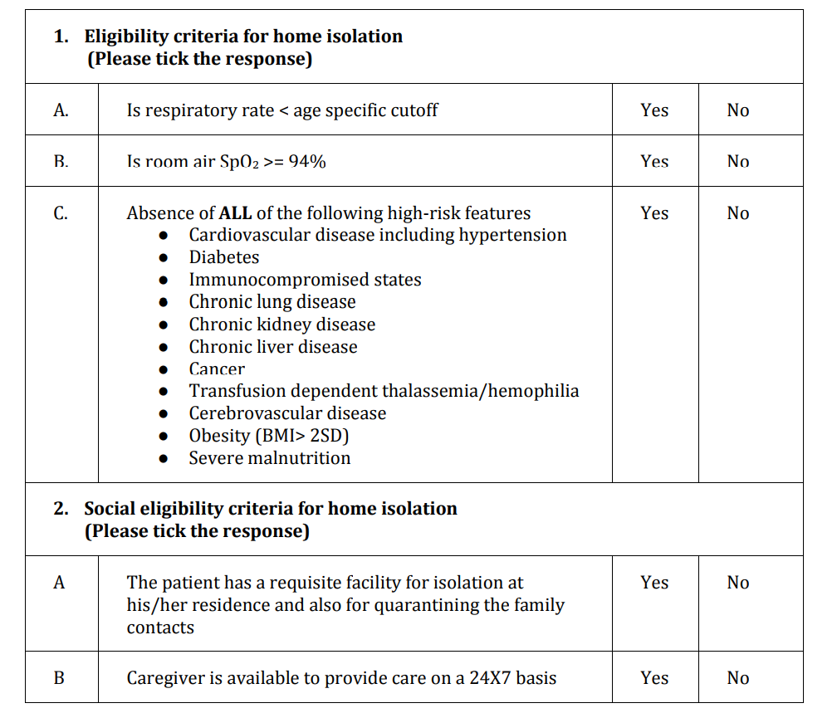
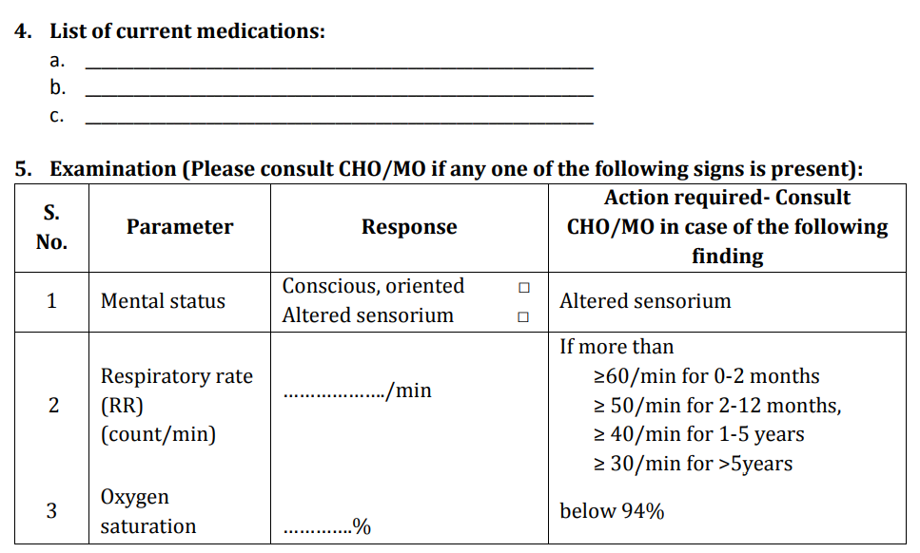
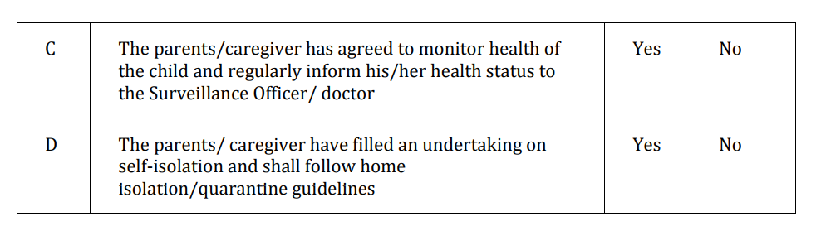

Slide 21
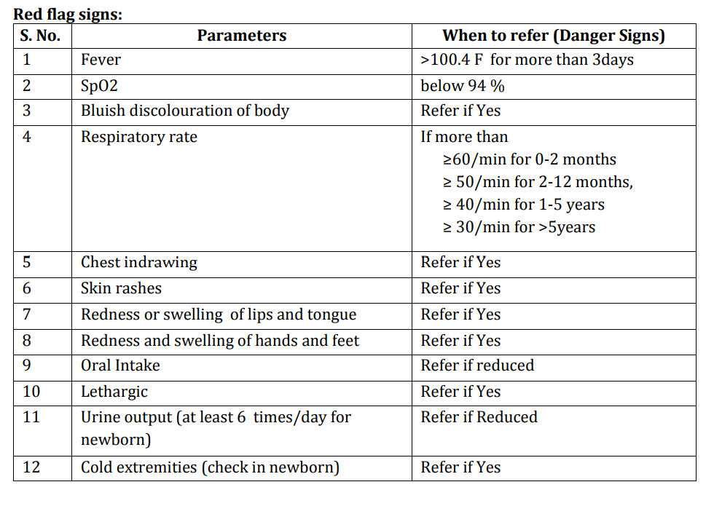

Slide 22
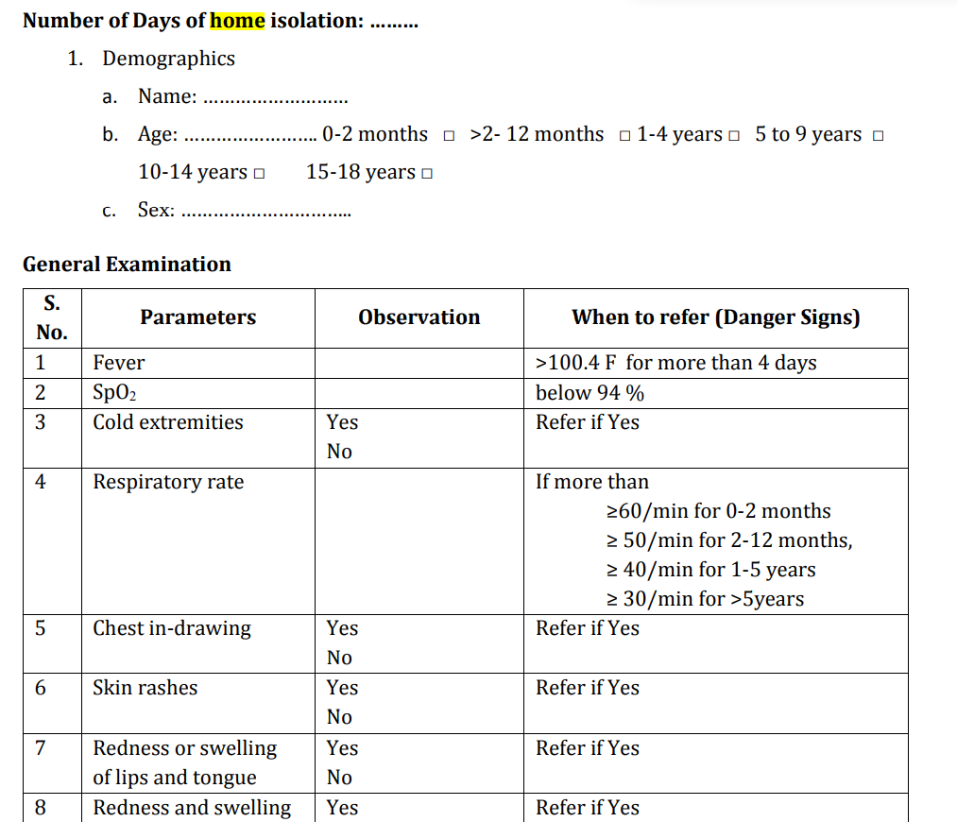
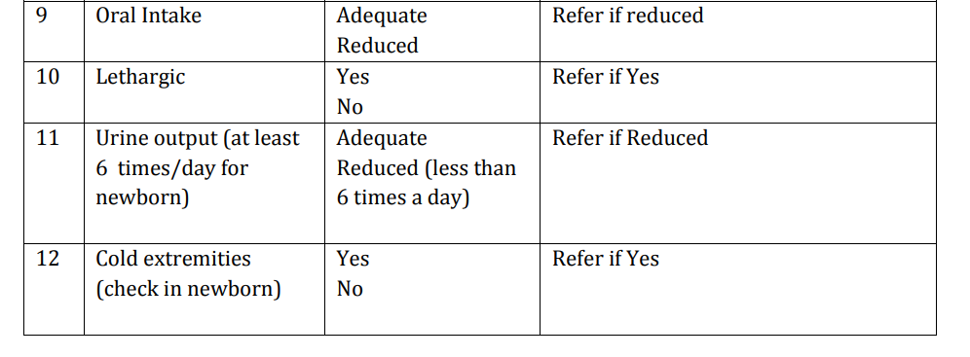
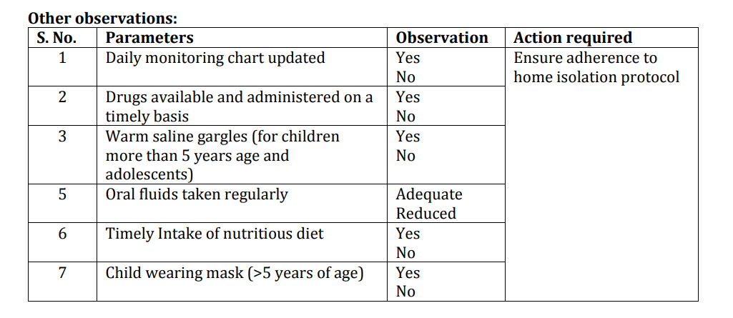
Physical Triage Checklist- Home Isolation Daily checklist (To be filled for 14 days)

Slide 23
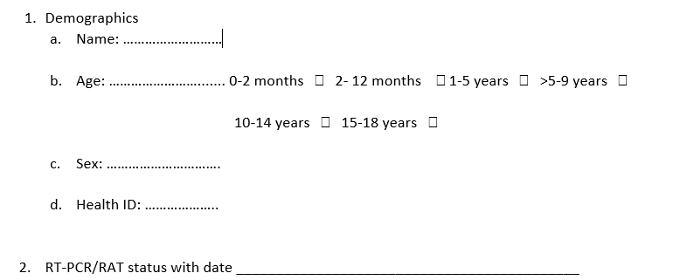
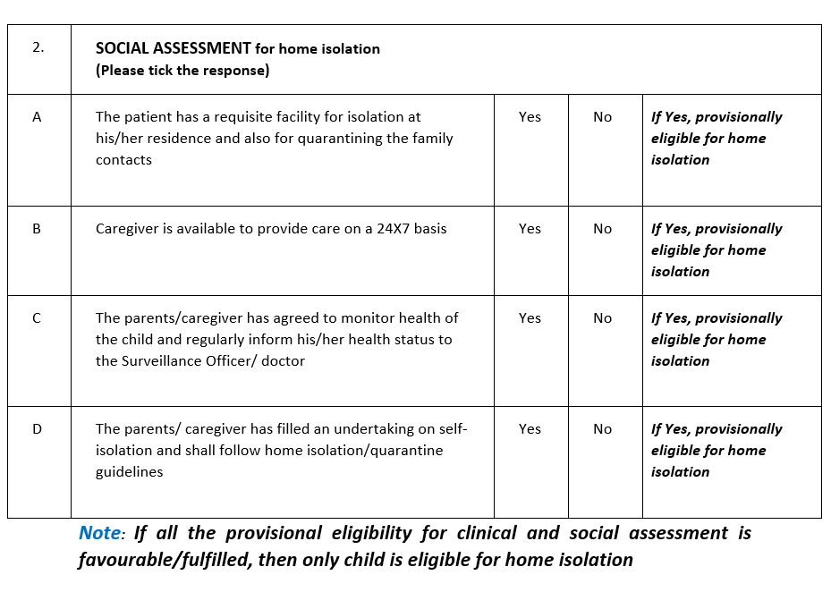
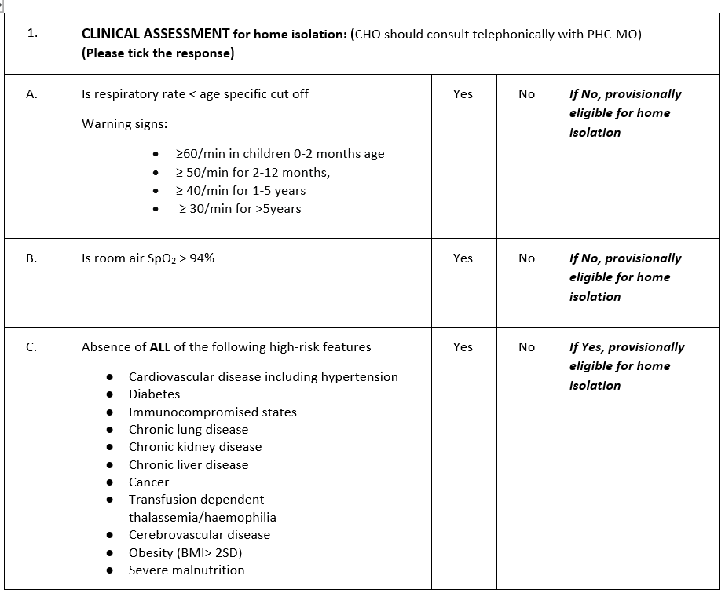
Facility level checklist for Surveillance in Children
(To be used by Community Health Officer/Staff Nurse/Medical Officer)

Slide 24
