Slide 1




PAEDIATRIC CARE IN COVID19
SPECIAL SITUATIONS

Slide 2



Objectives
By the end of the session participants will describe key points related to
Care of mothers and neonates born to COVID19 positive mothers,
Care for Neonates with late onset COVID19 Disease
Care of children with COVID where caregivers are not available

Slide 3
KAMLA’S STORY
Karun and Kamla were so happy when the pregnancy test came positive. They were married for 7 years and this was their first success. When Kamla was 8 months pregnant, her father was hospitalized because of COVID-19. All family members were then tested. When she was tested, she turned out positive for COVID too. She was devastated.
The ASHA visited her. She asked the ASHA just one question
“What should I do to be healthy and protect my baby?”

Slide 4
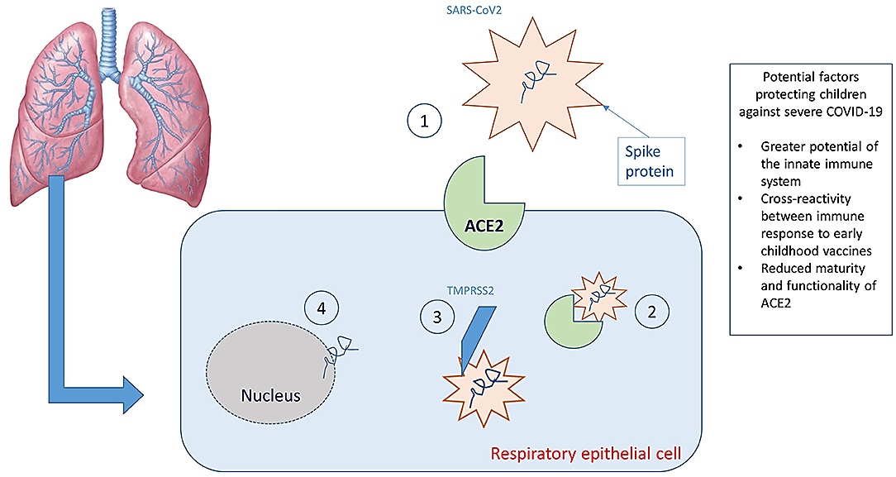
ASHA’S REPLY
Most babies do not get COVID -19. The Corona virus finds it difficult to live and multiply in babies' lungs
If they do get COVID 19 , most are asymptomatic

Slide 5
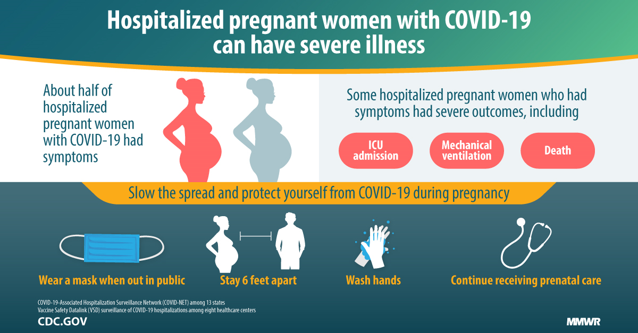
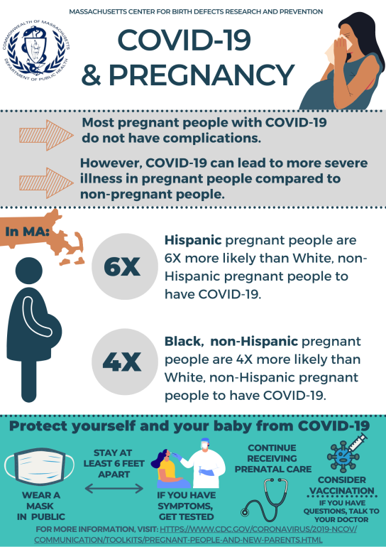
FACTS AS OF TODAY

Slide 6
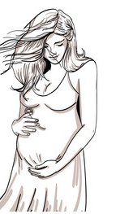

Care of COVID-19 positive pregnant mother
Same care should be provided for the management of COVID-19 positive pregnant women as recommended for adults.
COVID-19 itself is not an indication for induction of labour or Caesarean section.
Monitor oxygen status during labour and oxygen therapy should be titrated to maintain oxygen saturation of more than 94%.
COVID 19 positive pregnant women are more prone to getting Pre-eclampsia, Gestational Diabetes and Thrombosis (clots) and delivering before term

Slide 7

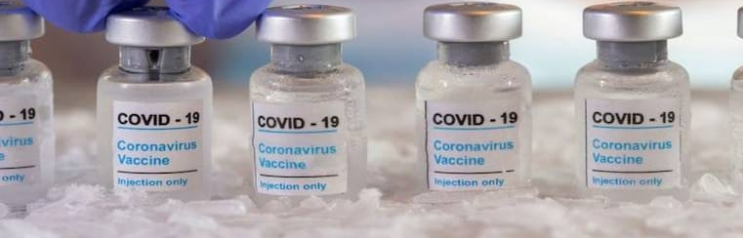
Kamla is still worried. The vaccination drive has come to her village. She asks the ASHA, “ Should I take the COVID vaccination. Maybe if I do, then my baby will be protected from COVID 19?”.
The ASHA REPLIES “ NO. you have COVID now so the vaccination cannot help you. Those who have COVID must wait 3 months after COVID19 infection for the vaccination to work.”
“What about other pregnant women and those feeding their babies?” Kamla asked curiously.
“Pregnant women can be given the vaccine any time during the pregnancy. This is the latest news from the government. Keep positive.
Mothers who are breastfeeding their baby can also have the vaccine Remember the most mothers with COVID19 give birth to healthy babies. Do call me when you feel worried.”
BREASTFEEDING

Slide 8
ROLE OF ASHA in follow up of COVID positive pregnant women
SERVICE PROVIDER
ANC, follow up Home visits, HBNC, HBYC, health education and teleconsultation
FACILITATOR
Support for testing and counselling
Arrangements for institutional delivery
Keeping ambulance service ready
HEALTH PROMOTER
Health promotion
Role model,
Vaccination drives

Slide 9


Care of neonates born to COVID-19 positive mothers
Approximately 10% of neonates born to COVID-19 positive mothers may be positive during the birth period
Majority of them remain asymptomatic
Small proportion of new-borns might require symptomatic treatment or oxygen support
A significant proportion of neonates may however require special or intensive care due to prematurity and perinatal complications.

Slide 10

Neonatal Resuscitation
Follow standard guidelines of resuscitation
Resuscitation should be done in a physically separate adjacent room earmarked for this purpose.
If physical separation is not possible: Maintain distance of 2 metres between delivery area and the resuscitation warmer.
Delayed cord clamping and skin-to-skin contact can be practiced.
Endotracheal administration of medications should be avoided.
Bathing is not recommended in view of risk of hypothermia and hospital acquired infections

Slide 11
KAMLA’S BABY IS BORN.
RISK OF PRE-TERM BABIES INCREASES
A week later, Karun and Kamla were happy when they saw their baby. Kamla went into labour early and delivered the baby in her 8th month. Baby’s weight was 1.90 kgs. The ASHA was happy that an institutional delivery happened.
When the ASHA went to see her, she had her triple layer mask on. Kamla asked the ASHA
“ They are making me breastfeed my baby. No isolation from my baby. But I have COVID. Won’t my baby get it?”

Slide 12
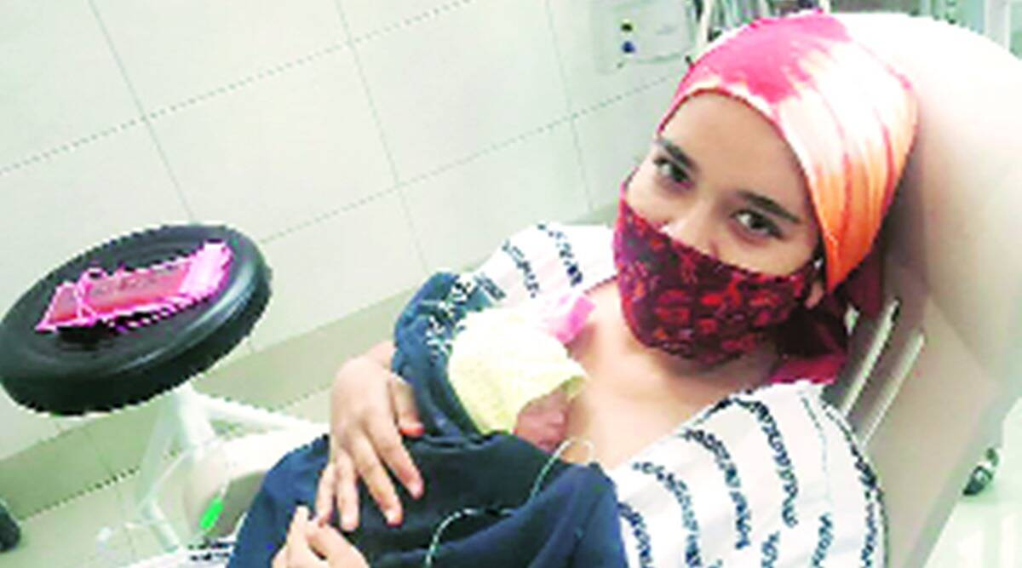
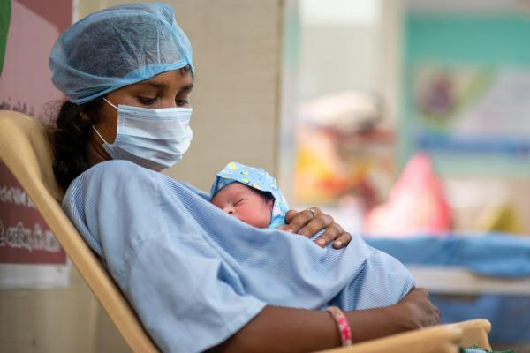
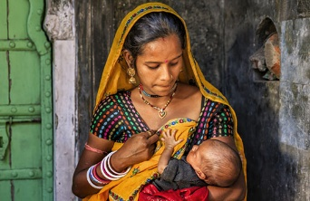
Care of stable neonates exposed to COVID-19
ASHA REPLIES
Breastfeeding, rooming-in, Kangaroo Mother Care (when required) should be encouraged in all cases
While Breastfeeding:
Mother should wash hands frequently including before breastfeeding
Mother should be advised to wear triple layer mask
If rooming-in is not possible because of the sickness in the neonate or the mother, the neonate should be fed expressed breast milk of the mother by a nurse or a trained healthy family member

Slide 13
KAMRAN IS NEARLY 6 WEEKS OLD
Kamla was happy when Kamran, her baby became 2.6 kgs after a month. Kamran was the joining of both hers and her husband Karan’s name. They named the child on the day the BCG immunization was given before she was discharged from hospital.
She had recovered from COVID and her baby was growing healthily too. It was time for the ROUTINE child immunizations.
When the ASHA made her 42nd day visit, Kamla said, “I’m supposed to bring baby to the anganwadi centre for her immunization. But considering I had COVID, can he be given the immunization? Penta, I think”

Slide 14

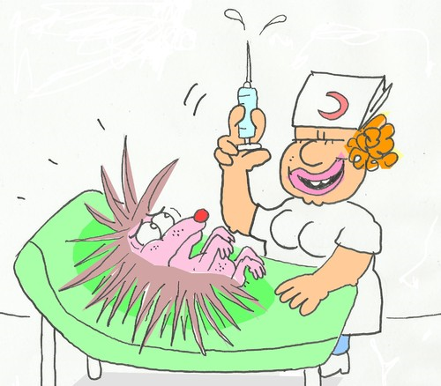
Immunization in Neonates exposed to COVID-19
Follow routine immunization policy in healthy neonates born to mothers with suspected/confirmed COVID-19.
In neonates with suspected/confirmed infection, vaccination should be completed before discharge from the hospital as per existing policy.

Slide 15
Care of Neonate with Late onset COVID -19

Slide 16
A CHILD HAS COVID IN KAMLA’S VILLAGE.
Kamla hears of a 20 day old child that has COVID in her village. She wonders what care the child will get. The mother had COVID too.
She phones the ASHA and informs her. The ASHA reassures her by saying that most people including children with COVID19 recover. She tells Kamla to ask the mother of that child to contact her so that she can screen her using the IMNCI approach.

Slide 17
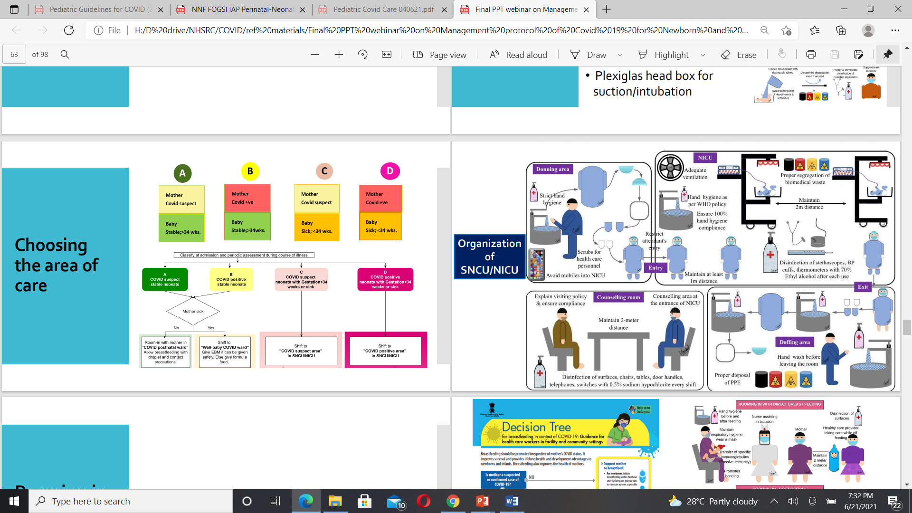
For CHO
PHC-MO

Slide 18
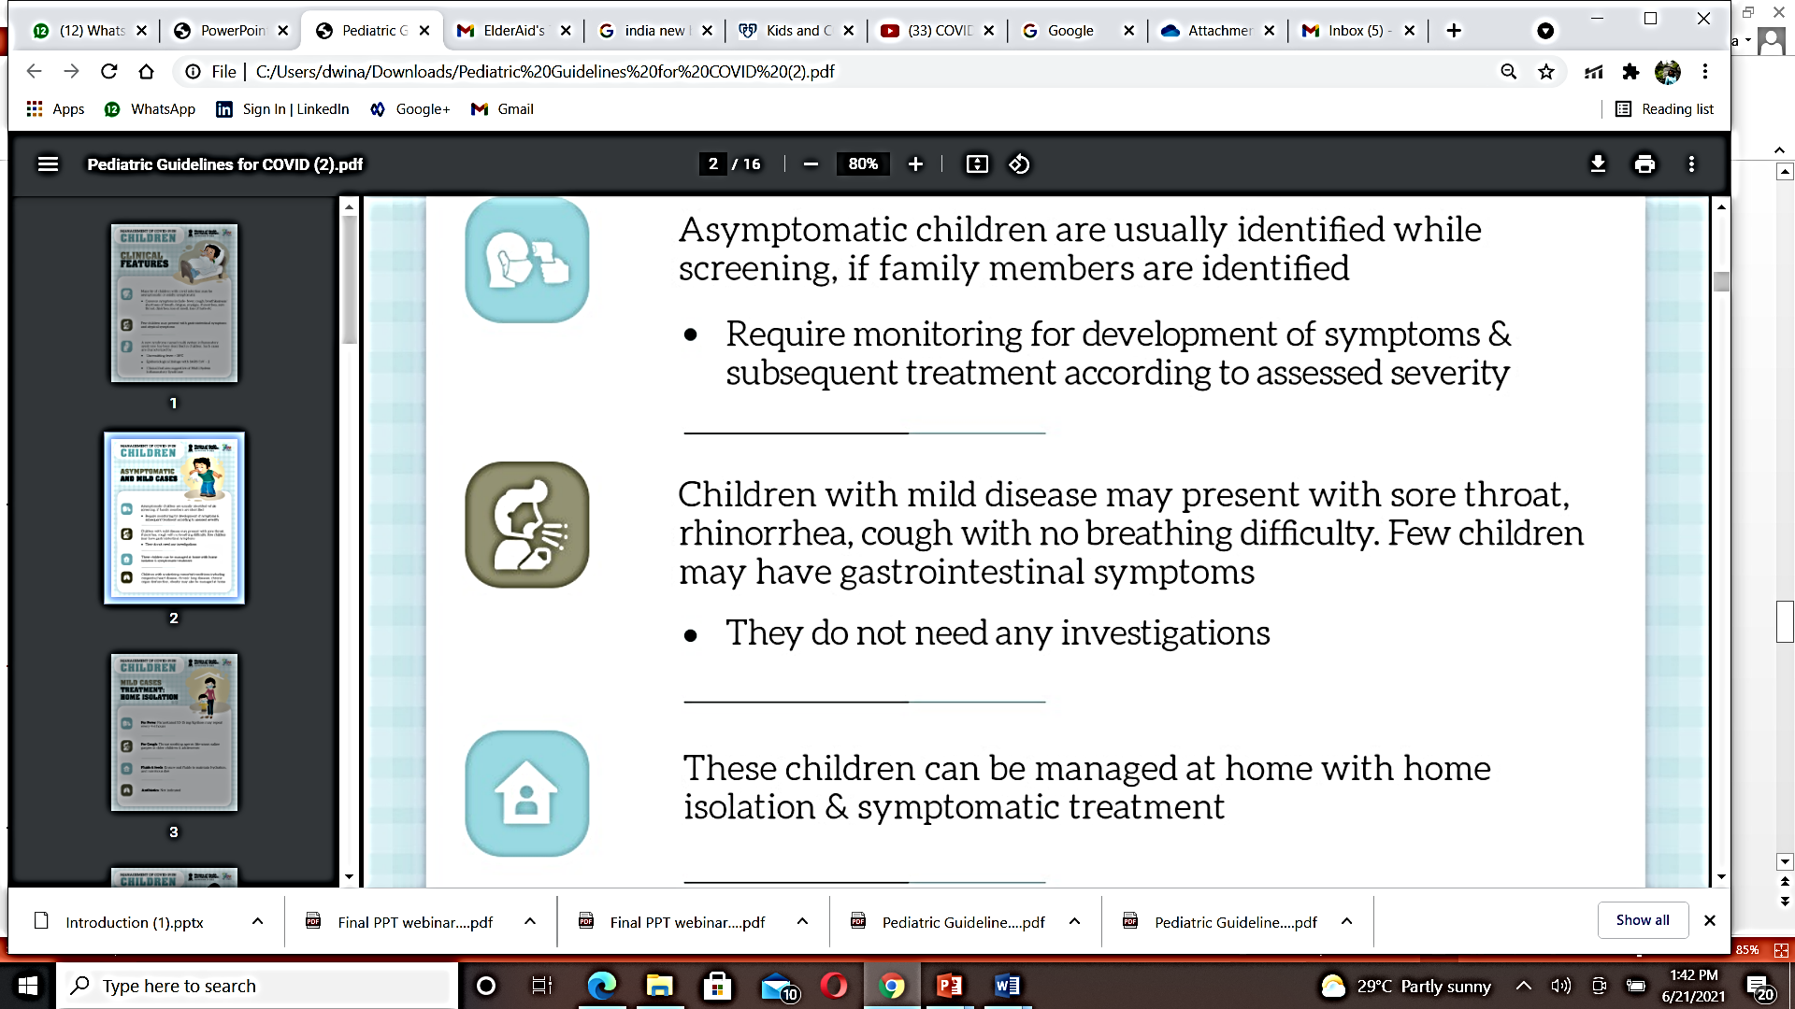
NEONATE POSITIVE FOR COVID AND HEALTHY (ASYMPTOMATIC)

Slide 19
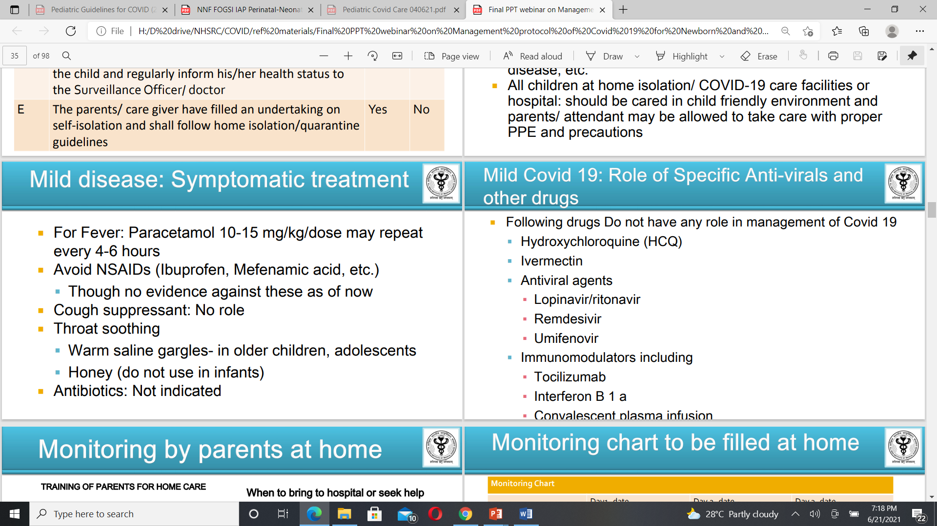
NO ROLE

Slide 20
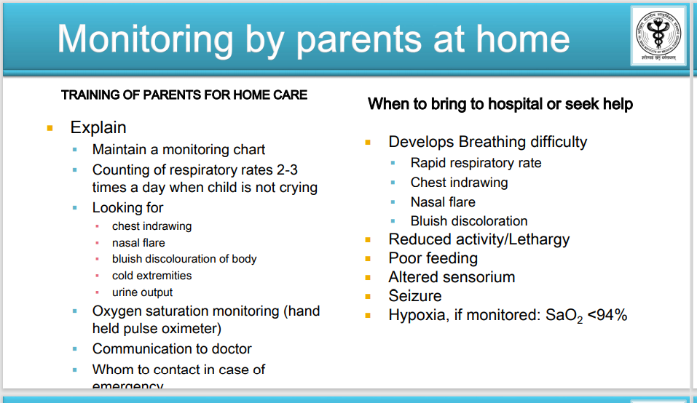
Danger Signs

Slide 21
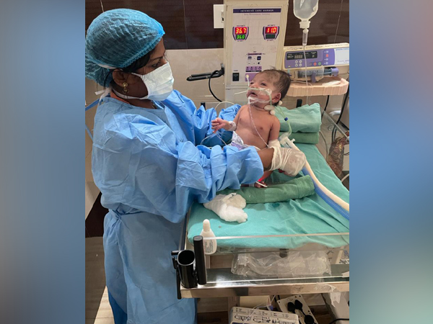
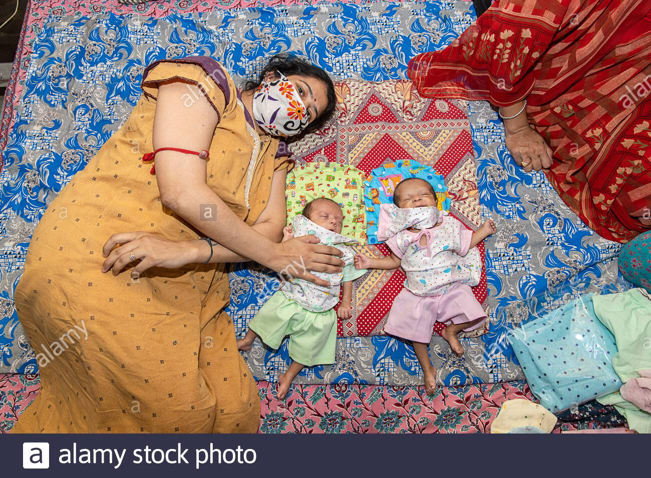
Care of Symptomatic/sick neonates
Managed in separate isolation facility, preferably in single closed rooms.
In case enough single rooms are not available, closed incubators (preferred) or radiant warmers could be placed in a common isolation ward for neonates, at a distance of at least 1 meter from each other.
Isolation rooms should have adequate ventilation

Slide 22
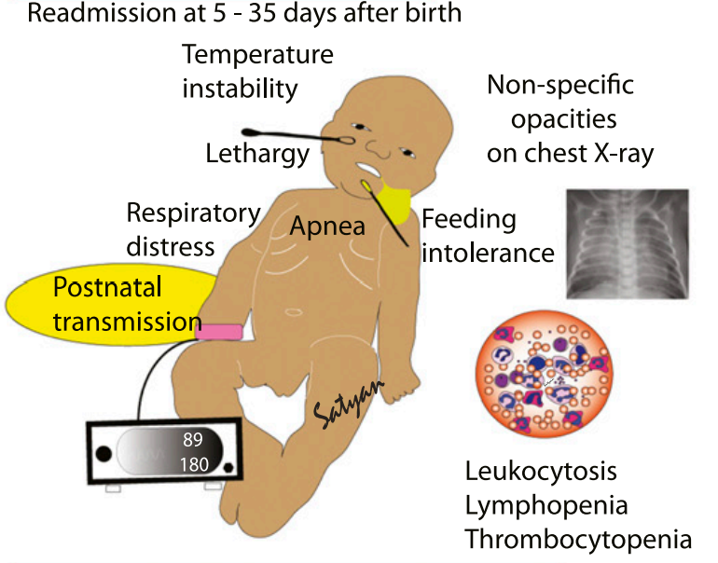
Neonates with Severe COVID-19 disease
During the second wave, an increasing number of neonates with moderate to severe COVID-19 pneumonia and gastrointestinal symptoms have been seen.
These neonates typically acquire the infection at home from other family members.
Occasional cases of MIS related to COVID antibodies transmitted from the mother have also been seen.
The paediatric HDU/ ICU should have suitable equipment and surgical items for care of these neonates e.g., servo-controlled open care systems, air-oxygen blending systems, CPAP, ventilators capable of supporting pre-terms and appropriate sized nasal interfaces and endotracheal tubes.

Slide 23


During the second wave, Kamla hears of her best friend who died. Her husband had also died of COVID a week before. They had run away from home and got married. They had two small children.
Kamla was wondering who could look after the two children. Should she take them in and care for them? Would they put Kamran, her baby at risk? Were they COVID positive too? She decided to ask the MPW..

Slide 24
Children with COVID where caregivers are not available
1098
Child can be isolated at nearest Covid Care centre
Seek support from close relatives or peer groups
ASHA/MPW should be in constant follow-up with the child
Providing symptomatic treatment in case of mild symptoms
Monitor the child for:
respiratory rates 2-3 times a day when child is not crying
chest indrawing
bluish discolouration of body
cold extremities
urine output
oxygen saturation (hand held pulse oximeter)
fluid intake, activity level, especially for young children.
Danger Signs

Slide 25
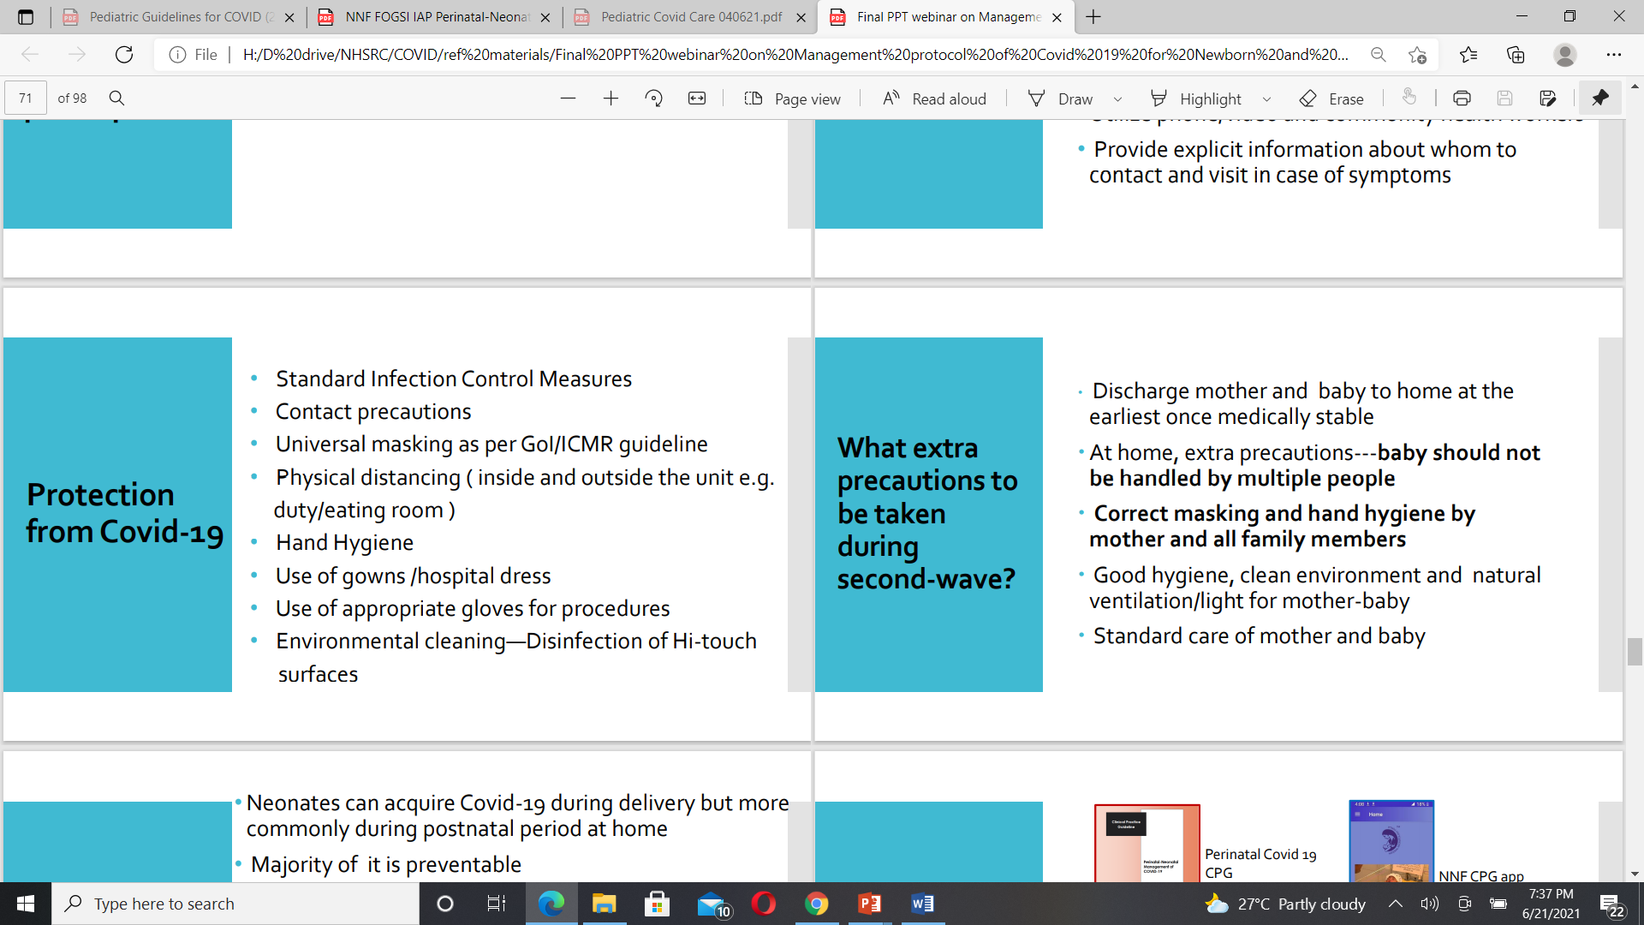
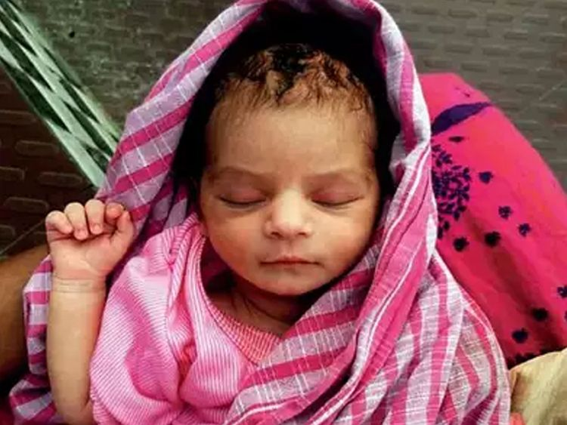
Vaccinate the mother 3 months after COVID 19 infection
Vaccinate all lactating COVID uninfected mothers

Slide 26
KEY POINTS
Pregnant women have a higher risk of eclampsia, clots, and diabetes if they get COVID -19. There is a higher risk of them delivering prematurely.
Babies with mother who has COVID 19 can breast feed and give kangaroo mother care to their babies using triple layer masks
ASHA and MPW can identify Danger Signs in babies and inform the CHO for further teleconsultation and referrals
Most babies who contract COVID-19 are asymptomatic, or can be managed at home. Some may need brief hospitalisation. Very few develop MIS-C and need specialised care
TEST, TRACK, TREAT and Vaccinate adults are strategies that need to continue to protect children

Slide 27
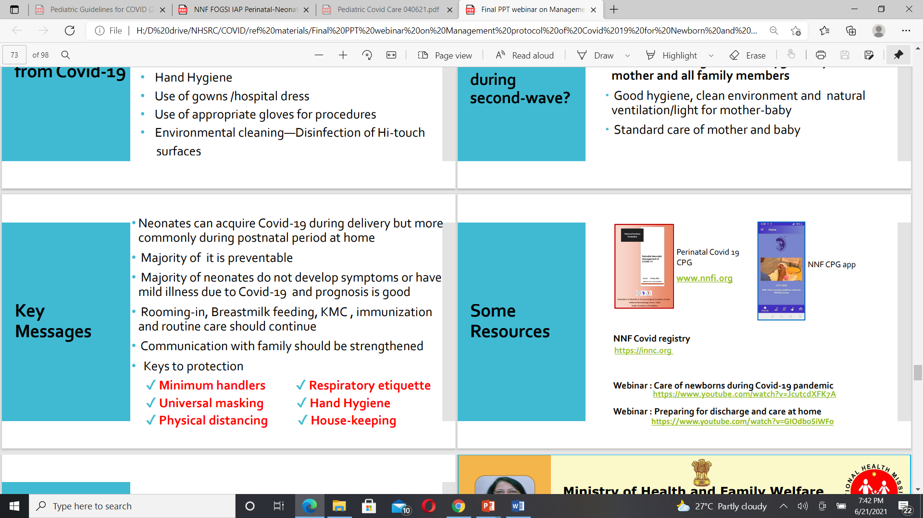
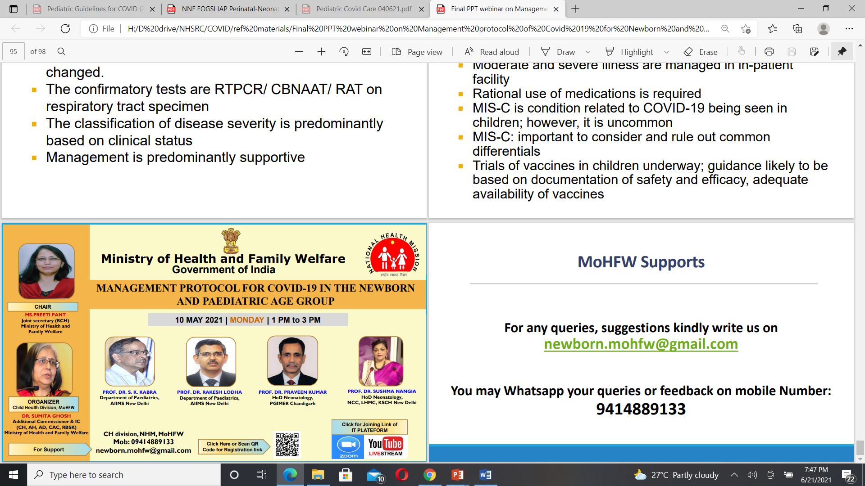
REFERENCES
Guidelines for District Level Team and Frontline Workers for COVID management
Paediatric Guidelines for COVID -19
Operating Guidelines for COVID 19 vaccination of pregnant women
NIMHANS, Psychological First Aid for children affected with COVID 19, 2020

Slide 28
THANK YOU

