Slide 1


Roles & Responsibilities of each Level for
Paediatric COVID Care
Dr Sangeeta Jund

Slide 2
Outline
What is the significance of Paediatric Covid Care?
What are the levels of care?
Roles & Responsibilities at Community level
    ASHA, MPW, CHO
Roles & Responsibilities at PHC level
    MO, SN
Roles & Responsibilities at Higher level
    CCC, DCHC, DCH

Slide 3
Significance of Paediatric Covid Care?
Experts are predicting a third wave with a disproportionately high burden among the pediatric population
Withdrawal of the lockdown
Third wave after
3-4 months
School re-opening

Slide 4
What CAN WE do?
Augment existing Covid care facilities to provide care to children with acute Covid (Paediatric specific equipment, infrastructure and paediatric formulations
Train
doctors, nurses, frontline health workers
Prepare for any future surge of Covid cases in children

Slide 5
Levels of Care
CHC/DH
Specialists
Primary Health Centre (PHC)
MO & SN
Health & Wellness Centre (HWC)
CHO
Home & Community
ASHA & MPW

Slide 6
FOCUS OF PRIMARY HEALTH CARE TEAM – PHC and HWC
Education on COVID appropriate behaviour
To reduce new infections especially children
Care of the COVID infected children by
early identification, strengthening support for home isolation and timely referral to higher levels of care
Encouraging and facilitating COVID Vaccination
to all eligible especially parents and caregivers of children
Continue other essential health services
of the Primary Health care package – RMNCHA, NCDs and others

Slide 7

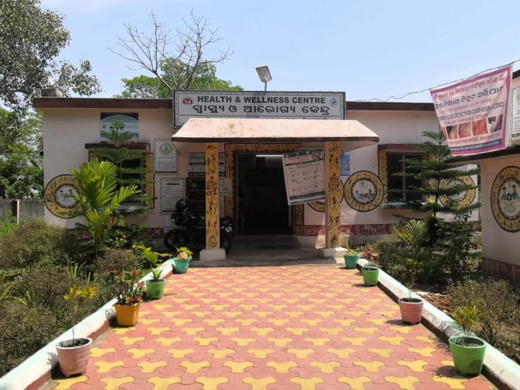
Responsibilities of Primary Care Team
  COVID RELATED
      Health promotion
      Facilitating access to COVID testing
      Home care visits for monitoring
      treatment and follow up support
      Vaccination
Enabling delivery of
non-COVID-19 essential
health services for all

Slide 8
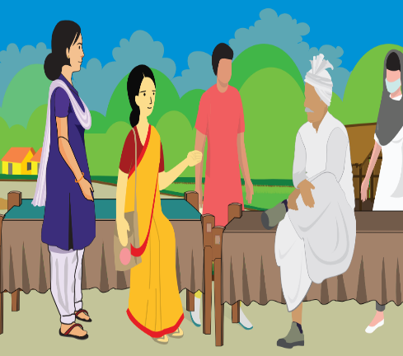
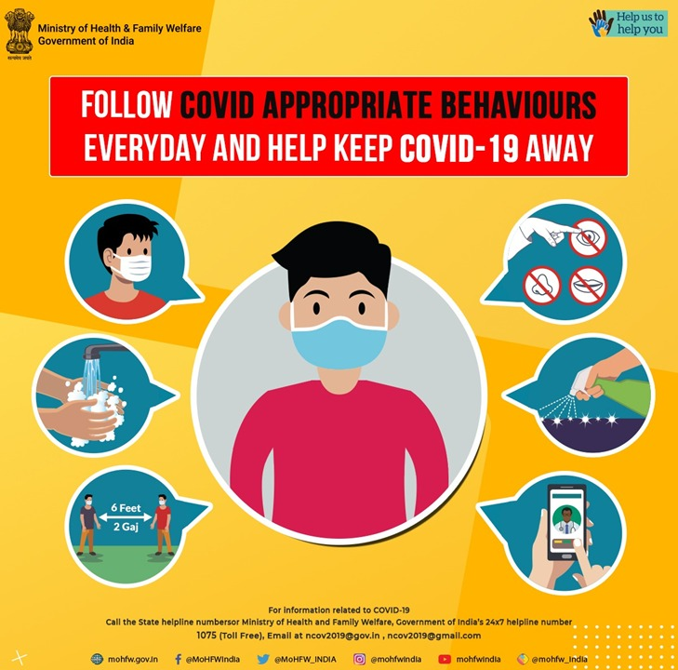
Role of ASHA & Multipurpose Worker (MPW-F/M)
HOME & COMMUNITY
Health Promotion
For community to follow COVID appropriate behaviors
FOCUS ON PARENTS, CAREGIVERS AND ALL CHILDREN

Slide 9
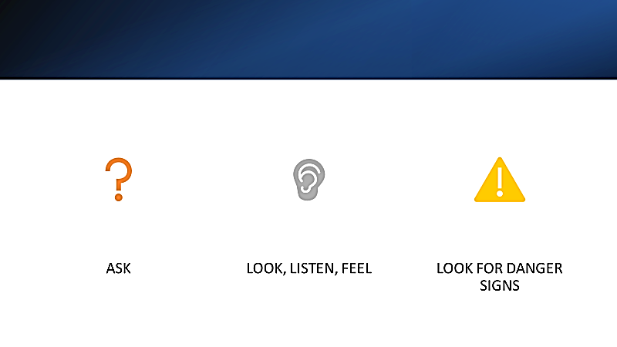
Role of ASHA & Multipurpose Worker ((MPW-F/M)
Use IMNCI based algorithm
To identify children with symptoms suggestive
of COVID
Refer for triage and testing to the HWC/ PHC

Slide 10

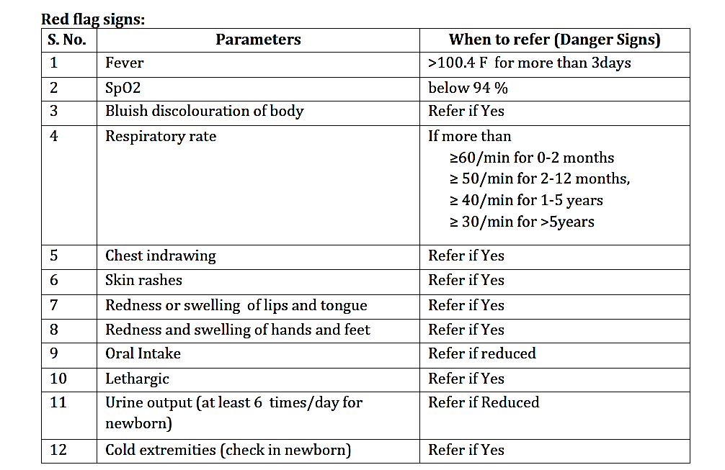
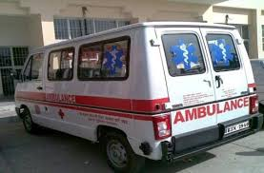
Role of ASHA & Multipurpose Worker
(MPW-F/M)
Red flag signs
Monitoring a child in home
  Isolation and early recognition of indications for referral
  Daily tracking of temperature, spO2
  Counseling on home isolation measures
  Monitor nutrition and hydration
  Look for red flag signs - Call ambulance as soon the respiratory rate is more than normal for age or any other red flag signs
Contact MO / CHO for teleconsultation, if anything worsening is suspected

Slide 11
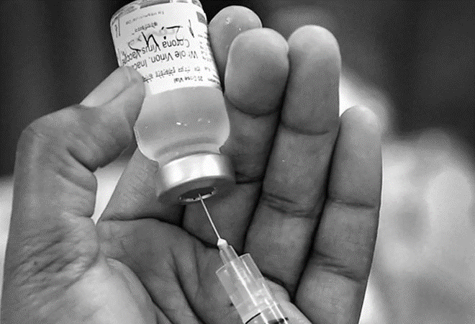
Role of ASHA & Multipurpose Worker
(MPW-F/M)
VACCINATION PROMOTION
To encourage and facilitate the vaccination drive for parents of children and then for the children once the guidelines are in place
Explain how to register in COWIN
Follow up for any reactions post vaccination
Look out for and adverse effects
( AEFI) and report to CHO

Slide 12
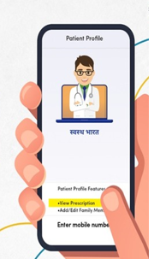
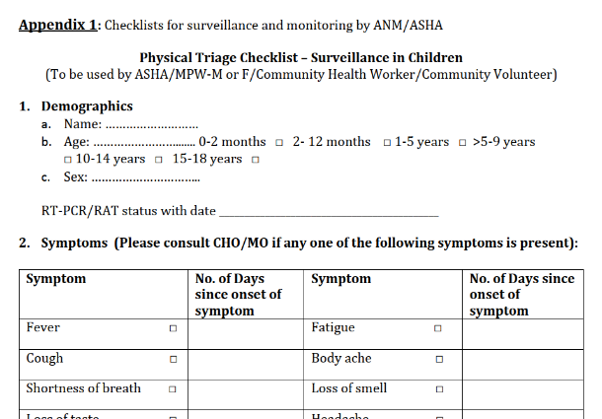
Role of ASHA & Multipurpose Worker
(MPW-F/M)
Checklists for the MPW/ASHA
  Physical Triage Checklist – surveillance
  Physical Triage checklist – Home isolation

Slide 13
Roles & Responsibilities of ASHA
Awareness Generation in community –
a) Signs and Symptoms of COVID -19 in Paediatric Age group
b) Red flag signs-Whom to contact
c) Where to go in case of symptoms
d) COVID Appropriate Behavior(CAB)
e) When and where to get tested
f) Reassurance to community – no need for Panic
Whom to visit –
a) Visit all houses with children and communities.
How Often –
a) During routine services and house to house visit
Surveillance –
a) House to House survey
Whom to visit –
a) All homes with special focus on Influenza like illness (Fever/Cold/ Runny nose/ Sore throat/ Cough etc
b) Acute respiratory symptoms in child
c) When the child has co-morbid conditions (Chronic disease/ Malnutrition)

Slide 14
Roles & Responsibilities of ASHA
Vaccinations –
a) Dispel myths and misconceptions
b) Mobilization for Routine Immunization
c) Facilitation in registration of eligible parents and caregivers for COVID vaccination
Case Management and follow-up –
a) Adherence to Home isolation guidelines
b) Linking of the child to the higher facility in case of complication
c) Post COVID follow-up
Whom to visit –
a) COVID positive / suspected children
How Often –
a) At least once a day / Telephone enquiry

Slide 15
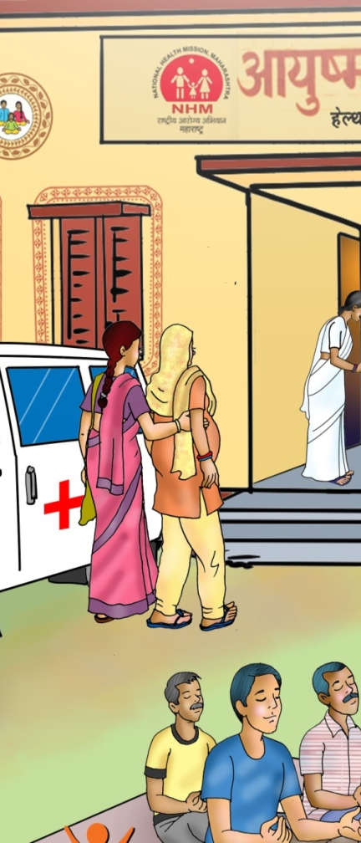
HEALTH & WELLNESS CENTRE
Community Health Officer

Slide 16
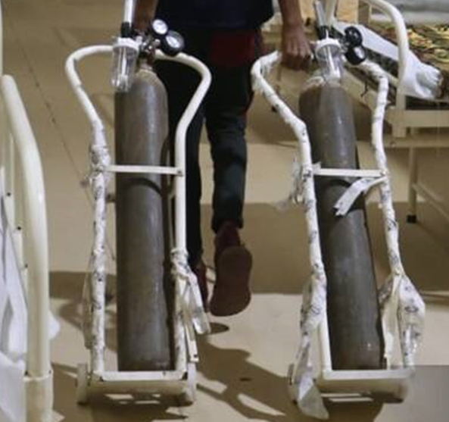
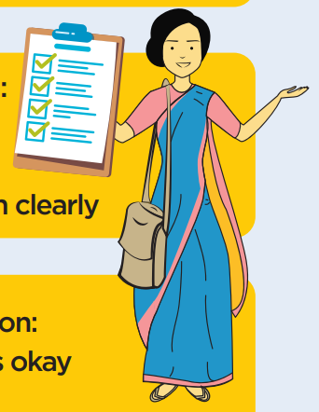
Role of CHO at HWC
Facilitate teleconsultation with the PHC Medical Officer
In case of emergency, provide oxygen to moderately sick patients till the arrival of the transport
Validate the line list of:
    COVID positive cases : adults and children in catchment area
    List of those eligible for COVID vaccination

Slide 17
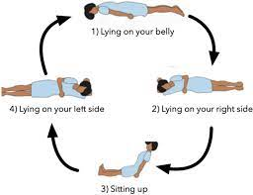
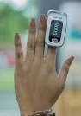
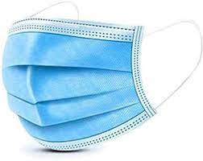
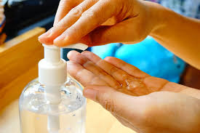
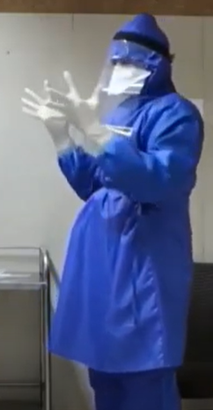

Role of CHO at HWC
PRONING
Ensure
Ensure essential commodities like PPE, mask and sanitizers, drugs and equipment’s such as Pulse Oximeter, thermometer for ASHA & MPW
Support
Support the MPW/ ASHA through telecommunication for home isolation monitoring.
Guide
Guide care-giver supported monitoring of health status, proning, exercise, diet etc
Educate
Educate patients under home isolation regarding discharge criteria

Slide 18

Role of CHO at HWC
Link with the existing groups like SHGs, Youth networks, VHSNC, JAS, Community volunteers, for any support like food/grocery delivery for quarantined households
Make a list of local influencers and discuss the situation and protocols/orders/notifications to be followed and seek their support in giving key messages
Ensure needed psychosocial and mental health support for the health care staff through National Helpline (080-46110007)

Slide 19
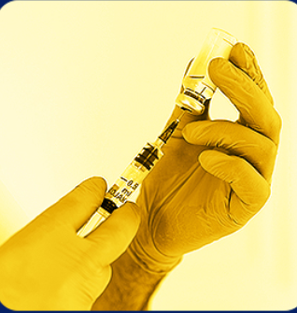
Role of CHO at HWC
VACCINATION
Support ASHA/AFs/MPWs to create awareness, educate regarding benefits of vaccination and encourage community to get vaccinated.
Ensure preferential vaccination of homebound, co-morbid patients and other vulnerable groups
Provide first aid and refer any person with Adverse Event Following Immunisation (AEFI) to the nearest PHC for immediate treatment and then regularly follow-up
Share positive experiences of vaccines with community members and reduce myths and stigma related to COVID vaccine through support groups.

Slide 20
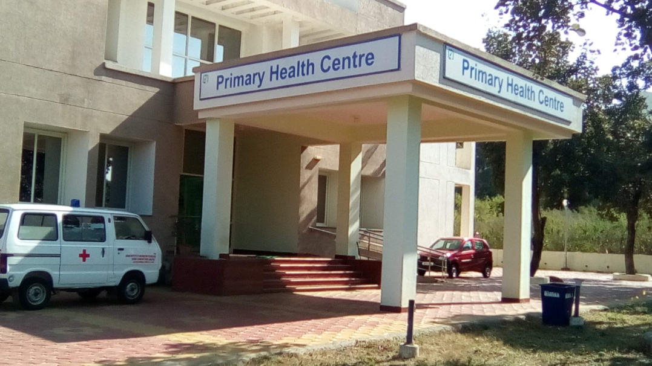
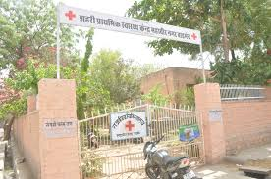
Primary Health Centre
Staff Nurse
PHC Medical Officer

Slide 21
Role of PHC - MO
Providing Comprehensive Primary Health Care
Guide, Mentor and Monitor CHOs in the linked SHC-HWC
Ensure PHCs readiness to manage Covid +ve cases
Manage clinically
Ensure continuity
Leverage community platforms

Slide 22
COVID-19 related services –
PHC 3-Pronged Strategy
:
A: Control the source of infection by Testing, Tracking and Treating both symptomatic and asymptomatic individuals in the community or visiting the facility
B: Break the chain of transmission by being an example and educating the community on COVID appropriate behaviour; by appropriate disinfection of premises and safe waste
C: Reduce susceptibility to infection - by timely COVID vaccination as per protocol

Slide 23
What PHC – MO should do?
Modify
PHC setting to include triaging of patients, separate waiting rooms, examination areas
Ensure
adequacy of PPE, hand sanitisers, diagnostics and drugs
Support
CHO and HWC Team
in educating the communities on COVID-19 symptoms, spread and measures to prevent COVID-19
Ensure
that the line list of COVID positive cases in catchment area
Manage
patients under Home Isolation, persons with AEFI

Slide 24
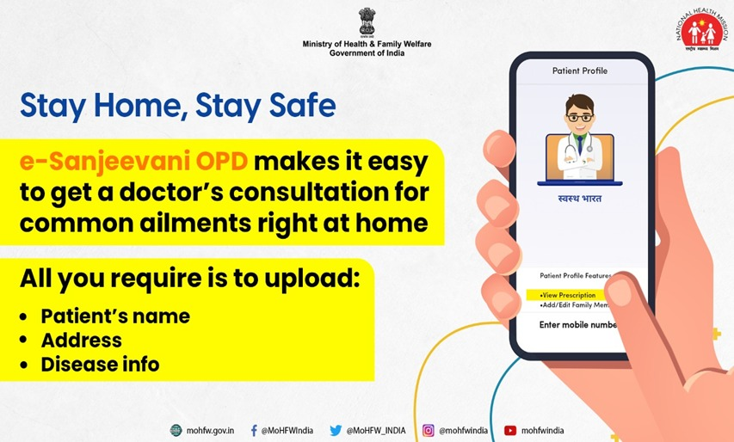
Non COVID Essential Services
Leverage telemedicine services for patients with minor illness and for follow up
Provisions for timely care of special population like pregnant women, children, patients with chronic diseases, TB patients and SAM patients
Focus on meeting set health outcome targets by continued implementation of national health programmes
Ensure frequent but less crowded VHSND and UHSND
Coordinate with community platforms like VHSNC/MAS and JAS for planned community action

Slide 25
Thank You!

