Slide 1


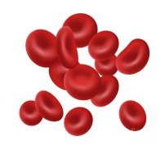



Prevention and Control of Hemoglobinopathies
Tamil Nadu, India 2017 to 2019
Dr. K. Senthil Raj IAS.,
Mission Director, National Health Mission ,
Government of Tamilnadu

Slide 2
Structure of presentation
  Background
  Rationale & Implementation
  Outcomes & opportunities

Slide 3

Hemoglobinopathies
PREVENTION & CONTROL OF HEMOGLOBINOPATHIES
tamil nadu
Genetic disorders of blood associated with chronic life threatening problems that can lead to disability or death
Major Hemoglobinopathies in India -Beta Thalassemia , Sickle cell anaemia , Hb E , and also can occur in combinations ( sickle thal )
Inherited as an autosomal recessive disease
Notes:
Haemoglobin E is more common in Bengal ( 5 % ) & in some pockets of Assam ( 19 – 20 %)

Slide 4
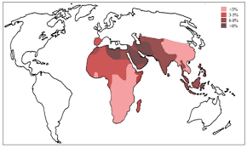
Background
Global Burden
Annually there are over 3.3 Lakhs babies affected by Hemoglobinopathies
2.75 Lakhs have a sickle-cell disorder
56000 have a major Thalassemia
30000 needs regular transfusions to survive.
Source : Bulletin of World Health Organization on Global epidemiology of haemoglobin disorders and derived service indicators

Slide 5
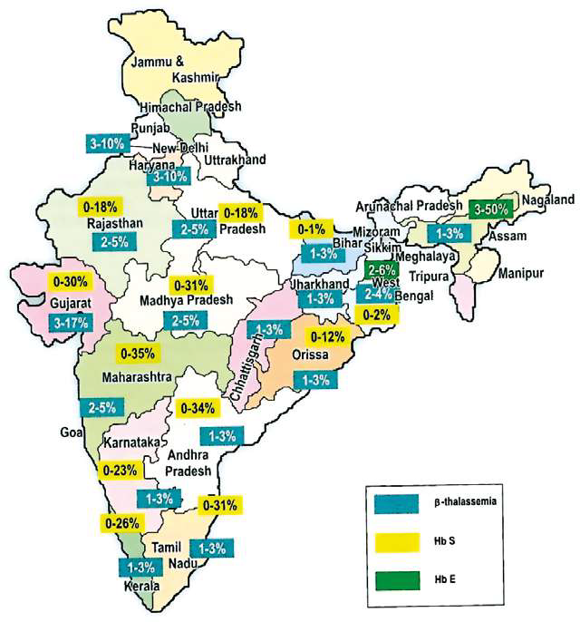
Burden in India
PREVENTION & CONTROL OF HEMOGLOBINOPATHIES
BACkground
Thalassemia
Largest number of Thalassemia children in the world 1-1.5 lakhs
42 million carriers of beta thalassemia trait
10,000- 15,000 of babies of thalassemia born every year
Sickle Cell Anemia
Carrier frequency of Sickle Cell Anemia 1-35%
Source: NHM guidelines for prevention and control of Hemoglobinopathies in India 2016

Slide 6
Tamil Nadu
PREVENTION & CONTROL OF HEMOGLOBINOPATHIES
tamil nadu
Estimated prevalence of Sickle cell anemia: 0 -31 %
Estimated prevalence of Thalassemia: 1-3%
Mostly prevalent among tribal population
Source: NHM guidelines for prevention and control of Hemoglobinopathies in India 2016

Slide 7
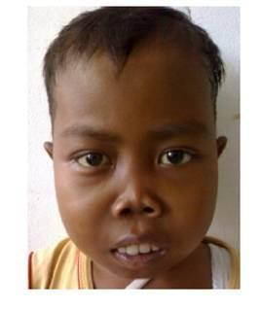
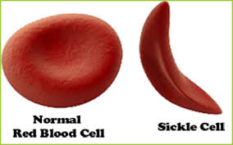
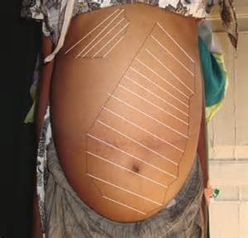
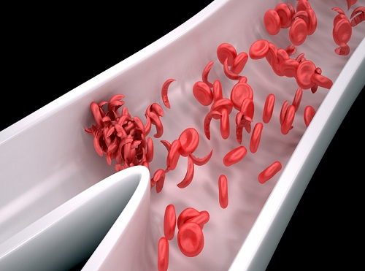
PREVENTION & CONTROL OF HEMOGLOBINOPATHIES
tamil nadu
Beta Thalassemia
Sickle Cell Anemia
Decreased synthesis of Beta globin chain in the Haemoglobin molecule
Rapid destruction of RBCs leading to severe anemia
Affected child is transfusion dependent for life
It is a qualitative defect of the Haemoglobin
The RBCs are sickle shape and they block the blood vessels causing severe pain in the affected organs
They also break down easily & cause anemia
eye

Slide 8
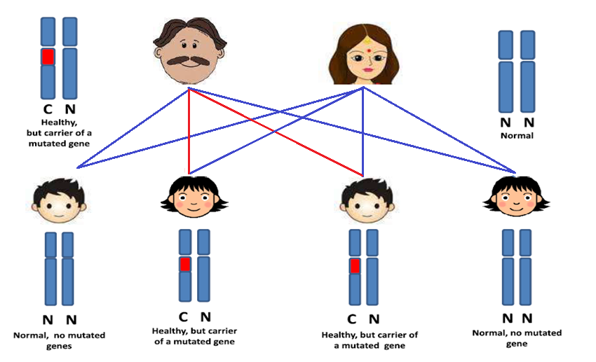
PREVENTION & CONTROL OF HEMOGLOBINOPATHIES
tamil nadu
PREVENTION & CONTROL OF HEMOGLOBINOPATHIES
tamil nadu
C- Carrier
N-Normal

Slide 9
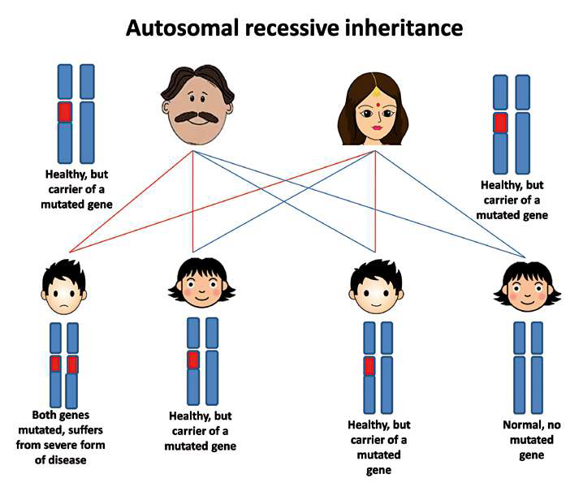
Non-directive genetic counselling is the key for prevention
Description of the Programme
Notes:
Heamoglobinopathy are inherited disorder of Hb synthesis ( thalessimia ) ans structure (sickel cell disease) with significant Morbidity Inherited disorder that are passed from parents to children , people have these disease if they inherit abnormal gene from one parent, then they are called as carriers or trait and they do not have the disorder . If the child inherits abnormal gene from both parents , the child suffers from the disease .Healthy Carrier are unaware of the status unless otherwise they are screened . If a couple carries hemoglobonopathy trait , there is 1: 4 chance of pregnancy with children having the disese

Slide 10
Rationale
The morbidity of Hemoglobinopathies is significant among tribals
Cost of treatment is very high
  repeated blood transfusion,
  iron chelation (Total cost of treating a child in India- 2,10,000INR/child/year )
  bone marrow transplant etc
Financial and Psychological burden to the family
Screening of the carrier status and genetic counseling is important to prevent birth of affected children

Slide 11
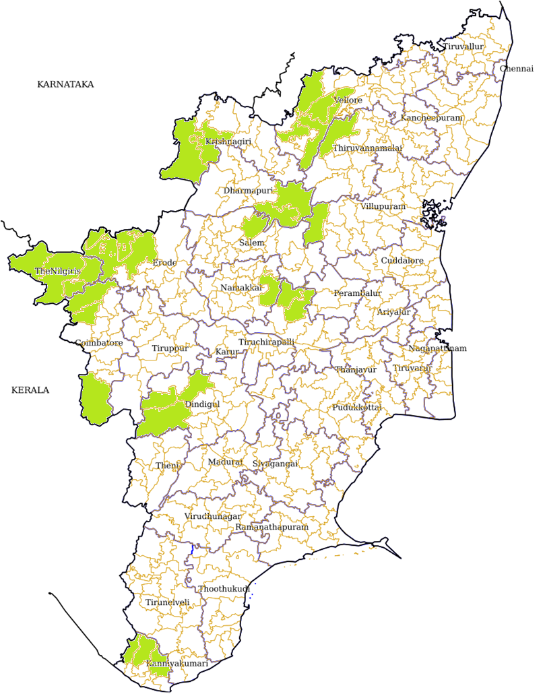
Implementation Blocks (Tribal)
Nariyampattu
Madhanur
Jolarpet
Jamunamathur
Alangayam
Harur
Pappirettipatti
Udhagamandalam
Yercaud
Kalvaran Hills
Gudalur
Kothagiri
Karamadai
Kolli Hills
Uppiliyapuram
Periyanayakanpalayam
Thuraiyur
Connoor
Anaimalai

Slide 12
Implementation of the Program
( 30 Blocks in 13 Districts )
    First Phase - Pilot in 4 Districts – Nov 2017
    ( Dharmapuri , Krishnagiri , Namakkal & Salem )
    Second Phase –September 2018 – Nilgiris & Coimbatore
    Third Phase - January 2019 – Vellore , Villupuram & Thiruvanamalai
    Fourth Phase – Erode , Kannyakumari , Trichy , Dindugal

Slide 13
Objective of the Program
Primary Objective
To create a community free of Hemoglobinopathies by proactive screening of children by identifying trait & preventing birth of thalassemia and sickle cell anemia children by genetic counseling.
Secondary Objective
To estimate the prevalence of Hemoglobinopathy carrier ( trait) in the tribal community
To provide affordable and adequate therapy to those affected

Slide 14
Implementation Process
Description of the Programme
10th & 12th std children in Government & Government aided schools are screened including school dropouts after getting proper consent
School teachers, parents, students & the community are educated on this
Tribal MMU Teams collect the stock solution for NESTROFT /Solubility Test from the Pathology Dept of designated Medical Colleges

Slide 15
Description of the Programme
Implementation Process
An ATP is drawn for Tribal MMU to visit schools on Mondays & Tuesdays. The collection of sample is limited to 40 per day
CBC, solubility, NESTROFT done on the same day at the Block PHC.
Positive samples are sent for confirmation to designated Medical Colleges for High Performance Liquid Chromatography (HPLC) test.
Reporting is done to the State Nodal Center, Chennai on the same week
Cascade Screening of family members

Slide 16
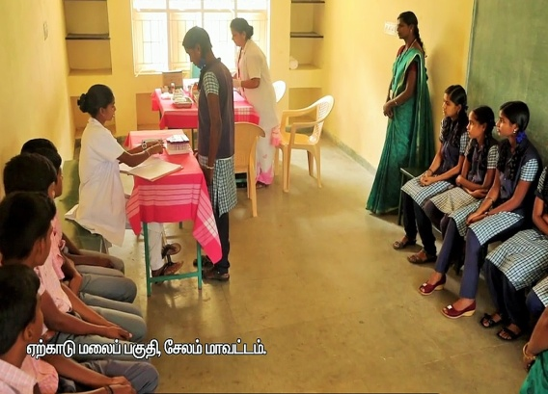
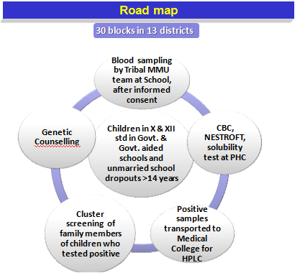
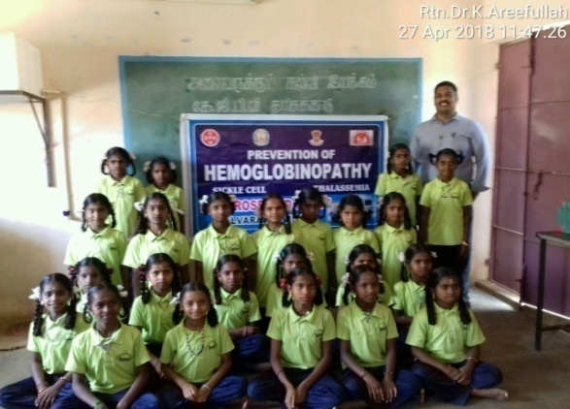
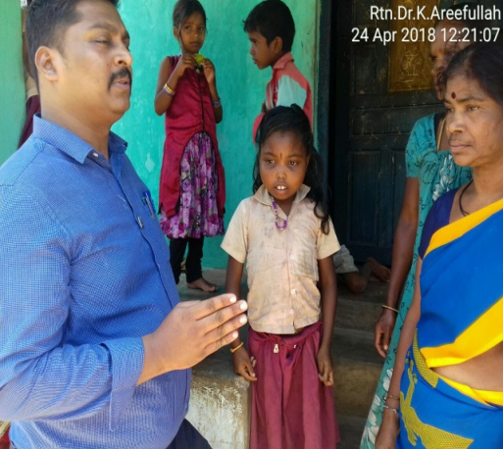
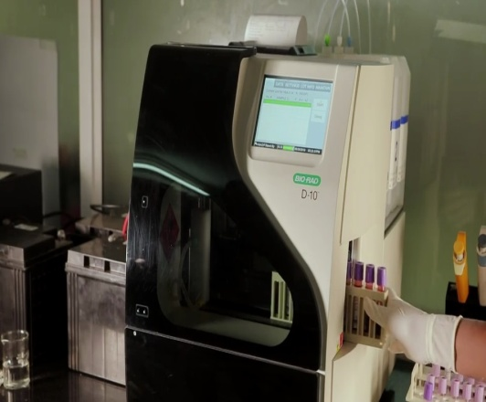
Description of the Programme
Implementation Strategy

Slide 17
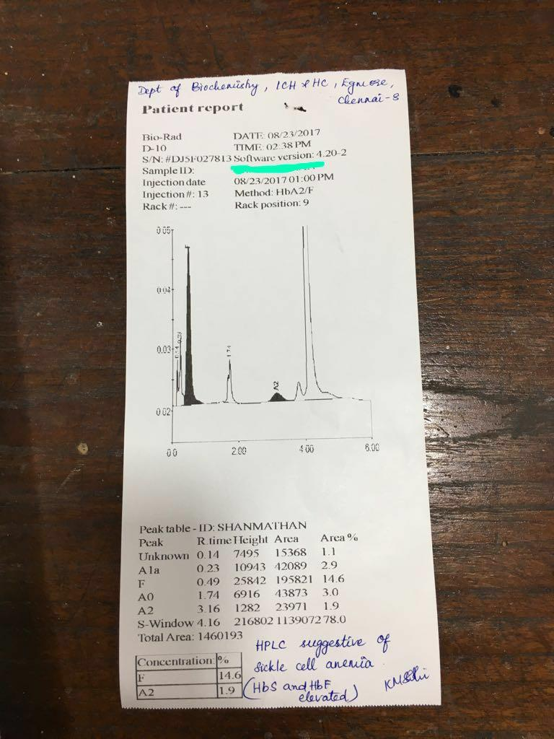
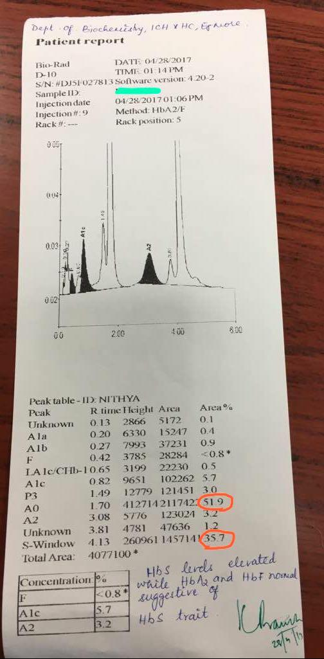
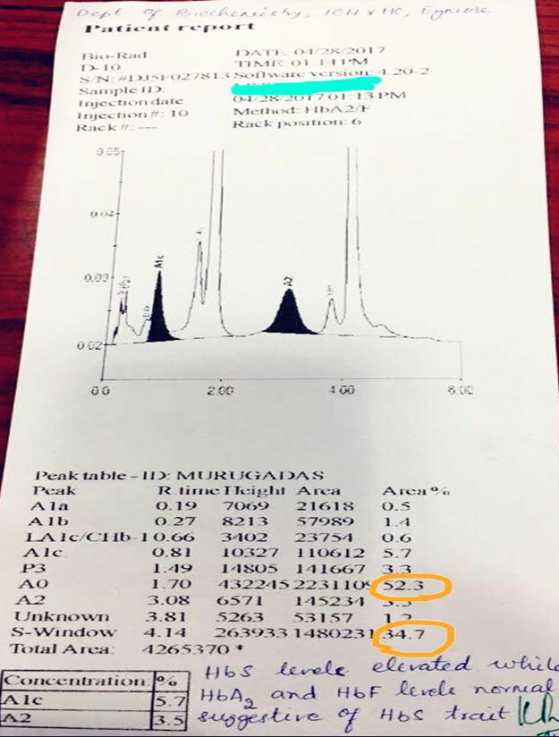
Sickle cell trait
HPLC Reports
Sickle Cell Anemia
Father’s report
Mother’s report

Slide 18

Outcomes
N=15000
Thalassemia trait
Sickle cell trait
Sickle cell Anemia

Slide 19
Prevalence of Hemoglobinopathies – Trait in Tribal Blocks of Tamil Nadu - India
(Nov’17 to Oct’19)
Name of District | Name of block | Proportion of children with hemoglobinopathies among screened
Krishnagiri | Thally | 9.3
 | Kelamangalam | 6.7
Salem | Yercaud | 10.7
Namakkal | Kolli hills | 9.0
Dharmapuri | Paperettipatty | 6.6
 | Harur | 7.4
Coimbatore | Karamadai | 0.8
 | Periyanakampalayam,Anaimalai | 2.6
The Nilgiris | Coonoor | 4.3
 | Gudalur | 4.2
 | Kotagiri | 6.6
 | Udhagamandalam | 2.3
Thiruvannamalai | Jamnamaruthur | 13.3
Vellore | Alangayam, Jolarpettai, Anaicut | 21.5
Villupuram | Kalrayan Hills | 9.4
Total |  | 8.7

Slide 20
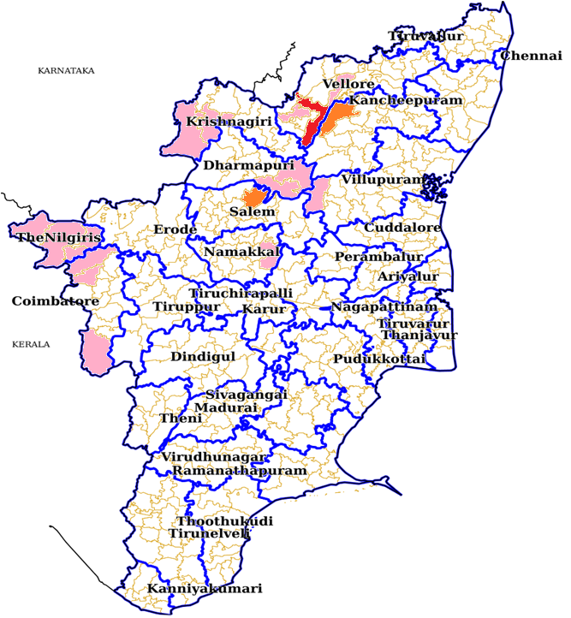
Prevalence of Hemoglobinopathies – Trait in Tribal Blocks of Tamil Nadu - India
(Nov’17 to Mar’19)
Tiruvannamalai
Prevalence of Hemoglobinopathies trait in % Range
0-10
11-20
21-30

Slide 21
Outcomes
Percentage of Carrier positive for Heamoglobinopathy Trait –Cascade screening in Tribal Blocks
N= 932

Slide 22
Funding
Description of the Programme
Year | Amount (in lakhs)
2016-2017 | 260
2018-2019 | 30
2019-2020 | 60
TOTAL | 350
Source :-RoP approval from NHM

Slide 23
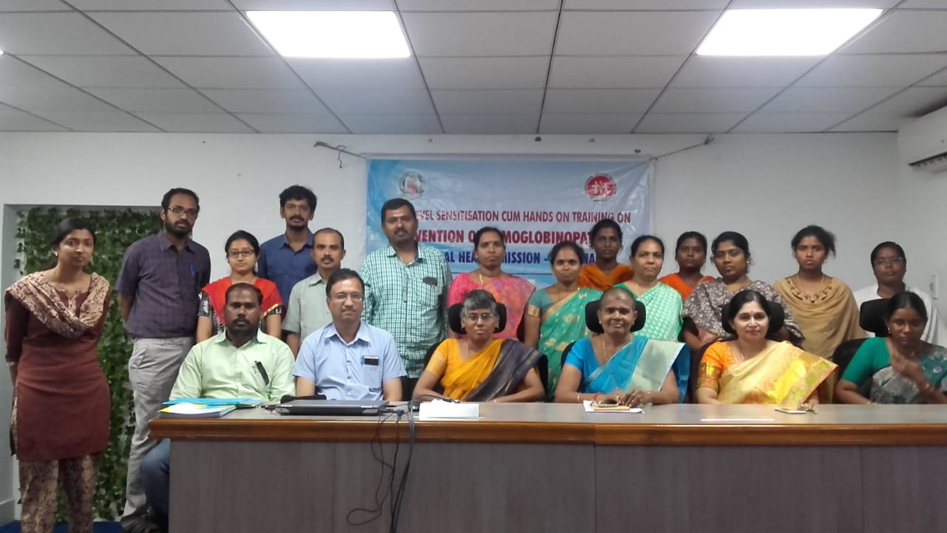
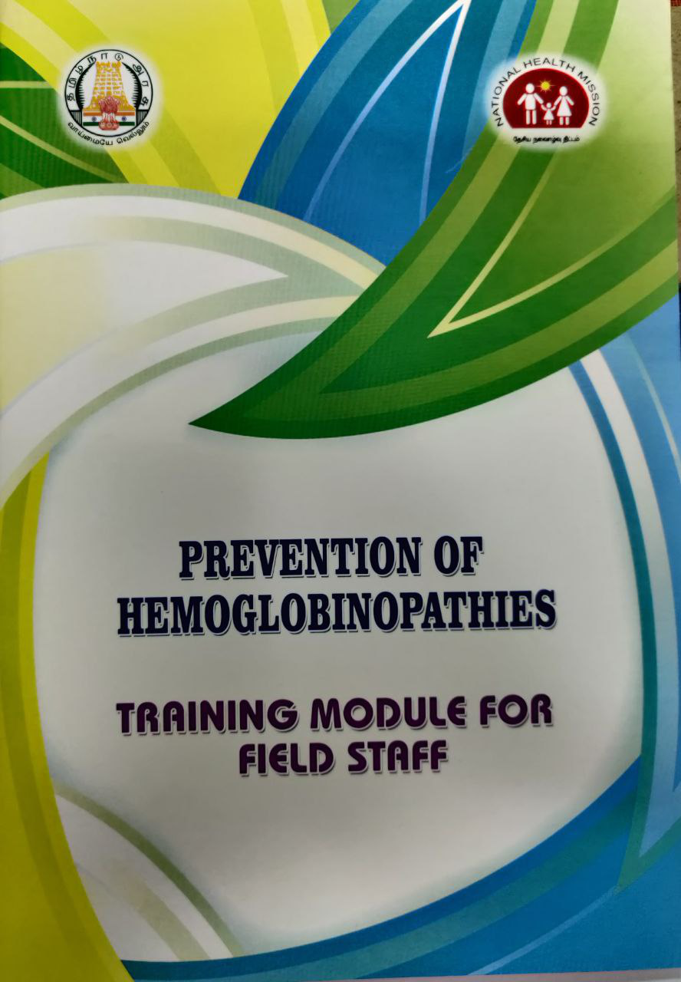
Training and Modules
Description of the Programme
4 hands-on workshops conducted.
Lab and Doctor’s Module developed

Slide 24
Genetic Counseling
Once a trait is identified by screening premarital counseling is offered
Spouse has to be tested for carrier state either preconception or early ante natal period
If the spouse is also a trait , pre natal diagnostic testing like chorionic villus biopsy /amniocenticesis are suggested to find out if the fetus is affected

Slide 25
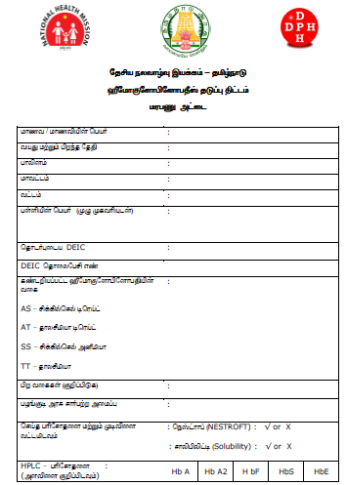
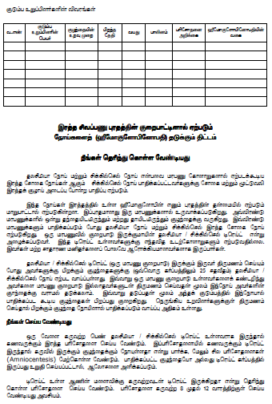

Slide 26
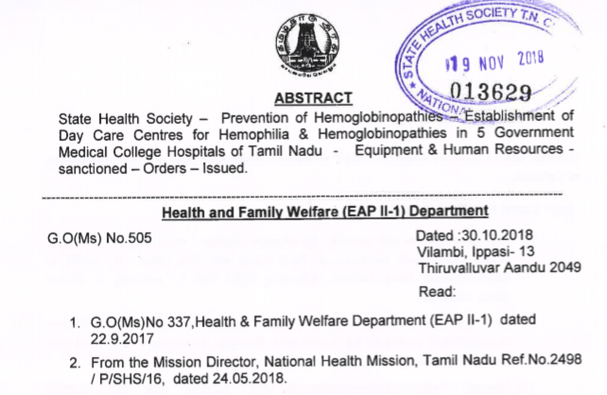
Opportunities
HPLC machines in 5 medical colleges
Increased awareness among tribal population and health care personnel
Anemia detection and treatment
Establishment of 5 regional day care treatment centres

Slide 27
Future plans
  Antenatal screening
  Establishment of Prenatal diagnosis facilities in Govt. Medical colleges
  Registry for Hemophilia and Hemoglobinopathies

Slide 28
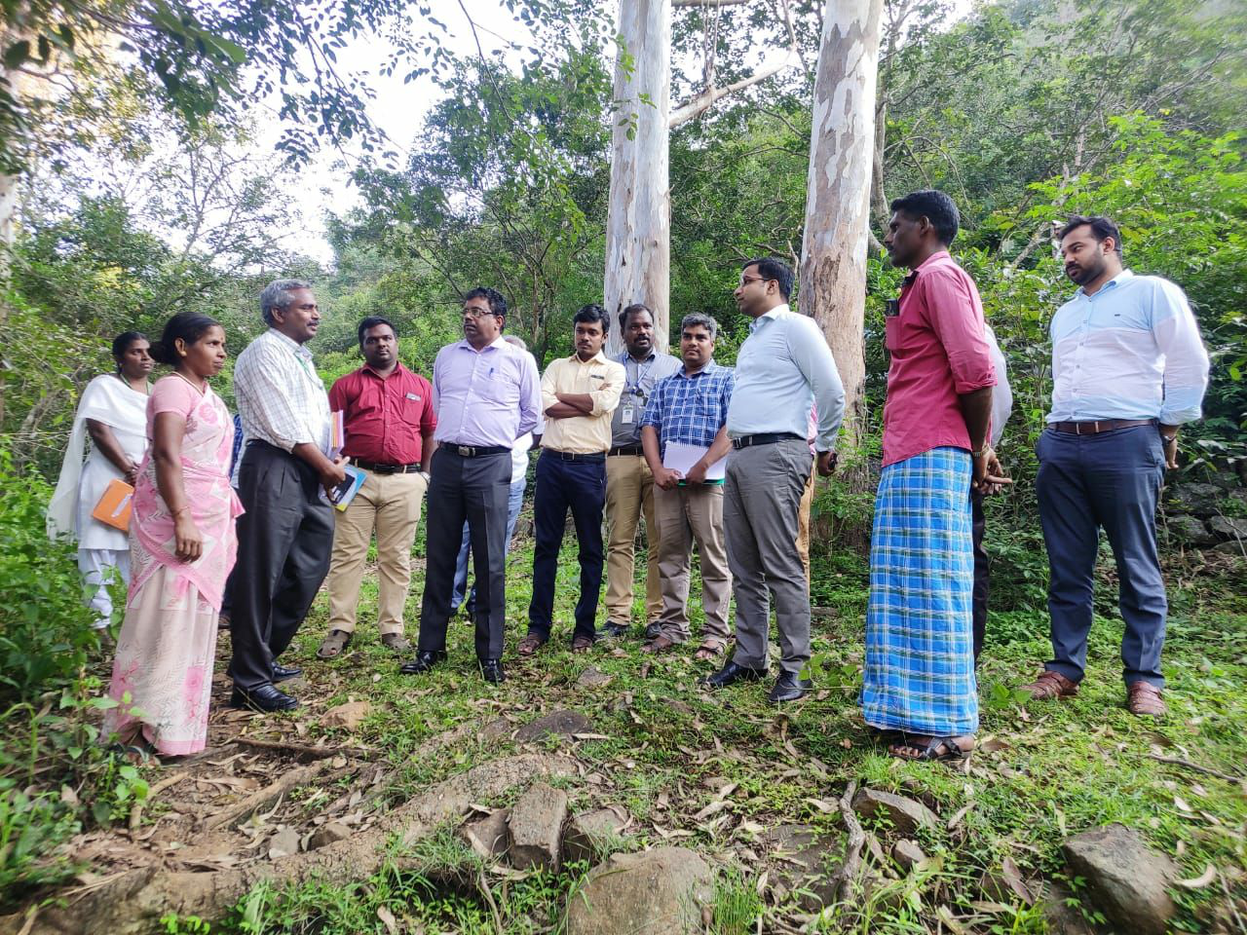
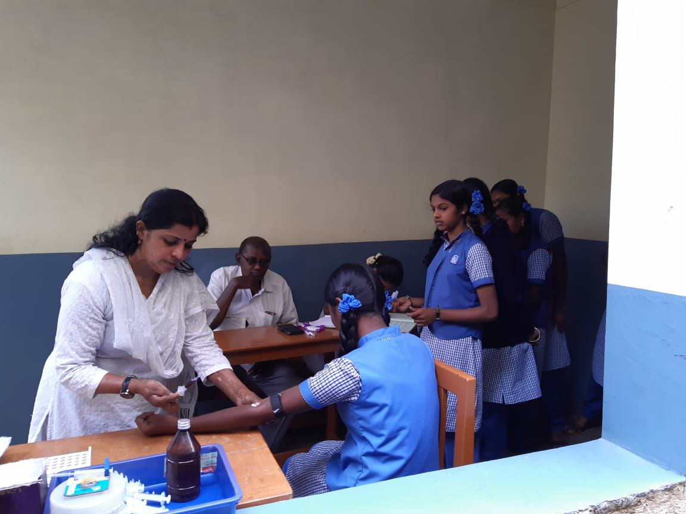
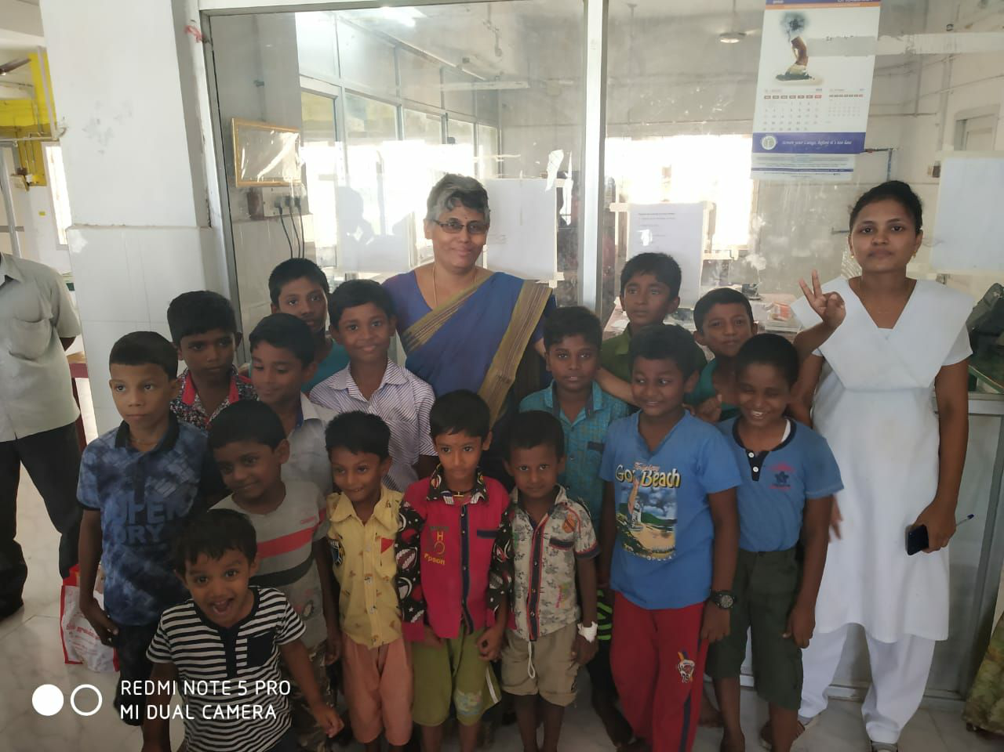

Slide 29
Prevention and control of Hemoglobinopathies
Tamil Nadu Tribal Hemoglobinopathies Ver2.mp4
THANK YOU

