Slide 1




Fight Against TB - Community Based Approach
Telangana
6th National Summit
17 November 2019 - Ahmedabad
Dr Yogita Rana, IAS
Mission Director, NHM &
Commissioner, Health & Family Welfare, TS

Slide 2
Status during January - August 2018
  Before the intervention

Slide 3
Status today
  Telangana Ranking in Country as per CTD
1
  TB Notification Against Estimated Target
1
  Universal DST among notified TB Cases
2
  Treatment Outcomes of Drug Sensitive TB

Slide 4
Gap Analysis of RNTCP in Telangana – Findings (Aug 2018)
No designated PO for TB
No DTC in districts
Stock out of lab consumables
No daily / periodical reports for review
Inadequate DMC
Lack in understanding on New Guidelines
Absence of Data workflow (NIKSHAY)
Non existence of Targets
Death Audit / Cause of Death - Not in place / review
Weak sputum collection & transportation
Poor digitization of data
Inadequate Monitoring
Low yield of samples
No DRTB Wards
No connectivity between DMC and CBNAAT
No DBT linkages for TB Patients
HR & Infrastructure
Knowledge Related
Process Related
Linkages Related

Slide 5
Some Questions
TB symptomatic persons voluntarily don’t get their sputum for testing?
TB patients don’t come out in public or feel shy to be recognized?
Compliance to the drug regime still remains a challenge?
Patients don’t seek treatment for the side effects associated with?
There is an increase in MDR and XDR TB?
Treatment outcomes still stagger around 81%?
?
Why

Slide 6

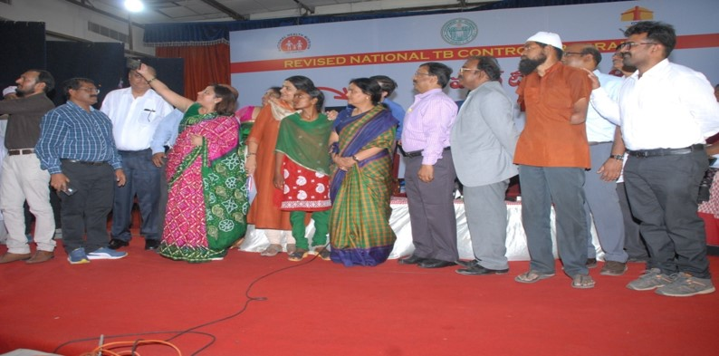
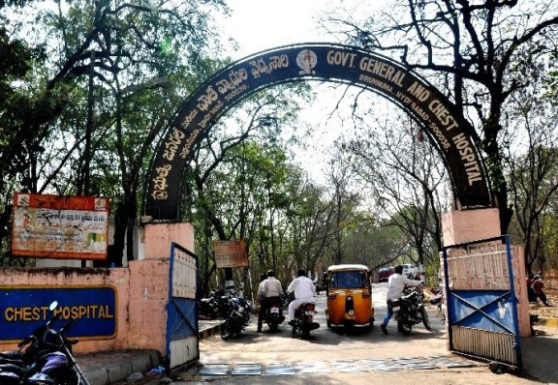
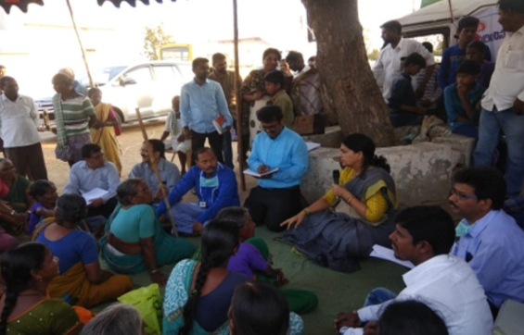
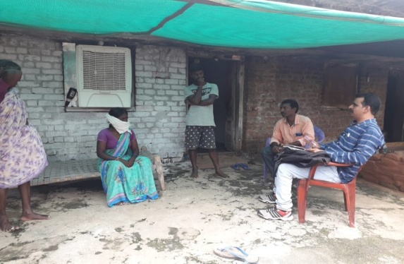
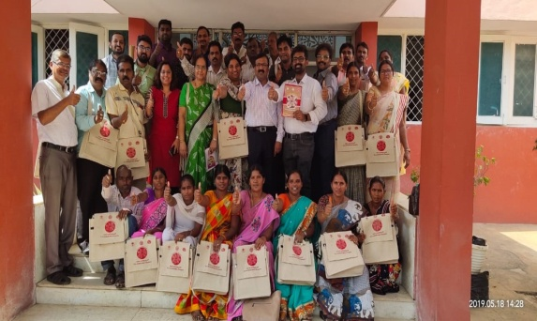
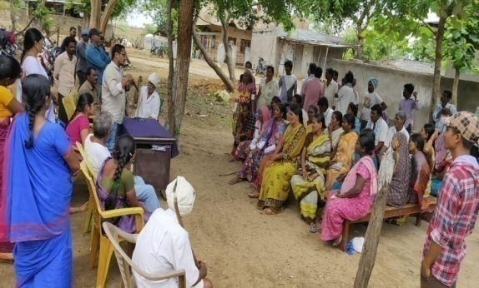
Strategy-components
Community based TB Management
Focus on TB Notifications
Training and Awareness
Monitoring & Supervision
TB Death Audit
Partnership with Private Sector
Infrastructure Strengthening
1
7
2
  TB Champions
6
3
5
4

Slide 7
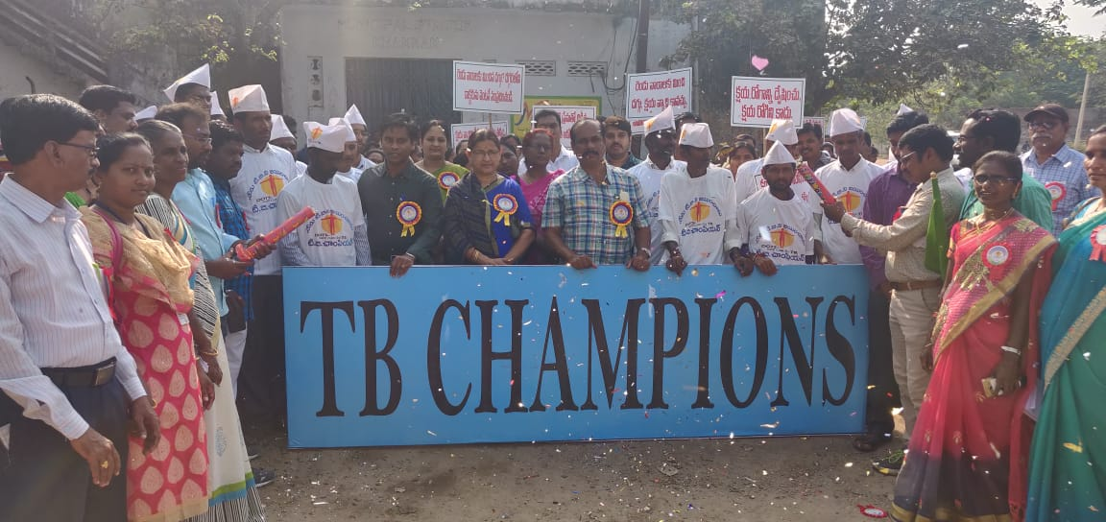
Community based TB Management
(Community Centric Approach)
TB Champions
  Cured Patient / Often MDR / Invariably having affected family member
  Their journey gives confidence to others
  “CONNECT” is immediate & effective
  Buys acceptance
Bold step towards breaking stigma in community and achieving sustainable impact

Slide 8
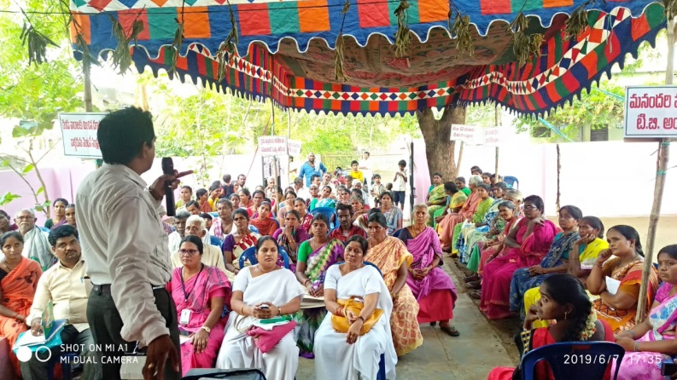
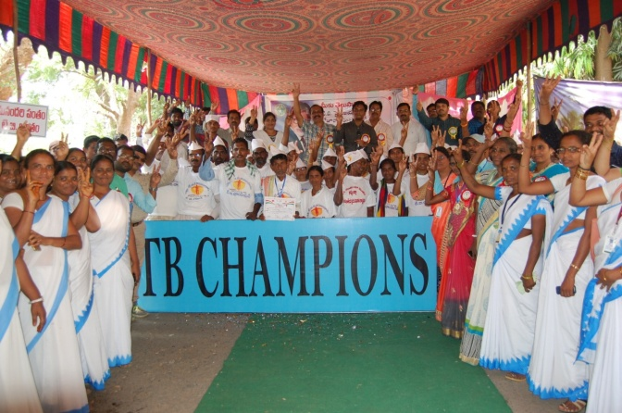
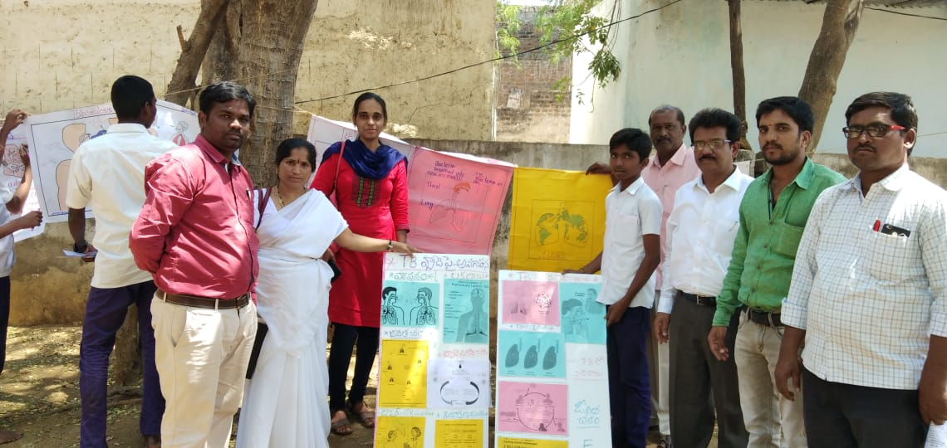
Contd…
1
2
  Training Modules for community
  Identification of TB
  Champions
3
4
  Imparting the training to the
  team of 5 Members
  Deployment of trained team
  (3 days for each village)

Slide 9
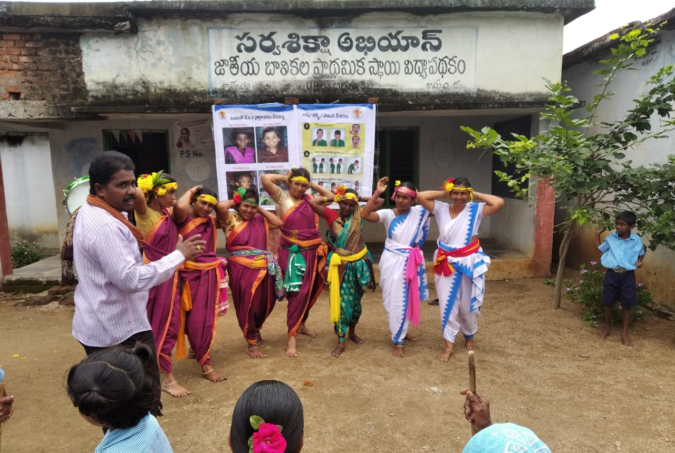
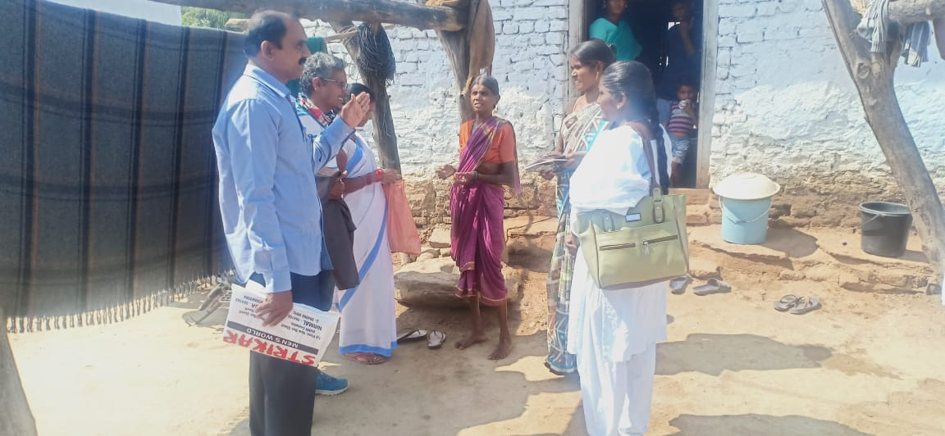
3 day activity - Role of TB Champions
  Motivates and counsel the suspects for giving sputum for test
  Counseling on overcoming drug side effects for compliance of the medication
  Home visits to retrieve loss to follow up of patients and bring them on
  Awareness generation through folk songs
  Education to patients on importance of treatment and adherence
  Awareness creation on risk of DR TB during Village Health & Sanitation Day

Slide 10
Status of Community Based Approach – Phase 1
249
Villages
49468
Attendance in Gram Sabha
1534
Village Officials Sensitized
1233
Cured
Patients
363
TB
Champions
158 / 171
LFU
Retrieved
1674
Patients received
DBT
1253
U-DST
Done
2050
Chest Symptom +
Contact Screening
1981
Tests done
168
Microbiologically Diagnosed
187
Clinically
Diagnosed

Slide 11
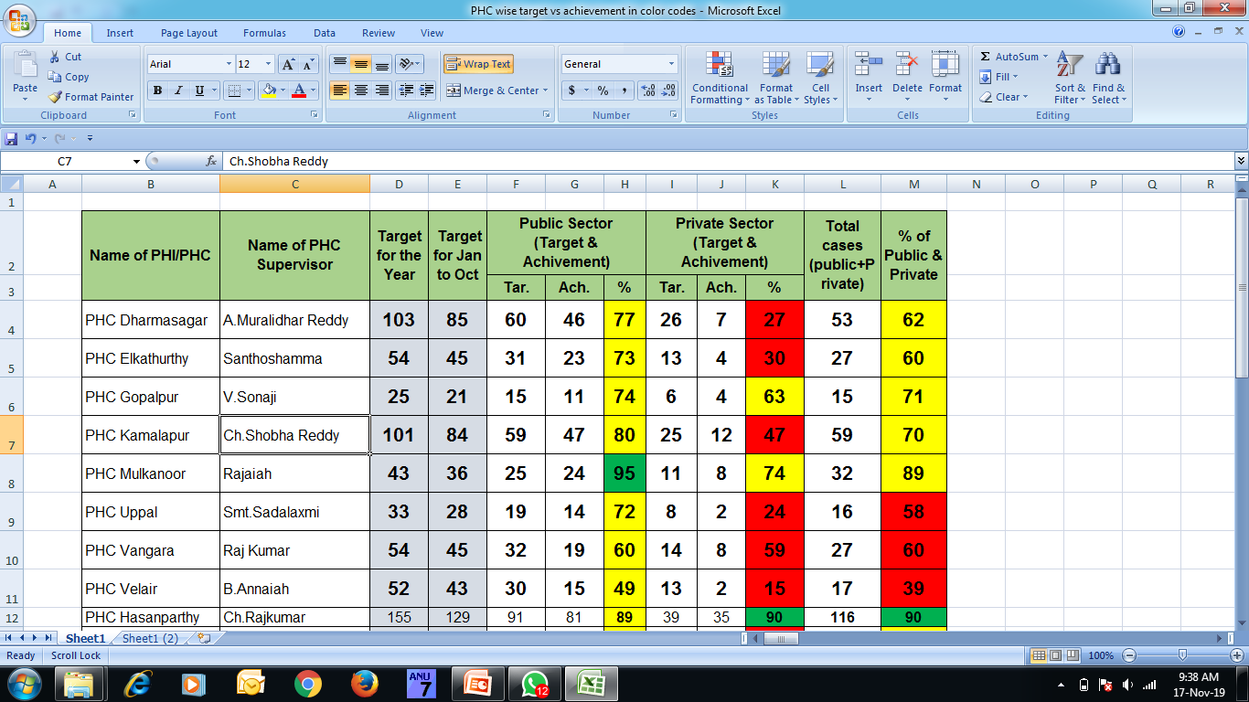
2. Focus on TB Notifications
  Targets to Sub Centers and supervisors
  20 Cups per month / per ASHA
  10 % of OPD - Screening Sputum samples

Slide 12
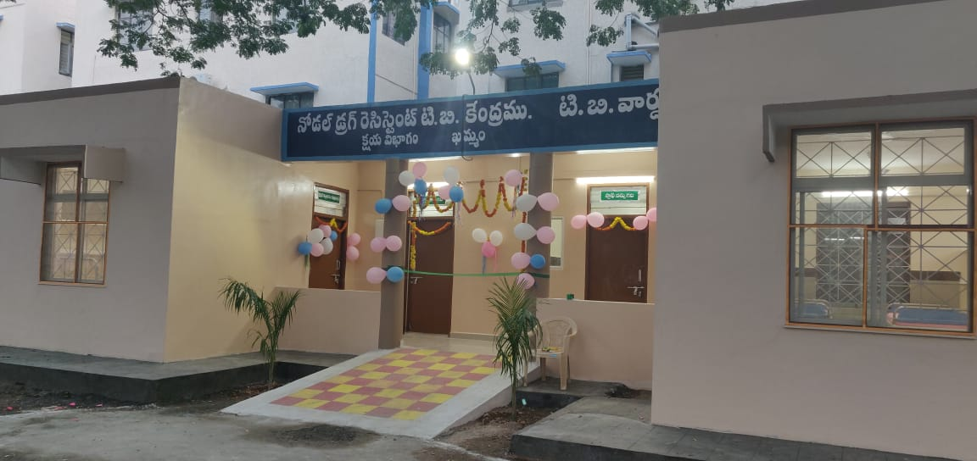
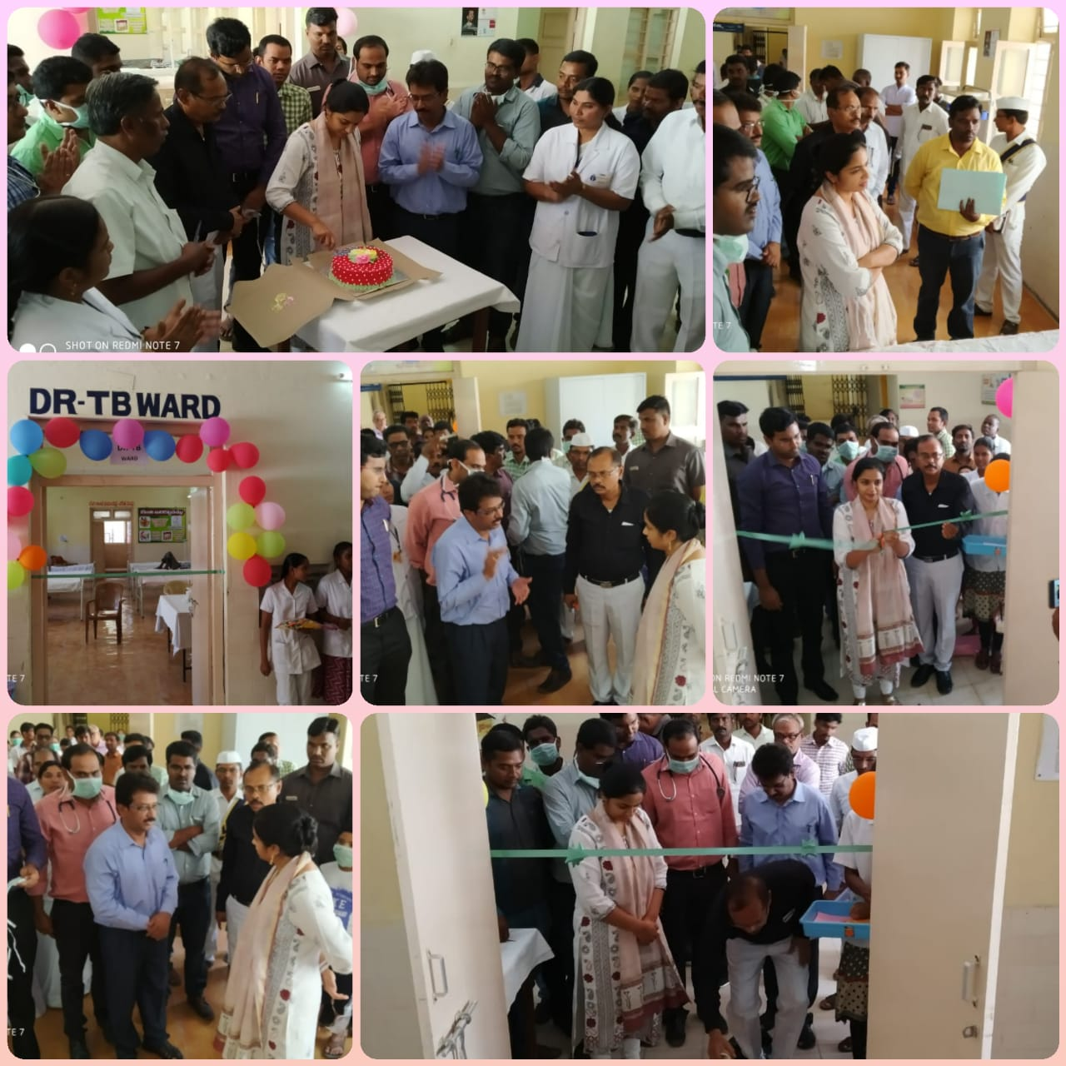
3. Strengthening of Infrastructure
  Conversion of all PHCs into DMCs (391 to 750) – Provided NIKSHAY IDs
  Increased efficiency of CBNAAT
      Free services to private sector
      Dedicated catchment area
      Double shift by positioning second LT
      (average testing 184 to 423)
  Increased DRTB wards from 11 to 24
  Decentralized procurement in case of emergency

Slide 13
4. Partnership with private sector
  Sensitization to 782 Private Practitioners
  Sensitization to 33 ToT District level Chemist Heads
  Conducted 66 District level CMEs with Private practitioners and IMA
  Conducted 24 CMEs to Medical Colleges
  Medical Colleges conducted ACFs in 56 vulnerable groups
  Daily follow-up with Private Practitioners on Notifications
  Awards to best performers in Private Practitioners in Notifications

Slide 14
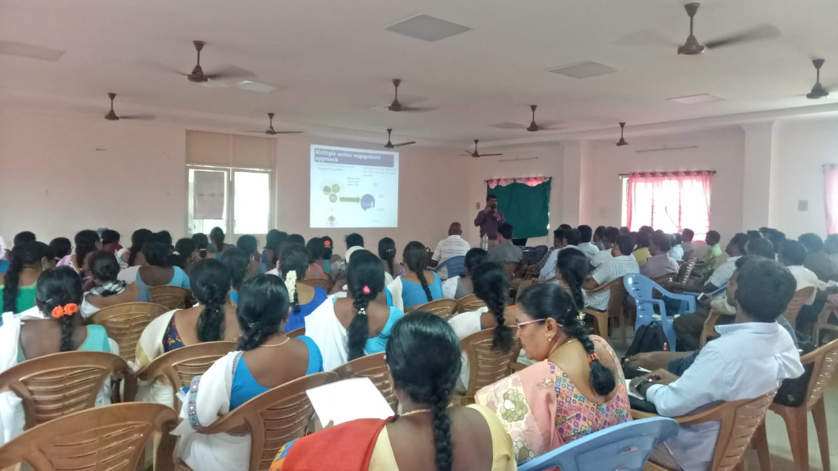
5. Trainings & Awareness
Sl. No. | Audience | Days of Training
1 | ASHA - 24800 | 2 Days
2 | ANMs - 7300 | 2 Days
3 | MPH Supervisors - 3200 | 2 Days
4 | Lab Technicians – 750 | 4 Days
5 | Data Entry Operators – 33 | 2 Days
6 | Pharmacists - 580 | 2 Days
7 | PHC Medical Officers – 635 | 3 Days
8 | Treatment Supervisors – 171 | 6 Days
9 | Lab Supervisors - 85 | 6 Days
10 | DRTB Coordinators - 11 | 6 Days
11 | PPM Coordinators - 24 | 4 Days
12 | District Programme Officers (TB) – 33 | 3 Days
13 | 104 Team – 16 | 2 Days
300 Awareness Campaigns
92000 Community Reach-out
GP Level TB Forums
(once in month)
School and AWC level awareness by MHT of RBSK

Slide 15
6. Monitoring & Supervision
Level | Type of Review & Periodicity | Audience
State Level | Monthly Review by Commissioner (12 Reviews) | DMHOs, District POs
 | Video Conference - Once in 15 days (28 VCs) | District POs, RNTCP Key Staff, ANM and Supervisors
 | Review of State Task Force (Medical Colleges) – Quarterly - (3 Meetings) | Medical College Nodal Officers
 | State Internal Evaluation (Quarterly Once) on Service Delivery (3 Evaluations & 9 Desk Reviews) | Entire District RNTCP Team
District Level | Monthly Review by DMHOs (280 Meetings) | District PO, RNTCP Key Staff, ANM, Supervisors
 | Quarterly Review by District Collector (62 Reviews) | DMHOs, District PO, MOs, RNTCP Key Staff, ANM, Supervisors

Slide 16
7. TB Death Audit
Deaths among the wage earners in informal sector is higher.

Slide 17
Contd…

Slide 18
Achievement : September 2018 to October 2019
  Before the intervention
  After the intervention

Slide 19
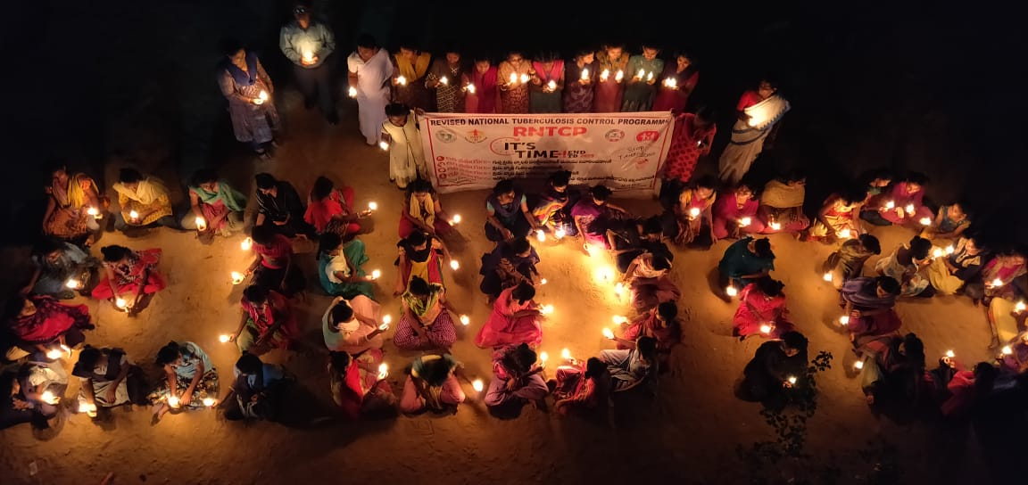
It is a mission to fight TB in the community,
for the community and by the community

Slide 20
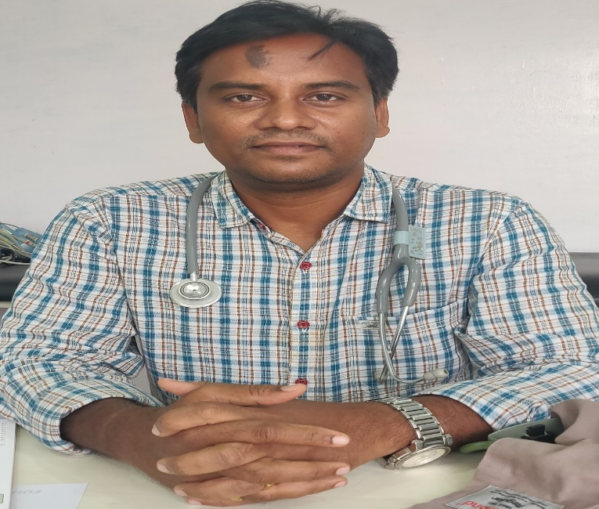
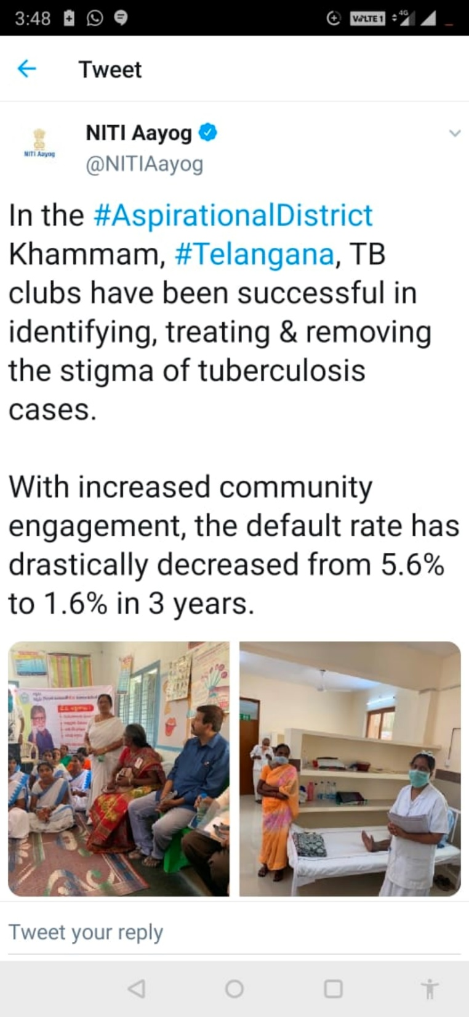
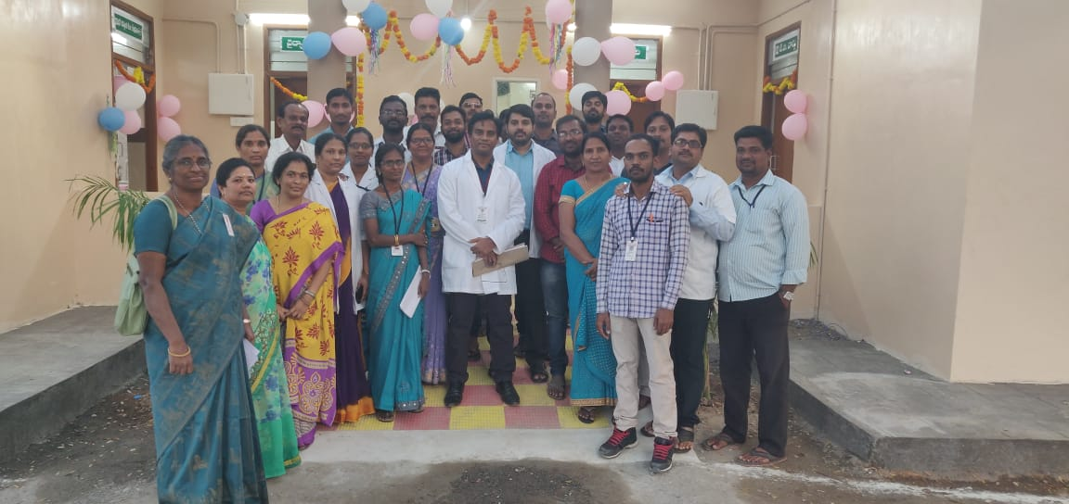
Dr.V. Subbarao – District TB Officer, Khammam,TS
Dr.Subbarao, a pulmonologist working under Gov of Telangana since last 13 years in TB Program. He has been serving as District TB Officer since last 2 years in Khammam district
The performance of Khammam was appreciated by NITI Ayog on twitter for its innovative concept of TB Clubs
With increased community engagement, TB indicators of Khammam has shown remarkable results compared between 2018 to 2019
  TB Notification from 98% to 129%
  UDST from 41% to 86%
  Treatment success rate from 79% to 93%.
Nodal DRTB Center, Center of Excellence is also established in the district.
Niti Ayog’s Tweet
Inauguration of Model DRTB Center in Khammam
TB Champions rally on World TB Day

Slide 21
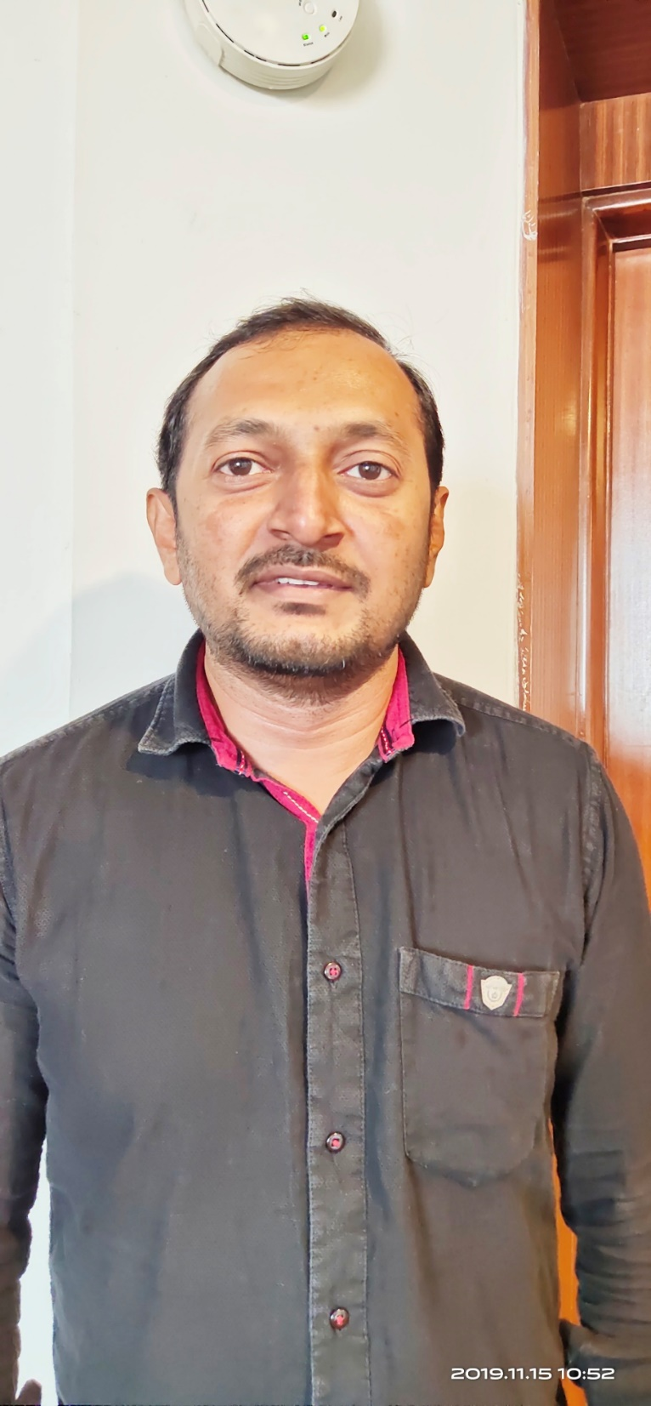
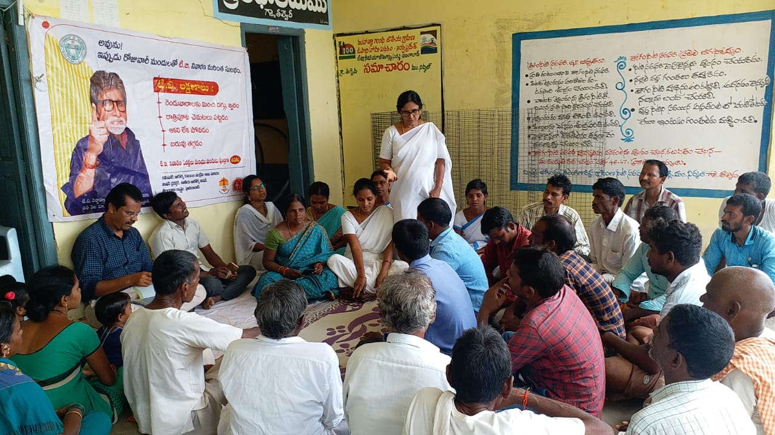
Mr. Mohammad Iliyas, Health Supervisor
Iliyas is a Health Supervisor in Hyderabad.
He has been Working for TB since last 10 years. He is involved in Community based approach in Hyderabad since its inception.
He closely Works in coordination with ASHAs, TB Champions and other supervisors
He says he has not seen this kind of change in the community behavior in his 10 years of services. Initially even when they used to do house to house visits no body use to listen to them
But since they have started involving TB Champions in their team in community activity, the response from community is very positive and more people are coming forward to know more about TB and its services.
Because of this community based approach -
  TB notification in Hyderabad increased from 85% in 2018 to 150% in 2019 against the given target.
  Universal Drug Susceptibility Testing – 30% in 2018 to 69% in 2019
  Success Rate- 85% in 2018 to 91 % in 2019
Community meeting

Slide 22
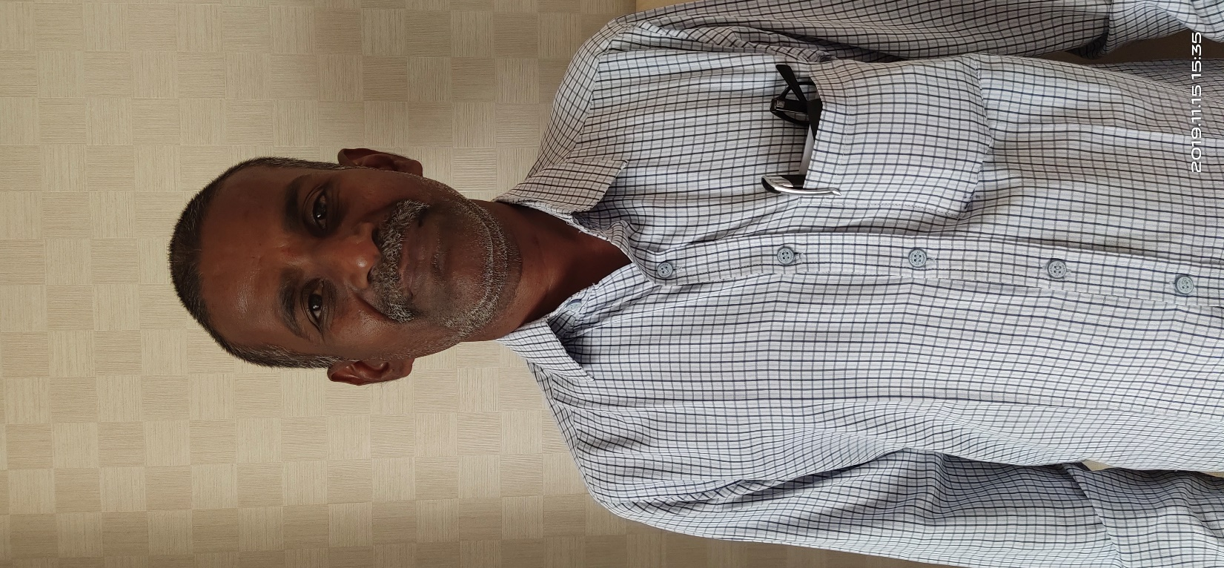
Nageshwar Rao, TB Champion
Nageshwar Rao, 46 years old is a TB Champion from Hyderabad. He was diagnosed with TB in 2017, he was scared and worried about what will happen to his family. He was counseled by ASHAs and supervisors to complete the treatment for 6 months. He completed his treatment and got cured after which he started his regular work.
Seven months later his daughter was diagnosed with TB of Eye (Extra Pulmonary TB)
But this time Nageshwar wasn’t afraid, instead he took his daughter to hospital and started her treatment with help of doctor and Health Supervisors.
Her daughter is taking regular TB treatment. She also passed 10th board scoring 84%. She is now in first year of her college. Nageshwar is very happy and proud of his daughter.
Since then he has been associated with TB team in sensitizing people to complete the treatment.
No of basti covered | No of meetings attended | No of TB patients counseled | Number of Loss to follow patient retrieved
36 | 65 | 33 | 9

Slide 23
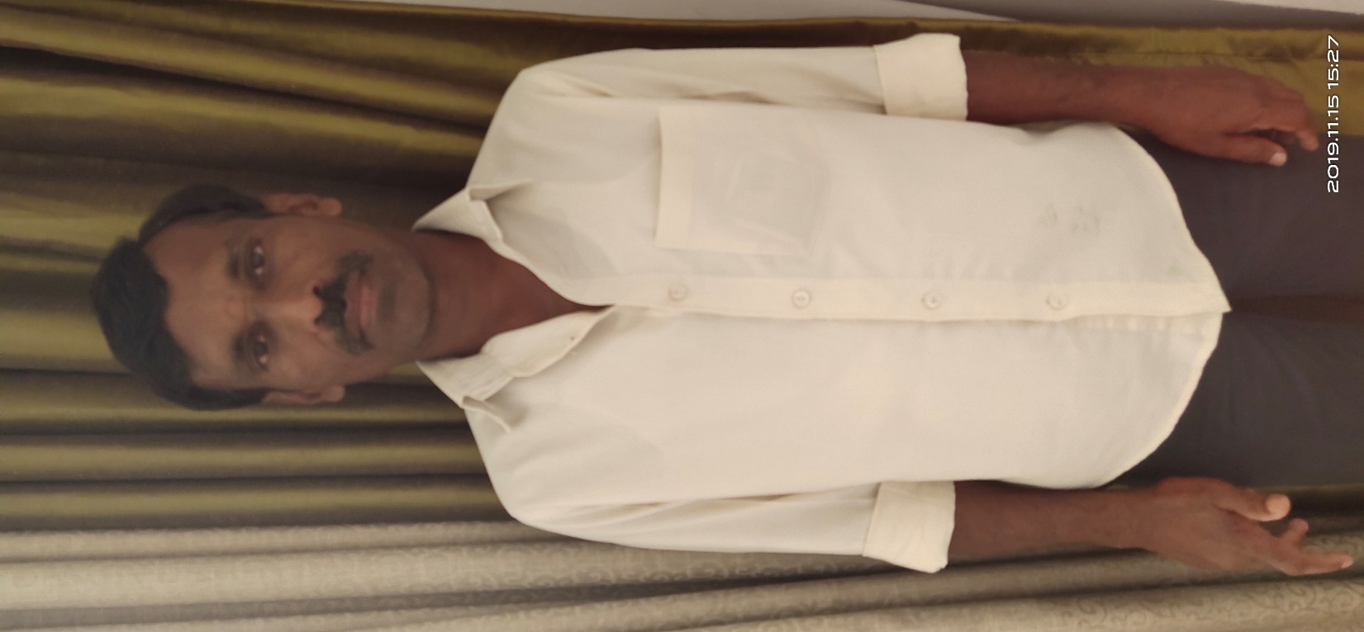
Ram Chander, TB Champion
Ram Chander is a 48 years old TB Champion who is a cook by profession.
He was first attacked by TB 18 years ago. He was counseled by health staffs to complete 6 months of treatment. But he stopped taking medicines from 5th month thinking that he is fine.
But in 2005, he was again diagnosed with TB for the second time.
This time the treatment course was for longer duration including injectable.
Ram Chander completed his treatment second time and got cured successfully.
But after that his daughter and sister-in-law was diagnosed with TB. He counseled both of them and supervised them in completing the treatment. Today all are cured and living happily.
This motivated him to help people and counsel them to complete the treatment.
He is helping TB patients to complete the treatment in his basti.
This is how he became one of the team member of Community based model.
No of basti covered | No of meetings attended | No of TB patients counseled | Number of Loss to follow patients retrieved
56 | 84 | 41 | 12

Slide 24
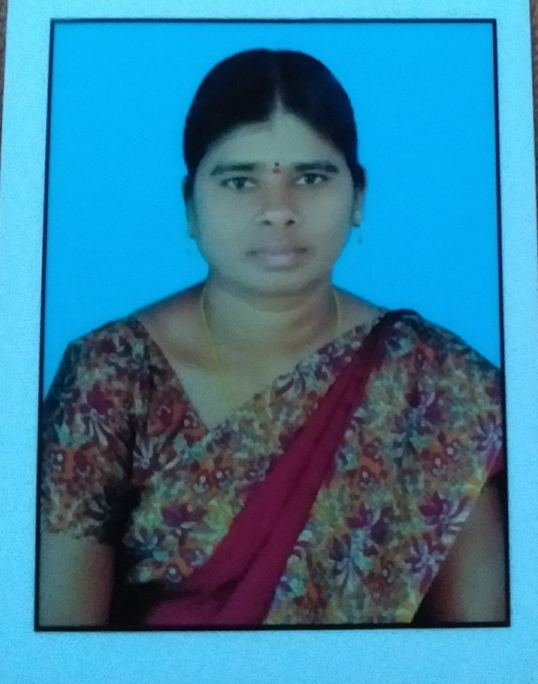
Kamala, TB Champion
Kamala is an ASHA worker and a TB Champion, She got TB in 2016
At that time, despite being a health worker teaching villagers about diseases, she ignored her own symptoms of TB
She didn’t get her sputum tested till she was very weak and sick. Finally when she got tested she was diagnosed with TB.
This resulted in behavior change in her husband and family members. They started keeping her in an isolated room and used to avoid talking to her.
Her friends and colleagues also stopped talking to her. But one of her ASHA friend supported and helped her in completing the treatment.
During that time Kamala understood the stigma and taboo attached to TB and why people doesn’t want to disclose when they suffer from TB.
After getting cured she committed herself that she will work on removing stigma against TB specially among women.
No of villages covered | No of meetings attended | No of TB patients counseled | Number of Loss to follow patients retrieved
121 | 164 | 142 | 23

