Slide 1

Comprehensive Counselling programme in Health Facilities in Maharashtra
Dr. Archana Patil
Director, Health Services
Govt. of Maharashtra

Slide 2
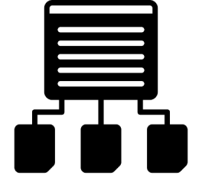
CONTEXT
Counselling critically important for change in behavior and improving health indicators.
Under NHM, counsellors appointed in various programmes e.g. RKSK, ICTC, Mental Health, Sickle cell, NCD at secondary hospitals especially DH, WH, GH.
These counsellors were trained in respective programmes and were providing counselling services only for that specific programme resulting into under-utilisation of HR at the health facility level.
Rationalization of human resources through multi-skilling necessary to improve outcome.

Slide 3
COUNSELLORS UNDER VARIOUS PROGRAMMES
SR. NO. | NAME OF PROGRAMME | NAME OF POST | APPROXIMATE POSTS OF COUNSELLORS 2016-17
1 | MSACS | ICTC Counsellor | 734
2 | NPCDCS | Counsellors | 243
3 | RKSK | AH/RKSK counsellor | 145
4 | NTCP | Psychologist/Counsellor | 50
5 | Haemoglobinopathy | Counsellor (Sickle cell and Haematology) | 35
6 | NPCB | Eye Donation Counsellor | 35
7 | NRC | Nutritionist | 24
8 | RNTCP | Counsellor | 20
9 | DMHP | Psychiatric Social Worker | 16
10 | NMHP | Clinical Psychologist | 16
 | Grand Total |  | 1318

Slide 4

OBJECTIVES
To ensure optimal utilization of counsellors in providing comprehensive counselling services to patients and their relatives at health facilities
To Improve acceptance and compliance of patients for various healthcare services
To improve overall awareness about various health programmes amongst patients and their family members visiting health facilities and thereby improving heath indicators

Slide 5



HEALTH INSTITUTIONS COVERED
Total number of health facilities covered: 40
  District hospitals/General hospitals: 27
  Women hospital: 13
Both OPD and IPD patients counselled from identified hospitals
Counselling to relatives of the patients also provided

Slide 6



STRATEGY/METHODOLOGY
CRITICAL TIME
DEVELOPMENT OF TRAINING MATERIAL AND COUNSELLING AID
  A training module for the counsellors along with flipchart was prepared by HFWTC faculty, SHSRC team, and edited by concerned programme heads.
  Final Material:
    Guide book for counsellors
    Flipcharts:
      RCH
      Communicable diseases and Non-communicable Diseases

Slide 7
MAJOR TOPICS COVERED (for counsellors from all programmes)
Counselling & Skills of Counselling Maternal Health ANC Check-up Counselling During Pregnancy Maternal & child Care JSSK, JSY, PMSMA Child Health Breastfeeding Counselling Supplementary Diet Counselling Scheme’s to reduce Malnutrition Routine Vaccination, IDCF, Childhood Disease like Diarrhoea, ARI, Pneumonia RBSK RKSK Family Planning OC Pills, IUD, Copper-T, NSV, DMPA, etc | Vector-borne diseases Dengue, Chikungunya, Elephantiasis, Malaria etc. National Leprosy Eradication programme, Revised National Tuberculosis programme, National Aids Control programme Non-Communicable Diseases Cancer, Diabetes, Coronary Diseases, Obesity, National Mental Health programme Prerana Prakalp, National Tobacco Control Act Organ donation Organ Donation Blood Donation, Eye Donation, Health Information and Vital Statistics Birth & death Registration Marriage Registration

Slide 8
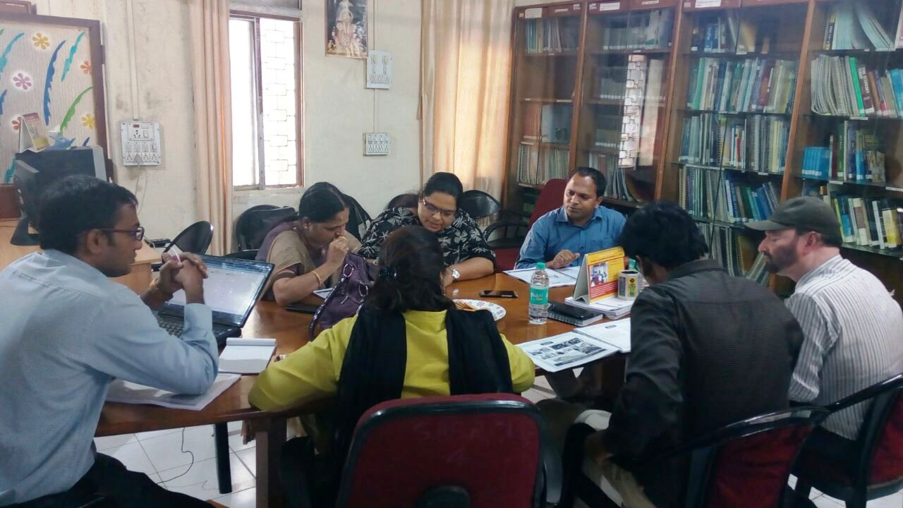
COUNSELLOR MODULE/FLIPBOOK PREPARATION MEETING

Slide 9
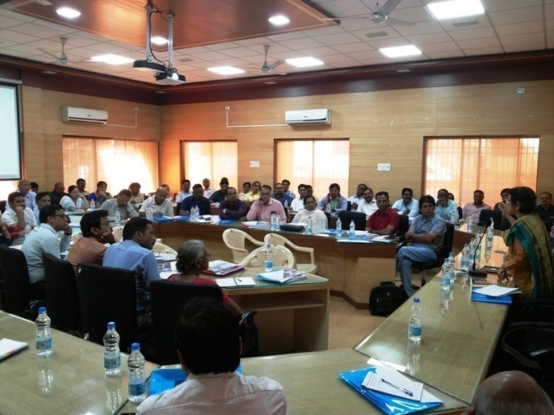
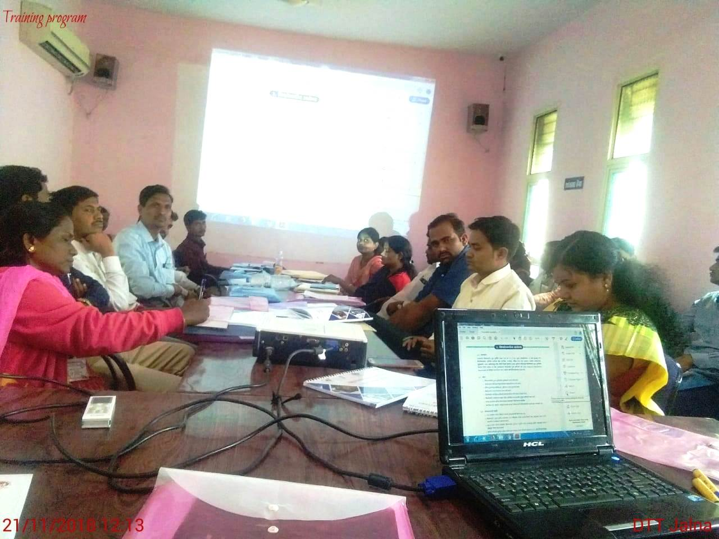
STRATEGY/METHODOLOGY (CONTD.)
CRITICAL TIME
TRAININGS:
State Level ToT:
    Two days ToT was conducted for HFWTC Principals and faculty members.
District level training:
    Two days training of all counsellors was conducted by HFWTC Principals and faculty trainers in their respective districts

Slide 10
STRATEGY/METHODOLOGY (CONTD.)
    IMPLEMENTATION AND FOLLOW-UP:
    Visit schedule of counsellors:
    Counsellors were performing their regular activities during OPD hours. In the afternoon, different wards were assigned to counsellors to counsel indoor patients and their relatives
    Counselling was done in groups as well as with individuals.
    Schedule was prepared according to the need of the facility, number of wards and counsellors available in the facility.
    Daily diary of counsellors:
    Daily diary was maintained by every counsellor in prescribed format to log counselling activities performed.
CRITICAL TIME

Slide 11
PERFORMANCE

Slide 12

IMPORTANT OBSERVATIONS
CRITICAL TIME
    More than 90% counsellors performed as per schedule.
    Training improved counsellors’ knowledge about all programmes including their original programme.
    IEC material prepared was used effectively by counsellors
    Training helped to improve their confidence
    Improvement is seen in process indicators.
    Family planning indicators showed better improvement

Slide 13
IMPROVEMENT IN KEY INDICATORS
SR. NO. | INDICATOR
 |  | April-Sept 2018 | April-Sept 2019 | % increase
1 | Number of PW having severe anaemia (Hb<7) treated | 3122 | 5053 | 61.85
2 | Number of institutional deliveries conducted (including C-sections) | 80942 | 82315 | 1.70
3 | Number of new-borns breastfed within 1 hour of birth | 72875 | 75821 | 4.04
4 | Child immunisation - Vitamin K1 (Birth Dose) | 78211 | 81372 | 4.04
5 | Child immunisation - BCG | 74768 | 79497 | 6.33
6 | Child immunisation - OPV 0 (Birth Dose) | 76867 | 78980 | 2.75
7 | Child immunisation - Hepatitis-B0 (Birth Dose) | 58751 | 64542 | 9.86
8 | Children aged between 9 and 11 months fully immunized – Male | 5339 | 6214 | 16.40
9 | Children aged between 9 and 11 months fully immunized – Female | 4976 | 5767 | 15.90

Slide 14
IMPROVEMENT IN KEY INDICATORS
SR. NO. | INDICATOR | STATE ALL FACILITY TOTAL
 |  | April-Sept 2018 | April-Sept 2019 | % increase
10 | Number of postpartum sterilizations (within 7 days of delivery by Minilap or concurrent with caesarean section) conducted | 5091 | 5823 | 14.39
11 | Number of postpartum IUCD insertions (within 48 hours of delivery) | 11910 | 13770 | 15.62
12 | Injectable contraceptive – Antara programme- first dose | 1329 | 2164 | 62.83
13 | Number of Centchroman (weekly) pill strips distributed | 1621 | 3617 | 123.13

Slide 15
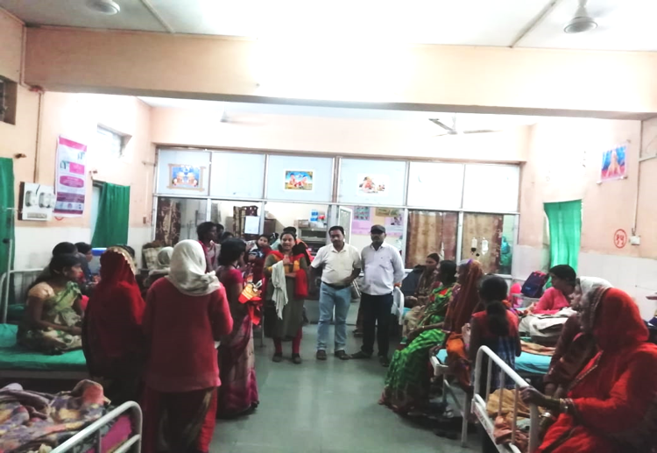
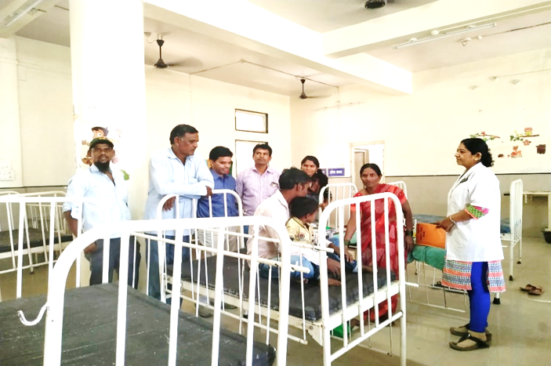
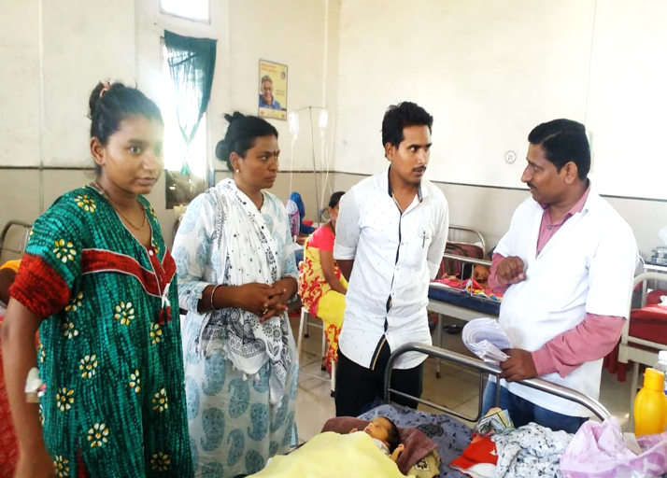
GALLERY
OPD counselling
IPD counselling
IPD counselling

Slide 16
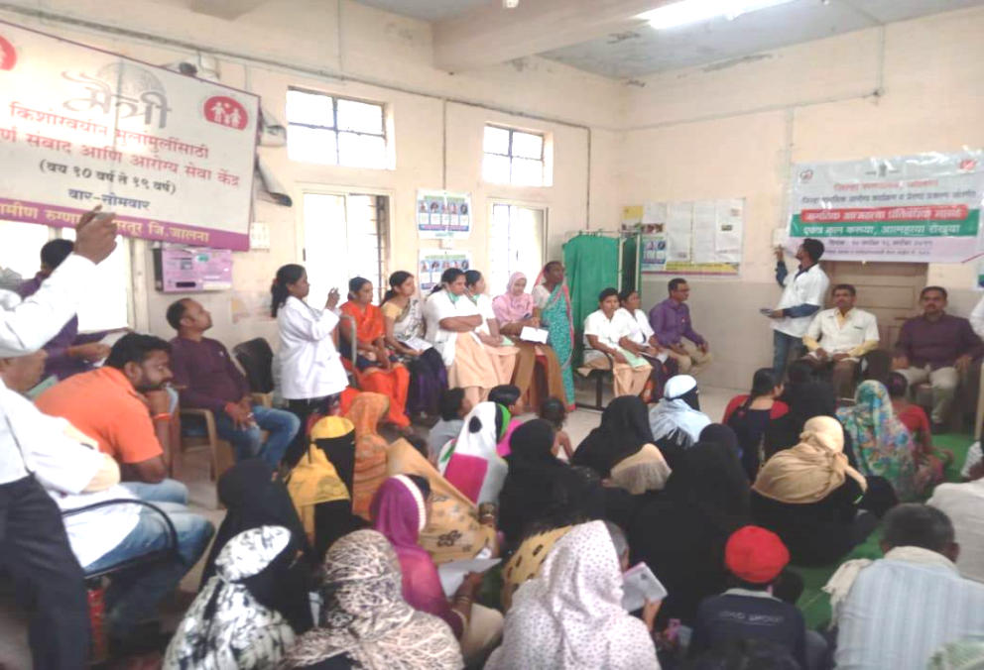
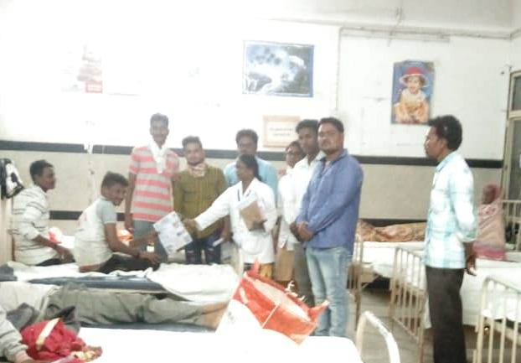
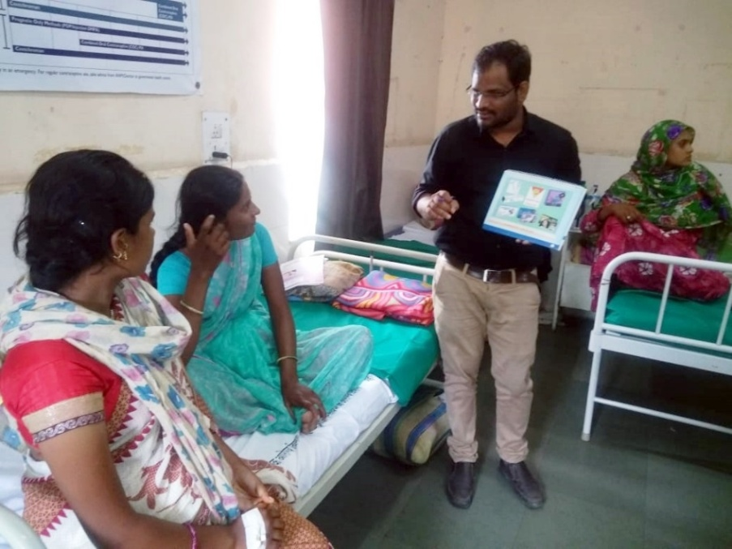
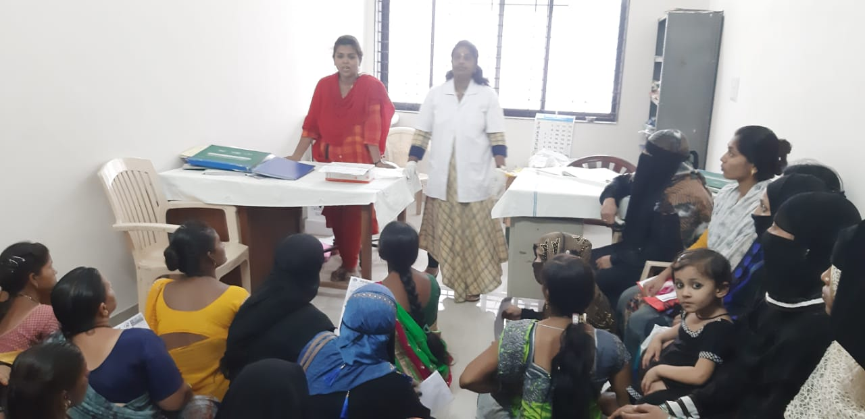
GALLERY
IPD counselling
OPD counselling
IPD counselling
OPD counselling

Slide 17

MONITORING AND REPORTING
At the facility level, programme was monitored by Additional Civil Surgeon (ACS)/Medical Superintendent and Matron
Monthly reporting format was submitted to district and shared with state authorities by 10th of every month.
Regular review by state taken through monthly Video Conference by SFWB and SHSRC.

Slide 18
FINANCIAL IMPLICATIONS
A total budget for the roll-out of comprehensive counselling programme including training, printing and designing resource material cost:
Rs. 37.62 lakh
Printing of training material:
Rs. 8.19 /- lakh
Training (both TOT and counsellor trainings):
Rs. 29.42/- lakh
No recurring Cost

Slide 19
LESSONS LEARNED
Rationalisation of counselling services and counsellors is possible
Optimum utilisation of counsellors for various health programmes.
Integration of IEC activities yields better outcomes.
Indoor/OPD patients as well as their relatives are counselled for different health programmes and services.
The programme has a potential for scaling up to other areas.

Slide 20


Slide 21
THANK YOU

