Slide 1



Rashtriya Bal Swasthya Karyakram (RBSK)
Child Health Screening & Early Intervention Services
SWASTHYA KIRANA
Online Reporting
Portal Application
Pankaj Kumar Pandey IAS
Commissioner
Health And Family Welfare Services
Karnataka

Slide 2

Introduction –
Rashtriya Bal Swasthya Karyakram (RBSK)
Aim - conduct health screening , identify children with health conditions, refer for appropriate timely treatment.
Implementation since 2013-14 covering Rural & Urban areas in the State
Screening for 38 health conditions classified under 4’D’s.
    0-6 years screened biannually at Anganwadis.
    6-18 years screened annually at Schools and Colleges.
Referral and treatment
    Children with conditions like Cardiac problems, Neurological issues, Cleft Lip and Cleft Palate are referred to Suvarna Arogya Suraksha Trust(SAST) empanelled hospitals for cashless treatment.

Slide 3
History of events with RBSK
Students Achievements Tracking System (SATS) - implemented through Education Department in Karnataka.
RBSK “Swasthya Kirana” meaning “Ray of Health” - An innovative technology to reduce defects, deficiencies and arrest deaths of children
  based on systematic early identification,
  monitors timely intervention from birth
  designed to enable District Early Intervention Centre (DEIC) to bring in systemic and effective interventions required for efficient referral linkages for different age groups of children.

Slide 4
Need of the hour
Integration
Convergence
Integration
RBSK
NPPCD
NPCB
RKSK
WIFS
MHS “Shuchi”
Health
Department
Education
Department
Women & Child Department

Slide 5

Need of the hour
  Accountability of each child health record, carried forward for successive years
  Accountability of IFA, Albendazole, Sanitary Napkin Pads reaching beneficiaries.
  Integration of screening, referral, follow up & reporting at Delivery points, MHTs and DEIC.
  Online health records of 0-19 year children.
  Real time data of health status of children.
  Tracking drop outs and left out children.
  Registration, health examination, referral and follow up of children.
  Monitoring Mobile Health Teams.
  Real time reporting

Slide 6
Application: RBSK-Swasthya Kirana
  Web-based system that integrates annual health check up of all children.
  Working calendar for Mobile Health Team (MHT) mapped with schools and Anganwadis to cover annual health check up of 100% of children.
  Hand held data access of children to MHTs - timely upload of health records.
  Referral linkage for further treatment.
  Live dashboards at all levels for timely intervention.
  Auto alert mechanisms for referral monitoring.
  All health services in single platform.
  Secured repository of annual health records.
  Back up on daily basis.
  MIS and reports.

Slide 7
RBSK Swasthya Kirana Work Flow
RBSK TEAM VISIT MESSAGE WILL BE DELIVERED 3 DAYS IN ADVANCE
PHC
TH
DEIC
SMS TO SCHOOL/AWC, PARENTS & RBSK TEAM
CHC
DH
ONE TIME ACTIVITY
IF NORMAL CHILD GOES BACK TO SCHOOL
REFERS CHILD TO ANY ONE OF THE HOSPITAL
TREATED CASES
SCHEDULES SCHOOL
REFERS CHILD
TREATMENT
RBSK TEAM
SCREEN’S CHILD
ALL CHILD DETAILS ARE DISPLAYED IN SOFTWARE AND THE MHT JUST NEEDS TO ENTER SCREENING DETAILS AND REFER CHILD
CASES IDENTIFIED
AUTO ALERT SMS
TREAT THE CASE AS MISSED CASE
HIGHER TREATMENT
SCHEDULES ANGANWADI
IF NORMAL CHILD GOES BACK TO ANAGNWADI
TWO TIME ACTIVITY
REFERRAL TO SPECIALITY CARE
FOLLOW BACK NOTIFICATION TO
REFERRED RBSK TEAM
SMS TO SCHOOL/AWC, PARENTS
PLAN B
RBSK TEAM VISIT MESSAGE WILL BE DELIVERED 3 DAYS IN ADVANCE
SMS TO SCHOOL/AWC, PARENTS, NODAL OFFICER OF THE FACILITY & DEIC

Slide 8





Inventory Module
Vendor
Alert sms will be delivered once vendor sends
THO
Alert sms will be delivered once THO sends
Vendor will distribute item to THO
PHC
Alert sms will be delivered once PHC sends
THO will further distribute item to PHC
PHC will further distribute item to all schools and anganwadi’s
Now school’s & anganwadi’s will distribute item to children and enter in software

Slide 9
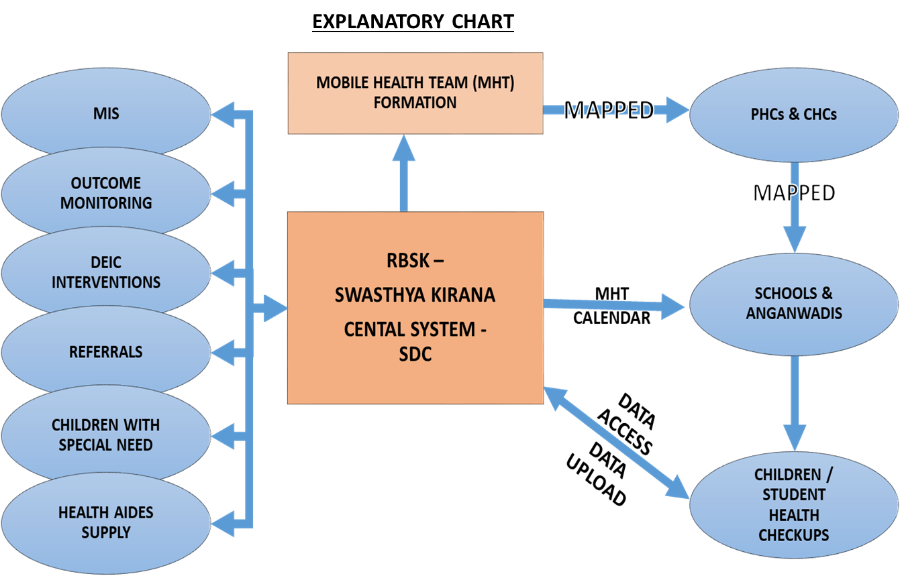
Application: RBSK-Swasthya Kirana

Slide 10
Application: RBSK-Swasthya Kirana
  Capturing the Comprehensive New Born Screening (CNBS) of all newborns at the Delivery Points of Public Health Institutes and follow-up of all babies requiring intervention at the DEICs.
  Health screening details of children between 0-6 years and 6-18 years (Anganawadis, Schools and Colleges respectively), Medical and Surgical requirements of the child and those requiring further referral to Government Hospitals and referral hospitals are automatically generated along with the beneficiary.
  SMS to School Head Master and College Principals are sent 03 days prior regarding the RBSK Mobile Health Teams visit.
  Auto alert sent to the Medical Officer of the referral hospital and parents intimated regarding the same
  Child health screening details, referral and follow-up information is also available.
  Health records of the newborn and all children screened at the Anganwadi, School and Colleges get automatically carried for the successive years.

Slide 11
Application: RBSK-Swasthya Kirana
  “Inventory Module” - includes information on Iron and Folic Acid tablets (IFA-Pink and IFA-Blue) distributed under Weekly Iron and Folic Acid Supplementation (WIFS) Program.
  Tab. Albendazole used for Deworming children between the age group of 01-19 years are also captured in the software during National Deworming Day (NDD).
  State Government owned program “SHUCHI” which promotes Menstrual Hygiene among adolescents girls (10-19 years) provides Free Sanitary Napkin Pads. Complete information on its procurement, supply, distribution and current usage are gathered in the software. The software helps in implementation and monitoring, the real time data.

Slide 12
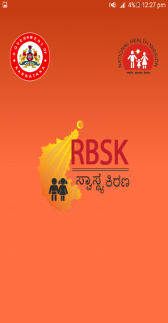
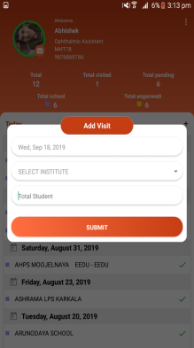
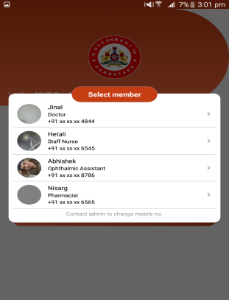
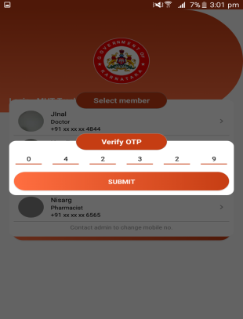
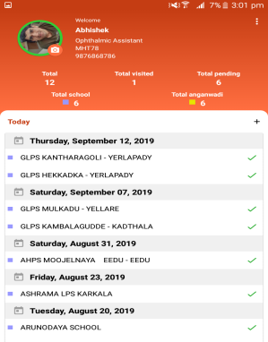
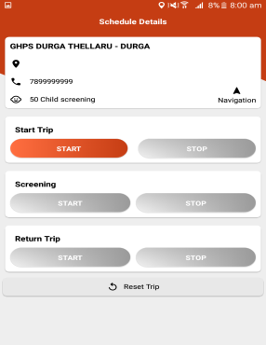
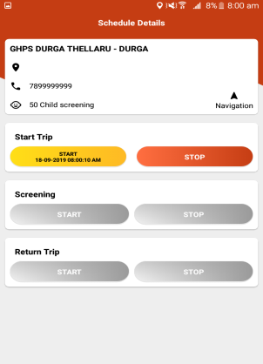
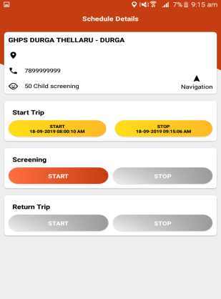
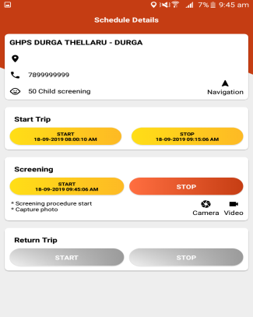
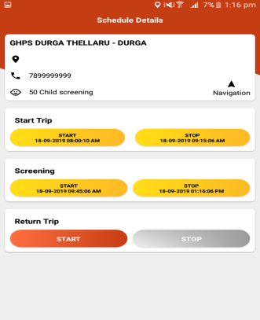
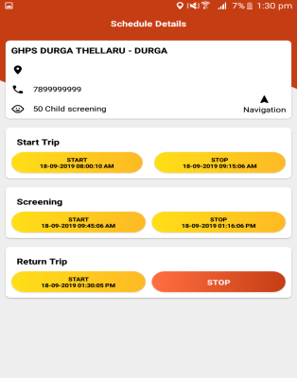
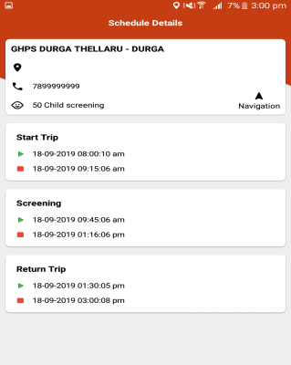
Swasthya Kirana MHT Tracking Application

Slide 13
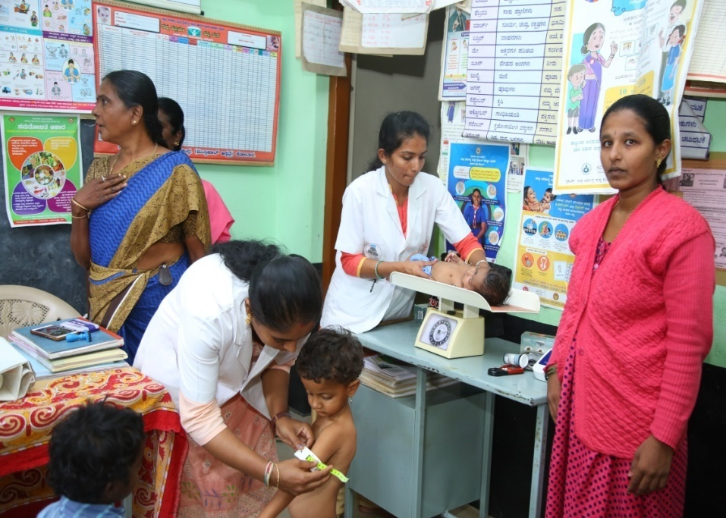
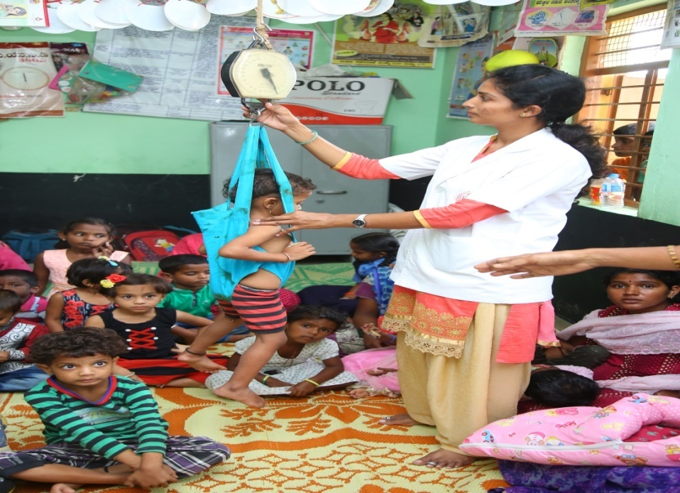
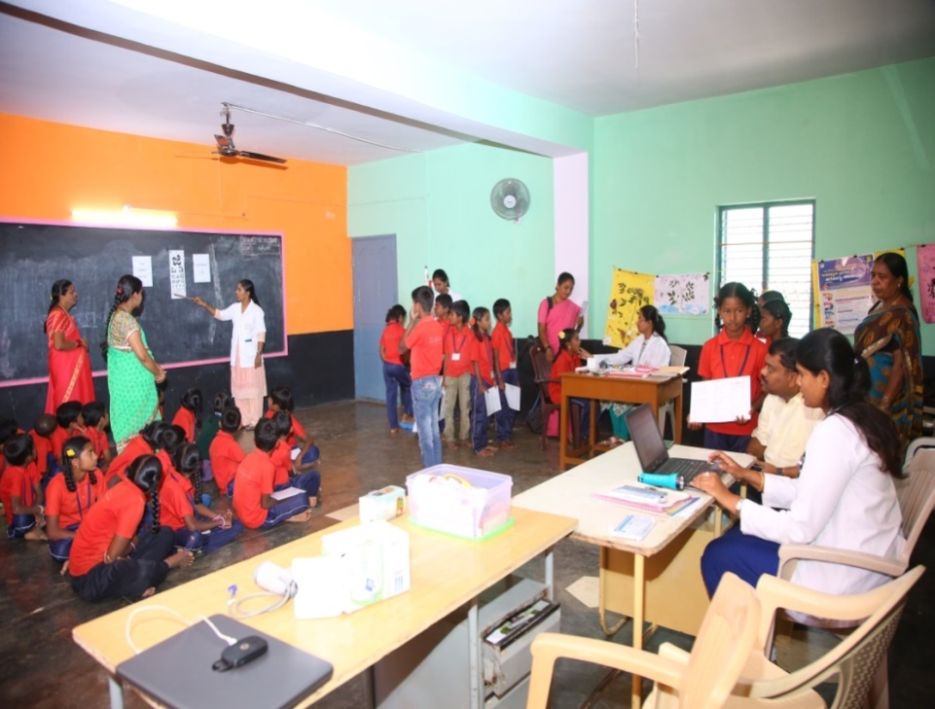
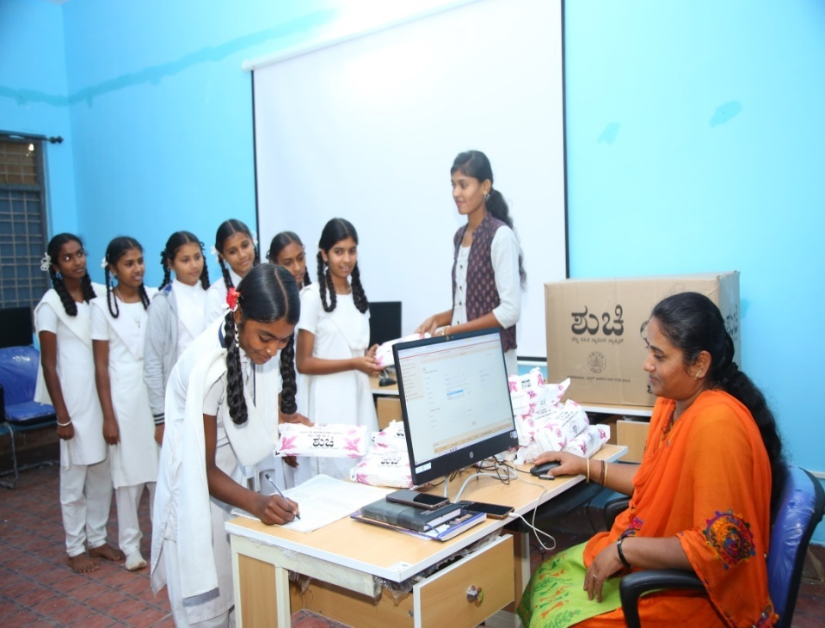
Anganwadi Screening
Anganwadi Screening
Health Screening & Real Time Reporting at School
Distribution of Sanitary Napkin Pads & Real Time Reporting at School

Slide 14
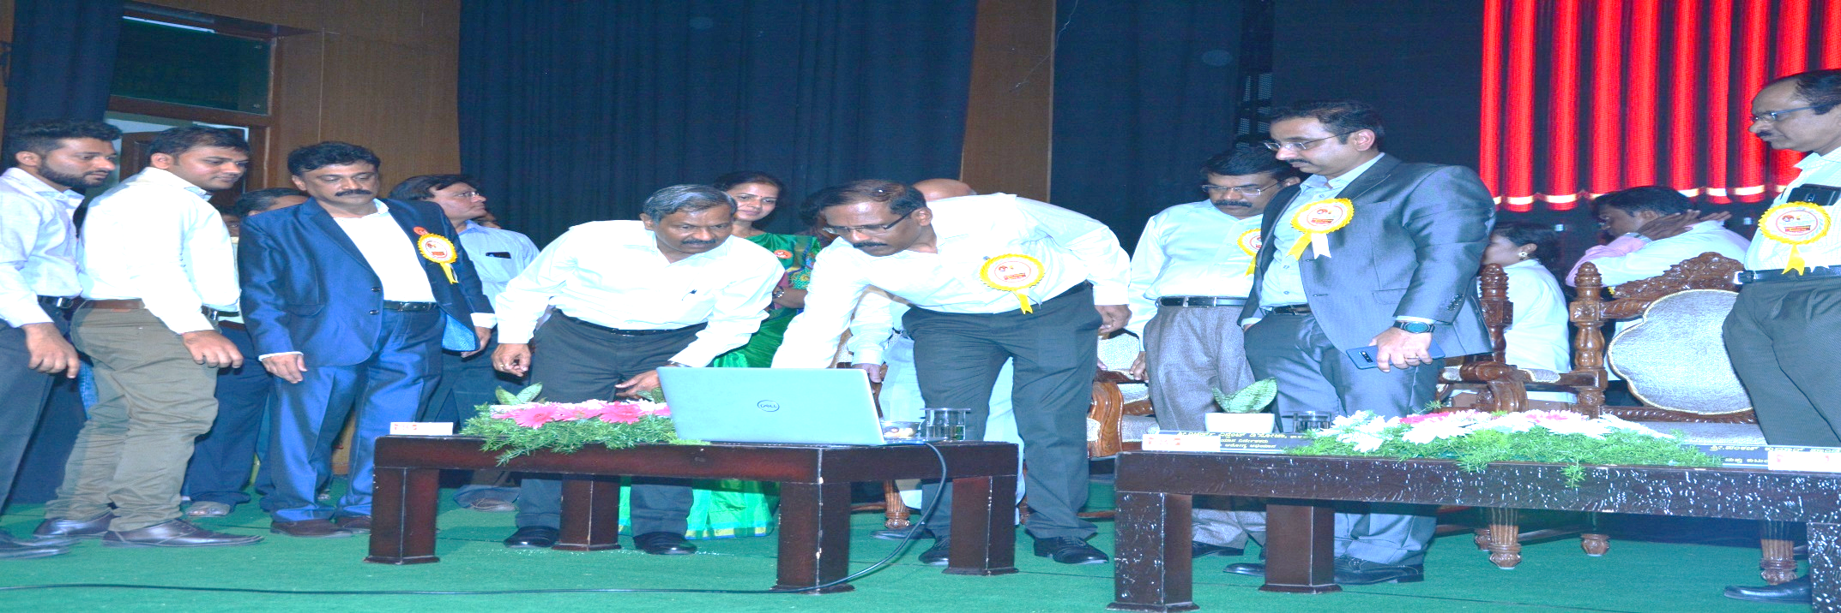
RBSK - Swasthyakirana State Launch

Slide 15
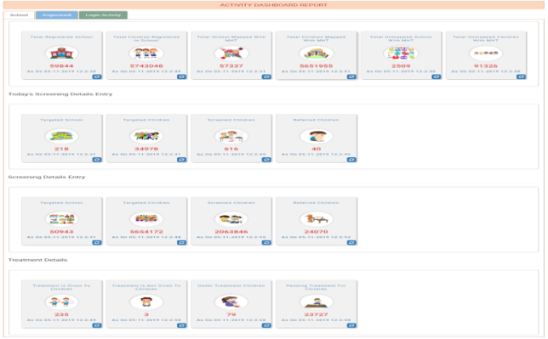
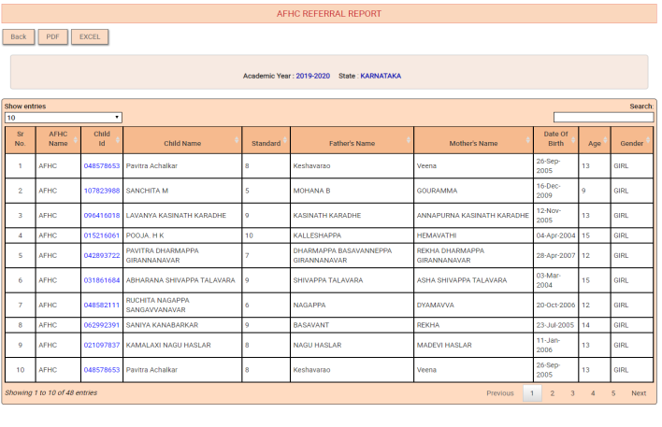
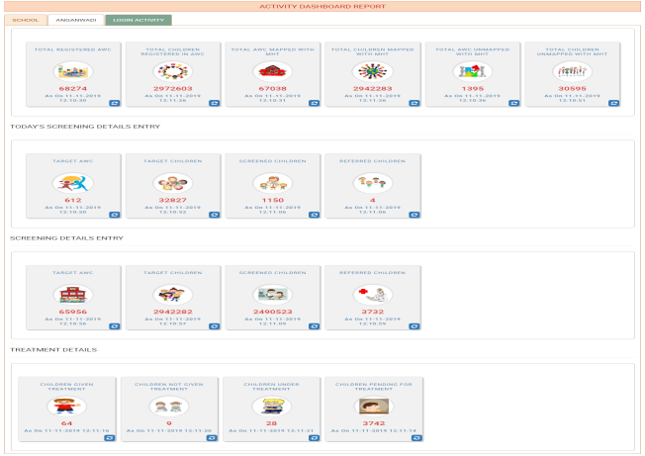
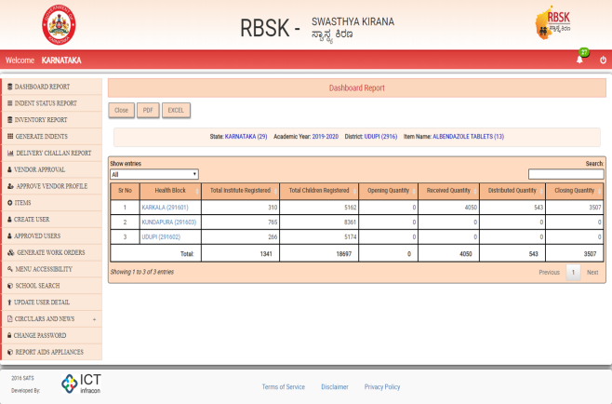
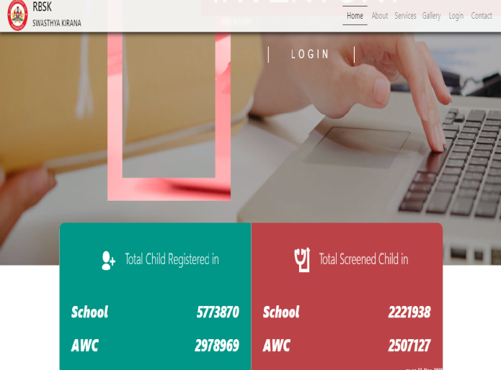
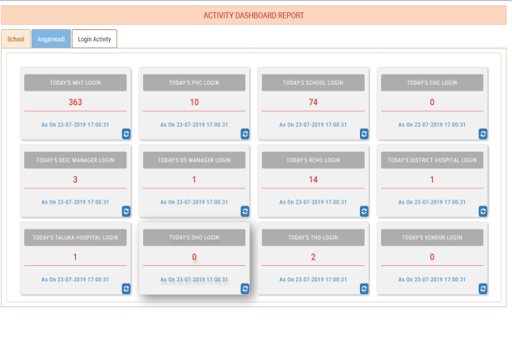
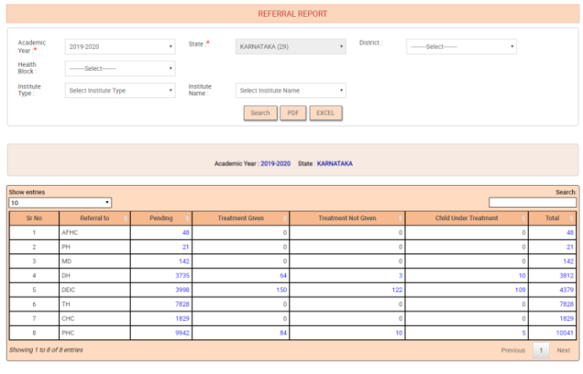
Swasthya Kirana
Activity Dashboard - School
Students Pending Referral at AFHC
Activity Dashboard-Anganwadi
Albendazole Tablets Stock Report
Main Dashboard
Health Activity Dashboard
Health facility wise Referral Report

Slide 16
Equipment
  Desktop computers for Delivery points.
  Laptops for MHTs.
  Smartphones for MHT tracking.

Slide 17
Monitoring & Supervision
State Level
Deputy Director (RBSK, RKSK)
District Level
DHO
Taluk Level
THO
CDPO
RCHO
DD PI
BEO
DD (WCD)
Other Departments

Slide 18
Challenges
  Internet connectivity issues- Offline upload of Excel sheet option
  Updating data at the time of screening.
  Training of Staff Nurse at delivery points for uploading screening and referral reports.
  Initial issues with software- Timely rectified.

Slide 19
Financial Implications
  Budget re appropriated from the approvals under mobility support for MHT @ 1000/ month from each vehicle for 430 vehicles.
  Rs.50 Lakh per annum for software maintenance and HR.

Slide 20
Outcomes
  100% of children in Anganwadis and in schools are covered.
  Child wise interventions are monitored.
  Optimal efficiency of Health programmes achieved.
  Swasthya Kirana is highly scalable in service and in size.
  Adaptable to the changing needs.
  Can handle a large volume of transactions without strain.
  Can be integrated with AB Ark and other related software.

Slide 21
Way Forward
  RBSK Swasthya Kirana +
  Add First Aid component at School with assistance of Red Cross and St. John’s Ambulance Association.
  Health Education Tools & talks: Sanitation, Immunization, Mental Health, Vector Borne Diseases, first half an hour of school visit.
  Health Counselling Day at schools: Done in coordination with RKSK
  Integration with Ayushman Bharat-Arogya Karnataka.
  Payment of referral services as per Swasthya Kirana reporting.
  Payment of vehicles hired under RBSK.
  Biometrics attendance and Linking of salaries of RBSK Staff.

Slide 22
Implementation of
Swasthya Kirana at Field
Click Here…..

Slide 23
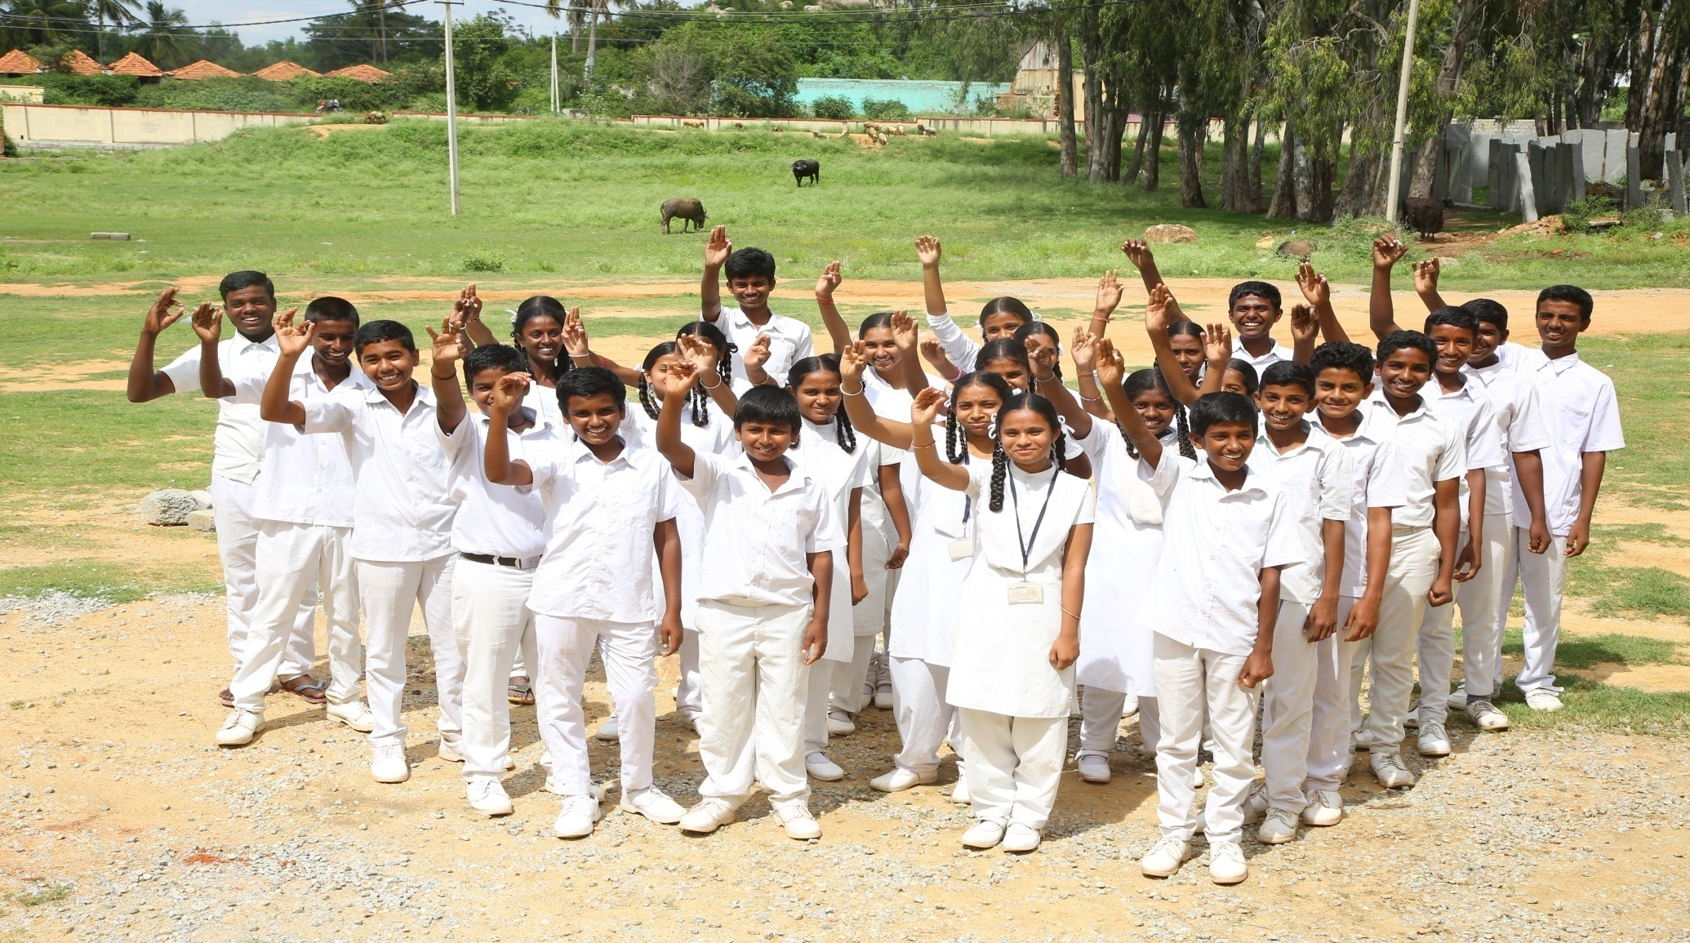
Directorate of Health And Family Welfare Services
Karnataka
THANK YOU

