Slide 1



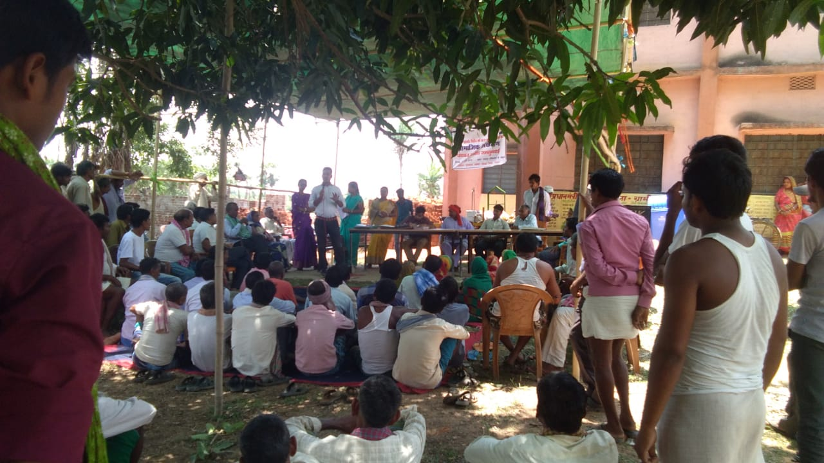

Moving miles - Resulting in improved Health Services
Community Monitoring of Health Services through Social Audit Unit in Jharkhand
By – Akay Minz (SPC-CP, NHM)
On behalf of
Secretary (Health) - Department of Health, Government of Jharkhand

Slide 2
Presentation outline
Overview about Community Action for Health (CAH) Process
Rationale for partnering with Social Audit Unit.
Partnership with Social Audit Unit
Scale of Implementation
Key field processes
Outcomes
Uniqueness
Learning and Scaling plan.

Slide 3
Overview on Community Action for Health (CAH) in state
One of the nine pioneer state, implemented Community based planning and monitoring program between year 2007 – 2009.
Three districts pilot project – Palamu, Hazaribagh and West Singhbhum.
Post pilot intervention - scale up the programme in all 24 *.
VSRC (CINI, ICCHN, NHSRC and NHM, Jharkhand) with support from State Trainer Team (STT) and Block Trainer Team (BTT) implemented the programme at village.
*Technical support from CINI

Slide 4
Rationale for partnering with SAU
Focus always centered to strengthen VHSNCs, resulting into low quality data sets from field for policy ramification and guidance.
VHSNCs members lack of clarity of their roles and responsibilities.
Limited Capacity of VHSNC member to undertake community monitoring.
To increase Competency of VHSNC member to analyze community monitoring data sets – resulting to Village Health Action Plan.
Over the period, CBM process became a routine task for VHSNC.
Instances of non judicious utilization of untied funds.

Slide 5
Partnership with Social Audit Unit
Social Audit Unit (SAU), Jharkhand is a credible organization of DoRD, Government of Jharkhand with a special understanding about auditing of different government schemes like -
NREGA, PDS/DBT, Samagra Shiksha Abhiyan, Integrated Watershed Development Mission, Swaksha Bharat Mission, Pradhan Mantry Awas Yojna (Rural and Urban), Fourteenth Finance Commission, Jharkhand Tribal Development Society’ programme, Jharkhand Schedule Caste Development Corporation’ programme etc.
It has potential to pull up the processes in a given span of time and close the loop.
To get an independent feedback on accessibility, affordability and quality of health care, that result in;
  Improved health services
  Increase in the utilization of untied funds
  Community taking center stage in decision making process, as envisaged in NHM Strategy
  State officials got a chance to make an interface with community and guide the district for corrective actions

Slide 6
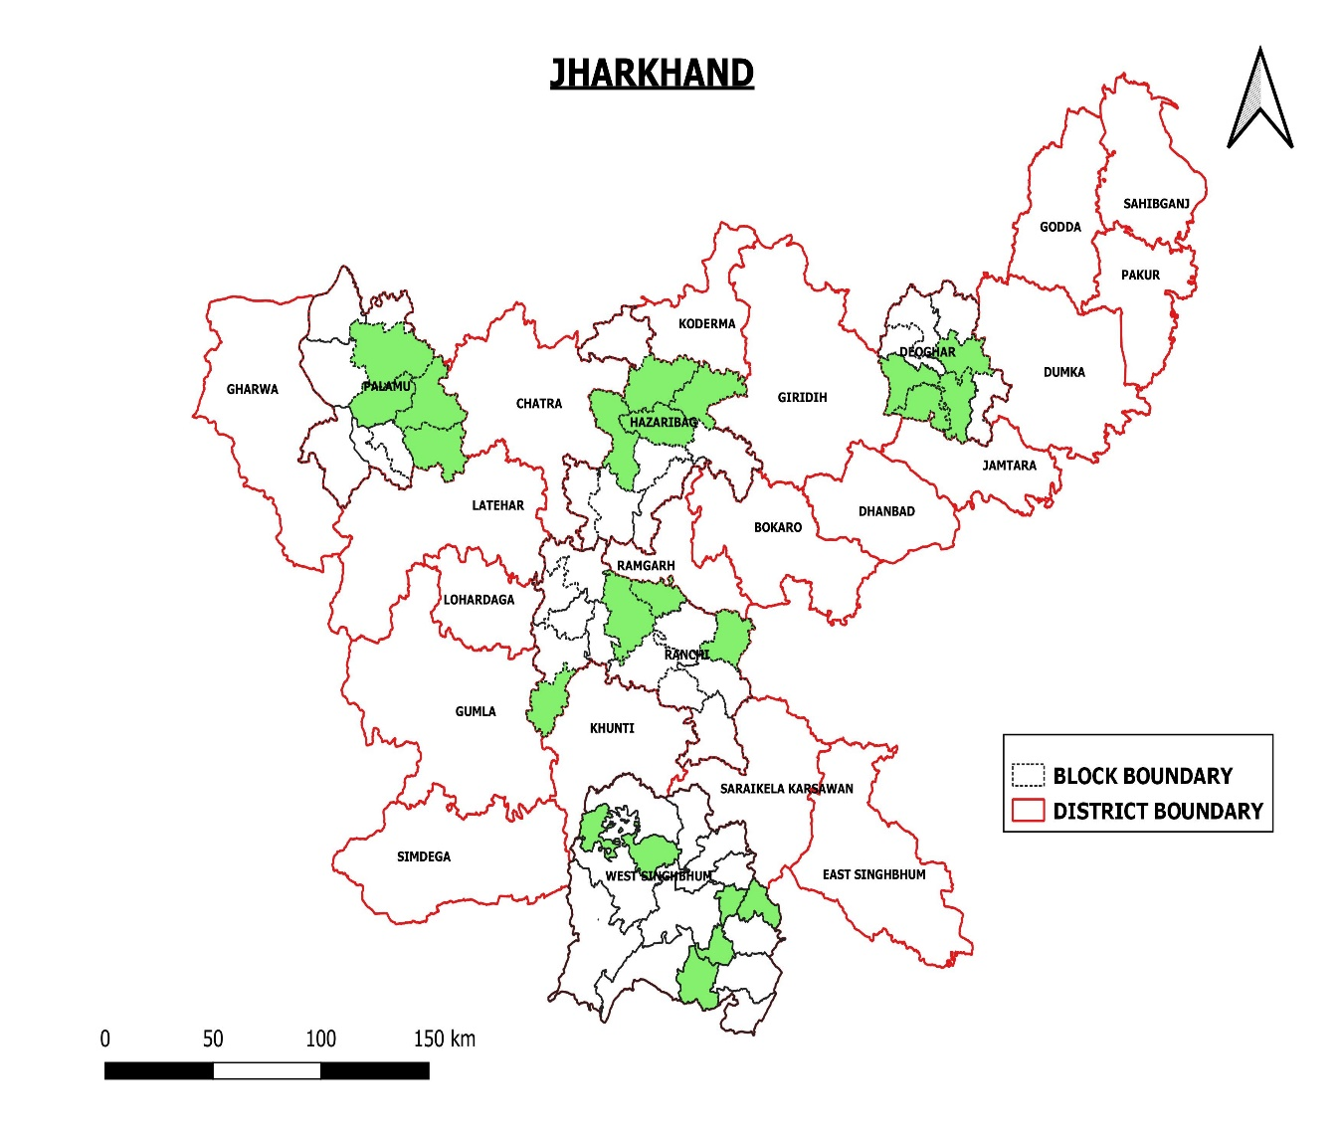
Scale of Implementation of Social Audit
4 Panchayats in each blocks -
covered total of 80 Panchayats
4 Blocks in each districts -
covered total of 20 blocks
5 Districts from each regional headquarter selected -
Ranchi,
West Singhbhum,
Deoghar,
Palamu
Hazaribagh

Slide 7
Processes followed at state level
A comprehensive toolkit developed in partnership for seeing community feedback
A pool of state/ district and village level resource persons from Social Audit Unit trained on field processes
A directive issued by NHM - authorizing SAU team for undertaking field audit of health services
Community mobilization cell of NHM, worked as an interface between DPMU and SAU – to avoid any field level problem
NHM mandated SAU to lead processes till block level and authorize DPMU to organize hearing at district level (to recreate the interest of district official towards communitization process)
Technical support from AGCA

Slide 8
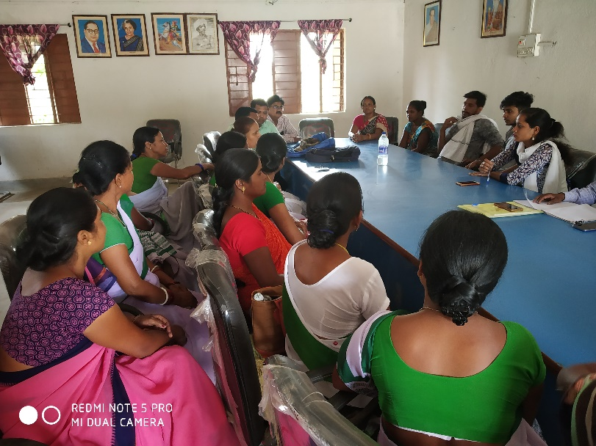
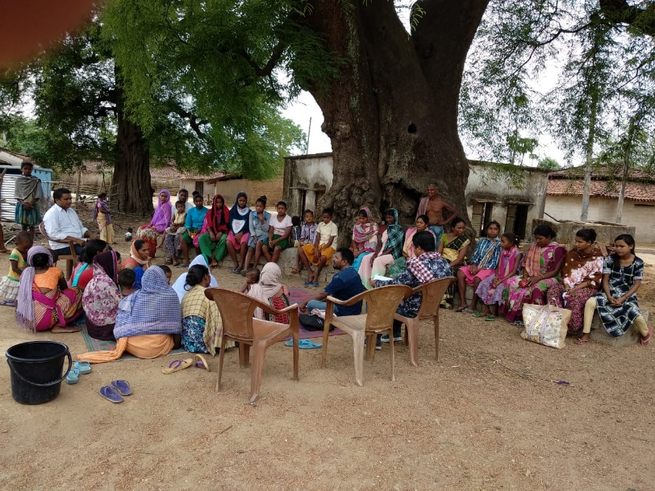
Stages followed at field
Village level
Entry Level meeting – Meeting with VHSNC member and PRI members along with general community members
Panchayat Level
Sharing of Panchayat level report cards with community members
Awareness generation on health entitlement and schemes
Community monitoring of health services based on tool – seek community feedback about their experiences

Slide 9
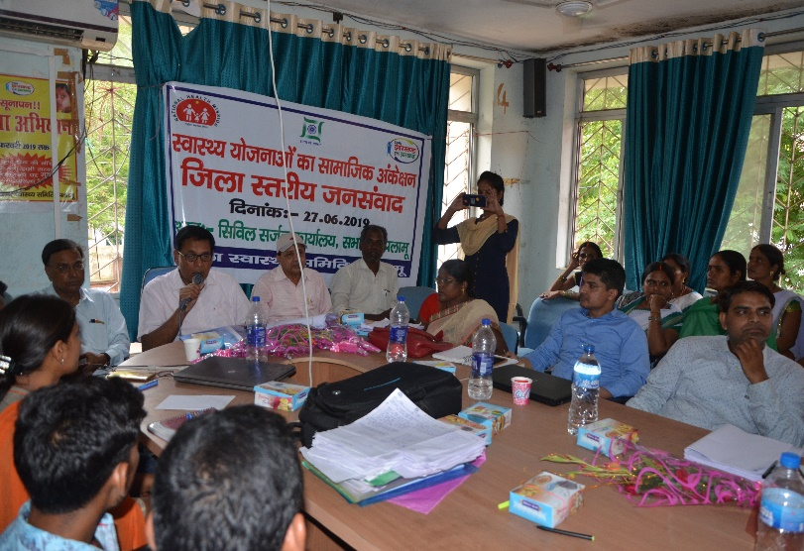
Stages followed at field
Block level
Presentation of report card at block level Jan Samwaad
District Level
Organization of Jan Samwaad at district level
Presentation of Action taken report from intervention blocks
Jan Samwaad chaired by Zila Panchayat Pramukh

Slide 10
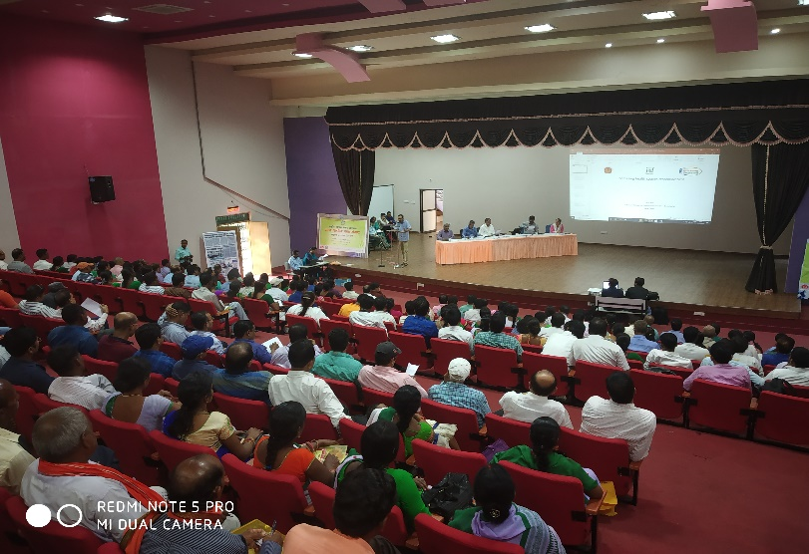
Stages followed at field
State level
Organization of Jan Samwaad at State level
Presentation of Action taken report by district officials
Jan Samwaad chaired by Secretary – Health and Mission Director, NHM

Slide 11
Outcomes from field
Field level (Till Block) | District and State level
Instances of Janani Suraksha Yojana incentives delay were paid. Delay of ASHA incentives related to National programme were cleared. Timeline defined for clearing it before 17th of every month All FRUs and DH place designated for ASHA rest room. (It become functional between twenty days of district hearing). VHSNC members have started showing greater interest and ownership in community health activity. Judicious use of RKS funds | Civil surgeon approved immediate training of ANMs for their knowledge gaps. Labor room mal-practice detected and disciplinary action has been taken. Efficient stock of IFA and Calcium tablets ensured at all facilities (PHCs/ CHCs/ FRUs) Judicious use of untied funds at VHSNCs increased State team participating at district Jan Samwaad coordinated with many line departments ( PWD, Energy). *
*Many decisions that were common to other districts – Same orders were sent

Slide 12
Uniqueness of Partnership
Panchayati Raj members have played pro- active role at all stages .
PRI members took ownership for issues raised during Panchayat and block level hearing and assured for raising the issues with concerned officials .
Zila Parishad Adhyakash chaired all District level hearing
Media was invited at all levels of public hearing to capture testimonials from field.
Total 457 village have been reached through this process and regained that trust in public health system.
Essence of the programme revived and also brings autonomy to the process holder (Community Mobilization Cell)
Timeline driven process with clear and distinctive role
Low financial implication with higher outcome
  Total cost – 9.75 lakh (3.60 lakh for state and district hearing and training and rest 6.15 lakh for Panchayat hearing and date collection given to SAU)
  Per panchayat cost – 7687/-
  Source of budget - under NHM ROP FY 2018-19

Slide 13
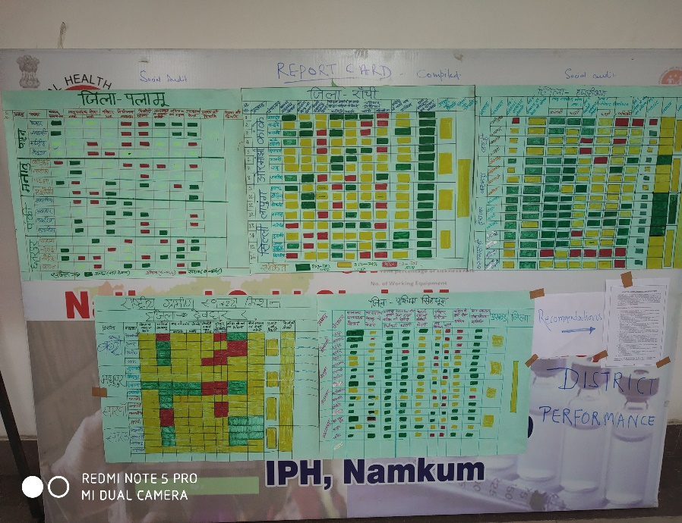
Learning and Scale up Plan
One cycle of Community Action for Health (Jan Samwad) can be completed in around 4 months period. The outcomes and findings from process would be included in state PIP planning process.
The NHM Jharkhand has planned to sustain the learning from FY 2018 – 19 through its DPMU and use the expertise and capacity of Social Audit Unit to new districts and blocks.
Joining Hands (Video from field_ process and outcome

Slide 14
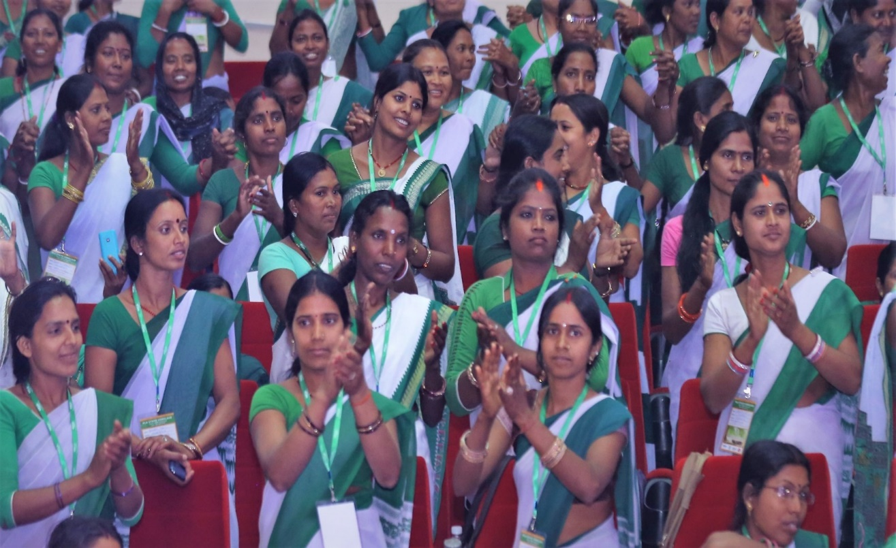
Thank you

