Slide 1
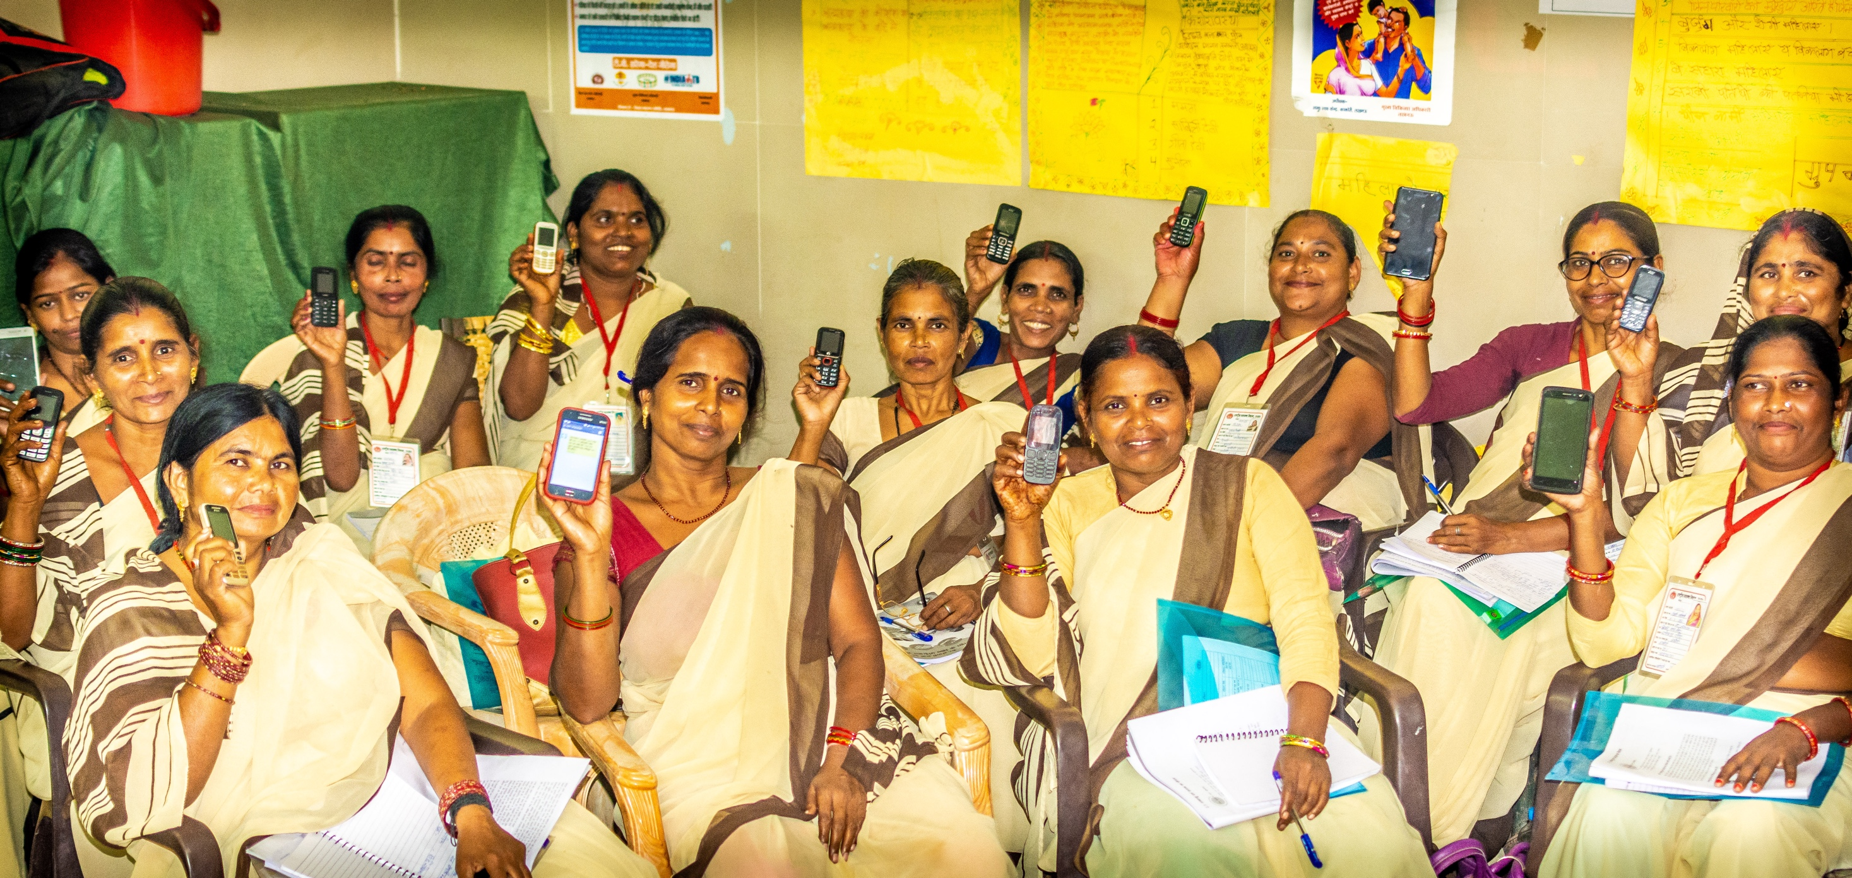

BCPM MIS :Key Objectives
Streamlining ASHA Payment in Uttar Pradesh
Ataur Rab, DGM – CP & CPHC, NHM Uttar Pradesh

Slide 2



Context and the Challenge
There are over 1.5 Lakhs ASHAs in Uttar Pradesh
ASHAs Key to improving last mile delivery of Health Services
ASHAs receive performance linked incentives
Despite improvement in payment processes for incentives, DELAYS in ASHA payments continue to be a challenge

Slide 3


Intervention
An integrated Android and Web Base tool for tracking and monitoring of ASHA and SANGINI payment and performance
WHAT IS IT
1. Reduce delays and defects in payment of incentives
2. Tracking and monitoring of head wise incentives
OBJECTIVES
3. Evidence based data for physical and financial review of programs

Slide 4
Programme Description
CP MIS
Modules
1. Mapping
2. Health Workers Profile
Web
Android
Analytica
Dashboard
3. ASHA Payment
4. Sangini Payment
https://nhm-bcpm.in/
Google App Store
https://t-analytica.org/
5. Monthly Reports
# https://play.google.com/store/apps/details?id=com.bcpm_app&hl=en_IN

Slide 5
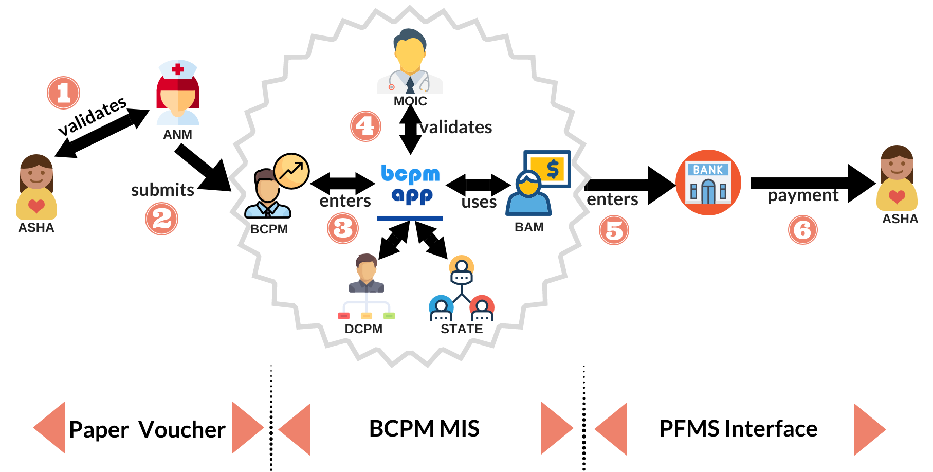
Programme Description
ASHA Payment Process Flow

Slide 6





Steps and Timeline in the Payment Process
ANM approved ASHA vouchers submitted to BCPM: 20th of month
BCPM enter submitted vouchers digitally into MIS: 25th of the month
MOIC approves voucher on MIS: 28th of the month
BAM pays using PFMS compatible excel sheets: 5th of next month
ASHA receive head wise payment status SMS at all stages of payments

Slide 7
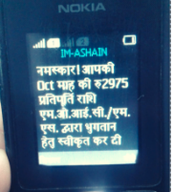
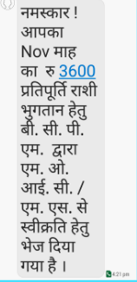
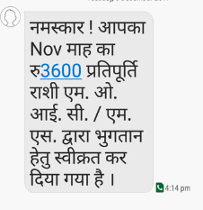
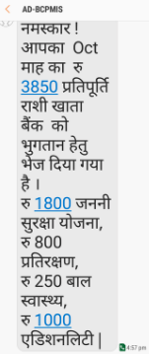
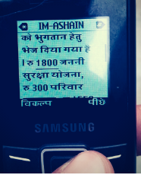
ASHA/Sangini Payment Status SMS
BCPM Submits
MOIC Approves
BAM Pays

Slide 8

Programme Outcome
Increased accountability and transparency in incentive payments
Motivated and empowered ASHAS and SANGINIS
90% of ASHAs are paid incentives by 5th of the following months
67% Non functional ASHAs have been reintegrated into the program
35% is the year on year increase in ASHA monthly incentives
‘ANALYTICA’ has enabled Strategic use of Data for physical and financial review and monitoring at state, division, district, and block level

Slide 9
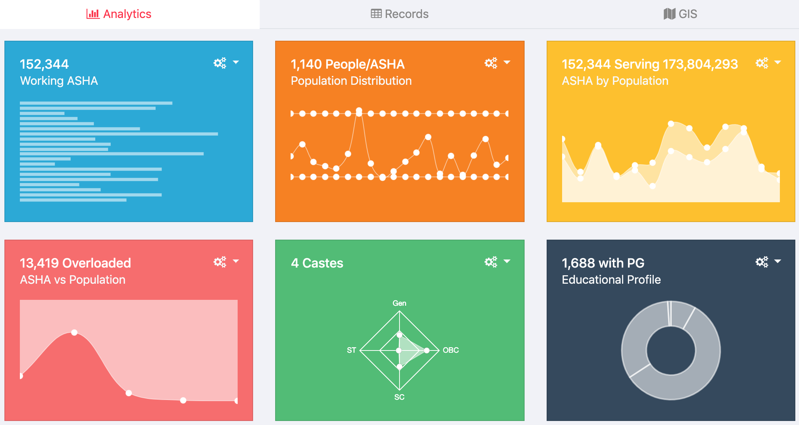
Analytica: Data into Information to Insight

Slide 10
Way Forward
Scaled up in all 820 blocks
Planned for scale up to urban ASHAs
Testimonial Video

Slide 11

THANK YOU!

