Slide 1



‘Akshaya Keralam’- TB Services at doorsteps during COVID pandemic
Team Kerala Health

Slide 2
Kerala- Setting
Population : 34.1 Million
I M R : 7 /1000 live births
Female Literacy Rate : 92.07 %
Systematic Primary Healthcare network (1 ASHA for 1000, 2 MPHW for 5000 population, 1 PHC for 25000 population, Nearly 100% Vacancies filled)
Strong Local Self Government System
‘Kudumbasree’- Women Empowerment Project
TB Elimination Program
Well integrated with the primary health care systems
Additional Structures Built for TB Elimination
District TB Elimination Board
LSG TB Elimination Task Forces
STEPS (System for TB Elimination in Private Sector)

Slide 3
Presumptive TB Examination rate Vs Total patients diagnosed under RNTCP (per 100000) - Kerala
High case finding efforts
  Increasing @ 7.5% annually
Low case notification
  Declining @ 3% annually
  Private sector drugs sales declining @10% annually

Slide 4
Objective
Government of Kerala has launched “Kerala TB elimination mission” aligning with the Sustainable Development Goals, with objectives to
Achieve TB Elimination by 2025
Zero preventable deaths due to tuberculosis in the state
Zero catastrophic expenditure for the families due to TB
Zero Stigma & Discrimination due to TB

Slide 5
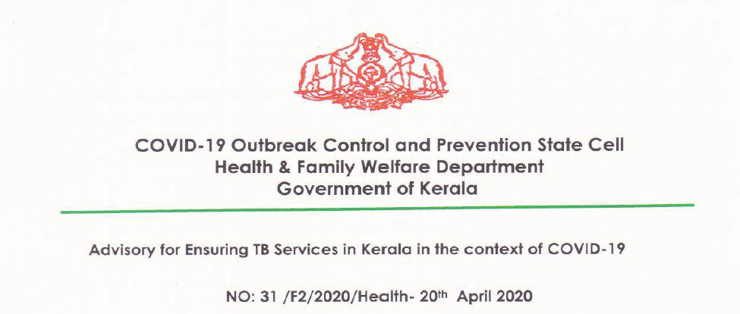
Actions taken to Mitigate impact of COVID on TB services
Medicines delivered at door steps
Medicines for Comorbidity delivered at door steps to TB patients
Telehealth Help line started at all districts
Telephonic follow up of every TB cases biweekly
District level Clinical Expert Committee set up
IEC through Social Medias
Constant reviews and trouble shootings
Best Practise documentation and facilitation of cross learnings

Slide 6
Trend Total TB Notification- Kerala (2020 Vs 2019)
Review in August revealed that, TB Case finding was affected due to COVID

Slide 7
Causal Analysis & Identified solutions to find out missed TB cases
Challenges | Solutions
People are afraid to come to hospitals/ can’t come to hospital due to transportation issues leading to delay in diagnosis | Deliver diagnostic services at door steps. A field based system for Case Finding
Decreased confidence in performing TB tests for peripheral health staff | Biosafety enhancements of laboratories
Stigma to ‘Cough’ and people are afraid to ‘cough’ | Strong ACSM campaign – Provider oriented & People Oriented
Health System preoccupied with COVID | Integrated Approach – RCH, NCD, CD control

Slide 8
System 1: Specimen Collection & Transportation
Robust specimen collection & Transportation system
Subcentre to BSL labs
(Hub & Spoke Model)
Collection Box, Sanitising mechanism, SOP
Training for collection, packing, Transport
SC 1
PHC 2
SC 2
PHC 1
PHC 3
Truenat Lab at TU
SC 3
District Hub
CDST Lab

Slide 9
Systems 2 : Molecular Tests & Biosafety Enhancements
 | Public Sector | Private Sector
Xpert (CB NAAT) | 36 (12 additional machines purchased) | 24
Truenat | 75 (20 additional machines purchased) | 52
All machines in public sector are equipped with biosafety cabinets

Slide 10
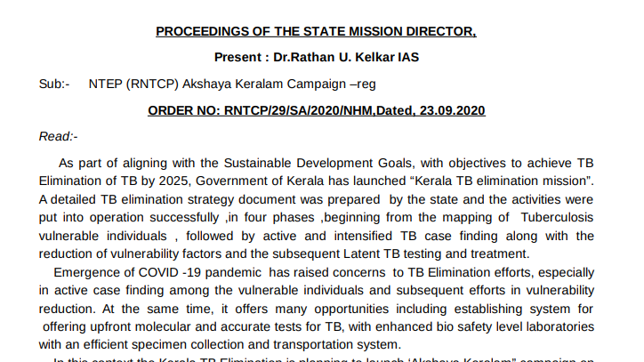
Catch Up Campaign – October-November 2020
Case Finding at the house of Vulnerable Individuals (database of individuals vulnerable to develop TB are available with the program)
Case Finding among elderly/palliative care patients
Case finding at Old age homes/ Destitute
Screening for TB among ILI/SARI cases
Offered Upfront Molecular tests

Slide 11
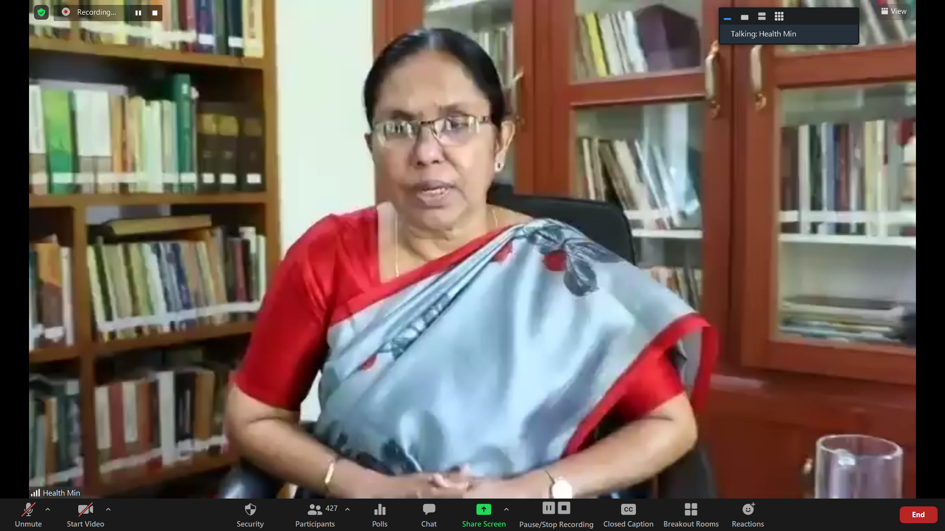
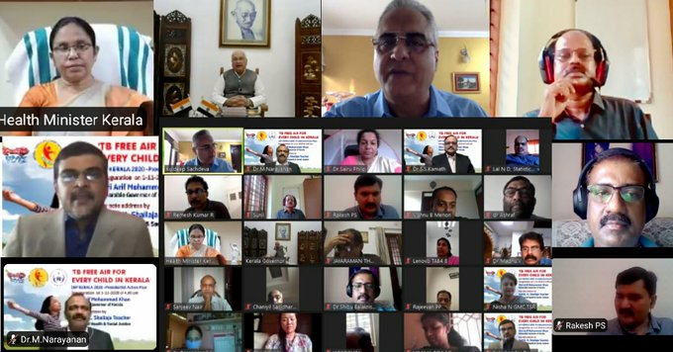
Political & Administrative Commitment
October 2, 2020
Nov 1, 2020

Slide 12
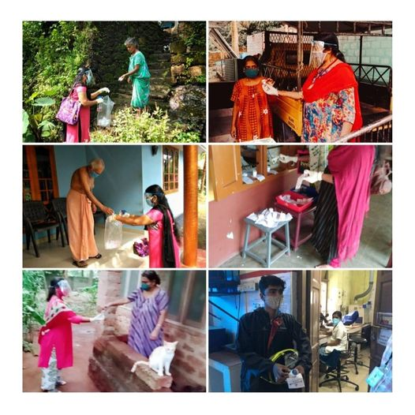
Motivated ASHAs & Primary Care Team visited the houses of vulnerable individuals and did TB Case Finding
Specific customised Guidelines prepared for transportation of specimens from home.

Slide 13
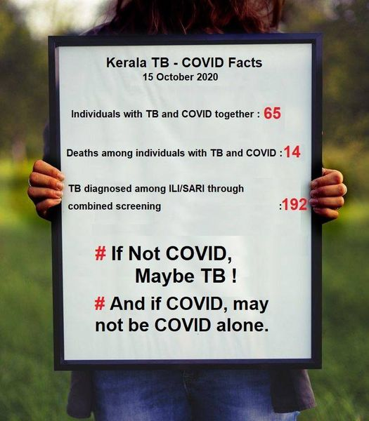
Targeted ACSM to find out missed TB cases
Provider Oriented IECs
Theme Songs
5 Padmasri Awardees
10 Celebrities
AKSHAYA KERALAM Award to LSGs
Private Hospital Consortiums
Leaders of Professional Medical Associations
TB Survivor’s advocacy
Other Sectors- AYUSH, ESI, CGHS
Social Media Campaign

Slide 14
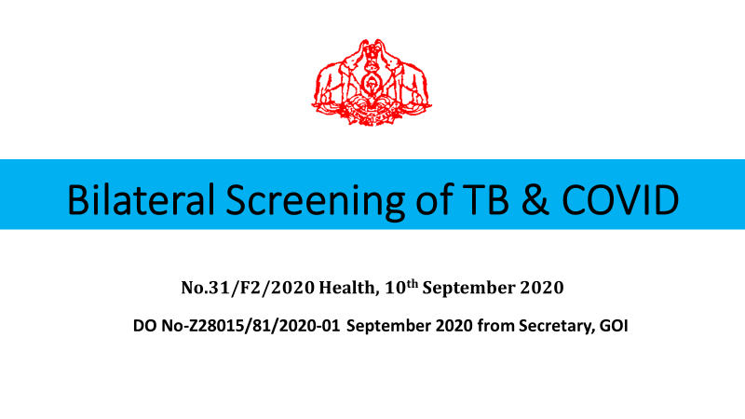
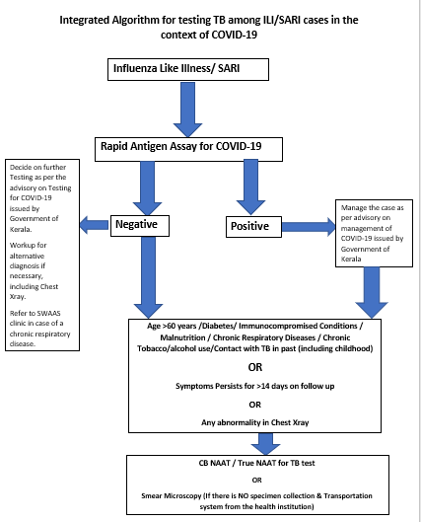

Slide 15
TB-COVID Facts- Kerala
Individuals with TB & COVID together - 174
Deaths among TB-COVID - 26
TB detected through ILI/SARI through - 207
Combined screening with COVID
Data as on Dec10, 2020

Slide 16
Summary of Active Case Finding
District | Eligible for screening | Actually screened | PTB identified | Tested for TB | Diagnosed as TB
Alappuzha | 86881 | 10990 | 1740 | 1479 | 64
Ernakulam | 65962 | 37765 | 1303 | 1115 | 79
Idukki | 58207 | 49239 | 3397 | 2571 | 40
Kasaragod | 28863 | 10685 | 2443 | 2076 | 129
Kollam | 106188 | 44956 | 1913 | 1234 | 42
Kottayam | 171767 | 156519 | 472 | 290 | 4
Kozhikode | 89047 | 71803 | 3844 | 2488 | 24
Malappuram | 95163 | 79983 | 3188 | 2953 | 85
Palakkad | 73198 | 12251 | 1652 | 1591 | 22
Pathanamthitta | 45235 | 19532 | 2394 | 1897 | 120
Thrissur | 130813 | 75621 | 5408 | 5052 | 32
Trivandrum | 119226 | 57480 | 7461 | 4099 | 47
Wayanad | 43508 | 1572 | 1145 | 1145 | 95
Kannur | 56976 | 33074 | 1325 | 1176 | 19
Kerala | 1171034 | 661470 | 37685 | 29166 | 802

Slide 17
Results of Active Case Finding/Intensified Case Finding as part of catch Up campaign
Category | Mapped for Screening/ Universe | Actually screened | Presumptive TB identified | Tested for TB | Diagnosed as TB | Test Positivity Rate
Individuals with High Vulnerability to develop TB (Vulnerability Mapping) | 976147 | 537371 | 30900 | 23585 | 610 | 2.6
Palliative Care/Bedridden | 132800 | 66156 | 1753 | 1066 | 37 | 3.5
Elderly at old age homes | 19494 | 15350 | 1743 | 1226 | 25 | 2
ILI | 36417 | 34417 | 2437 | 2437 | 69 | 2.8
SARI | 6176 | 6176 | 852 | 852 | 61 | 7.2

Slide 18
Presumptive TB Examination & Microbiologically Confirmed TB – November 2019& November 2020
10 out of 14 districts had diagnosed same number of TB cases in November 2020 as compared to November 2019

Slide 19
Comparison of Data- 2019 & 2020 -NIKSHAY
 | 2019 | 2020
TB Notification | 25614 | 21206 (82%)
UDST | 58% | 63%
Aware of HIV status | 87% | 91%
Contact Tracing | 61% | 85%
Lost to Follow Up (Jan-June) | 2 % | 2 %

Slide 20
Summary
COVID had impacted early finding of TB cases
Through meticulous planning including (1) causal analysis and establishment of systems (2) highest political and administrative commitment (3) locally customised guidelines (4) increasing efficiency of testing (5) integration with other programs (6) sustained motivation to staff at field, (7) supportive supervision and motivation- the state was able to find 82% of cases as compared to previous year.
Through delivering services at doorsteps through a robust primary healthcare system, no interruption to treatment, public health actions or increased mortality among TB patients occurred.

