Slide 1
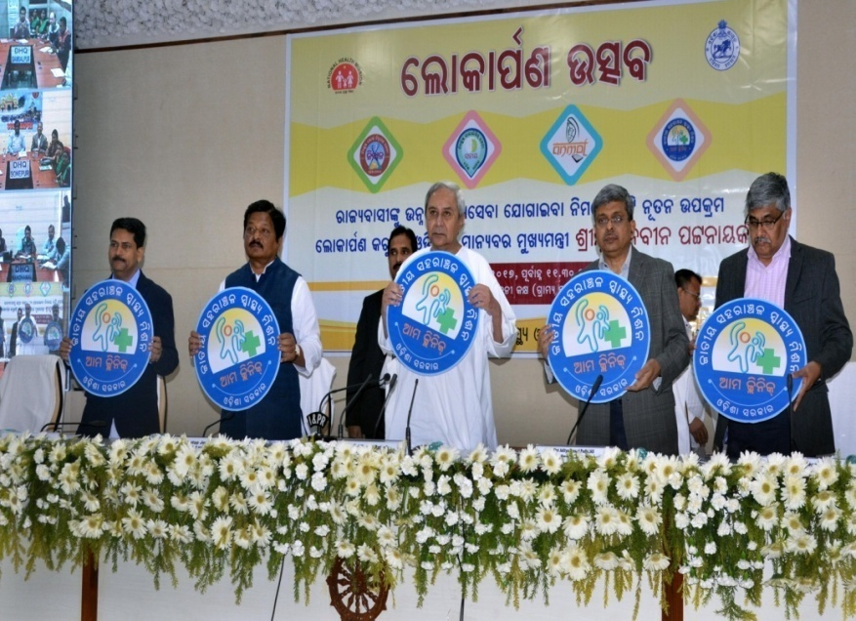



Ama Clinic: Our Clinic …
Providing Comprehensive health care at UPHCs through engagement of Specialists
Presented by
Mrunal Kanti Das, OAS
Addl. Mission Director, NHM, Odisha
AMA Clinic
Launched by Hon’ble CM-Odisha : 19th Dec 17

Slide 2
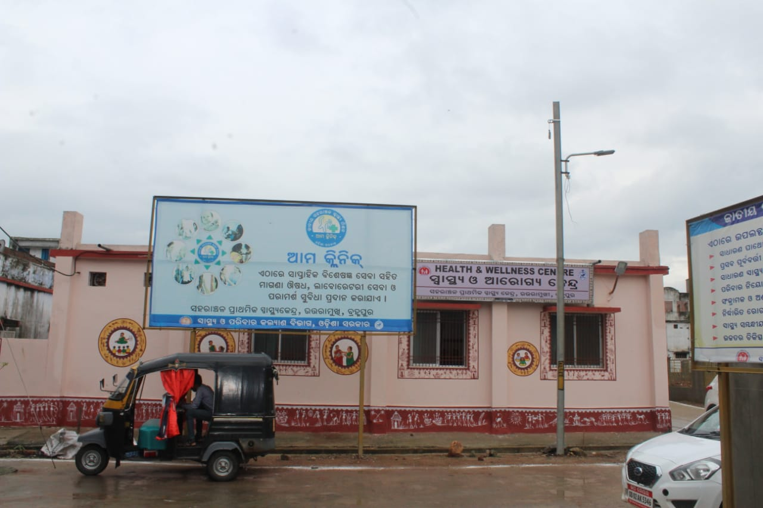
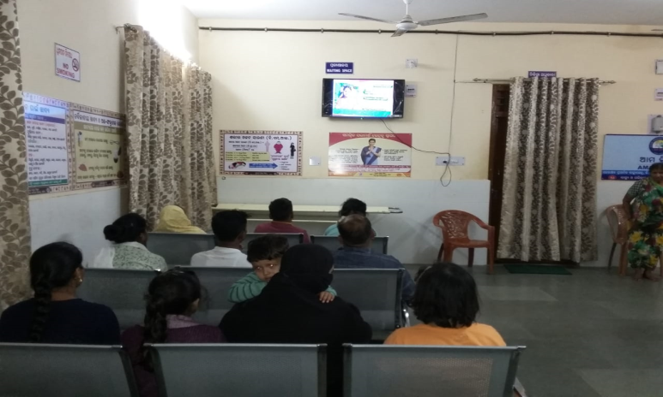
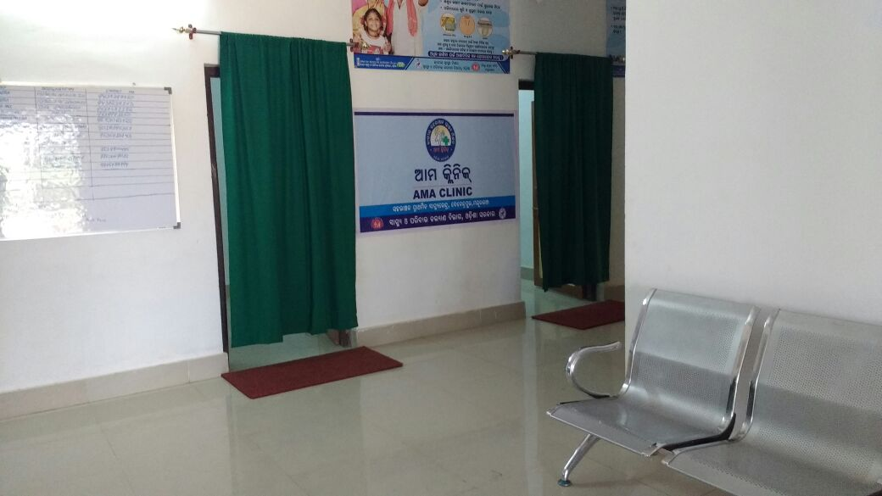
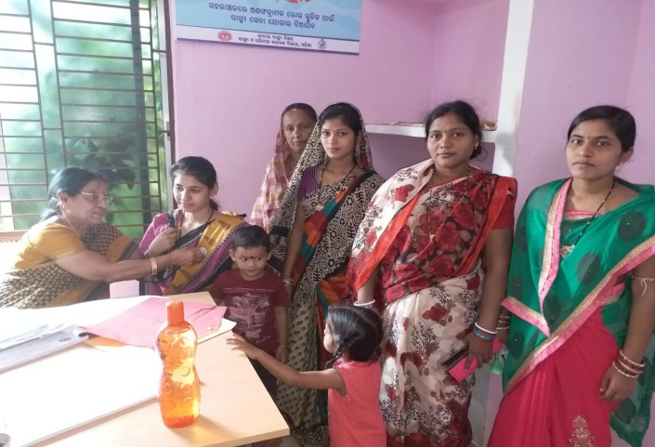
Ama Clinic At Urban PHC : CPHC ++
Provisioning of Specialist Services (on a designated Day of a Week)
Conducting screening of Critical illness & Medicines
Decongestion of Caseload (District/City Hospitals /Medical Colleges)
Provision for more inclusive choice of drugs (as per EDL)
Saving time & reducing distance
Schedule f Spl.services
Branding of Ama Clinic
Waiting space
Ama Clinic
O&G Services at Ama Clinic

Slide 3
PACKAGES OF SPECIALIST SERVICES
Ama
Clinic
Paediatric
Psychiatric
Geriatric
Physiotherapy
Vision
Sradhha Clinic
Nutrition
O&G
Day | Specialist services
Monday | O & G specialist
Tuesday | Nutritionist Physiotherapist services
Wednesday | Pediatric specialist
Thursday | Medicine/Geriatric specialist Physiotherapist services
Friday | Skin-VD /Dental / Eye/ ENT
Saturday | Psychiatric specialist Adolescent counseling Physiotherapist services
Vary from facility to facility

Slide 4


How we moved on … (Since Dec,2017)
Operational Guidelines (State specific)
EOI at city/district level for selection of specialists
Monitoring & reporting
Empanelment of specialists
Orientation for the specialist
Procurement of equipment/ furniture, drugs
Branding of the institutions
Communication plan
Service Provision

Slide 5
Patient trend
Specialist availability
Specialist from various sources

Slide 6

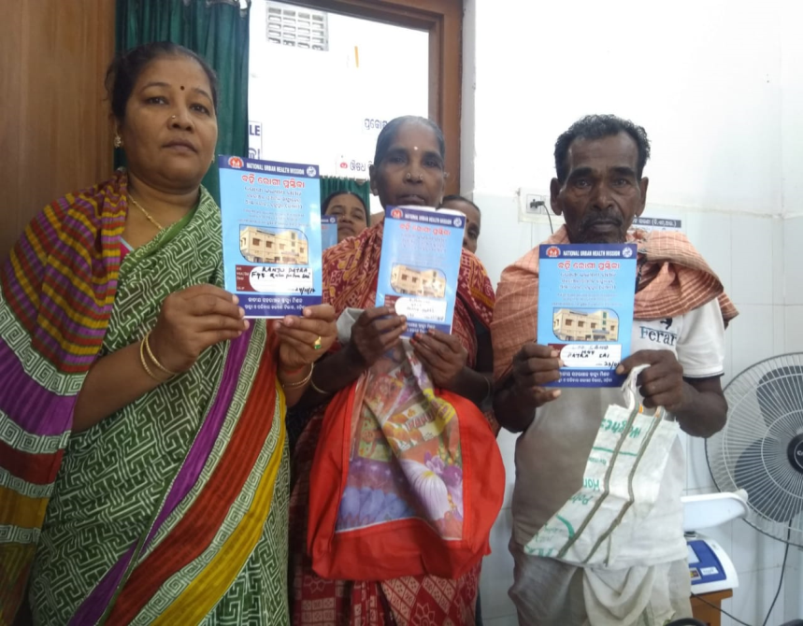
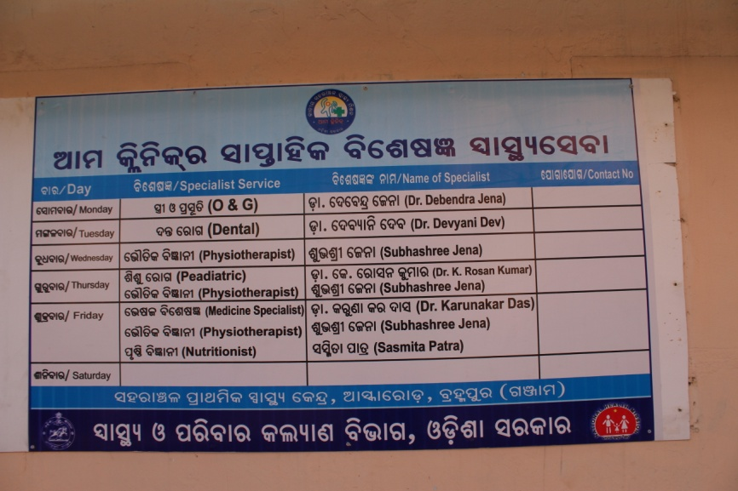
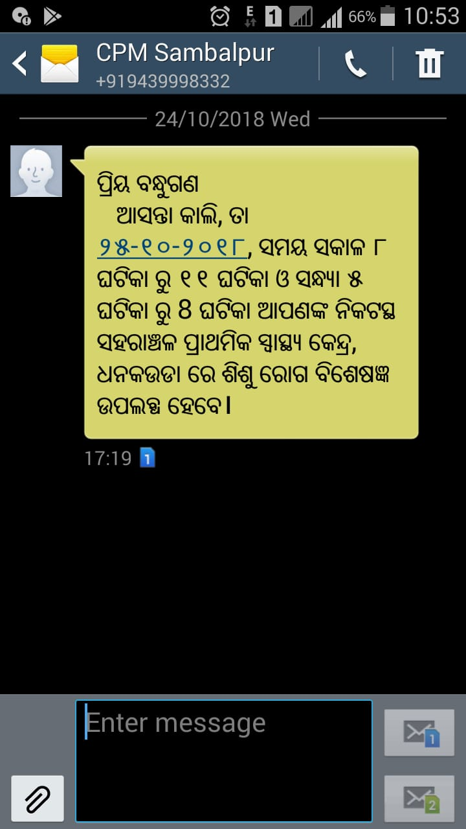
Communication strategies ….
Schedule of Spl.services
Health card for the patient
Branding of the services
Used electronic & print media
102 large/1215 small hoardings installed for different cities/towns
Branding of health facility
Sensitization of Ward Kalyan Samiti, MAS, ASHAs & Community
SMS Alert to the patient/MAS on Service availability on the roll
SMS alert in Odia language

Slide 7

Financial Implications ….
Direct :
Rs. 1250/-per session ( 3 hours) & two sessions per day
No cost towards specialist from DHH/ Medical Colleges
Monthly payment to the specialist (as per claim sheet) through DBT( Direct BeneficiaryTransfer )
Indirect :
Branding & Media Communication
Equipment

Slide 8

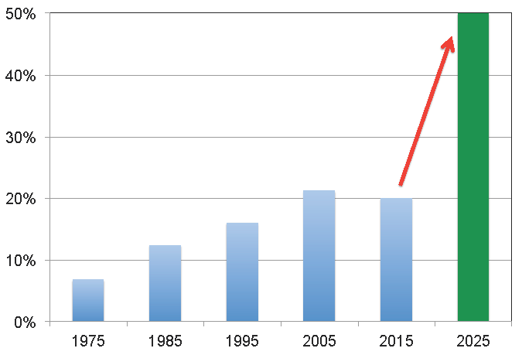
Monitoring & Reporting Mechanism
Separate OPD register for each services
Biometric attendance
RKS and QI committee level review meeting
Patient satisfaction format
Facility Level
Monthly review meeting
Monthly progress report
Field monitoring by CPMU/DPMU
City Level
Quarterly review at State level
Monitoring visit by State official/SIMT
State NUHM Level

Slide 9
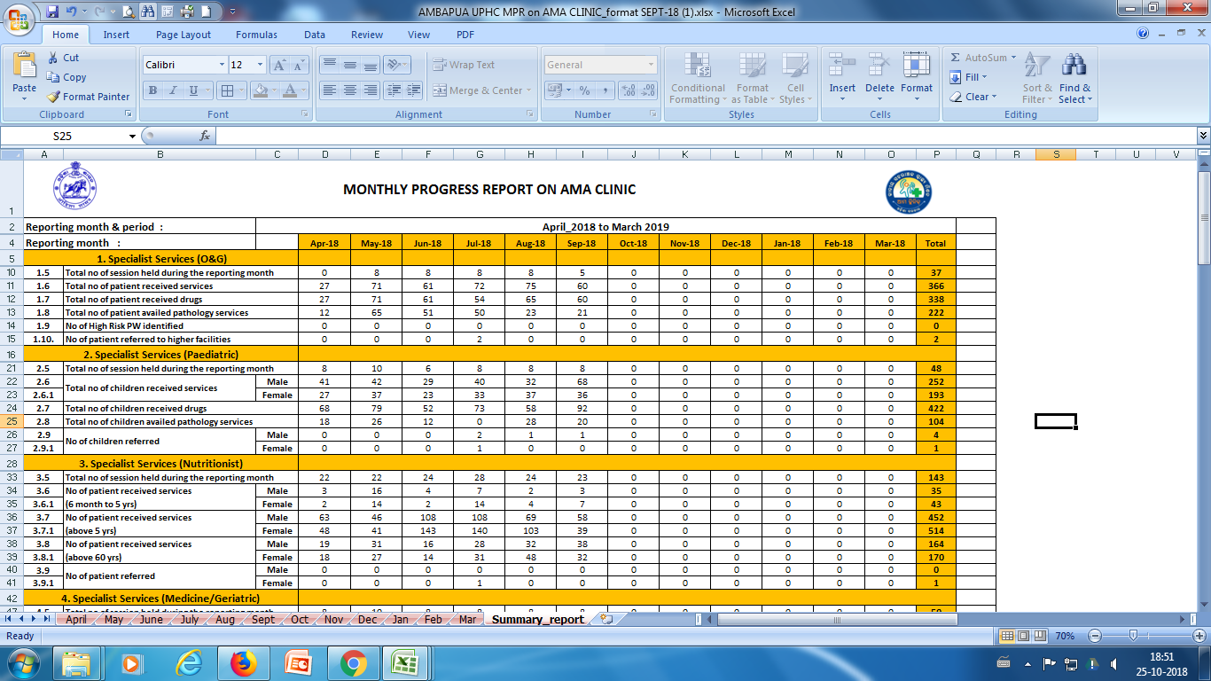
AMA clinic MPR
Reporting flow
Facility Level
Feedback
Report
City Level
Feedback
Report
State NUHM Level

Slide 10
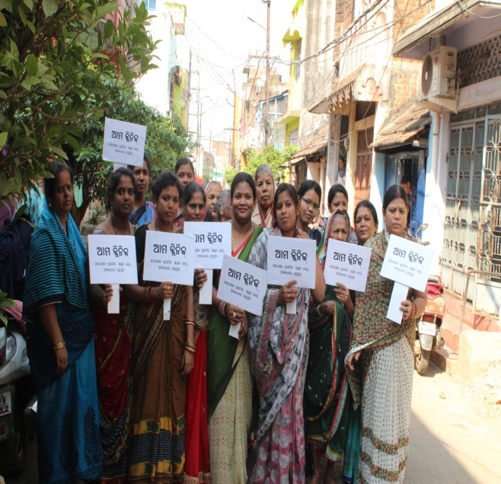
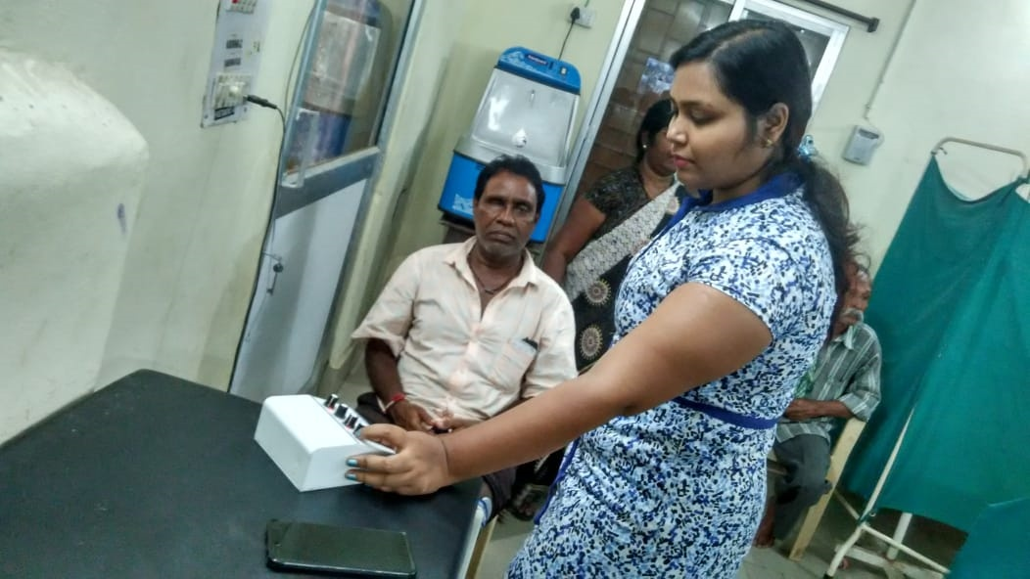
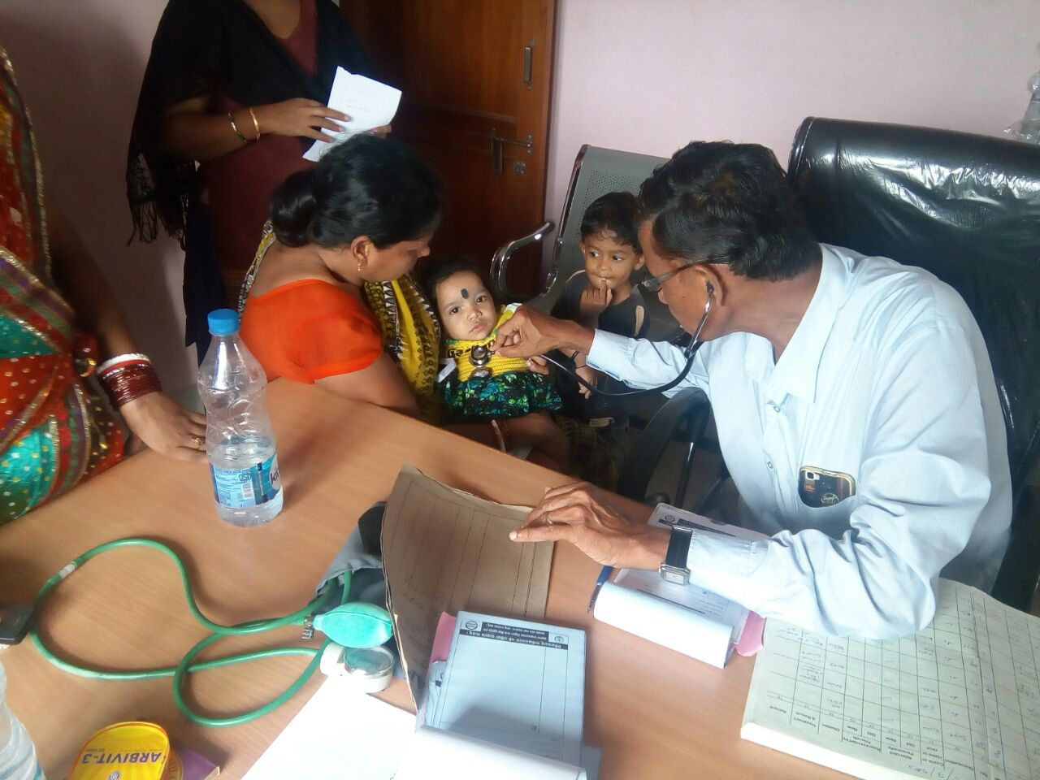
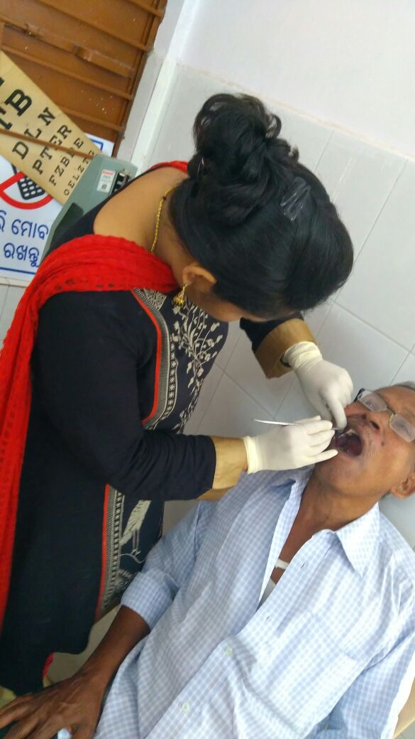
Program outcomes …
Community awareness
Physiotherapy services
Paed. Services at Ama Clinic
Increased Awareness of community on AMA Clinic
73 UPHCs (Out of 87) of Odisha providing specialist services under AMA clinic
Increased Patient flow (3,16,105 patients received services: Dec,2017-Sept,2018) leading to reduced Out of pocket expenditure
Monthly Average patient receiving services is 31,611 ( 73 UPHCs) (361 patients per facility per month)
Dental Services at Ama Clinic

Slide 11
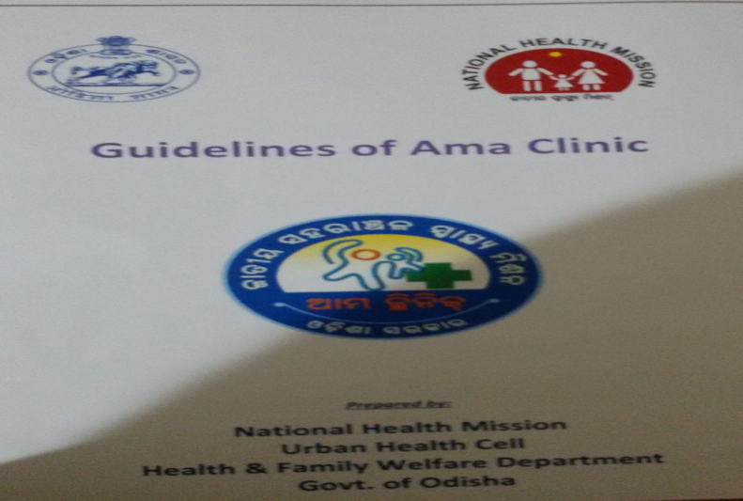
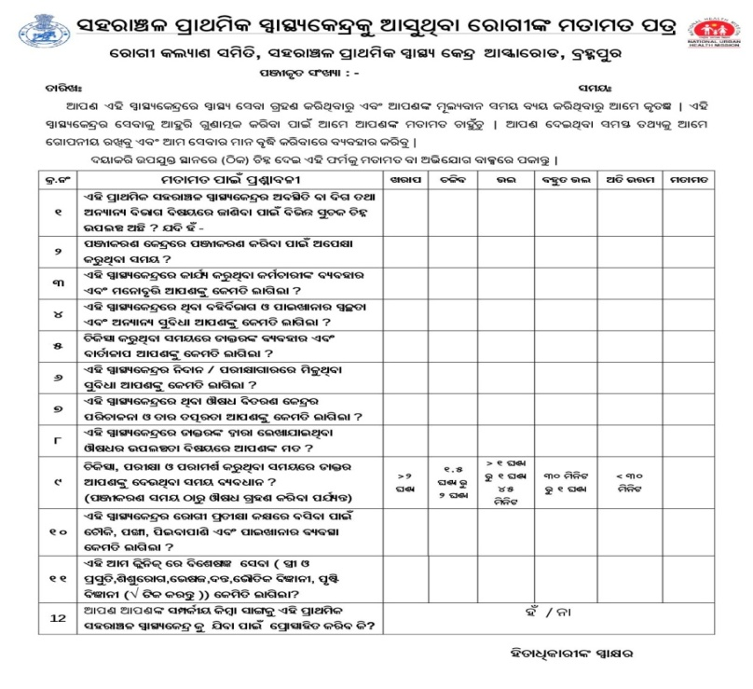
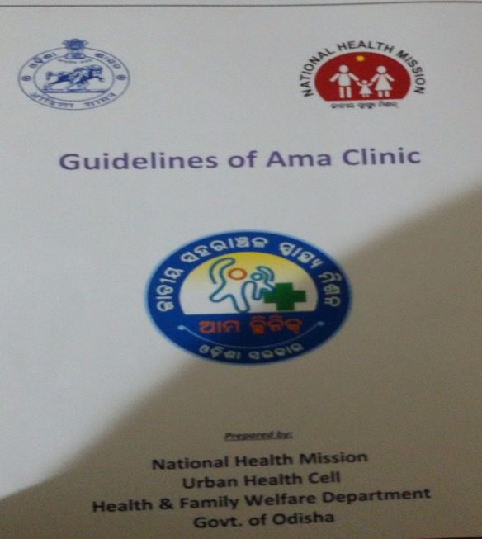
Areas to be considered for Replication…
May refer the guidelines of NUHM, Odisha
Start with a few facilities (Pilot mode)
Mobilization of private practitioners & Govt. doctors for weekly specialist services
Specific Communication plan for Demand generation
Monitoring & feedback mechanism (Progress & achievement)
Patient satisfaction survey
Utilization of fund under NUHM
Patient feedback form

Slide 12
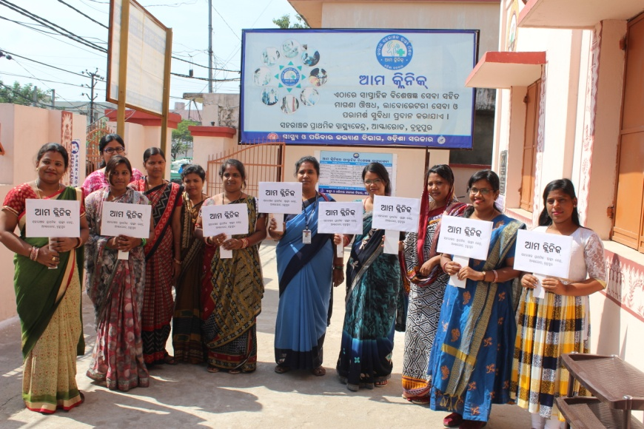
Thanks

