Slide 1

Auxiliary Nurse Midwife On-Line (ANMOL)
Best Practice in Andhra Pradesh
Principal Secretary, HM&FW Department
&
Mission Director, National Health Mission,
Govt of Andhra Pradesh

Slide 2
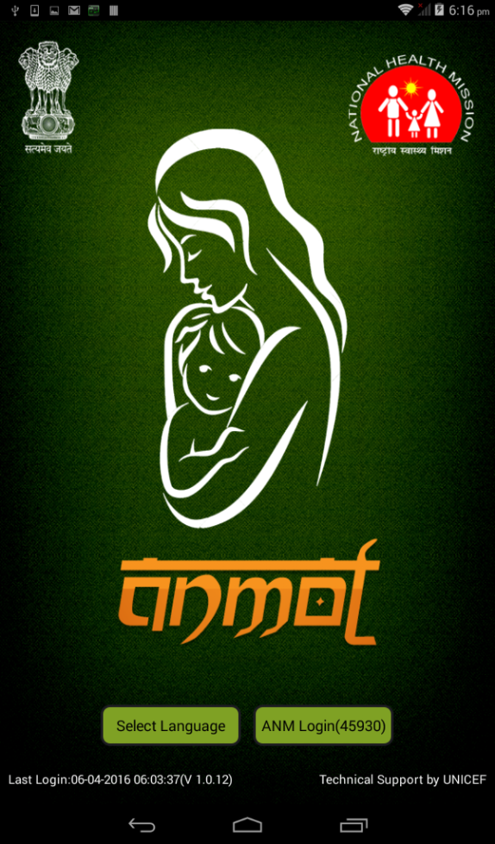
ANMOL - Auxiliary Nurse Midwife Online
(TABLET APPLICATION OF RCH APPLICATION)
MCTS application - upgraded as RCH application - early identification and tracking of beneficiary - throughout the reproductive lifecycle.
RCH application helps in tracking of beneficiary for proper health care and promote family planning methods being adopted by them.
Facilitates - timely delivery of antenatal, postnatal & delivery services
Tracks children for complete immunization services including AEFI.
RCH portal – designed to meet the requirements of the RMNCH program - incorporating additional functionality and features of the MCTS.

Slide 3
WHY RCH APPLICATION?
PARAMETER | MCTS | RCH
ANTI NATAL CHECKUP | Only Date of Visit was Captured | Urine Test Blood Sugar Foetal Heart Rate Fundal Height | Weight Blood Pressure Haemoglobin
DELIVERY | Only Date of Visit was Captured | Date / Place / Who / Type Complication Live birth / Still Birth | Full term/ pre term Baby cried / Breast Feeding Birth Dose
POST NATAL CHECKUP | Only Date of Visit was Captured | IFA Tablets Danger Sign | Infant Death Cause/Place
IMMUNIZATION | Only Date of Visit was Captured | Date as per the scheduled is captured Vaccination | Adverse Events Exclusive Breast Feeding Complementary Feeding

Slide 4
RCH application process flow
Simplest way
One time
activity
RCH Id
Child Id
Village
Profile
Eligible
Couple
Pregnant
Women
Children
Pregnancy +ve
Delivery outcome
Full immunization

Slide 5

RCH Application
Major advantages over MCTS
No re-registration of PW | Once a beneficiary is registered as a Eligible couple. The RCH id no. of woman will remain the same throughout her span of reproductive period up to the age of 49 Years
Village level registration | Village level registration helps in capturing real-time data of beneficiaries
Inter State Migration | RCH Application has 12 Digits out of which 9 digits are running numbers which are accessible through the State / UT’s removing the need of migration in and migration out
Better Work plan | Each work plan would be generated with Work plan ID, provisioning DEO to update all beneficiaries in a single click.
Dynamic & Analytic Reports | RCH portal has the provision of dynamic & Analytic reports providing an ease of access and insights of data
Cloud based solution | The cloud based solution will increase the flexibility, security, scalability and speed of the RCH application

Slide 6
Salient Features of ANMOL
FEATURE | ADVANTAGE
Aadhaar Enabled | Scan the QR code of Aadhaar card to register the beneficiary
Offline | Works in online & offline mode. Data gets auto sync to server whenever internet connectivity is available.
Dashboard | Ready available- Registration & service delivery status for Family Planning, ANC, Deliveries, PNC, Immunization, Critical Indicator and KPI fact sheet etc.
RCH register | On the fly generates - RCH register, EC register, PW register, ANC, Delivery & PNC register, High Risk register, Severe Anaemic register, Child Immunization, LBW child register etc.
VHND | On selection of date and place generates - VHND due list, Logistic planning and Logistic used
Counselling | Empowers ANM with Video & Audio Counselling, E Book, e Tutorials, User Manual, Case focused counselling.
Work-plan | Sub centre wise, village wise, Service wise, ANM wise, ASHA wise, Beneficiary wise, High Risk PW wise, LBW child wise
Update | Two way transaction details from TAB to Server both successful and failed
Connect | Directly connects to beneficiary through Voice, SMS and can share counselling Audio/video

Slide 7
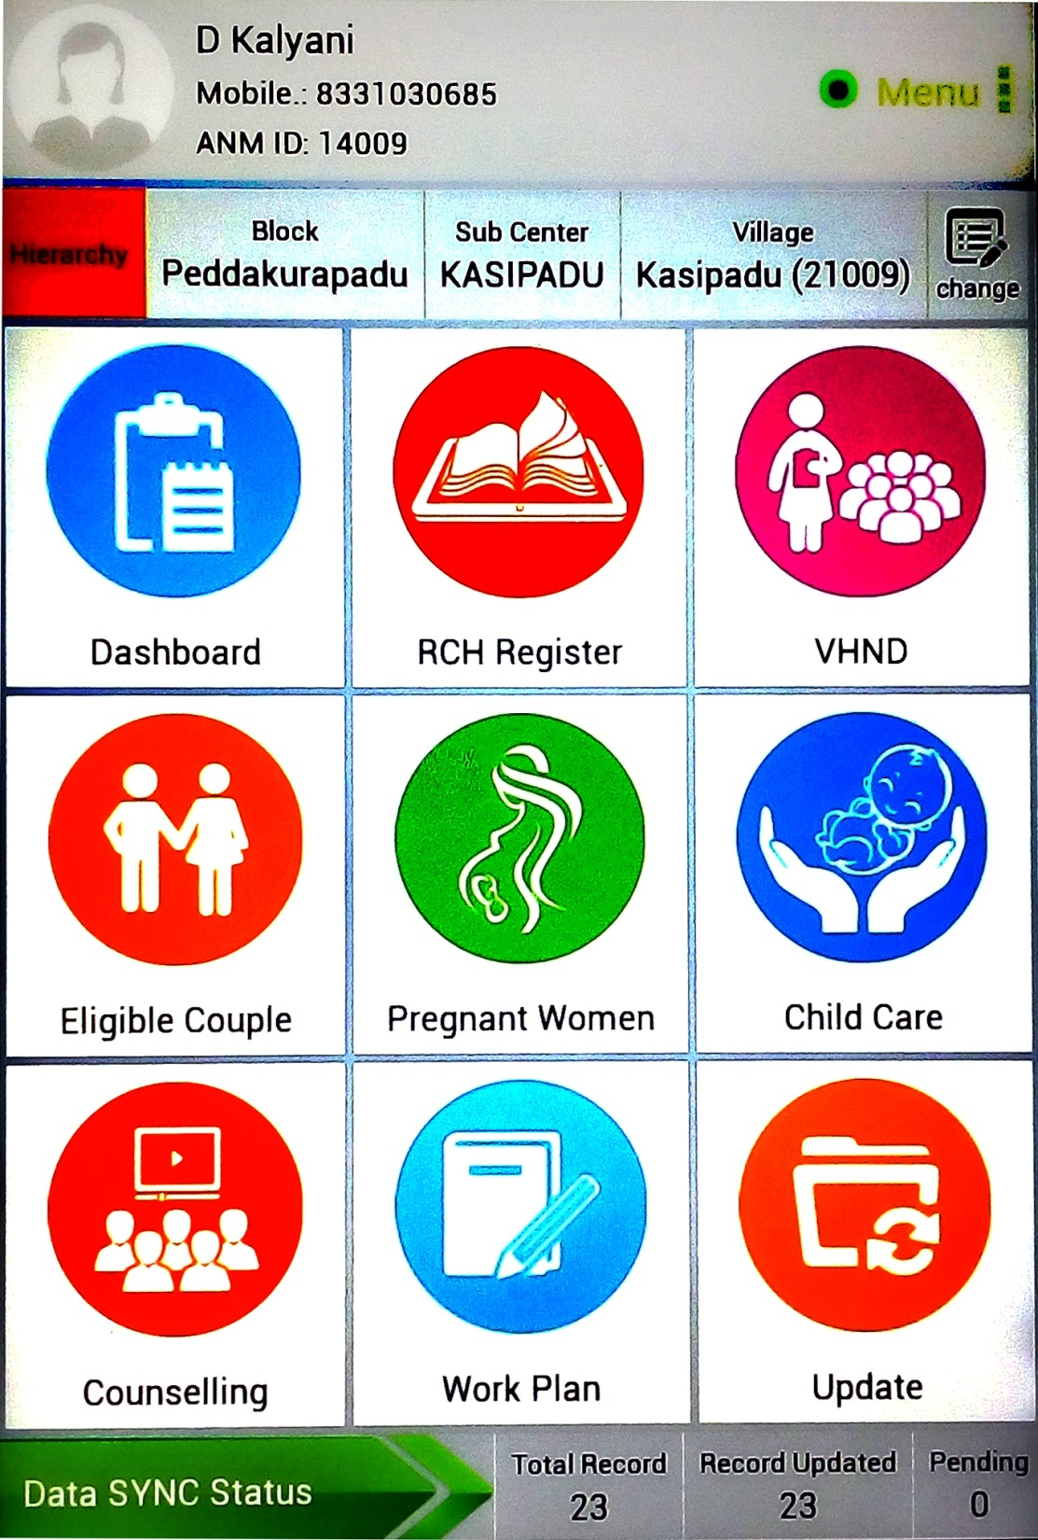
ANM Details
Internet Connectivity
Hierarchy
Count Based Details
Indent Logistic
ANMOL FEATURES
ANM
Data entry
Video & Audio
Upload Data from Tab to Portal & Software Update
Pending & Current Work list
Data Upload status

Slide 8
Implementation of ANMOL in Andhra Pradesh
Implementation
Pilot Training Phase – 1st Feb to 6th Feb 2016
Training in 2 districts (Krishna & Guntur) 31 Block officials | 166 MOIC | 1868 ANM
Pilot implementation - By 28th Feb 2016
More than 134 Issues and requirements from fields were addressed and stable version of Anmol 1.0.12 was released
User Acceptance Test – By 2nd March 2016
UAT by 29 ANM’s was taken
Rollout Phase – 14th March to 29th March
Live Districts – 13
ANM Online using ANMOL – 11,697
Rollout & Deployment
From each District 10 Master Trainers were identified – Total 130 – trained for 2 days March 11th and 12th.
Two teams (each team of 2 State officials + 2 GoI representatives) rolled out the application in 13 districts from 14th to 29th March
Rollout in each District:
District Level Training supported by 10 Master trainers– Participants – MOs of PHCs, Dy DMHOs of Blocks
Block Level Training supported by a Master Trainer – Participants – ANMs
Each day ANMs of one PHC – Training & Deployment of application from Playstore
No of days depends on No of PHCs
Everyday training photographs to be sent to DM&HO
District Helpdesk – with 4 identified Master trainers – dedicated to one revenue division each.
Support centre – To post unresolved technical issues with a ticketing system.
Notes:
Refer BIHAR or VC

Slide 9

THANK YOU

Slide 10
Experiences from field
Implementation of ANMOL in AP: ANM’s perspective

Slide 11
Introduction of ANM
Name of the ANM : TASLEEM
No. of years as ANM : 7 YEARS
Name of the District : ANANTHAPURAMU
Name of the PHC : SOMANDEPALLI
Name of Sub-centre : NAGINAYANIPALLE
No. of Habitations : 5
Population covered : 4,324

Slide 12
My Experience with Softwares
MCTS:-First software that I have experienced and took more time to understand
-Data entry at PHCs & CHNCs by the DEOs with PHC user-id & Password required long waiting time
-No offline data entry
-Errors in data
-Sub-centre work suffered as lot of time got wasted for waiting time for data entry
-Due to pressure from Districts I resorted to paid private network centre which resulted in expenditure.
-After data entry also, the services were updated weekly in the software
RCH: -PHC user-id & Password
-No offline data entry
-Same data entry difficulties prevailed as for MCTS
ANMOL:-Application is very easy to understand
    -I enter data with my user-id & password: there by errors are minimized
    -Most important- Facility of offline data entry

Slide 13
My experience with ANMOL
Data Entry & Reports :
Data entry is easy, as the fields are similar to RCH register
Data entry is done concurrently while delivering the services in the field
Aadhar linkage is available, hence entry of basic data of the beneficiary is not required
Pictures of the pregnant woman & the newborn are captured for better identification when the names are similar
  The work done can be easily shown to the supervisors from PHC and above
Automatic generation of reports :
  Monthly sector reports &
  Enumeration of VHND/ OR session beneficiaries
  Logistics for the VHNDs/ Sub-centre sessions available for arrangement
Contd…

Slide 14
My experience with ANMOL
2. Seamless flow of data:
  From the EC list to ANC list,
  From ANC list to High risk ANC list, if needed
  Reverting back of the aborted ANC to EC list
3. Performance improvement:
  Less time is spent in entering in to the registers leading to more time available for beneficiaries
  No errors in data entry as we enter the service delivered information ourselves
  Pending work is not taken back to complete at home, quality time with family
  Working in style, now we are being called as smart ANMs / Android ANMs
4. No out of pocket expenditure
  for data entry
  To clarify doubts with PHC MO
  To talk with concerned ANMs to inform about the pregnant women, if they have gone to mother’s place for delivery

Slide 15
5. Time saved per month with use of ANMOL
Time taken for area of work | Before | After
Data entry at PHC including travel period (twice a week) | 40 hrs | 4 hrs
Preparation of reports for monthly sector meeting once a month | 8 hrs | One click
Preparation of beneficiary enumeration list and logistic requirements list for VHNDs | 20 hrs | One click
Time taken for preparing the details on all major indicators for Gramasabha | 2 hrs | 0.5 hrs
Entry of field services in to RCH register | More (From diary) | Less (from TAB)
A total of 65.5 hours are saved per month

Slide 17

THANK YOU
MY ANMOL

