Slide 1
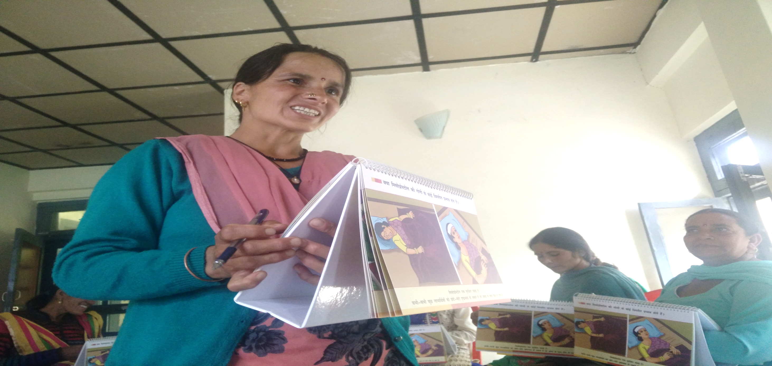
Community Based Advanced Distribution of Misoprostol to prevent PPH
Innovations in Implementation
Himachal Pradesh
सुरक्षा
Notes:
Good Afternoon, I am Dr. Anadi Gupt, State program Officer at NHM, Himachal Pradesh, and with me I have here Dr. Rakesh Parashar, state lead from USAID. Today we will be presenting how we innovated the implementation of ‘Community Based Advanced Distribution of Misoprostol to prevent post partum hemorrhage’, to make this programme a success in Himachal Pradesh.

Slide 2
GOI rolled out guidelines in 2014
Till early 2016 no learnings about implementation on ground (except initiation in Jharkhand and MP)
HP took the challenge of hitting the ground with developing scalable implementation model in collaboration with Project Vriddhi (Scaling Up RMNCH+A Interventions)- USAID
Initiated implementation in April 2016 (GOI TOT in March 2016)
Identified one very remote block with institutional delivery rate of about 10% - Janjheli (Mandi district)
Context
Notes:
Government of India had rolled out the guidelines for this programme in 2014. To our knowledge Jharkhand and Madhya Pradesh tried pilots of the program, yet till early 2016 there were no learnings about implementation on the ground. HP took the challenge of hitting the ground with developing a scalable implementation model in collaboration with USAID, the development partner for the state. We initiated the implementation in April 2016, just after being trained as a trainer at Delhi in March, 2016. We identified one very remote block of the high priority district of Mandi, with an institutional delivery rate of just 10%.

Slide 3

An overview – Block Janjehli, District Mandi, HP
Altitude – 2150 meters
Population – 86597 (census 2011)
Total ANC registrations (FY16)– 1466
Total Deliveries reported- 667 (45% outcome available)
Total home deliveries reported- 596 (89%)
ANMs -26 , ASHAs- 103
Notes:
The chosen block, Janjheli, is at an altitude of more than 2000 Meters and has a population of nearly 87 thousand. Most of the area of this blocks gets landlocked in winters. In the year 2015-16, the Ante-natal registration in the block was 1466, out of which 667 deliveries were reported. Of the reported 667 deliveries 596 were home deliveries, a home delivery rate of 89%. The Block had 6 supervisors, 26 ANMs and 103 ASHAs in place at the time of initiation of the programme.

Slide 4
Steering group meeting and implementation plan
Objectives
Consumption of tablets in home delivery cases
Improve institutional delivery rate & health system improvement
Decisions
To procure single 600 mcg tablets
ASHA incentives and conditionality
Rethinking of training and communication material
Implementation Plan for
Rigorous follow up and post training support
Effective reporting, monitoring and mid course corrections
Notes:
The state constituted a state level steering group headed by the Mission Director, having State officers and representation from USAID. The group met to finalize the implementation plan where it was decided that the objectives would not only be the distribution and consumption of Misoprostol tablets, but also improving the overall health system and the institutional delivery rate of the block.
It was decided that we will procure 600 mcg tablets of misoprostol instead of the prevalent 3 tablets of 200mcg for the ease of consumption by the women and programme implementation. It was decided that ASHAs would be line listing all the pregnant women of their area and would distribute the tablets. They would be given an incentive of Rs.200 if the women consumes the tablet after the home delivery and Rs.100 if an unconsumed tablet is received back by the ASHA . It was decided to formulate state specific training and communication material before training the ASHAs and ANMs of the block. A district level orientation & block level training calendar was finalized.
It was decide that there would be rigorous follow up in the cluster meetings of the ASHAs when they would be reporting their monthly progress at the PHC level. There would be a system of continuous post training support. A system for weekly & monthly MIS updating was devised. A monitoring mechanism at the Community, block & district level was put in place. Reviews meetings were planned to make any mid course corrections.

Slide 5
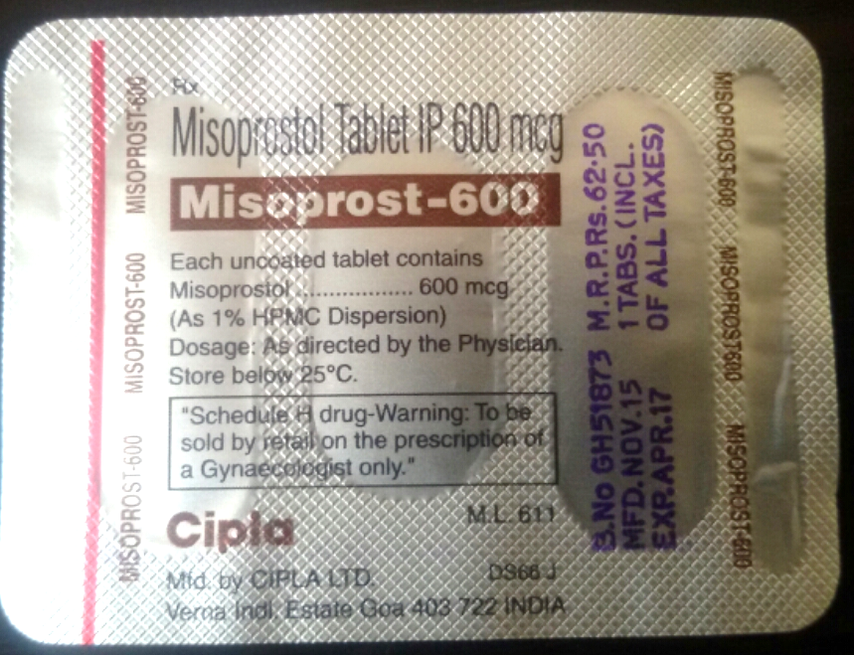
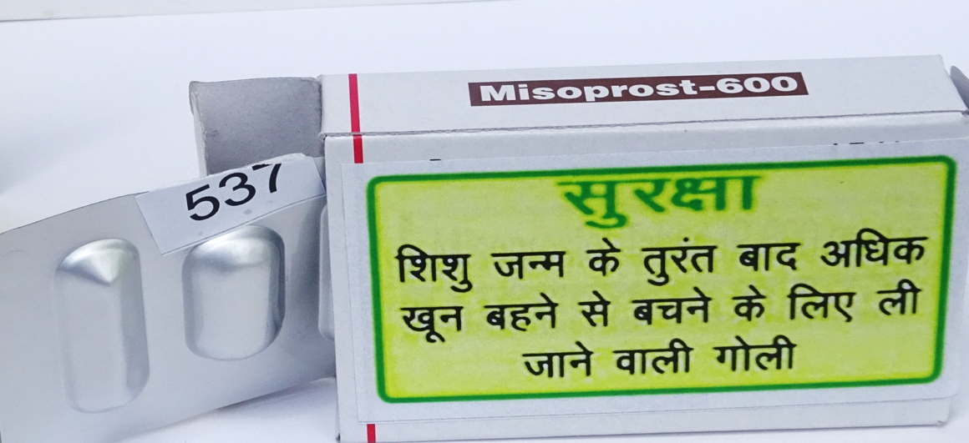
600 mcg Misoprostol tablets
Mandi became the first district to procure and use this in a public health program setting in India
Single Vendor Procurement at District level
Easy to package, distribute and consume
Notes:
Procurement of single tablet of 600mcg was done from a single vendor at the local level to make the process easier, quicker and to prevent stock outs. The program and the tablet was named Suraksha , meaning protection. This was done in consultation with front line workers. The tablets were given unique numbers and the box of the tablet was stickered.

Slide 6
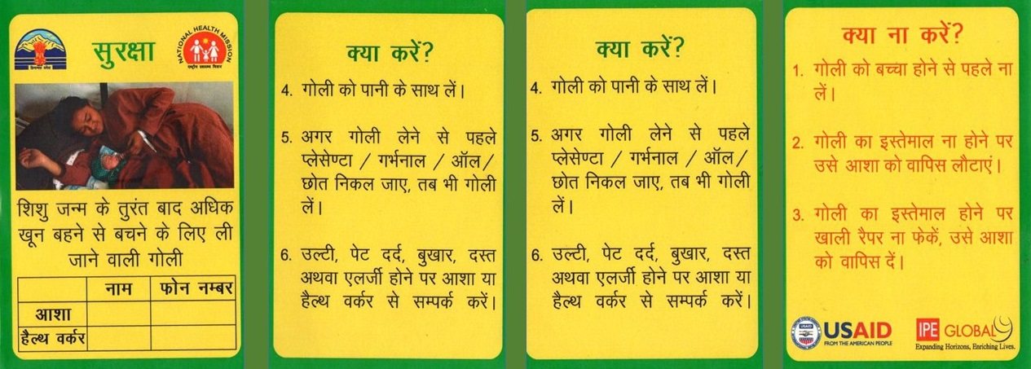
Cover Page with Caption and ASHA/ANM details
DO’s
DO’s
DONT’s
Pack Insert
Notes:
A pack insert was designed in Hindi with ASHAs’ and ANMs’ phone numbers and instructions for the women in the form of Do’s and Don'ts and placed in a packet with the box of the tablet. This was put inside a transparent polythene zipper with the tablet packet.

Slide 7
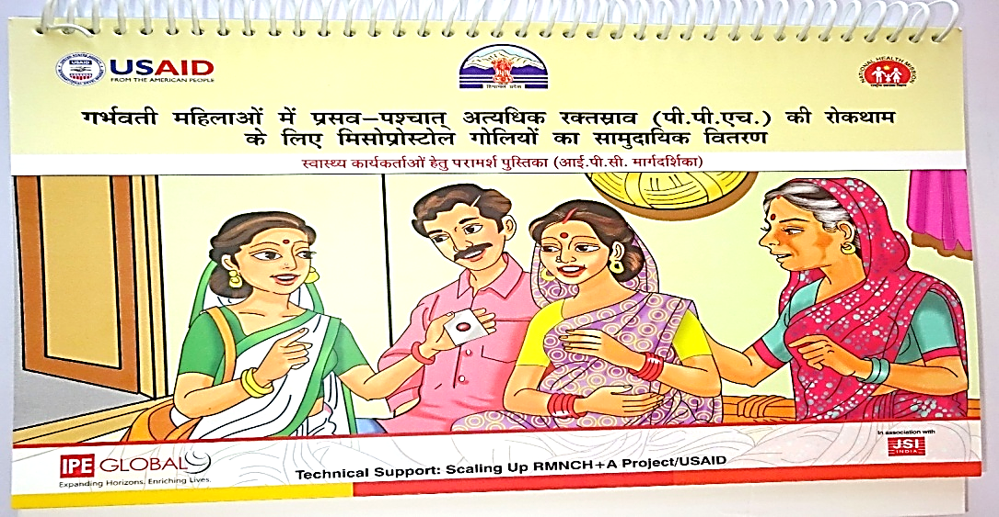
Counseling Flip Book
Notes:
A Flip book was designed for ASHAs to help her during counseling of the pregnant women at their residences regarding consumption of Misoprostol tablets

Slide 8
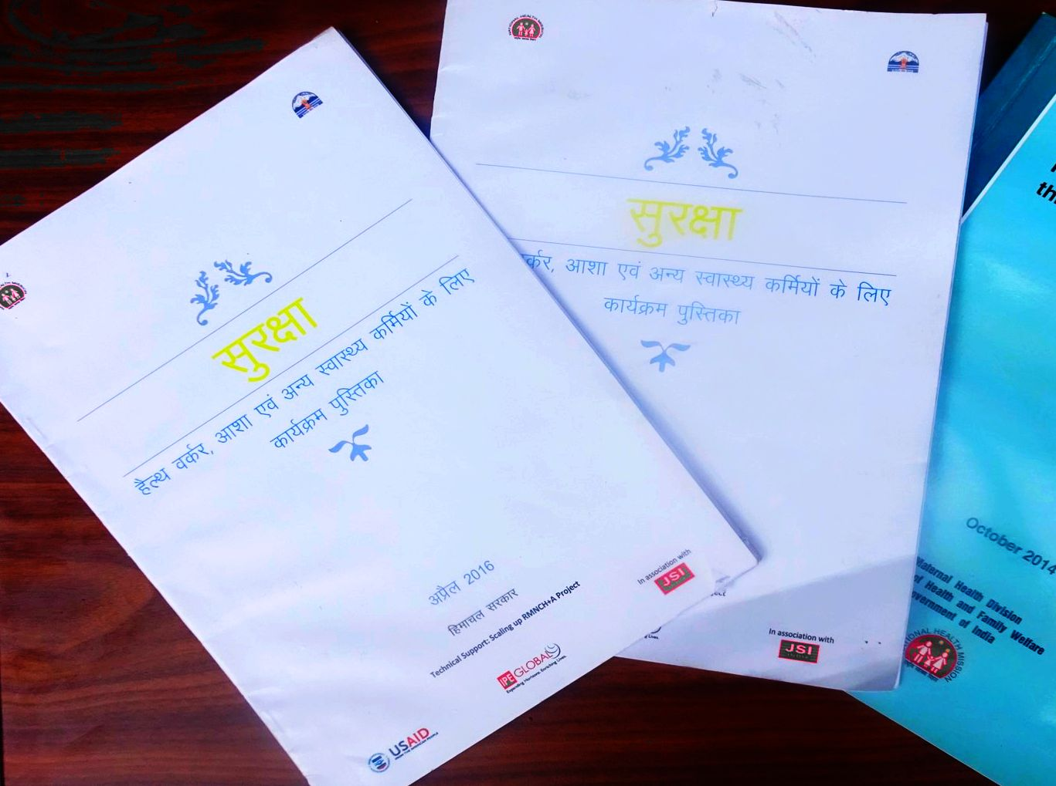
A simplified, Hindi Booklet, containing
Program outline
Roles and responsibilities of ANMs/ASHAs/Supervisors
One master copy of all the recording and formats
Notes:
A booklet with program outline was devised with the roles and responsibilities of the Supervisors, ASHAs and ANMs. A format of all reporting and recording was made a part of this booklet.

Slide 9
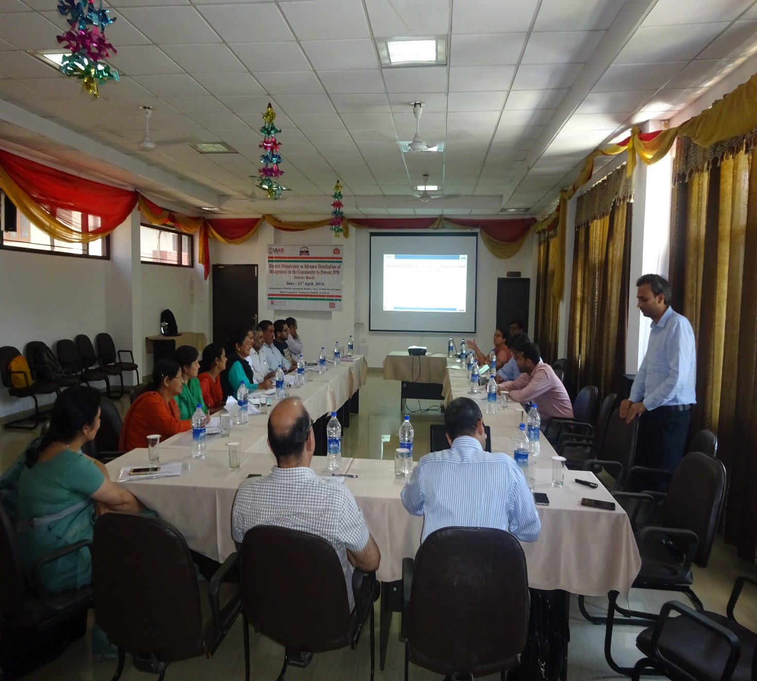
District Orientation
District level Orientation
Program guidelines
Role of program managers and supervisors
Tablet storage, distribution and monitoring chain
Notes:
A district level orientation for the Chief Medical officer and concerned district and block officers was organized where program guidelines were discussed, the role of program managers and supervisors was discussed and instruction on tablet storage, distribution, reporting system and the monitoring chain was given.

Slide 10
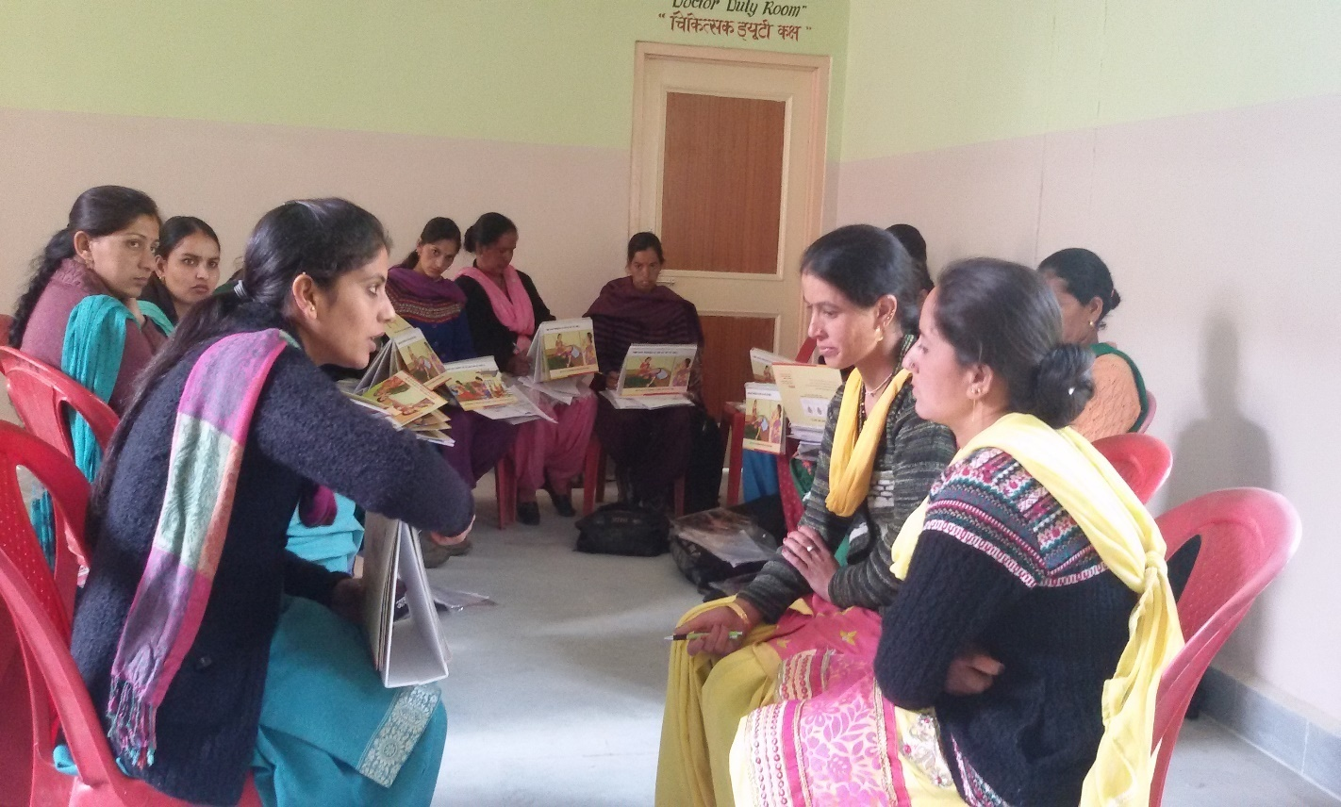
Block level trainings
Common program overview to all in first two Hours
Group work on counselling & reporting in 8-10 participant groups
Tablet distribution and recording in presence of Pharmacist
Notes:
After the district orientation, the block level training was organized for ASHAs and ANMs during which our focus was more on inculcating quality counseling exercise and make them understand about reporting formats. Group work on counseling in batches of 8-10 participants was made a part of the training. The ASHAs had been asked in advance to bring the line list of pregnant women and were distributed the tablets as per the requirement on the same day. The ASHAs and ANMs were asked to report their progress in the cluster meetings at the PHC level.

Slide 11
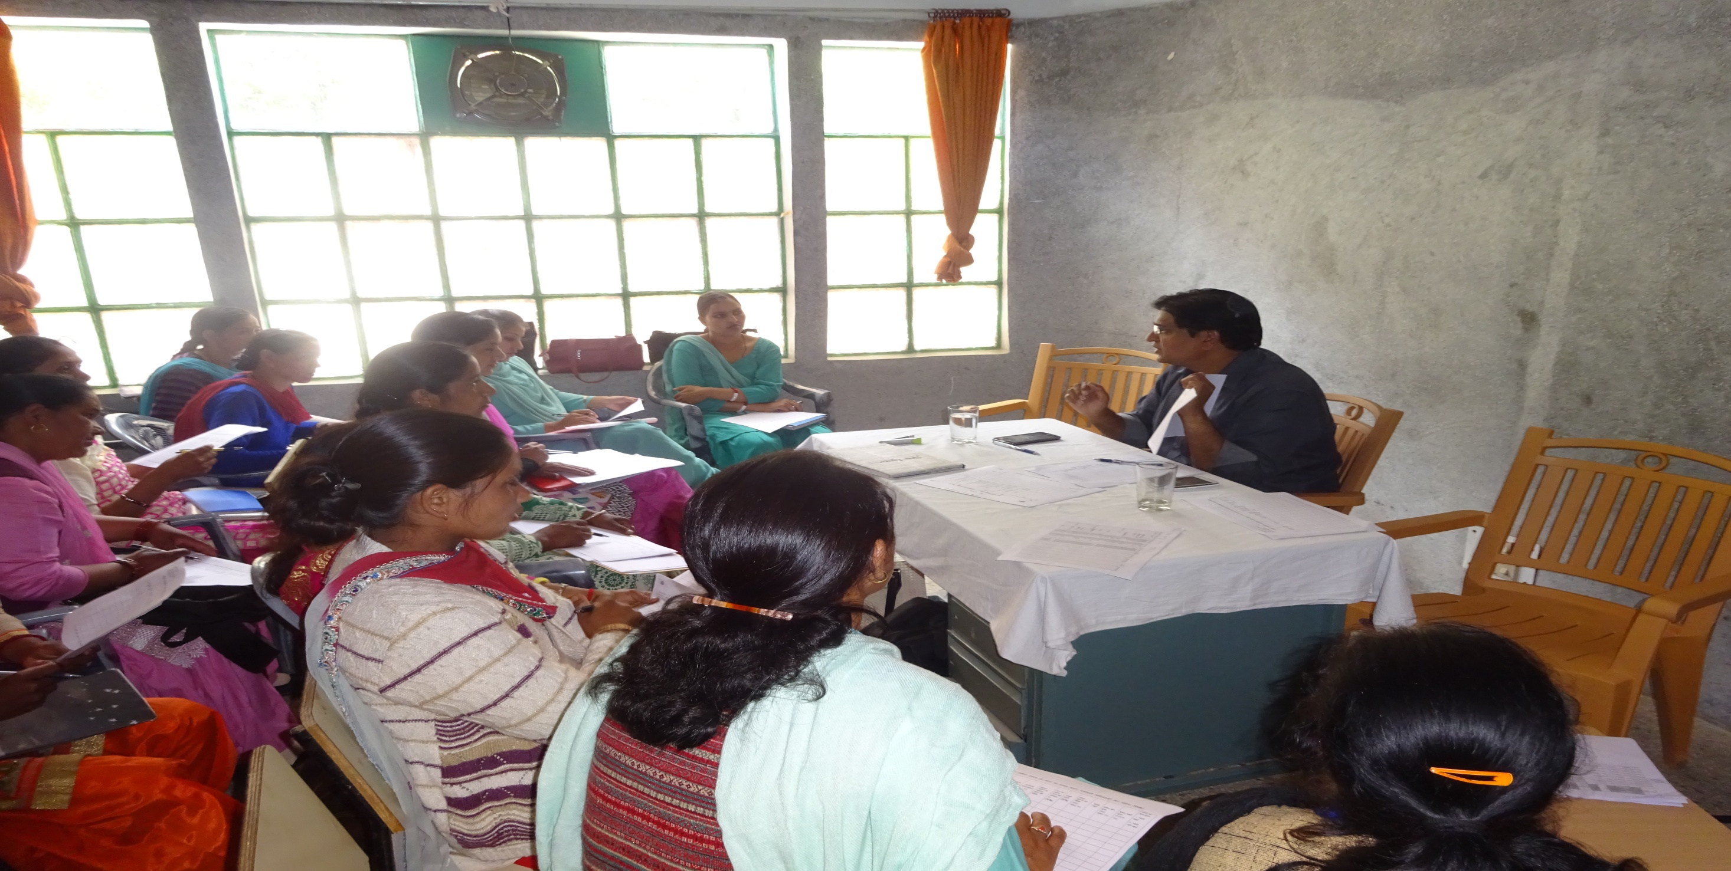
Cluster Meeting
Monthly Cluster meeting at each CHC/PHC to discuss the progress
Problem solving in recording, reporting and other challenges
Notes:
The cluster meetings were the mainstay of the programme where all issues and challenges faced by the ASHAs and ANMs were resolved. Problems in filling the reporting formats was encountered in many places which was sorted out. Updating of MIS was also done during these meetings.

Slide 12
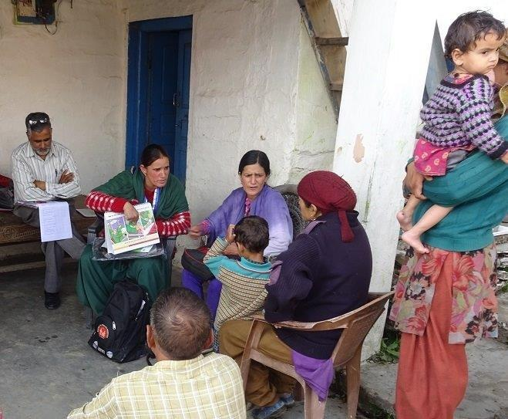
Community Visits
Community visit to monitor the distribution of tablet
To monitor and improve the counseling done by ASHA at home
Notes:
The supervisors and field officers of USAID were involved in extensive monitoring in the community. They weekly visited the Health sub-centres and the villages to check the distribution of tablet. They monitored the counseling and improved on the same where ever required.

Slide 13
Primary Outcomes (Period - 6th May to 31st July 2016)
PPH cases reported – Zero in tablet consuming mothers and one in non consuming mothers
Notes:
Now the results. For the period 6th May to 31st July which is nearly 3 months, 251 women delivered in the block of which 140 delivered in institutions and 105 delivered in home. Of the 105 home deliveries 70% were distributed Suraksha tables and 65% actually consumed the tablets after delivery. Though it is too early to comment on impact on PPH and maternal mortality but so far only one PPH case from the block has been reported in home delivery cases, where mother had not consumed the tablet.

Slide 14
Secondary Outcomes - Rise in reported deliveries and institutional Delivery rate
11% institutional Deliveries
56% institutional Deliveries
Expenditure: Rs. 2.32 Lac on trainings, procurement and ASHA incentives
8% institutional Deliveries
Notes:
As per HMIS, in the year 2015-16, 667 pregnancy outcomes were reported with a Institutional delivery rate of 11%.
For the period April to July 2015, 201 pregnancy outcomes were reported on HMIS with an Institutional delivery rate of 8%.
For the corresponding period in 2016, after the implementation of Suraksha Program, 357 pregnancy outcomes were reported and the Institutional rate increased from 8% to 56%. The state has incurred an expenditure of 2.32 Lac on trainings, procurement of tablets and ASHA incentives.

Slide 15
Challenges
Scale Up Plan
Manual line listing of pregnancies
Packaging of tablets
Maintaining the unique number of tablets
Missing out on tablet distribution to home deliveries
Phasic scale up
Maintaining Suraksha MIS via MCTS work plan
Bulk procurement and simplified packaging of tablets by Vendor
Dilute the criteria of likely home deliveries to improve coverage
Notes:
We faced some challenges in implementation of the program. Suraksha MIS was updated with entry of pregnant mothers from ASHA level line listing format in each cluster meeting, which is an intensive task. The packaging of tablets with sticker, pack insert and unique number of tablets will be a challengeat a larger scale. As per guidelines women likely to deliver in Institutions are not distributed Misoporsotol tablets. Many number of times these women ended up delivering at home and could receive the tablet.
For scale up it is important to mitigate these challenges. A phasic scale up has been envisaged in another 3-5 blocks after taking care of the problems faced. To get over with manual updating of pregnant mothers details, MCTS shall be utilized to generate work plan and Misoprostol related columns shall be added to the work plan for receiving the tablet, consumption and adverse event. This will reduce the burden of reporting for the FLWs. Also, the unique numbering will be done away with and packaging shall be outsourced to the supplier of the tablets. To improve coverage the criteria of not distribution of tablets to women likely to deliver in Institutions will be relaxed so as to improve the coverage further.

Slide 16

THANK YOU
Notes:
Thank you. We would be happy to assist any state which plans to launch this program. Any questions?

