Slide 1


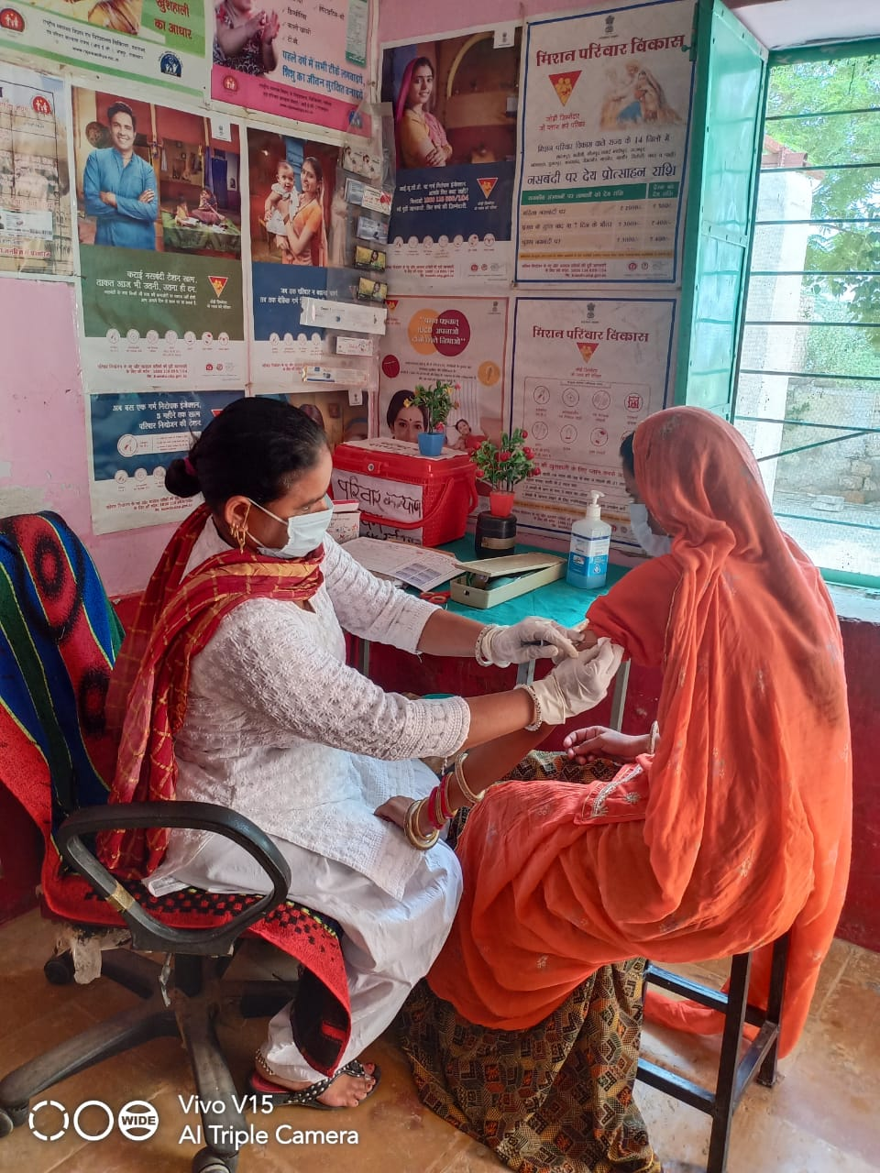
Increasing access and availability of Injectable Contraceptives to new clients through telephonic screening and counselling from Sub Centers in Rajasthan
Dr Girish Dwivedi
Project Director-FW
DMHS, Rajasthan

Slide 2
Background
Impact of COVID-19 on health system:
Entire health system and staff was busy in containing/managing COVID-19.
It affected the systems ability to provide regular family planning services.
All elective surgeries, including sterilization services were almost stopped.
There was an increase in unmet need for contraceptives as:
Clients were unable to seek family planning services due to stringent restriction on movement.
Reluctance to visit health facilities due to fear of COVID-19.
Many migrant workers had returned to their homes, which resulted in increased demand for contraception.

Slide 3
Impact of COVID-19 on Family Planning Services during lockdown
Performance | Apr-May (2019-20) | Apr-May (2020-21) | % change
Female Sterilization | 44170 | 2878 | -93.5
Male sterilization | 413 | 16 | -96.1
Interval IUCD Inserted | 41028 | 20810 | -49.3
PPIUCD inserted | 36526 | 29310 | -19.8
PAIUCD inserted | 640 | 465 | -27.3
Total Injectable doses | 33540 | 27046 | -19.4
Condom Distributed | 5327510 | 4716403 | -11.5
Mala N Distributed | 533074 | 475415 | -10.8

Slide 4
Impact on uptake of Injectable Contraceptives uptake
Doses | April-May 2019 | April-May 2020 | Change
Injectable Contraceptive- First Dose | 15338 | 9004 | -6334
Injectable Contraceptive-Second Dose | 10404 | 8453 | -1951
Injectable Contraceptive-Third Dose | 4745 | 4209 | -536
Injectable Contraceptive-Fourth or more than fourth | 3053 | 5380 | 2327
Access of injectable contraceptives to new clients was severely restricted as GoI guidelines only allow a trained doctors to give first dose after proper screening of client.
Clients were able to get subsequent doses as the same can also be given from trained ANMs from sub centers

Slide 5
Innovation
To address unmet need for contraceptives arised due to COVID-19, state decided to focus on Injectable Contraceptives due to following reasons:
  It is long terms (3 months) reversible contraceptives and highly effective (99.7%-perfect use).
  It can easily be provided by trained ANMs from sub centers reducing unnecessary burden to higher health centers. Also reducing clients travel time and unnecessary exposure from higher health facilities.
State decided to allow trained ANMs to provide first dose of injectable contraceptives to new clients, but telephonic screening of client by a trained medical officer was made mandatory. Detailed guidelines for the same developed in consultation of UNFPA

Slide 6
Dissemination of Guidelines an Preparations
An official order was issued to districts in this regard (Letter No 10 dated 04.05.2020).
An virtual meeting was organized of district level officials under the Chairpersonship of Director (RCH) to orient them about guidelines for telephonic counselling and screening.
Checklist for screening of Antara clients was already developed and supplied with support of UNFPA

Slide 7


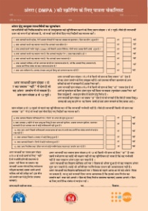




Steps of Providing 1st dose of Injectable Contraceptives from sub centers
New client contact sub centers for seeking injectable contraceptive services
ANM will welcome the client and call a trained Medical Officer for counseling and screening of client
Medical officer will counsel the client and screen her using a standard checklist
Client is not eligible for injectable contraceptives: Medical officer will counsel her about other suitable contraceptives ask the ANM to provide her selected contraceptive
Client is eligible for injectable contraceptives:
Medical officer will ask the ANM to administer injectable contraceptive to the client

Slide 8
Impact
Doses | June-July-19 | June-July 2020 | Change
Injectable Contraceptive- First Dose | 16659 | 20852 | 4193
Injectable Contraceptive-Second Dose | 8589 | 8312 | -277
Injectable Contraceptive-Third Dose | 6434 | 5831 | -603
Injectable Contraceptive-Fourth or more than fourth | 3768 | 6790 | 3022
Significant improvement in clients new clients of Injectable contraceptives in subsequent months. Additional 4193 clients were served compared to same period last year.
Total 10083 new clients have been provided injectable contraceptive services from sub centers during April to Sep, 2020

Slide 9
Lessons Learnt
Telephonic counselling and screening of clients is an effective approach to increase access and availability of injectable contraceptives to new clients.
Screening checklists are good tool to standardise screening process. It can easily be replicated in other states.

Slide 10
Thank You

