Slide 1

Kanti Velugu

Slide 2
Context
A large percentage of vision impairment is avoidable and can be addressed with a simple pair of glasses or a cataract surgery.
People mostly tend to live with eye problems or postpone until it is too late.
Women, Elderly – most neglected .

Slide 3
What is “Kanti Velugu?”
Vision : Build “Avoidable blindness free” Telangana.
Mission : Holistic, Hassle free service at door steps.
Goals :
  Universal eye screening .
  Provide reading glasses, medicines on the spot and prescription glasses in 45 days.
  Arrange for surgeries , other form of treatments .
  Create awareness about eye care & prevention of serious eye diseases.
Entire service is free of cost

Slide 4
Estimate of services to be delivered
1 | No. of People to be covered | Universal eye Screening
2 | No. of Reading glasses | About 35 Lakhs
3 | No. of Prescription glasses | About 20 lakhs
4 | No. of surgeries | About 3 lakhs

Slide 5
Preparatory Activities
Consultations with various stake holders ( Subject Experts, NGOs, Hospital Teams etc.)
Conducted Pilots
  To understand the work flow & IT
  To develop a simple, effective and a standard implementation Model .
Implementation strategy– .
  Village / Ward level camp
    Eye screening, primary treatment and Reading glasses – camp at village level
    Team to be comprised of -Medical Officer, Optometrist, Supervisor, ANM& ASHA – about 8-10 members.
    Material to be carried -Auto Refractometer, Snellen Chart, Trial lens box, Spectacles, Medicines, 2 Tabs, IEC Material etc.
    Visit Schedule prepared for all the teams
    Only screening , primary care and handing over of spectacles at village level. Secondary and tertiary care – institution based.
    Full time vehicle provided to each of the team
    No camp on public holidays
ii. Public, private and NGO hospitals ( 114) empanelled for surgeries

Slide 6
Preparatory Activities
4. IT System for implementation & monitoring
  A robust End to end online system - Online Portal for implementation & Monitoring of the Program (www.kantivelugu.telangana.gov.in)
  Work flow based
  Android app – Offline & Online to capture the data
MIS –
  Daily Team Performance Report
  Exceptions Report
  Daily Reading and Prescription glasses Report
  Daily Secondary and Tertiary Care Report

Slide 7
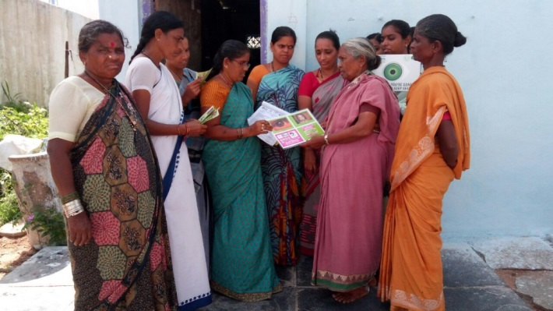
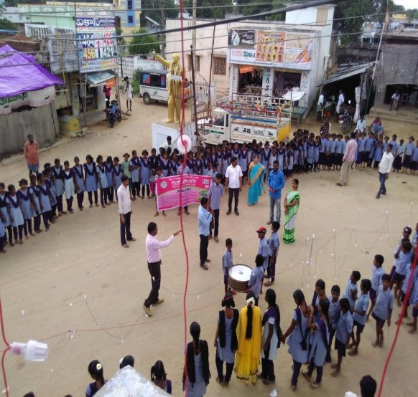
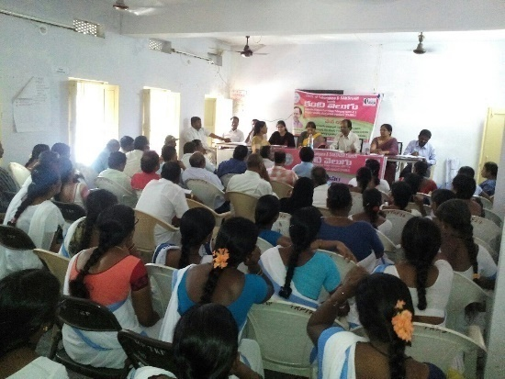
Preparatory Activities
5. Environment Building
  Orientation of line departments at District and Mandal level
  Orientation of all Public Representatives -MPs, MLAs, MLCs, ZP Chairmen, chairmen of corporations, all elected representatives,approx.1000 in each district
  Gram Panchayat level/Stake holders: Sarpanch, Ward Members, Village Health and Sanitation Committee Members and Village Assistants
  Meetings (Medical, Ophthalmologist Associations, Lions, Rotary club etc.)
  Meetings with NGOs, CBOs

Slide 8
Preparatory Activities
6. Capacity Building
  State level – Training of DM&HOs on overall program and how to conduct a Kanti Velugu Camp
  District Level-Trainings to Medical Officers (MOs) & field staff
  Special Trainings to Optometrist by experts in higher institutions (LV Prasad, Sarojini Hospital etc) to augment their skills
  Training Video on the workflow in camp, Do’s, Don't’ (http://kantivelugu.telangana.gov.in/KantiVelugu/videos.htm)
  About 40,000 Health Dept Personnel have been oriented & trained
DM&HOs | Deputy-DM&HOs | POs | MOs | Optometrists | ANMs | Data entry Operator (DEOs) | Health Supervisors | ASHAs
31 | 75 | 130 | 1500 | 1000 | 6000 | 1800 | 2000 | 27000

Slide 9
Preparatory Activities
7. Quality Control Arrangement
  Constitution of State level Technical advisory committee
  State Quality Control Team (12 Teams)
  District Quality Control Team (31 Teams)
  Partnerships with subject experts (Optometrist, ophthalmologist, Doctors, Academician etc) from higher institutions (LV Prasad, Pushpagiri, Sarojini Devi etc.) for ensuring the quality of the service
  State and district level control room (Call Centres)
  Standardization of the processes in Kanti Velugu Camps
8. Arrangements for continuous supervision, Q.C and Trainings

Slide 10
Field Deployment
1 | Number of Teams | 827
2 | Total No. of persons in teams | About 10,000
3 | Reading glasses Procured | 35,00,000
4 | Autorefractometer (AR) deployed | 827
5 | No. of Tablets (PC) | 2481
6 | No. of Trial Lens Box | 827
7 | Snellen Chart | 2481
8 | Medicines Provided at the Camp | Antibiotic Eye Drops / Ointments, Vitamin-A Tabs / Solution & Paracetamol Tablets
Medical Officers | 850
Optometrists | 900
Support Staff | 8200
Total | 9940

Slide 11
Kanti Velugu- Launch
Hon’ble CM launched KV Program on 15.08.2018
827 teams reached villages as per the pre- announced schedule
Teams are self contained with manpower, equipment , medicines, Reading glasses etc
While the medical teams take care of the eye screening, other govt depts provide coordination and support

Slide 12



Work Flow in the Camp
Step – 1 – Registration Desk
} Basic information about the beneficiary
} Issuance of Kanti Velugu Card
Staff- 2 ASHAs
Step -2 – Unaided Visual Acuity (UVA)
} Snellen Chart
} Record details in KV Card
Staff - ANM & AWWs
} Medical & Ocular History, Anterior Segment
Evaluation
Distribution of Medicines – need basis
} Records details in KV card
  Staff- Medical Officer, Staff
Nurse & ANM
Data Entry – Tab 1
Step 3- Examination by Medical Officer

Slide 13


Work Flow in the camp
Step -4 - Objective Refraction & Subjective Refraction
} Examination through Auto Refractometer
} Trial lens
} Record details in the KV card
Staff- Optometrist & Support staff
} Reading glasses issued at the camp
} Indent placed for prescription glasses /referrals
  Staff -ASHAs, Health Supervisor, ANMs
  Data Entry with Photo of the Reading glasses /prescription – Tab 2
Step 5- Issue /Order of Spectacles /referrals

Slide 14



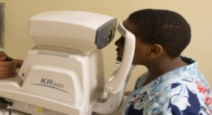


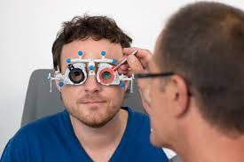


Camp Layout
Room size
10 x 20 Sft
Room size
10 x 20 Sft
Room size
15 x 20 Sft
Room size
15 x 20 Sft
Room size
15 x 20 Sft
Table - 1
Table - 2
Table - 3
Table - 4
Table - 5
Medical Officer checkup
Objective Refraction
3 mtrs distance
Issue of Spectacles
Data Entry – First level
Subjective Refraction
Data Entry
Unaided Visual Acquity
Medicine Distribution
Registration

Slide 15
IT as a backbone for Implementation & Monitoring
Data entry is done with 2 tabs, deployed at Table No. 3 and 5
Simple input with 13 data points (10 with Check Box) – 3 minutes
Patient will have a Hard Copy of Record
Wherever Reading glass is given, Photo of the beneficiary with glass is taken & uploaded
Wherever follow up is required, Photo of Patient Record is taken & uploaded
Supply Chain & Management of Prescription Spectacles:
Data entry at field level -- QC of data at state level –- place order
Order gets populated in vendor’s login
Vendor takes the order, manufactures & dispatches district wise
Each of the prescription glasses is barcoded with patient details
ANM/ASHA hands over glasses to the beneficiary, Scans the barcode, take photo & Upload

Slide 16
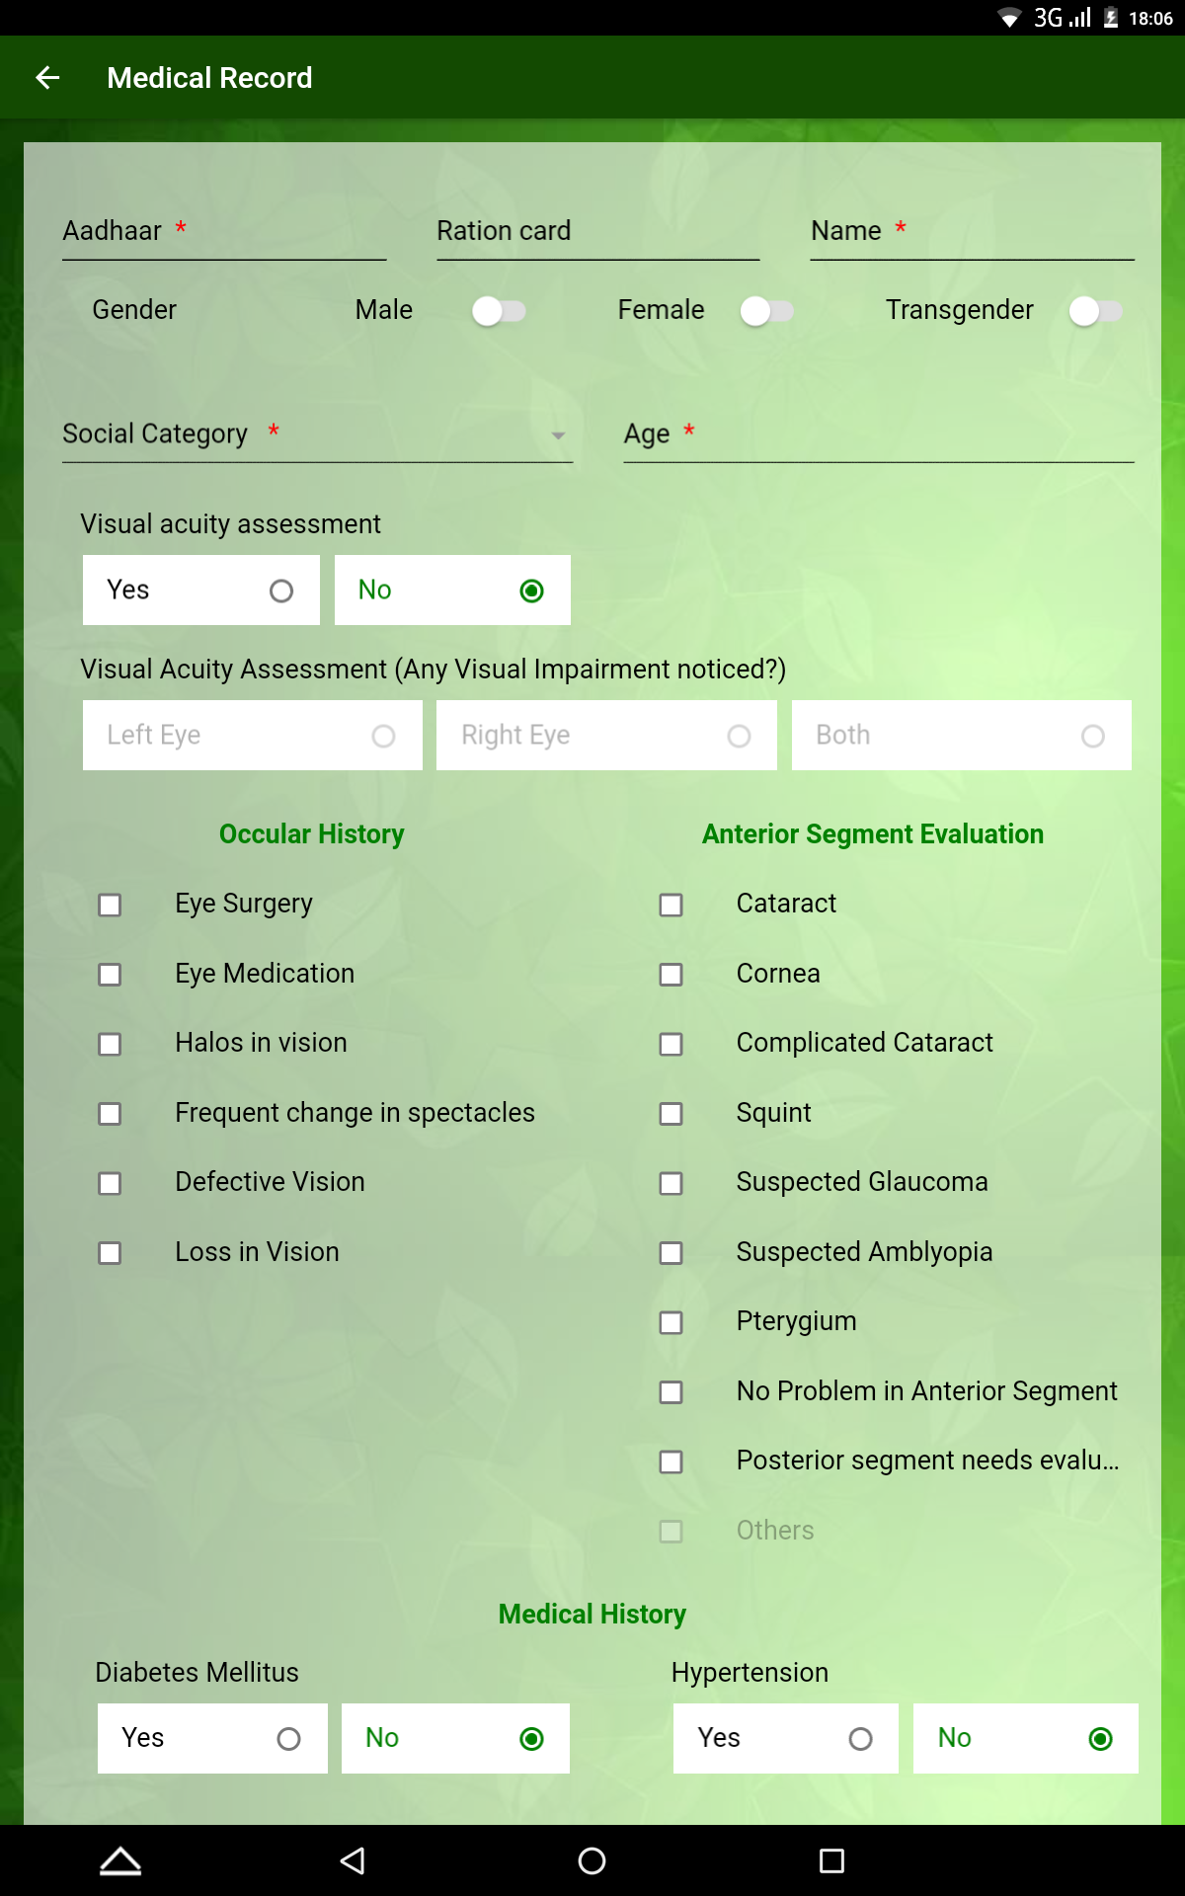
Recording of the data in Tab 1–Basic Details & Medical History

Slide 17
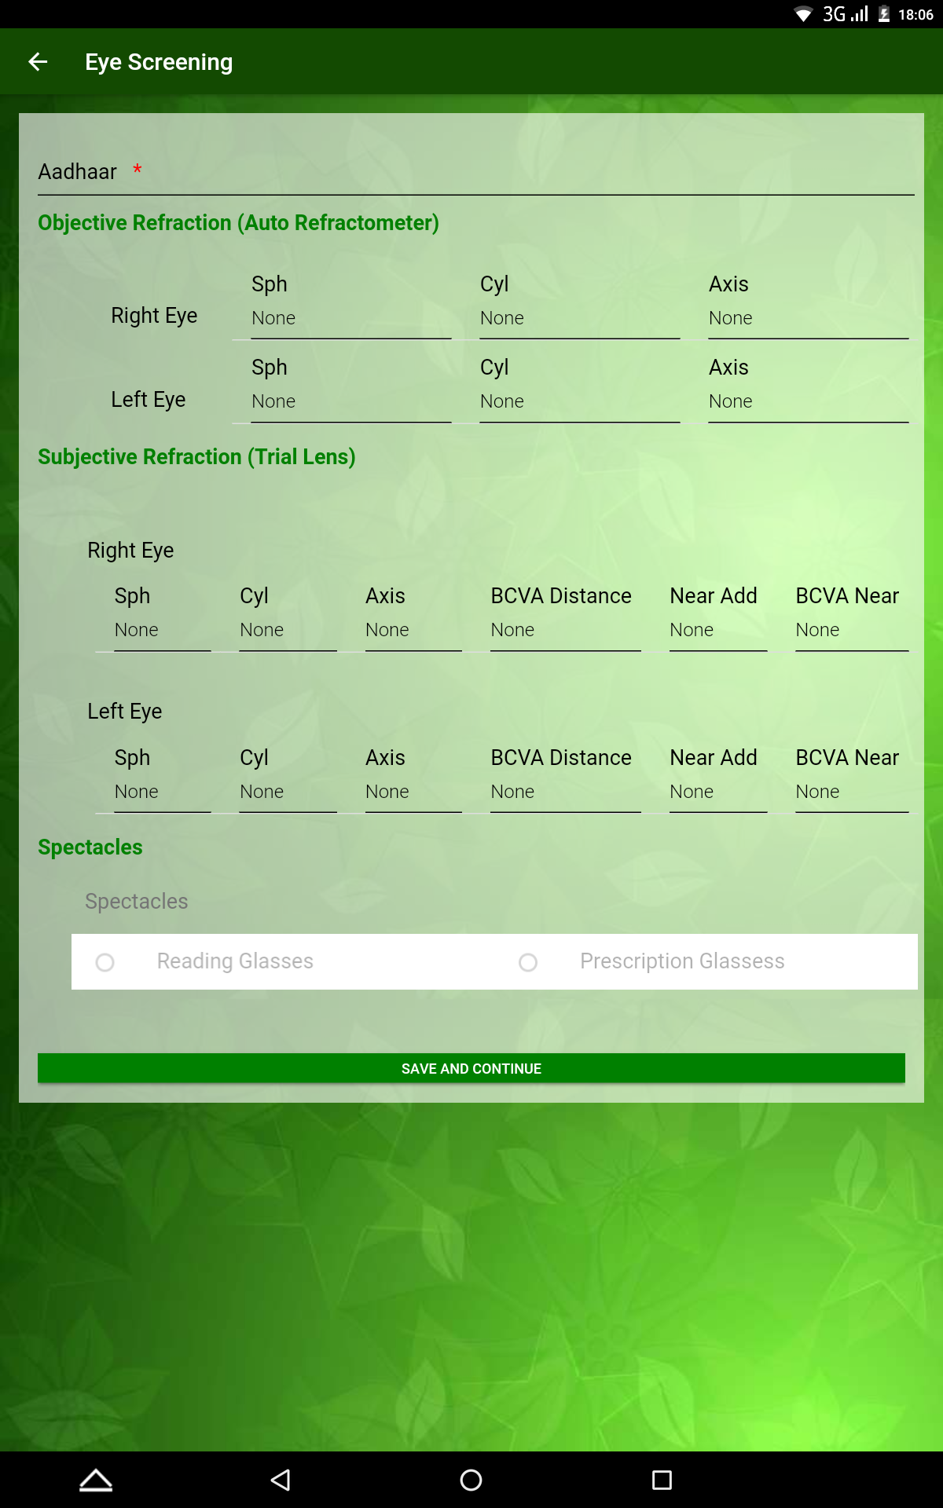
Recording of the data in Tab 2

Slide 18
Daily Output
Daily Output
1 | Number of teams | 827
2 | Average no of people screened | 1,50,000
3 | Average no. of reading glasses Distributed | 28,000
4 | Average no. of prescription glasses | 10,000
5 | Average no. of referrals | 12,000

Slide 19
MIS Report-CM’s Dash Board (As on 30.10.2018)
S.NO | INDICATOR | ACHIEVEMENT | %
1 | Number of Villages Completed | 3865 | 38.9
2 | Number of Wards Completed | 276 | 30.3
3 | Number of People Screened | 67,91,030 | -
4 | Number of Reading Glasses Handed Over | 12,63,266 | 18.6
5 | Identified for Prescription Spectacles | 10,49,088 | 15.4
6 | Identified for Secondary & Tertiary Referrals | 5,37,827 | 7.9
7 | People Identified for Follow Up (5+6) | 15,86,915 | 23.4
8 | People with no eye related issues | 39,40,849 | 58

Slide 20
% Eye conditions identified out of screened population

Slide 21
Cost Analysis
Reading Glasses | 35 Cr
Prescription Glasses | 55 Cr
Drugs & Surgeries | 50 Cr
Logistics | 29 Cr
Additional HR | 21 Cr
Procurement of AR & Other Equipments | 25.4 Cr
IEC Material | 4 Cr
Contingency | 1.5 Cr
TOTAL | 220 Cr
Estimated turnout of Beneficiaries | 1.8 Cr.
Incremental Cost of per service per beneficiary | Rs 110

Slide 22
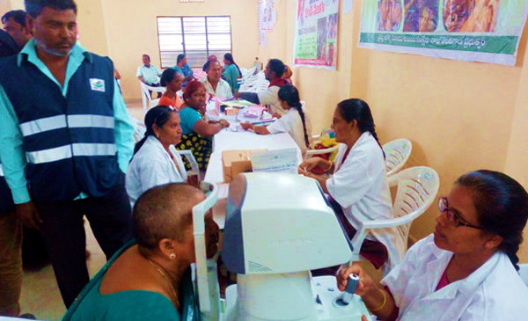
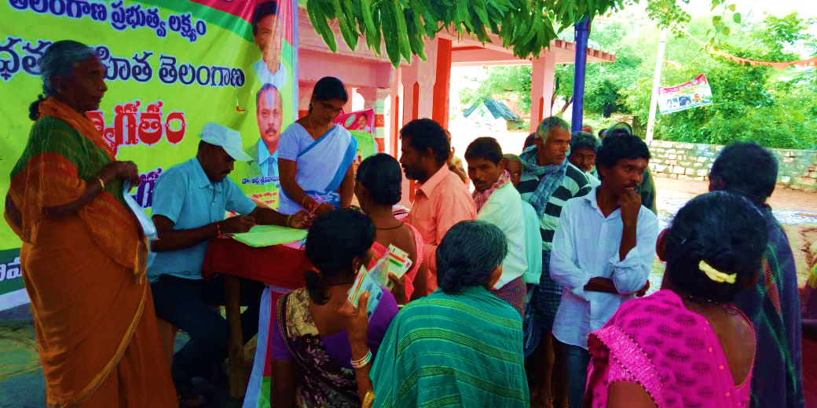
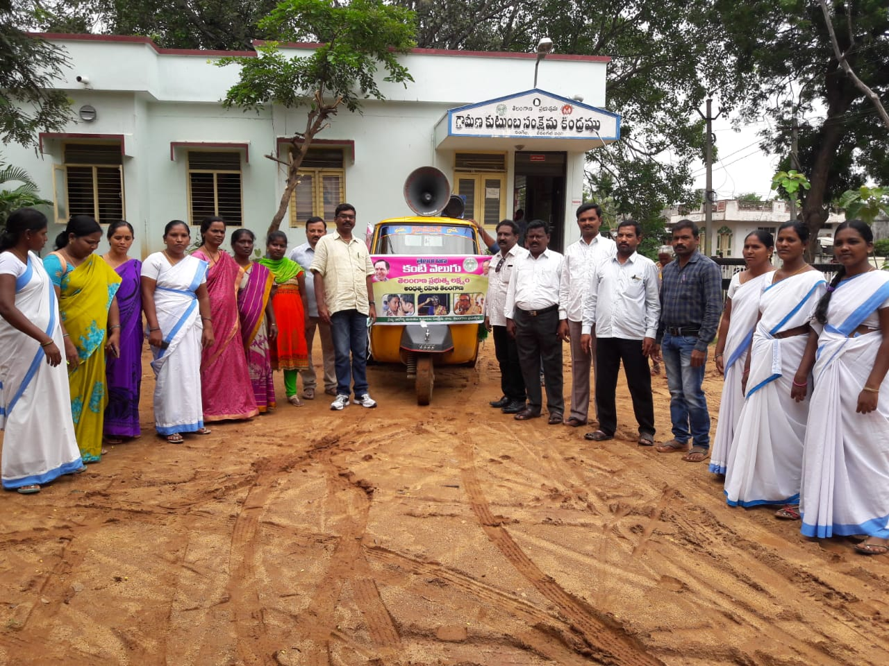
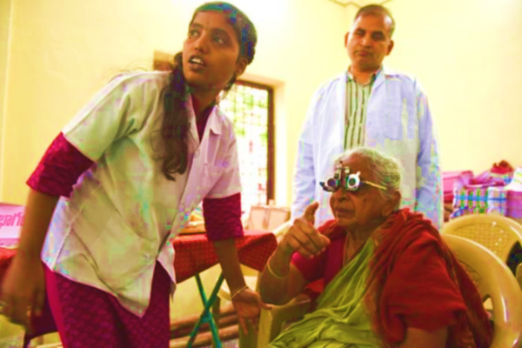
Glimpses from Field

Slide 23
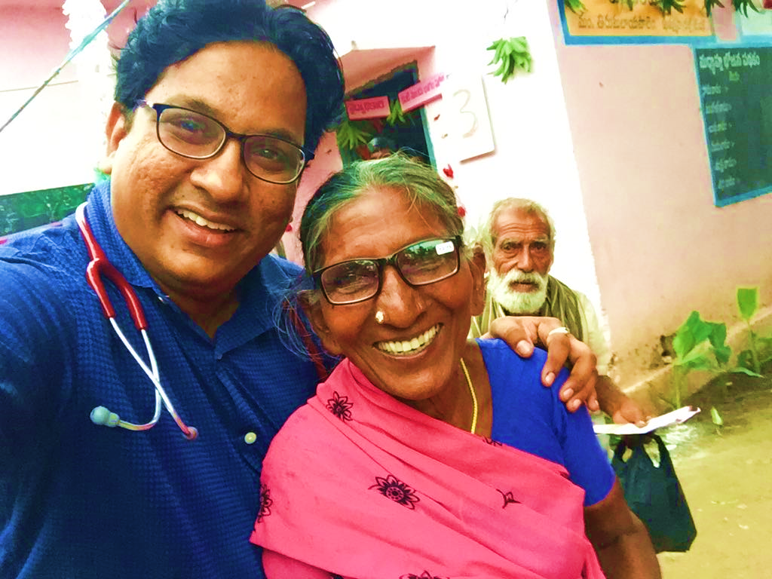
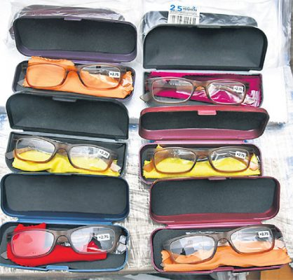
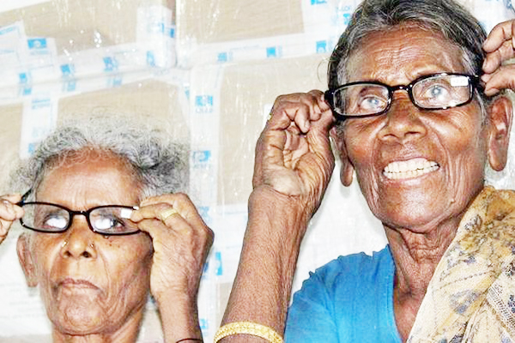
Glimpses from Field

Slide 24
Way Forward
Analysis of the data captured to understand
        Extent of eye related diseases- age & region wise
  To formulate the policies and streamlining efforts accordingly
Making CHCs/PHC across the state (900) as vision centres to carry out regular eye –check ups
Equipping all the district hospitals to function as secondary care institutions to cater for eye related diseases and conduct surgeries

Slide 25


