Slide 1



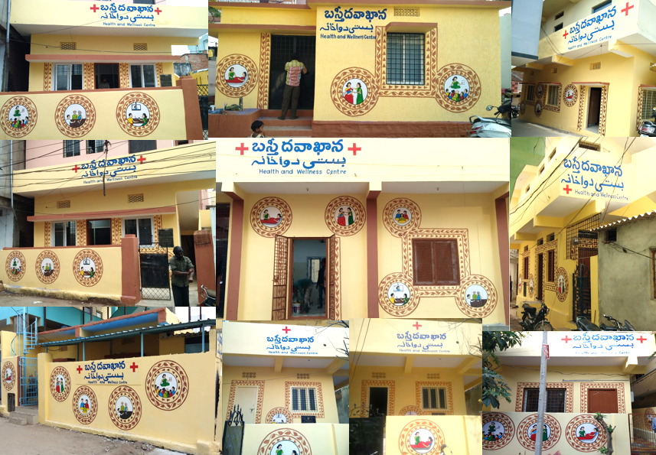
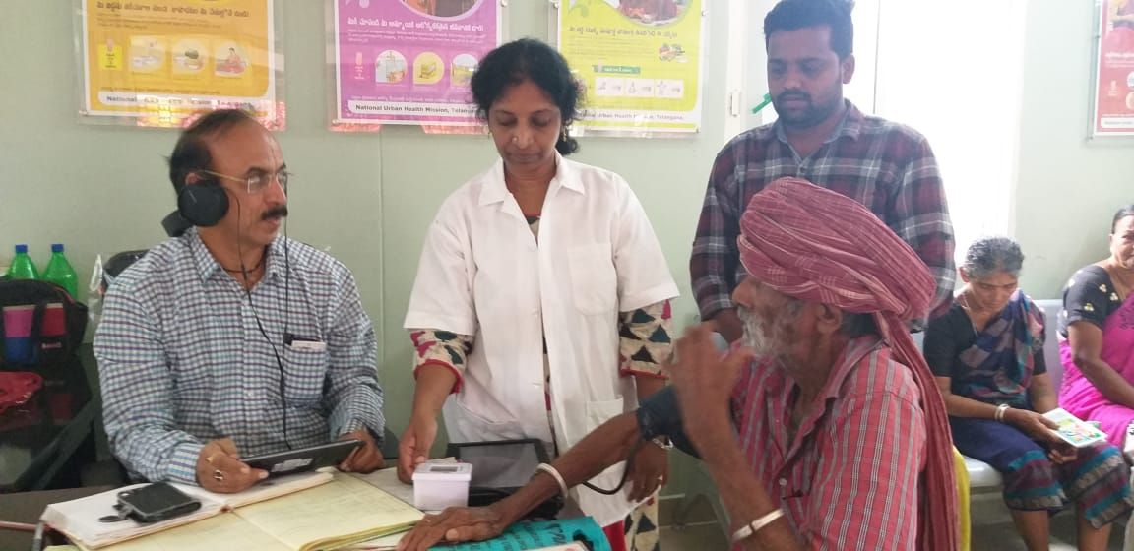
BASTHI DAWAKHANA
Urban Health Initiative of Telangana
Dr Yogita Rana, IAS
Mission Director, NHM &
Commissioner, Health & Family Welfare

Slide 2
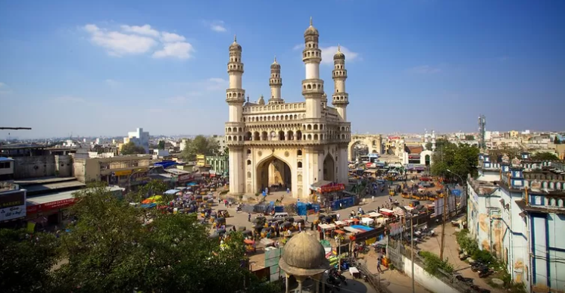
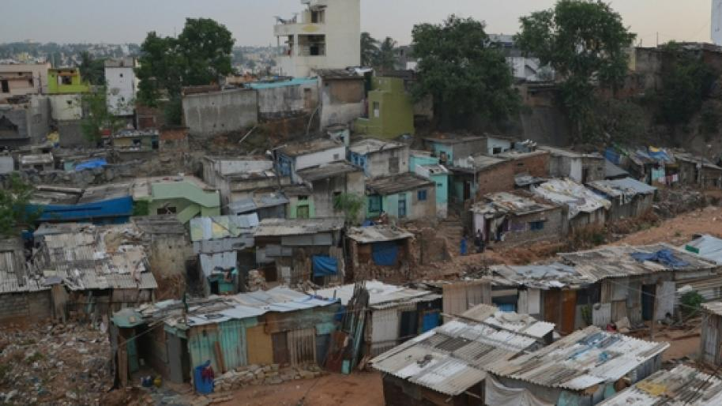
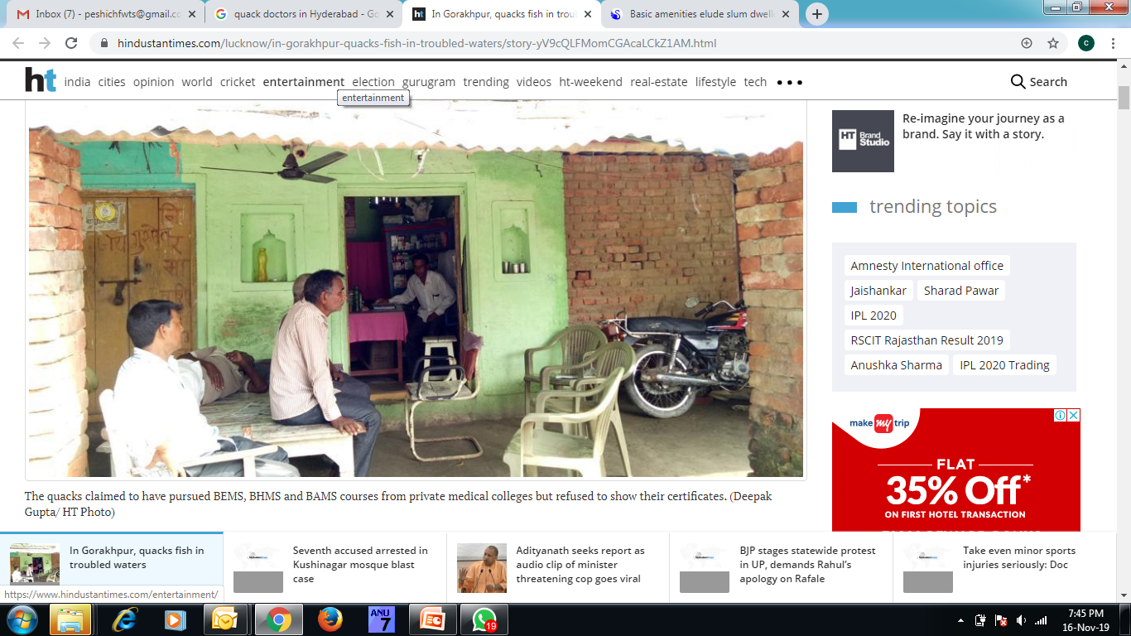
Background
Hyderabad City – 5th largest metro in the country - Population is about 10 million.
2 / 3 / 4 / 5 – syndrome: with improved life expectancy and increasing burden of NCDs
Significant percentage of urban population is daily wagers; migrant workers etc.,
Existing UPHCs (149) are too few and far to cater to slum population.
Low health seeking behavior of slum dwellers and unmet demand for health services.
Dependence on quacks and other unqualified practitioners.
High out of pocket expenditure.
©Hindustantimes

Slide 3
Salient Features
  One Basthi Dawakhana for 5,000 to 10,000 population - located in slums.
  Specialist consultation on Tele Medicine
  ONE STOP SERVICE : Free - Doctor, Diagnostics & Drugs
  Simple & Quality Health Care Solution at doorsteps
  Strengths :
  Reduce of Travel & Waiting Time
  Sustainable Platform for convergence of other NHM Programmes
  Reduce of Pocket Expenditure
  Reduce of burden on Secondary & Tertiary Health Care Facilities
Diagnostics available
53
Total BDK-
Tele-consultations
10
Functional BDKs
115
Drugs available
196

Slide 4
Convergence
Municipal Corporation
(GHMC)
MEPMA
Health Department
  Positioning of Medical and Para Medical Staff
  Consumables,
  Medicines,
  Diagnostics etc
  Day to day running of the facilities
  Rent Free Buildings
  Water Connection
  Daily House Keeping
(Cleaning, Waste Disposal)
  Involvement of Urban SHGs / MAS
  Community Awareness and Mobilization

Slide 5
Bouquet of Services
  OPD Service (Online OPD Module)
  Drug Dispensation
  Diagnostics (53 Tests Hub & Spoke)
  Outreach Services
      Anti Natal Care
      Immunization
      STI/ RTI
      Family Planning
      NCD Screening
      Elderly Care
      Palliative Care
      Mental Health Care
  Wellbeing Activities
      Yoga, Health Education, Counseling on Healthy Lifestyle
  Referral Services (Tagged with SDH, DH)
  Tele Consultation with Specialists
  Awareness Generation in Schools & AWCs

Slide 6
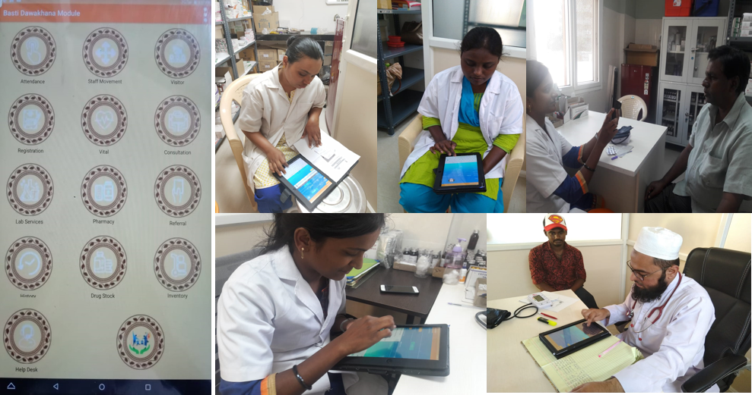
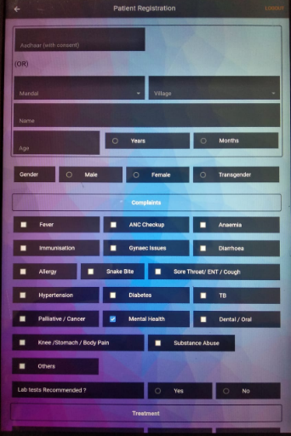
IT Enabled (OPD Module)

Slide 7
OPD & Lab Tests
Performance from April 2019 to October 2019
Total OPD | Average OPD per day per BD | Total Lab Tests | Average Lab Tests per day per BD
15,21,140 | 101 | 2,23,000 | 21

Slide 8
OPD – BDK Vs UPHCs
Total HR in BDK
3
Total HR in UPHCs
7

Slide 9
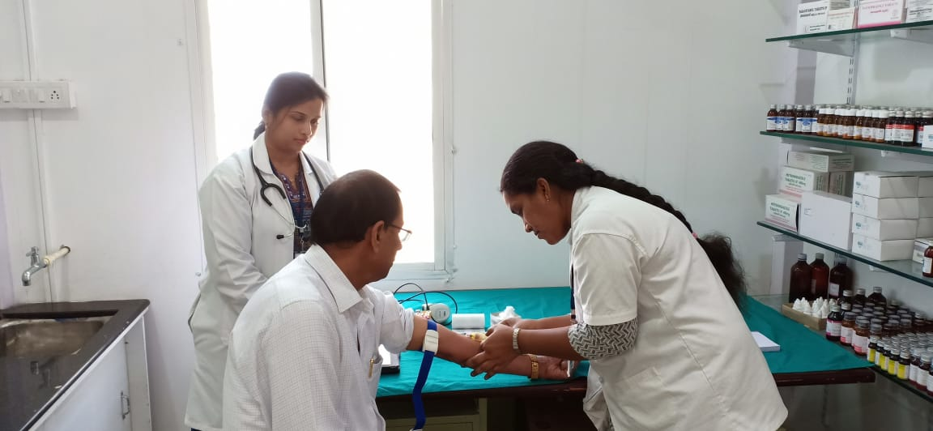
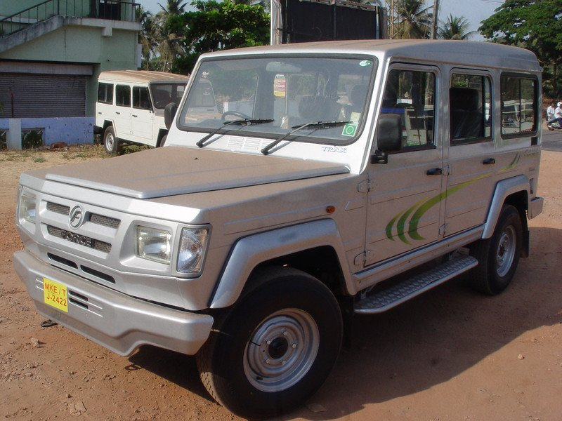
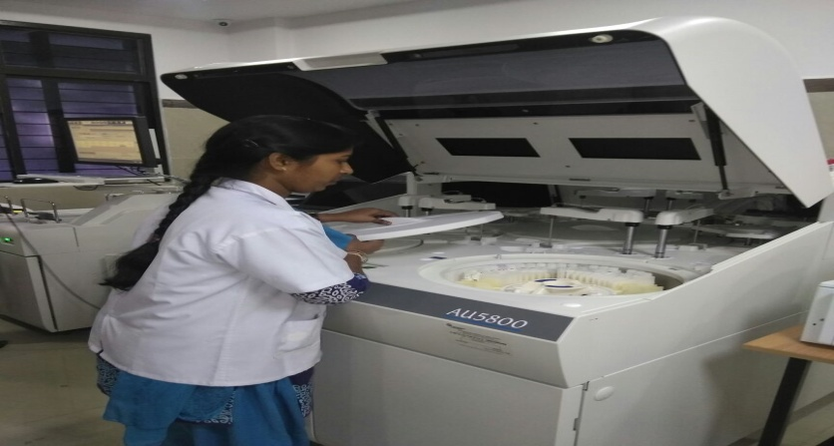
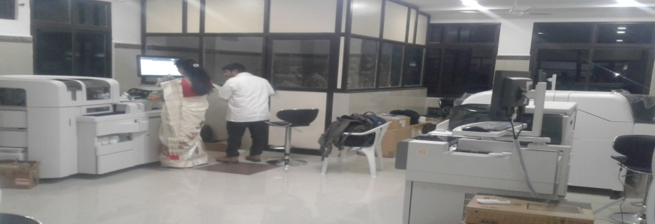
Diagnostics – Hub & Spoke
1
2
Sample Collection at BDK Spoke
(Bard Coded)
Transportation of Samples to Collection Points (25) - Hub
4
3
Results Transmitted ONLINE
Sample Testing at the Hub Laboratory

Slide 10
Referral Linkage
Basti Dawakhana
Specialist Evening Clinics in UPHCs
Teaching Hospitals
UCHCs, Area Hospitals, District Hospital

Slide 11
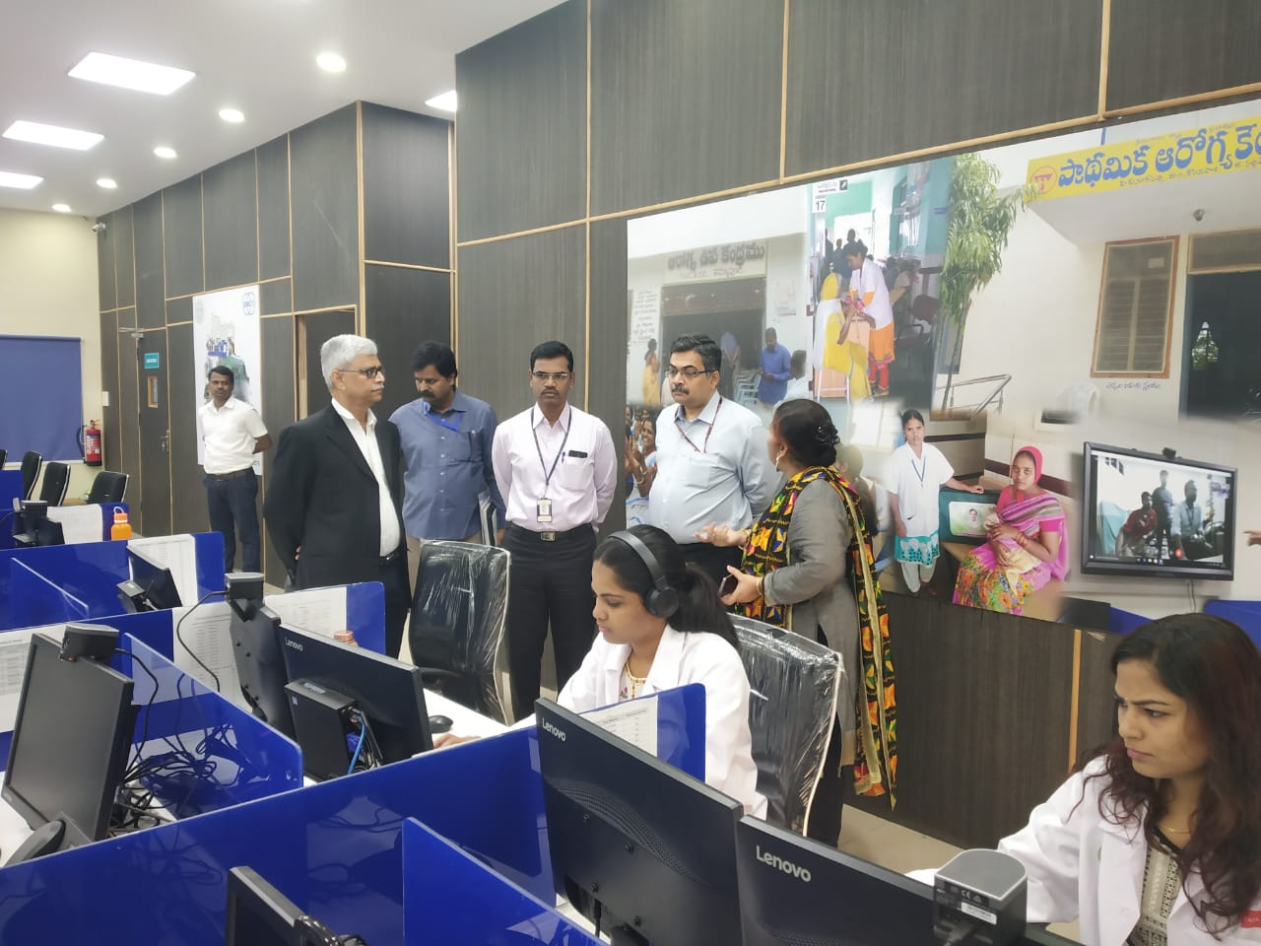
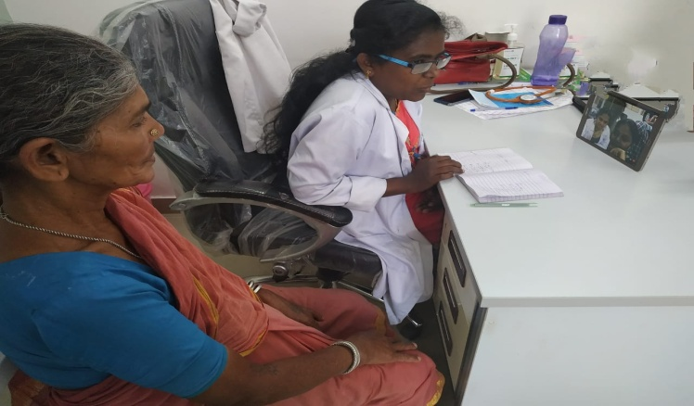
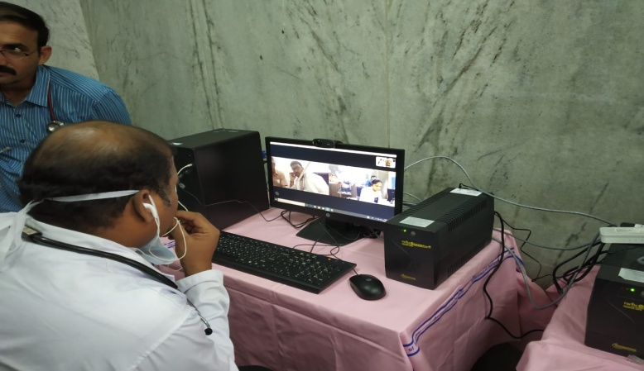
Tele Consultations
Linked to Osmania General Hospital through the Digital Nerve Centre (10 BDKs).
Specialists provide teleconsultation on fixed timings
Digital Nerve Centre
1755 Tele Consultations
(Apr 2019 to Oct 2019)
Physiotherapy - 1132 (65%)
Internal Medicine – 352 (20%)
Dermatology – 125 (7%)
Dietary – 111 (6%)
Orthopedics – 22 (1%)
Others – 13 (1%)
Basthi Dawakhana
Teaching Hospital

Slide 12
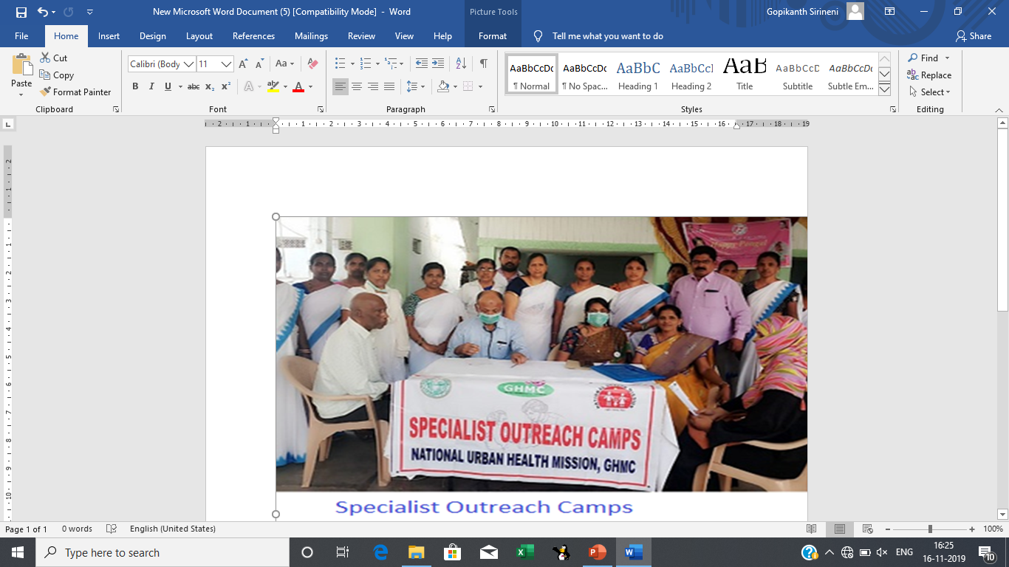
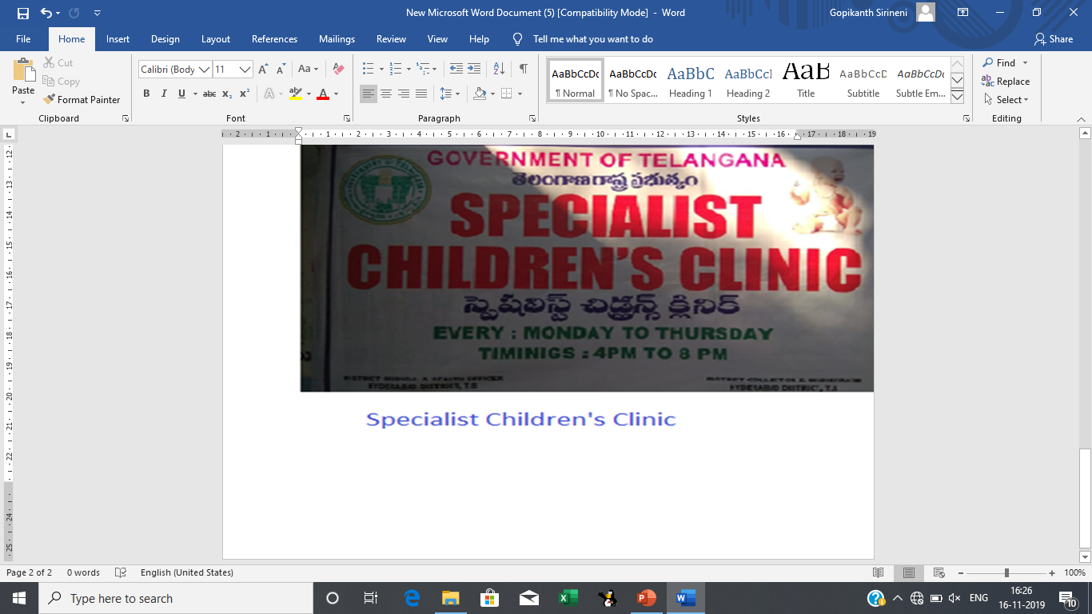
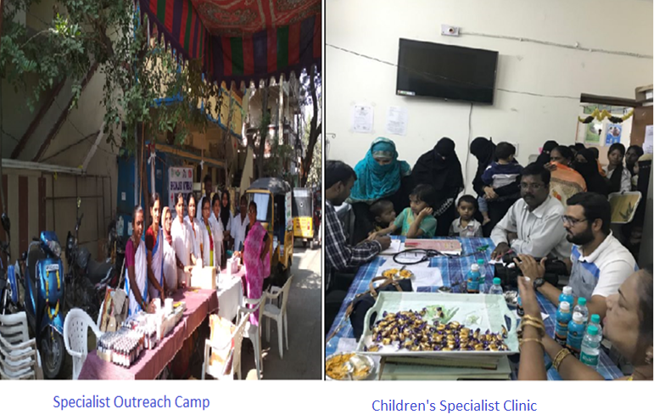
Other Urban Initiatives
Specialist Evening Clinics
evening consultation in the 30 UPHCs from 4.00 pm to 8.00 pm
Evening Clinics
Part time doctors providing evening services in 40 UPHCS

Slide 13
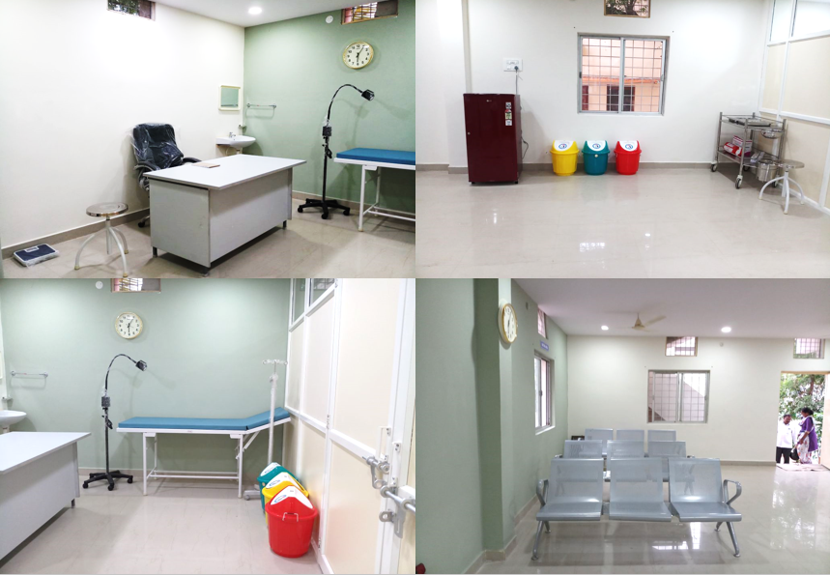
BDK-Standardization

Slide 14
Way forward
  To make 132 more BDKs functional
  Establish BDKs in other cities and towns in the state
  Roll out of specialist Telemedicine across all BDKs
  Enhance outreach services through UPHC staff

Slide 15
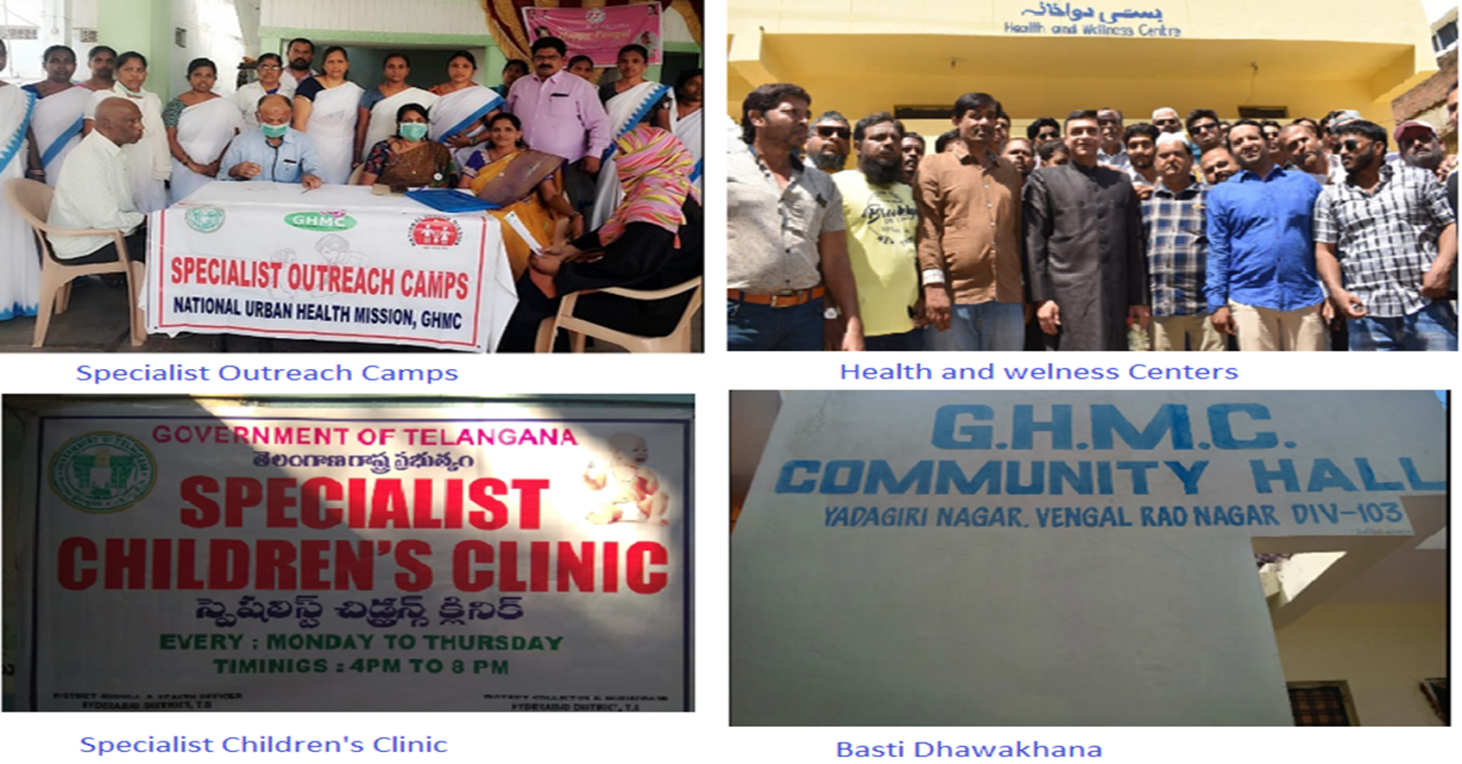
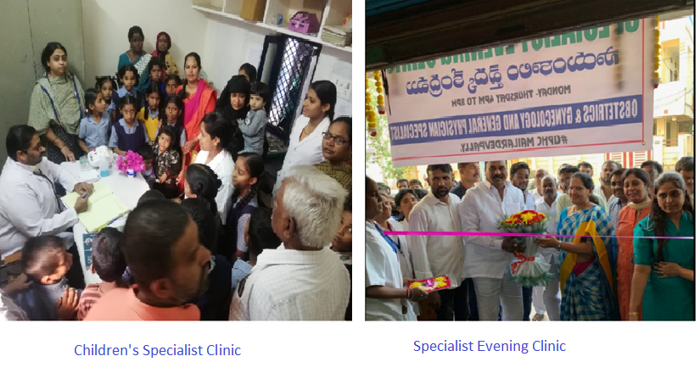
Buy in from Public Representatives

Slide 16
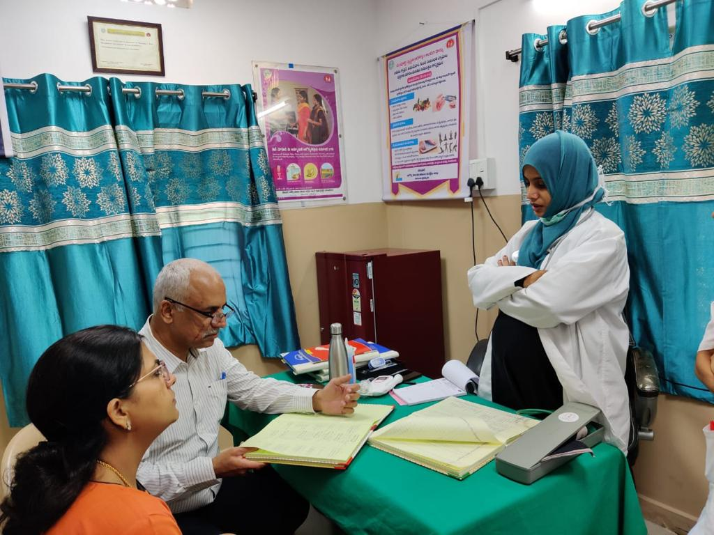
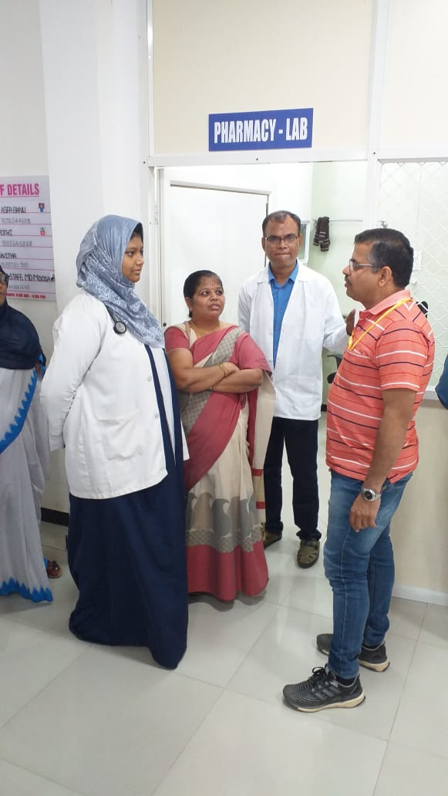
Bastidawakhana visit by Sri.Manohar Agnani, JS(P) & Sri.Yuvraj, Director (NHM)

Slide 17
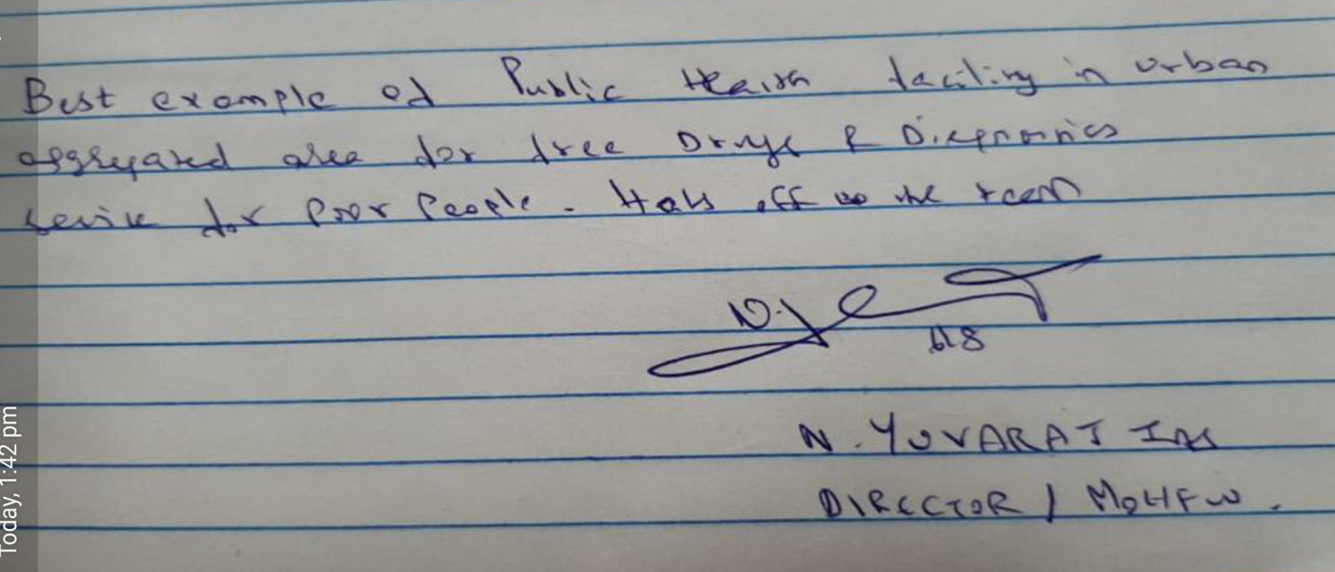
Bastidawakhana visit by Sri.Manohar Agnani, JS(P) & Sri.Yuvraj, Director (NHM)

Slide 18
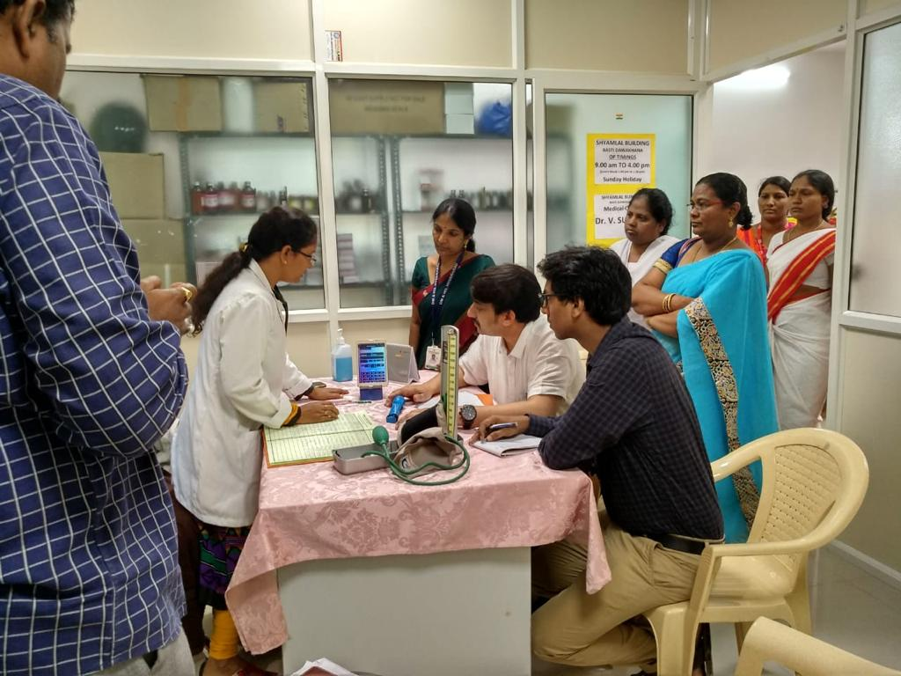
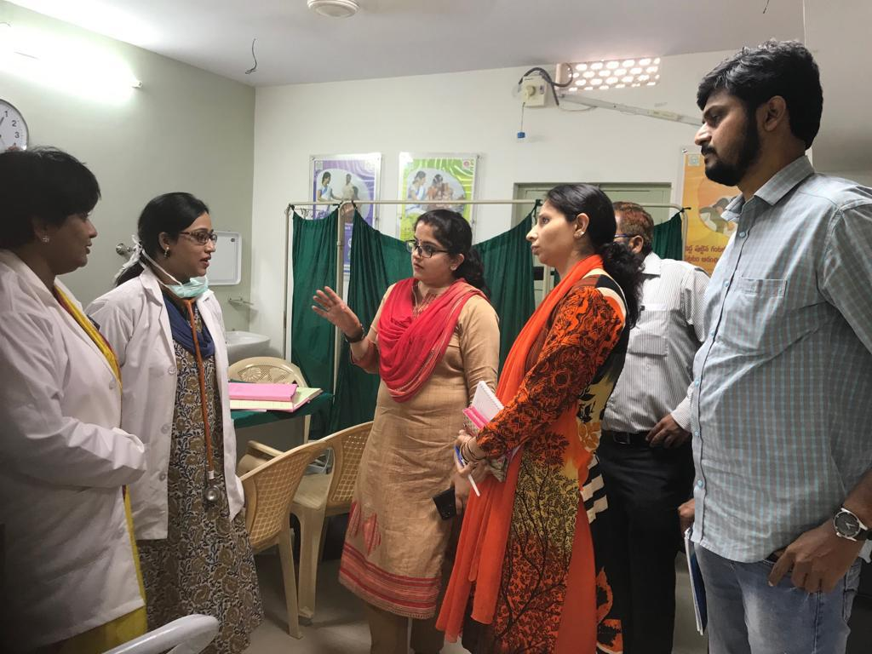
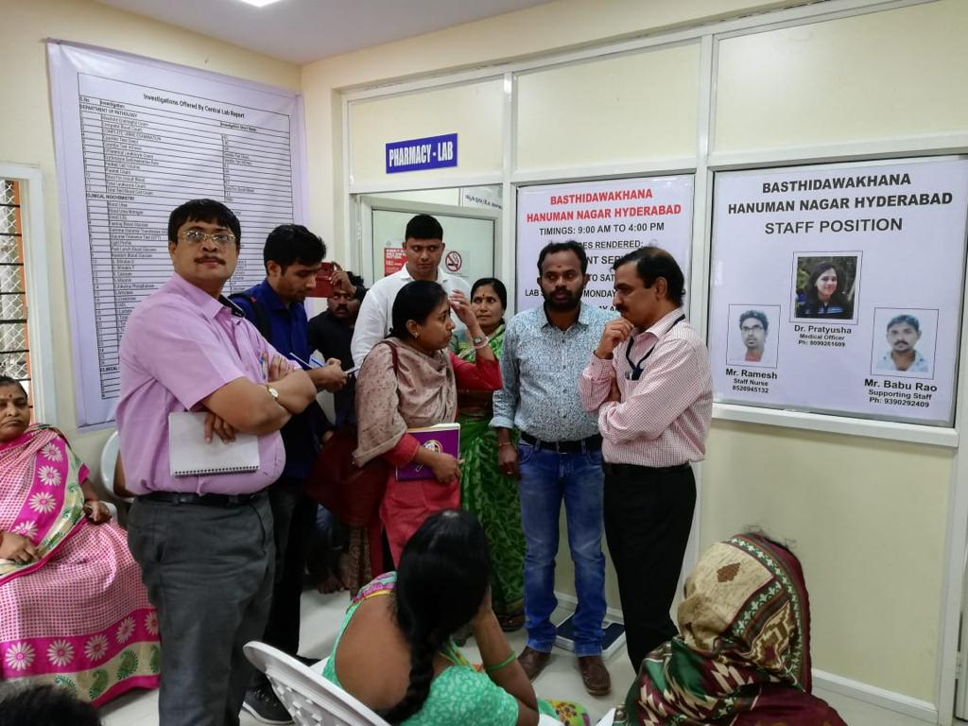
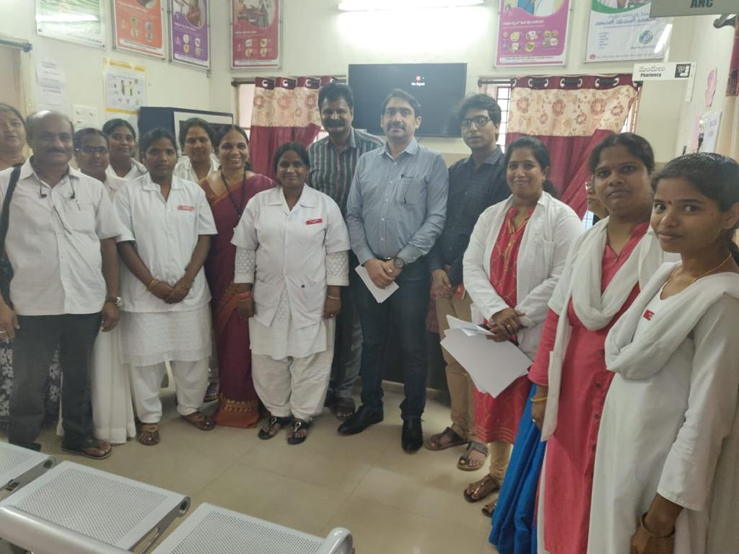
NHM, GoI Team visit to Bastidawakhanas

Slide 19
Thank you !!

