Slide 1
Betul Initiative for Zero TB District
Dr Rahul Shrivastava,
DTO, Betul

Slide 2
District Profile
1 | Projected Population (in lakh) – 2018 | 1745246
2 | Urban Population (in lakh) | 228883
3 | Rural Population (in lakh) | 557478
4 | Tribal Population (in lakh) | 958885
5 | Total No. of TB Units & Blocks in the district | TUs- 10 Blocks- 10
6 | No. of Designated Microscopy Centres | 21
7 | No of District /Satellite Hospitals in the district | 1
8 | No of CHC Hospitals in the district | 10
9 | No of PHC Hospitals in the district | 33
10 | No. of PHIs submitting monthly reports in the district | 16/42 (38%)
11 | Total number of X Ray Units in district, out of them Number of Functional | 10
12 | No of ICTCs in district | 2
13 | No of Functional FICTCs In District | 9
14 | No of DMC & ICTC/FICTC Colocated | 47

Slide 3
Background
In 2016, Active Case Finding (ACF) was initiated in Betul district.
District reached the Notification rate of 234/Lakh to 242/lakh from 119 per lakh
From 4Q16, Notification rate of the district started declining.
Data was Plotted Block wise and Village wise
Nikshay data was mapped on Block maps- village wise

Slide 4
Process of Mapping
Villages were marked on Block maps- Source Nikshay Notification- Jan 17-June 18
Villages with zero notification- Marked Green
Villages with 1-2 TB Patients notified-Marked Yellow
Villages with more than 3 TB Patients- Marked Red
House to House Survey in Green Marked villages
BMO, MPWs, ANMs, ASHA Sahyoginis and ASHAs were to be involved in the process along with RNTCP Staff.
Block wise lists of green villages was hand over to respective STS/ STLS, MPWs
Activity calendar was prepared for whole district

Slide 5
iqujhf{kr jk"Vªh; {k; fu;a=.k dk;ZØe ftyk cSrwy ftys esa vk;ksftr f'kfoj dsys.Mj vDVw0 2015
Øa0 | mipkj bdkbZ dk uke | fodkl[k.M dk uke | f'kfoj LFky | fnukad | uksMy vf/kdkjh dk uke | izHkkjh vf/k0 | fpfdRld MhVhvks@ch,evks@,evks | ,lVh,l@,lVh,y,l | yscVsDuhf'k;u | Hk`R; | fjekdZ
1 | vkeyk | vkeyk | jrsMk | 29/10/2015 | Jh vt; ukxys 930004244 | ch,evks | MkW jkgqy JhokLro@MkW euh"k tksutkjs | Jh ;ksxs'k lw;Zoa'kh | Jh lhrkjke okLdys | Jh eqUuk yky | ysizk lkslk;Vh
2 | fppksyh | fppksyh | ihiycjkZ | 14/10/2015 | Jh vt; ukxys 930004244 | ch,evks | MkW jkuw oekZ@MkW r:.k lkgw | Jh gfjjke egktu | Jh jke:i dsu | Jh bUnznso okxnzs | ysizk lkslk;Vh
3 | fppksyh | Hkheiqj | pkanw | 19/10/2015 | Jh vt; ukxys 930004244 | ch,evks | MkW jkgqy JhokoLro | Jh gfjjke egktu | Jh c`tyky mbds | Jh eqUuk yky | ysizk lkslk;Vh
4 |  |  | fiifj;k xqokZ | 23/10/2015 | Jh vt; ukxys 930004244 | ch,evks | MkW jkgqy JhokoLro | Jh gfjjke egktu | Jh c`tyky mbds | Jh bUnznso okxnzs | ysizk lkslk;Vh
5 | HkSlansgh | vkBusj | fgMyh | 26/10/2015 | Jh vt; ukxys 930004244 | ch,evks | MkW jkgqy JhokLro@MkW jathr | Jh dksey okfMok | Jh iatkcjko dukVs | Jh eqUuk yky | ysizk lkslk;Vh
6 |  |  | iqlyh | 30/10/2015 | Jh vt; ukxys 930004244 | ch,evks | MkW jkgqy JhokLro@MkW jathr | Jh dksey okfMok | Jh lq/kkdj lqjtqls | Jh bUnznso okxnzs | ysizk lkslk;Vh

Slide 6
Activity
As per the Calendar, house to house survey was conducted in all green marked villages (350 villages) in all blocks simultaneously.
BMOs supervise the whole activity.
All filled formats were submitted to DTO by BMOs after cross checking
Out of 350 green marked villages, in 102 villages either TB Presumptive or new TB Case was found.
248 Villages have been identified with Zero TB applying the definition of 18 months and where not a single presumptive or case found on survey in the whole district.
WHO Consultant made visit to 5 villages on random basis in 2 visits along with DTO to cross verify the details.

Slide 7
Notification- Betul District

Slide 8
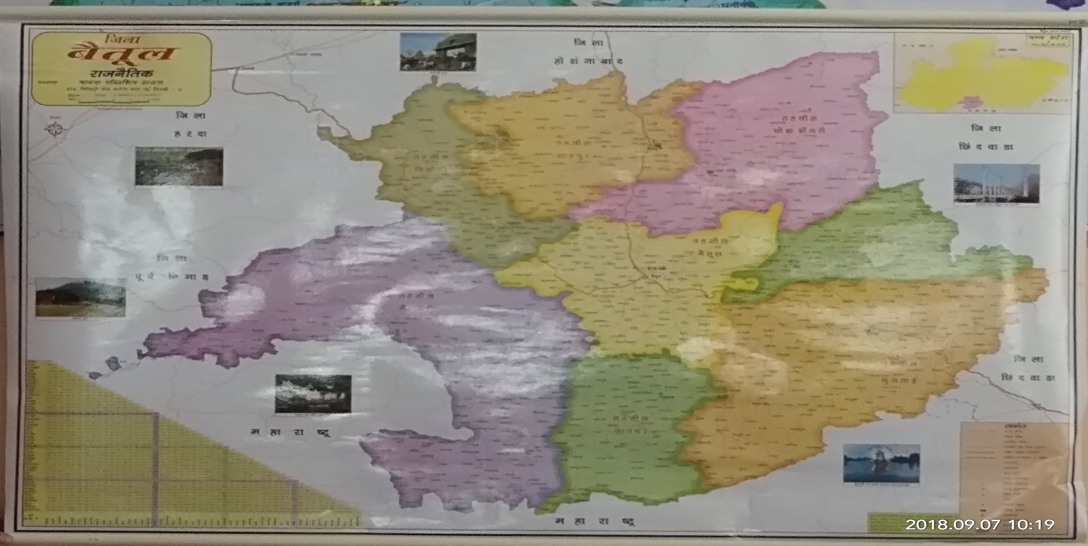
Betul District Map

Slide 9
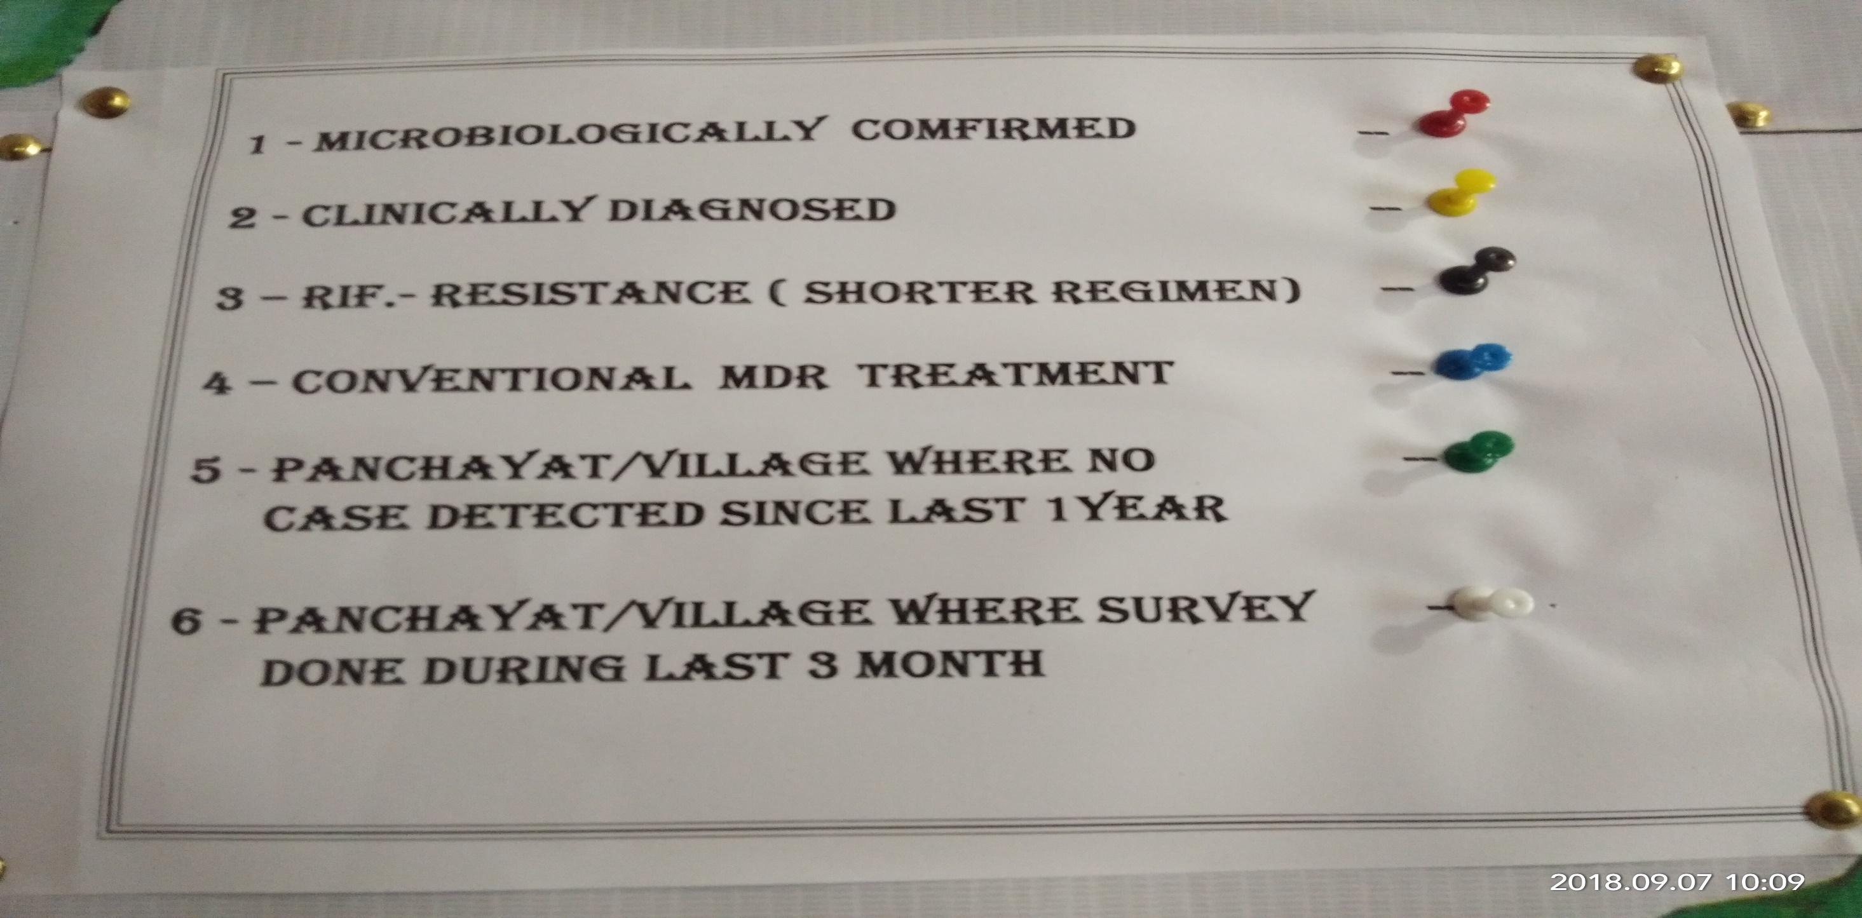
Criteria of Mapping Patients

Slide 10
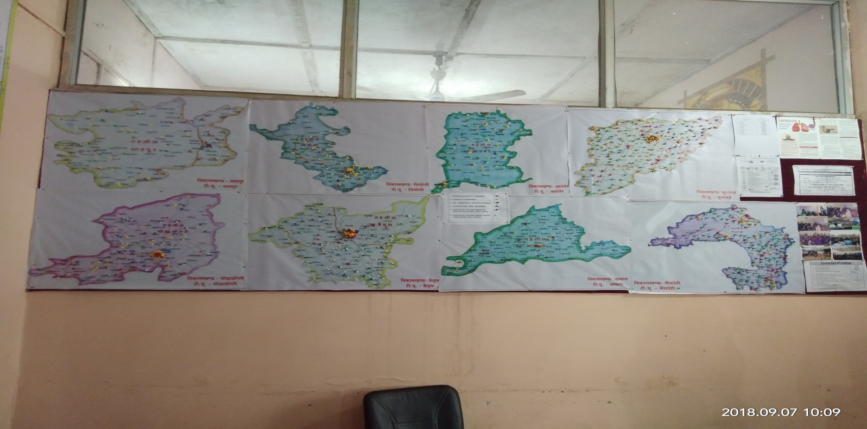
Map of all Tehsils of Betul

Slide 11
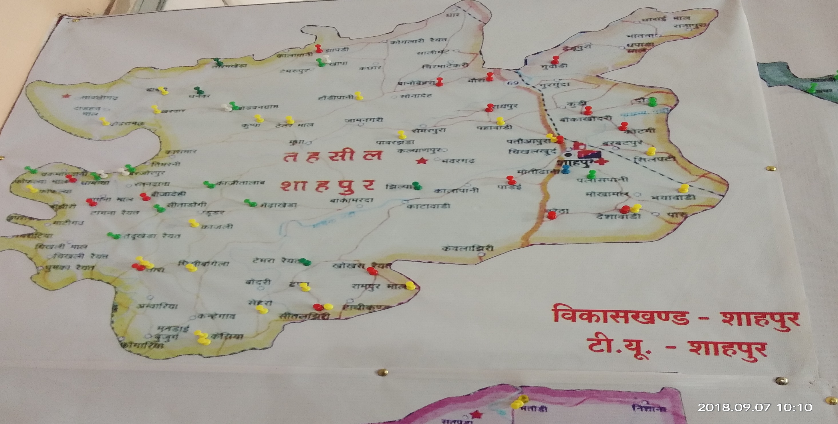
Shahpur Tehsil

Slide 12
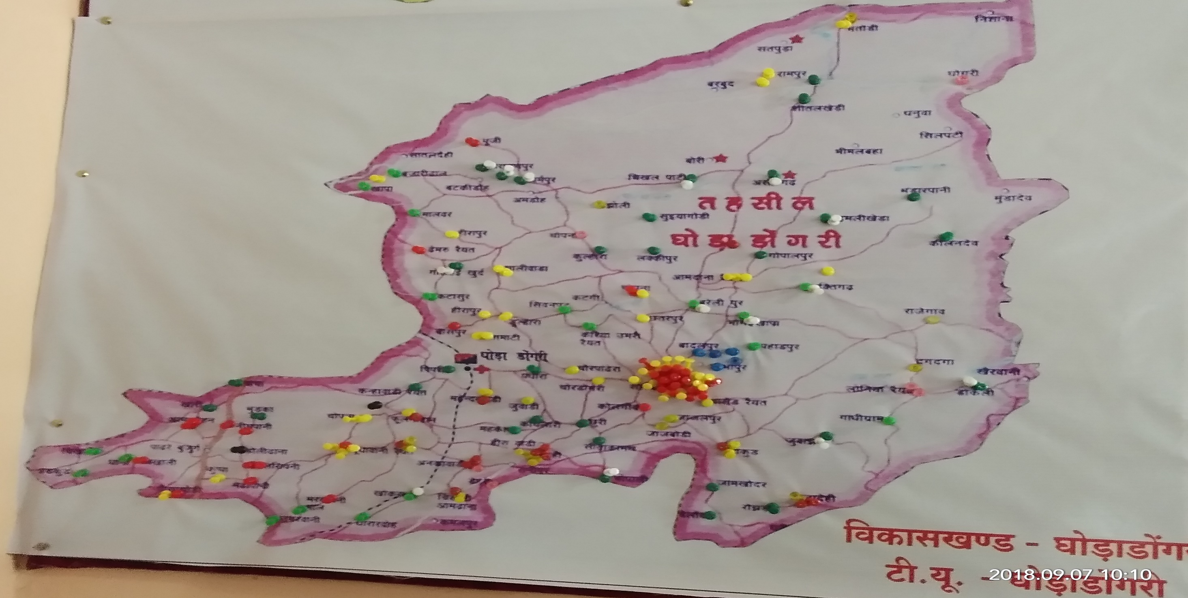
Ghodadongri Tehsil

Slide 13
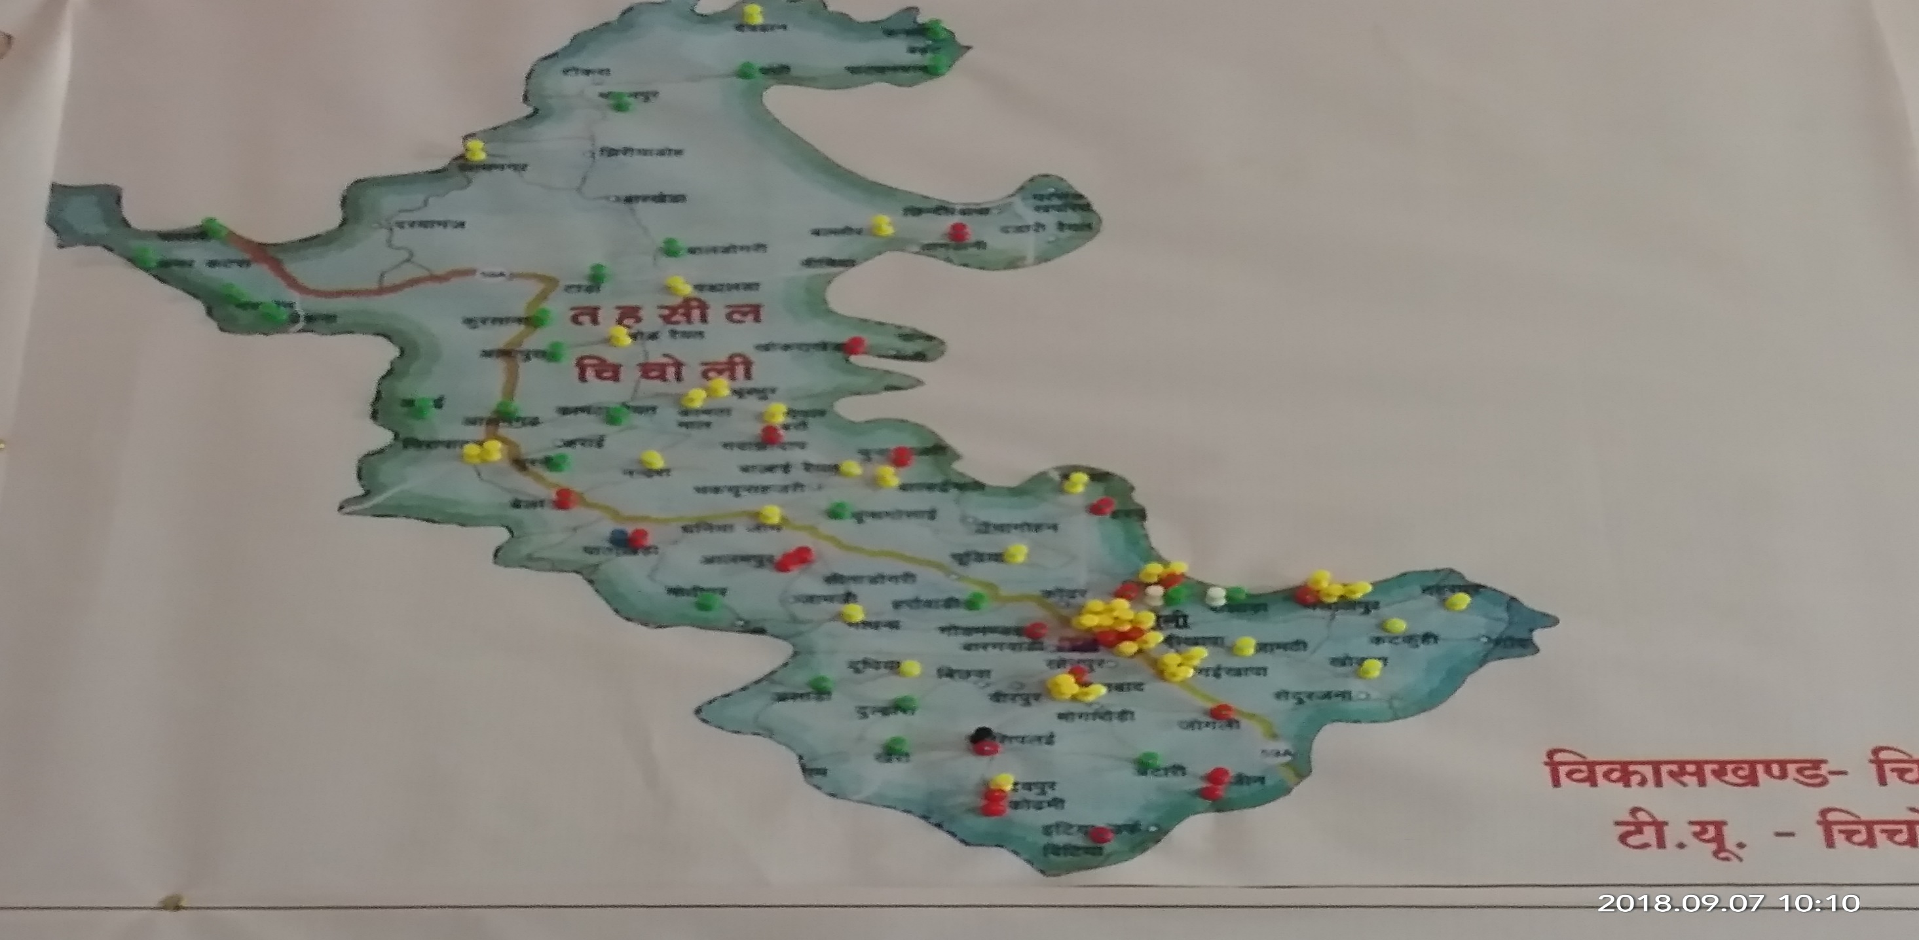
Chicholi Tehsil

Slide 14
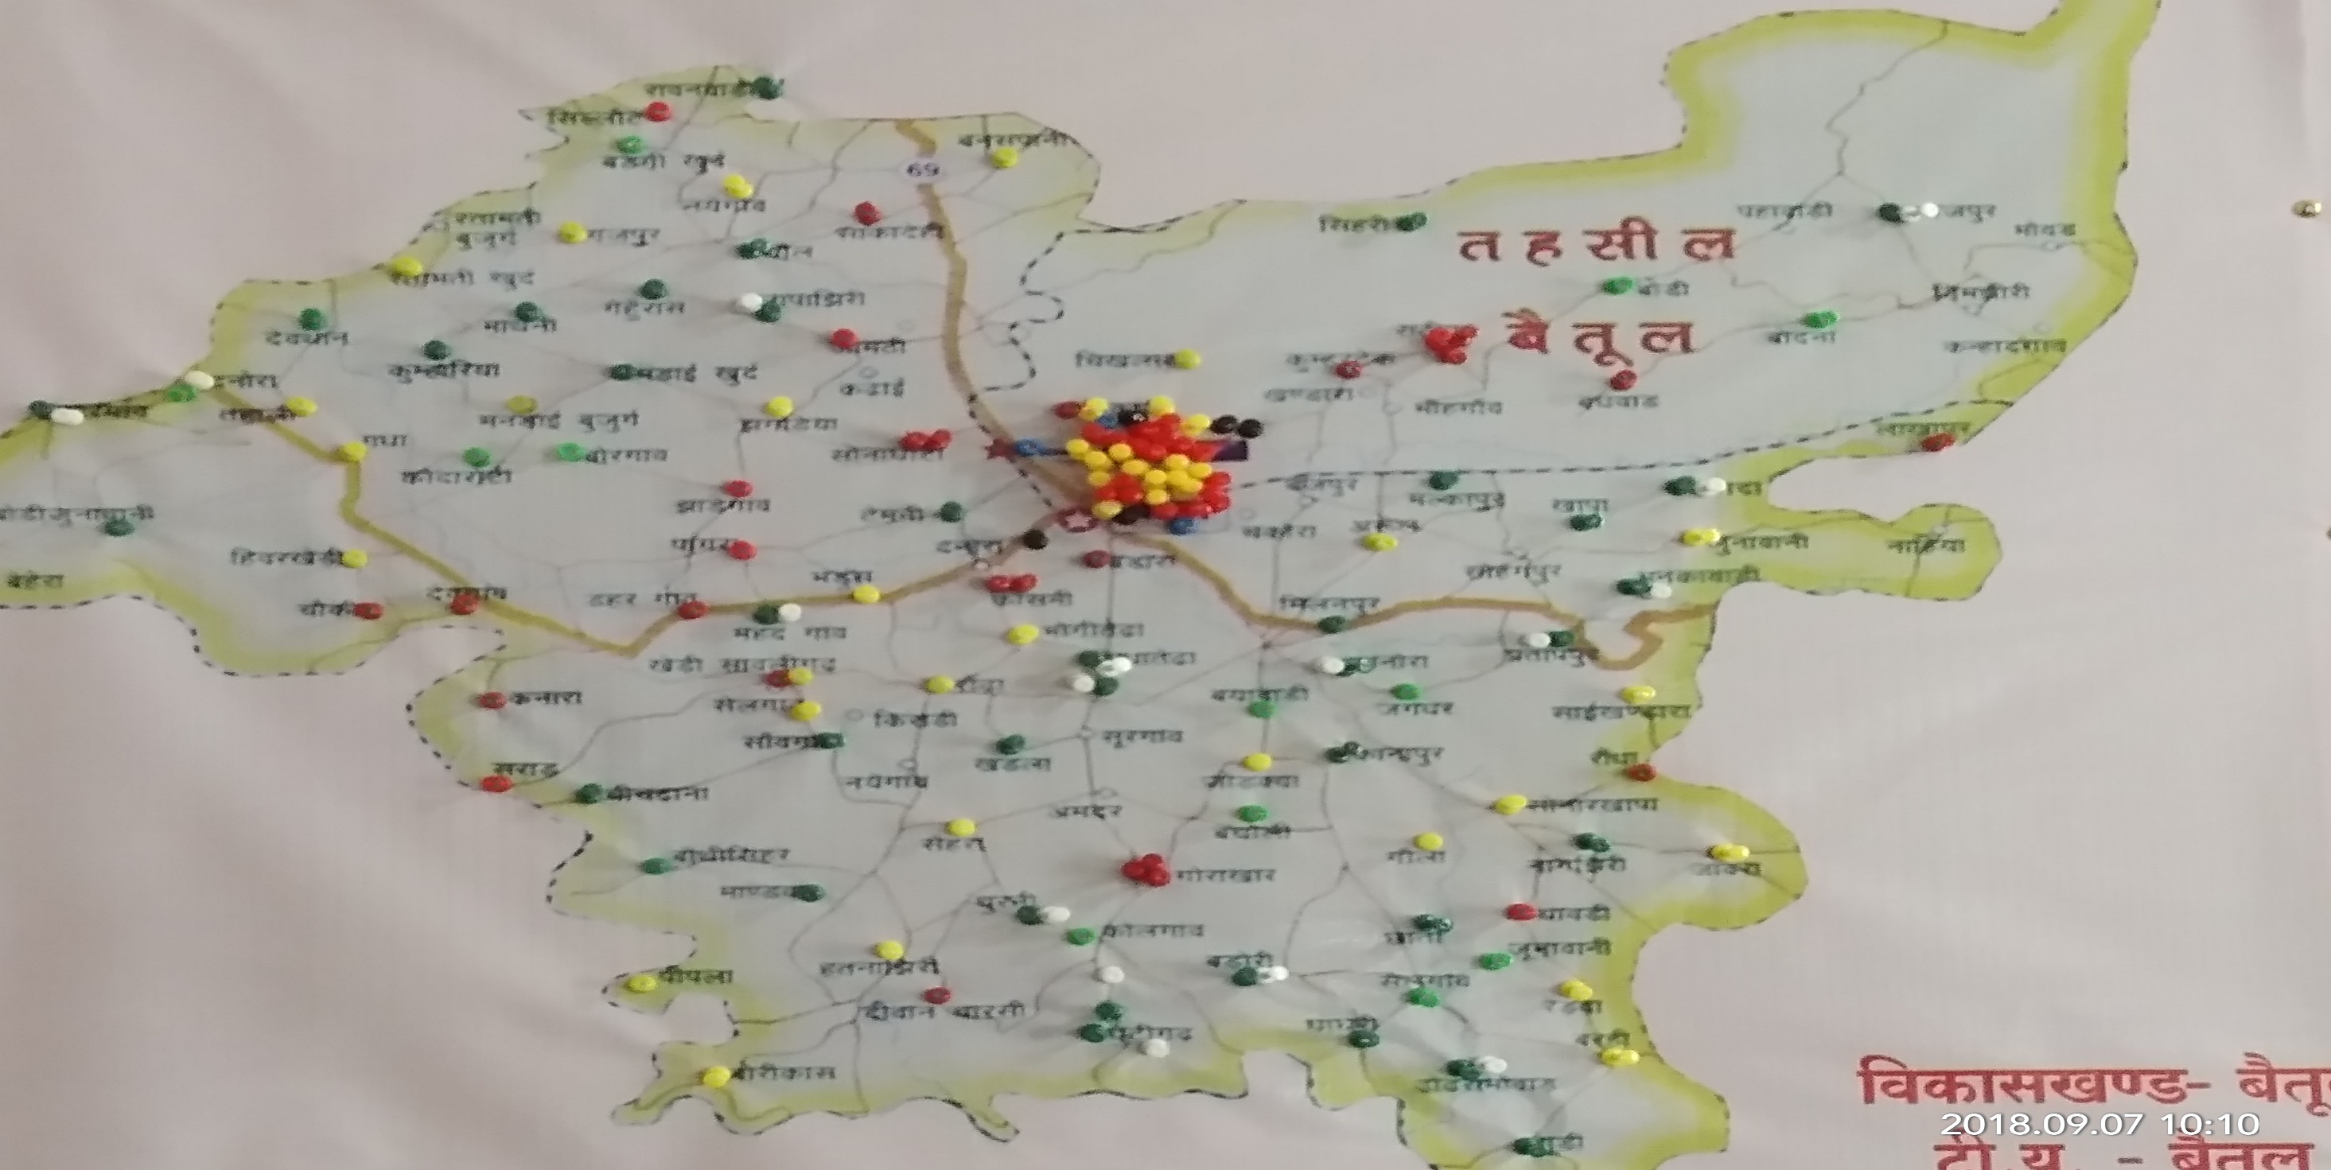
Betul Urban & Sehra Block

Slide 15
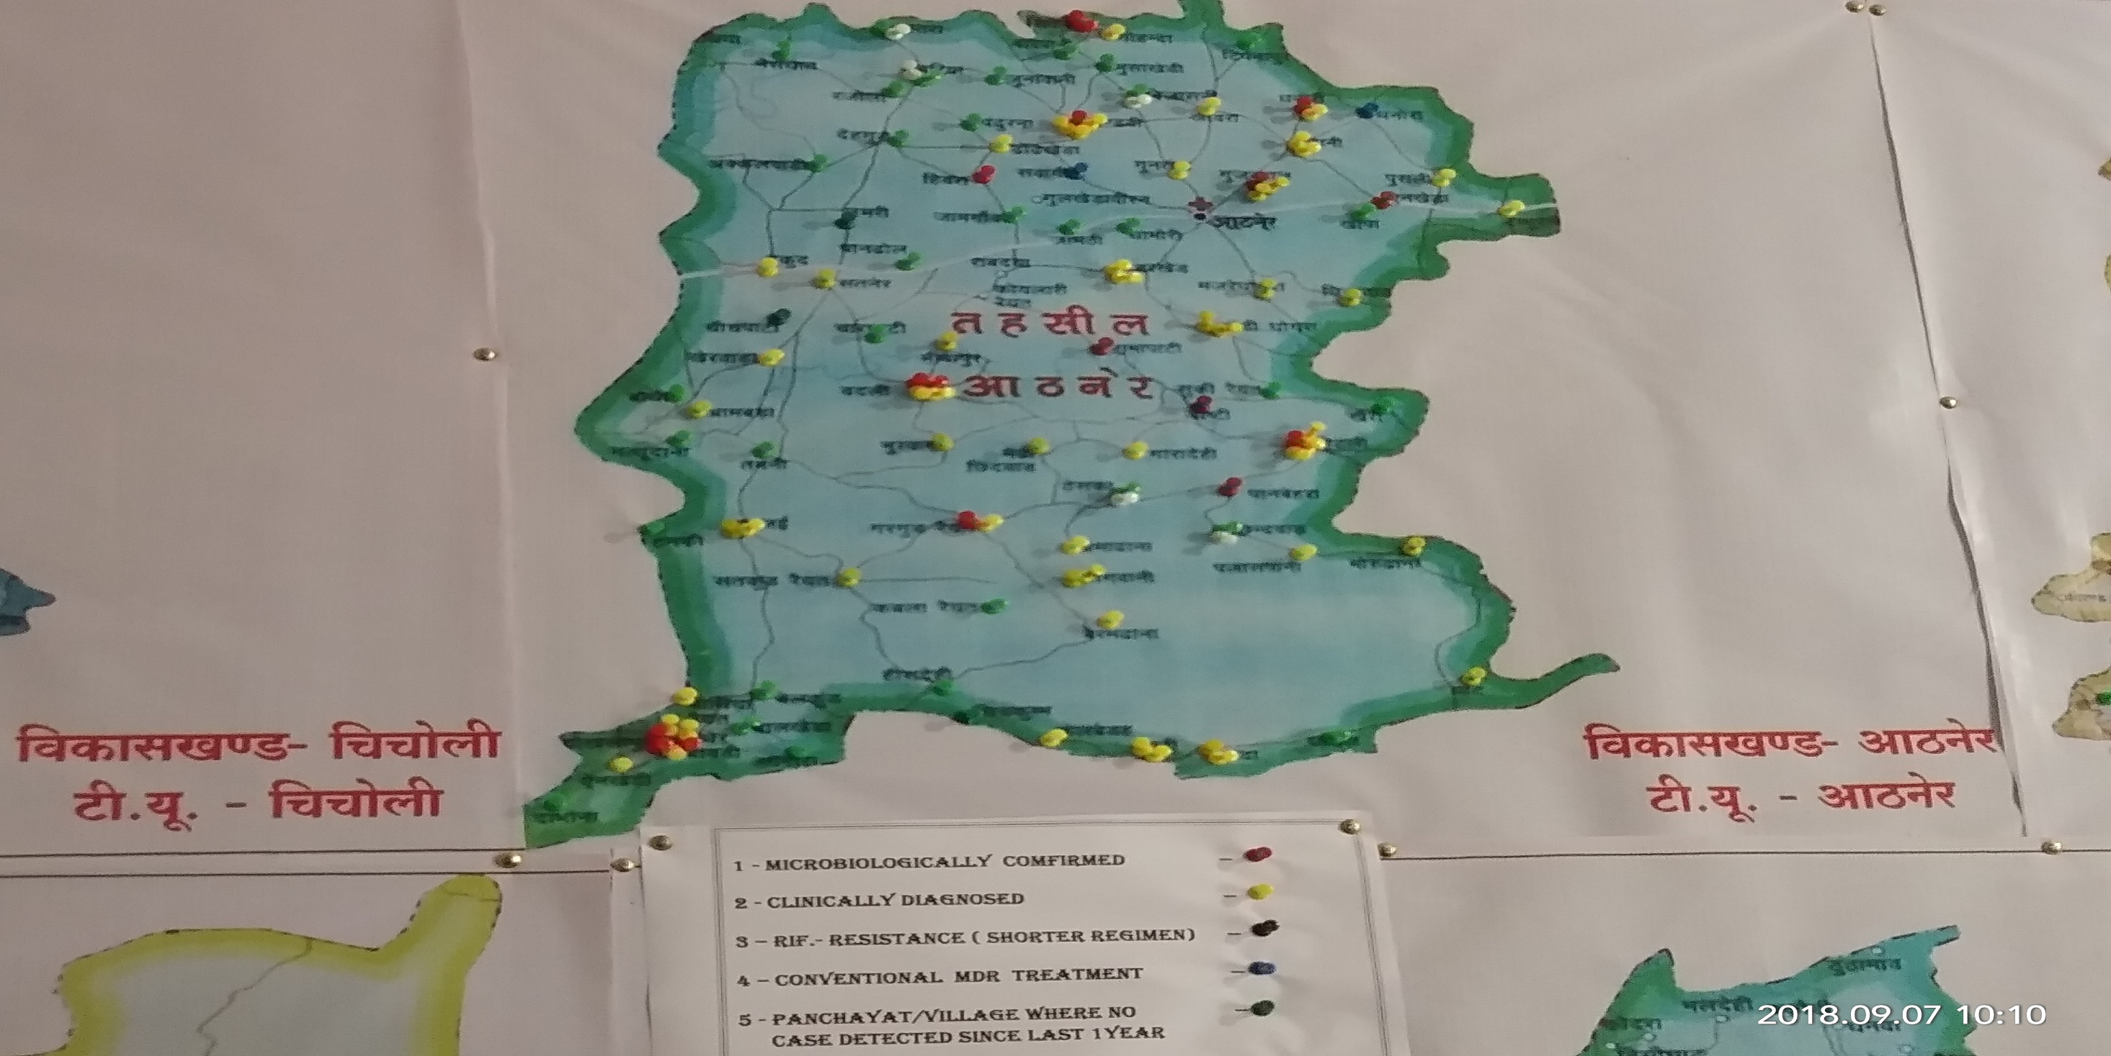
Athner Tehsil

Slide 16
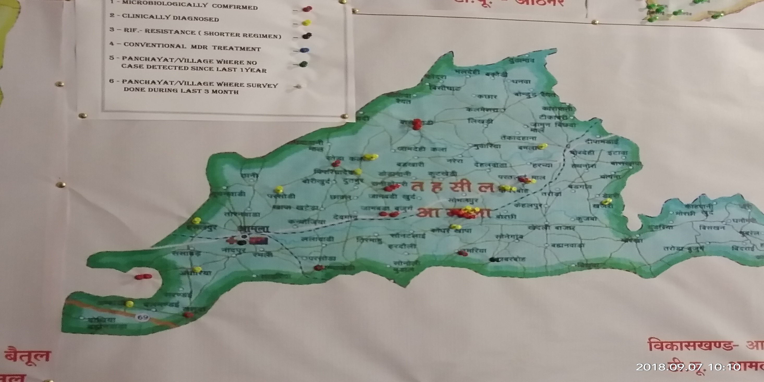
Amla Tehsil

Slide 17
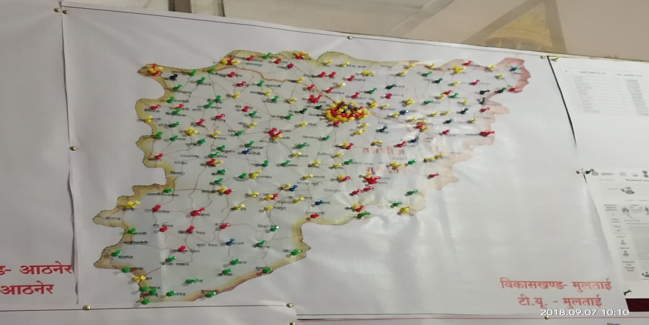
Multai Tehsil

Slide 18
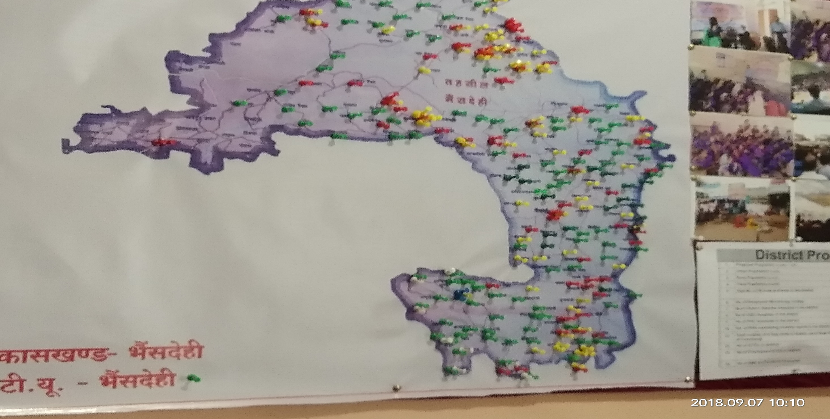
Bhainsdehi Tehsil

Slide 19
Zero TB Villages
Criteria to label Zero TB Village
If in any village, there is no New TB Patients identified in last 18 months, we are labelling village as Zero TB Village
Applying above criteria, there are almost 248 villages identified in Betul district which can be labelled as Zero TB Village, if we apply time line from January 2017 till June, 2018.
These villages have been shown as green in tehsils maps

Slide 20
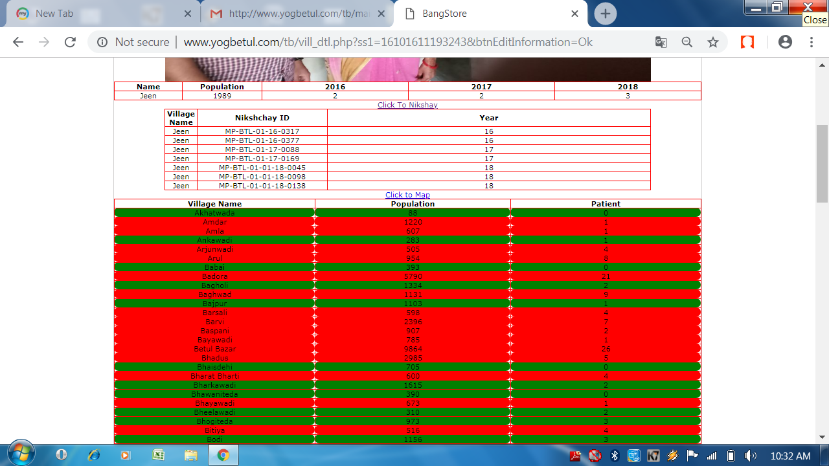

Slide 21
Observations
It is evident from the mapped Patients, that villages nearing the borders of other districts of MP or Maharashtra, are showing more number of TB Patients.
Villages bordering other tehsils of Betul have less number of TB Patients.
Mapping of TB Patients has given a new direction to plan actions in the specific Panchayats and villages.
Few villages and Panchayats have shown declining trend of new TB infection.
Areas from which migration is observed have shown more number of TB Patients.
This will help us to re organize the TB services in the district.
Active Case Finding activities can be planned in more meticulous manner to get maximum results.
Few Urban red pockets will attract more effort now

Slide 22
Lessons Learnt
Mapping of TB Patients is not impossible or difficult
TB Free Village/ Panchayat Concept- is achievable
Meticulous planning and dedicated RNTCP Staff- can make TB Free District Concept materialize
Classification of villages- as per disease burden- Really works
Assessment of disease burden geographically- is possible in available resources

Slide 23
THANKS

Slide 24
Block -- Betul
SNO. | Village | SNo.Temni | Village
1 | Ravan Wadi | 11 | Mahadgaon
2 | Badgikhurd | 12 | Sawnga
3 | Dhol | 13 | Churni
4 | Devthan | 14 | Bodi
5 | Kumhariya | 15 | Bodna
6 | Borgaon | 16 | Khapa
7 | Kodaroti | 17 | Malkapur
8 | Lapajhiri | 18 | Ankawadi
9 | Mandai Khurd | 19 | Milanpur
10 | Sihari | 20 | Partapur

Slide 25
Block -- Betul
SNO. | Village | SNo.Temni | Village
21 | Bayawadi | 31 | Ghutigad
22 | Hathnora | 32 | Badori
23 | Jagdhar | 33 | Kolgaon
24 | Bagholi | 34 | Mandwa
25 | Chhata
26 | Junawani
27 | Selgaon
28 | Ghoghri
29 | Gudi
30 | Dhodramehar

Slide 26
Block -- Amla
SNO. | Village | Sno | Village
1 | Bamni | 11 | Kajli
2 | Kohpani | 12 | Itawa
3 | Khanapur | 13 | Pindarai
4 | Turaborgaon | 14 | Lilajhar
5 | Bangaa | 15 | Ladi
6 | Sasabad | 16 | Chutki
7 | Bhuyari | 17 | Thanimal
8 | Kelpur | 18 | Deepamandai
9 | Dangariya | 19 | Ghatawadi
10 | Kanojiya | 20 | Rajegaon

Slide 27
Block – Multai, Prabhat Pattan
SNO. | Village | SNo. | Village
1 | Borped | 11 | Jamthi
2 | Kund | 12 | Malegaon
3 | Dabka | 13 | Junapani
4 | Kalapathan | 14 | Rana
5 | Sukna | 15 | Baregaon
6 | Sarsi | 16 | Sirsawadi
7 | Pipriya | 17 | Kanjana
8 | Jhunkari | 18 | Sonekhedi
9 | Sivanpani | 19 | Pipriya
10 | Jamthi | 20 | Karpa
21 | Khedikort | 22 | Khedi Bujurg

Slide 28
Block – Multai, Prabhat-Pattan
SNO. | Village | SNo. | Village
23 | Kuppa | 34 | Magonakala
24 | Hadoli | 35 | Parsodi
25 | Nindbohi | 36 | Jogikheda
26 | Parangi | 37 | Pohar
27 | Katanga | 39 | Shirdi
28 | Chirolijhipa | 40 | Kajli
29 | Sawari | 41 | Kanhakhapa
30 | Semriya | 42 | Aambada
31 | Hivra | 43 | Datora
32 | Lakhapur | 44 | Kutkhedi
33 | Bhaisadand

Slide 29
Block -- Shahpur
SNO. | Village | SNo. | Village
1 | TaramKheda | 11 | Chikhli Rayyet
2 | Kahapa | 12 | Temra Rayyet
3 | Bodawan Gram | 13 | Kalapani
4 | Chakmagwani | 14 | Palaspani
5 | Dhamnya | 15 | Doudi
6 | Barjorpur | 16 | Khapa
7 | Seetadongri | 17 | Jhhilpa
8 | Tendukheda
9 | Kaji Talab
10 | Mendakeda

Slide 30
Block -- Ghoradongri
SNO. | Village | SNo. | Village
1 | Banjaridhal | 11 | Suiyagondi
2 | Kahapa | 12 | Kumhara
3 | Rampur | 13 | Lakkipur
4 | Shitalkhedi | 14 | Gopalpur
5 | Malwar | 15 | Golhai Khurd
6 | Chikhalpani | 16 | Shaktigad
7 | Aseergad | 17 | Bhogaikhapa
8 | Bhandarpani | 18 | Barelipur
9 | Imlikheda | 19 | Sivanpat
10 | Kilandev | 20 | Katasur

Slide 31
Block -- Ghoradongri
SNO. | Village | SNo. | Village
21 | Kreya Rayyit | 31 | Seetakamath
22 | Pahadpur | 32 | Duri
23 | Umri | 33 | Padhara
24 | Gandhigram | 34 | Pipri
25 | Dokli | 35 | Koylari
26 | Juwajhar | 36 | Mehkar
27 | Rojhad | 37 | Kanhawadi
28 | Jamkhodar | 38 | Khokhra
29 | Bellot | 39 | Dharakhoh
30 | Bhopali | 40 | Jhadkund

Slide 32
Block -- Chicholi
SNO. | Village | SNo. | Village
1 | Patangram | 11 | Ajai
2 | Panchhi | 12 | Alamgad
3 | Mohanpur | 13 | Kamtha Raiyyat
4 | Chalsi | 14 | Niwari
5 | Amarkatra | 15 | Rojhda
6 | Gawasen | 16 | Chira Patla
7 | Baldongri
8 | Tanda
9 | Kursana
10 | Amapura

Slide 33
Block -- Athner
SNO. | Village | SNo. | Village
1 | Damona | 11 | Khedi
2 | Ainkheda | 12 | Sukirayyiat
3 | Hiradehi | 13 | Nathudhana
4 | Chichkund | 14 | Bothi
5 | Sonora | 15 | Choch
6 | Chalkheda | 16 | Charpati
7 | Tanki | 17 | Jamthi
8 | Kawla Rayyiat | 18 | Dhamori
9 | Tenmi | 19 | Pandhol
10 | Teska | 20 | Akkalwadi
21 | Umri | 22 | Dehgud

Slide 34
Block – Bhaisdehi, Bhimpur
SNO. | Village | SNo. | Village
1 | Burhanpur | 11 | Nirugi
2 | Jamalni | 12 | Khadgat rayyit
3 | Patoli | 13 | Sakli
4 | Kasai | 14 | Dahpani
5 | Jamukheda | 15 | Matka
6 | Kokra | 16 | Khapa Rayyait
7 | Bothiya Khabra | 17 | Khemgaon
8 | Baramacha | 18 | Rainka Khapa
9 | Palaskhedi | 19 | Chikalpur
10 | Udma | 20 | Sioni
21 | Pipriya | 22 | Pohar

Slide 35
Bhaisdehi, Bhimpur
SNO. | Village | SNo. | Village
23 | Koylari | 35 | Dodajam
24 | Boregaon | 36 | Thengna
25 | Siwanpat | 37 | Tigariya
26 | Manchi | 38 | Kalida
27 | Maharpani | 39 | Bijori
28 | Kumbhi | 40 | Bori
29 | Duni | 41 | Utri
30 | Kotmi | 42 | Malegaon
31 | Jamudhana | 43 | Dahriya
32 | Naharpur | 44 | Kawda
33 | Dabit Rayyity | 45 | Harra
34 | Khaira | 46 | Salwan

Slide 36
Bhaisdehi, Bhimpur
SNO. | Village | SNo. | Village
47 | Dhara Gohan
48 | Gohati
49 | Putanga
50 | Lapa
51 | Ghutiya
52 | Jamu
53 | Uti
54 | Dodra
55 | Ratamati

