Slide 1


Bringing to forefront
Maternal Death Surveillance and Response during COVID-19 Pandemic Madhya Pradesh
National Health Mission
Department of Public Health and Family Welfare
Madhya Pradesh

Slide 2
MADHYA PRADESH – DEMOGRAPHIC PROFILE
Area | 3 Lakh Sq Km
Population Census 2011 | 7.2 Crore
%Scheduled Tribes | 20.8
%Scheduled Castes | 15.6
Districts | 51
Development Blocks | 313
Tribal Blocks | 89
%Literacy | 70.60
Density of Population | 236 per Sq. Km.
Sex Ratio at Birth | 925 (SRS 2016-18)

Slide 3
RATIONALE
Madhya Pradesh is the 2nd largest state with 3rd highest MMR in the country
MMR is 173 per 1,00,000 live births (SRS 2016-2018)
Rate of decline in MMR is less than desired
(SDG goal of reduction of global MMR to 70 per 1,00,000 live births by 2030)
State level Maternal Death and Surveillance Review (MDSR) program initiated in 2015-16, completed the state and district level orientation
Districts did not show satisfactory compliance to the MDSR program even after repeated instructions and reviews by state.
During COVID 19 Pandemic MDSR program became more neglected.

Slide 4
Maternal Mortality Ratio (MMR) Trends: India & M.P.
Average Annual Rate of Reduction (AARR) of Maternal Mortality Ratio (MMR) for Madhya Pradesh is 5.51 and to achieve SDG 2030 goals required AARR is 6.96

Slide 5
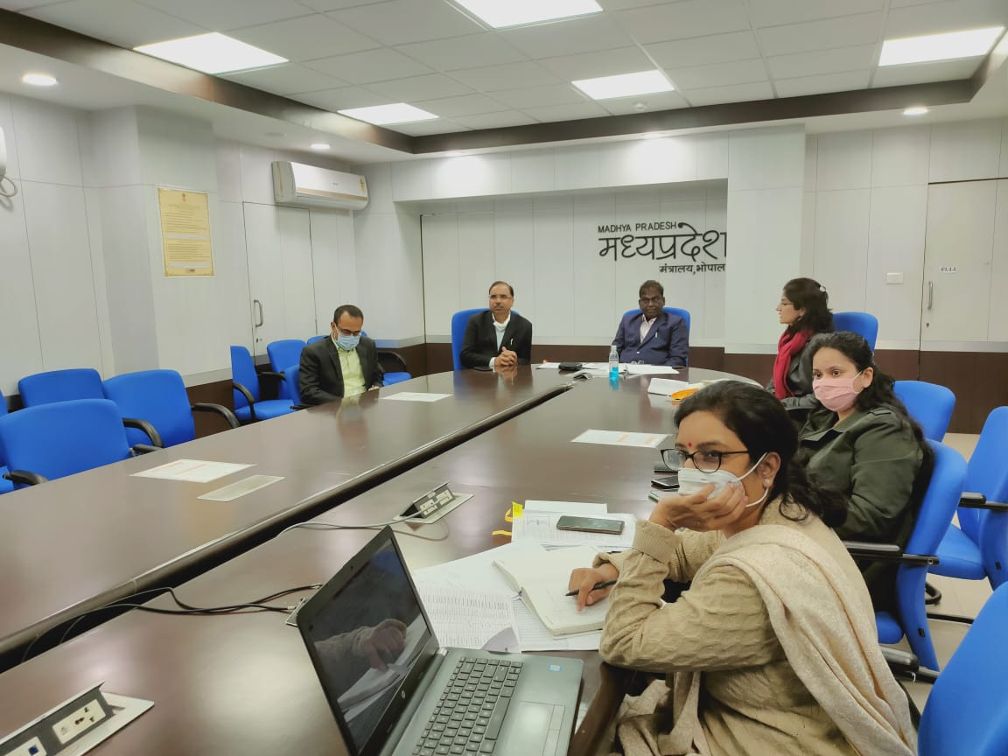
INTERVENTION AT A GLANCE
Online maternal death reviews from state level in presence of higher officials to keep focus on MDSR during COVID pandemic.
Online State Level MDR Review Meeting chaired by Hon’ble Health Minister, Additional Chief Secretary, Commissioner, Mission Director & Additional Mission Director NHM and
Deputy Director Maternal Health

Slide 6
INTERVENTION AT A GLANCE
Online MDSR intervention intensified in April 2020
Online 78 maternal deaths reviewed at state level
Overall status of maternal deaths, in depth review of selected cases and near miss cases
Concerned district officials including Gynecologists, MOs, Staff Nurses, ANMs, Blood Bank Incharges, LTs etc. attend the review along with the faculty from Medical Colleges and Regional Team

Slide 7
PROCESS OF MDSR AT STATE LEVEL
Three major activities performed:-
Presentation on division wise MDSR status by two Regional Directors on rotation.
Presentation of two Maternal death case per division.
Presentation of two near miss cases.

Slide 8
Process of Divisional MDSR Status
A presentation template for divisional reviews shared by state
Regional directors with support of regional RMNCHA Coordinator collect the data and enter on the template
Every month two divisions are identified for presentation on divisional MDSR status review by state
Regional Directors present the divisional MDSR status updates in presence of Medical College faculties
Referral cases to Regional Medical Colleges and place of maternal death included in the presentation

Slide 9
Process of Review of Maternal Death Cases
List of MDR cases and a template for MDR presentation shared with districts
Districts conduct CBMDR, FBMDR and share findings in presentation form
Every month two maternal death cases (mostly with preventable cause) per division are identified for state level review
State level officers review the cases based on supporting documents prior to MDSR meeting
District level officers present the case during state level Maternal death review

Slide 10
Process of Near-Miss Case Review
Districts share the brief description of management of near miss cases
Selection of two near-miss cases
Details of Near-miss cases invited from districts
Treating Doctors and Nursing Staff present the case

Slide 11
MATERNAL DEATH REPORTING AND REVIEW STATUS

Slide 12
CAUSE WISE ANALYSIS OF MATERNAL DEATHS (n=873)
Division wise leading cause of Maternal death
PPH is leading cause of maternal mortality in Gwalior division (29%) and Sagar division (27%)
Hypertensive disorders are leading cause for maternal mortality in Jabalpur division (27%)
Anemia is responsible for 25% of maternal deaths in Rewa division and 23% in Gwalior division.
Other causes are higher in Bhopal (44%) and Indore (46%) division.
Focus on Quality of MDR in Bhopal and Indore division.

Slide 13
KEY OBSERVATIONS OF THE MDR DATA ANALYSIS
74% of maternal deaths among less than 25 year of age women.
56% of deceased women primigravida
64% of deceased women registered in ≥ 12 weeks
50% of deceased women not received any ANC service by MOs.
Only 26% of deceased women detected as high risk during ANC period by ANM/MO.
Abdominal examination done in only 20% of deceased women and urine albumin in 58%.
54% of HRP detected at the time of admission

Slide 14
Gaps identified during MDSRs and corrective action taken
Field Level
Gaps related to ANC Services:
  HRP tracking and monitoring
  Quality of ANC services at VHNDs
  Quality ANC services at facilities
  Logistics at VHNDs
Corrective Action Taken:
  Customized RCH portal has been developed to track HRPs
  Establishment of Integrated Command and Control Centre (ICCC) at state to track all HRPWs
  Online training of more than 8000 ANMs in quality ANC services completed
  Gaps of logistics fulfilled in a structured way by utilizing untied funds of HWC, SHC and VHSNC
  Digital Haemoglobinometers (cuvette based) provided to 4000 CHOs and at 149 delivery points for accuracy
  Foetal doppler provided to 5278 ANMs of aspirational and HPD districts to accurately measure FHR
  Approx. 2000 CHOs are trained to deliver quality ANC services and administration of IV iron Sucrose injections
  HRP clinics are organized on every Friday to provide specialist care to HRP women.
Notes:
Recently CHAI, conducted a gap analysis related to availability logistics at VHND sites in this gap analysis Hb meter, urine albumin testing kit weighing machine and BP instruments was found in more than 80% at VHND sites.

Slide 15
Gaps identified during MDSRs and corrective action taken
Facility Level
Gaps related to Delivery Services:
  Availability of Human Resources at delivery points
  Clinical skills of the nursing staff and MOs at delivery points
  Quality services at delivery points
  Blood transfusion services
  Anaemia a leading cause of Maternal mortality
Corrective Action Taken:
  Process of recruitment of more than 2500 staff nurses under NHM
  Dakshata Trainings initiated in all districts
  Total 290 facilities selected to certify under LaQshya program
  Bulk licensing of Blood Storage Units completed by the blood cell of the directorate of health services
  Organization of Blood donation camps to ensure availability of blood in BSUs and Blood Banks
  Inj. FCM is administered to more than 2500 PNC mothers and a research study approved to generate evidence related to safety issues of Inj. FCM in ANC period

Slide 16
Other Actions Taken
Planned Birth waiting home in FRUs
Inservice CPS diploma course initiated and DNB course planned in DH
Individual monitoring of the specialists for regular functionality of FRUs
29 sanctioned obstetric HDUs out of them 17 are functional , remaining will be functional by the end of FY 2020-21
Collaboration with Medical Education Department for better coordination between new Medical Colleges and District Hospitals running in the same campus for averting unindicated referrals

Slide 17
Thank You

