Slide 1


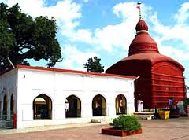
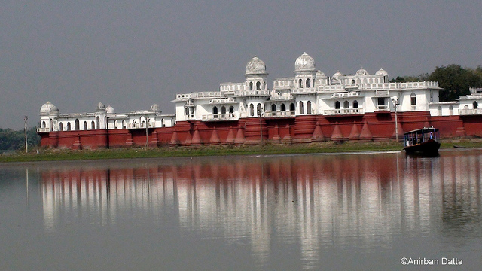
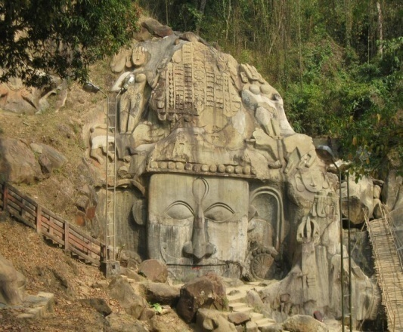
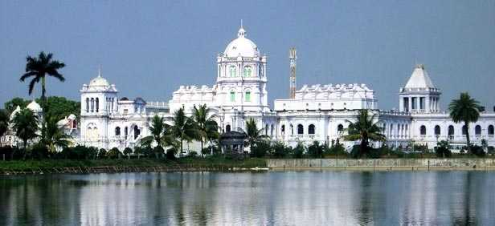
Cataract Backlog Free District Initiative:
North Tripura District
Dr Shailesh K Yadav, IAS
MD NHM, Tripura

Slide 2
NORTH TRIPURA DISTRICT
PROBLEM STATEMENT
1 | Population | 4,22,370
2 | Blocks | 08
3 | District Hospital | 01
4 | Sub-Div Hospital | 01
5 | PHC, CHC | 18
6 | GP / ADC Village | 121
7 | Household | 91,000
9 | Total families enrolled for RSBY | 50,251
North Tripura is a Newly Created District having Border with Assam, Mizoram and Bangladesh
Difficult areas, hilly terrain, Tribal dominated
No dedicated DBCP Unit leading to poor eye services
Long queue for cataract surgery
People were going to Silchar (Assam) for eye care services in pvt. Sector, leading to high OOPE
Local Community Demand for eye care services.

Slide 3
Project Outline
  Special Initiative by District Administration & DHFWS
  Baseline Survey (Tripura Eye Study): RAVI Method
    L.V Prasad Eye Institute, Hyderabad in August, 2016
  Planning
    SWOT Analysis
    MoU with Help Me See & P.C. Chatterjee Eye Hospital (NGOs)
    Fund Provision: NHM & RSBY
  Strengthening of Health Infrastructure
  Training of ASHA/ Community Mobilization
  PRI Body / Local NGO/CBO Involvement
  Community level Screening by ASHA
  Patient Evaluation at health facilities in campaign mode
  Advance Calendar for Eye Screening and Cataract Surgery by DPCB

Slide 4
Programme Description
Strengthening Health Infrastructure
  District Hospital established in 2014
  District Blindness Control Programme (DBCP) notified in 2016
    Involvement of District Hospital Rogi Kalyan Samity (RKS)
    Necessary repair & maintenance of Eye OT + 3 OT tables
    50 Bedded dedicated Eye ward

Slide 5
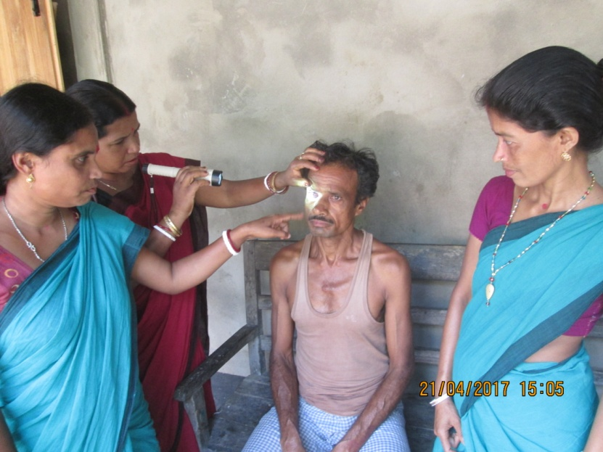
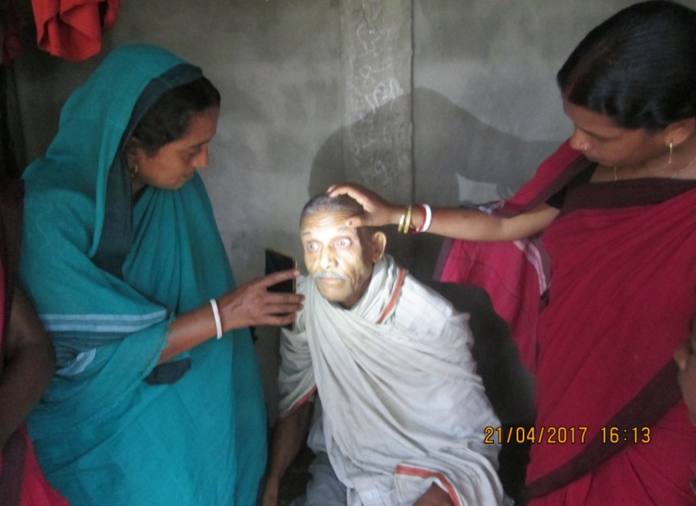
Programme Description
Community mobilisation:
1. Sensitization of PRI and NGO Members
- District and Block level
2. Development of Training Module for ASHA
- AYUSH MOs as ToT & Monthly ASHA Varosha Divas
3. Advocacy Meeting and VHNDs
- MLA/ BDO/ CDPO/ School Education
- Four VHND in each GP/ADC per month
4. IEC -BCC
- Four Types of Display in each GP/ADC Village
- District IEC Mobile Van
5. Screening by ASHAs & Patient Mobilization
House to House visit by ASHA (covering 300 population by each ASHA)
Mobilization of patients in PHC for evaluation on pre-determined dates

Slide 6
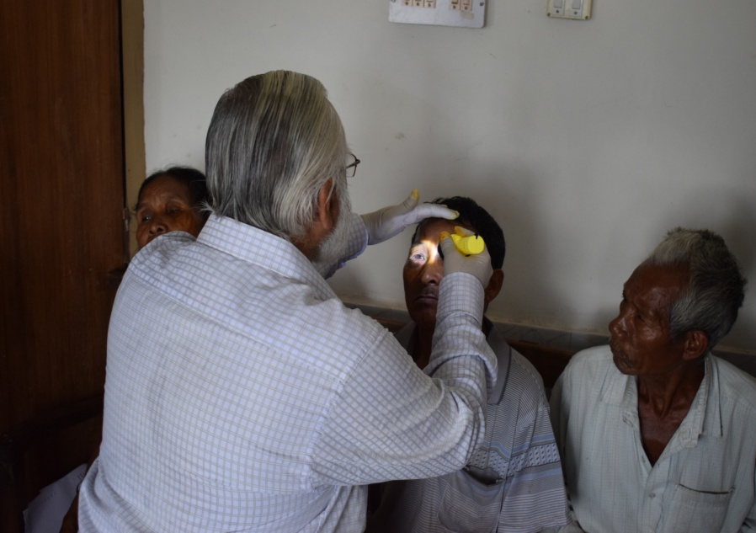
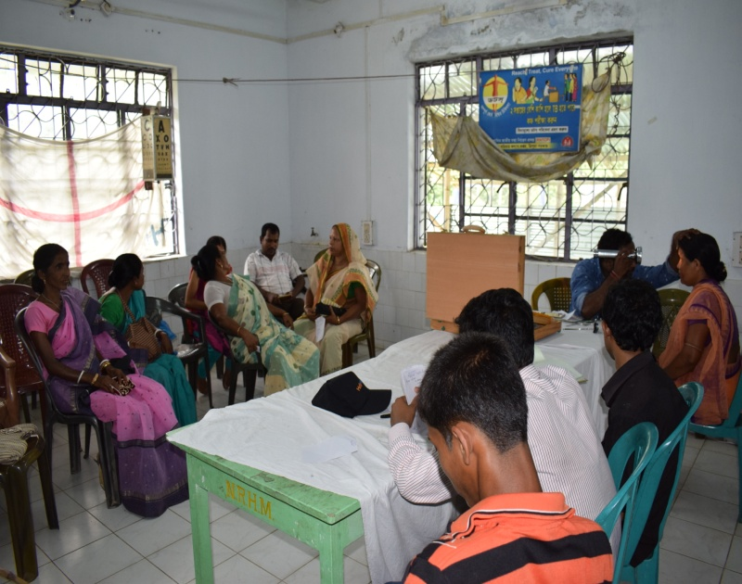
Programme Description
Patient Evaluation at Health Facility level:
Camp approach evaluation at each PHC by District Eye Surgeon, MO I/C, Ophthalmic Assistant
On spot Computerised data base on the basis of diagnosis
line listing of cases done
Supply of spectacles within 10 days to the PHC / CHC
Distribution of spectacles by ASHAs at patient doorstep.

Slide 7
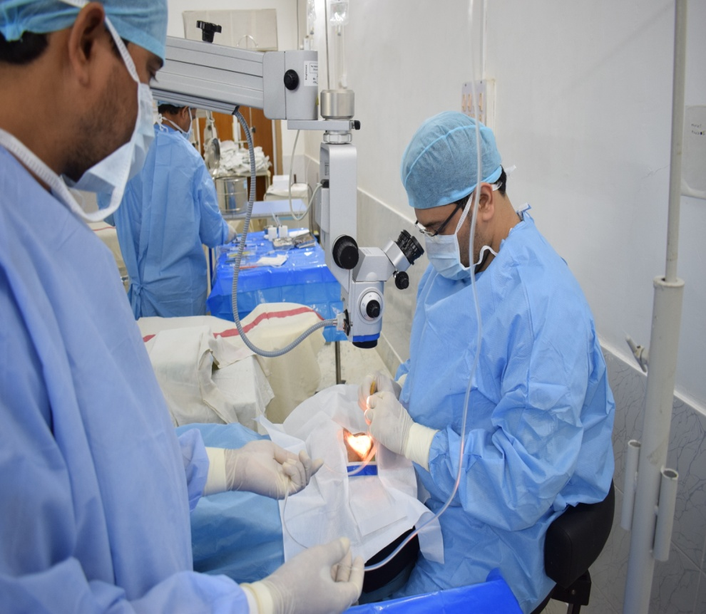
Programme Description
Cashless Services for Patients :
A prime feature of the project
Free To and fro of patient from PHC to District Hospital
Hiring of Two Mini Buses (30 Seated) for free transportation
Providing cashless services under RSBY and NPCB to patients
Availability of Pre-sterilised single use kits along with experienced eye surgeons (Help Me See and P C Chatterjee)- MSICS
IEC, Post -surgery counselling (Local NGO/CBO)

Slide 8
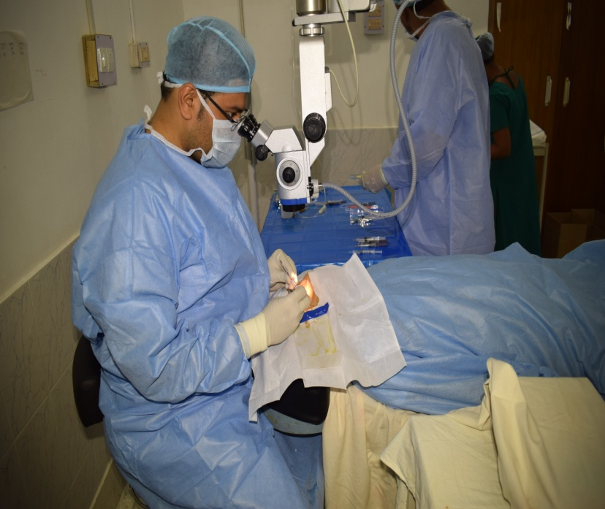
Financial Implication
ASHA incentive of 3 Rs per household visit and regular incentive under NPCB
- Rs. 2.5 L – ASHA incentive from MFP.
Repairing infrastructure of Eye OT at District Hospital
- Rs. 5.00 L from District Hospital RKS.
Development of IEC Materials, Training Kit
- Rs. 2.00 L From IEC head under MFP.
RSBY beneficiaries
NPCB: NGO provision

Slide 9
Programme Outcome
Estimated blindness suffering population - 1281 as per study
- 80000 household visit by 907 trained ASHAs
- 2286 Patients evaluated at Health Facility level
648 cataract cases identified within 03 months from 121 villages
- 83% surgery (538) done successfully in single OT at North District Hospital between March to May 2017
Cashless services to beneficiaries under RSBY
Cashless services to non-RSBY from NPCB
1500 nos. Refractive Error corrected by distribution of spectacles
- Tele-ophthalmology (1200 nos.) / Health Camp (300 nos.)
Community Ownership and Demand Generation at village level.
Self reporting, patient inflow from Assam/Bangladesh- 300 surgeries in pipeline.

Slide 10
Scalability
  Since 2012-2013, the 08 North Eastern States on an avg could do only 32% of Cataract Surgeries against the target.
  As per data from NPCB: total estimated backlog for North Eastern states is 10,12,868.
Disease Burden
Financial Resources
  RSBY And National Health Mission
  CSR Funds
Human Resources
  MPWs, ASHAs, Ophthalmic assistants
  NGOs
WHO and NPCB target is to reduce prevalence of Blindness to less than 0.3 % . By use of all resources in planned manner with focus on high backlog areas above targets can be achieved
Vision 2020

Slide 11
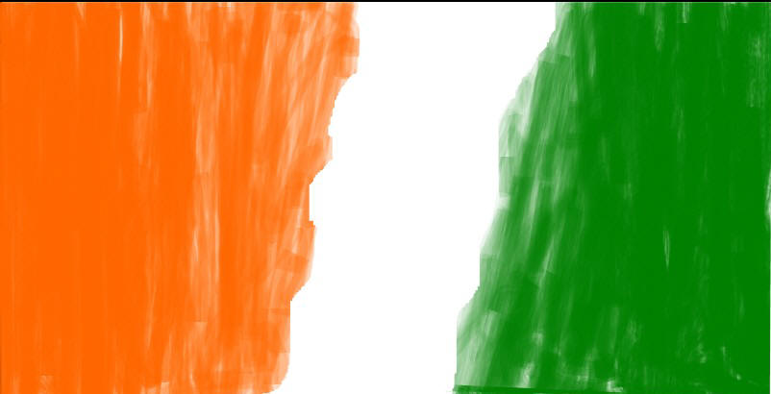

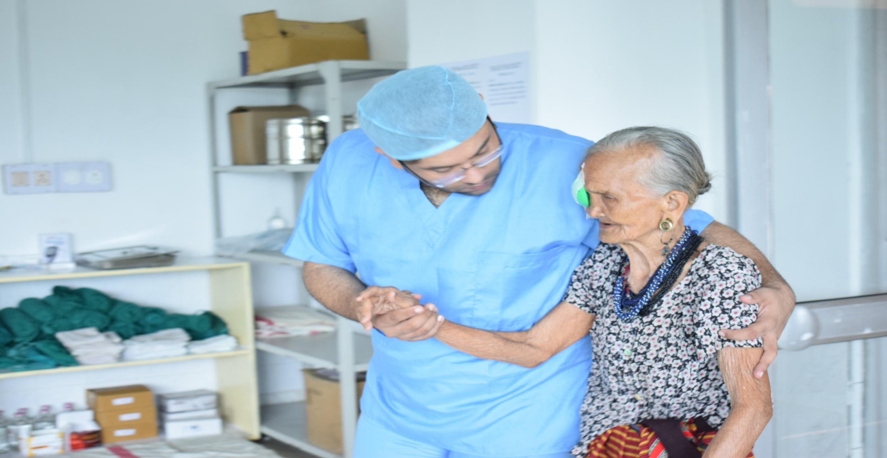
THANK YOU
Notes:
11

