Slide 1




Comprehensive Mental Health Package in Karnataka
5th Summit on Good and Replicable Practices and Innovations in
Public Healthcare Systems,
Kaziranga, Assam
30/10/2018 -1/11/2018

Slide 2
Objectives and Goals of the Package
to provide accessible, affordable and comprehensive mental health care to the needy
to reduce the treatment gap for mental illnesses
to build capacity in the area of mental health
to leverage technology to the maximum extent possible in order to achieve the above objectives

Slide 3
Comprehensive Mental Health Package in Karnataka
District Mental Health Program (DMHP) status report
  1. Clinical Services
  2. Training and Capacity building
  3. IEC activities
Innovations that are replicable
  MoU between Govt. of Karnataka & NIMHANS, Bengaluru
  Manochaitanya Program
  Maanasadhaara Program
  Tele-mentoring for Primary Care Doctors
  E-monitoring of DMHP
  Assisted Home Care for the Severe Mental illnesses
  Mental Health Care Management Software
  Taluk Mental Health Program (TMHP)
Background work for innovations
  Taluk Mental Health Program
  Tele-OCT
Future Directions

Slide 4
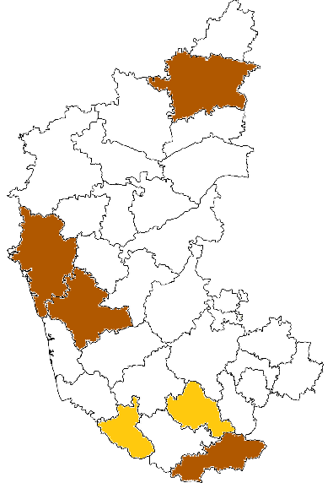
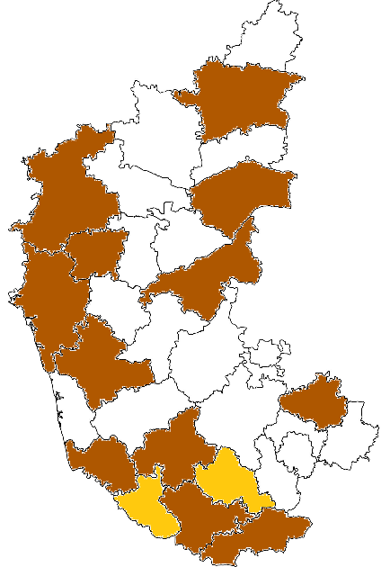
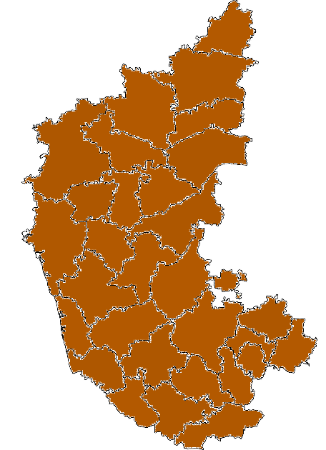
Status Report on DMHP Clinical services
2004 to 2015
2015 - 2016
2016 - 2017
Gulbarga,
Uttara Kannada,
Shivamogga, Chamarajanagara
+ Belagavi, Dharwad, Bellary, Raichur, Dakshina Kannada, Hassan, Chikkaballapura, Mysore
Entire State covered

Slide 5
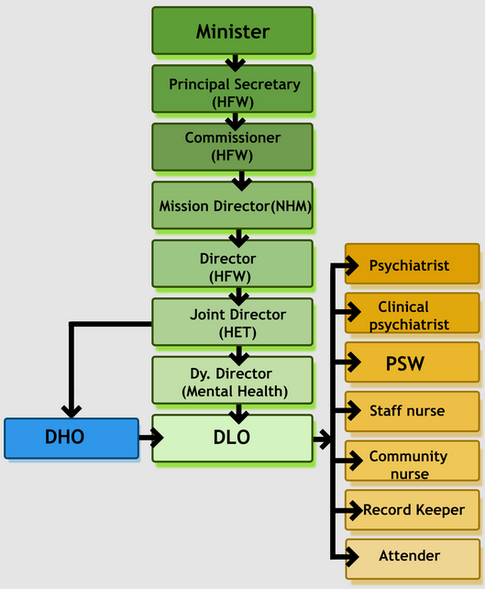
Comprehensive Mental Health Package in Karnataka
Staff working for DMHP
  1 Psychiatrist every district
  1 Clinical Psychologist
  1 Psychiatric Social Worker
  2 Nurses
  1 Record Keeper
  1 Ward Assistant
Total staff
>210 throughout State

Slide 6
Training and Capacity Building by DMHP
Persons trained | 2017-18 | 2018-19
Medical Officers | 1673 | 482
Paramedical workers | 9375 | 876
RBSK/RKSK | 658 | 92
AYUSH | 873 | 66
KSAPS/WCD counselors | 1648 | 88
Police/Prisons staff | 1473 | 8
Faith Healers/NGOs/ Elected representatives | 1380 | 8
ASHA workers | 23775 | 5163
Lifeskills imparted
Teachers | 9379 | 850
Clients in Colleges | 17433 | 3672
Clients in workplaces | 7480 | 2275
Urban slum dwellers | 5775 | 2187

Slide 7
Reaching out….

Slide 8
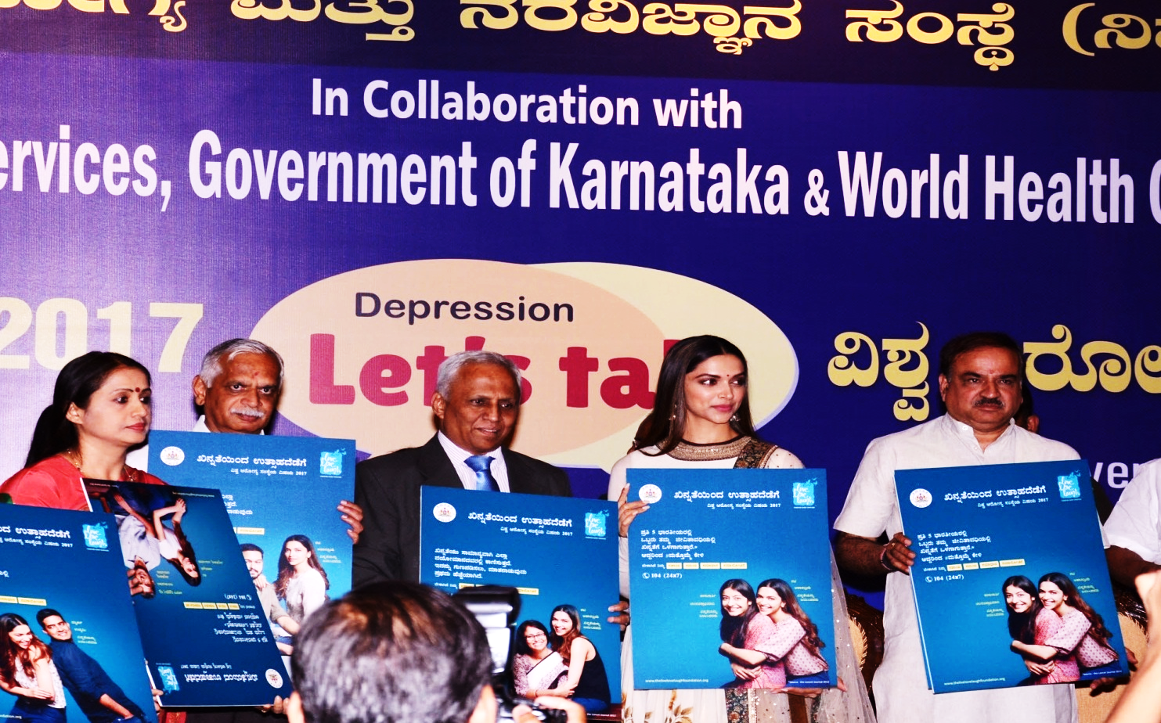
Information Education Communication activities
More than 3,00,000 persons reached
World Health Day celebrations (2017)
International Day against Drug abuse (2017, 2018)
Suicide prevention day (2017)
Commemorating World Health Day 2017 with brand Ambassador Ms Deepika Padukone

Slide 9
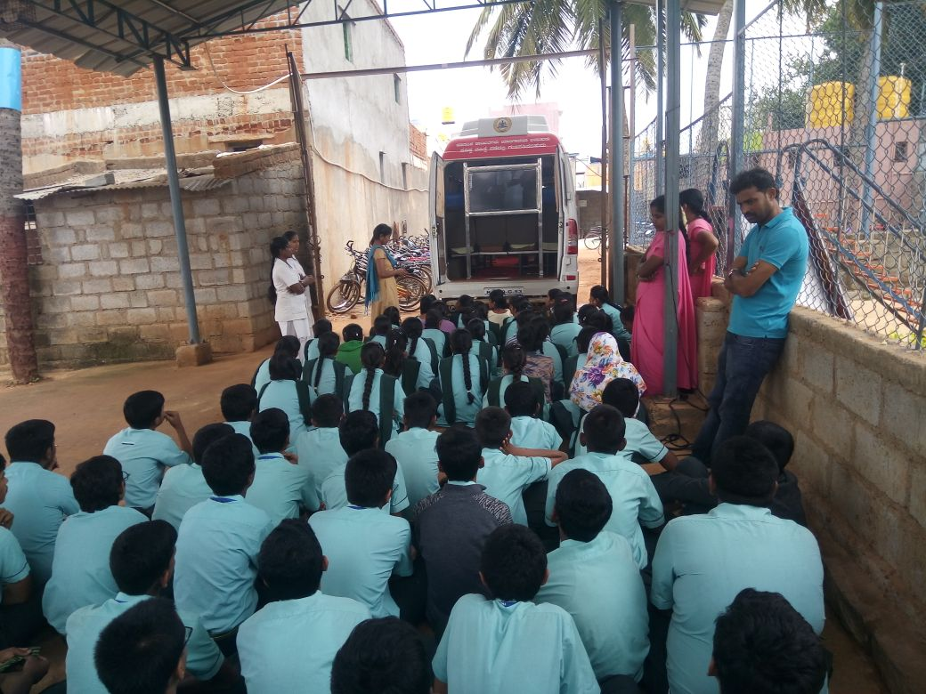
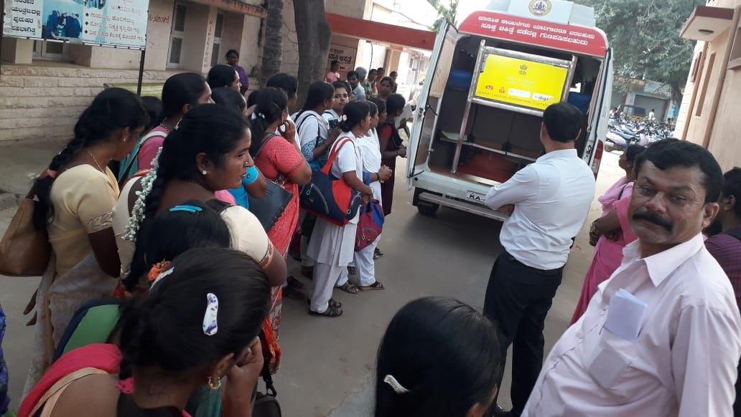
Mental health awareness using a re-furbished Ambulance
IEC activities

Slide 10

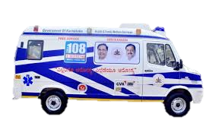
Arogyavani 104, Ambulance 108 services
100 + 100 seats
Counselors, doctors, and a psychiatrist on Tuesdays
69,000+ MH issues addressed
108 is shifting mentally ill patients
>2200 patients used the service
Staff sensitized

Slide 11
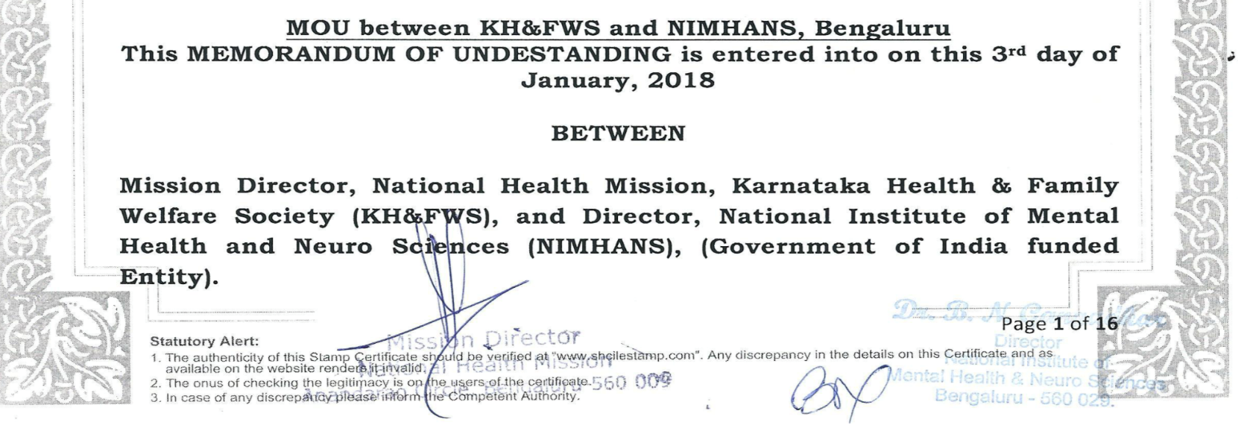
Innovation: MoU GoK & NIMHANS
Formation of the State Level Implementation team (SIT)
  To up-scale DMHP activities
  NIMHANS to work in collaboration with the Govt. of Karnataka
State level Nodal Officers
  Operations and Overseeing
  Evaluation of the program
  Training and IEC
  Drugs and Logistics
District
  DLO, DMHP team

Slide 12
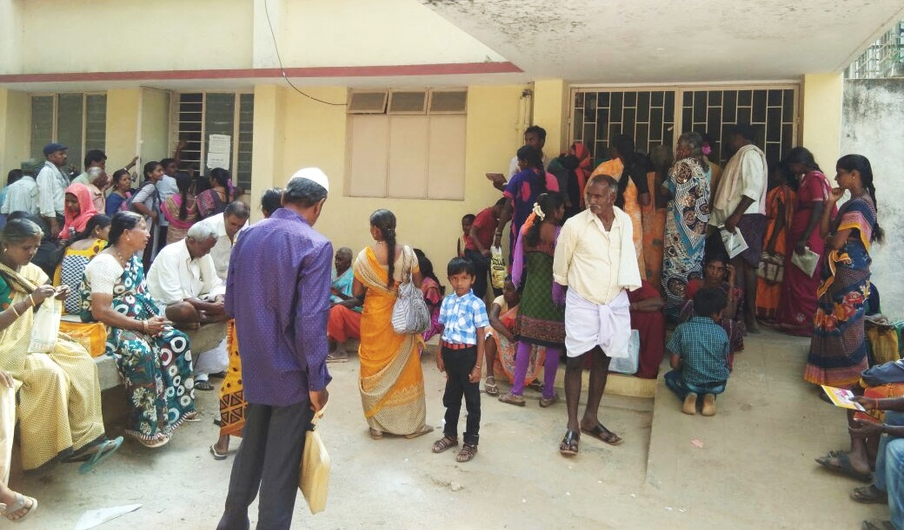
Manochaithanya –
Fixed day clinic at subdistrict level
Manochaitanya program is an innovation in Mental Health Care by GoK
Fixed day strategy for delivery of Mental Health Care at sub-district level
DMHP team conducts services in rotation (predominantly referral care)

Slide 13
Manochaitanya Program (Apr-17 to Sep-2018)

Slide 14
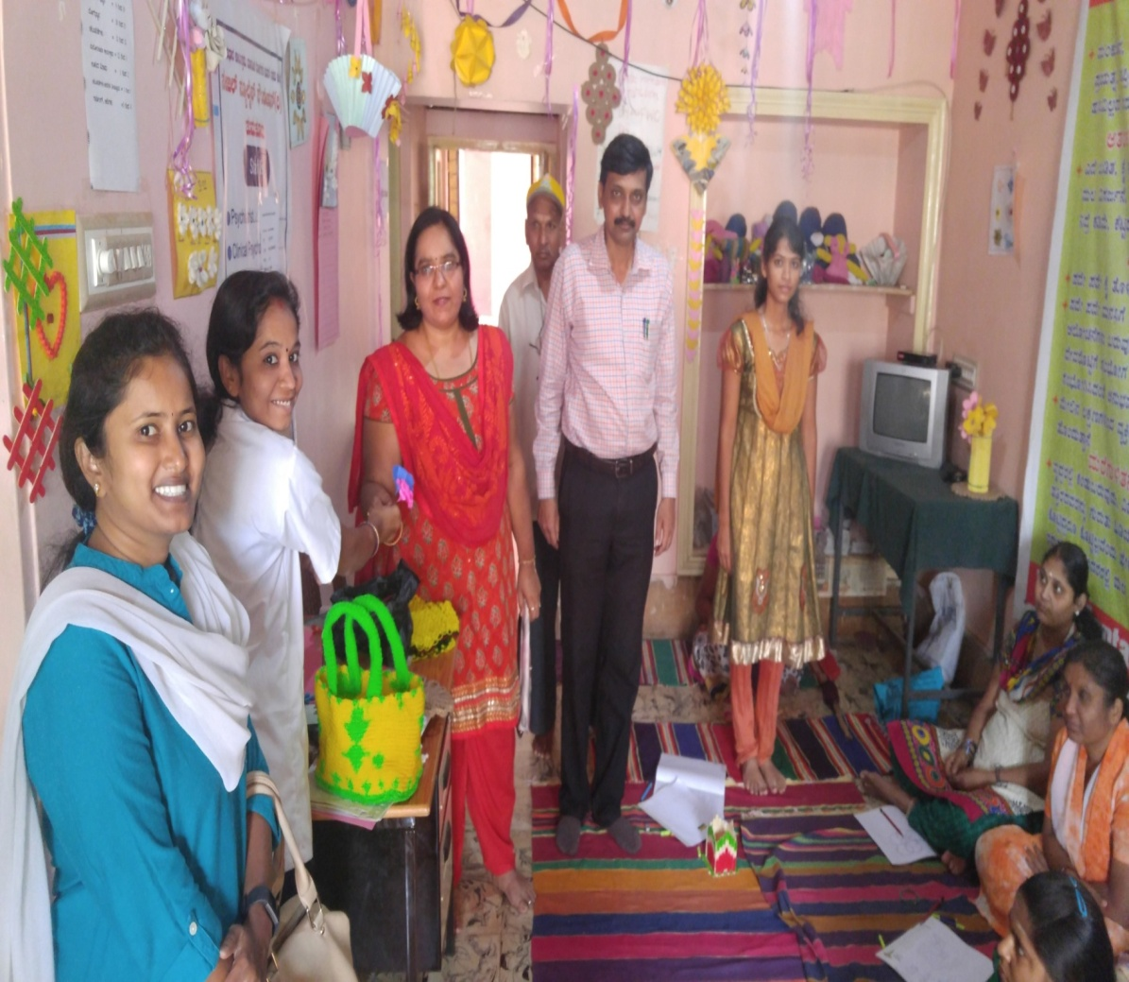
Manasadhara program – Rehabilitation services
Rehabilitation of treated chronic mentally ill patients
Run by NGOs selected by District Deputy Commissioner
Functioning in 14 districts
Beneficiaries:1439
Tumkur District

Slide 15
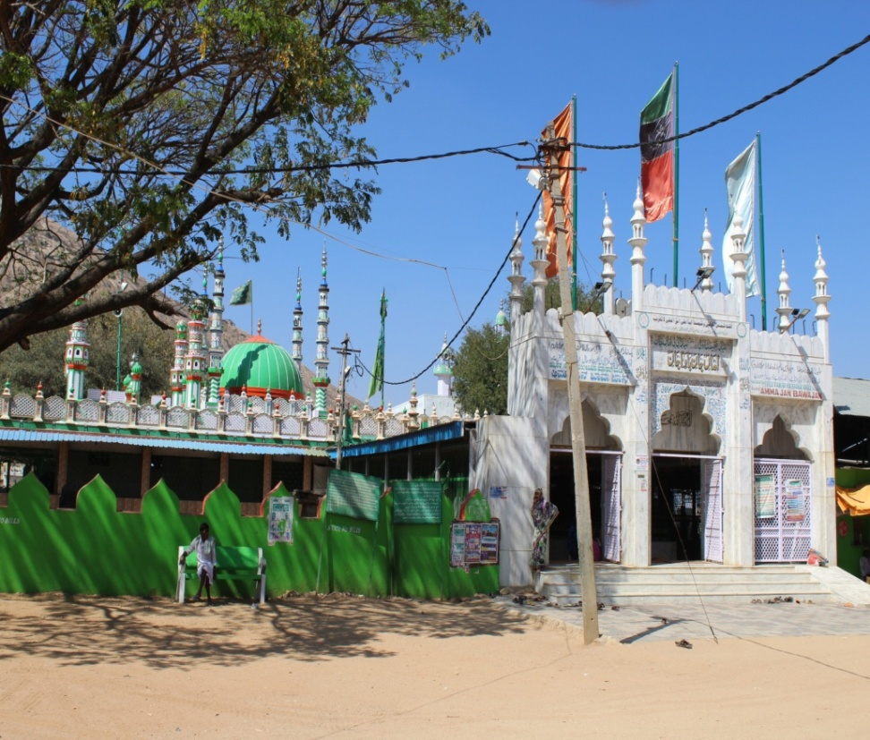
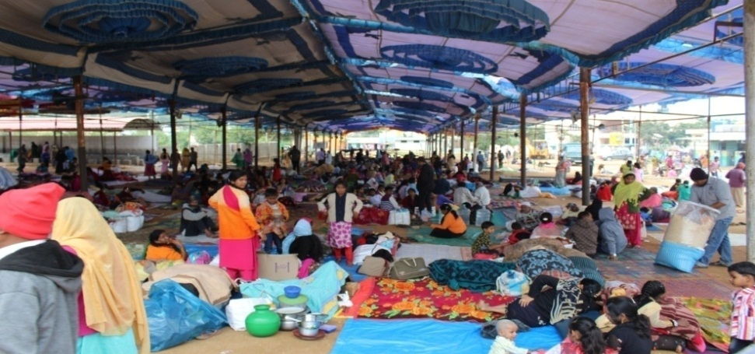
Dava and Dua
Murugamalla Dargah in collaboration with WAQF Board
DMHP team is visit once in 15 days
Plans to strengthen and expand ongoing

Slide 16
Telementoring for primary care doctors
Telemedicine based On-Consultation Training (Tele-OCT)
Rationale
  High prevalence of psychiatric disorders
  Primary Care: > 50% of patients (Depression, Anxiety & stress disorders, Alcohol & Tobacco disorders)
  Inadequate clinical skills to make diagnosis of psychiatric disorders & even in MBBS required skills are NOT adequately covered
  Drawbacks of traditional classroom teaching
GOK In collaboration with Telemedicine unit of NIMHANS
Tele-OCT, since 2 years in Mandya
Plans to expand this to the entire state
Potential game changer in our national health programs of our country since Tele-OCT is not specific to psychiatry, can be replicated for other medical illnesses too.

Slide 17
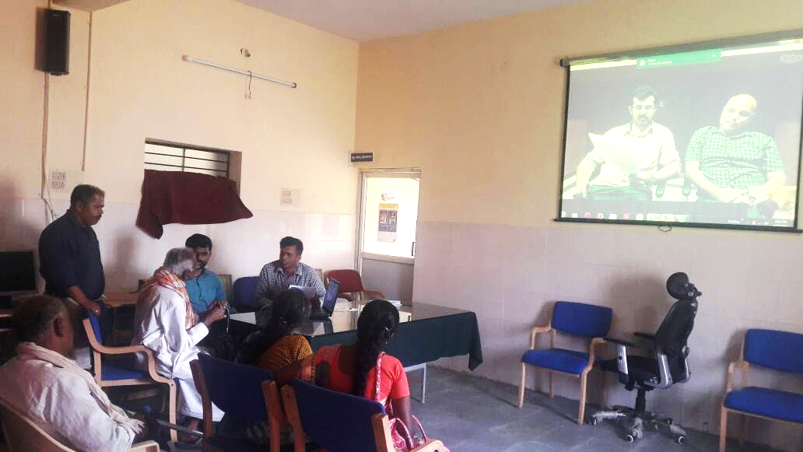
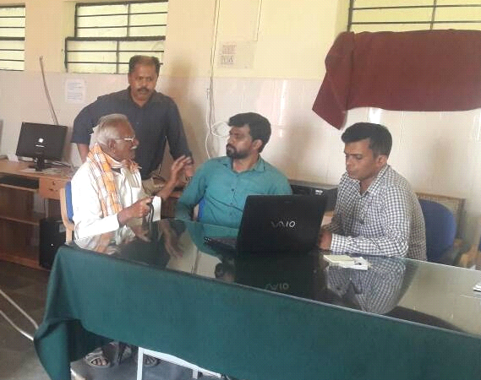
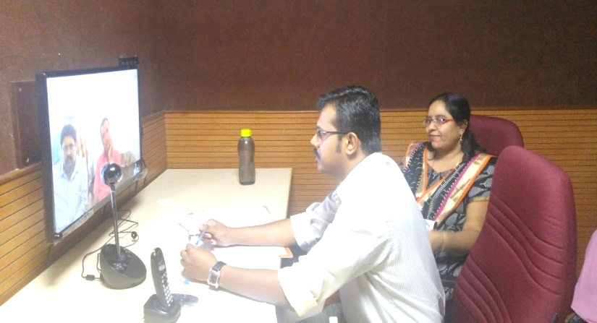
What happens during the Tele-OCT session?
A psychiatrist sits with two PCPs (one is active, another is passive) at their clinic
One to one training during their real time consultations
Selection of patients are chosen from the PCP’s general pool of patients
Psychiatrist demonstrates them how to screen by asking right kind of questions that elicit symptoms,
Identify common psychiatric disorders
Assists them to provide first line treatment.

Slide 18
Advantages of Tele OCT, Scaling up
For patients: Saves time, energy and money
  >20,000 patients covered till date
For PHC doctors: Skills transfer rather than knowledge only
For the Community:
  Less burden from psychiatric disorders
  Ensuring treatment early
  will make patients functional and begin work
  Mandya: likely saving lives of many farmers from preventing from committing suicide by providing earlier treatment at their doorstep
Tele-OCT can be easily replicated
Inbuilt direct skill transfer, acceptability and high translational value
Tele-psychiatrists to learn principles and technique of Tele-OCT to train PHC doctors through structured training
Easily available internet connectivity and digital technology
Potential similar to DOTS of TB
Though labour intensive, benefit outweighs the cost

Slide 19
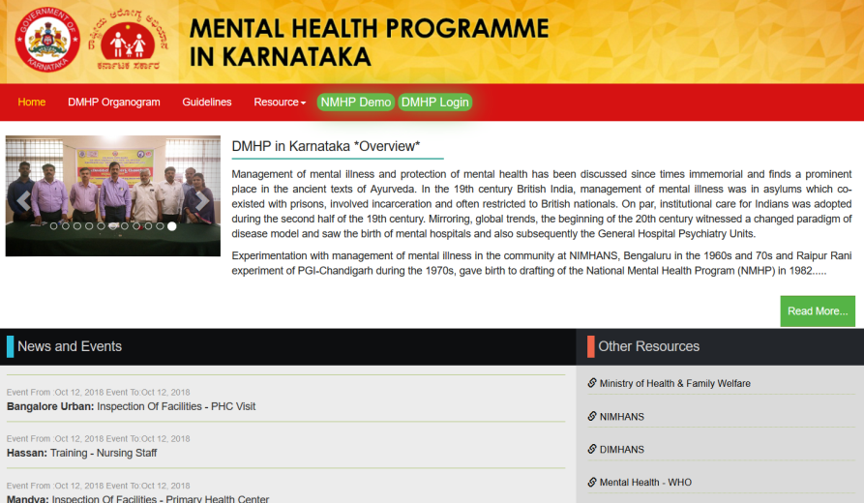
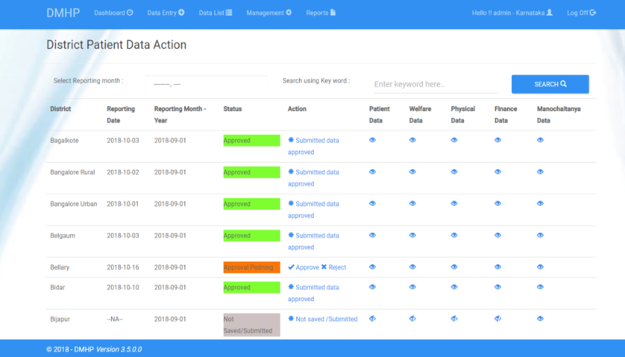
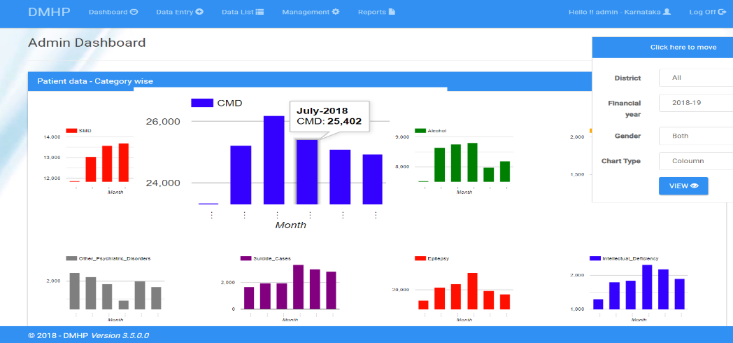
e-monitoring of DMHP
The modular approach helps scale up the software to the National level
(i) patient care
(ii) Training and events,
(iii) Budget and expenditure
(iv) Human resources
Dash board provides the Program Officer to monitor activities on a day to day basis at the State / District level
The next phase of the software development is aimed at designing mobile application for entering patient care data.

Slide 20
Assisted home care (AHC) for Severe Mental Illnesses (SMDs)
Severe Mental Illnesses are amongst the most disabling of all medical disorders
Though about 90% of persons with first episode psychosis show remission, 80% of those recur in the next 3-4 years
  Most common reason for relapses and recurrences are non-adherence to medications
AHC is a service to reach out to the door steps of such patients who drop out of treatment
  Provision of medication and counselling services
Methodology followed for AHC
Line listed SMD’s (A)
(from the time the pilot began)
List of cases which are irregular to follow from the line listed SMD’s (B)
Phone call responders (a)
Cases with no contact details (b)
Cases not consenting for AHC (c)
Any other reason/s (d)
Eligible cases recruited for AHC (C)
C = B-(a+b+c+d)

Slide 21
Assisted Home Care Pilot Project Progress
DMHP Team | No of cases Recruited (1st Visit) | 2nd visit | 3rd visit till 26/09/18
Bengaluru Urban | 46 | 26 | 13
Bengaluru BBMP | 35 | 22 | 11
Ramanagara | 24 | 7 | -
Total | 105 | 55 | 24
This program is making difference in following terms: patients’ symptom control is better resulting in lower disability scores. This in turn is translating into better work-functioning
Though formal cost effectiveness analysis are not yet done, the service is bound to be largely cost-effective.
It does not require additional funds as activities will be conducted with the available funds
services reach the door-steps of families, there is a big saving in terms of the travel cost. If patients remains in recovery phase, there is financial gain that can potentially occur because of their employment

Slide 22
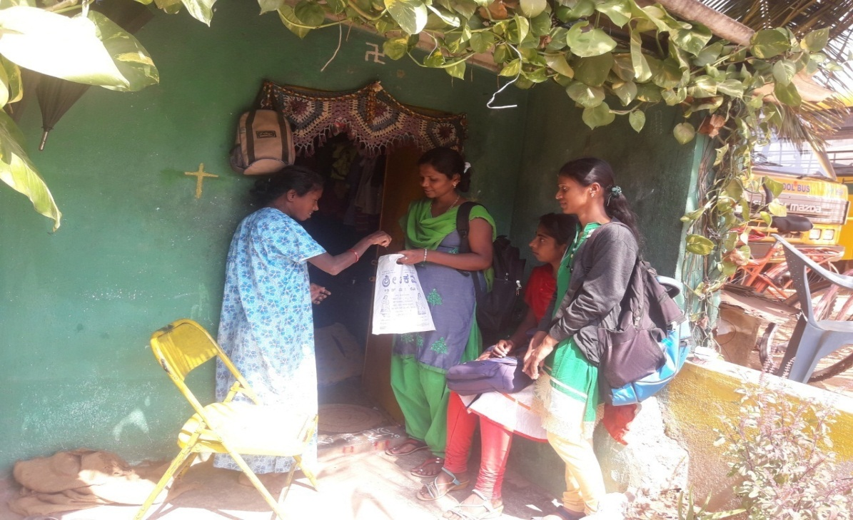
Scaling up AHC in others States
Low-cost high effectiveness model that could make meaningful impact on the lives of persons with Severe Mental Illness.
Can be easily integrated into the existing framework of DMHP functions
Where DMHP teams have social workers and nurses, this AHC services can be rolled out
A half-a-day orientation workshop is required before starting
The orientation workshop can be conducted online
Home visit for Assisted Home Care (AHC) by Community nurse

Slide 23
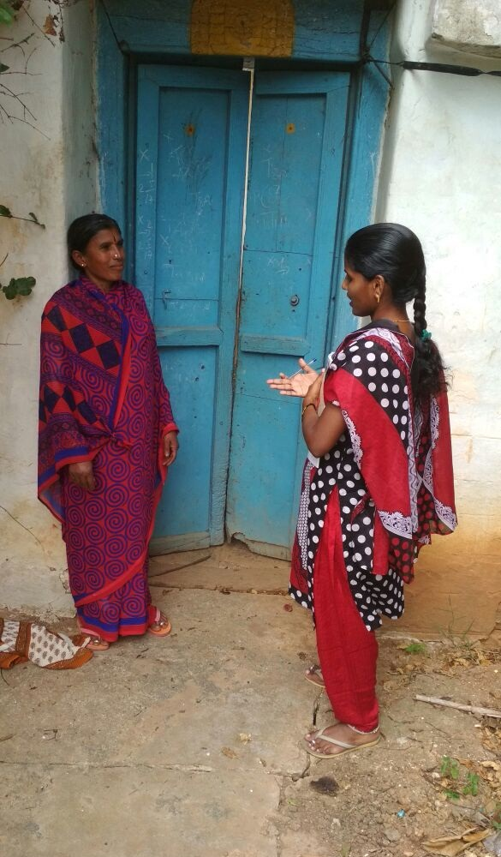
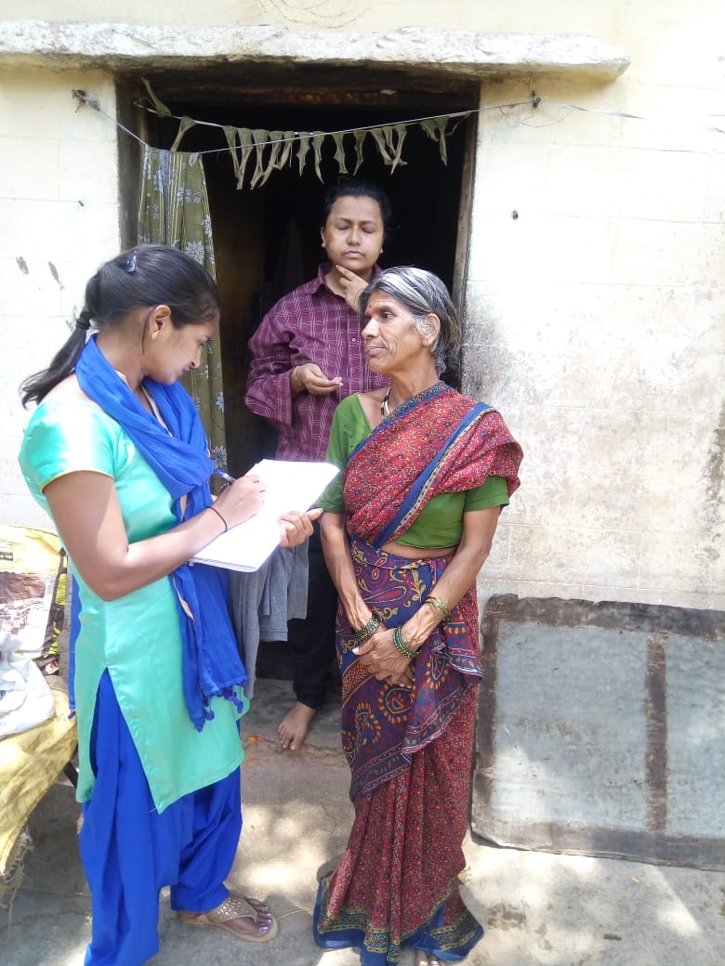
Home visits by DMHP team

Slide 24
Interactive portal for Mental Healthcare Management
Probably the first of its kind in the country
Done in collaboration with NIMHANS, Bengaluru and IIIT-Bengaluru
This portal is to facilitate e-governance aspects of implementation and adherence to Mental Healthcare Act, 2017
Registration, Monitoring and Audit of Mental Health Establishments (MHEs)
Advance Directive and Nominated Representative Management
Dashboard for Mental Health Review Boards
Mental Health Registry for Establishments and Professionals
Health Records Management
Integration with Arogya Karnataka Initiative

Slide 25
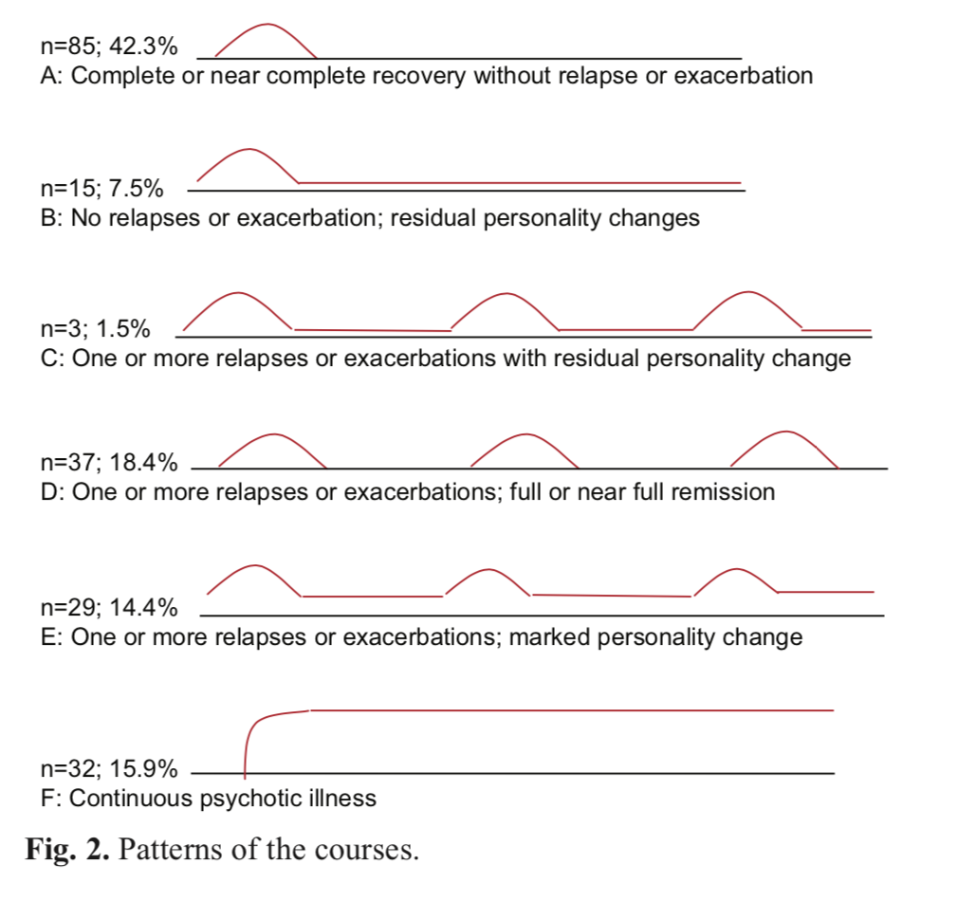
Research
After 4 years of follow-up, 70% had satisfactory outcomes
Best course pattern and least disability were seen in patients with best treatment adherence

Slide 26
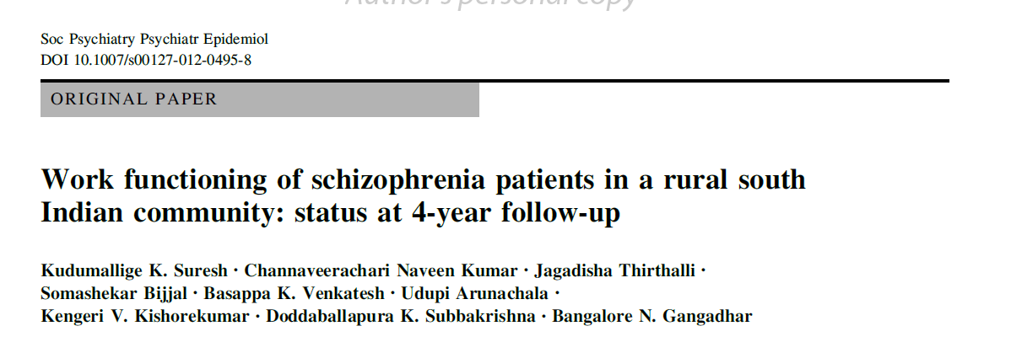
Research
Disability reduced from 70% at baseline to about 40% at 4-year follow up

Slide 27
Research

Slide 28
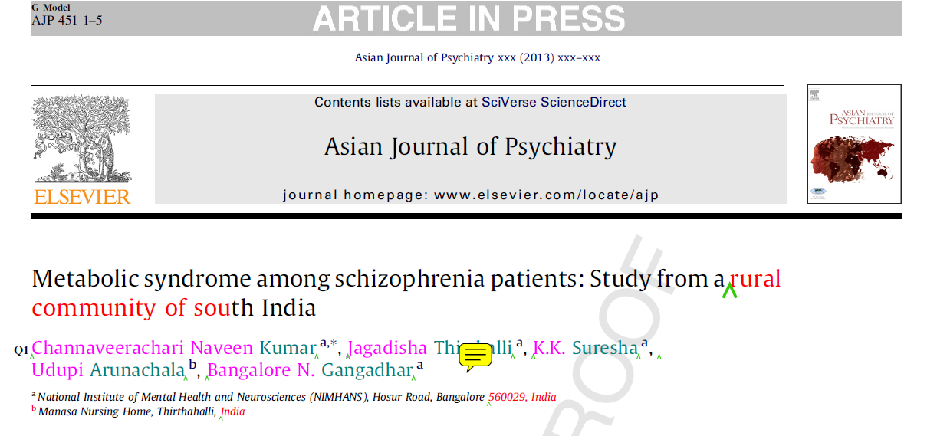
Research
  Are antipsychotics harming patients?
  10 % metabolic syndrome
  32% had central obesity

Slide 29

Research
Both patients (n=157) and general population controls (n=263) had comparable prevalence of metabolic syndrome
Drug naïve patients had significantly lesser prevalence of MS
Antipsychotic use is one of the predictors for MS

Slide 30
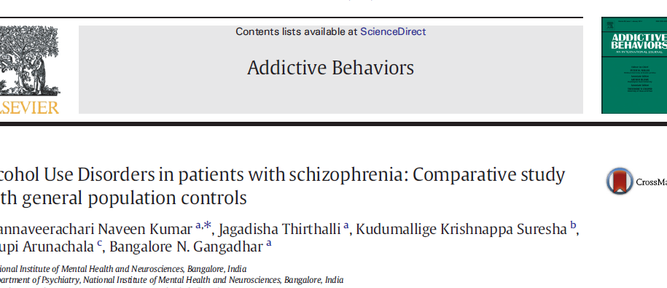
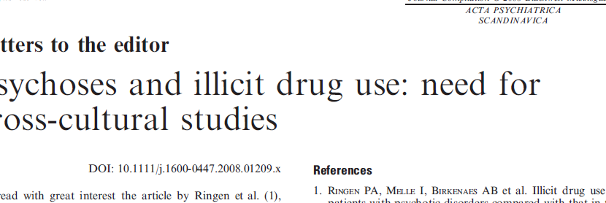
Research:
Why antipsychotics alone may be working?
Prevalence of AUD is significantly lower in patients than in the general population in this community.

Slide 31
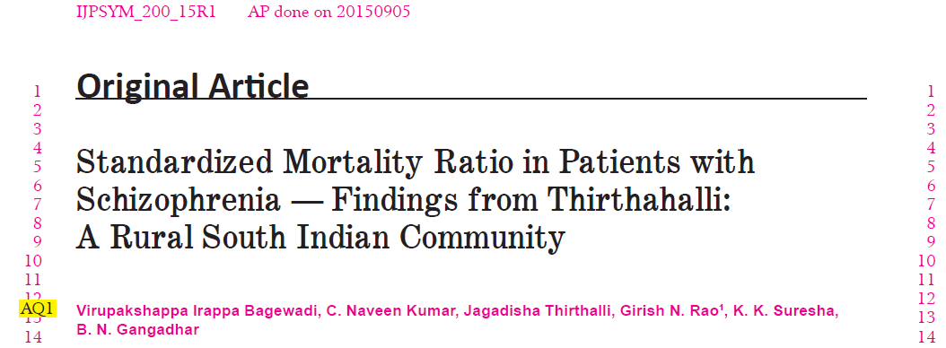
Research: Mortality Experience of the cohort
Mortality among schizophrenia patients in this rural cohort is considerably lower than patients from developed countries. Nevertheless, nearly two-fold excess mortality in schizophrenia calls for attention to their medical and psychosocial needs

Slide 32
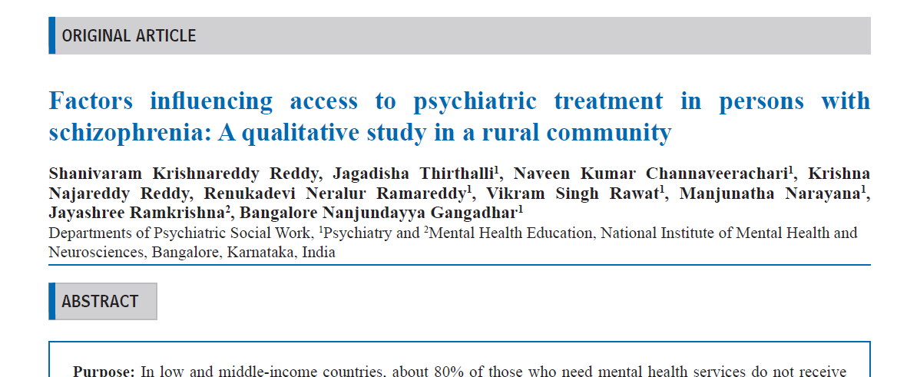
Research:
Access and continuation of Treatment

Slide 33
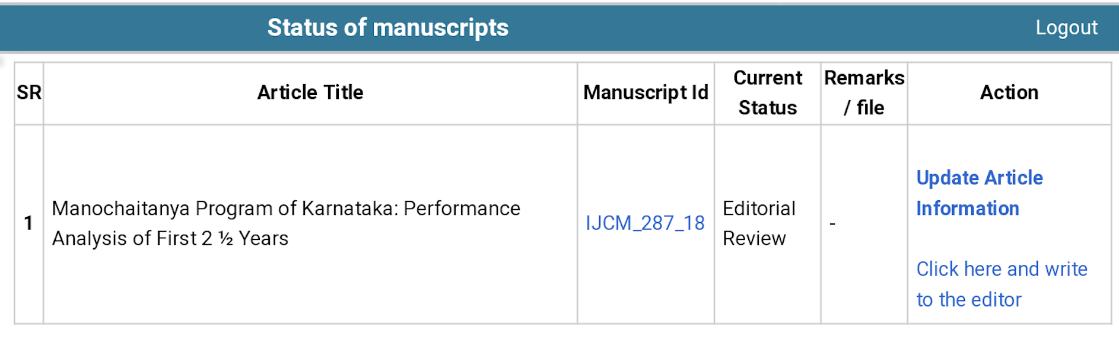
Research

Slide 34
Ongoing Research
Impact of DMHP on the treatment gap
Evaluation of the impact of tele-OCT
Evaluation of AHC services
Evaluation of online mentoring for ASHA workers
Clinical Schedules for Primary Care Psychiatry

Slide 35
New beginnings: Taluk Mental Health Program

Slide 36

Way forward 2018-19
Taluka
Mental Health Programme
Research in DMHP
Urban DMHP
Expanding tele-mentoring throughout the state
IT portal for Mental Health care Management Solutions

Slide 37

5 Pillars Of Success
Policy
Delivery
Budget
Leverage
Innovate
Secret Sauce – Team Work

Slide 38

Join Hands to Reach the Unreached
to
Create History

